Slide 1
Docker
Asst.Drusawin Vongpramate
Information Technology
Buriram Rajabhat University

Slide 2
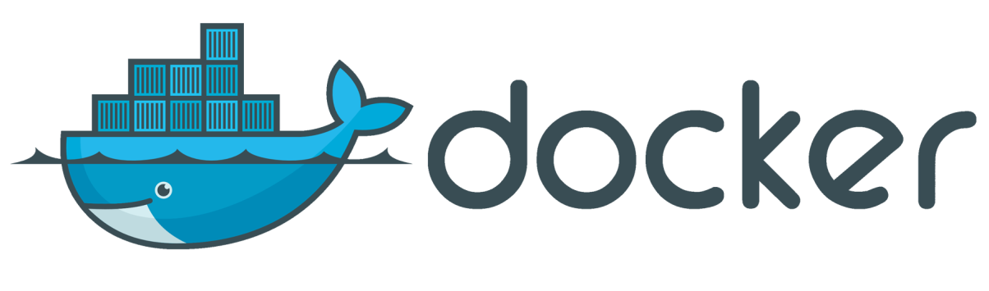
In 2013, Docker introduced what would become the industry standard for containers. Containers are a standardized unit of software that allows developers to isolate their app from its environment, solving the “it works on my machine” headache. For millions of developers today, Docker is the de facto standard to build and share containerized apps - from desktop, to the cloud. We are building on our unique connected experience from code to cloud for developers and developer teams.

Slide 3
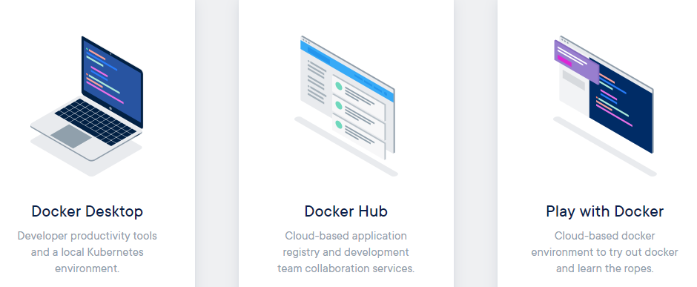
Get Started with Docker

Slide 4
Docker concepts
Docker is a platform for developers and sysadmins to build, run, and share applications with containers. The use of containers to deploy applications is called containerization. Containers are not new, but their use for easily deploying applications is.

Slide 5
Images and containers
Fundamentally, a container is nothing but a running process, with some added encapsulation features applied to it in order to keep it isolated from the host and from other containers. One of the most important aspects of container isolation is that each container interacts with its own private filesystem; this filesystem is provided by a Docker image. An image includes everything needed to run an application - the code or binary, runtimes, dependencies, and any other filesystem objects required.

Slide 6
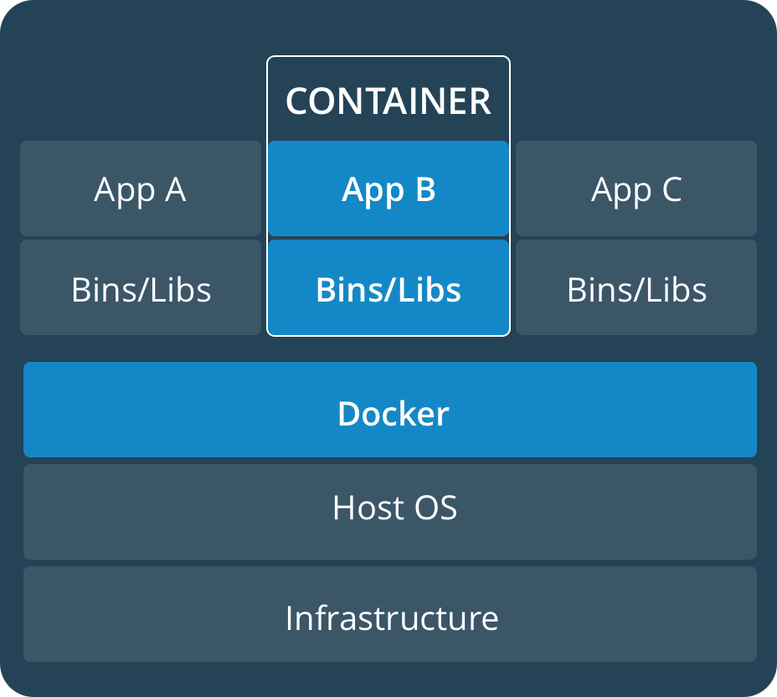
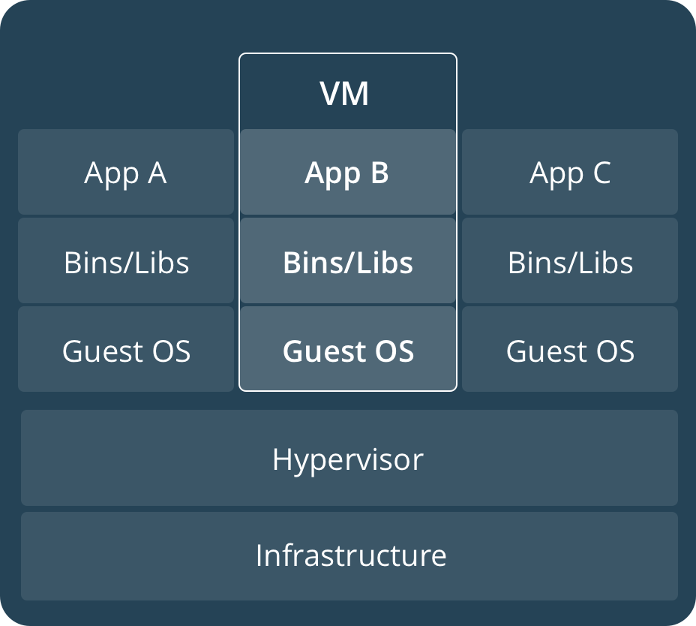
Containers and virtual machines

Slide 7
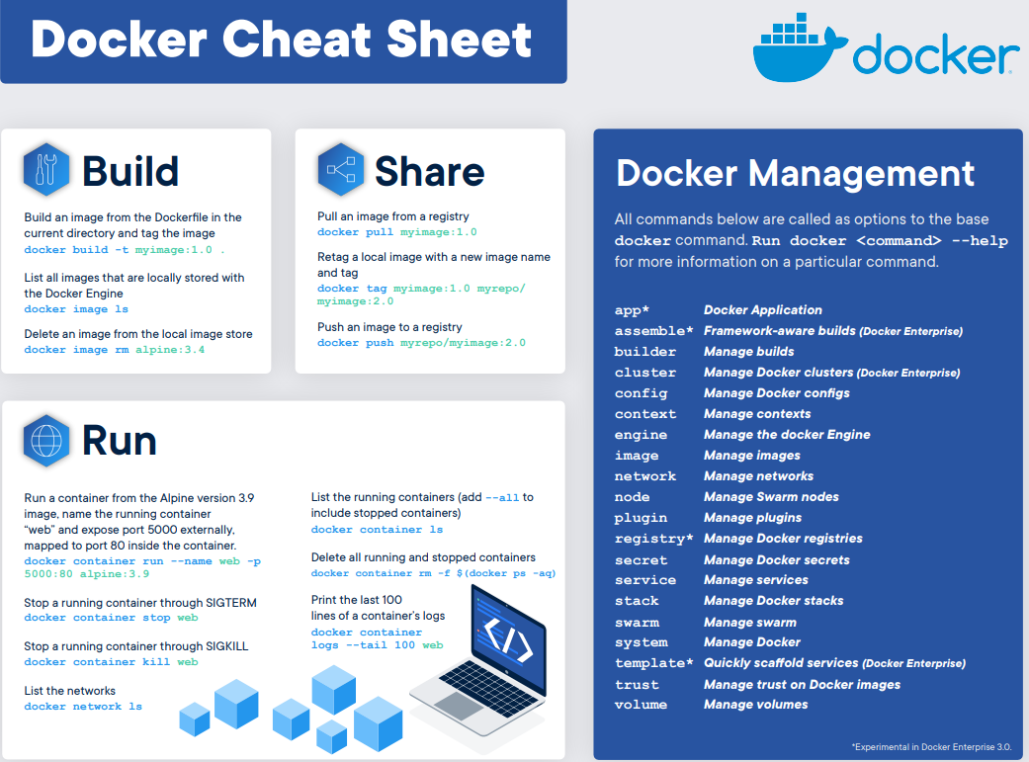

Slide 8
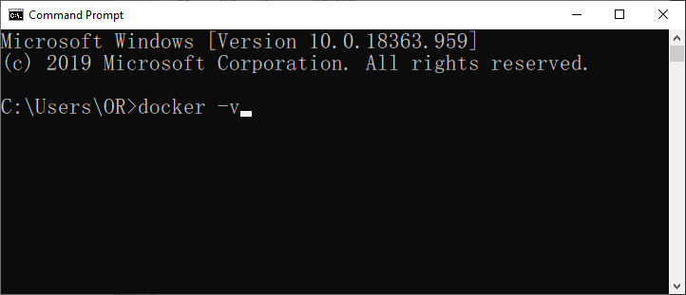
Example
View docker version
>> docker --version
or
>> docker -v

Slide 9
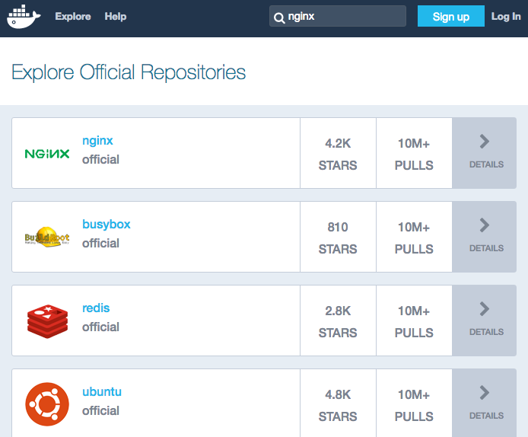
Example
1. Pull Docker Image from https://hub.docker.com/
>>docker pull nginx

Slide 10
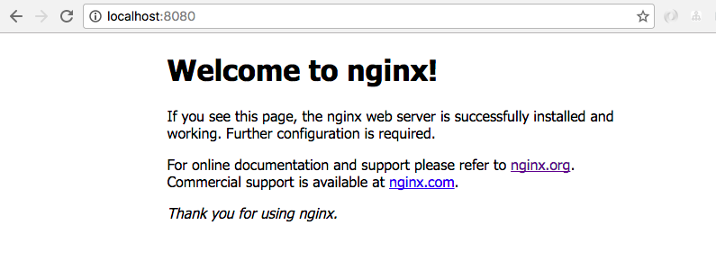
Example
2. Build container from image
>>docker run --name myweb -p 8080:80 -v /myweb:/var/www/html -d nginx
3. Test http://localhost:8080/

Slide 11
Commands
Check container status
>> docker ps
>> docker ps -a
Run a command in a “running container”
>> docker exec -it nginx bash
Stop container
>>docker stop Cxxxxxxd
Remove container
>>docker rm Cxxxxxx

Slide 12
Commands
View images
>> docker images
Remove image
>> docker rmi xxxxxxx
Remove unused data
>> docker system prune

Slide 13
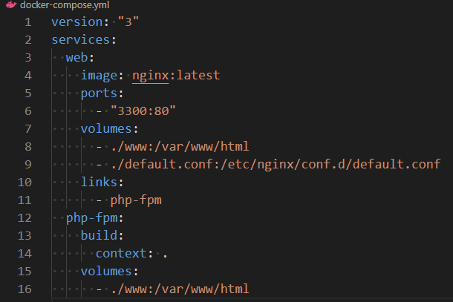
Docker-Compose
Compose is a tool for defining and running multi-container Docker applications. With Compose, you use a YAML file to configure your application’s services.

Slide 14
Docker-Compose
Create and start containers
>> docker-compose up –d
Stop and remove containers, networks, images, and volumes
>> docker-compose down
Start services
>> docker-compose start
Stop services
>> docker-compose stop

Slide 15
Q & A

