Slide 1
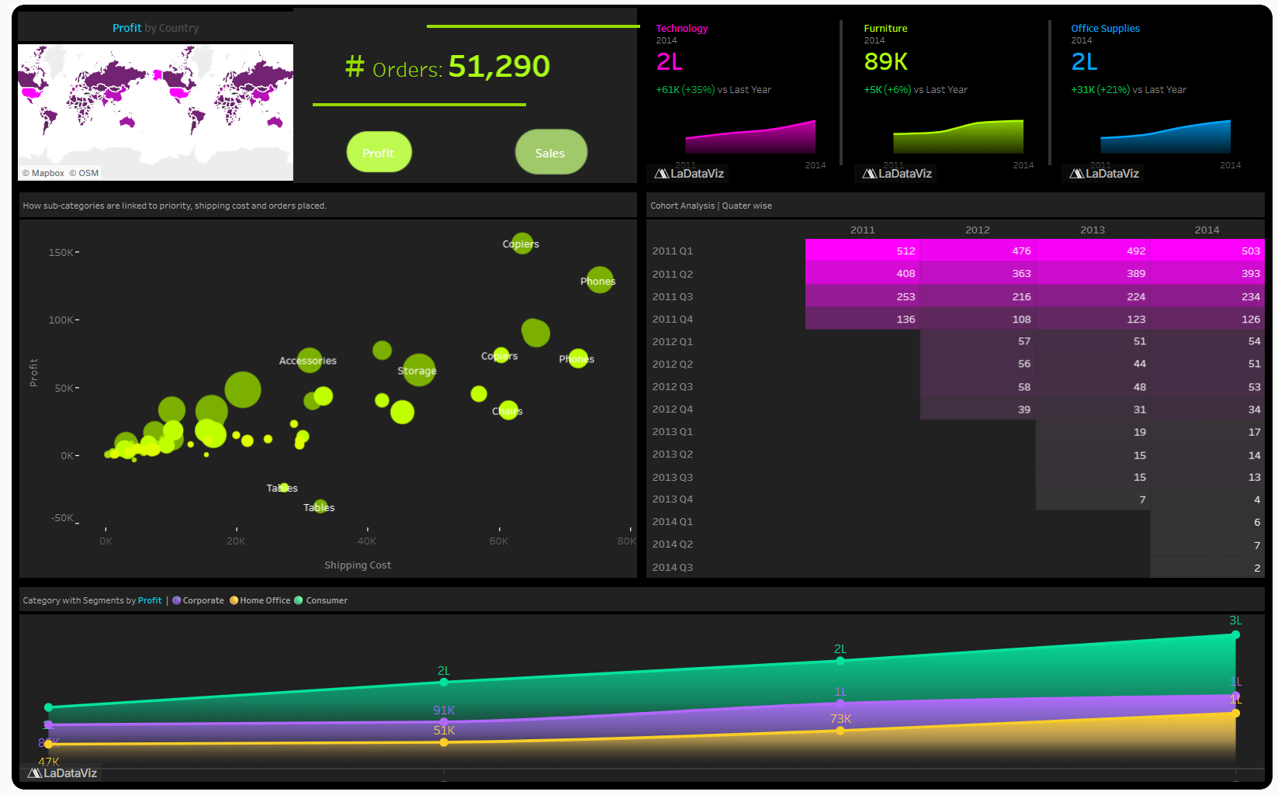
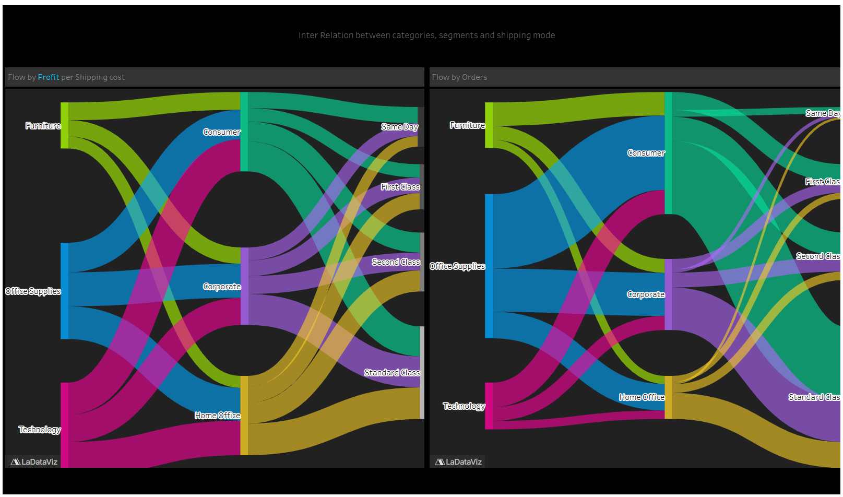
BUSINESS ANALYST / PORTFOLIO CASE STUDY
GLOBAL SUPERSTORE
2011–2014 • TABLEAU
PERFORMANCE / CUSTOMER COHORTS / SHIPPING FLOWS
01 GLOBAL PERFORMANCE
02 CATEGORY → SEGMENT → SHIPPING
Country filtering • Category KPIs • Profit/Shipping scatter • Quarterly cohorts • Segment trends
Two Sankey views: commercial measure per shipping cost and order volumes across category, segment & mode.
EXPLORE GITHUB CASE STUDY
OPEN LIVE TABLEAU STORY
ACCESS RAW EXCEL FILE
From executive performance monitoring to customer behavior and operational flow analysis

