Slide 1
School of Computer Science & Engineering
AI Application Development – IA1
Travio

Slide 2
Team members & roles
Team member name | Role
Ullas | Team Lead
Srujan L | Development Lead
Thejas M G | Marketing Lead
Shreyas B R & Shreyas D | Customer Contact Lead
Shashank Naik | Test Lead
Notes:
Talk about how they are managing their documents, how google docs does automatic versioning
As them what they know about Android and IoS versions

Slide 3
Modified Problem Statement
Urban commuters in India lose an average of 23 minutes per trip navigating three disconnected platforms — routing, parking, and food ordering — with zero shared intelligence between them.
Notes:
Talk about how they are managing their documents, how google docs does automatic versioning
As them what they know about Android and IoS versions

Slide 4
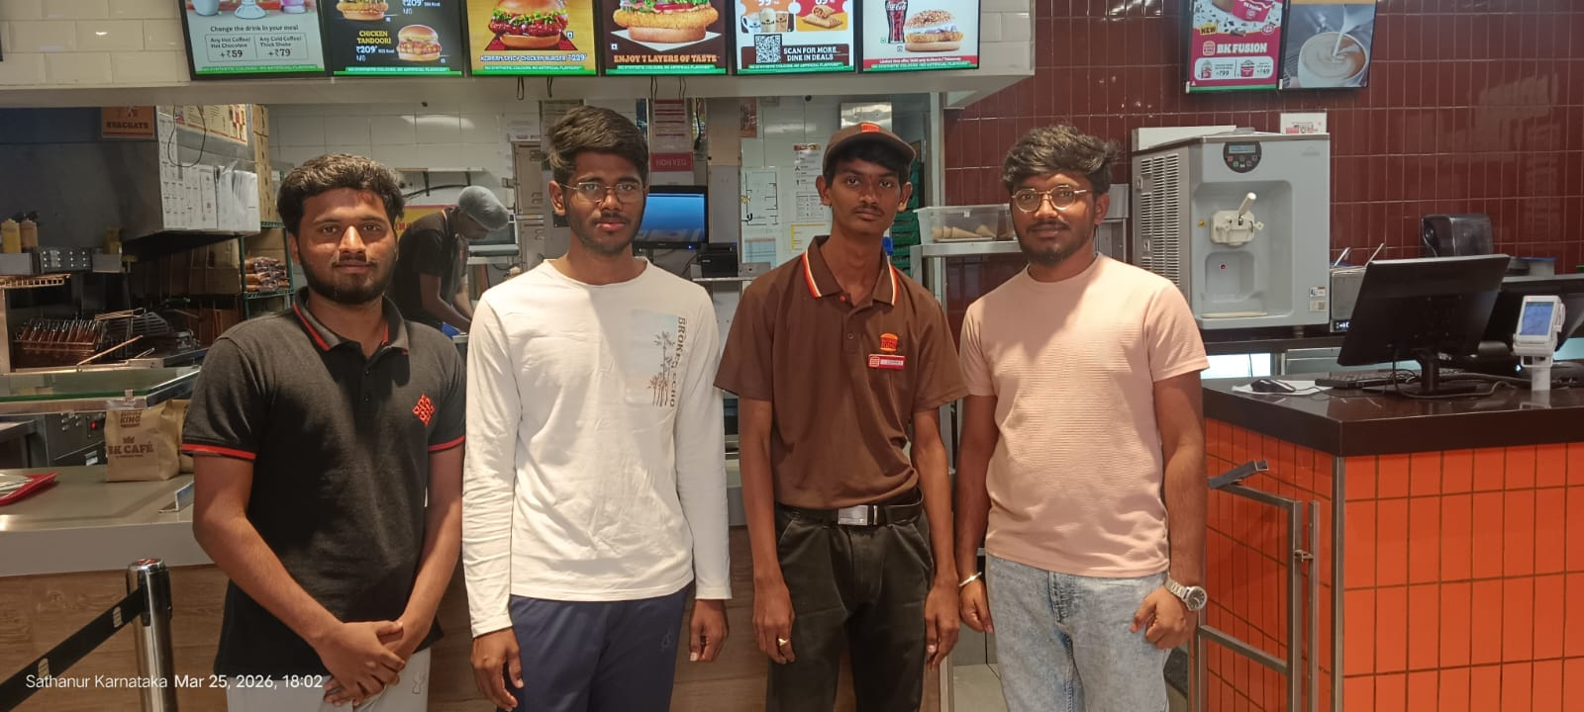
User/ Customer Understanding
Interview Questions Asked:
How long do you typically spend finding parking near a restaurant or mall?
Have you ever received cold or delayed food because you ordered too early or too late?
Would you pay a small fee to have one app handle parking, navigation, and food ordering together?
Key Findings:
78% said parking was their biggest commute frustration
65% had received cold food due to poor order timing
91% said they would use a unified journey app
Notes:
Talk about how they are managing their documents, how google docs does automatic versioning
As them what they know about Android and IoS versions

Slide 5
Ideal Customer Profile (ICP)
1. Demographic Profile
Age: 20–45 years
Location: Urban & semi-urban cities (e.g., Bengaluru)
Occupation: Working professionals, students, frequent travelers
Vehicle Ownership: Owns a car or bike
Tech Usage: Regular smartphone and app users
2. Psychographic Profile
Values time efficiency above cost savings
Prefers smart and automated solutions
Gets frustrated with traffic, parking delays, and waiting time
Comfortable using digital payments and apps
Open to trying AI-driven services
Notes:
Only stress on the 1st sentence – the definition
Come back to the 2nd sentence in the end as part of revision

Slide 6
Customer Persona (CP)
Name: Ramesh, 21
Occupation: Software Engineer, Bengaluru
Commute: Daily driver, 8–12 km per outing
Pain Points:
Spends 20+ minutes finding parking near Koramangala restaurants
Orders food too early — arrives cold; too late — waits hungry
Juggles Google Maps, Zomato, and BookMyShow separately every weekend
Goal:
"I just want to enter where I'm going and have everything else sorted."
Notes:
Only stress on the 1st sentence – the definition
Come back to the 2nd sentence in the end as part of revision

Slide 7
Product USP
Unified Journey Platform
One application that integrates navigation, parking, and food ordering into a single seamless experience
AI-Based ETA-Triggered Automation
Automatically places food orders based on real-time GPS and estimated arrival time
P2P Parking Marketplace
Enables users to book nearby private parking spaces without IoT infrastructure
Real-Time Intelligent Decision System
Continuously adapts to traffic changes and optimizes timing without user intervention
Notes:
Only stress on the 1st sentence – the definition
Come back to the 2nd sentence in the end as part of revision

Slide 8
Use Cases & High level Requirements
# | Use Case | Input | Output
1 | Book P2P Parking | Destination + arrival time | Confirmed nearby parking slot
2 | Auto-trigger Food Order | Pre-selected meal + live GPS | Order placed at optimal ETA moment
3 | Host a Parking Spot | Photos + availability + price | Listed spot earning passive income
4 | Dynamic Pricing | Event data + time of day | Auto-adjusted spot price for host
5 | Natural Language Trip Planning | Voice/text prompt | Full journey booked end-to-end
Notes:
Only stress on the 1st sentence – the definition
Come back to the 2nd sentence in the end as part of revision

Slide 9
Proof of Concept (PoC) / Prototype Demo
Notes:
Only stress on the 1st sentence – the definition
Come back to the 2nd sentence in the end as part of revision

