Slide 1

Process Mining Virtual Internship
by
C.SREELATHA
Roll No. 224G1A33B1
Department of Computer Science and Engineering(AI & ML)
Srinivasa Ramanujan Institute of Technology
Autonomous
Rotarypuram Village, BKS Mandal, Ananthapuram – 515701.
2023-2024
224G1A33B1 DEPT.OF COMPUTER SCIENCE AND ENGINEERING(AL & ML) SRINIVASA RAMANUJAN INSTITUTE OF TECHNOLOGY 1

Slide 2
CONTENTS
Course Objective
Introduction
Technology
Applications
Modules
Real Time Applications
Learning Outcomes
GitHub Link
Queries
224G1A33B1 DEPT.OF COMPUTER SCIENCE AND ENGINEERING(AL & ML) SRINIVASA RAMANUJAN INSTITUTE OF TECHNOLOGY 2

Slide 3
Course Objective:
The goal of process mining is to improve the performance of business and make data-driven decisions
The idea of process mining is to discover, monitor and improve real processes by extractingknowledge from data readily available in an organization’s information systems.
The objectives of the Process Mining Virtual Internship are to equip participants with acomprehensive understanding of process mining concepts and methodologies
The main objectives of a process mining course could include:
Understanding Process Mining Concepts: Understanding fundamental concepts of process mining, such as event logs, process models, process discovery, conformance checking
224G1A33B1 DEPT.OF COMPUTER SCIENCE AND ENGINEERING(AL & ML) SRINIVASA RAMANUJAN INSTITUTE OF TECHNOLOGY 3

Slide 4
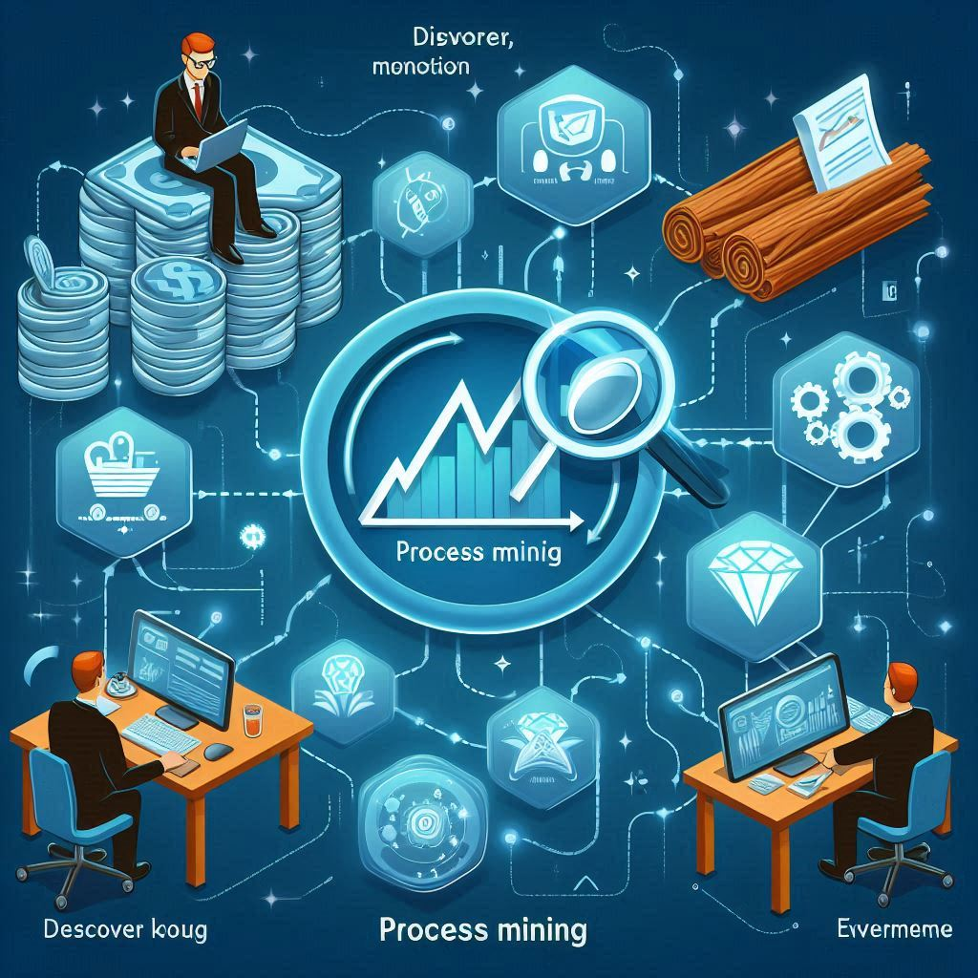
Introduction
What is Process Mining?
Process mining is a data-driven methodology that involves analyzing event logs from various information systems to discover, monitor, and improve business processes. It aims to provide insights into how processes are actually executed, rather than how they are supposed to be executed according to predefined models orguidelines
•Process mining holds significant importance for organizations across various industries due to its ability to provide valuable insights and drive operational improvements
•Process Mining is often described as occupying the area between business process
224G1A33B1 DEPT.OF COMPUTER SCIENCE AND ENGINEERING(AL & ML) SRINIVASA RAMANUJAN INSTITUTE OF TECHNOLOGY 4

Slide 5
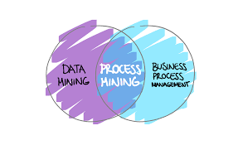
The main components of Process Mining:
•Understanding Data Sources : How to collect, preprocess, and transform event data from various sources such as information systems, logs, and databases into suitable formats for analysis
•Process Discovery : Introduce techniques for automatically discovering process models from event data, including algorithms like Alpha Miner, Heuristic Miner, and Inductive Miner.
Enhancing Process Models :: Cover techniques to improve the accuracy andcomprehensibility of process models by incorporating additional information or domain knowledge.
Process Analysis and Visualization : Providing knowledge about techniques for visualizing process data, analyzing process performance, and deriving insights from process metrics.
224G1A33B1 DEPT OF COMPUTER SCIENCE AND ENGINEERING(AI & ML) SRINIVASA RAMANUJAN INSTITUTE OF TECHNOLOGY 5

Slide 6
Benefits of Process Mining:
•Improve performance management
•Eliminate unnecessary steps
•Reduce reaction time
•Identify and resolve process bottlenecks
•Resolve inter-process conflicts
•Analyze audit data faster
224G1A33B1 DEPT OF COMPUTER SCIENCE AND ENGINEERING(AI & ML) SRINIVASA RAMANUJAN INSTITUTE OF TECHONOLOGY 6

Slide 7
TECHNOLOGY:
Process Discovery Tools
•Disco: A popular process mining tool that offers process discovery, conformance checking and performance analysis capabilities
•Prom:
An open-source framework that provides a wide range of process mining plugins,including various process discovery algorithms
•Celonis:
Offers a process mining platform with advanced AI capabilities for discovering,monitoring, and improving processes
•Predictive Process Monitoring Tools :
These tools use historical process data to predict future process behavior, allowing for proactive interventions
224G1A33B1 DEPT.OF COMPUTER SCIENCE AND ENGINEERING(AL & ML) SRINIVASA RAMANUJAN INSTITUTE OF TECHNOLOGY 7

Slide 8
•Data mining:
Data mining is the process of extracting knowledge from data. In the context of process mining, data mining is used to identify patterns and trends in event data
Machine learning :
In the context of process mining, machine learning is used to build models that can predict future behavior of processes
•Process modeling :
Process modeling is the process of representing a process in a graphical or textual form. In the context of process mining, process modeling is used tocreate a graphical representation of the actual process
224G1A33B1 DEPT.OF COMPUTER SCIENCE AND ENGINEERING(AL & ML) SRINIVASA RAMANUJAN INSTITUTE OF TECHNOLOGY 8

Slide 9
APPLICATIONS:
DEPT. OF COMPUTER SCIENCE AND ENGINEERING (DATASRINIVASA RAMANUJAN INSTITUTE OF
Process Mining Virtual Internship
214G1A3246
Applications
•Performance Analysis:
Process mining allows organizations to monitor process performance and identify areas for improvement
•Visualization and Reporting :
Provide visual representations of process models and performance metrics for better communication
•Process Mining and Supply chain :
Process mining offers a lot of optimization opportunities to the complex work.
•Procure to pay, order to cash , production process , account payable/account receivable management
Performance Analysis
Visualization and Reporting
Process Mining and Supply chain
224G1A33B1 DEPT.OF COMPUTER SCIENCE AND ENGINEERING(AL & ML) SRINIVASA RAMANUJAN INSTITUTE OF TECHNOLOGY 9

Slide 10
Modules
Process Mining
Celonis Process Mining Fundamentals
Technical Rising Star
EMS
224G1A33B1 DEPT.OF COMPUTER SCIENCE AND ENGINEERING(AL & ML) SRINIVASA RAMANUJAN INSTITUTE OF TECHNOLOGY 10

Slide 11
Celonis Process Mining Fundamentals
Process mining is a set of techniques used for obtaining knowledge and extracting insights from processes by the means of analyzing the event data, generated during the execution of the process.
This training track provides both the theoretical and applied foundations around Process Mining.
Process mining reads this data, converts it into an event log, and then creates visualizations of the end-to-end process, along with insightful analytics.
An event log contains each step performed during the process (the activity), the time at which the event occurred (the timestamp), and for which instance of the process (the case ID).
Using this event log, algorithms generate a process model that shows the process as it really is - including the timing of each step and all variations
224G1A33B1 DEPT.OF COMPUTER SCIENCE AND ENGINEERING(AL & ML) SRINIVASA RAMANUJAN INSTITUTE OF TECHNOLOGY 11

Slide 12
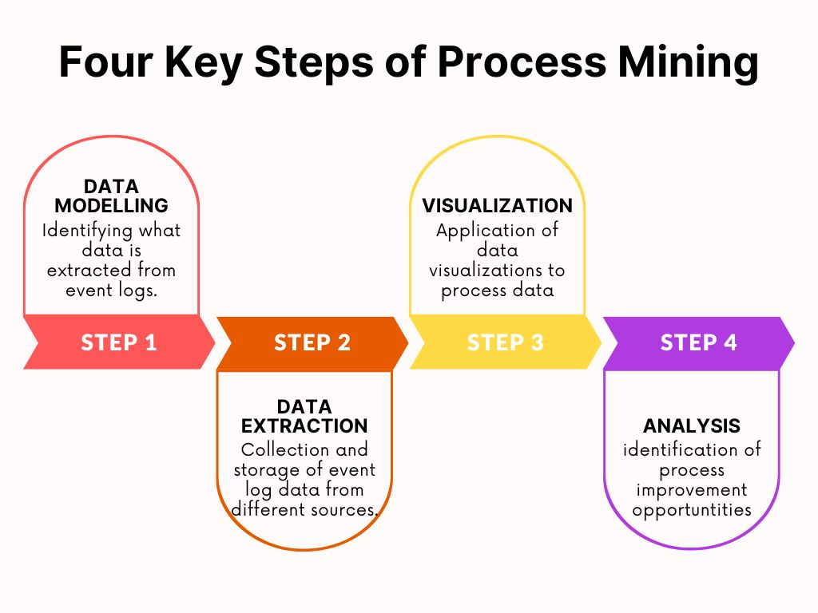
Celonis Process Mining Fundamentals
Main Stages in Process Mining:
Data Modeling.
Data Extraction.
Data Visualization.
Data Analysis.
224G1A33B1 DEPT.OF COMPUTER SCIENCE AND ENGINEERING(AL & ML) SRINIVASA RAMANUJAN INSTITUTE OF TECHNOLOGY 12

Slide 13
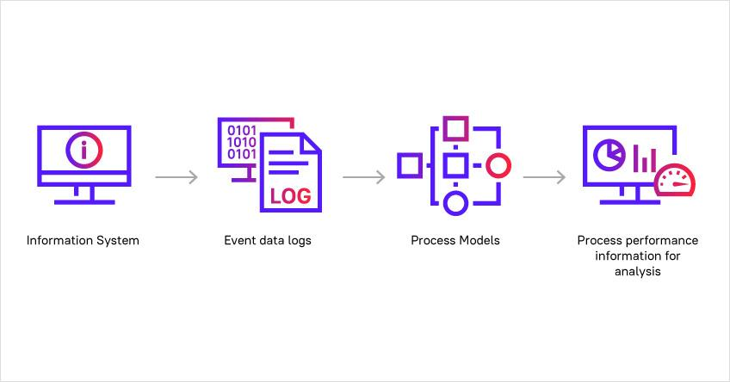
Celonis Process Mining Fundamentals
There are a number of ways Process Mining can be applied:
Automated business process discovery/mapping – tracking event logs to identify the activities performed by employees, and defining a process around these activities
Performance analysis/process optimization – an enterprise can boost performance by analyzing information from the event log to determine opportunities and adapt or improve process models according to the data of the real process
Operational support – directly influencing and improving the process not by changing the model but by providing data-driven support in the form of warnings, predictions, or recommendations.
224G1A33B1 DEPT.OF COMPUTER SCIENCE AND ENGINEERING(AL & ML) SRINIVASA RAMANUJAN INSTITUTE OF TECHNOLOGY 13

Slide 14
Execution Management Consulting For Students
The Execution Management Consulting program for students is a certification program provided by the Celonis Academic Alliance. :
Celonis has 5 different categories of components.
Process Components: Visualize your activities and the way processes flow through them (Process Explorer and Variant Explorer).
Charts and Tables: Plot you data or group, segment and arrange them in tables (OLAP Table, Pivot Table, World map)
Single KPI Components: Track your data according to a single KPI.( Key Performance Indicator )
Selection Components: Helps the user create selections.
Design Components: Create design elements for your analysis.
224G1A33B1 DEPT.OF COMPUTER SCIENCE AND ENGINEERING(AL & ML) SRINIVASA RAMANUJAN INSTITUTE OF TECHNOLOGY 14

Slide 15
Execution Management Consulting For Students
Introduction to EMS platform service : An Execution management system is an application utilized by traders designed to display market data and provide seamless and fast access to trading destinations for the purpose of transacting orders.
This application contains broker provided and independent algorithms such as TWAP and VWAP, global market data and technology that is able to help predict certain market conditions
One of the important features of EMS is the capacity to manage orders across multiple trading destinations such as
1.Stock exchanges
2.Stock brokerage firms
3.Crossing networks and electronic communication networks.
EMS helps businesses maximize execution capacity across the enterprise.
224G1A33B1 DEPT.OF COMPUTER SCIENCE AND ENGINEERING(AL & ML) SRINIVASA RAMANUJAN INSTITUTE OF TECHNOLOGY 15

Slide 16
PQL
Process Query Language.
PQL is the important component in process mining.
It is different from the SQL. It is designed based on requirements .If we give a question to it, it processes the data and gives the meaningful answer.
Design goals and the history of the PQL:
1.Simplicity:Easy to use and translates the complete process questions into data queries.
2.Flexibility:Formulates any question, regardless of the process.
3.Event log centered: supports process mining functionalities.
4.Business Focus : Combine process Mining and business intelligence capabilities.
5.Frontend interaction: Support of a graphical user interface(GUI).
PQL are executed in visual and code editors.
224G1A33B1 DEPT.OF COMPUTER SCIENCE AND ENGINEERING(AL & ML) SRINIVASA RAMANUJAN INSTITUTE OF TECHNOLOGY 16

Slide 17
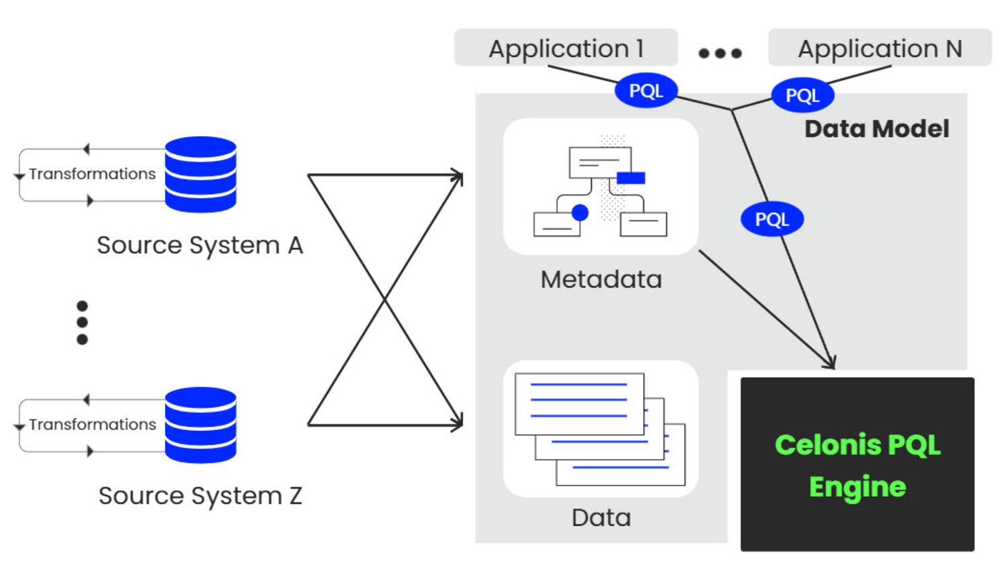
Architecture of software PQL Engine
224G1A33B1 DEPT.OF COMPUTER SCIENCE AND ENGINEERING(AL & ML) SRINIVASA RAMANUJAN INSTITUTE OF TECHNOLOGY 17

Slide 18
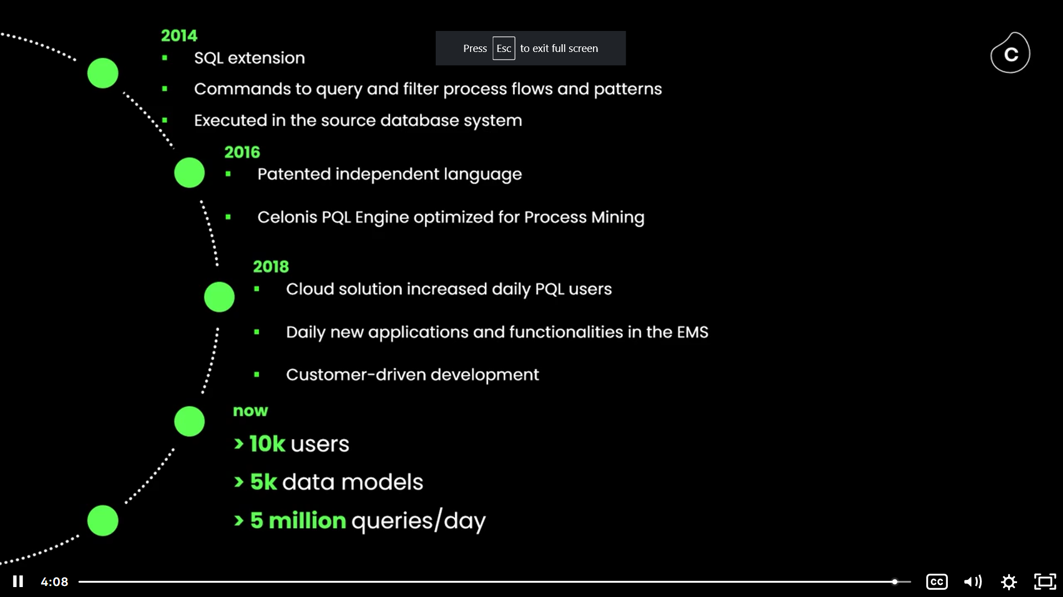
224G1A33B1 DEPT.OF COMPUTER SCIENCE AND ENGINEERING(AL & ML) SRINIVASA RAMANUJAN INSTITUTE OF TECHNOLOGY 18

Slide 19
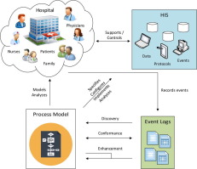
Real-Time Examples:
Process mining is a technique that blends data mining and process management to analyze business processes based on event logs. Below are four interesting real-time examples of process mining applications:
1. Healthcare Process Optimization:
Use case: A hospital uses process mining to optimize patient flow, reduce wait times, and improve overall care quality.
How it works: The hospital collects event logs from patient admissions, treatments, diagnostics, and discharge systems. Process mining identifies bottlenecks such as long waiting times in emergency departments or delays in scheduling surgeries. By analyzing these logs in real-time, hospital administrators can take immediate action to streamline operations and improve the patient experience.
Real-time benefit: Allows dynamic resource allocation (e.g., doctors, rooms) based on real-time patient demand and improves throughput.
224G1A33B1 DEPT.OF COMPUTER SCIENCE AND ENGINEERING(AL & ML) SRINIVASA RAMANUJAN INSTITUTE OF TECHNOLOGY 19

Slide 20
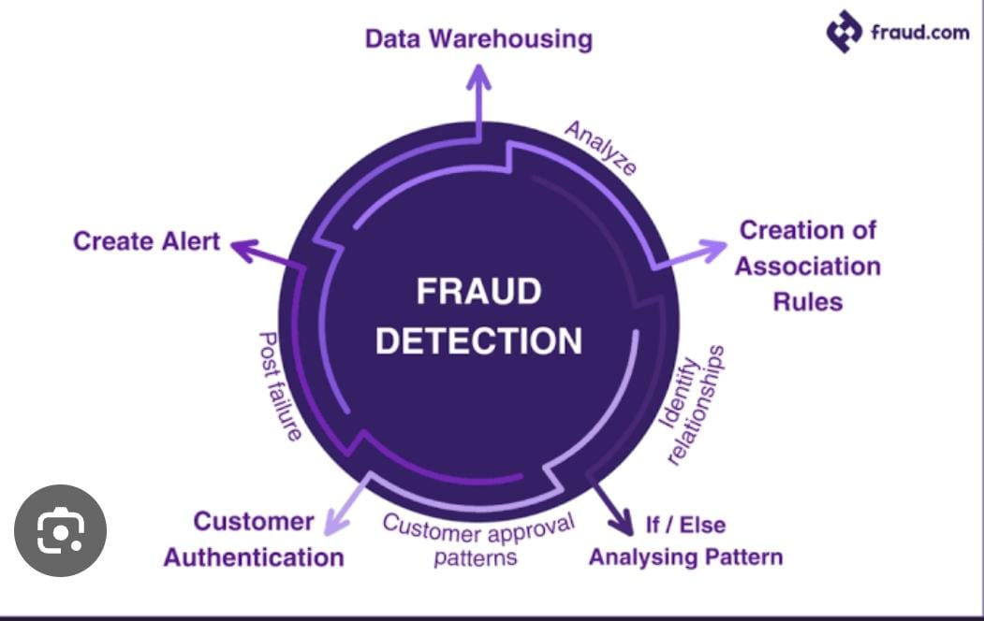
2. Financial Transaction Fraud Detection:
Use case A bank employs process mining to detect fraudulent activities within its transaction processes.
How it works: Event logs from customer transactions (such as money transfers, withdrawals, or account changes) are monitored. Process mining detects deviations from normal transaction flows. For instance, if a customer typically makes transactions below a certain threshold and suddenly makes a large, suspicious transfer, it triggers alerts.
Real-time benefit: Enables immediate detection of fraud patterns or anomalies, allowing the bank to freeze suspicious accounts and reduce financial risk.
224G1A33B1 DEPT.OF COMPUTER SCIENCE AND ENGINEERING(AL & ML) SRINIVASA RAMANUJAN INSTITUTE OF TECHNOLOGY 20

Slide 21
Learning Outcomes:
Gain an understanding of basic process mining concepts.
Understand what process mining is and the basics of how it works.
Gaining experience in analyzing and optimizing business processes.
Learning about Real world applications of Process Mining.
224G1A33B1 DEPT.OF COMPUTER SCIENCE AND ENGINEERING(AL & ML) SRINIVASA RAMANUJAN INSTITUTE OF TECHNOLOGY 21

Slide 22
GITHUB:
224G1A33B1 DEPT.OF COMPUTER SCIENCE AND ENGINEERING(AL & ML) SRINIVASA RAMANUJAN INSTITUTE OF TECHNOLOGY 22

Slide 23
Any Queries?
224G1A33B1 DEPT.OF COMPUTER SCIENCE AND ENGINEERING(AL & ML) SRINIVASA RAMANUJAN INSTITUTE OF TECHNOLOGY 23

Slide 24
Thankyou
224G1A33B1 DEPT.OF COMPUTER SCIENCE AND ENGINEERING(AL & ML) SRINIVASA RAMANUJAN INSTITUTE OF TECHNOLOGY 24

