Slide 1



2005 Timeless Transport Models
BUSINESS
ANNUAL REPORT
TIMELESS TRANSPORT MODELS
Bea Sauve / Elton Nichols / Kainen Osborne
NSCC | Data Analytics in Business |CSB304 | Eric Lloyd

Slide 2
BUSINESS ANNUAL REPORT
CONTENTS
1
Introduction
- About Us
- Project Objective
EDA
- Seasonality
- Trends
2
3
Production
- Forecasting
- CPU
4
Profits
- Margins
- Forecasting
5
Customer Engagement
- Orders
- Email Interaction
6
Deliverables

Slide 3


About Us
01
Timeless Transport Models
Serving thousands quality modeled cars, trains, trucks, buses, ships and planes since 2003.
Forecasting,
more Refinement,
more Sales
Introduction - About Us
Provide actionable insights based on past productions, current sales, and upcoming trends.
Maximizing Profits
Focusing Efforts
Building Relationships
Marketing efforts

Slide 4
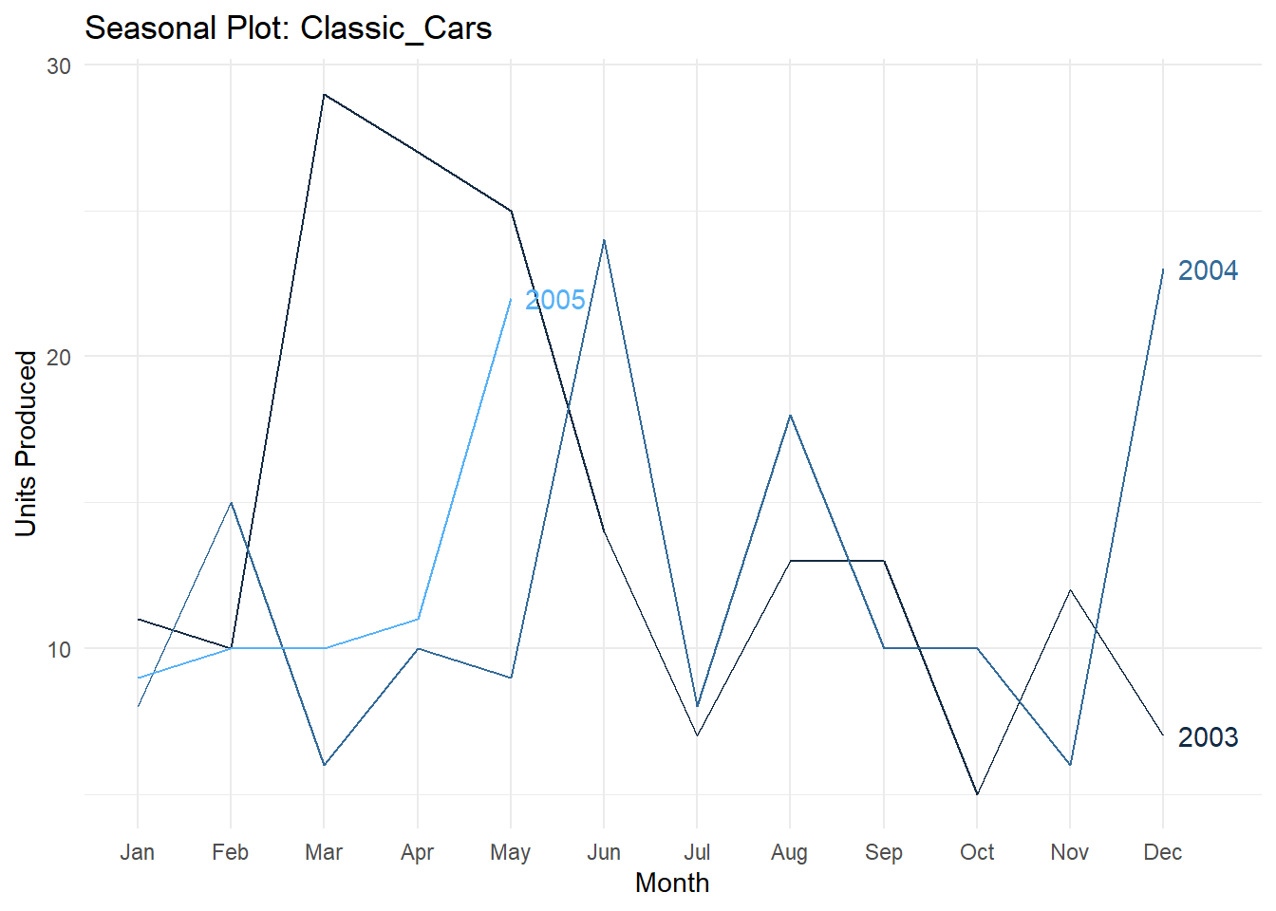
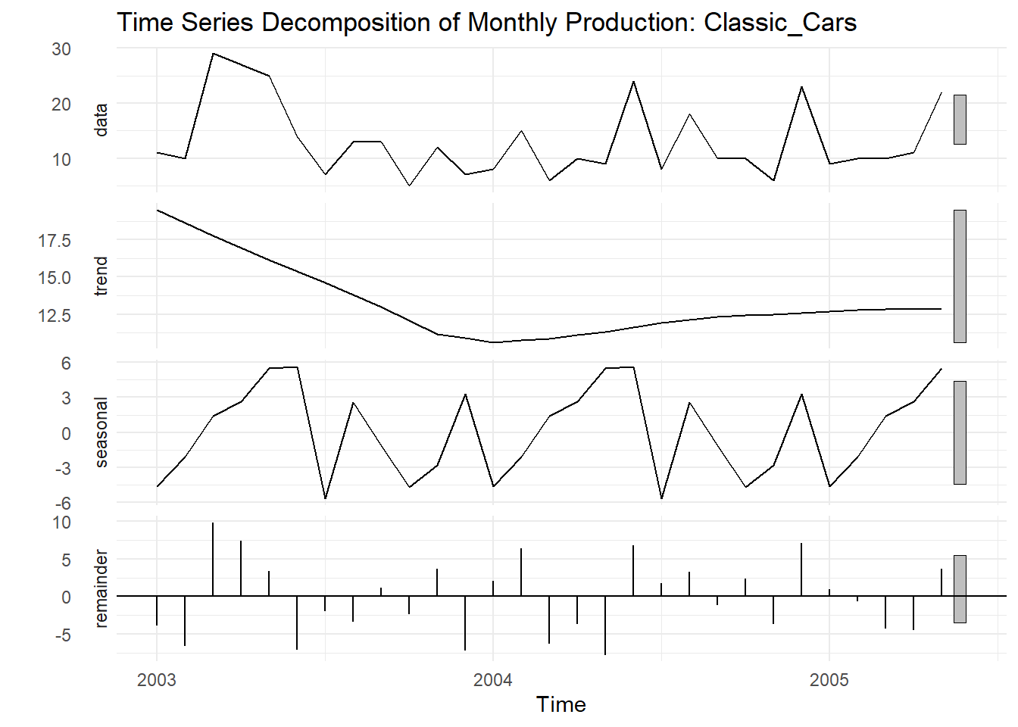
02
EDA
Business - Business Goals

Slide 5
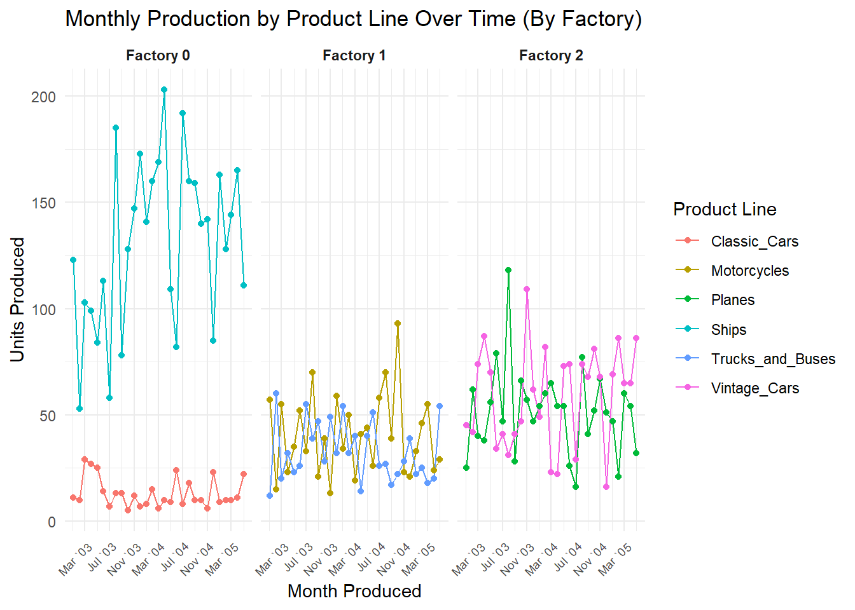
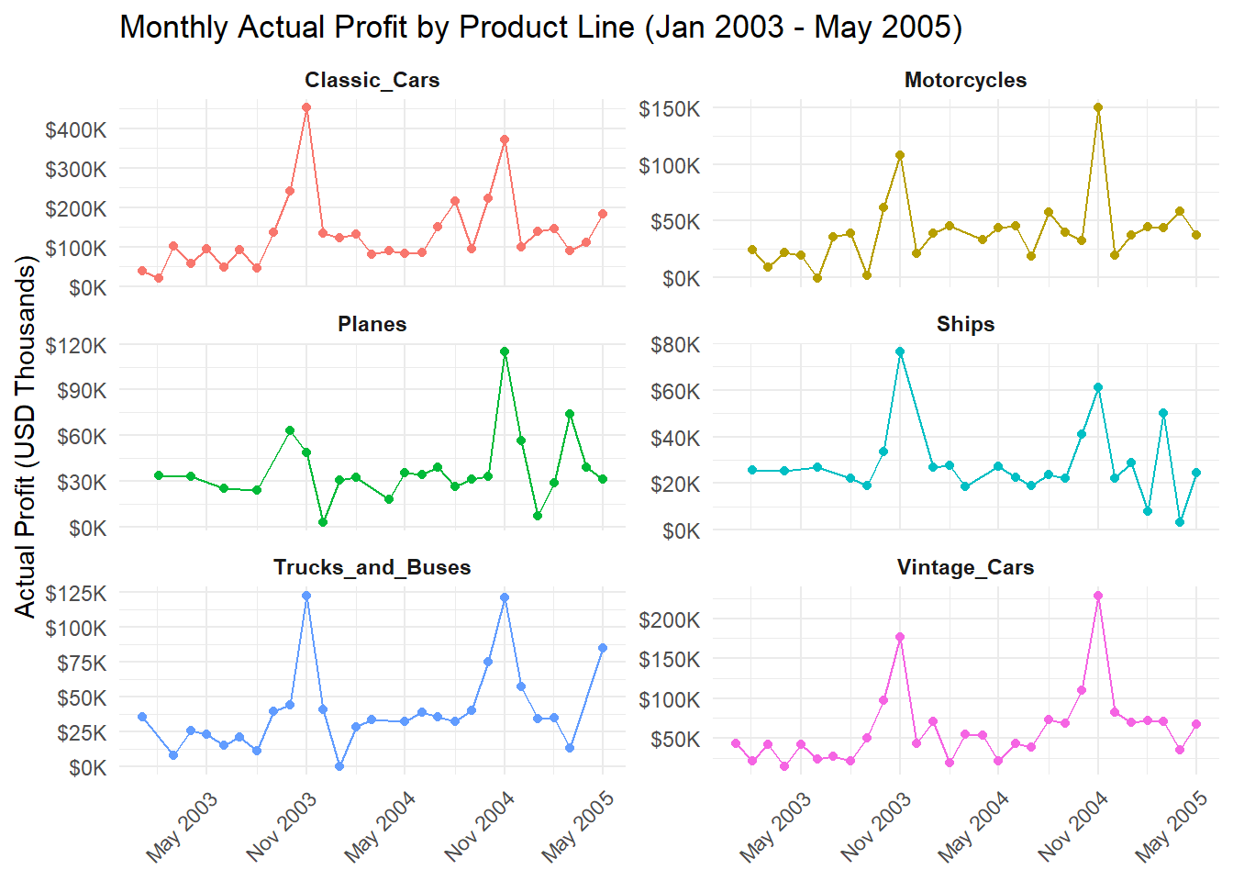
03
EDA
Business - Business Goals

Slide 6

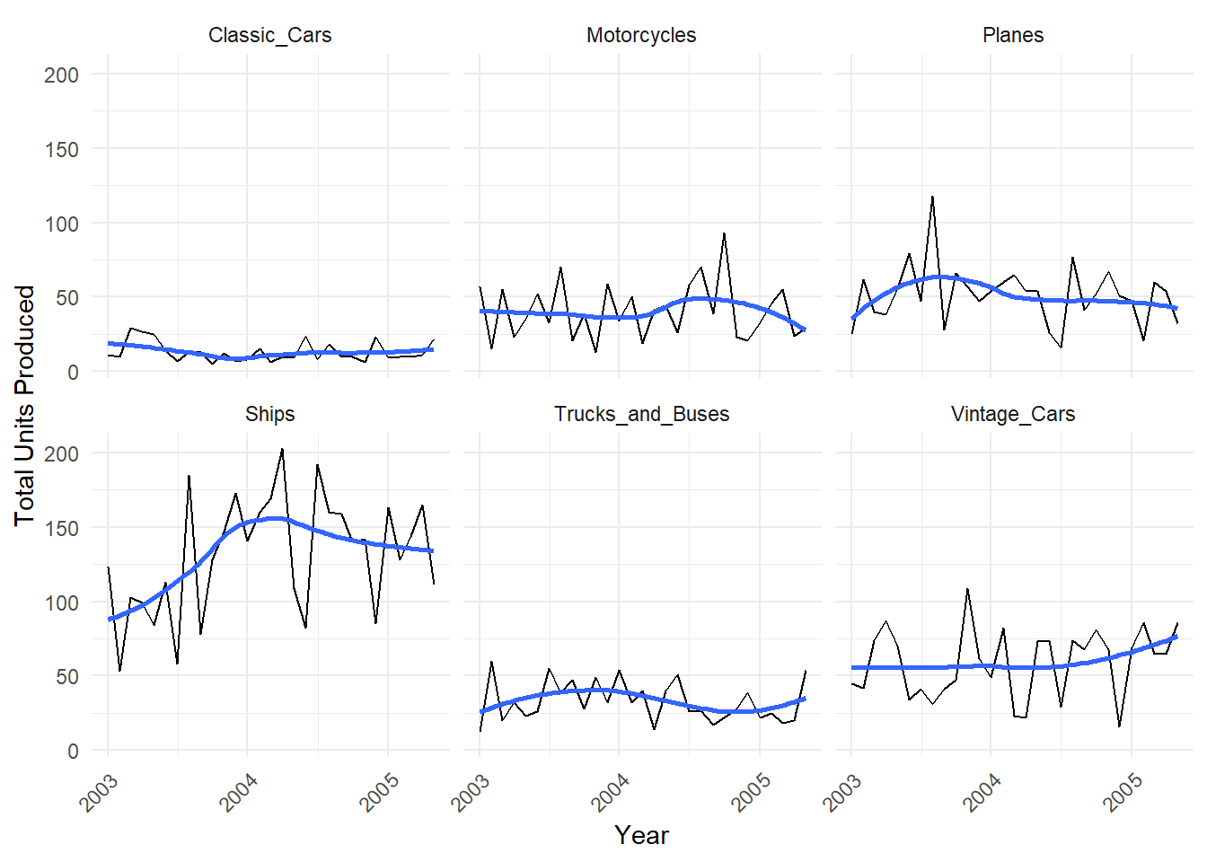
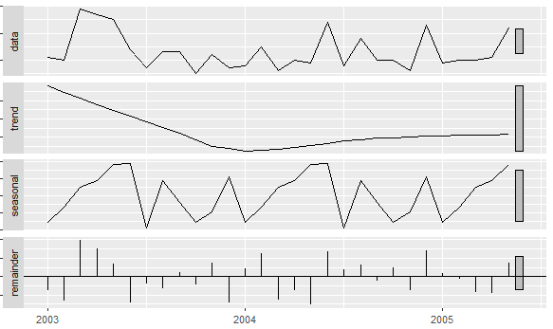
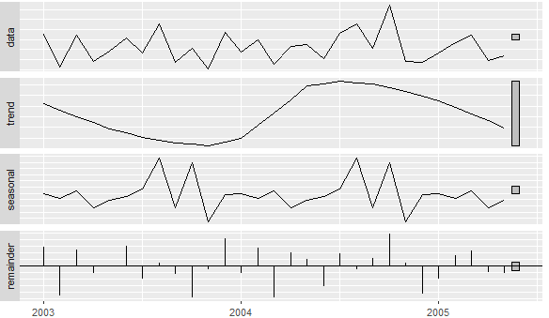
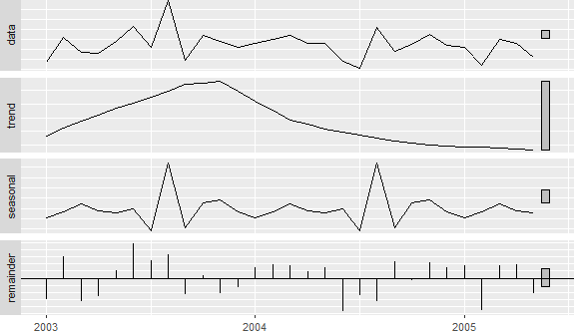
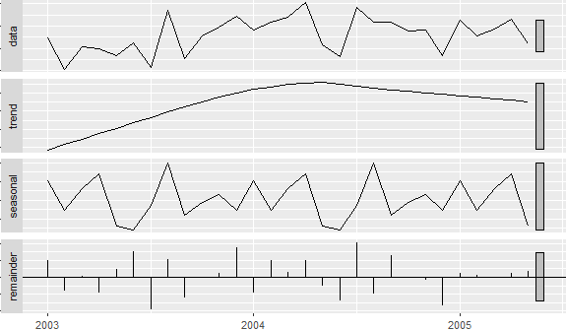
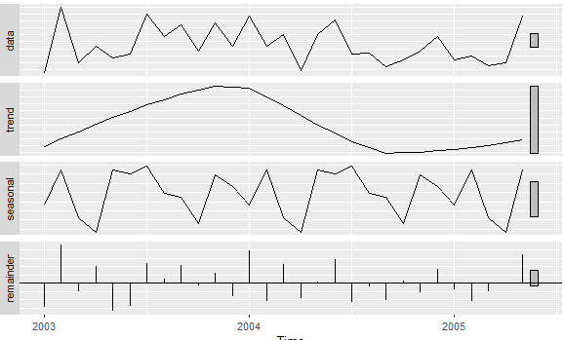
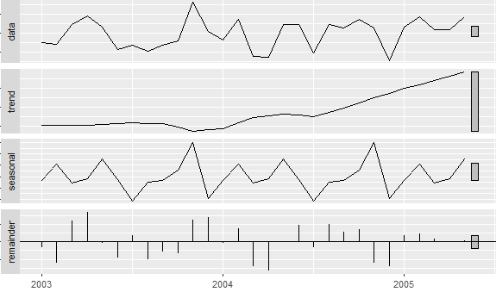
Automation systems
Seasonality and Trends
04
Anlaysis - Market Analysis
Weak Seasonality
Flat Trendline
Irregular Productions
Moderate Seasonality
Curved Trendline
Irregular Productions
Weak Seasonality
Curved Trendline
Irregular Productions
Rough 4 Month Seasonality
Strong Upward Trendline
Low-High Production
Low Seasonality
Curved Trendline
Irregular Productions
Moderate Seasonality
Curved Trendline
Low-High Production

Slide 7
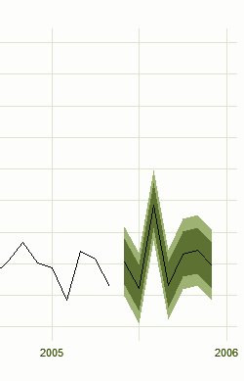
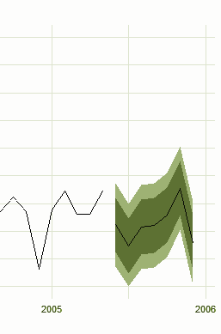
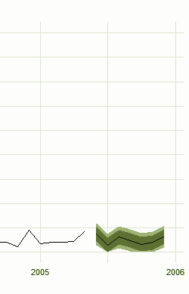

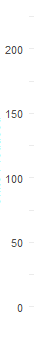
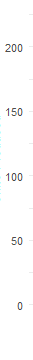
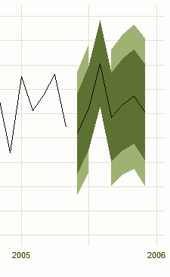
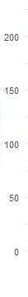
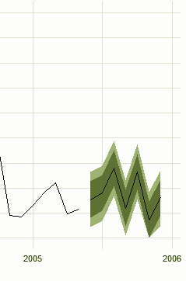
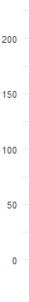
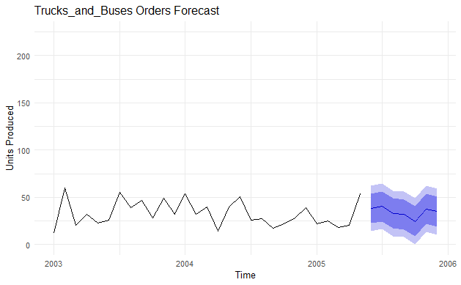
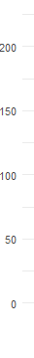
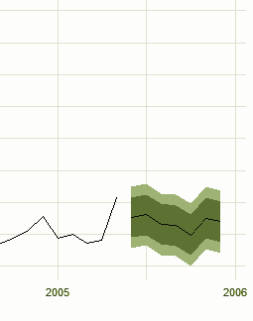


Automation systems
Forecasting Production June 2005 - December 2005
05
Due to the limited precision of the forecast, production ranges should be used as a guidance as opposed to precise targets.
Anlaysis - Market Analysis
Production Range
Low: 5
High: 15
Holiday: 20
Production Range
Low: 15
High: 45
Holiday: 60+
Production Range
Low: 30
High: 60
Holiday: 90+
Production Range
Low: 100
High: 140
Holiday: 170+
Production Range
Low: 25
High: 40
Holiday: N/A
Production Range
Low: 35
High: 60
Holiday: 85+

Slide 8
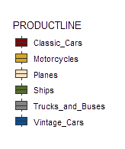


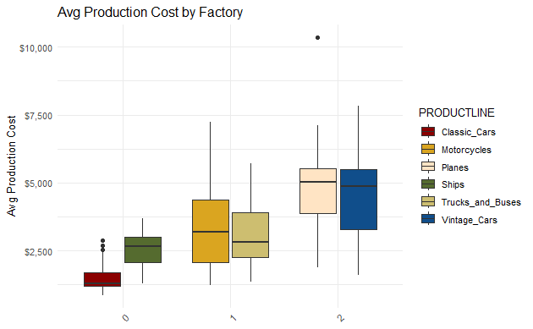













06
Production Costs
Production Costs
$91.04
Highest Average Production Costs : Factory 2
Cars have the 2nd highest CPU, but the lowest production costs
Ships have the highest number of productions yet the second lowest production cost
$83.73
$83.10
$75.09
$66.67
$15.91
Average Production Cost:
$2,000 -$6,000
Average Production Count :
25-75 units
Factory 0
$448.03
Factory 1
$256.69
Factory 2
$546.77

Slide 9


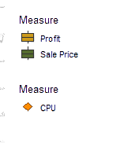
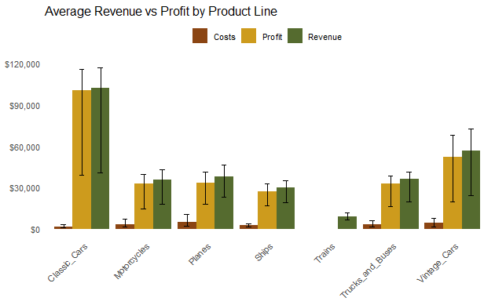
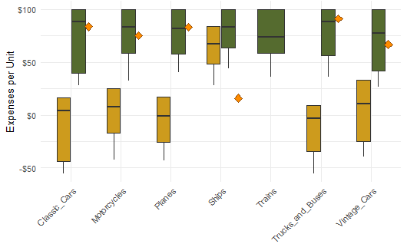
07
Profit & Revenue
Deliverable:
Drop production of trains and increase selling price to CPU + 10-15%
Profits
Note: Trains have the lowest revenue, and little data observe
Finances
Note: Plots indicate instances selling below CPU
Business - Business Goals
Top Product
Classic Cars
Cost Ratio
12.4%
Profit Margin
87.6%
Top Product
Ships
Avg Profit
$ 13.39
Avg Sale Price
$82.56
Finance Ranges by Product Line
Diamonds indicate production cost
Avg Revenue vs Profit by Product Line

Slide 10
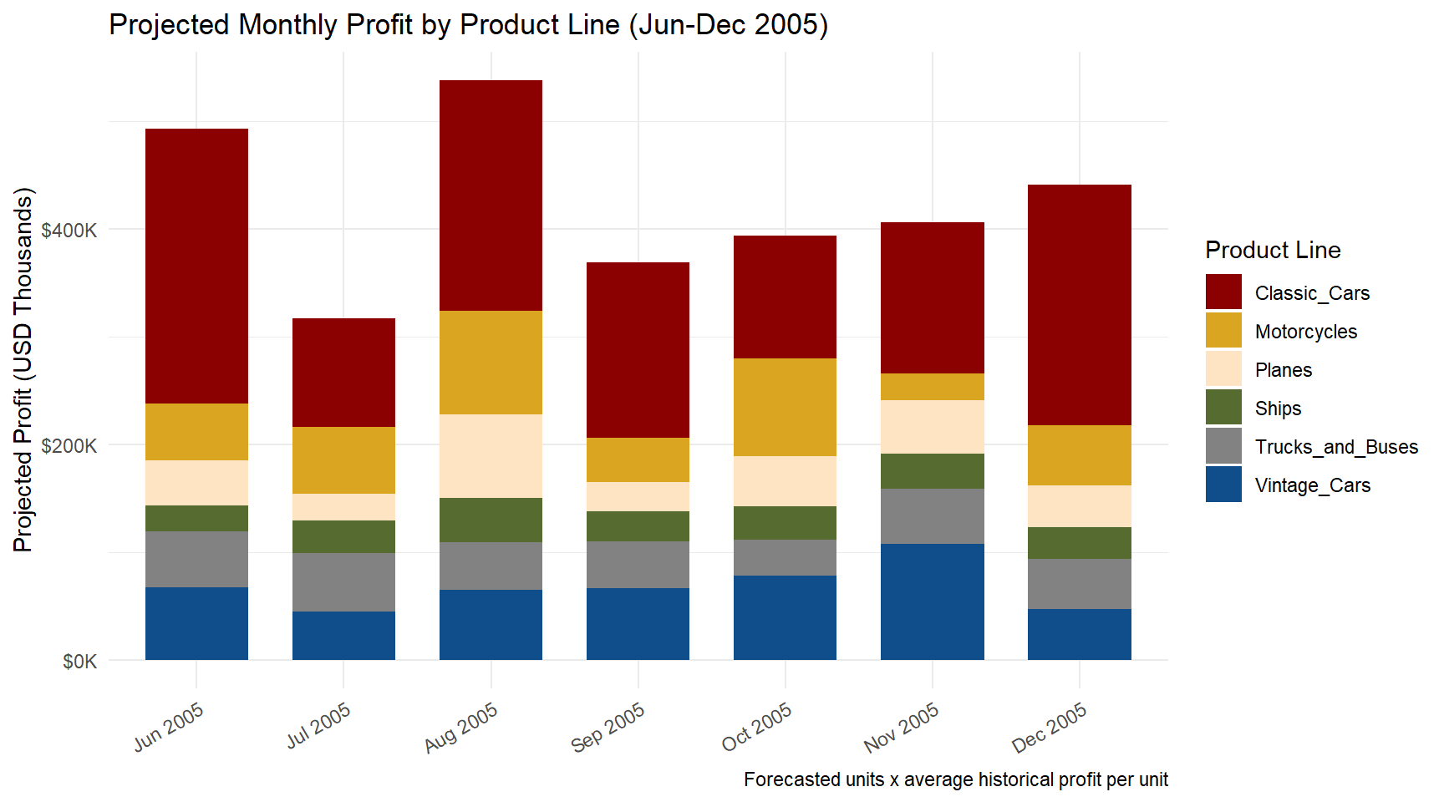
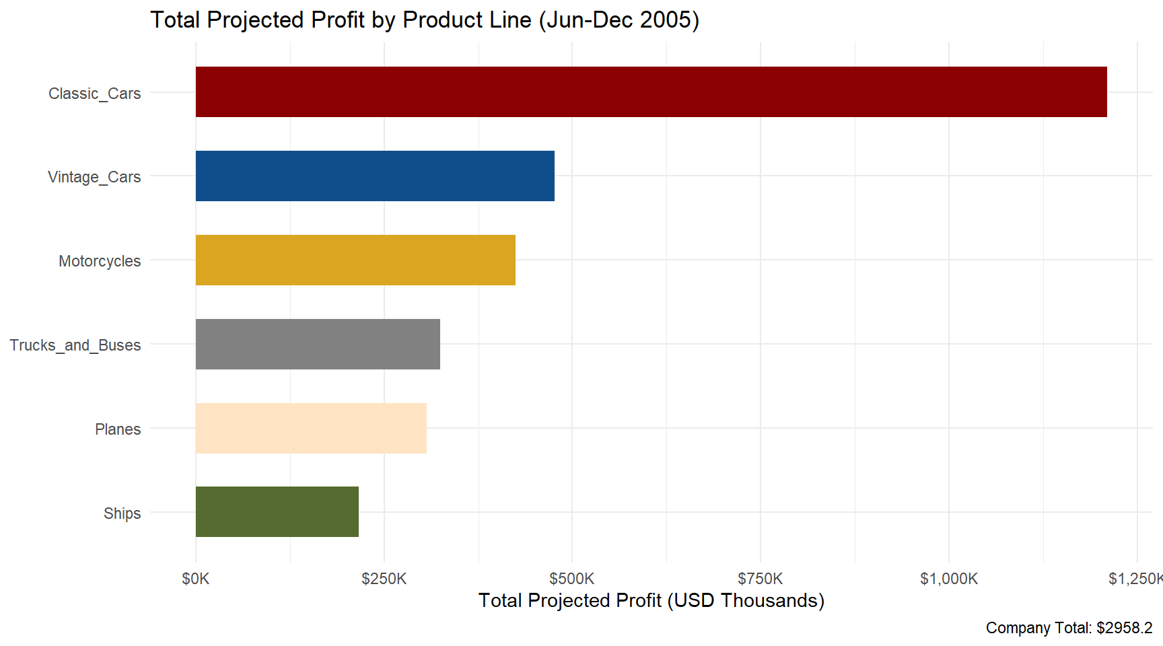
08
Forecasting Profits
Business - Business Goals

Slide 11
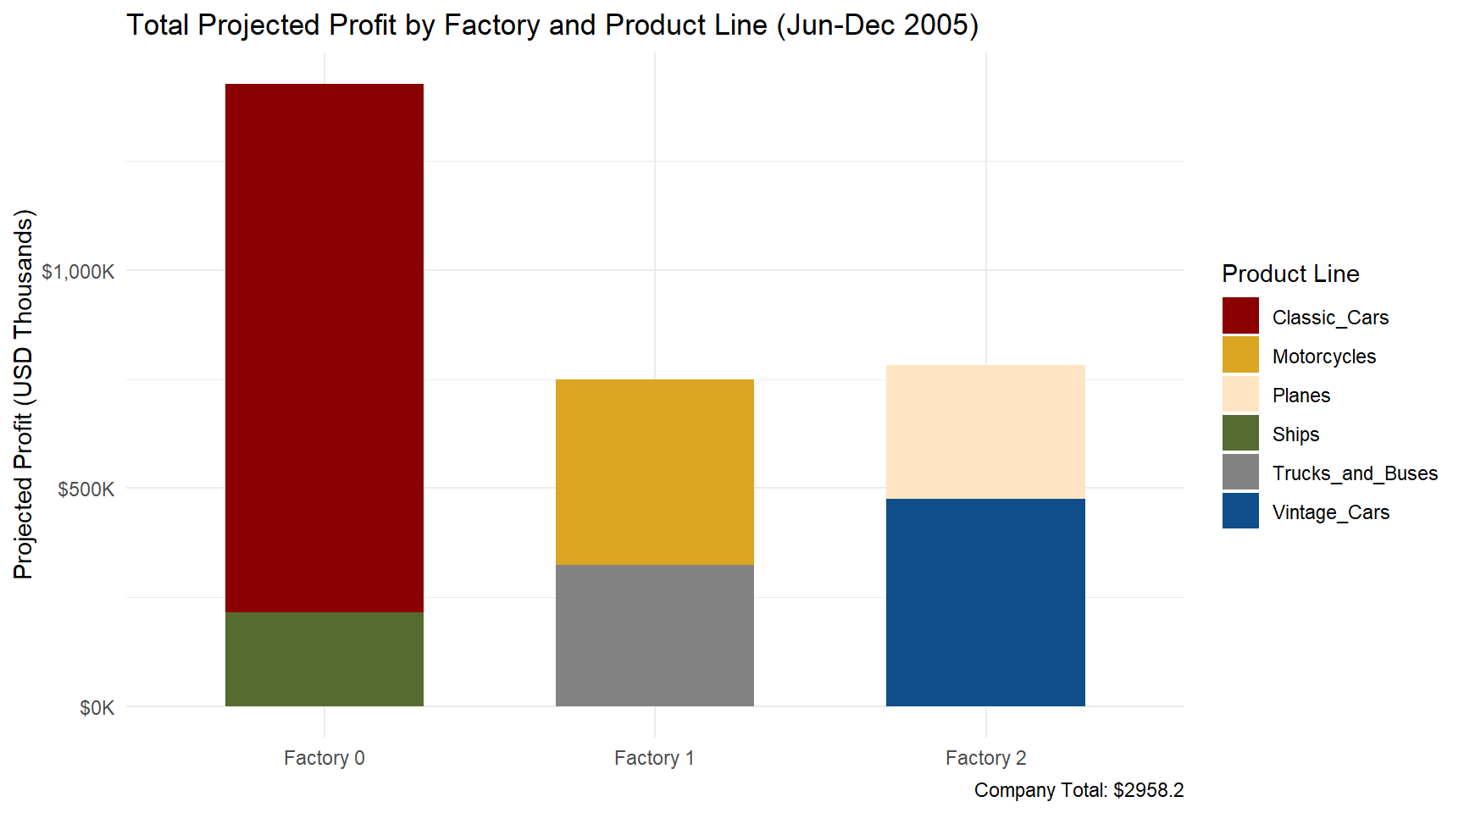
09
Forecasting Profits
Business - Business Goals

Slide 12


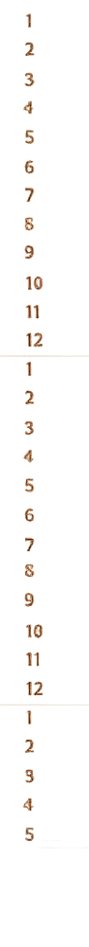

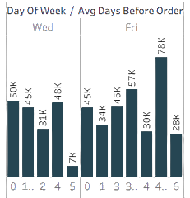
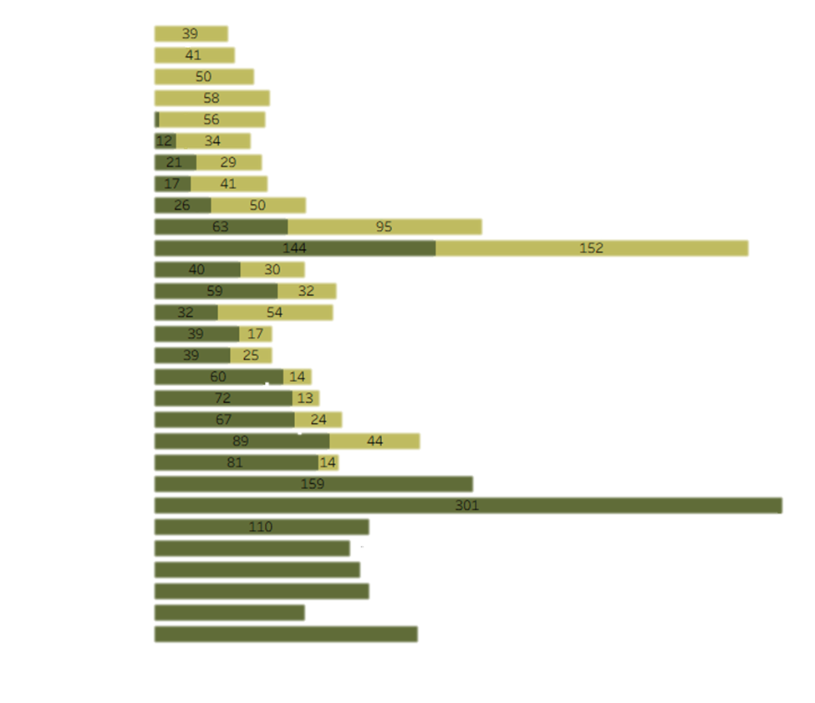





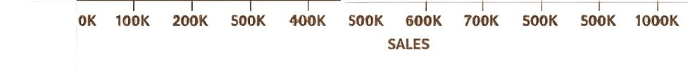
10
Highest customer email engagement with conversational emails sent on Wed and Fri
Client Engagement
Conversation Email Rates
Month
Sales: New vs Returning Customers
6.5%
0.7%
1.6%
CLICKS
OPENS
UNSUB
ORDERS
3.8%
Business - Business Goals
2003
New customer engagement is decreasing while returning customers remain stable.
Deliverable:
Send Conversational emails on Wednesdays and Fridays to boost customer engagement in orders, and reach new customers
Alarming Email Rates
CLICKS
OPENS
UNSUB
ORDERS
10%
2.9%
0.5%
2004
3%
99
97
2005
106
56
120

Slide 13
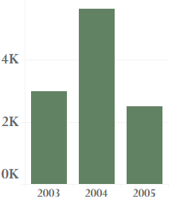





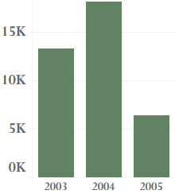





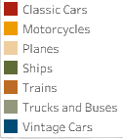

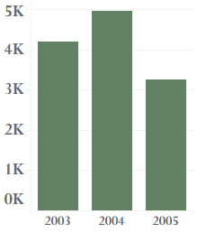

FRANCE STATUS
Regional Sales Performance
$1,110,916
11
# ORDERS
PRODUCT %
NORTH AMERICA STATUS
$3,627,983
# ORDERS
PRODUCT %
UK
FRANCE
478,880
Regional Sales Performance
SPAIN
188,168
NORTH
AMERICA
JAPAN
SPAIN STATUS
Singapore
$1,215,686
288,488
North America, Spain, and France are our biggest contributors to order quantities and profits. They prioritize the purchasing of Classic Cars, Vintage Cars, and Motorcycles. We would like to look at their sister countries and reach into the untapped markets based on our main contributors preferences
# ORDERS
630,623
PRODUCT %
AUSTRALIA

Slide 14
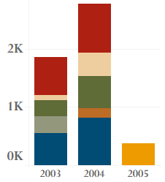

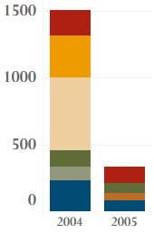

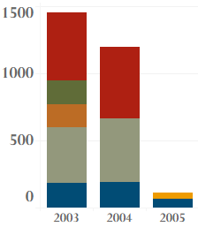

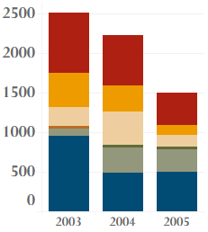

Regional Sales Performance
UK STATUS
JAPAN STATUS
SINGAPORE STATUS
$478,880
$188,168
$288,488
Deliverable:
Send Conversational emails to indicated regions, focusing on their developing interests
12
# ORDERS
PRODUCT %
# ORDERS
PRODUCT %
# ORDERS
PRODUCT %
UK
FRANCE
Regional Sales Performance
SPAIN
188,168
NORTH
AMERICA
JAPAN
Singapore
AUSTRALIA STATUS
$630,623
UK: Planes and Ships
Japan: Planes and Motorcycles
Singapore: Trucks and Buses
Australia : Motorcycles, Trucks, Buses, Planes
South America: Trucks, Buses, Planes
AUSTRALIA
# ORDERS
PRODUCT %

Slide 15











Deliverables
13
This plan of action outlines our strategy for Timeless Transport Models to maximize their profitability through the second half of 2005
Expand our Reach
Schedule Production
High potential markets in UK, Japan, Singapore, Australia, and South America. Send conversational emails on high engagement days (Wed and Fri)
Schedule production increases for August and November-December based forecast ranges
Deliverables
June 2005
Halt Train Production
Increase Pricing
Halt train production and reallocate space for active productions
Increase minimum unit selling point to
CPU + 10-15% margin buffer

Slide 16



TIMELESS TRANSPORT MODELS
E-mail
TimelessTM@fake.com
Thank you
Phone
1-123-456-7890
Homepame
TimelessTM.com

