Slide 1
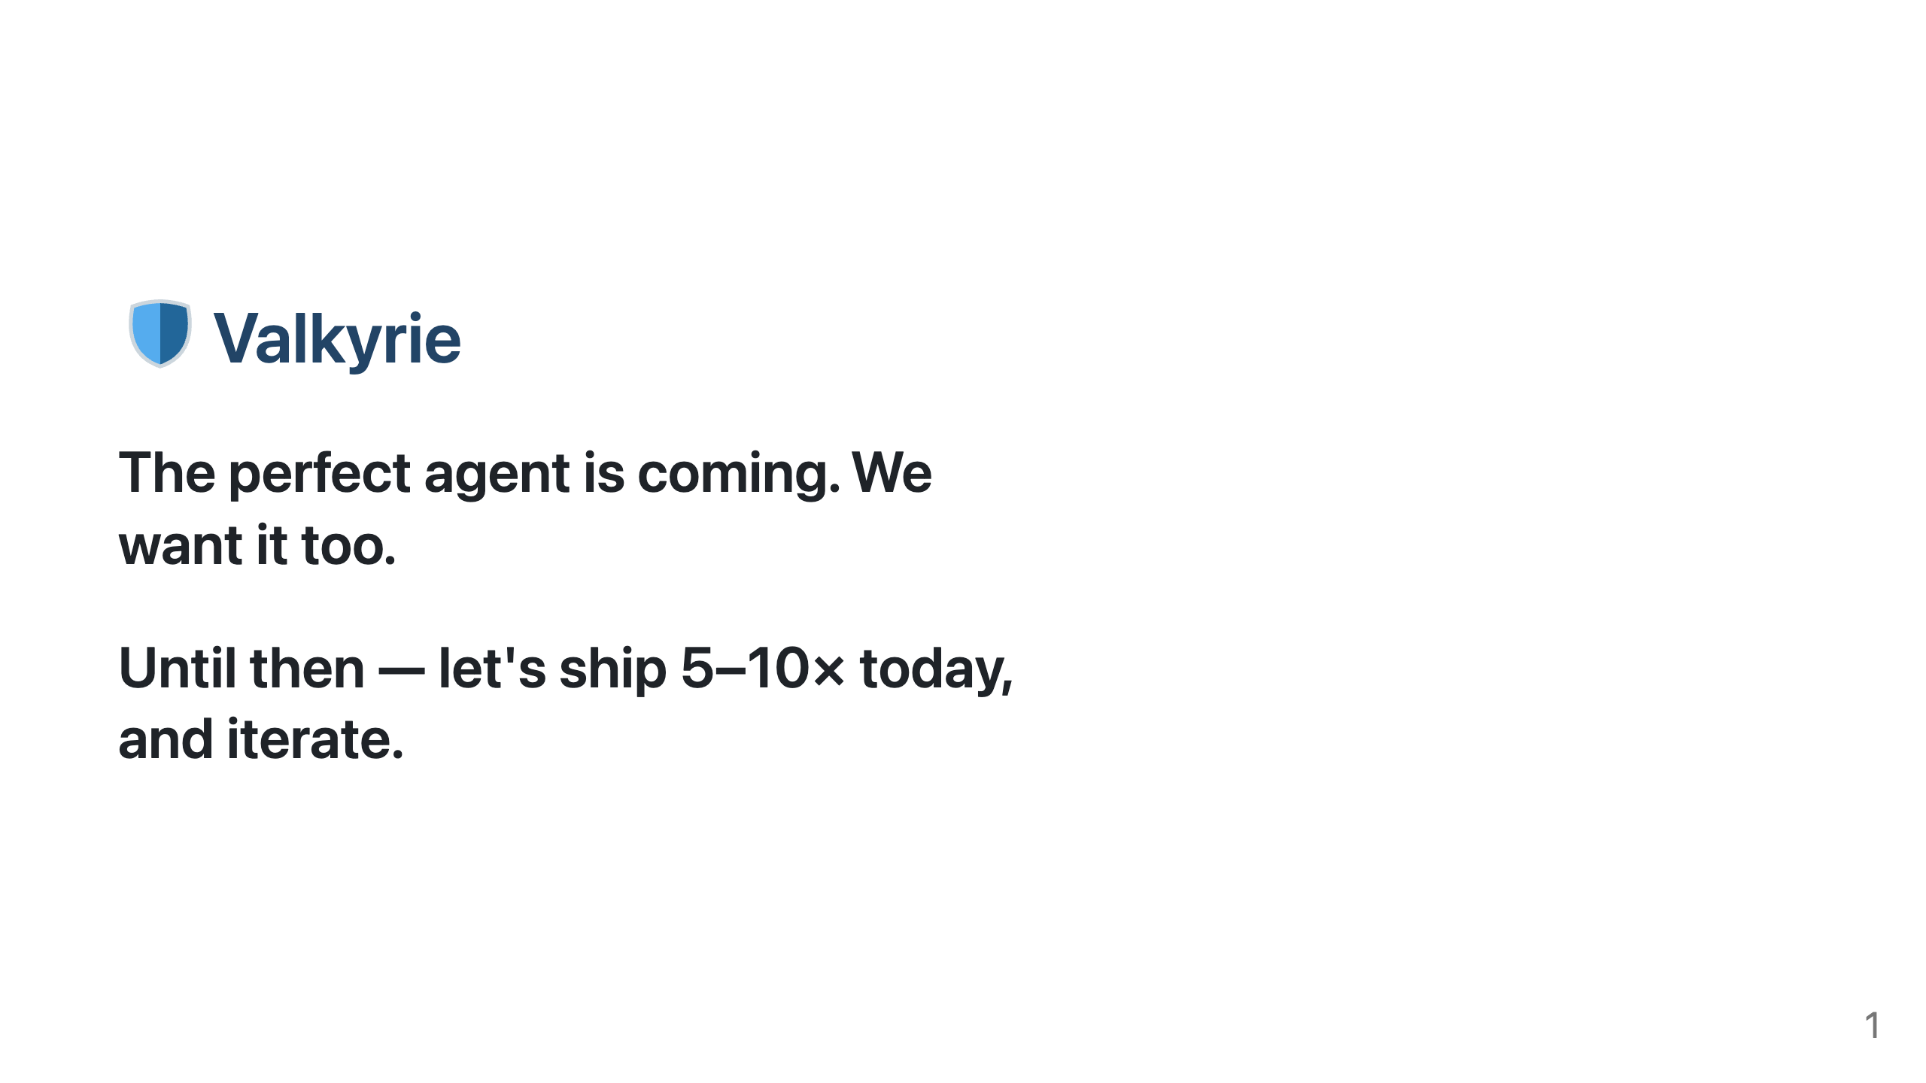
Notes:
TITLE-SLIDE IMAGE: Drop a Valkyrie-helm image at: docs/onboarding/assets/helm.png The `![bg right:40% w:80%]` directive puts it on the right 40% of the slide. If no image is present, Marp silently omits it and you're left with the 🛡 emoji + headline — still readable. Stock options to grab one (manual download): - unsplash.com (search "viking helmet", "valkyrie") - pexels.com (free, no attribution required) - flaticon.com (icon-style — search "viking helm") Or generate with any image model and save as helm.png.

Slide 2
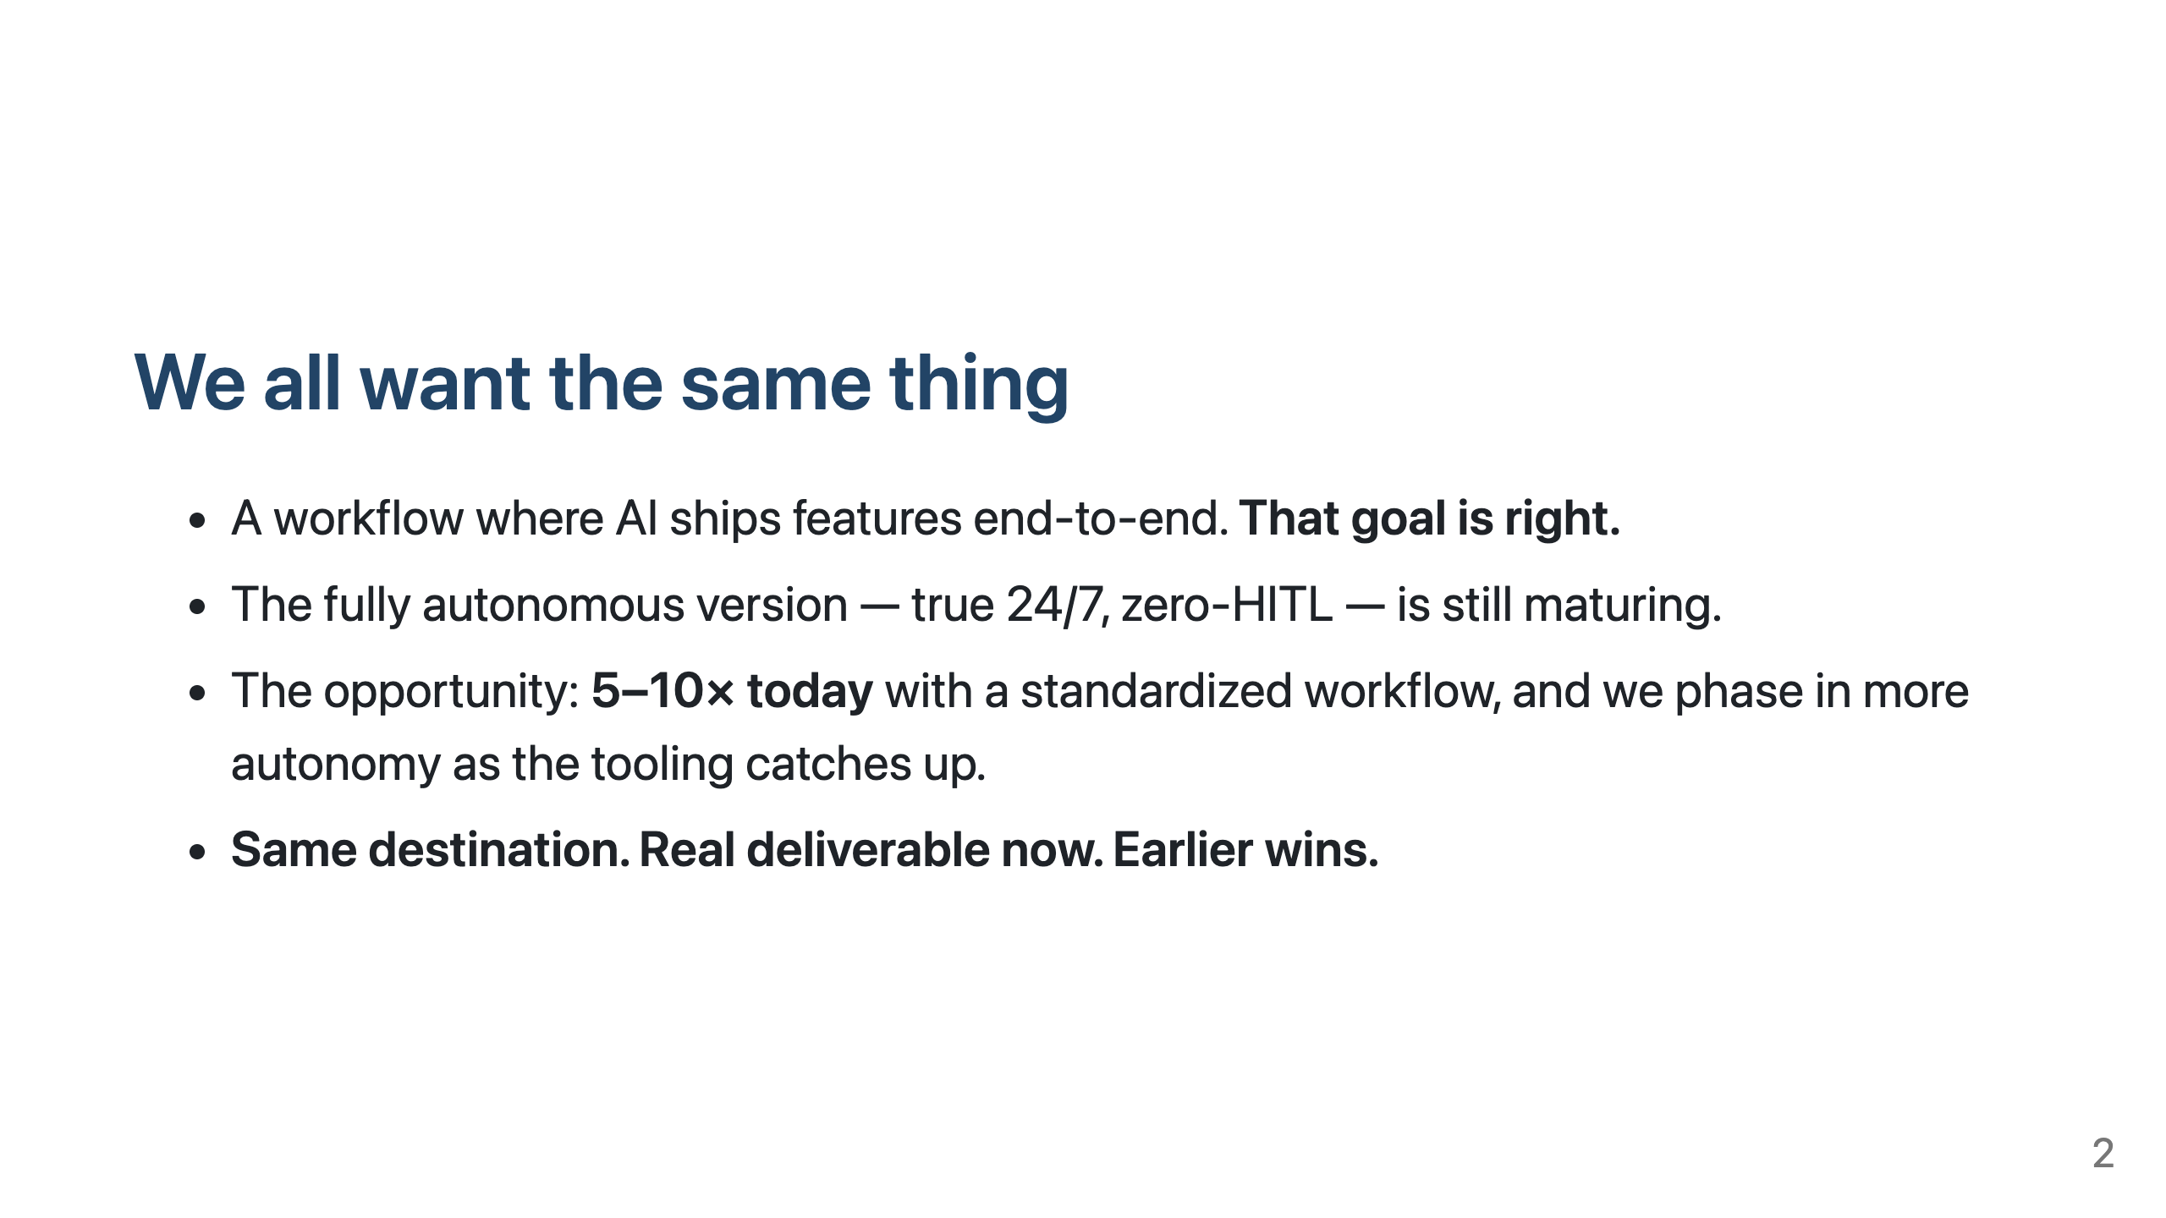

Slide 3
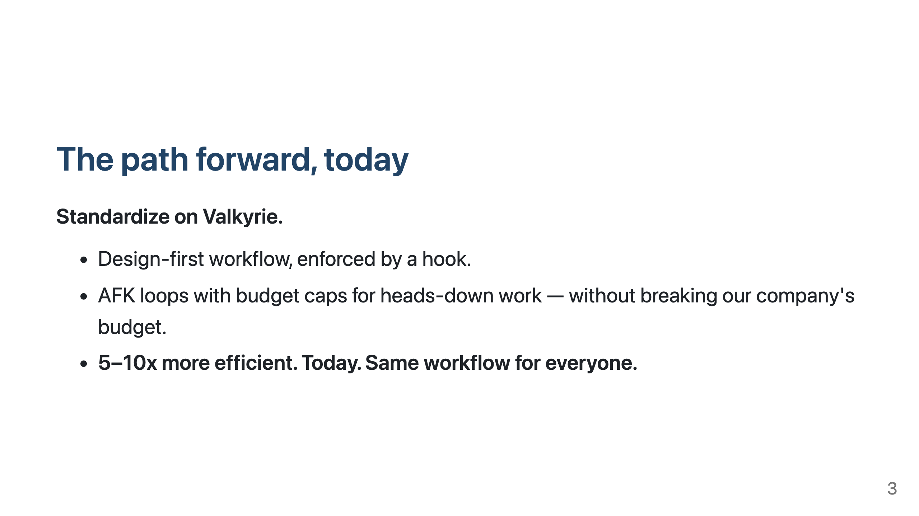

Slide 4
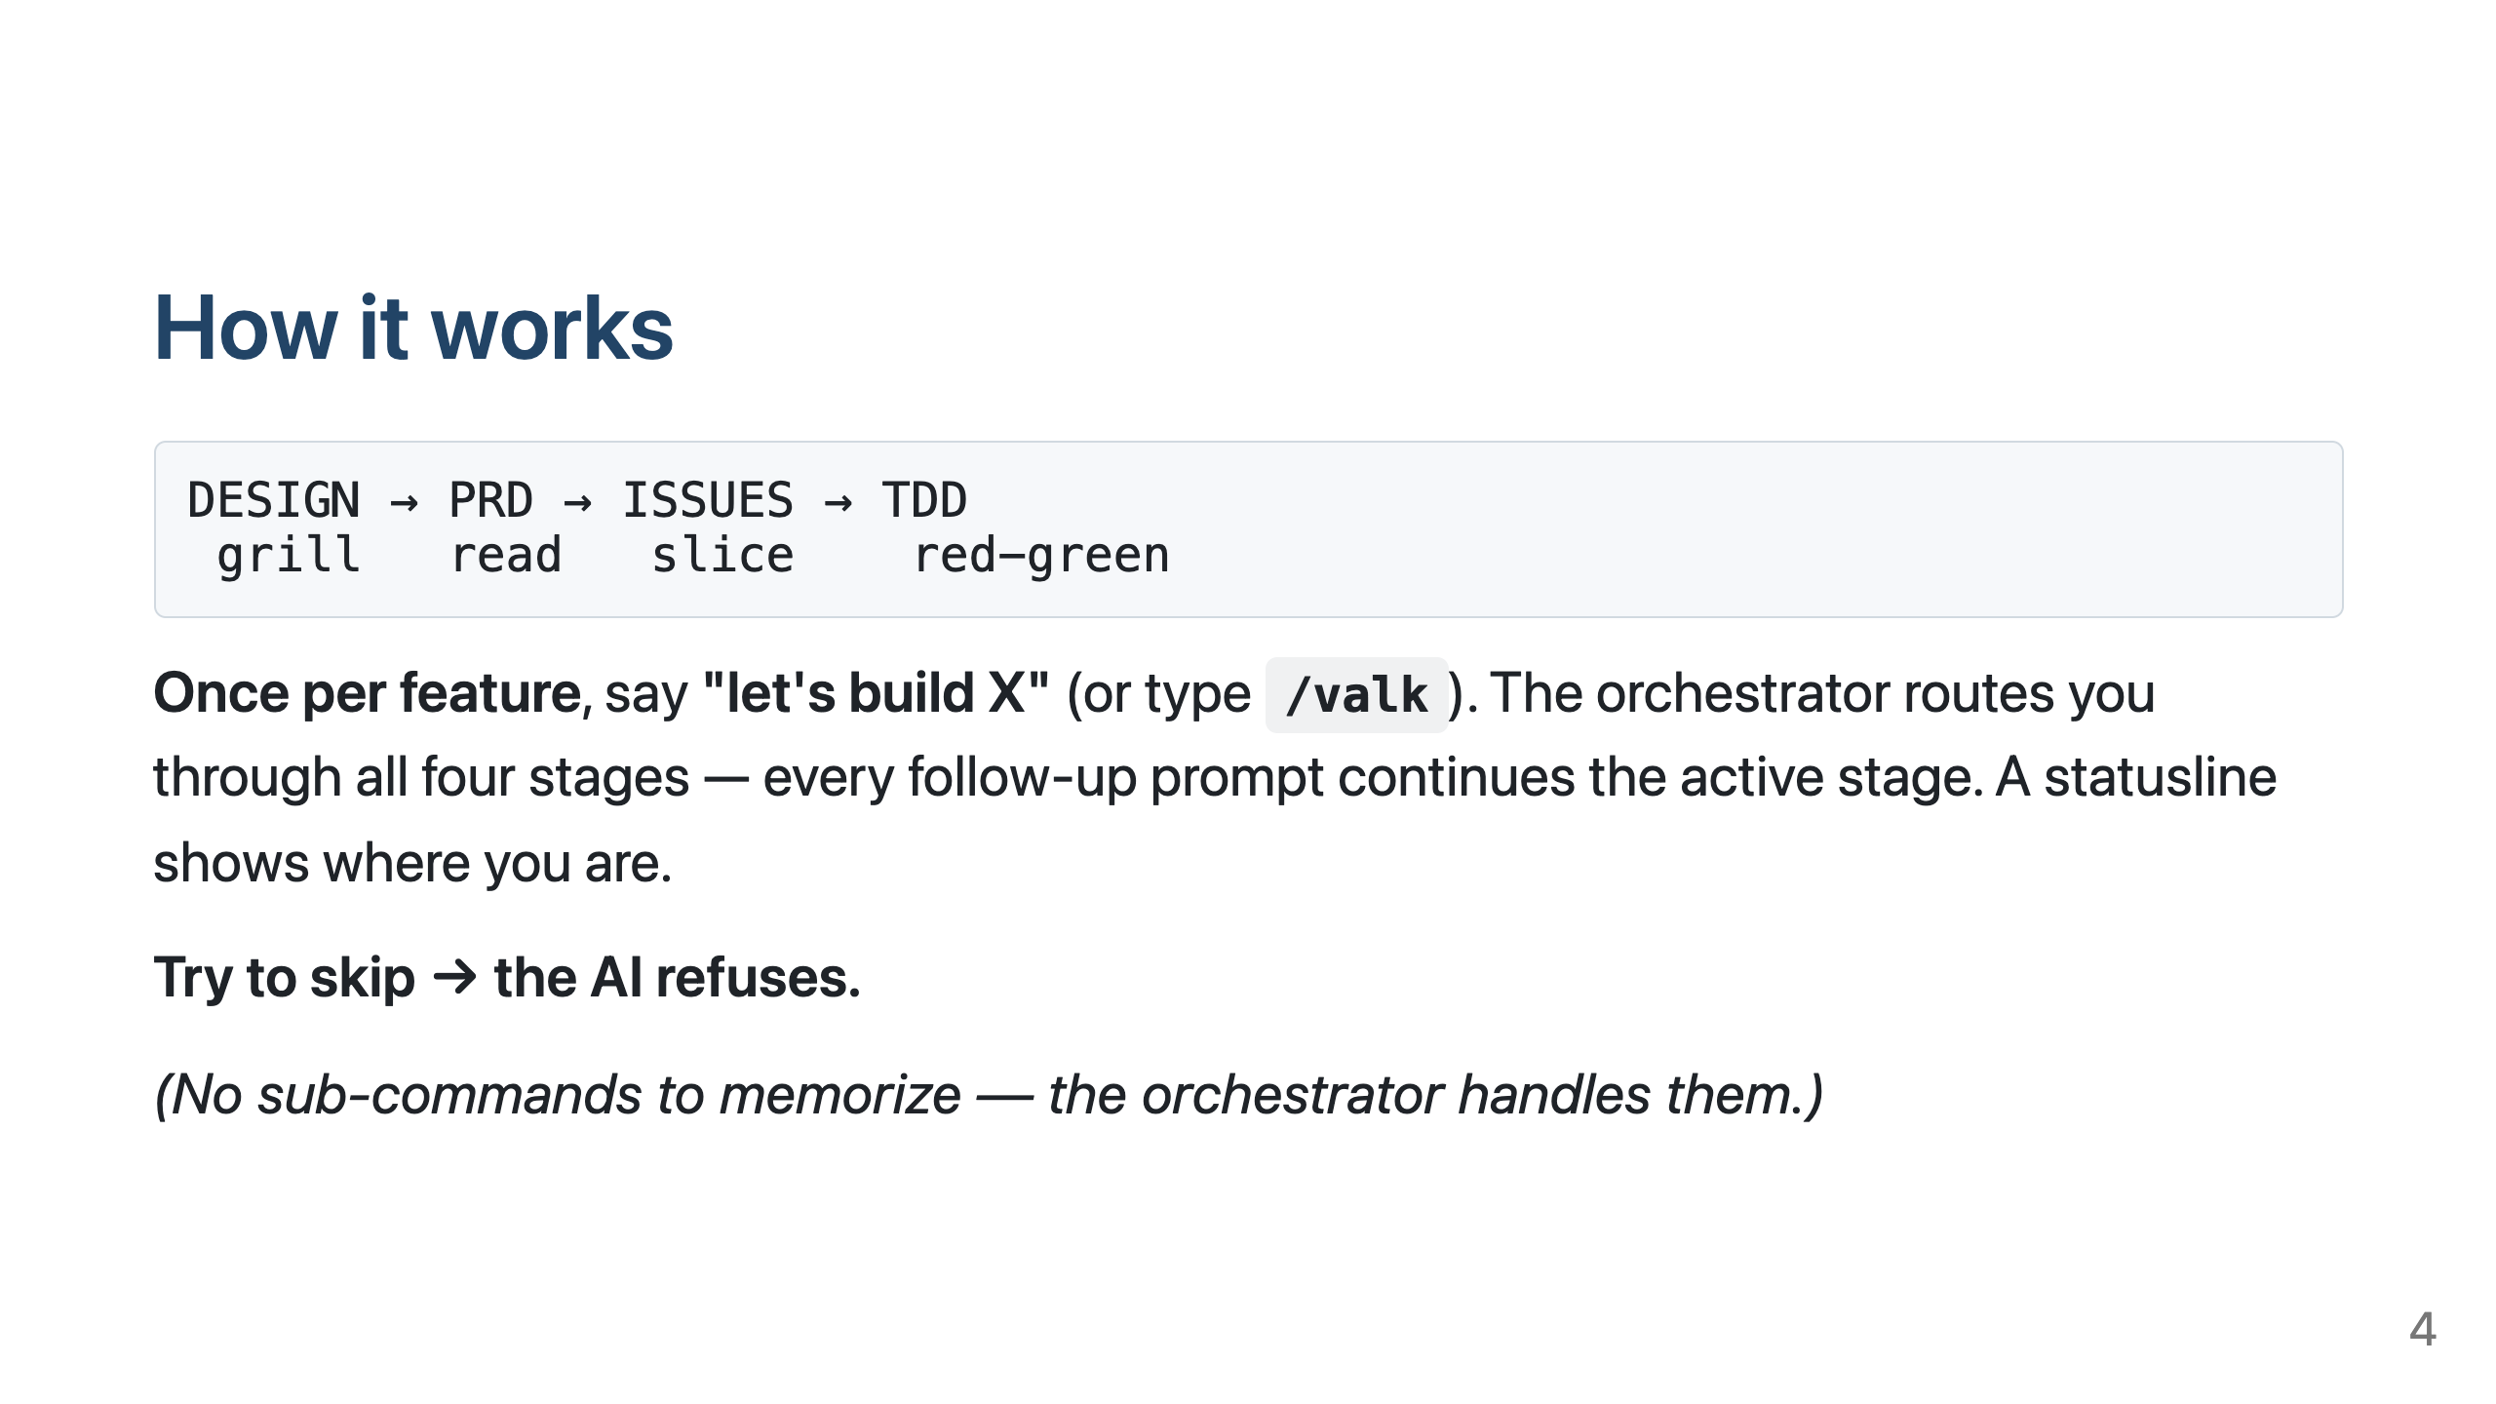

Slide 5
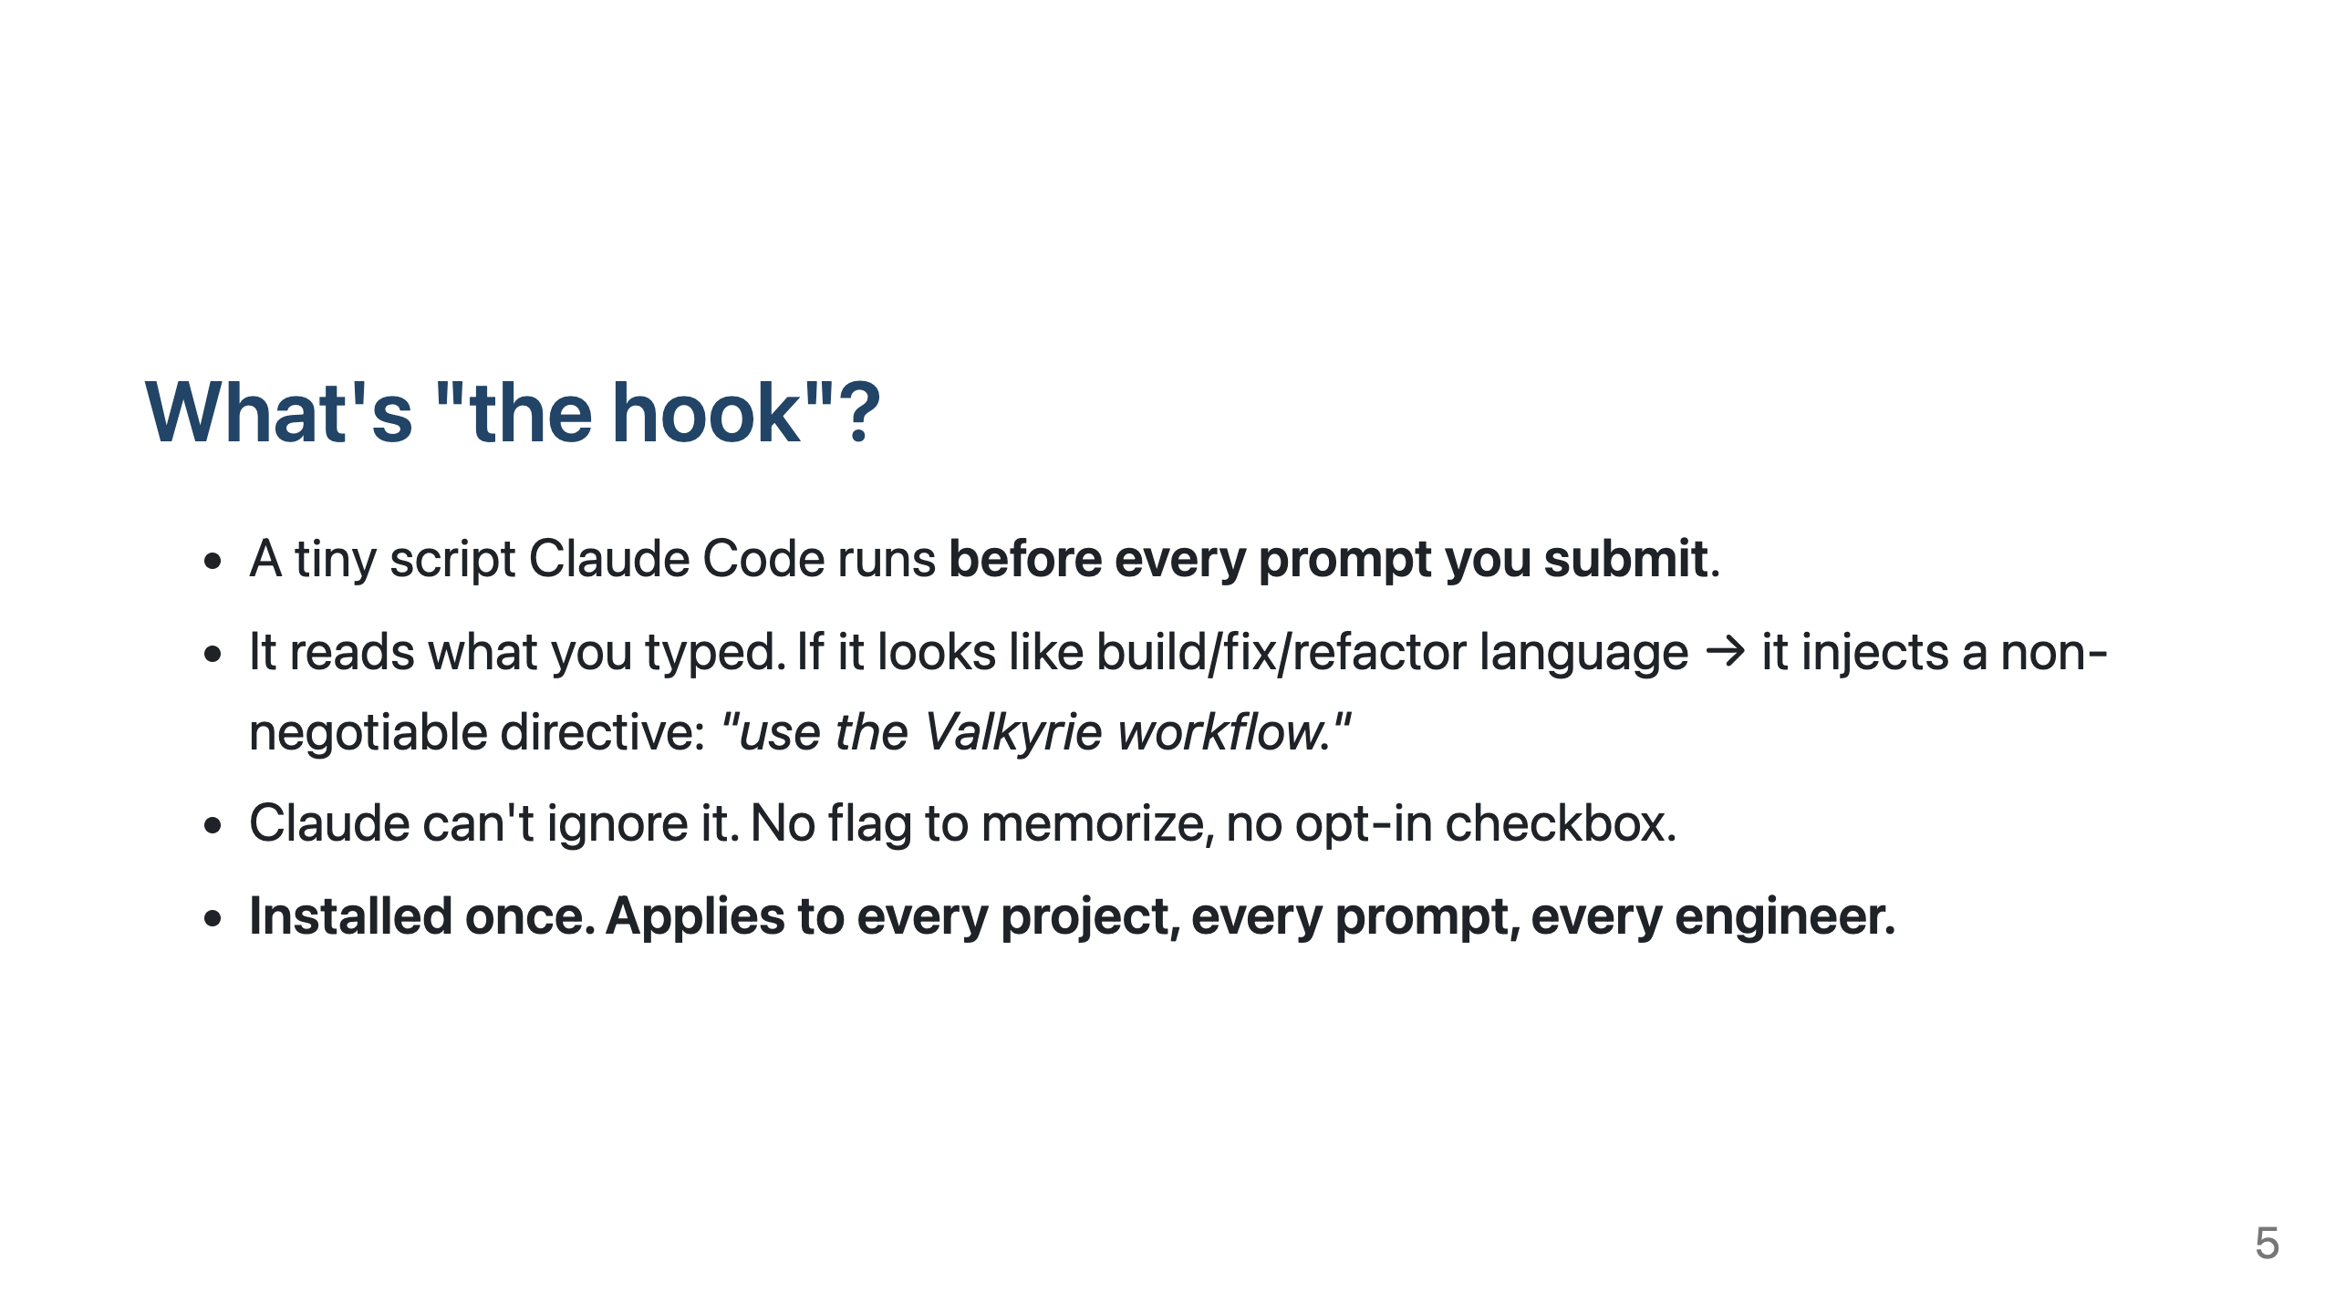

Slide 6
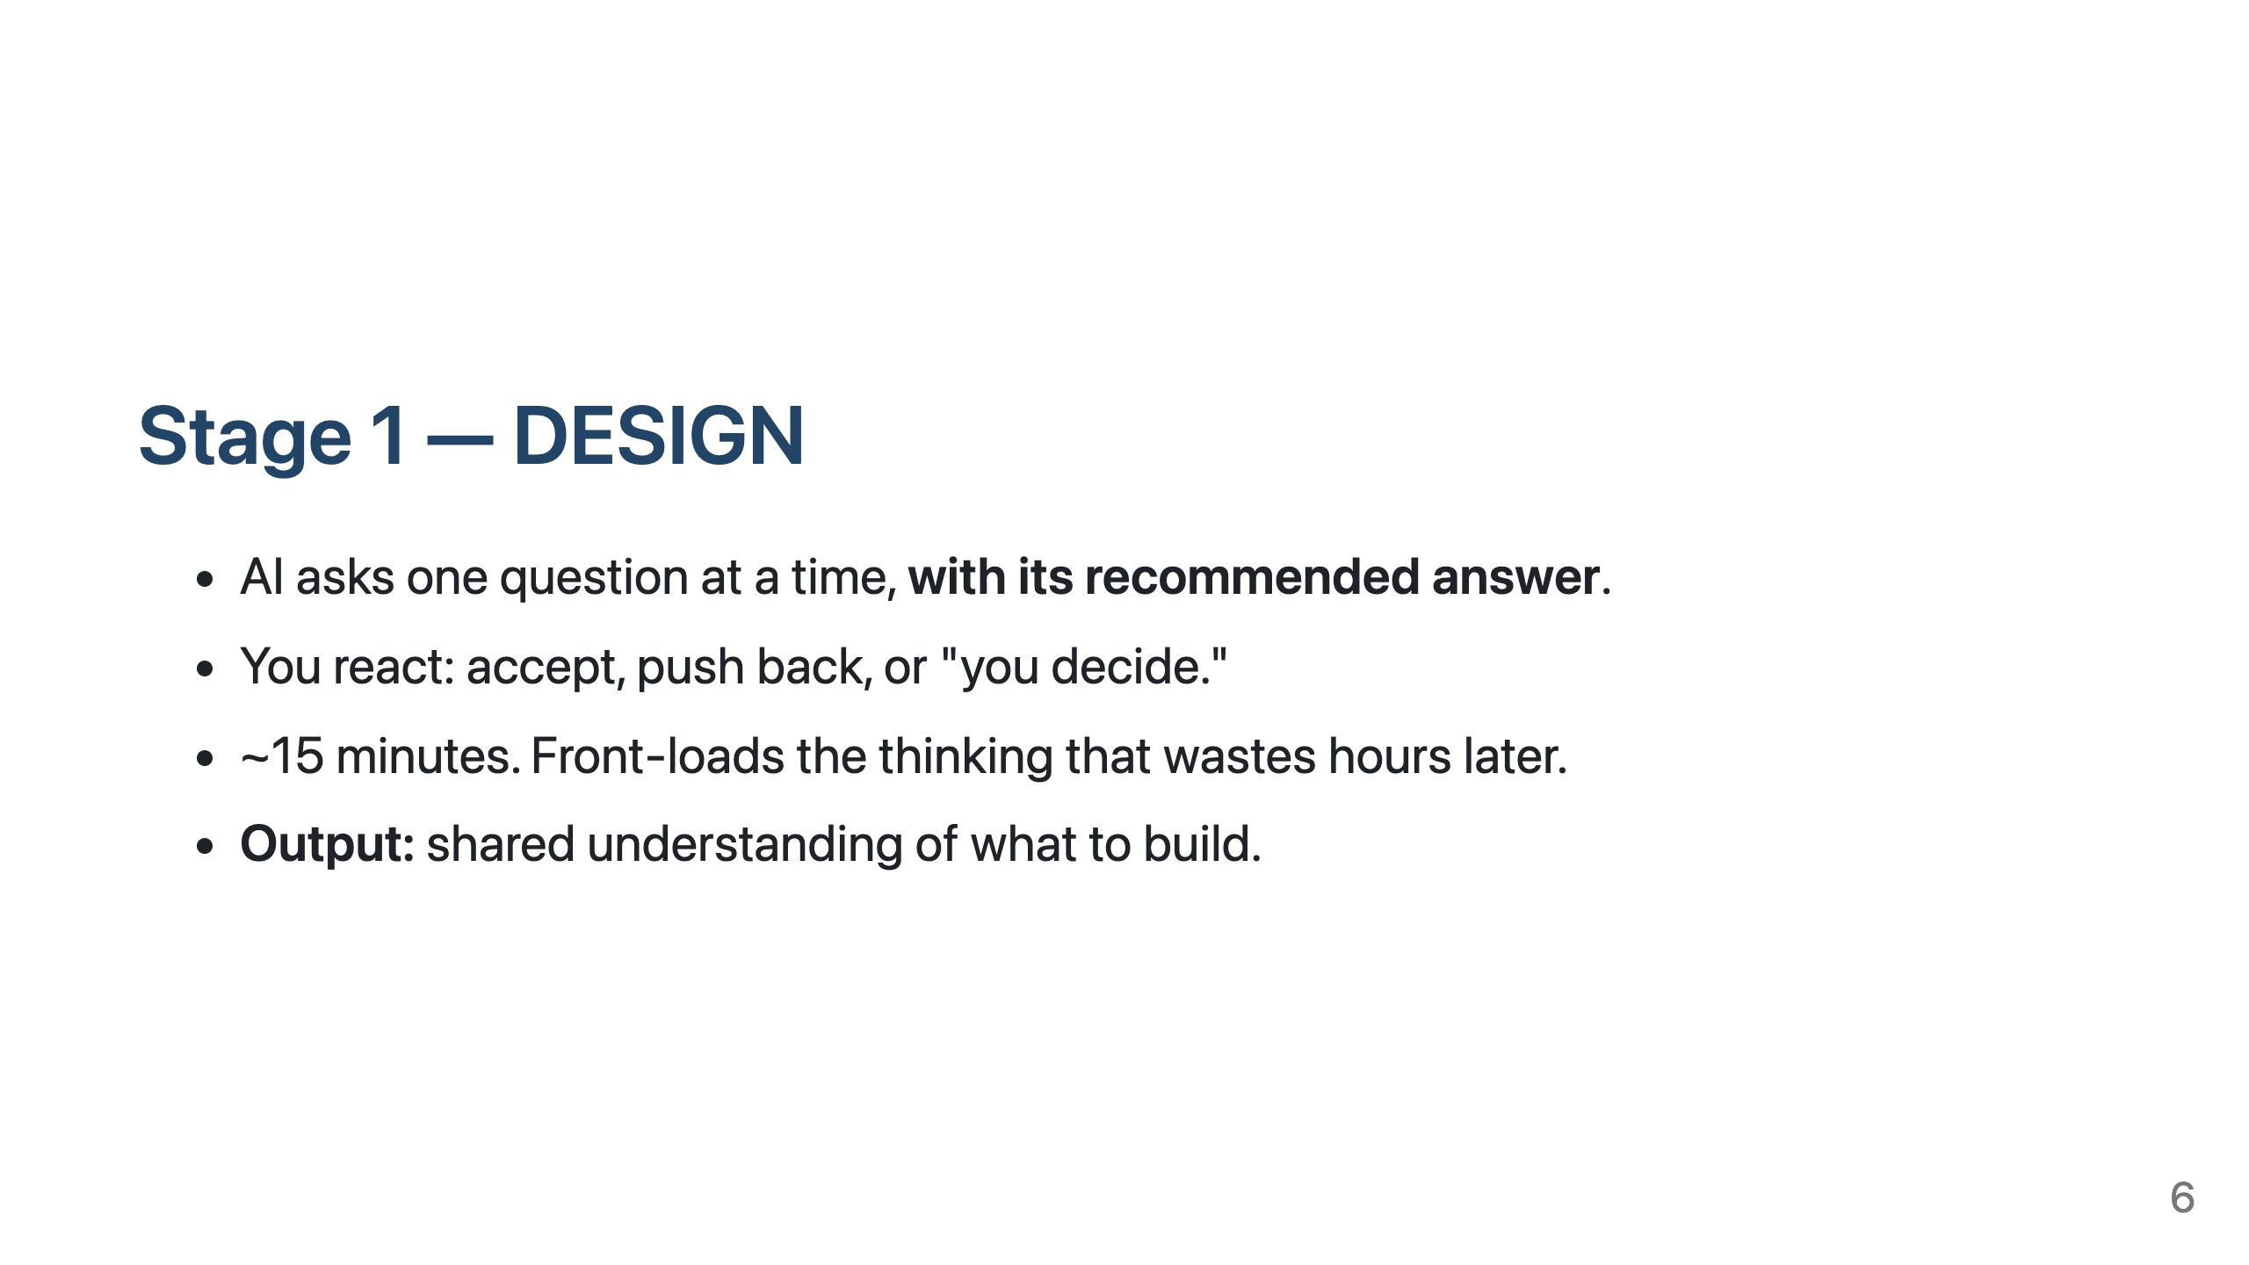

Slide 7
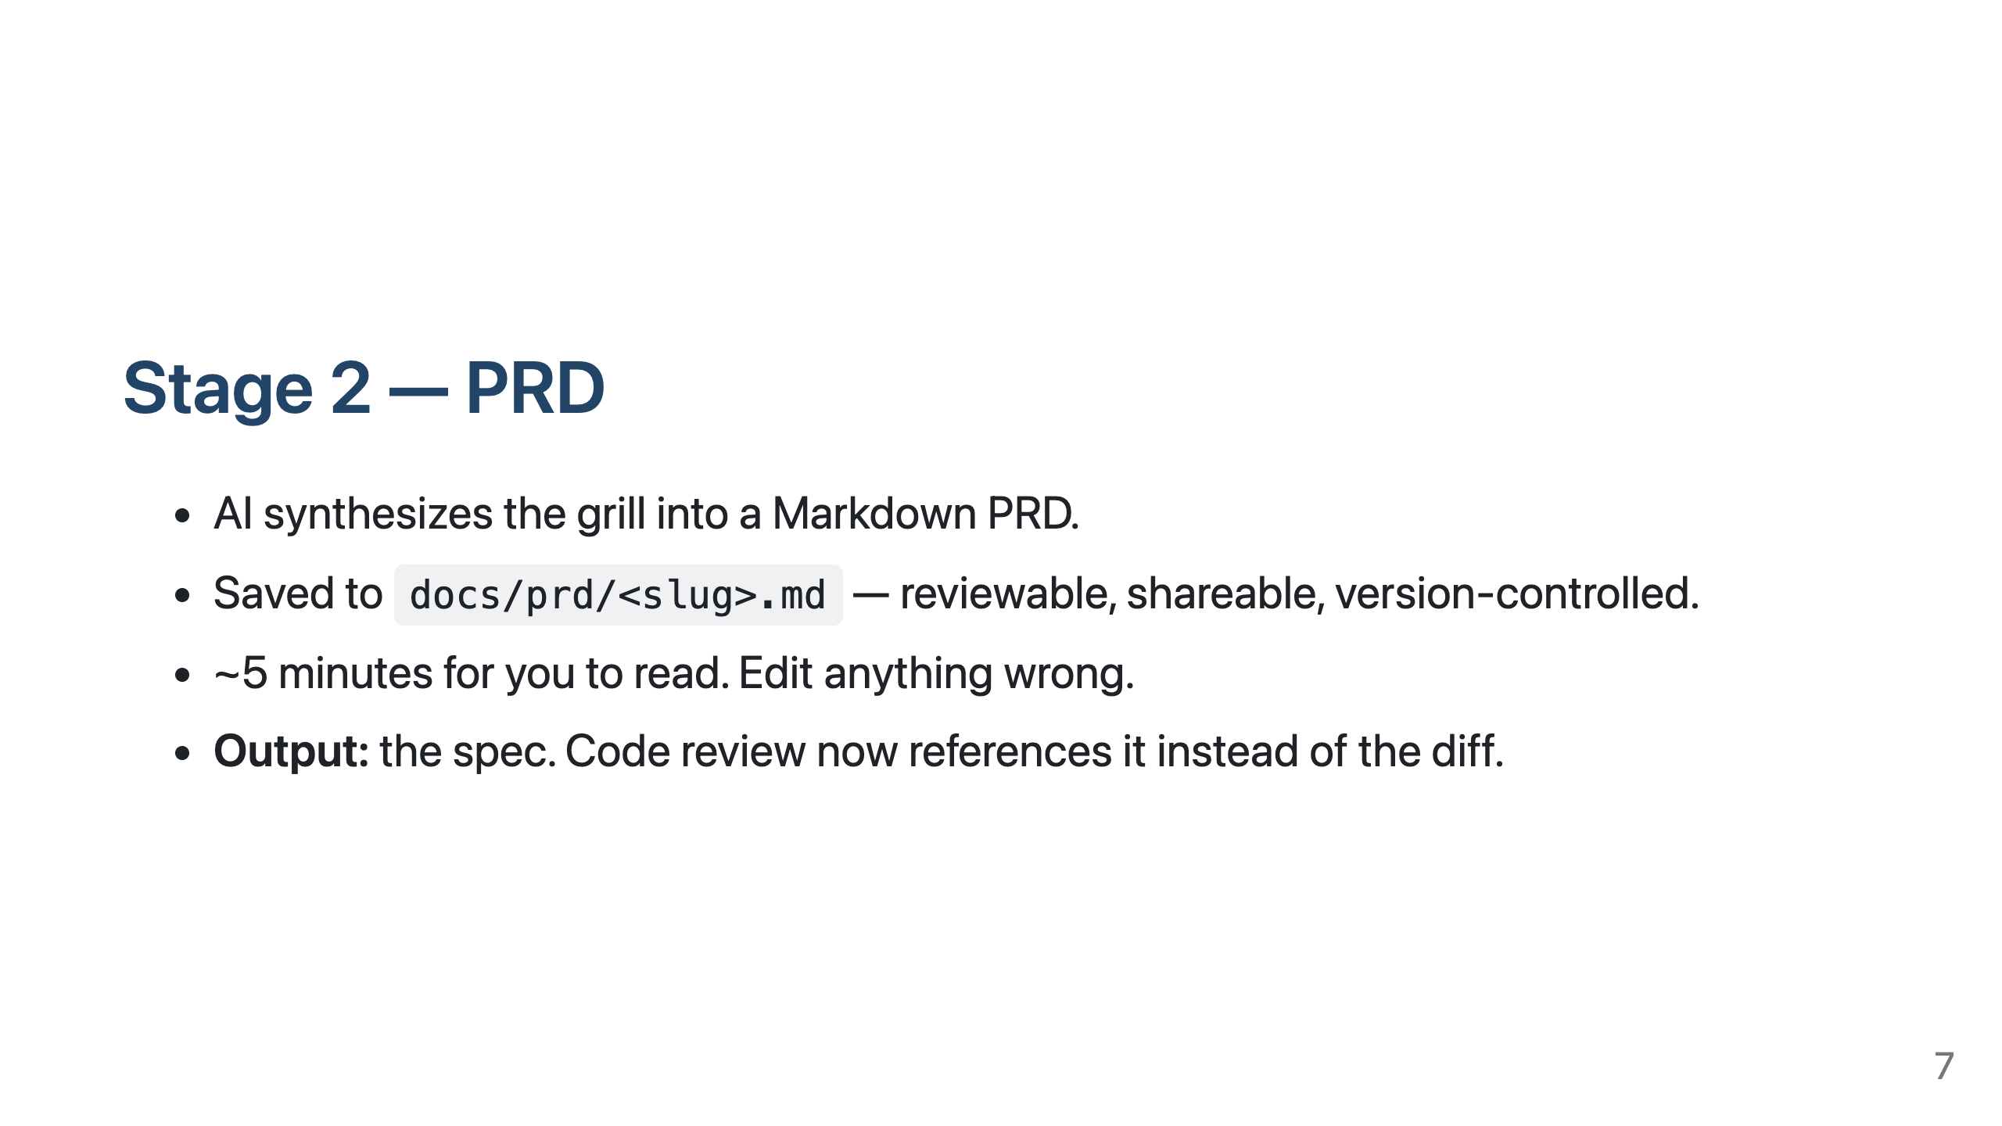

Slide 8
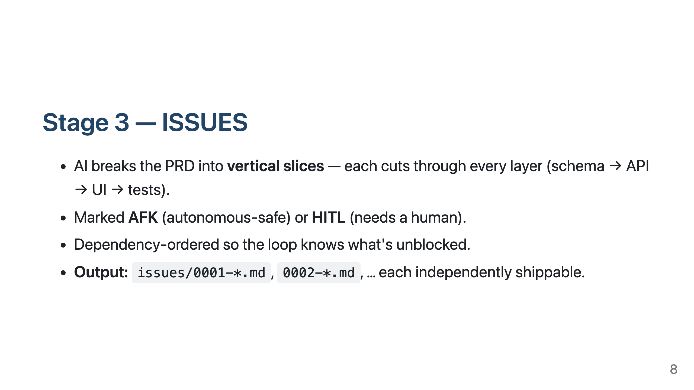

Slide 9
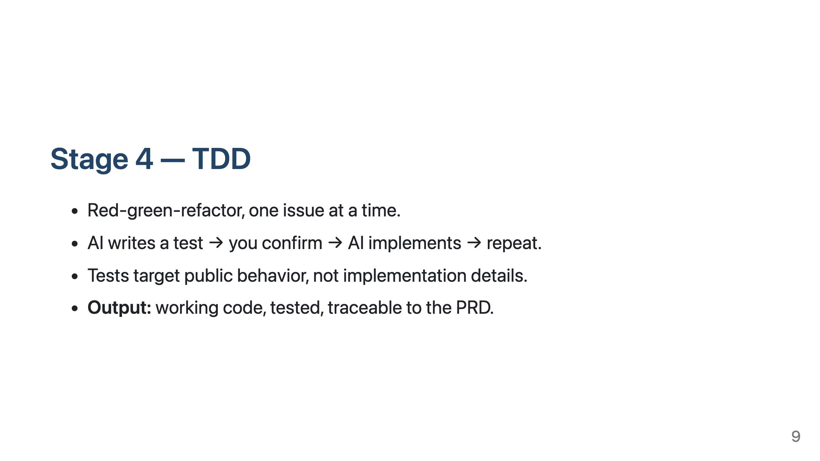

Slide 10
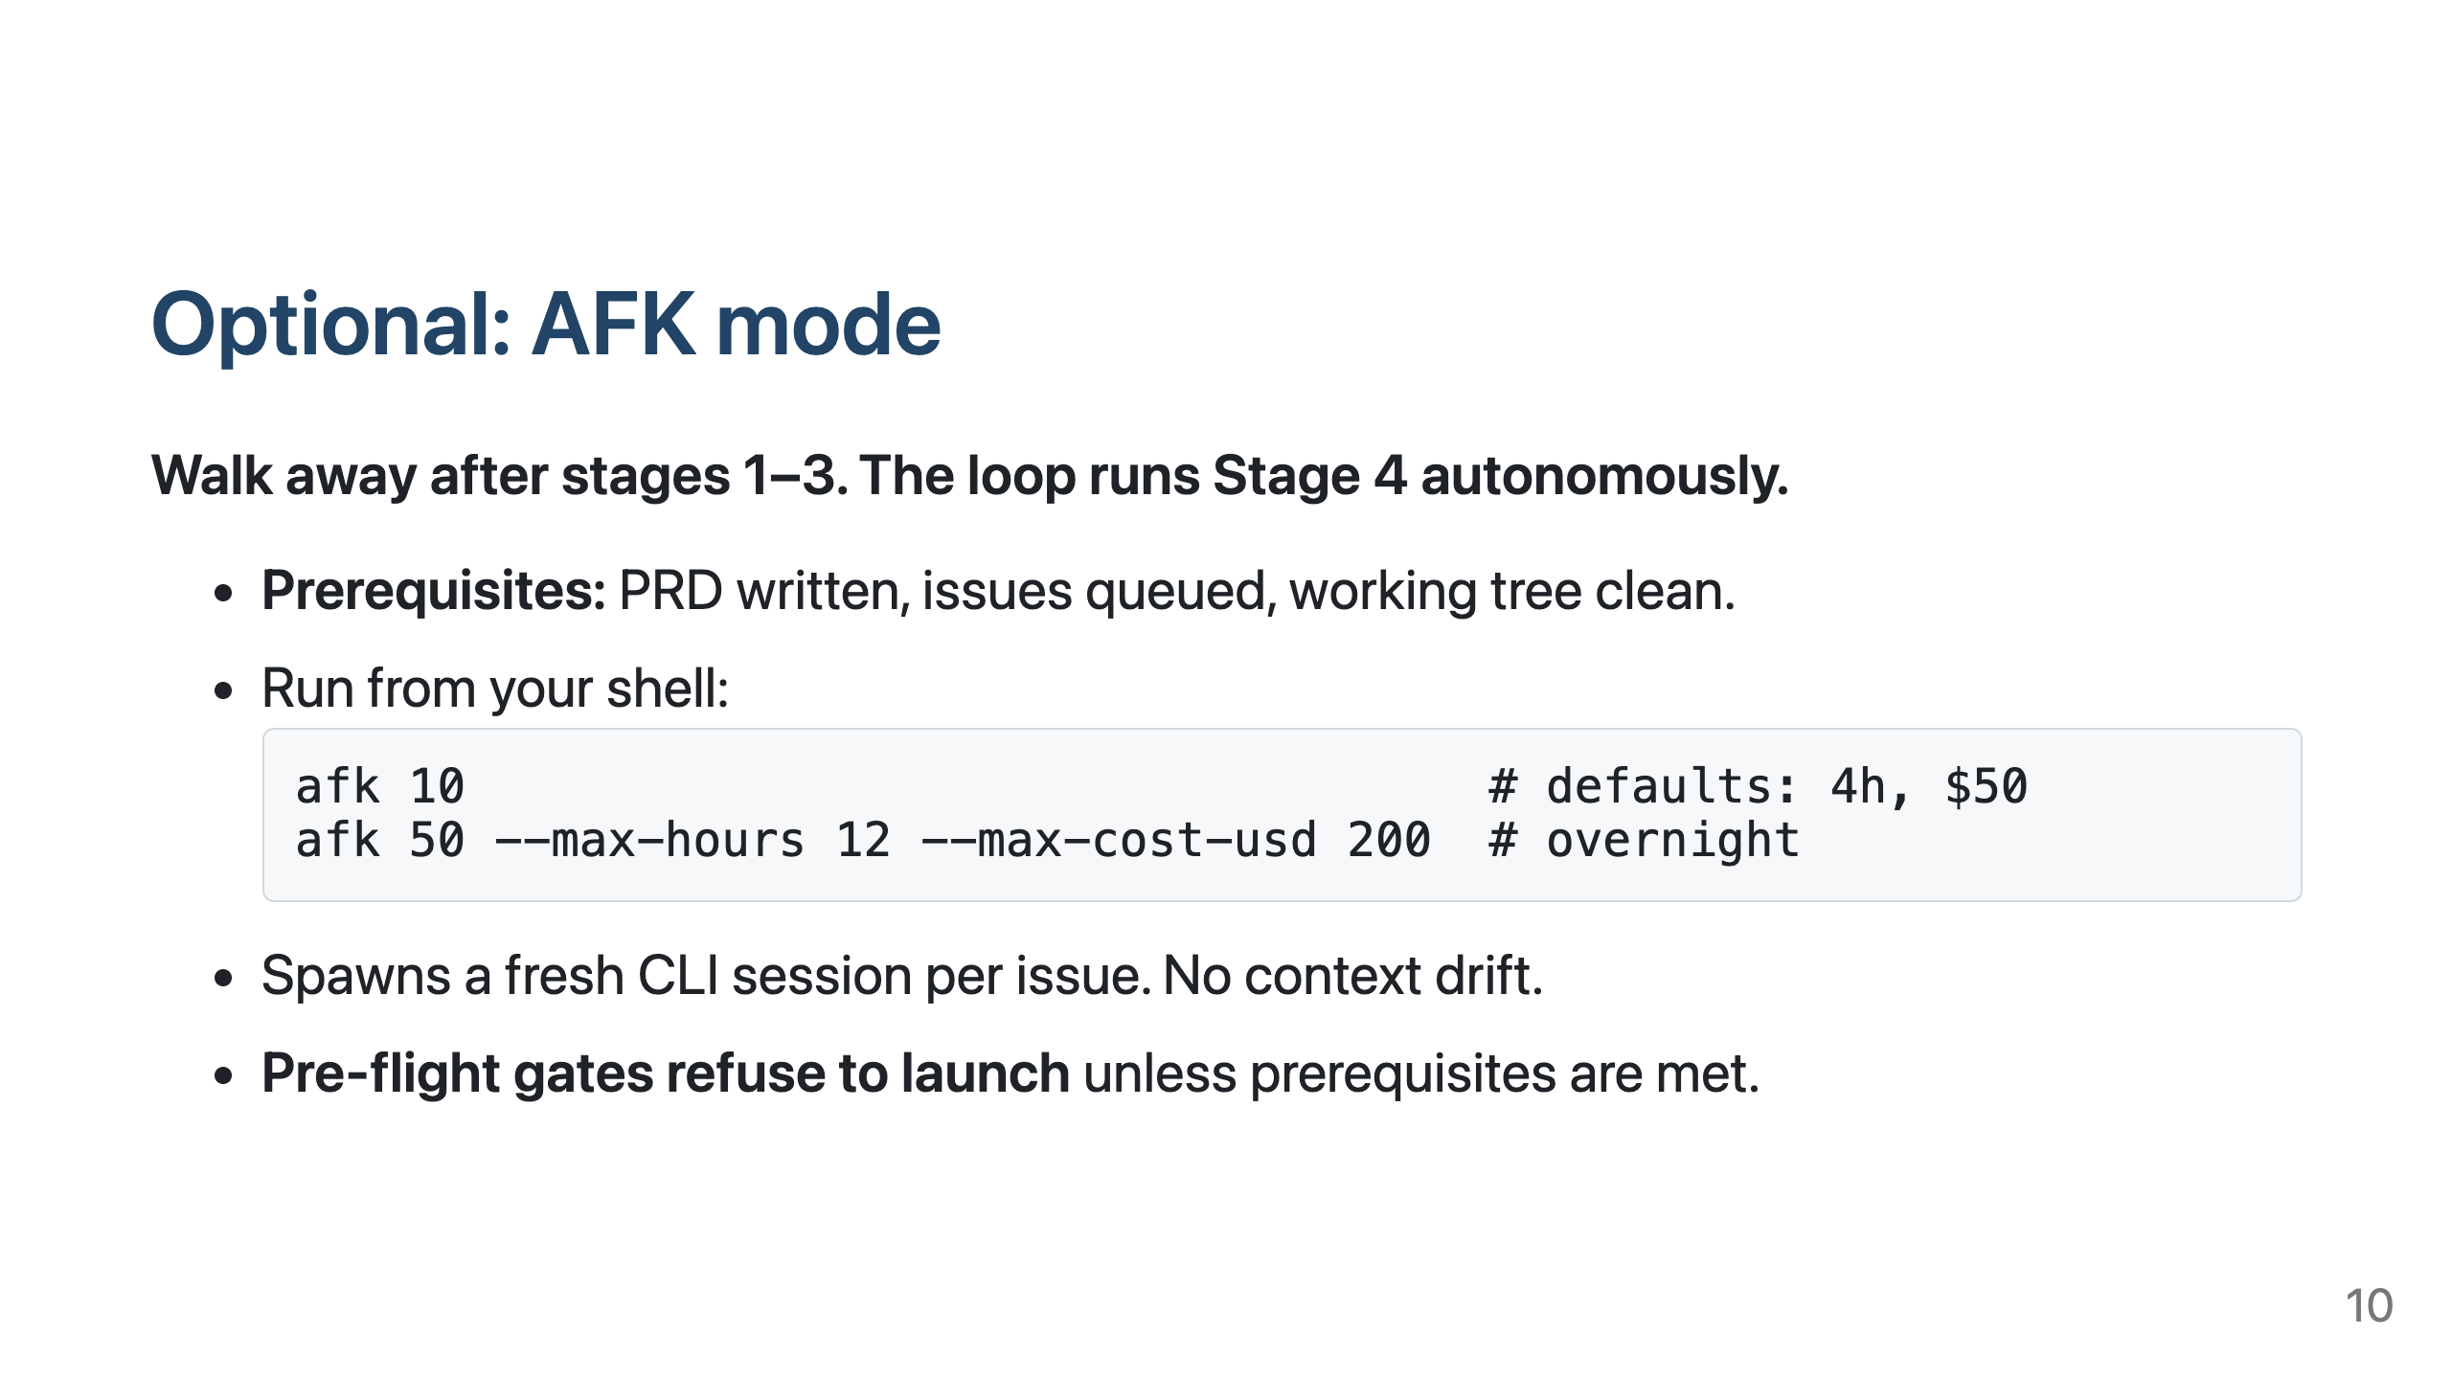

Slide 11
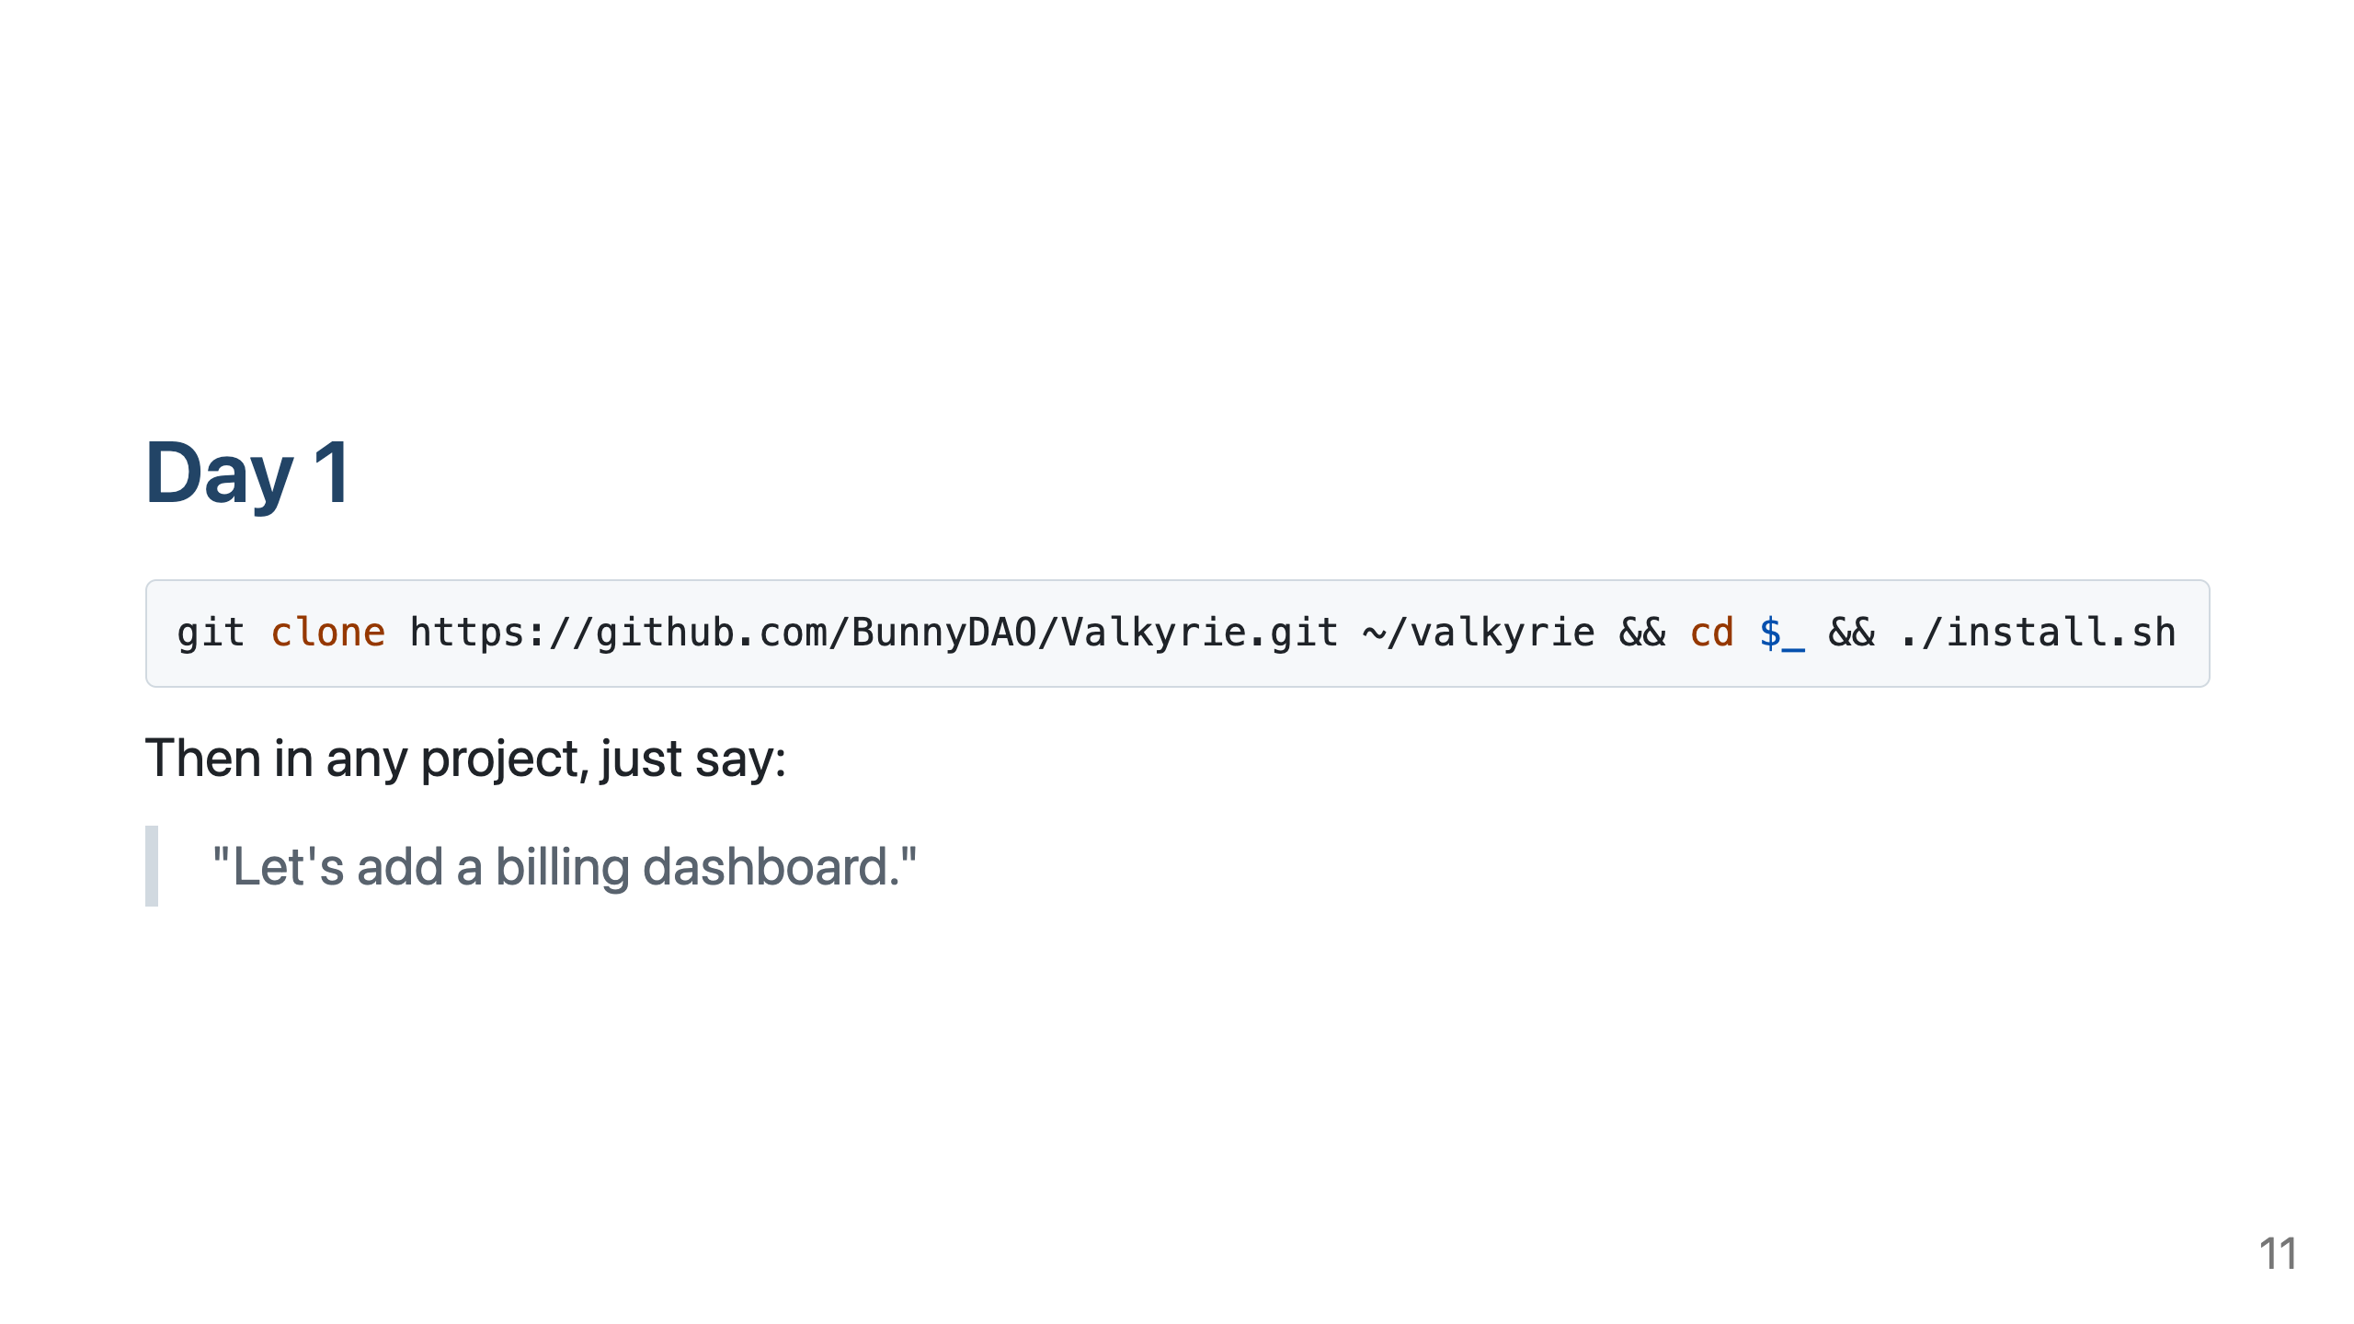

Slide 12
