Slide 1
Generating Summary for Terms and Conditions Document Based on the Query provided.
Sai Teja Paladi
Email: spaladi@email.sc.edu

Slide 2
Overview
● Objective
● Introduction
● Problem
● Approach
● Evaluation
● Conclusion
● References

Slide 3
Objective
We introduce a system for summary generation based on the terms of service documents we usually agree to by reading the entire or useful content.
To have a system that can summarize the piece of information that you are worried about in a large document and get the important sentences?
Our system takes the URL of these terms and conditions documents and the query we are concerned about as the input and produces the summarized sentences.
Notes:
Tuned to match the composition, bias, and media consumption patterns of a specific target audience
Software agents infused with human-like decision parameters
Incorporates both traditional and social media influence
Live subjects incorporated with agents enhance realism
Player units and experimenters inject new information and observe both the spread of information and the changes in the network topology
Free-thinking and adaptive opposing forces accurately reflect current threats and near-peer competitors

Slide 4
Introduction
Usually when we come across the terms and conditions documents most of the users just simply click on agree button and move on rather than reading the entire document.
And some people might search for some points like is their data is confidential or not.
And to make sure the user get’s the data that he’s concerned about and also in a simple summary we are fetching the data based on the user interest and summarizing it.
If we do so we don’t need to worry about reading the entire document or missing any important points.

Slide 5
Problem
Summarization Tool
In our system we have two inputs one is the document that we are currently dealing with In our project we are summarizing the terms and conditions documents which mainly talks about the privacy of the data.
And based on the provided input document and the area of interest we will be fetching out the sentences that provide the useful information.
Summarization Tool
Summary
URL

Slide 6
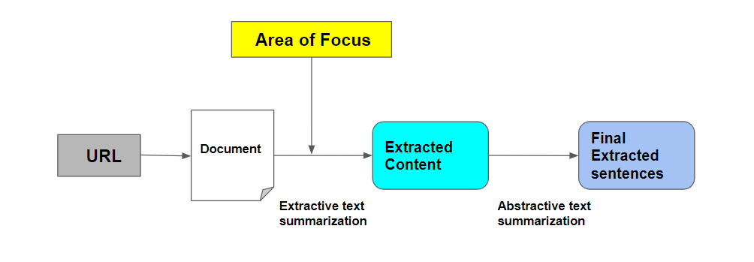
Approach
In our problem we cannot directly perform the text summarization to get the sentences based on the area of focus we have to first get the relevant data or passages from the long documents that we use as an input based on the area of focus that we provide and ask for.

Slide 7
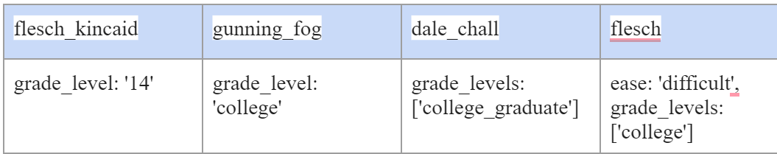
Approach
Readibility metrics
Before getting into the actual data pre processing and summarization. We are using some readability metrics to the raw data in the document. These readability metrics helps us to understand the ease of how a user can read the actual document. It depends on the content in the document and the size of the document.
Here are some results of four types of readability metrics that we used to evaluate the document.
We can clearly observe that for each readability metric here the level of difficulty is above the grad level which is difficult to read.

Slide 8
Approach
Data Pre Processing
Our data pre processing consists of the following steps
Input data
Importing libraries
Stopword removal
Word Tokenization

Slide 9
Evaluation

Slide 10
Conclusion

Slide 11
References
https://www.sciencedirect.com/science/article/abs/pii/S0885230820300991
https://blog.agolo.com/query-based-summarization-in-action-ea729df3109c
https://ieeexplore.ieee.org/document/7557434

