Slide 1

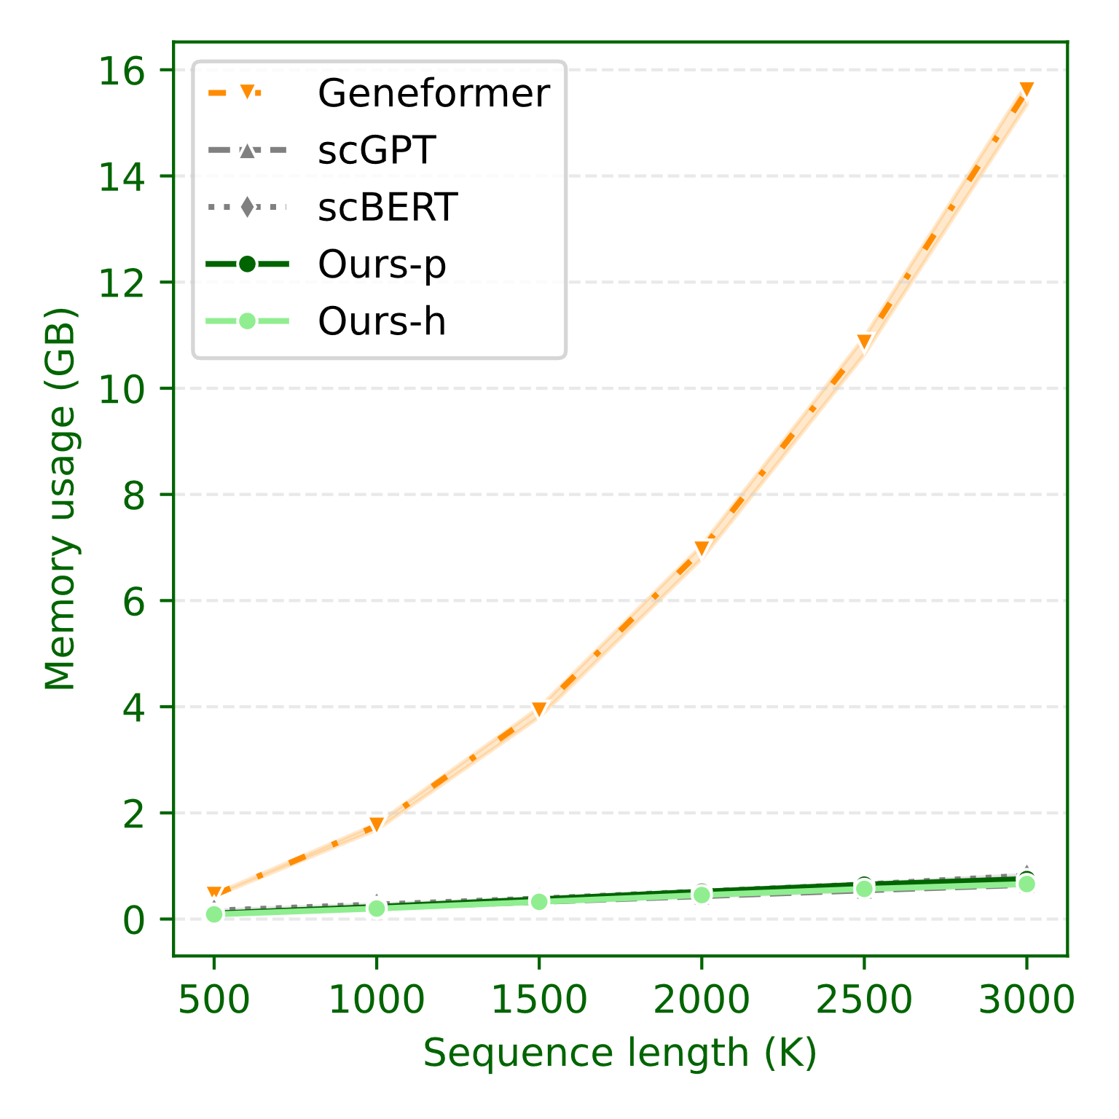
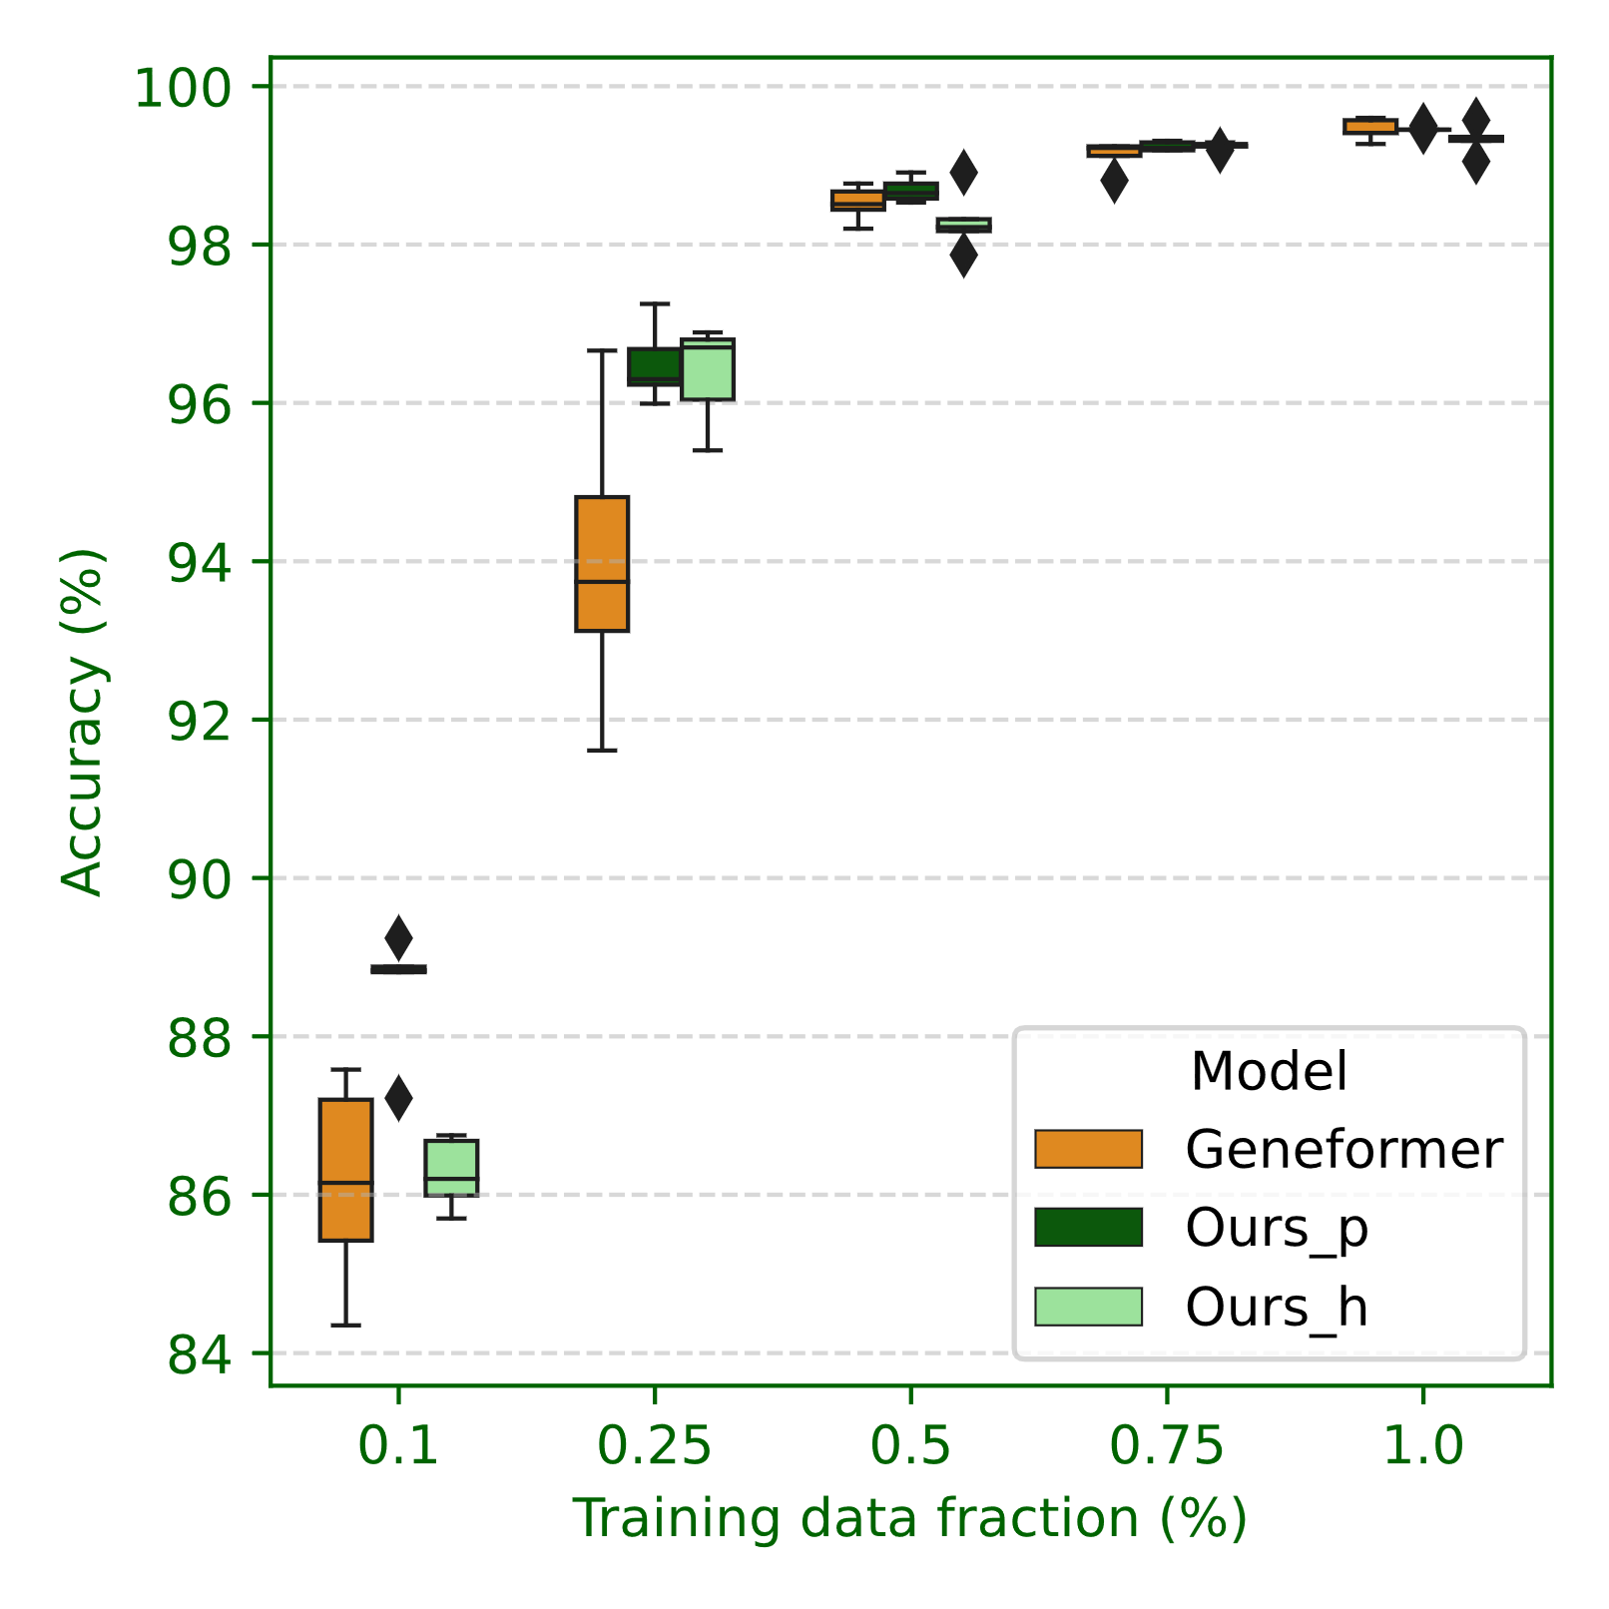
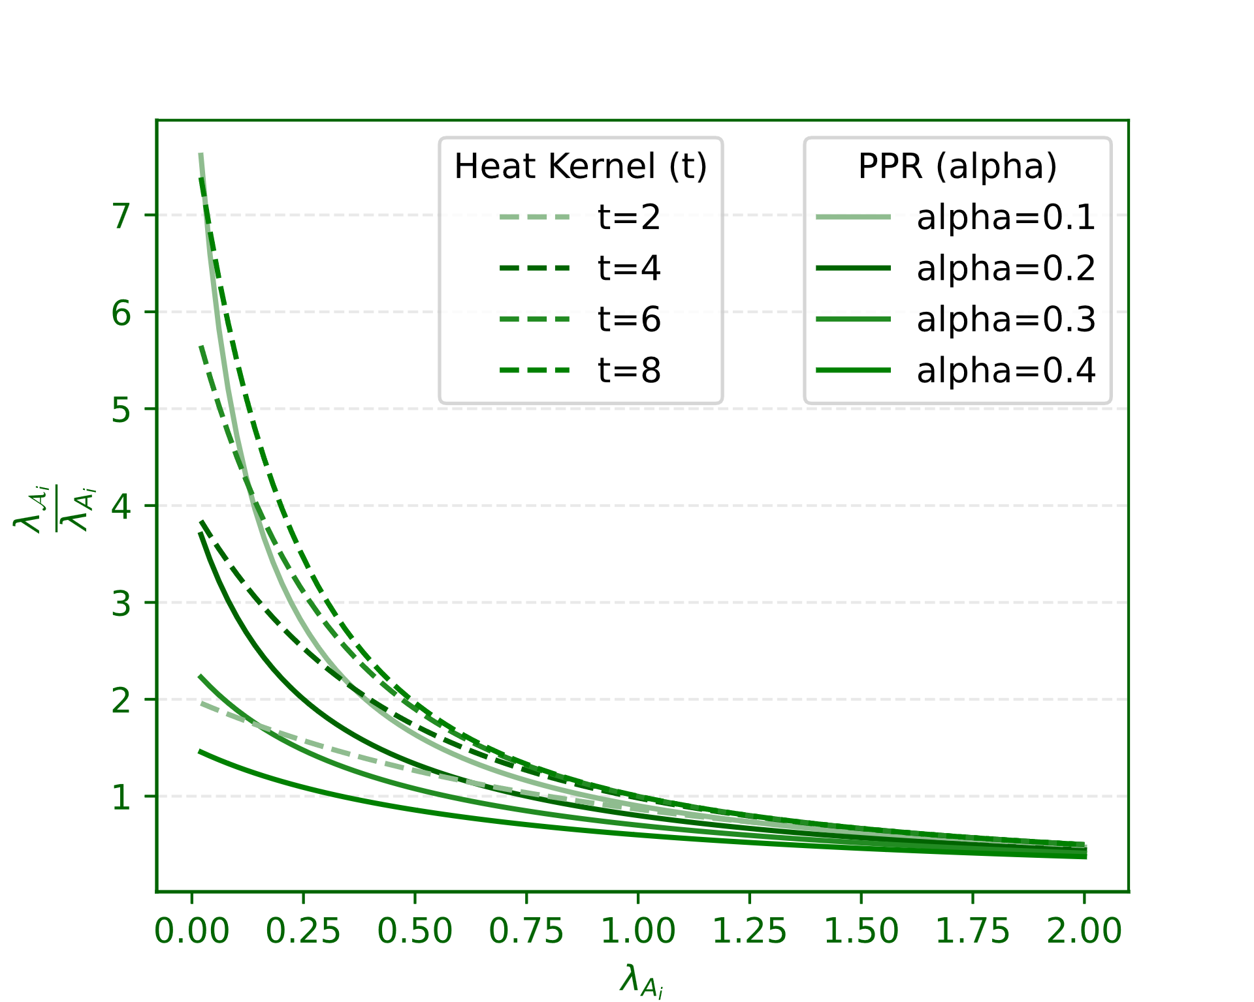


Gene tokens
Gene
values
(optional)
Condition
tokens
(optional)
Step 1
Step 2
Step 3
Step 4
V
$$？$$
$$？$$
$$？$$
Cell-type Annotation
Perturbation Prediction
K
Feed Forward
Embedding Layers
Task Specific Heads
Seq2Graph (a)
Graph2Seq
Memory Saving
Few-shot Potential
Iteration (b)
Q
Genetic Relationship Network
(a)
(b)
Actual Information
flow process
Calculate
Approximate
Information flow
process
Known Regulatory Network
Iteration 1
Iteration 3
The Framework of Typical Single-Cell Foundation Models
Database
Seq2Graph
Query
KEGG,
ENCODE,
CHEA,
Iteration 2
Iteration & Graph2Seq
……
Head 1

