Slide 1
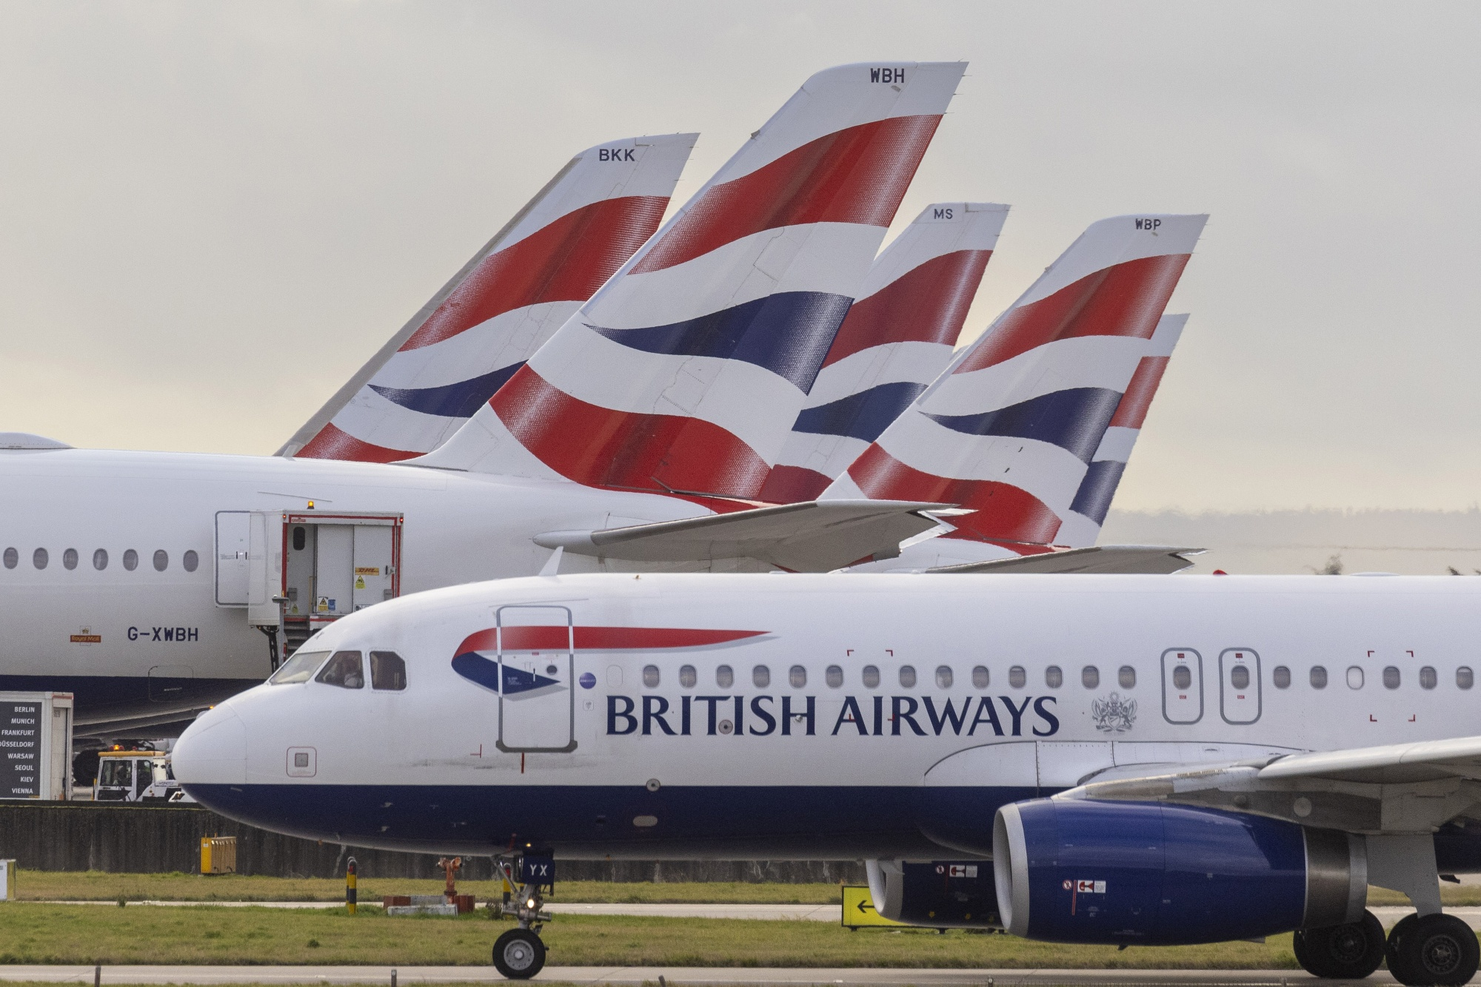
TITLE
CUSTOMER REVIEWS INSIGHTS

Slide 2
INTRODUCTION
Today's highly competitive airline industry, customer satisfaction and experience play a pivotal role in driving business success and fostering customer loyalty. British Airways, as a renowned airline, recognizes the importance of understanding customer sentiments and continuously improving service quality to meet evolving passenger expectations.
The objective of this project is to conduct a comprehensive analysis of customer review data pertaining to British Airways. By harnessing the power of natural language processing (NLP), sentiment analysis, and data visualization techniques, we aim to derive actionable insights from customer feedback. This analysis will provide valuable information about customer sentiments, concerns, and satisfaction levels, enabling British Airways to make informed decisions and implement targeted improvements across various service touchpoints.

Slide 3
OVERVIEW OF CUSTOMER FEEDBACK DATASET
Dataset Source: Customer feedback reviews related to British Airways is extracted from the Skytrax website using web scraping.
Total Number of Reviews: 3500
Scraping and Data Collection: Utilized Python and BeautifulSoup for web scraping to extract review data from the Skytrax website.

Slide 4
Data Preprocessing
Text Cleaning: Removed irrelevant text like "✅ Trip Verified" and other noise from each review to focus on meaningful content.
Data Cleaning: Performed comprehensive data cleaning tasks, including handling missing or duplicate entries, standardizing text formats and removing special characters, user handles, tokenization and removal of stop words.
Data Transformation: lemmatization or stemming to normalize text data, tokenization of the dataset using RegexpTokenizer.
Model Selection: Count Vectorization and TF-IDF Vectorization both are tested along with kmeans algorithm for identifying the best vectorization technique for the dataset. TF-IDF stood out to be the best because of its Document Frequency dependents of our data.

Slide 5
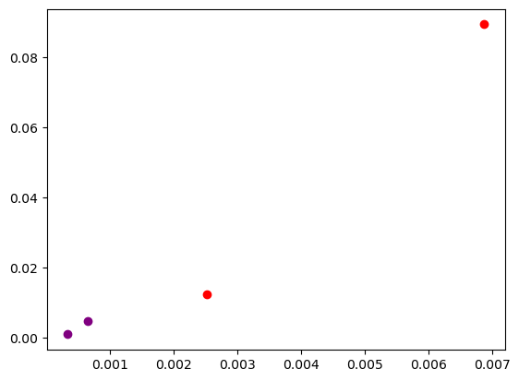
CLUSTERING ANALYSIS
Created a cluster model using the k-means algorithm to analyze reviews scraped from a website.
The goal was to differentiate between positive and negative reviews, which were intermingled on the website.
The model clusters reviews based on similarities, aiding in the identification of sentiment without manual analysis.
Scatter plot of the clusters centers of the reviews
Red dots – Count Vectorization
Violet dots – TF-IDF Vectorization

Slide 6
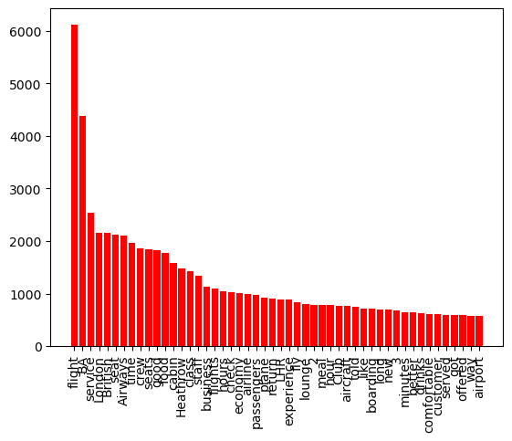
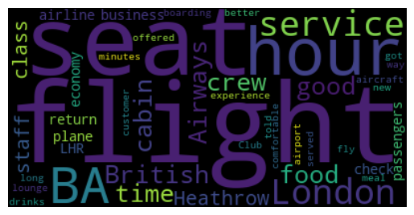
INITIAL DATA EXPLORATION
This step provides the key insight about the high frequency used words used by the customers in their reviews.

Slide 7
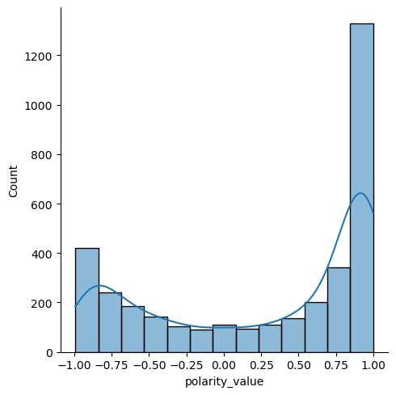
SENTIMENT ANALYSIS
The sentimental analysis step consists of finding the different sentiments present in the data. We are using vader module for this purpose.
The vader module is used to determine the polarity scores for different reviews that is used for identification of the sentiment of that review.
While the majority of reviews are positive, there is a higher proportion of negative feedback than usual.
The distribution of the polarity scores of the reviews.

Slide 8
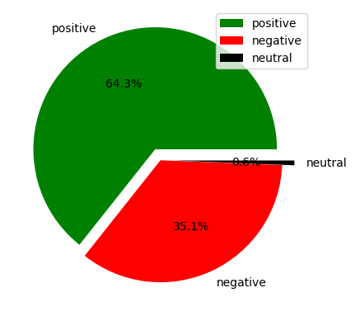
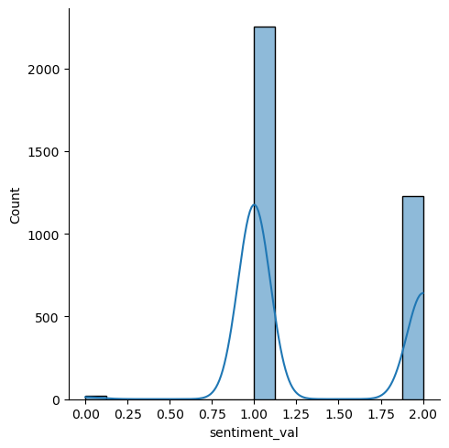
OVERVIEW OF REVIEWS
In the dataset of 3500 reviews, After conducting a VADER analysis we observed.
Positive Sentiment reviews: 2251 (64.3%)
Negative Sentiment reviews: 1227 (35.1%)
Neutral Sentiment reviews: 22 (0.6%)

Slide 9
STRENGTHS OF BRITISH AIRWAYS
Excellent Customer Service:
Several customers praised the friendly and efficient check-in process.
They highlighted the fast and friendly service provided by the staff.
High-Quality In-Flight Meals:
Positive reviews commended the quality and substantial portions of the in-flight meals.
Attentive and Responsive Crew:
Some passengers appreciated the crew’s attentiveness and responsiveness during the flight.
Particularly, they promptly topped up drinks.
Good In-Flight Entertainment:
The inflight entertainment was generally well-received.
It provided passengers with a satisfactory selection of entertainment options.

Slide 10
WEAKNESS OF BRITISH AIRWAYS
Inadequate Customer Service:
Negative reviews highlighted instances where the airline’s customer service fell short.
Passengers reported a lack of care and insufficient assistance during flight disruptions.
Specific complaints included no explanation, no apology, and no assistance in finding alternative flights.
Seating and Comfort Issues:
Customers expressed dissatisfaction with cramped seating and uncomfortable conditions during flights.
Economy seats were described as tiny, leading to shoulder-to-shoulder seating.
Lack of Communication:
Negative feedback pointed out a lack of proactive communication with passengers.
Specifically, passengers were not notified proactively about flight cancellations or delays.
Quality of In-Flight Meals:
Some reviews criticized the quality and suitability of the in-flight meal options provided.
An evening meal was described as near-inedible, with both choices being spicy foods.

Slide 11
Recommendations for British Airways based on customer feedback
1. Improve In-flight Entertainment:
Enhance the variety and quality of in-flight entertainment options.
Provide a wide selection of movies, TV shows, music, and games.
2. Optimize Flight Scheduling:
Address frequent delays and cancellations by evaluating flight schedules.
Proactively manage potential issues to minimize disruptions.
3. Enhance Customer Service Training:
Invest in comprehensive training for flight attendants.
Focus on empathy, problem-solving, and effective communication.

Slide 12
4. Implement a Robust Feedback System:
Establish a streamlined feedback system.
Promptly respond to feedback and take necessary actions.
5. Personalized Offers and Loyalty Rewards:
Implement personalized offers and loyalty rewards.
Tailor offers based on individual preferences to enhance customer retention.

Slide 13
Conclusion
1.Customer Sentiment Overview: The sentiment analysis indicates a predominantly neutral sentiment among reviews, suggesting a balanced mix of positive and negative feedback. However, there is potential for enhancing overall customer satisfaction.
2. Strengths Recognized:
British Airways was praised for its efficient and friendly check-in process.
Passengers appreciated the substantial in-flight meals provided.
The range of in-flight entertainment options was deemed satisfactory.
3. Identified Weaknesses:
Negative feedback highlighted issues with flight delays and insufficient communication during disruptions.
Some passengers reported subpar customer service experiences.

Slide 14
4. Actionable Recommendations:
Enhance in-flight entertainment to cater to diverse passenger preferences.
Optimize flight scheduling to minimize delays and disruptions.
Invest in comprehensive customer service training to improve interactions with passengers.
Implement a robust feedback system to promptly address customer concerns.
Offer personalized incentives and loyalty rewards to enhance customer retention.
Implementing these recommendations will enable British Airways to address key issues and capitalize on opportunities to enhance overall customer satisfaction and service quality.

Slide 15
Thank
You

