Slide 1
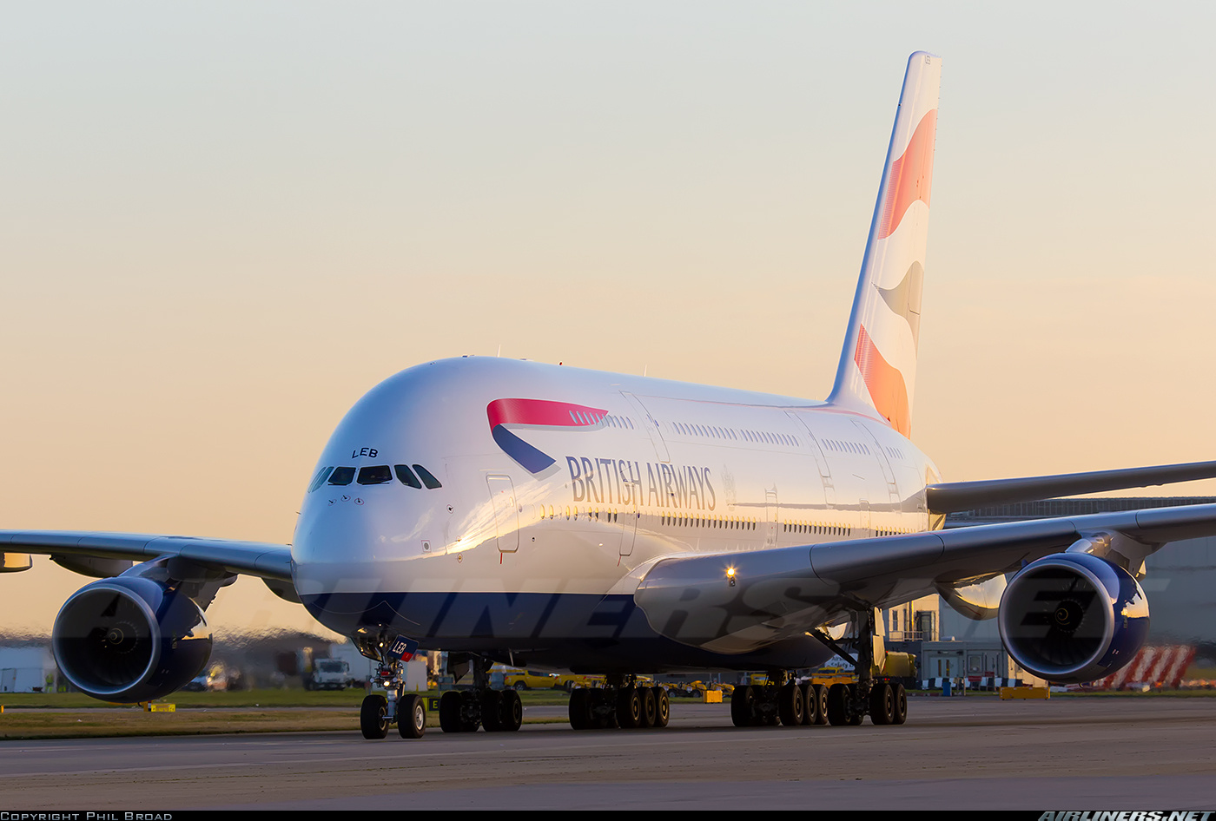
TITLE
Customer Booking Patterns

Slide 2
INTRODUCTION
The dynamics of customer acquisition have undergone a profound transformation. Today, customers no longer make spontaneous purchasing decisions at the airport. British Airways Airlines must now proactively engage potential customers long before they embark on their journeys. This shift underscores the crucial role of customer accessible data in attracting and engaging customers.

Slide 3
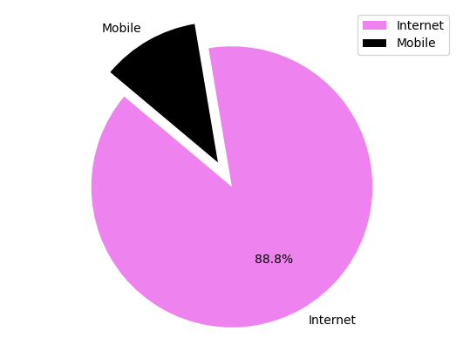
PLATFORM
More customers are booking flights through the internet rather than mobile devices. By enhancing website features and providing extensive data accessibility, we can attract more visitors to our site. Implementing advertising strategies across both platforms can further boost site traffic and lead to increased ticket bookings and sales.

Slide 4
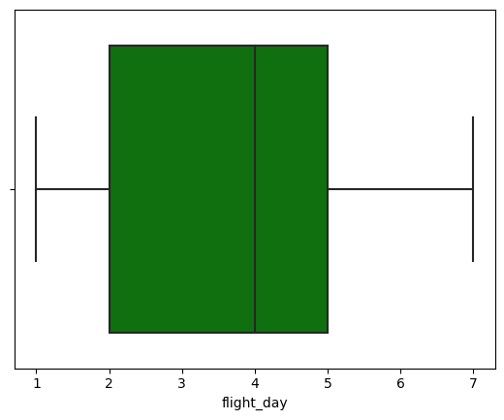
Weekday Specials and Exclusive Offers
During the 2nd, 3rd, 4th, and 5th days of the week (Tuesday, Wedneday, Thursday, Friday), there is increased activity in ticket booking and site visits. To capitalize on this trend, we can showcase various entertainment options, dining experiences, coupons, and special offers on our site. This approach aims to engage customers and encourage them to make bookings during these peak periods.

Slide 5
CONCLUSION
The greater the variety of services requested by the customer, the higher the likelihood that they will purchase a ticket in the future, up to a certain threshold where future sales stabilize.

Slide 6
Thank
You

