Slide 1
CryptoShare
Background, Stakeholders, And More…

Slide 2

Project Vision
Contrived for investors and the financially diligent, who lack the ability to manage their finances privately and securely, CryptoShare is a self-hosted and open-source solution that allows them to track their income and investments through a unified interface featuring a website, desktop app, and mobile app.

Slide 3
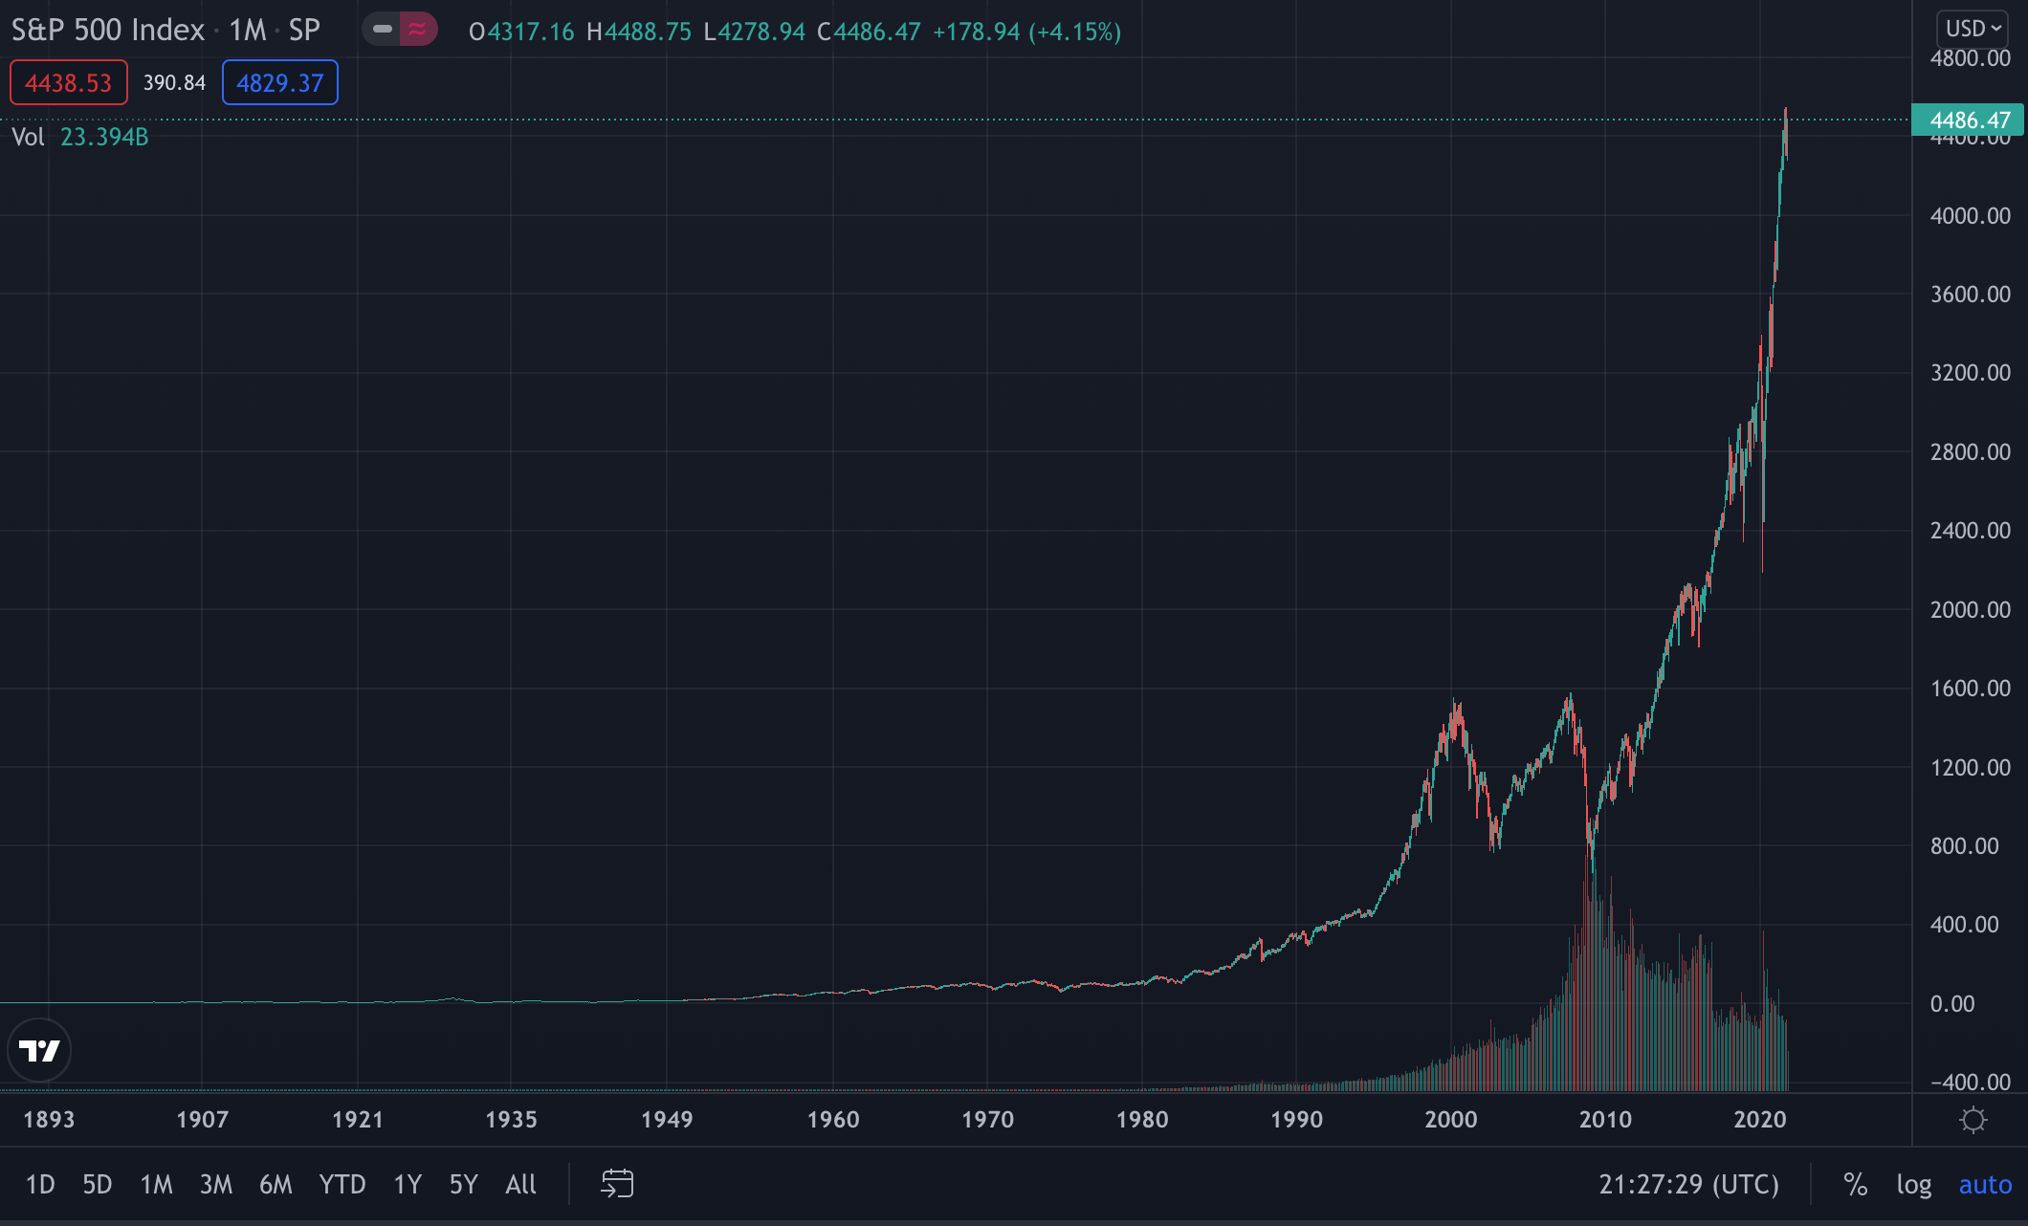
Background - Stocks
On average, stock ETFs (such as the S&P500), which are indexes that include the world’s biggest stocks by market capitalization, continue to grow. It’s becoming increasingly common to see young adults trading and investing in stocks.

Slide 4
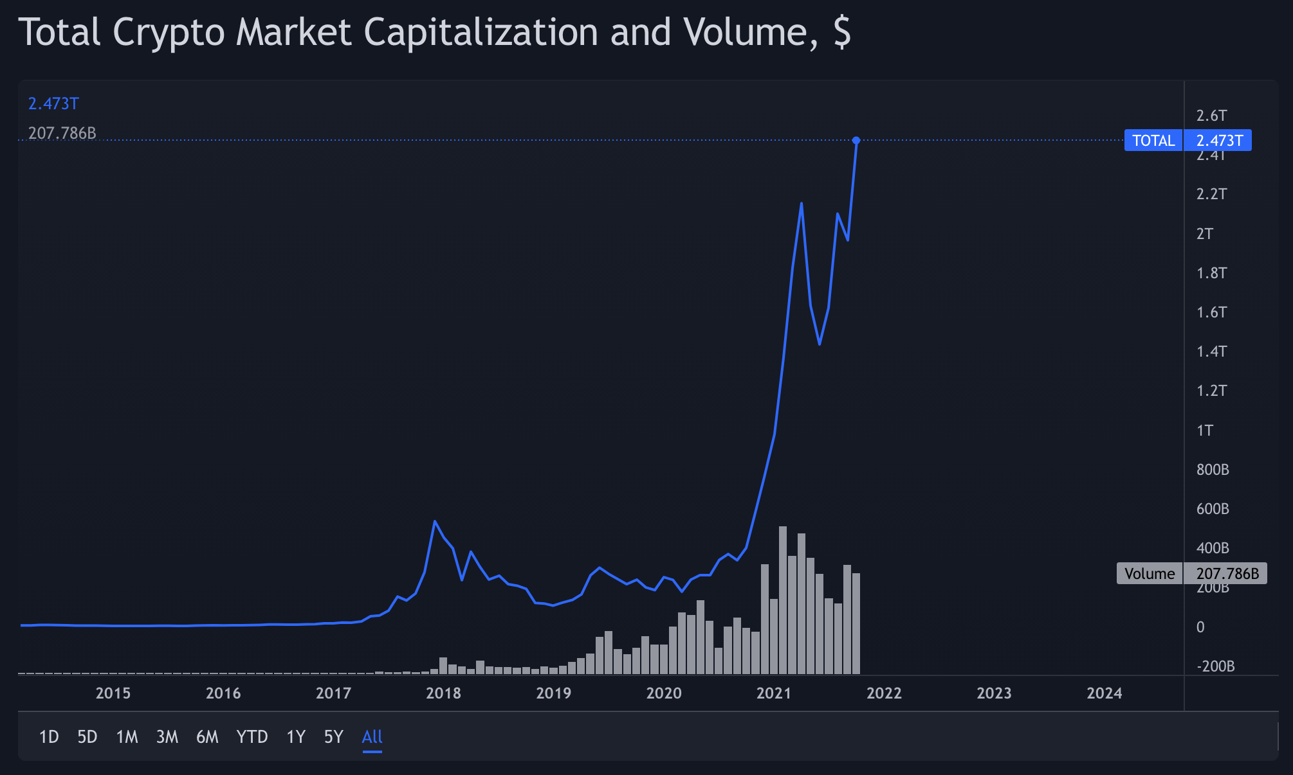
Background - Cryptocurrencies
An equally astonishing amount of growth can also be seen in the cryptocurrency market, with individuals as young as 18¹, such as myself at the time, investing in a variety of cryptoassets.
1: https://www.researchgate.net/figure/Age-Distribution-of-Bitcoin-User-Sample_fig1_286425346

Slide 5
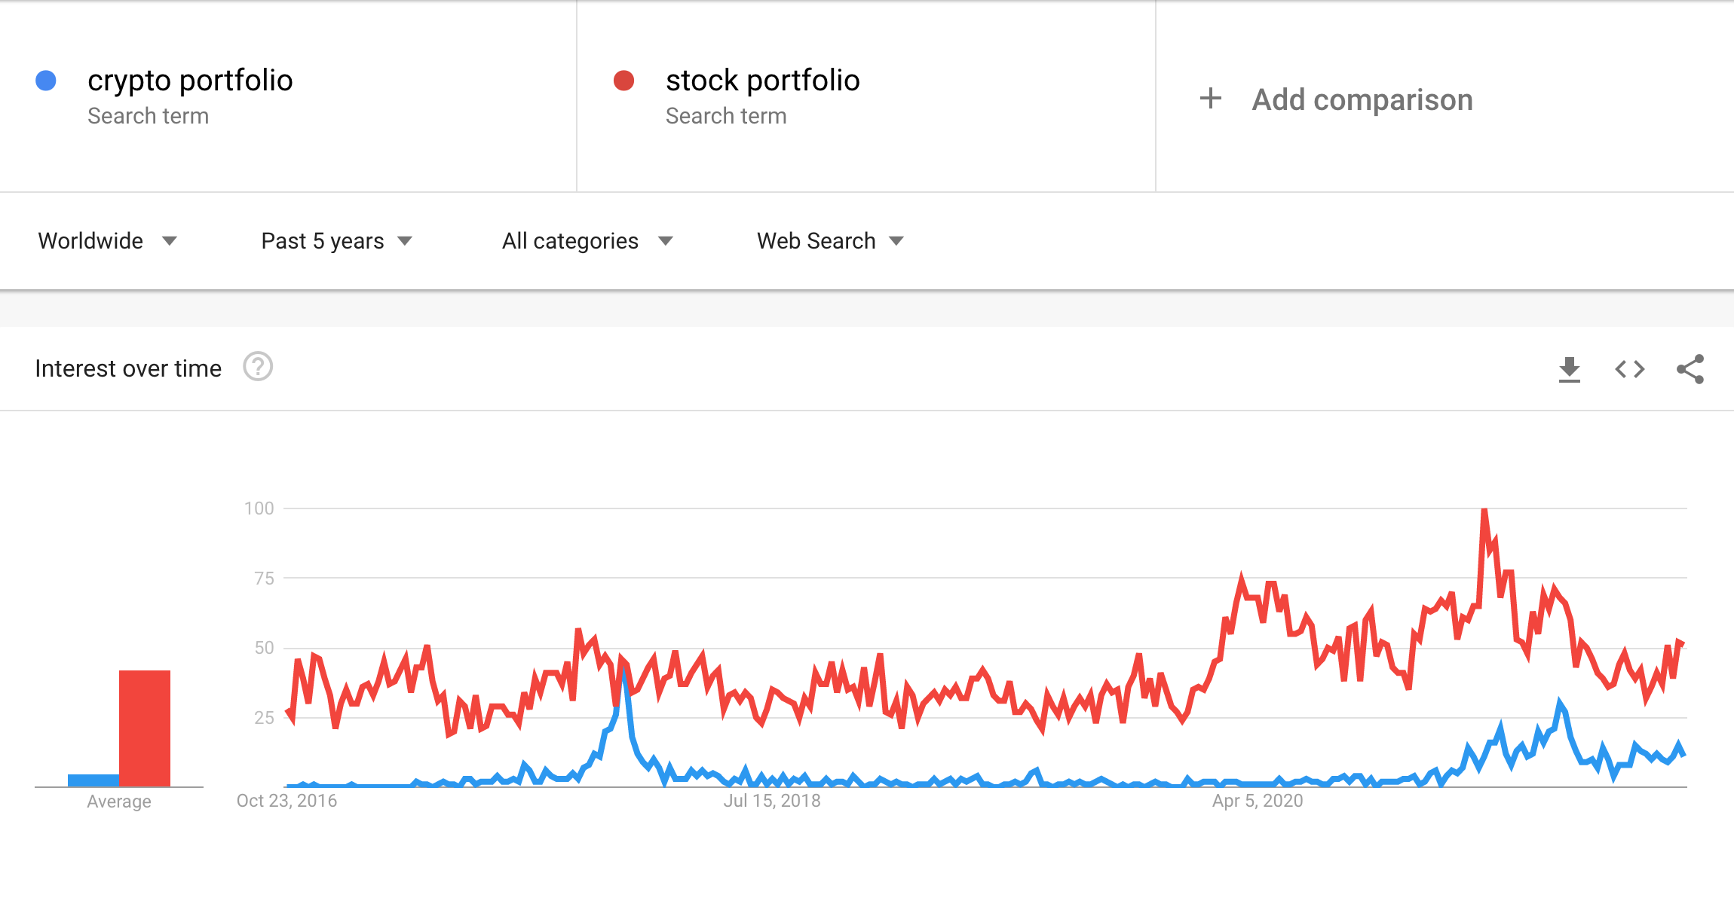
Background - Trends

Slide 6
Background - CryptoShare
As discussed in the previous meeting, current solutions have a lot of downsides. Users’ financial data is often stored on unknown servers, the apps are rarely open-source, and most of them do not allow the user to track both their stock and cryptocurrency portfolio in the same place, while managing or budgeting their income while taking those investments into account.
CryptoShare aims to solve these problems by providing a unified interface investors can use in order to manage their finances.
Apps like CryptoShare appeal to more and more people every day, with no foreseeable shortage in interest.

Slide 7
Stakeholders & Their Importance
CryptoShare would provide functionalities that’d be useful to both professional investors, retail investors, and the average person.
It’s important to know who the main stakeholders are, in order to prevent project management issues…
For example, scope creep is prevented by having a set number of features that would be provided. The goal of the project is to provide a private and unified interface for the management of income, with cryptocurrencies and stocks being the only two investment categories.
Similarly, gold plating is also prevented by only providing features that are useful to the majority of stakeholders, rather than developing features that only a handful of users would ever find worthwhile.

Slide 8

Stakeholder – ”The Investor”
As a fairly tech-savvy retail investor in stocks and cryptocurrencies, Eve is aware of how private her financial data is, and how likely it is for proprietary apps to store her details. She doesn’t want to trust “the cloud” with said data. She requires an app that is open-source, so that it can be vetted by other individuals, and an app where she has full control of her data. She’d like to manage her investment portfolio, whether it be stocks or cryptoassets, and be able to see how each market is performing on any given day. She’d like all this data to factor into her income budgeting and financial management.
Eve

Slide 9

Stakeholder – ”The Average Person”
As a financially responsible and diligent individual, Adam tracks his income, sets reasonable budgets for himself, pays his mortgage, and has certain goals when it comes to saving money. He requires an app that can help him manage his finances, and automate tasks such as calculating whether or not he can afford to partake in an activity that costs money. For example, if he wants to travel next summer, he wants to know how that’d affect his savings, and how much he can afford to spend on various categories of things (food, accommodation etc.) in order to pay for his vacation.
Adam

Slide 10
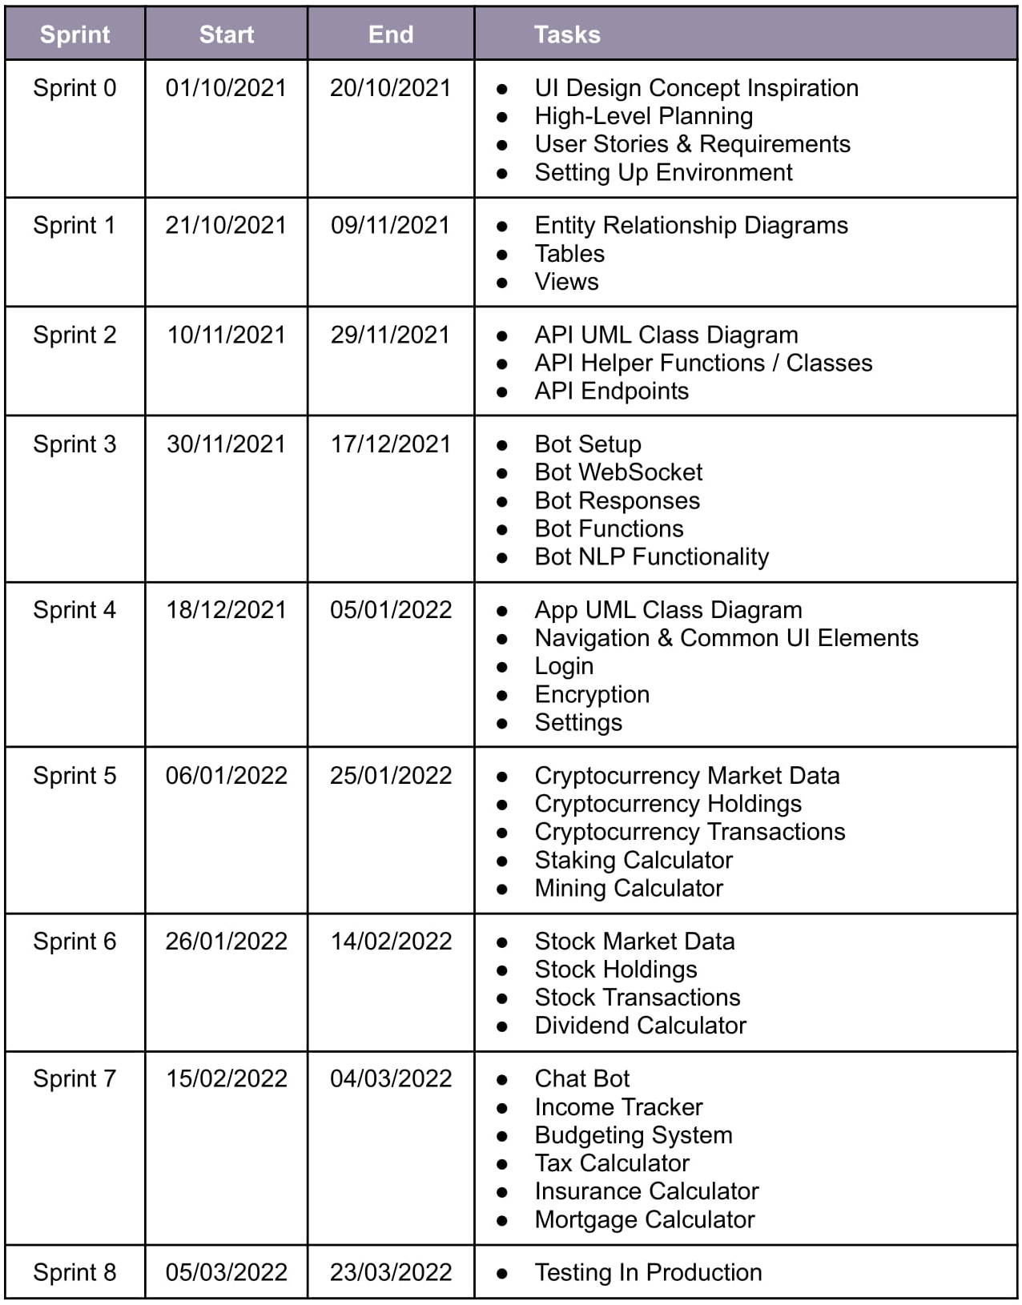
Product Backlog
2 week sprints.
8 sprints total.
8 hour work days.
40 hour weeks.
20 day months.
Each task/feature beyond and including sprint 4 needs to be developed on 3 platforms: web, desktop, and mobile.
The chosen tech stack ensures high quality code and efficient debugging/testing procedures by having 1 primary programming language for the entire codebase.

Slide 11
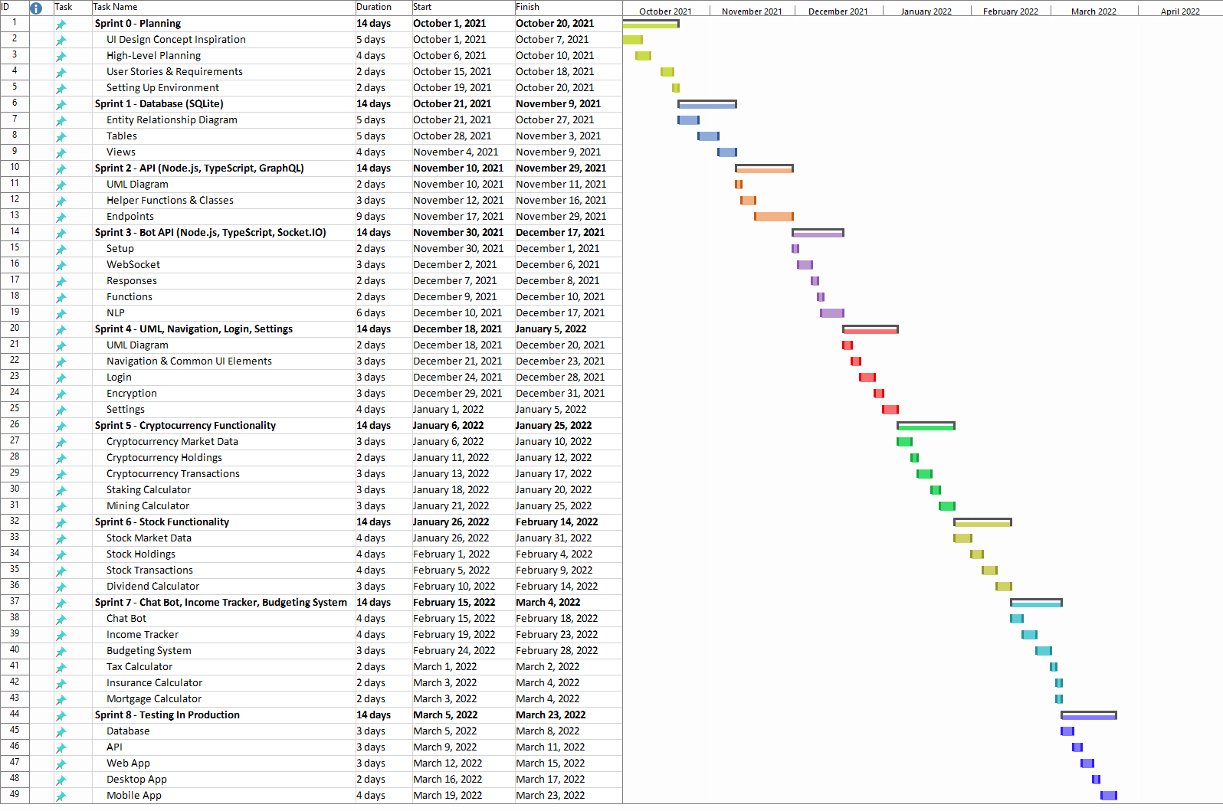

Slide 12
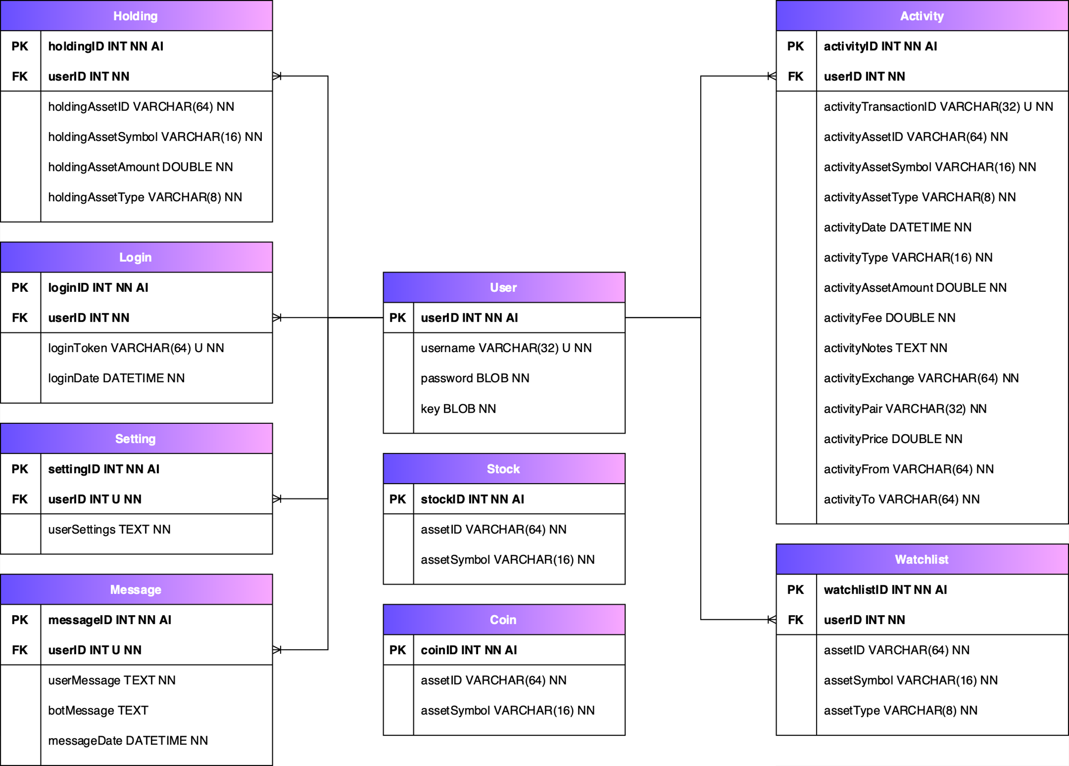
ERD Plaintext

Slide 13
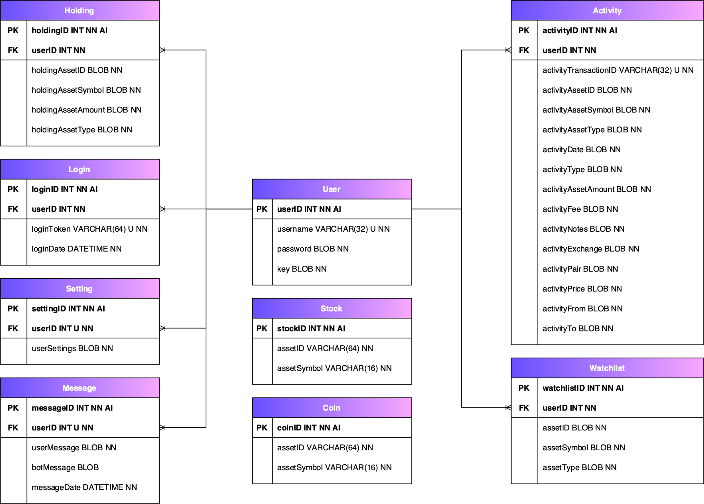
ERD Encrypted

