Slide 1
CryptoShare
Tech stack, development environment, And Product Backlog

Slide 2
Main Programming Language
Mainly JavaScript/TypeScript for the API, web app, desktop app, and mobile app.
Allows for a more unified codebase, where the syntax and logic is the same regardless of the platform.
Significantly improves testing efficiency and speed. If the logic, calculations, object manipulation etc. are tested and work on one platform, it’ll work on the other ones so long as platform-specific features aren’t used.
TypeScript reduces the ambiguity that JavaScript inherently has by making it strongly typed. This also helps with debugging.

Slide 3
Architecture
Server/client, as clients would not interact with one another, and would interact with a GraphQL RESTful API for CRUD functionality.
Multi-user support is part of the functionality that CryptoShare aims to provide, and a server/client architecture is ideal for this.
The server is self-hosted, with the user having full control over their data.

Slide 4
Tech Stack - Database
SQLite database, stored on the self-hosted server.
Doesn’t require user installation or configuration.
Easy backup procedure for users.
Server is self-hosted, which means low user traffic, making SQLite an ideal database solution.
Relational alternative to MongoDB and other popular database solutions used for Node.js applications.

Slide 5
Tech Stack - API
Node.js, TypeScript, and GraphQL.
The software has features that utilize web sockets, such as a chat bot. Node.js is ideal for this as the server is always “alive” and allows for real-time, full-duplex data exchange.
GraphQL allows for incredibly efficient and customizable APIs. Using resolvers and queries, the client can, without modifying server code, decide exactly what pieces of data they want to receive, and have the server omit ones they don’t require. This also increases performance as the server doesn’t even fetch data that isn’t requested.
Since the API would be fetching market data that is oftentimes megabytes in size, it would be inefficient for clients to request all the data with every request. GraphQL allows for flexibility in this area.

Slide 6
Tech Stack - Web App
HTML, CSS, and TypeScript (JS).
No use of templates, as the custom user interface is a big part of the application. Templates may also not be available for the mobile app, and since the idea is a unified interface for managing ones finances, the design of the platforms need to be uniform.
No preprocessors or JS frameworks to keep the set up process as easy as possible, with as few external libraries as possible.

Slide 7
Tech Stack - Desktop App
NeutralinoJS, EJS, CSS, and TypeScript (JS).
NeutralinoJS is a lightweight alternative to Electron, which is a framework used by popular apps such as Discord, GitHub Desktop, Atom etc. to develop desktop applications using web technologies. An Electron app is usually 100MBs or more, whereas NeutralinoJS ones are around 2MBs as Node.js modules cannot be used (in CryptoShare’s case, they aren’t required anyway).
EJS is Embedded JavaScript, and allows for PHP-like inline code within HTML code. This allows the NeutralinoJS code to easily modify and pass variables to the front-end.

Slide 8
Tech Stack - Mobile App
React Native, and TypeScript (JS).
Cross-platform app development.
Fast-refresh capabilities.
CSS-like styling, which makes UI development easy.
Incredibly large number of libraries thanks to NPM support. A lot of libraries required to develop CryptoShare are either non-existent or outdated for Flutter and Xamarin.
Not a WebView app. React Native apps and their components are compiled into native components and code, which drastically improves performance.

Slide 9
Testing
Since JS is used as the main programming language, most of the testing would be done using Jest.
In terms of hardware, a PC running Windows and Linux would be used to test the desktop app. A 2021 MacBook Pro would be used to test the macOS desktop app and its compatibility with Apple Silicon. A 2015 MacBook Pro would be used to test the macOS app without Apple Silicon. Two Android phones would be used to test the mobile app on physical devices (one with a notch, one without), and Android emulators would be used to test it on different Android OS versions. The web app would be tested using different display sizes (including mobile) to ensure responsiveness.
Web Accessibility testing would also be carried out.
GitHub Actions would be used for Continuous Integration.

Slide 10
Development Environment
Hardware: A MacBook Pro, Windows laptop and PC would be used for coding, and a Raspberry Pi would be used to host the API.
Software: VS Code would be used as the main code editor due to its performance, flexibility, and useful extensions. Docker would be used during API testing as it makes the process much faster. Android Studio would be used solely for access to Android emulators. GitHub and GitHub Desktop would be used as part of the version control system.

Slide 11
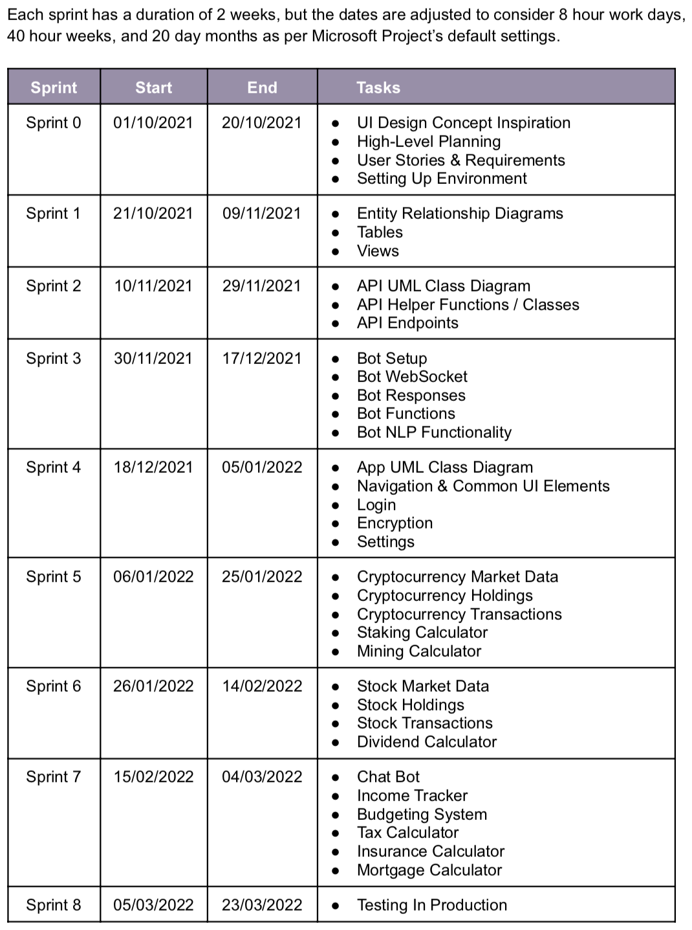
Product Backlog
2 week sprints.
8 hour working days.
40 hour weeks.
20 day months.
Expected to finish development by the end of March, allowing for time to go over the final report, double check requirements, get others to test the app as part of the usability testing and quality assurance etc.

