Slide 1
Predicting Student Dropout
Methodology, model comparison, explainability and fairness audit
Technical presentation for peers · PGD in AI & Machine Learning — Capstone
Einar Ramos Abuyuan
Notes:
Goal: show how we framed, built, evaluated and audited a dropout early-warning model, and how every number can be reproduced from the GitHub repository with one command.

Slide 2
Binary classification: will this student drop out?
4,424
32.1%
Success targets (Dropout class, test set)
Metric | Target | Why
Recall | ≥ 80% | Missed dropout = costliest error
Precision | ≥ 70% | Keeps advisor workload credible
AUC-ROC | ≥ 0.85 | Cut-off-free ranking quality
CV AUC SD | ≤ 0.02 | Stability across folds
TPR gap | ≤ 0.10 | Equal opportunity across groups
students, 36 input variables
dropout rate (2.11 : 1 imbalance)
Framing
Unit: one student; prediction made after first-year results
Target: Dropout = 1 vs Graduate / Enrolled = 0
Output: P(dropout) → cut-off → advisor shortlist
Supporting task: clustering for risk segments
Accuracy is reported but not targeted: predicting 'no dropout' for everyone already scores 67.9%.
Notes:
Recall is primary because a missed dropout costs far more than an unnecessary supportive conversation. Precision floor keeps the list actionable. The fairness target is part of the definition of success.

Slide 3






Clean public data and a leakage-safe pipeline
Load
Engineer
Select
Split
Scale
Tune & choose
UCI #697 (CC BY 4.0) — 0 missing, 0 duplicates, all values in range
22 domain features (20 genuinely new)
Fixed 25-feature list
Stratified 64 / 16 / 20 — 2,831 / 708 / 885, seed 42
StandardScaler fitted on training data only
CV on train; cut-off on validation; test touched once
Data understanding highlights
Outliers kept: 16–20% zero grades are the at-risk group, not errors
Strongest raw signals: 2nd-sem grade (r = −0.57), approved units (−0.57), fees up to date (−0.43)
Dropout rate: fees in arrears 86.6%, debtor 62.0%, age > 25 55.9%
1st/2nd-semester approved units correlate at r = 0.90 → ratio features + selection
Notes:
Key leakage controls: scaler fit on train only; hyperparameters by cross-validation on training data; decision cut-offs chosen on the validation set; the test set is used once. Outliers are retained because they encode genuine disengagement.

Slide 4
Engineered features dominate every importance ranking
Feature engineering
Approval and engagement ratios normalise for course load
Financial hardship index (0–3); age > 25 binning
Rule-style flags: failed majority, no evaluations
14 of 25 final features are engineered
Selection: filter + embedded + wrapper
ANOVA F-test (top 20), RF importance (top 25), RFE (20)
13 features chosen by all three methods
Final: RF top 25 = 81% of total importance
PCA: 7 components for 80% variance — used for insight, not modelling
Notes:
The top two features in both the filter and embedded rankings are engineered ratios. PCA was not used for modelling because advisors need named, explainable drivers; feature selection had already reduced 58 to 25 features.

Slide 5
Five supervised model families, tuned and seeded
Model | Family | Tuning / configuration
Logistic Regression | Linear | C = 1.0, class weight 2.11 (not grid-searched)
Random Forest | Bagged trees | GridSearchCV, 96 combos × 5 folds → 200 trees, depth 15, log2 features
XGBoost | Boosted trees | Fixed: 150 trees, depth 7, lr 0.05, L1 0.1 / L2 1.0, scale_pos_weight 2.11
SVM | Kernel | GridSearchCV, 12 combos × 5 folds → RBF, C = 1, gamma = scale
Neural network | Deep (MLP) | 128-64-32, batch norm, dropout, L2; early stopping on val AUC (best epoch 6)
Unsupervised
Why no CNN / RNN / LSTM / Transformer?
K-Means (silhouette K = 2–6), hierarchical (Ward), DBSCAN, Isolation Forest, PCA
Static tabular rows — no images, sequences or text; 2,831 training rows; tree ensembles still lead on tabular data
Notes:
Recommendation systems were also ruled out: there is no student–intervention interaction data. A single decision tree was not fitted separately; RF and XGBoost are tree ensembles that fix single-tree variance.

Slide 6
Three of five models meet every target on the test set
Model | Cut-off | AUC | Targets
Logistic Reg. | 0.50 | 0.919 | ✓ all
Random Forest | 0.40 | 0.930 | ✓ all
XGBoost | 0.45 | 0.930 | ✓ all
SVM | 0.40 | 0.913 | ✗ recall
Neural net | 0.45 | 0.915 | ✗ recall
Targets: recall ≥ 80%, precision ≥ 70%, AUC ≥ 0.85. Test set = 885 students (284 dropouts), never used for any choice.
AUC spread 0.913–0.930 ≈ CV standard deviation → top three are statistically close
Notes:
SVM and the neural network narrowly miss recall even after the validation-chosen cut-off; we report this rather than lowering the cut-off by looking at test data.

Slide 7
Validation-chosen cut-offs fix recall without test-set peeking
Model | Recall @0.50 | Precision @0.50 | Recall @chosen | Precision @chosen
Random Forest | 74.6% | 86.9% | 81.3% (0.40) | 82.2%
XGBoost | 80.3% | 83.8% | 82.0% (0.45) | 83.5%
SVM | 78.5% | 81.1% | 79.2% (0.40) | 80.4%
Neural net | 76.8% | 79.3% | 77.8% (0.45) | 76.7%
Rule: highest cut-off whose validation recall ≥ 80%, applied once to test
Reproducibility fixes that changed results
Unseeded neural net: two identical runs gave recall 80.3% and 78.9% → seeded
Keras metric renaming disabled early stopping in CV folds (200 epochs) → fixed; CV AUC 0.886 → 0.908
Notes:
Every script now produces identical output on repeated runs. The neural-network bugs are a good example of why reproducibility checks matter: they changed both the conclusion on recall and the cross-validation picture.

Slide 8
Clustering finds risk tiers without using the label
10.8%
Low risk — dropout rate
2,916 students
66.7%
Medium risk — dropout rate
789 students
80.5%
High risk — dropout rate
719 students
K = 2 separates best; K = 3 (amber) chosen for three actionable tiers
Isolation Forest: 133 anomalies (3.0%), 69.2% dropout vs 31.0%
DBSCAN noise points (8.6%): 66.0% dropout · PCA: 7 components = 80% variance
Notes:
Unsupervised results independently confirm the supervised signal: segments found without the label range from 10.8% to 80.5% dropout.

Slide 9
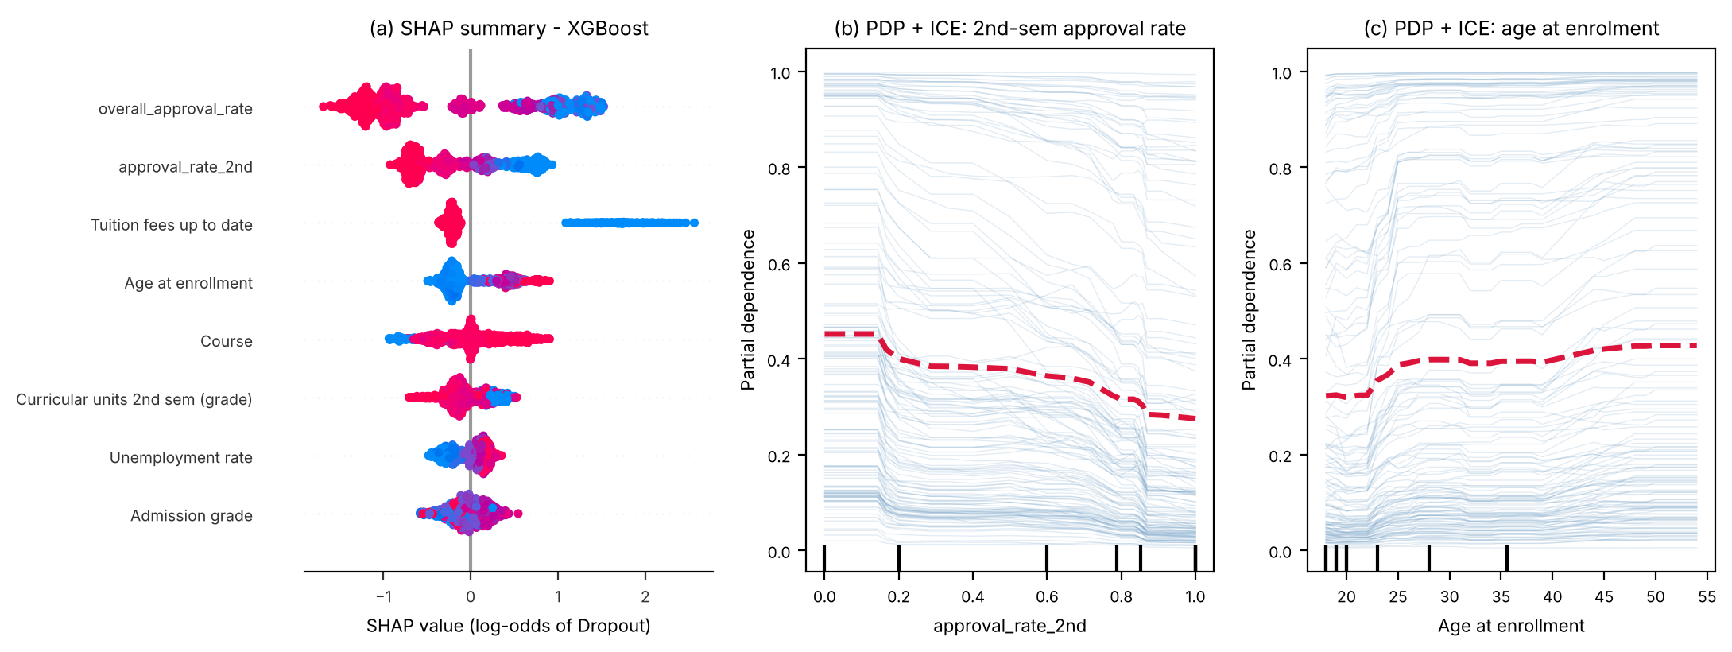
Academic progress, fees and age drive predictions
SHAP: overall approval rate (0.97), 2nd-sem approval (0.50), fees up to date (0.41), age (0.28)
PDP: fees paid → P(dropout) 0.64 → 0.35; 2nd-sem approval 0 → 1 → 0.48 → 0.31
ICE: median 16-pt drop, IQR 9–25 → one intervention does not fit all · LIME agrees with SHAP per student
Notes:
XGBoost SHAP and linear SHAP for logistic regression share 5 of their top 10 features. ICE curves show heterogeneity: for students with very high baseline risk, improving approval alone barely moves the prediction.

Slide 10
Fairness: young and scholarship dropouts are missed more
Demographic parity fails — by design
DI 0.26–0.51, but flag ratios mirror real dropout ratios (male 1.96× flagged vs 1.86× actual). Primary criterion: equal opportunity (TPR).
Mitigation | Recall | Prec. | Age TPR gap
Baseline | 82.4% | 78.0% | 0.205
M1 Unawareness | 83.1% | 78.9% | 0.195
M2 Reweighing | 79.9% | 76.2% | 0.122
M3 Group thresholds | 85.9% | 72.4% | 0.117
Recommend M3: lifts age ≤20 TPR 71.6% → 80.4%, keeps precision ≥ 70%
Notes:
Age TPR gap is statistically significant (bootstrap 95% CI 0.105–0.305). Unawareness fails because remaining features predict age > 25 with AUC 0.914. Reweighing drops recall below target and widens the debtor gap.

Slide 11

Reproducible by one command — with known limitations
Reproducibility
Limitations
pip install -r requirements.txt → python run_all.py (≈ 7–10 min)
Nine numbered scripts; seeds everywhere; relative paths
Outputs: models/, reports/model_metrics.csv, figures
Results notebook reads outputs — never disagrees with code
Two consecutive runs give identical results
Timing: 2nd-sem data needed; enrolment-only AUC 0.814, + sem 1 0.907
Single institution (Portugal, 2008–2019); no ethnicity data
Course code used as numeric; one-hot pending
Feature selection on all rows (minor optimism)
LR and XGBoost not grid-searched
Notes:
The temporal ablation is the most practically important limitation: a staged deployment can use a 1st-semester model for earlier, lighter-touch outreach.

Slide 12
Select Logistic Regression; keep XGBoost as challenger
Recall 82.0% · Precision 78.7% · AUC 0.919 — explainable, stable, audited
Next: group thresholds (M3) · staged early model · one-hot encoding · fairness monitoring each term
Notes:
The 0.011 AUC gap to the ensembles is within cross-validation noise, so interpretability decides. XGBoost offers higher precision (83.5%) if advisor workload becomes the binding constraint.

