Slide 1
Matlab Tutorial

Slide 2
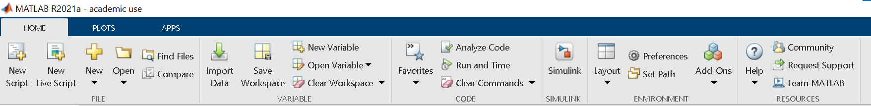
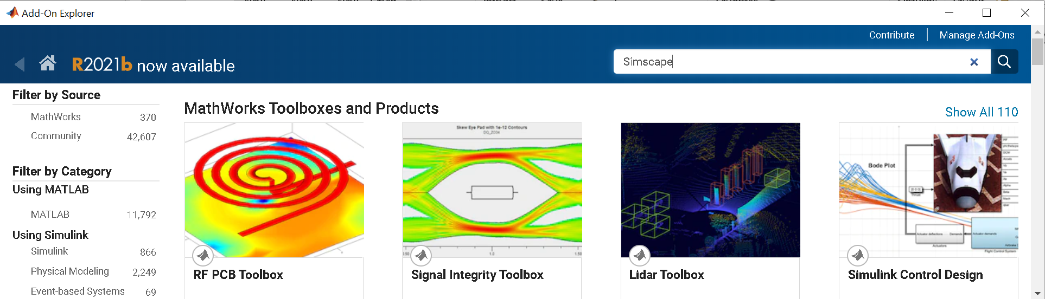
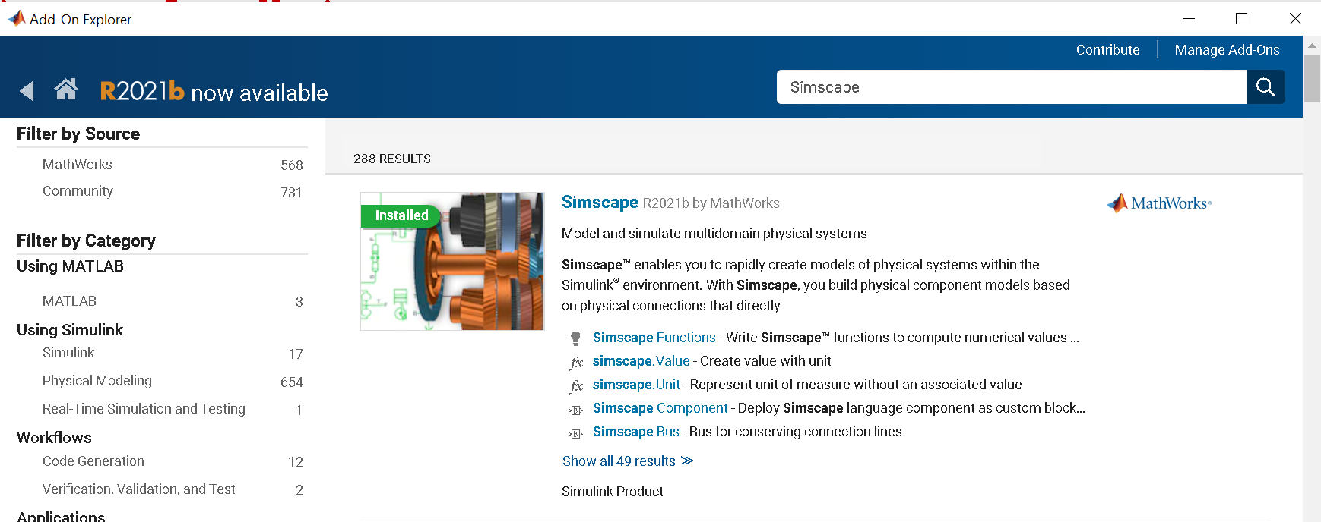
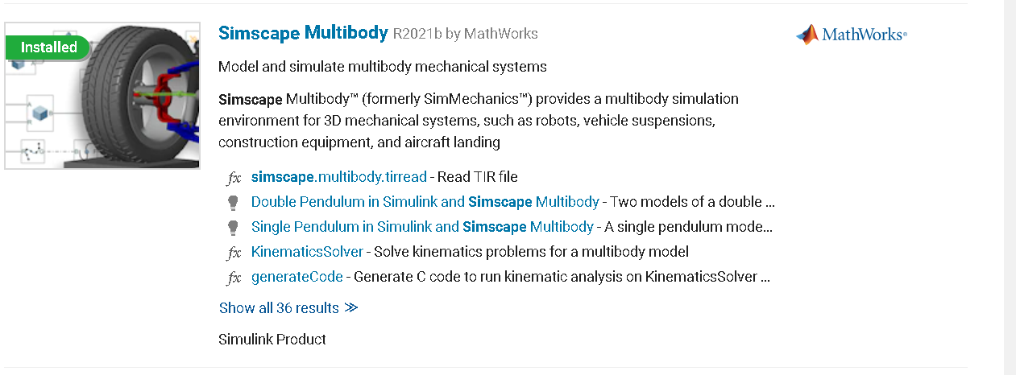
Toolbox installation
Click on Add-ons
Search for Simscape in the search bar
1/*x speed
Install Simscape and Simscape Multibody

Slide 3
Common Matlab function for HWs
plot3(X,Y,Z): To plot a set of coordinates connected by line segments specify X, Y, and Z as vectors of the same length.
patch(X,Y,Z,C): creates the polygons in 3-D coordinates using X,Y, and Z. To view the polygons in a 3-D view, use the view(3) command. C determines the polygon colors.
Syms: Create symbolic scalar variables and functions, and matrix variables and functions.

Slide 4
Simscape Multibody Tutorial

Slide 5
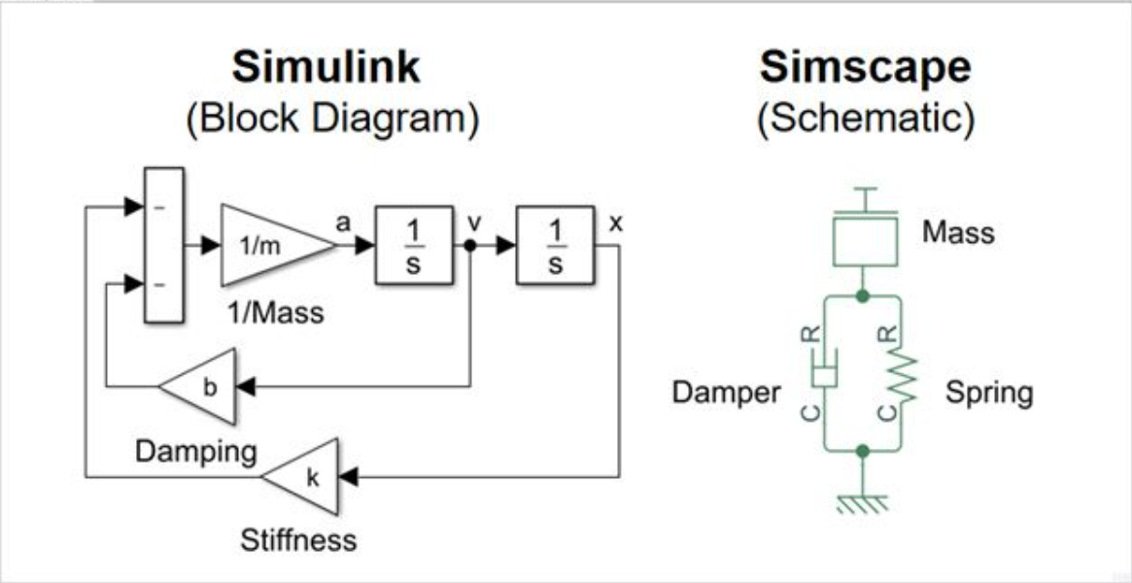
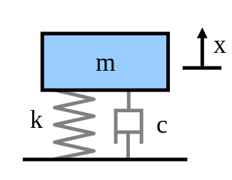
What is Simscape
Simscape enables you to rapidly create models of physical systems within the Simulink environment.
With Simscape, you build physical component models based on physical connections that directly integrate with block diagrams and other modeling paradigms
Physical Model
Resources:
Getting started with Simscape
Simscape Onramp

Slide 6
Simscape Multibody
Simscape Multibody provides a multi-body simulation environment for 3D mechanical systems, such as robots, vehicle suspensions, etc.
You can model multibody systems using blocks representing bodies, joints, constraints, force elements, and sensors
Simscape Multibody formulates and solves the equations of motion for the complete mechanical system.
Resources:
Simscape Multibody presentation page
Getting started with simscape multibody

Slide 7
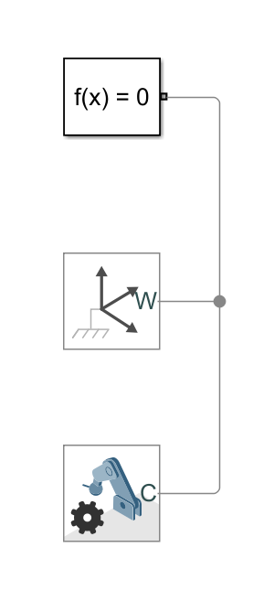
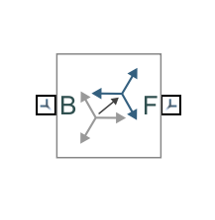
Fundamental Blocks
Each Simscape model always needs these 3 blocks:
Solver configuration: no need to change parameters
World Frame: provides access to the world or ground frame, a unique motionless, orthogonal, right-handed coordinate frame predefined in any mechanical model
Mechanism Configuration: mainly used to decide the direction of gravity vector wrt world frame
Rigid Transformation: Defines a fixed 3-D rigid transformation between two frames. Two components independently specify the translational and rotational parts of the transformation.

Slide 8
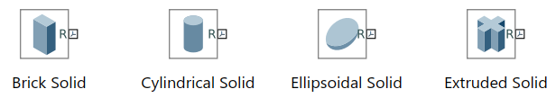

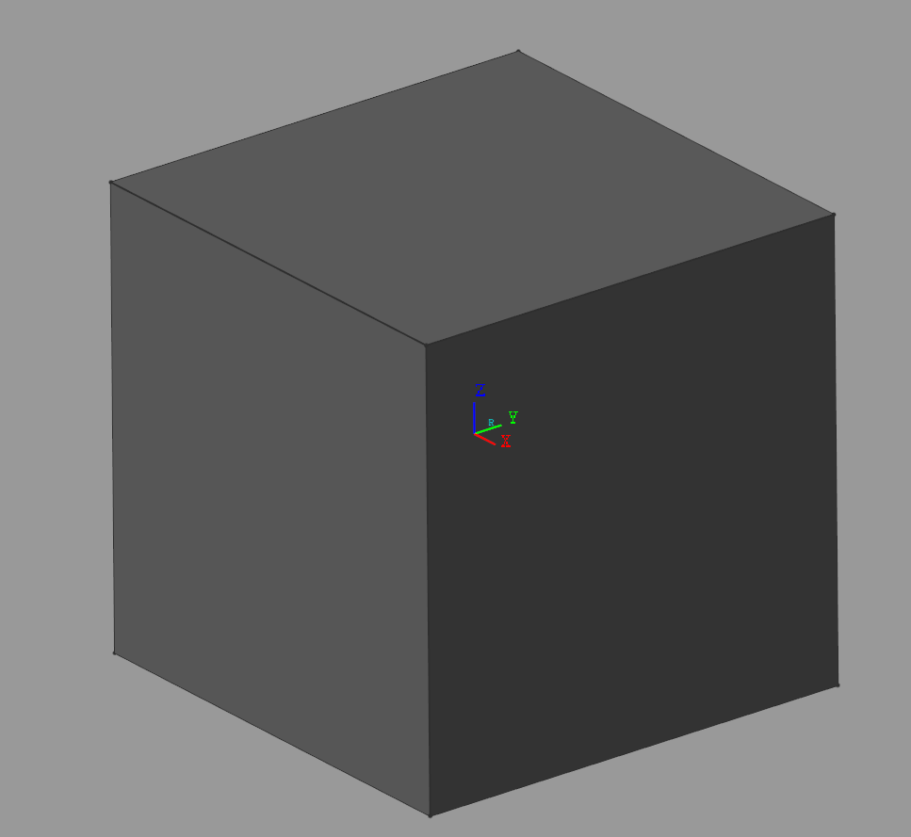
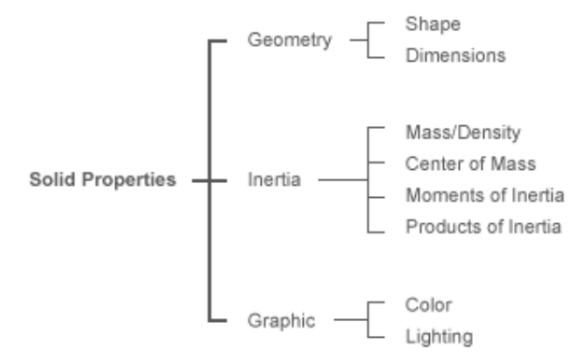
Bodies
Bodies are the basic constituents of a multibody model. They are the solid components that you connect when assembling a model
There are multiple types of body blocks you can use in Simscape Multibody
Every solid body has these properties that can be modified
Each solid body has at least one frame connected to it, in order to connect it to other bodies, joints, etc.

Slide 9
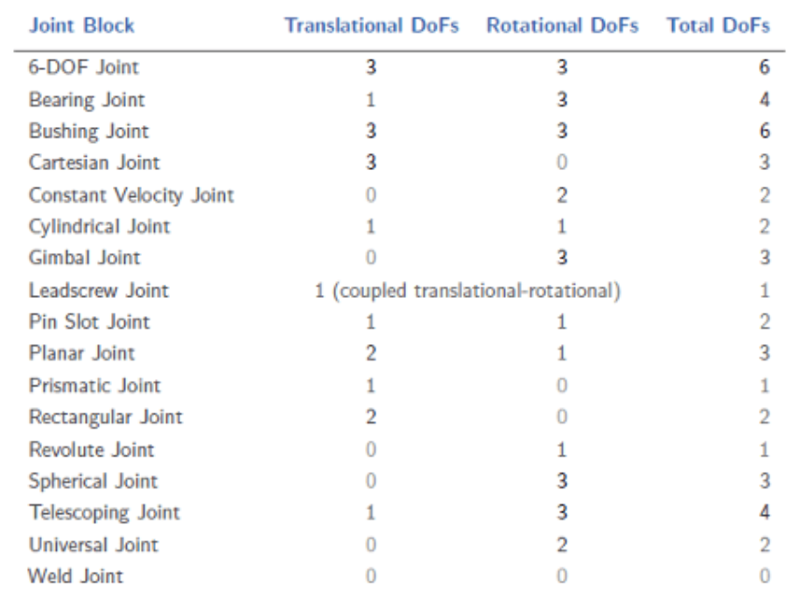
Joints
Joints determine how connected bodies can move relative to each other.
Each Joint block connects exactly two bodies.
Such a connection determines the maximum degrees of freedom, or DoFs, that the adjoining bodies can share.

Slide 10
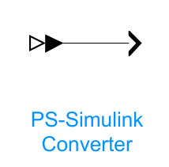
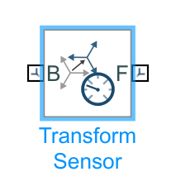
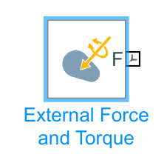
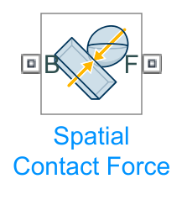
Other Useful Blocks
You can find all the Simscape Multibody blocks in the Simulink Library Browser under Simscape/Multibody tab
Physical signal to Simulink Converter: the signal connecting simscape blocks are specific physical signals not compatible directly with Simulink. In order to use these signals, you need to convert them with these blocks.
Measures time-dependent relationship between two frames, e.g relative position, velocity, orientation, etc. Can measure quantities in the world frame or in any other frame.
Applies an external force and torque at the attached frame. The force and torque are specified by the physical signal inputs.
Applies a contact force between the two geometries that the block is connected to. The forces tend to prevent penetration by acting in a direction that accelerates the geometries away from each other near the point of contact.

Slide 11
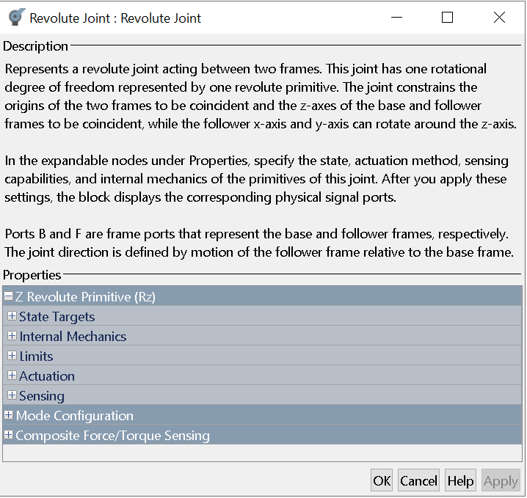
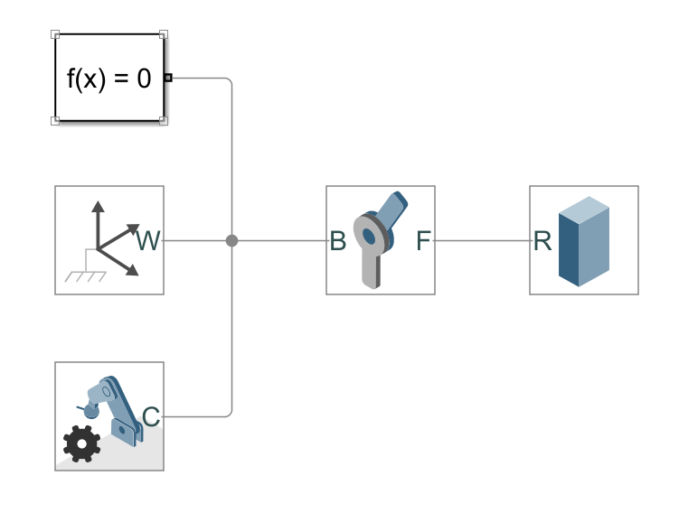
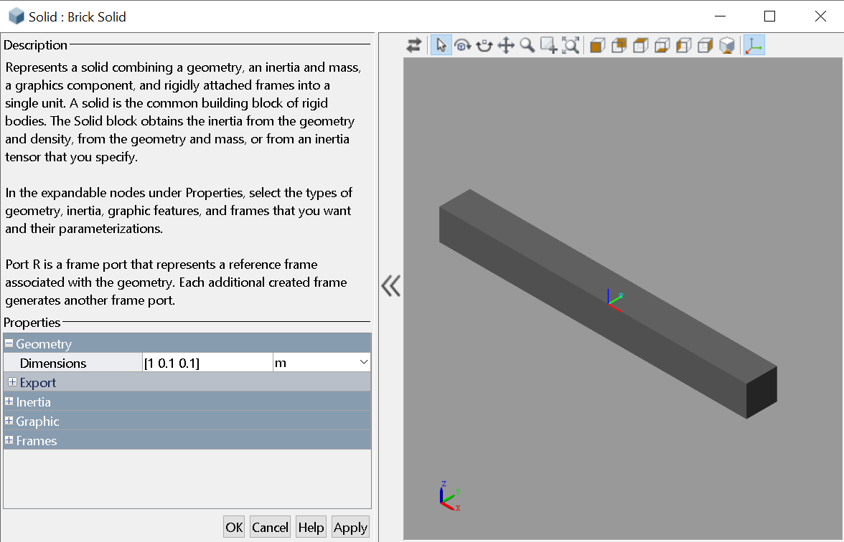
1 Link Model
The simplest model we can create. What do we need?
World frame
1 Body
1 Joint
Rigid transformations?
NOT CORRECT!!!!

Slide 12
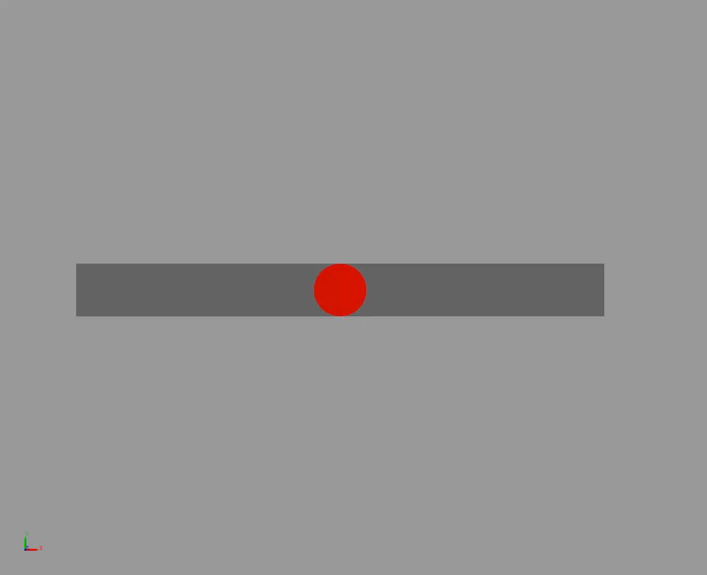
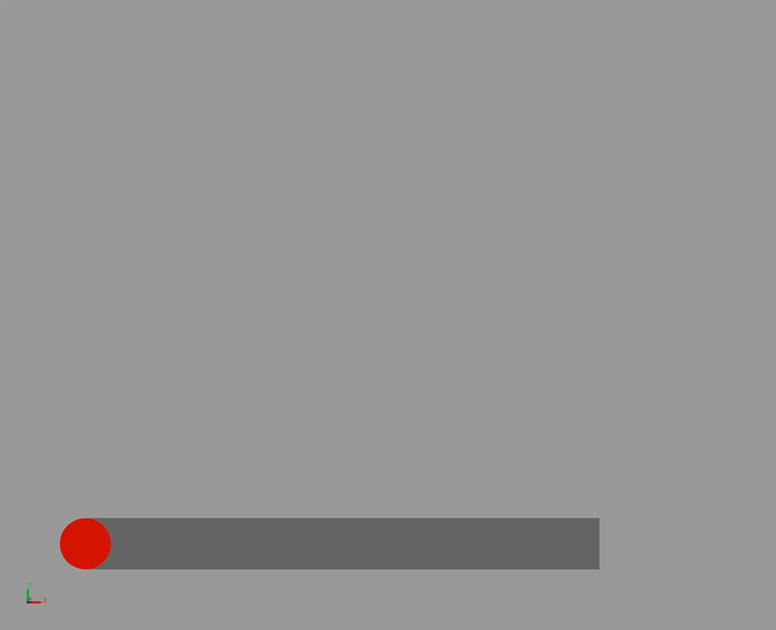
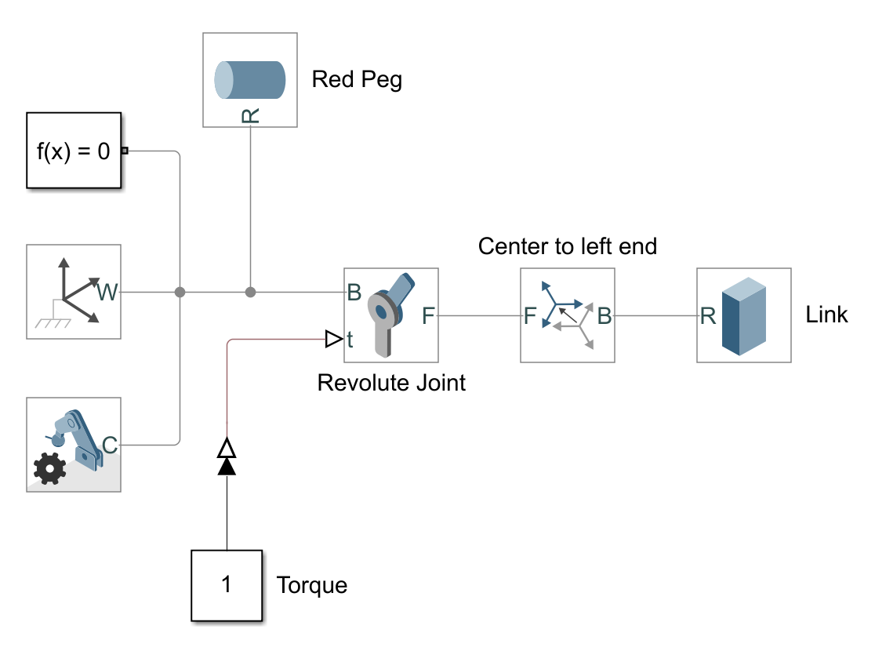
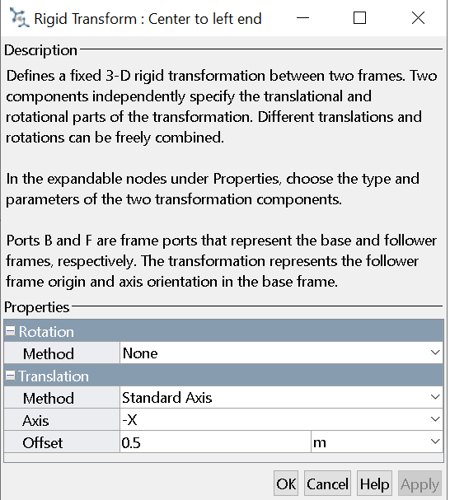
1 Link Model
The link rotates around is center, and not around one end!!
How to solve this problem?
Rigid transformation
Change the reference frame on the body
Cylindrical body attached to world frame
Torque input on the joint
Simulink-PS converter
Simulink constant block to act as torque on the joint

Slide 13
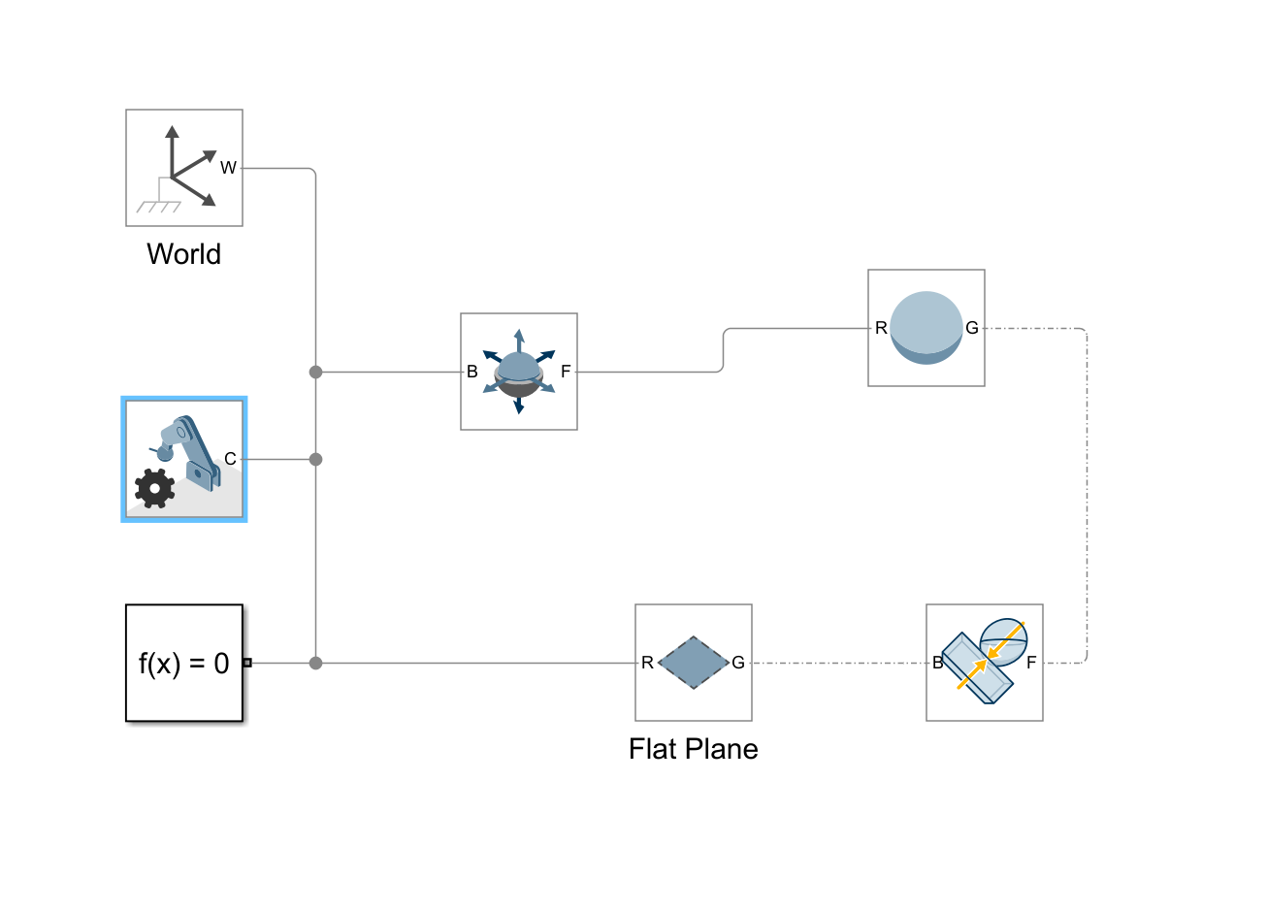
Example: How to setup a Ball drop simulation
Simulation configs
Add world frame
Add configuration (gravity, solver)
Env setup
Ground plan
Rigid bodies (joint and links)
Contact
After clicking start button, the simulation will show up in the matlab window

Slide 14
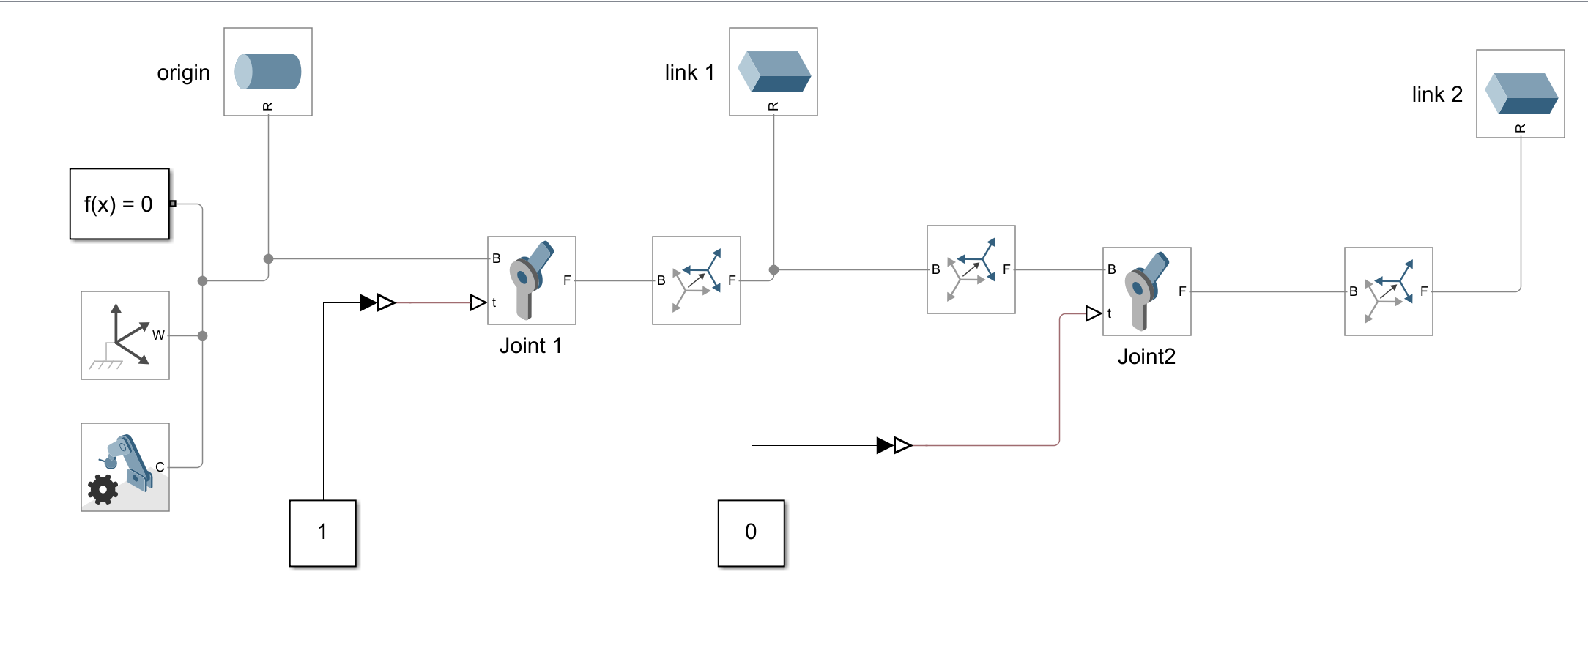
Example: Fixed base 2-link robot
Env setup
Ground plan
Rigid bodies (joint and links)
Define joints and links based on kinematic chain

Slide 15
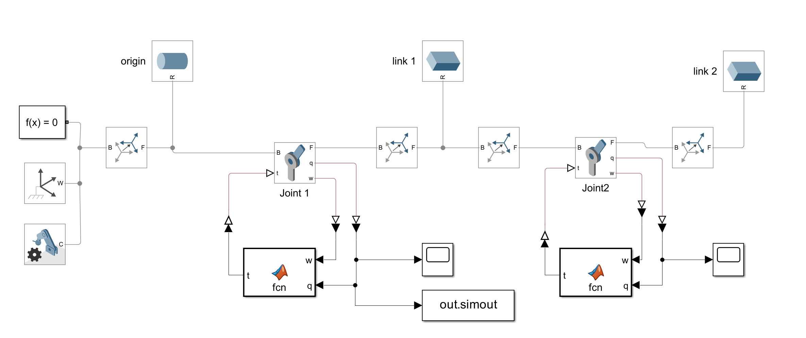
Example: setup a controller
From the previous simulation setup, replace the input block with matlab function or control blocks that has the controller implementation

Slide 16
QUESTIONS?

