Slide 1
Job Search
Job ads
Résumé

Slide 2
Job Search
Reading & Using job ads

Slide 3
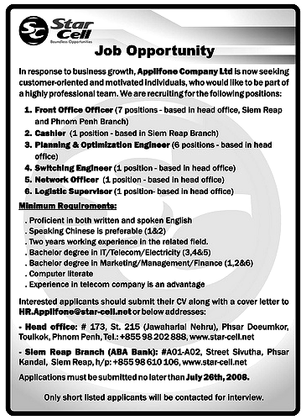

Company info
Job titles & description
Job requirements
Application requirements
Contact info

Slide 4
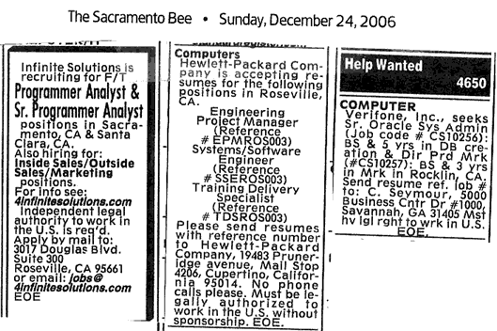
Abbreviations

Slide 5
Words used in ads
Job opportunity / job opening / job offer / vacancies
…wanted / needed
…available / open/ vacant
seek / look for / recruit / hire
accept resumes, add staff
offer job opportunities
Qualification /experience

Slide 6
Abbreviations
Infinite Solution is recruiting for F/T Sr. Programmer Analyst.
Independent legal authority to work in the U.S. is req’d.
Verifone , Inc., seeks Sr. Oracle Sys Admin: BS & 5 yrs in DB creation
Mst hv lgl rgh to work in U.S.

Slide 7
More Abbreviations
PT/FT server wanted
Exp pre
No exp req
Work M-F
Starting sal $9.63/hr plus benefit.
20 hrs/wk, 10 months per year, one night/wk.
Min wage + tip

Slide 8
Common Abbreviations
Admin= administrative/-tion
Incl = including/included
Avail = available
Bet = between
Bkgd = background
Bus = business
Mgr = manager
Nec = necessary
Dept = department
Opp/Oppty = opportunity
Engr = engineer
Eves = evenings
Sal =salary
Jr /Sr = junior / senior
$9 p/h= $ 9 / hour
$1,200/mo = $1,200 /month

Slide 9
How to use a job ad?
To tailor your résumé and cover letter to a specific company
Write down how you meet each criteria

Slide 10
Items to note and use
company description & goal
job title and job responsibilities
Qualifications and experience required
Application requirement
Explain how you are a good match for their organization
Use it in the objective line of your résumé and in the introduction of your cover letter
Explain how you meet the requirements; highlight the experience required
A résumé or an application, or both? References of your past employers? Hard copy? Electronic? Deadline?

Slide 11
How to use a job ad
Looking for Keywords
  Words are most frequently used.
  Count synonyms as well: "team player," "coordinate with co-workers," and "interact with other groups across the company"
Reuse keywords in your résumé and cover letter

Slide 12
What to do if…
  a company describes itself as a “fast-paced, team oriented food service?
  it requires that “applicant must be proficient in both written and spoken English”
  applicants must have a minimum of two years of experience
Write in cover letter that you do well in fast-paced jobs where people have to work together
Explain you have a good command of written and spoken English
explain that you meet those needs: “I graduated from Peking University in 2007 and have worked at …since then.”

Slide 13
r
  What to do if it requires …
  “hands-on experience” related to…?
  Strong analytical skills-result-oriented to achieve objectives and solve problems
  A self-starter, quick learner and highly-motivated toward self-improvement
Write in cover letter and resume your project /internship /work experience and the proven track record
Show your potential or such abilities demonstrated in school work or other activities

Slide 14
Job Search
Writing a Strong Résumé

Slide 15

résumé AmE
curriculum vitae (CV) BrE
personal history
data sheet
vita (longer than a CV)
Notes:
resume = self-promotional document
Personal summary of your education, professional history and qualifications

Slide 16
Purpose of a resume
Purpose: Sell yourself & a job interview
  Basic Job Search Principle = Market Yourself!
  Resume: Marketing Tool
Which Resume is Best?
  The one that best positions your experience for the open position!
strong candidate + poor resume= no job interview
Notes:
Summarizes how your skills and abilities can contribute to their company
Helps get you a job interview

Slide 17
Types of resume
Traditional / Chronological resume:
Functional /skill based resume
Combined resume

Slide 18
Format of a résumé
Format: Keep it short/simple /easy to read
Length: Limit resume to 1-2 typed pages
Font: choose professional font type such as Arial or Times New Roman
Paper: choose plain white, ivory color, light cream, or grey
  bright color such as green or yellow is a big NO.
Notes:
Do not use more than one font in your resume. Stay consistent by choosing a font that is fairly standard and easy to read, and don't change it for different sections.

Slide 19
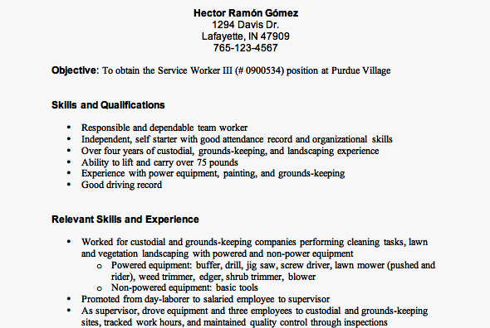
Format of a Résumé
Plenty of space
Headings
Bullet lists

Slide 20

Content
Content: keep it relevant.
Irrelevant items
- Hobbies - Age - Marital Status - Height and Weight
- Salary - Photograph
- Religious or Political Affiliations
Irrelevant to the position

Slide 21
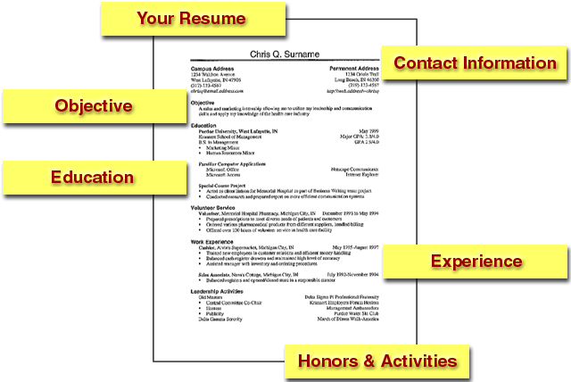
Sections of a Résumé

Slide 22
Contact Information/ Personal details: 简历信头/个人信息
Goes at the top of the resume and must be accurate.
Be sure to include at least your name on each page of the resume
Include:
    Name
    Permanent and/or campus addresses
    Permanent and/or campus phone numbers
    Email address

Slide 23
Contact Information:置中的信头
Cameo Bohnino
227 Harrison, Apt. 5
West Lafayette, IN 47906
Cell: 765.410.6283
Email:cbohnino@purdue.edu

Slide 24
Contact Information:分两栏的信头
Cameo Bohnino
Campus Address: Permanent Address:
227 Harrison, Apt. 5 5226 Buckbridge
West Lafayette, IN 47906 Fort Wayne, IN 46815
765.410.6283 260.482.670 Email: cbohnino@purdue.edu
Cell: 765.410.6283

Slide 25
Job Objective / Career Goal / Career Objective 工作目标
a specific job or position
you seek
long-term goal
benefit you bring to employer
Find key words from the job title or job description of job ads.

Slide 26
e.g.
A position as a Bookkeeper
Seeking a position as a Licensed Vocational Nurse for St. Mary’s Hospital
To obtain a position as a
A summer internship in a sales/marketing position
Entry-level position in ….
Full-time / Part-time position as a…
A position requiring…skills in the area of…
Advertising trainee position with opportunity to use skills in computer graphics and possibility to work into advertising associate position
广告实习职位，有机会使用计算机制图技能，有可能晋升到广告部副主管。

Slide 27
Effective Job Objective 有效工作目标
Position as a teacher
x
To obtain a full-time position as a math teacher
in a secondary school
√
Part-time, entry-level EFL teaching position in a
secondary school in China
√

Slide 28
Effective Job Objective 有效工作目标
My immediate goal is to obtain a challenging
meaningful entry-level sales position in the
computer industry, which will enable me to utilize
my hard-earned communication and computer
skills in the pursuit of organizational objectives.
x
Entry-level computer sales position in which
exceptional communication and computer skills
can be used to maximize sales and profitability
of multiple product lines
√

Slide 29
Education学历
Academic Experience /
Educational Background
Beginning with the highest level of educational achievement, include:
  University / school attended
  Major/Minors
  Date of program completion information
  GPA (if 3.0 or above)
  Related courses
  Honors and awards

Slide 30
Education: University/ School/ Degree/major
Example 1
Example 2
Bachelor of Science in Management December 2007
Purdue University, Krannert School of Management, West Lafayette, IN
December 2007 Bachelor of Science in Management
Purdue University, Krannert School of Management
West Lafayette, IN

Slide 31
Education: courses
Bachelor of Science in Management December 2007
Purdue University, Krannert School of Management, West Lafayette, IN
Relevant courses:
Courses:
Specialized courses

Slide 32
Education: Academic records/ Marks /Grades 学习成绩
Overall GPA: 87/100
Major GPA: 88/100
ranked in top six of 210 member class.

Slide 33
Education: Academic awards/ Scholarships 学术奖励
获得一等奖学金
Top Scholarship winner/ First-Class Scholarship winner
北京大学奖学金
Scholarship from Peking University
被授予三好学生称号
Won the title of Merit Student / Excellent Student Award
全额研究生奖学金
Full graduate assistantship scholarship from Florida Polytechnic Institute

Slide 34
Education: Academic Experience学术经历 (projects, research)
2007.8--present Undertake research on
predicting sound fields in large
rooms and pressure vessels using
Diffusion Equations, School of
Architecture, Florida Polytechnic
Institute
2005.3—2005.8 Undertook research on wave fields
synthesis, State Key Laboratory of
Modern Acoustics, Nanjing
University

Slide 35
Education: Publications发表作品
Submitted On diffusion equation models,
submitted in Feb. 2007 to
Journal of the Acoustical Society
Accepted Random Stress-induced Frequency
Shifts, accepted in Jan 2007 by
IEEE Transaction on Ultrasonics
Published Influence of Immersed Electrodes on
Force Frequency, published in 2006
by Japanese Journal of Applied
Physics

Slide 36
Work Experience/ Experience 工作经验
Employers want to know: “What is this individual going to do for me?” “What skills can you offer me?”
List your results and/or achievements that relate to the position desired
Not a job description! Not just job duties.
Match your headings to the job
Sell benefits, not skills

Slide 37
Work Experience/ Experience 工作经验
Name of the employer/company, contact info, period
Job title + responsibilities & achievement
  (Use numbers, percentages, statistics, examples to illustrate your achievements)
Reverse chronological order or in order of importance
Write in past tense for previous jobs
Present tense for current job

Slide 38
Example Accomplishment Statements:
Management: “Developed and managed an annual budget of $50M meeting department’s profit goals.”
Inventory Control: “Managed company’s 500-item, $10M stock inventory warehouse with 100% accountability.”

Slide 39
Work Experience: Highlight job title
Server May 2003-June 2006
The Blu Tomato, Fort Wayne, Indiana
  - Provided customers with superior service and ensure their comfort in an upscale restaurant environment
  - Achieved net sales averaging between $400 and $750 a night
Swim Coach Summers 2004-2005
Blackhawk Swim Team, Fort Wayne, Indiana
  - Improved the swimming skills of children ages 4-18 while encouraging the children to stay on task
  - Constructed line-ups for a competitive advantage at swim meets
Duties and accomplishments: V-ed or V

Slide 40
Experience: Highlight companies
Purdue Athletic Promotions, West Lafayette, IN April 2004-Present
Manager of Promotions for Purdue Swimming and Diving
Create and implement a promotional campaign to increase attendance at swimming and diving events
Design advertisements for newspapers, radio, and campus
Blackhawk Swim Team, Fort Wayne, Indiana Summers 2004-2005
Swim Coach
Improved the swimming skills of children ages 4-18 while encouraging the children to stay on task
Constructed line-ups for a competitive advantage at swim meets

Slide 41
Experience: responsibilities/ achievements
Tips:
Use phrases instead of sentences
Avoid “I”, “me”, “my”
Use concrete and strong action verbs
Use parallelism
Use the correct tenses

Slide 42
Key
I assisted the manager (太模糊，使用句子）
Assisted insurance manager in training employees, selling policies, filing claims, making bank deposits and answering emails and letters.
Worked as a volunteer twelve hours a week （需要细节）
Volunteered twelve hours weekly for a nonprofit suicide prevention agency. Answered the hotline telephone calls, and prepared a computer analysis of client issues and viable solutions

Slide 43
Key
Developed a new product line which sells well （需要用具体数据突出业绩）
Developed a new product line that added 50, 000 yuan in sales and increased the market share by 5%

Slide 44
Responsibilities: （非平行结构）
  Reviewing contracts
  Helped train new employees
  Correspondence with customers
Responsibilities
  Reviewed contracts
  Helped train new employees
  Corresponded with customers

Slide 45
Experience (Internship / Summer Jobs / Part-time Jobs / volunteer experience)
Full-time in summers as a...at … + responsibilities
Part-time as a …during school
Worked part-time as an interpreter for…
Volunteered for 2008 Beijing Olympic Games. Wrote brochures and received guests.
Notes:
Key points: 担任报告书的准备工作,可以显示出处理事务的能力以及思考周密

Slide 46
Extracurricular activities/Activities 课外活动/活动
Active in college student union/council
Senior year: President, coordinated and planned organization activities including educational and social programs
July 2004-June 2005, Membership Chairman, ABC Club: Increased membership by 20%, in charge of public relations
Captain, College Soccer Team
Contributed to the winning of College Soccer Contest
Won first place in the Competition for the Best Ten Singers of Peking university

Slide 47
Personal: Skills
Computer Abilities
Skilled in use of MS Frontpage, Win 95/NT, Sun, Javabeans, HTML, CGI, JavaScript, Perl, Visual Interdev, Distributed Objects, CORBA, C, C++
Experienced in Project 98, Office 2003, Rational RequisitePro, Process,Pascal, PL/I and SQL software
Working knowledge of all common office machines.

Slide 48
Skills: Language / Language proficiency
Proficient / Fluent in English
CET-6: 86; TOEFL:623
Have a good command of both spoken and written English .

Slide 49
Education: Publications发表作品
Submitted On diffusion equation models,
submitted in Feb. 2007 to
Journal of the Acoustical Society
Accepted Random Stress-induced Frequency
Shifts, accepted in Jan 2007 by
IEEE Transaction on Ultrasonics
Published Influence of Immersed Electrodes on
Force Frequency, published in 2006
by Japanese Journal of Applied
Physics

Slide 50
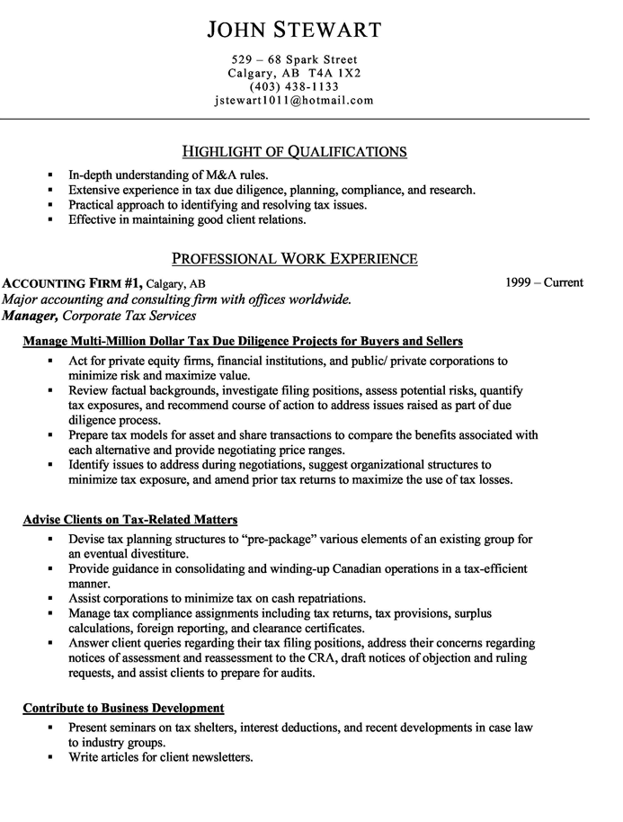

Slide 51
