Slide 1

Differences between Chinese and Western treatments of Cyber Privacy
Reported by：王天娇，黄冰衡

Slide 2
1
Differences of Individual
Content
2
What has government done

Slide 3
1
Differences of Individual

Slide 4
Good people use your data to push ads to you.
Bad people use your data to scam you.

Slide 5
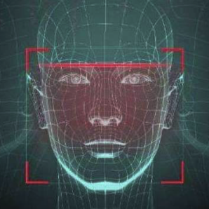


Westerners think cyber privacy is very important. What they care more about is what you do with their data. Even if you take their information to do some big data analysis, some people think their privacy have been violated.
Face recognition

Slide 6
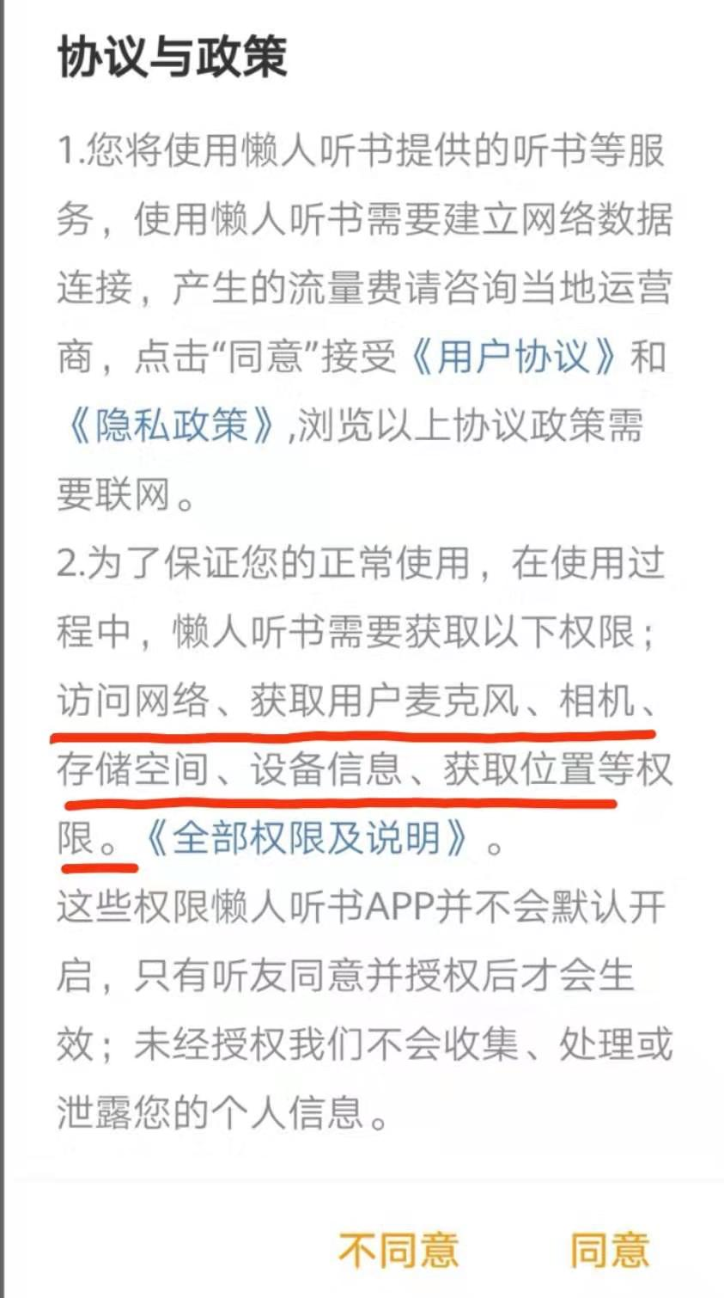
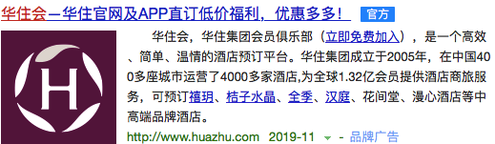
Disclosure of personal information is not good. But as long as the bad guys don‘t threaten my normal life, I can stand it. It is acceptable for government, educational institutions, and Internet companies to have personal information. If collecting personal information can be beneficial to social development, I will agree.

Slide 7
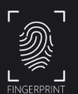

In China, 97% of respondents believe that it is feasible to establish fingerprints and DNA files for newborns and support the establishment of a children's fingerprint database nationwide.
But in the West, any proposal, no matter how good the original intentions, and for its sufficient reasons, as long as it involves the privacy of citizens, will cause a heated discussion.

Slide 8
China:
1. Collectivism. For the benefit of the collective, when necessary, the individual needs to suppress himself or even sacrifice himself.
2. Acquaintance society with a small population movement.
Of course, modern people pay more attention to their privacy issues.

Slide 9
Western:
1. Individualism. Individual-centered, the individual's behavior is completely from his own inner feelings and motives, against the stifling of personality and the violation of individuals.
2. The population is highly mobile and there are always strangers around. They do not want others to pry into themselves.

Slide 10
The willingness of the masses to protect their privacy,
we can see the inclination of law and system.

Slide 11
2
What has government done？

Slide 12
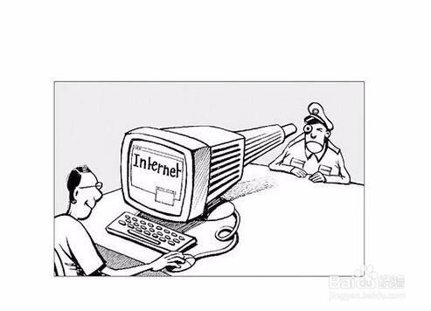
Cyber privacy Act
1
America
2
European union
3
China

Slide 13
America
1
3
1967-----Freedom of Information Act
2
1974-----Privacy Act
Restrain the federal government
4
1988-----Children's Online Privacy Protection Act
Prevent children under the age of 13 from being collected user information.
2018-----CCPA

Slide 14
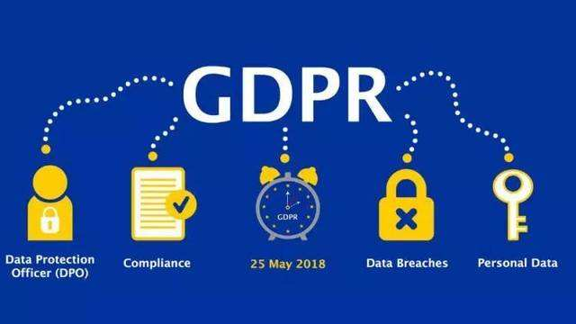
European Union
1995-----《Data Protection Directive》
2018.5.25---《General Data Protection Regulation》
The strictest protection of cyber privacy

Slide 15

China
Ren Zhengfei: China should enact privacy protection Act and it should be very strict
2009-----《中华人民共和国侵权责任法》

Slide 16
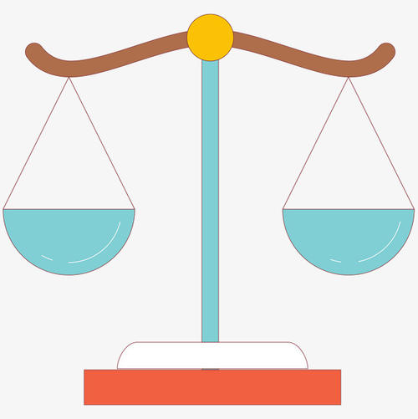
Two ways to protect cyber privacy
1.Enact laws
Advantage： enacting laws can protect privacy strongly
Shortcoming：the inelastic laws will curb economic development and hinder the development of new network technology
Industry self-discipline
Enact laws
Industry self-discipline
Advantage： The flexibility of industry self-discipline is good, which can provide space for self adjustment of network economy
Shortcoming：No legal restriction will urge enterprises to violate the right of network privacy for the sake of interests

Slide 17
Summary
1.Protecting the right of cyber privacy has become the top priority of legislation in various countries.
2.With such a large number of Internet users in China,China needs to accelerate legislation and carry forward the self-discipline awareness of the industry.

Slide 18
Thank you

