Slide 1
Digital marketing project phase 2
Team leader Burada kalpana
Team member Angur padma
Team member Ambati sailja
Team member Bejawada Rajeswari
Team member Bommali Deepika

Slide 2
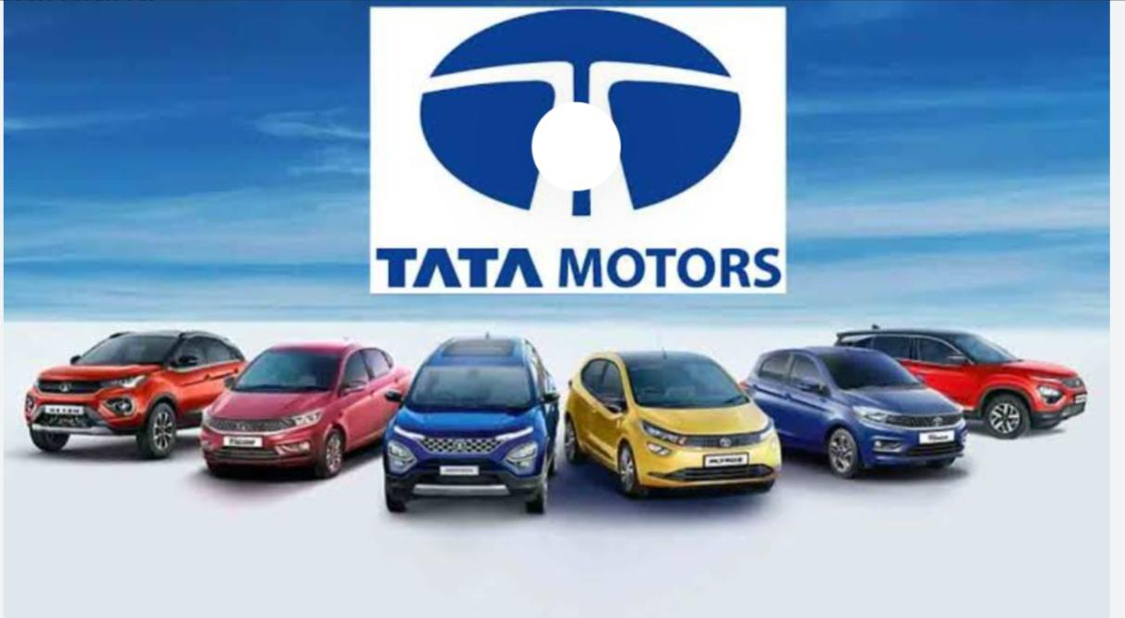
Tata motors

Slide 3
Part -1 Brand Study, Competitor Analysis & Buyer’s/Audience’s Persona
Research Brand: Tata Motors Limited is an multinational automotive company, headquartered in Mumbai, and part of the Tata Group. The company produces cars, trucks Tata Motors is the largest automotive oem company in India with an extensive range of integrated, smart, and e-mobility solutions.
Mission/Values: To deliver value through our products and services and to be the most trusted global network for our customers and suppliers. To be a responsible value-creation partner for all shareholders. To innovate mobility solutions with a passion to enhance the quality of life.
Usp:- Tata Motors took a risk by emphasising safety as a selling point. They recognised that the strength and safety of a vehicle should be the top priority for car buyers. Tata aimed to disrupt the market dominated by Maruti by introducing safety as their unique selling proposition
Analysis Brand Tone and Identity:-Connecting Aspirations’ represents the personality of Tata Motors as an interconnected system of mobility solutions that are intelligent, perceptive, warm and expressive. It is a symbolic tagline that is representative of the past, present and future.

Slide 4
Part-1 Brand Study, Competitor Analysis & Buyer’s/Audience’s Persona
Goals:- To deliver value through our products and services and to be the most trusted global network for our customers and suppliers. To be a responsible value-creation partner for all shareholders . To innovate mobility solutions with a passion to enhance the quality of life.
KPIs:- Tracking fleet management key performance indicators (KPIs) helps measure efficiency across your fleet. Setting fleet management benchmarks and measuring KPIs is the best way to enhance fleet productivity and control costs.

Slide 5
Part-1 Brand Study, Competitor Analysis & Buyer’s/Audience’s Persona
Buyer’s/ AudIence’s Persona:- The following Indian population segments were primarily targeted by Tata Motors: First, the Middle Class 1. The lower middle class in general, Middle to lower class 2. Typically, those who ride two wheels.
Social Media Marketing: Tata Motors uses social media platforms like Facebook, Instagram, and Twitter to promote its products and engage with customers. They share images and videos of their vehicles and also run social media campaigns to attract new customers.

Slide 6
Competitor Analysis:-Tata motors faces heavy competition from both domestic and foreign car manufacturers. Some of the competitors that Tata Motors has in the passenger vehicle segment are Maruti Suzuki, Hyundai, Mahindra & Mahindra, Honda, Toyota Kirloskar, Ford Motors etc.
Competitor 1:- TATMOL
Competitor 2:-ASHOKL
Competitor 3:- FORMOT

Slide 7
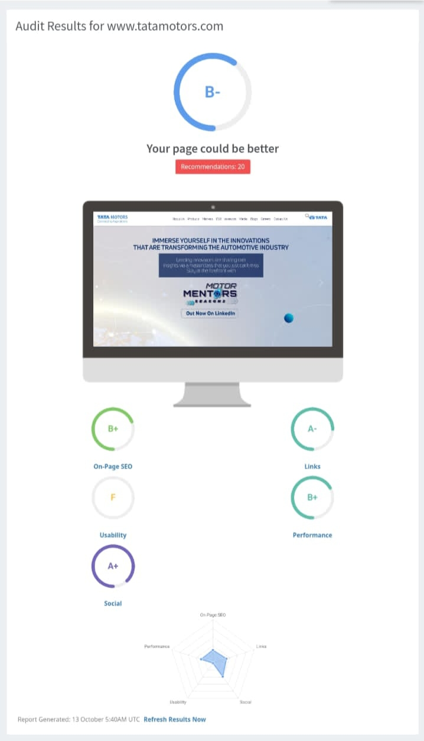
SEO & Keyword Research
Seo Audit:-

Slide 8
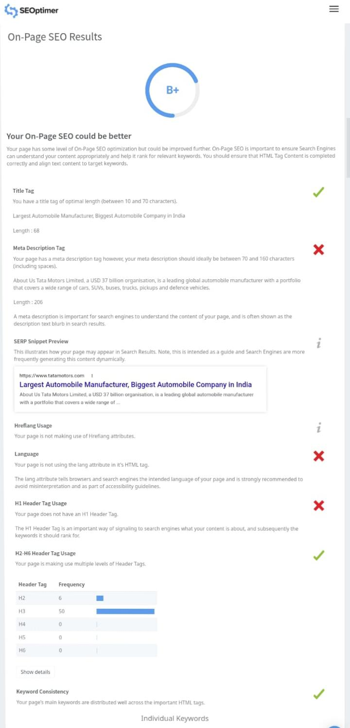
On Pages Seo Results

Slide 9
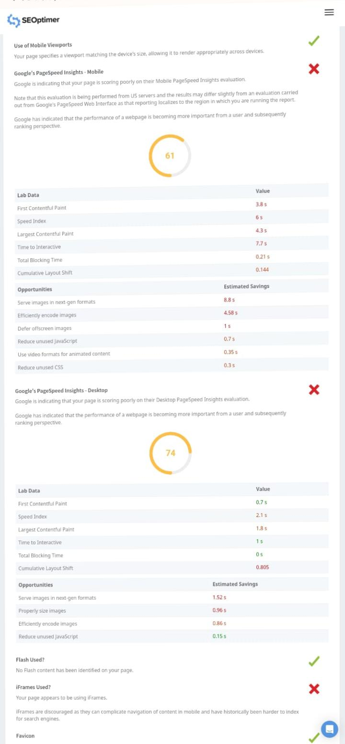
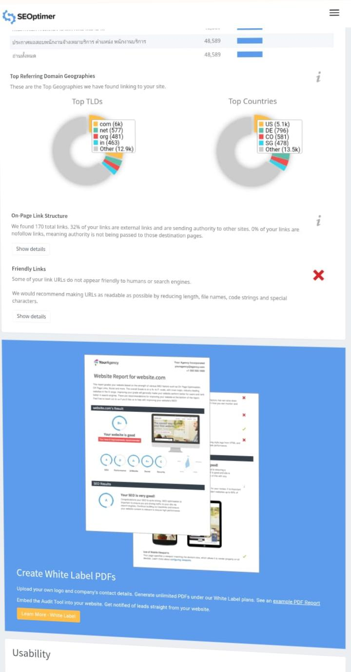
Links

Slide 10
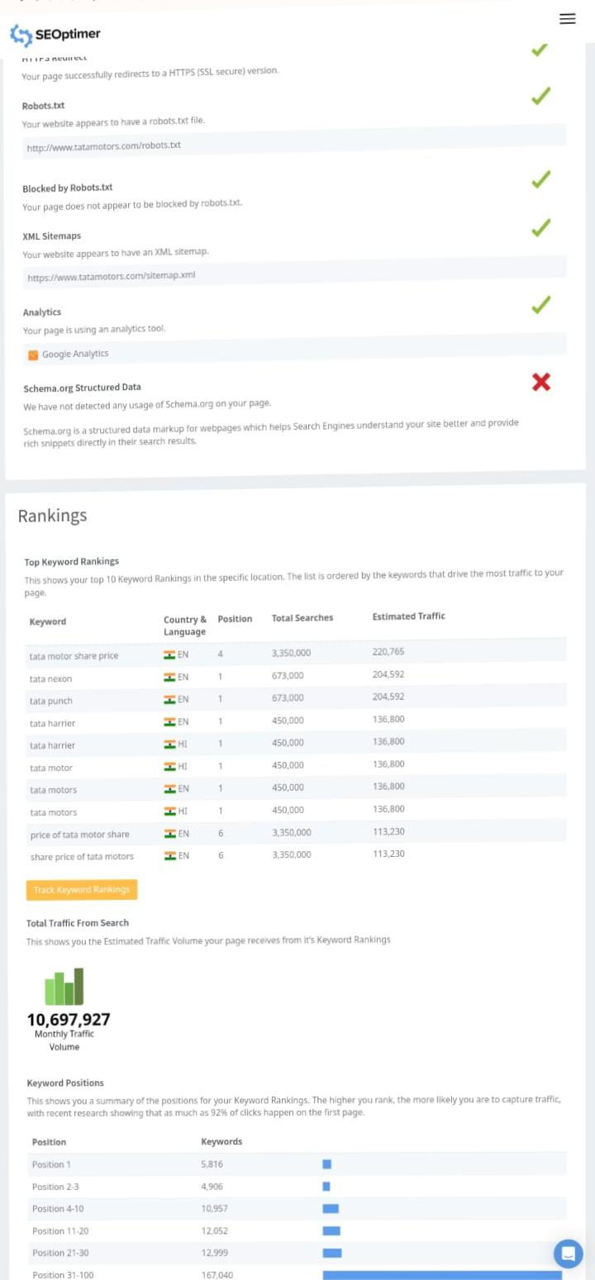
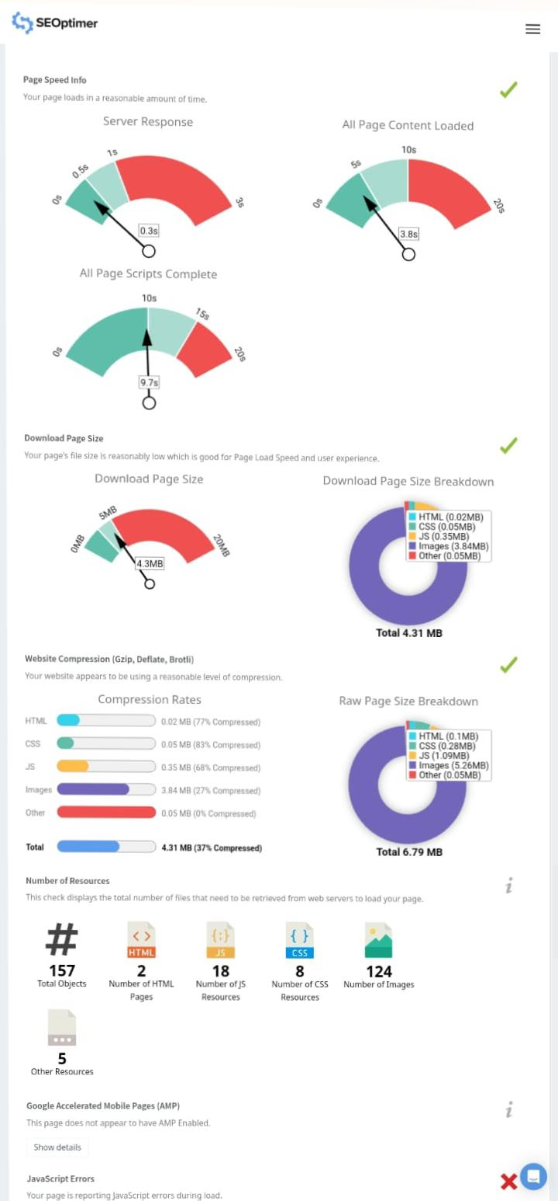
Goggle page insides
Ranking

Slide 11
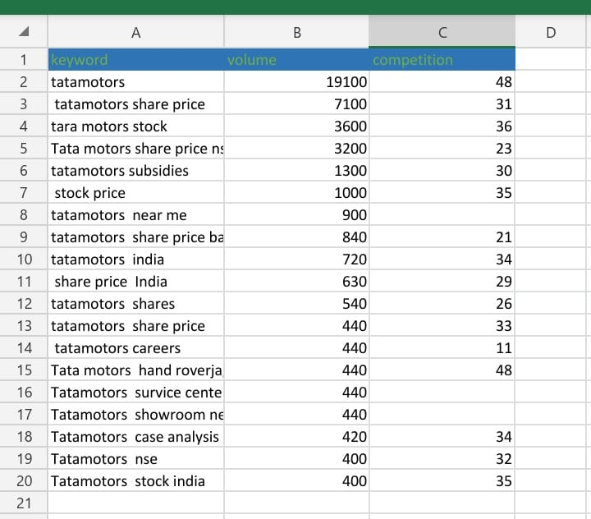
Key word Research:-

Slide 12
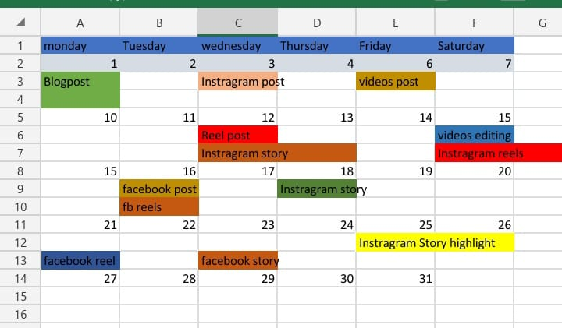
Content Ideas And Marketing Strategies
Content Idea Generation & Strategy:- Content ideation is the process of generating ideas for content creation. It involves exploring various topics and angles that align with a brand’s goals and values. Essentially, it is the process of brainstorming ideas for content that is engaging, insightful, and resonates with the target audience.

Slide 13
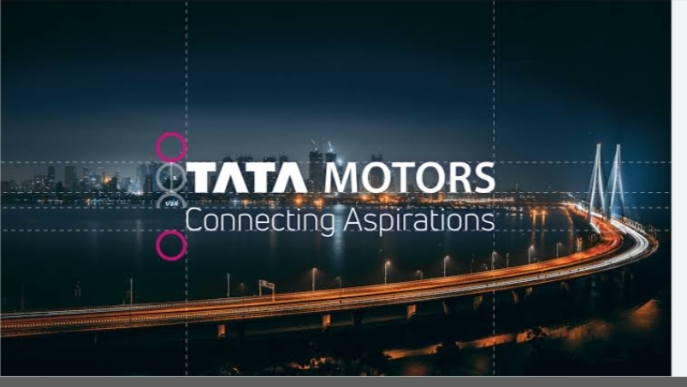
Content Creation And Curation
Post creation :- Its diverse portfolio includes an extensive range of cars, sports utility vehicles, trucks, buses and defence vehicles. Tata Motors is one of India’s largest OEMs offering an extensive range of integrated, smart and e-mobility solutions.
Farmat 1:- The most accurate and popular Tata motors email format is frist - last .
Farmat 2:- Tata motors common email format is john.

Slide 14
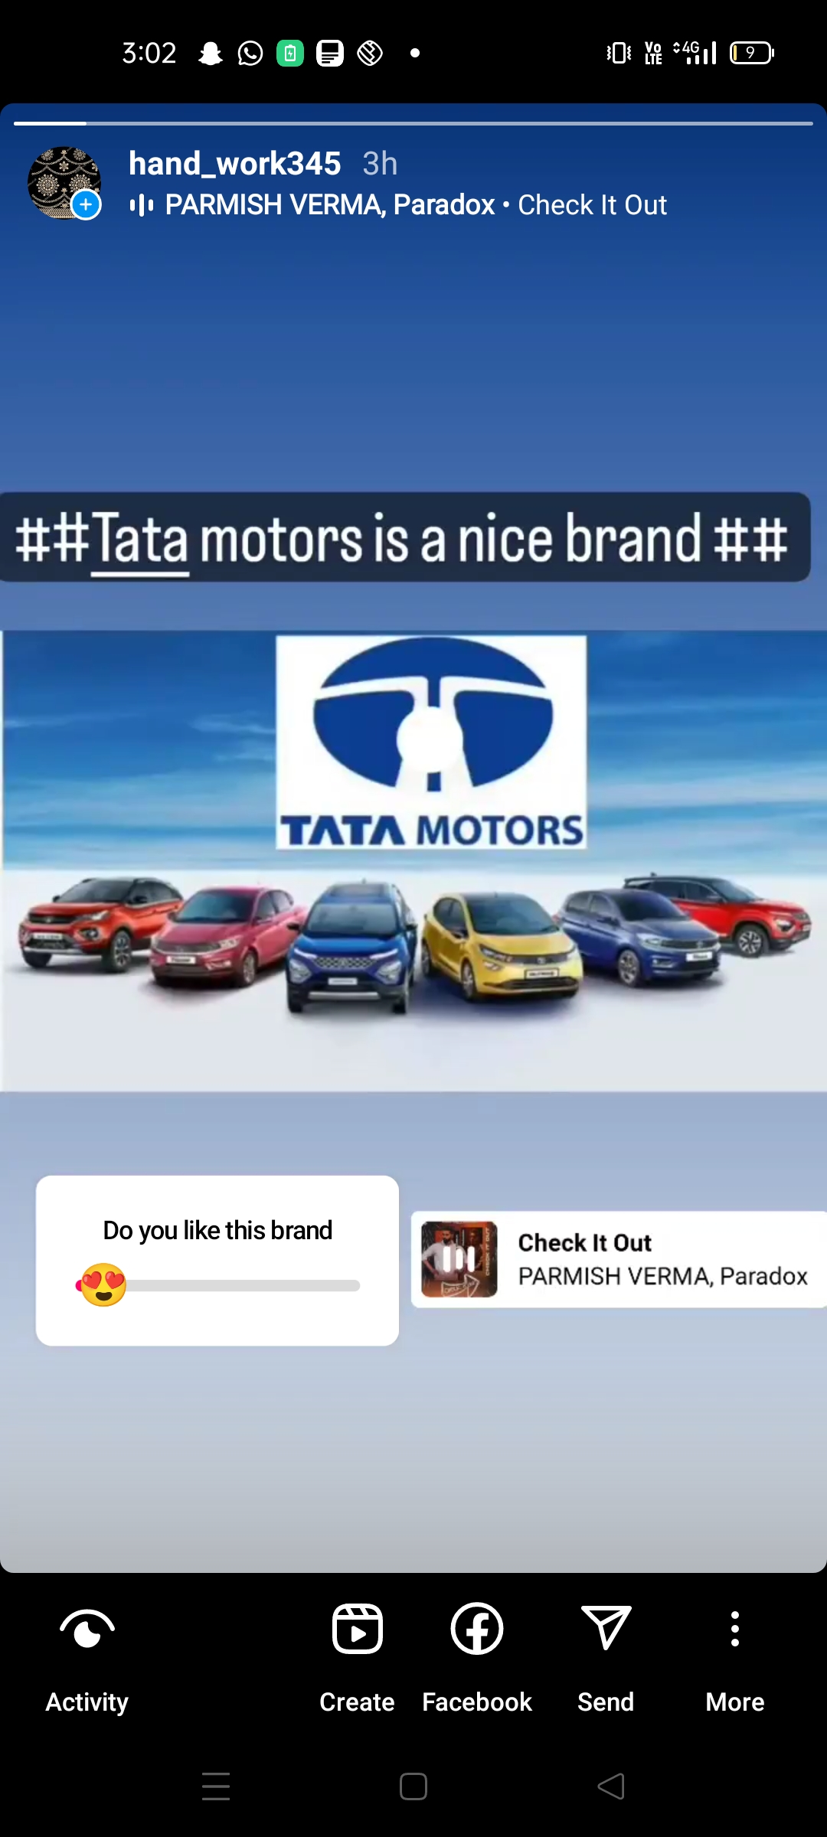
Instagram Story
https://instagram.com/stories/hand_work345/3212489505226247175?igshid=Y2QyNjM0MDJkNg==
https://www.instagram.com/s/aGlnaGxpZ2h0OjE3OTU4Mzg0OTM1NjU0NzU2?story_media_id=3212489505226247175_62088050700&igshid=NzZlODBkYWE4Ng==
https://instagram.com/hand_work345?igshid=NzZlODBkYWE4Ng==

