Slide 1

2024-2025 fall – dsa210 course Project presentatıon: Analyzing the Factors Affecting My Academic Success
BURAK ALA - 32480

Slide 2

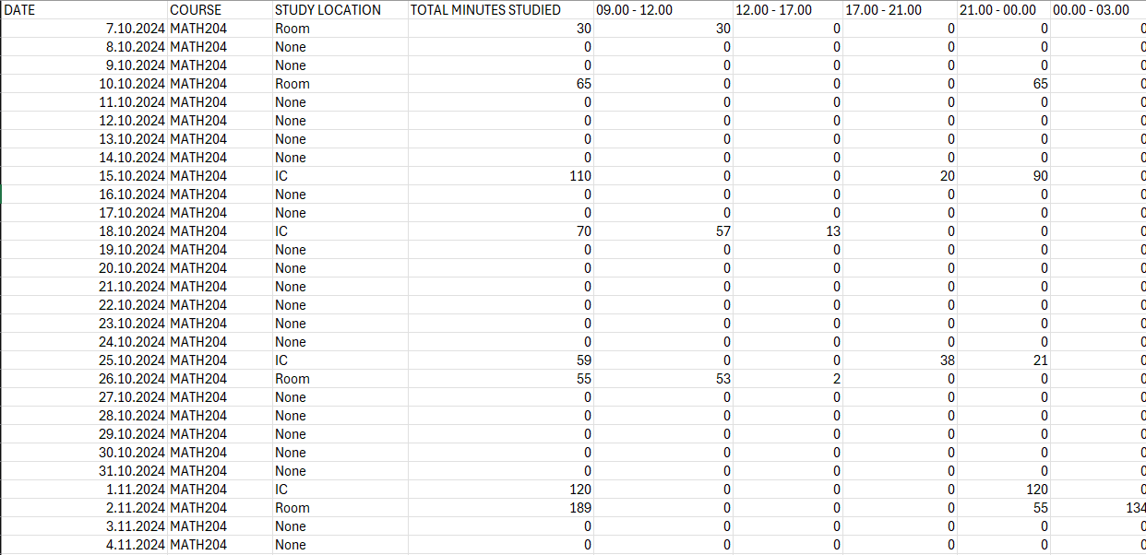
Dataset
I recorded where and when I studied throughout the semester (92 days) and recorded it in a csv file for each course I am taking throughout the semester.
I took 5 courses this semester. CS300, CS303, CS308, DSA210 and MATH204.
Then I conducted an analysis regarding my study time and location and exam grades.
A small part of my MATH204 study data

Slide 3
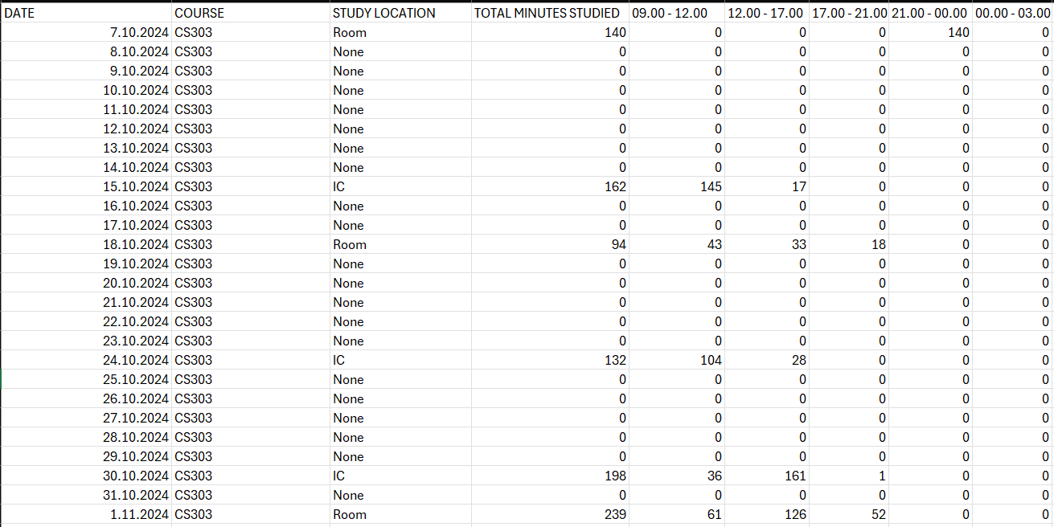
DATASET
I classified my study location as either room or IC.
I divided the day into 5 time blocks as: 09.00 – 12.00, 12.00 – 17.00, 17.00 – 21.00, 21.00 – 00.00, 00.00 – 03.00.
I recorded this data from October 7th to January 6th.
A small part of my CS303 study data

Slide 4
HYPOTHESIS
Null Hypothesis (H₀): Study location and time of day have no significant impact on my exam performance.
Alternative Hypothesis (H₁):
→ H₁a: Studying in my room leads to better exam performance compared to studying in the IC.
→ H₁b: Morning and afternoon are the most productive time blocks for achieving higher exam grades.

Slide 5
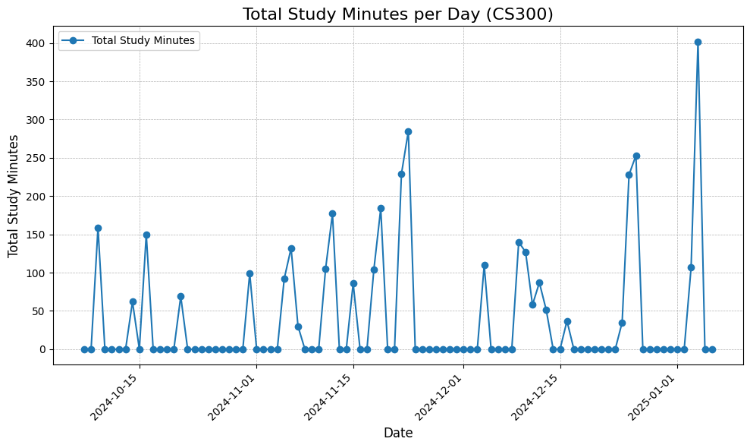
CS300 course - DATA VISUALIZATION

Slide 6
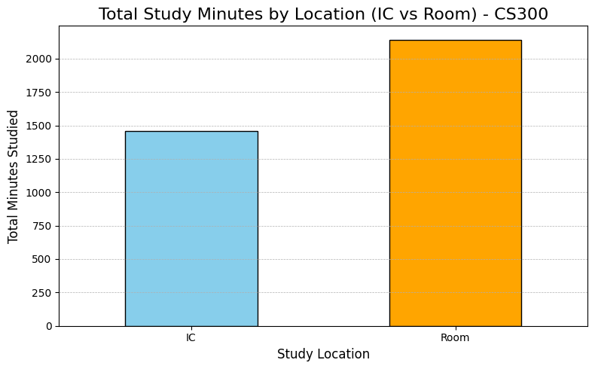
CS300 course - DATA VISUALIZATION

Slide 7
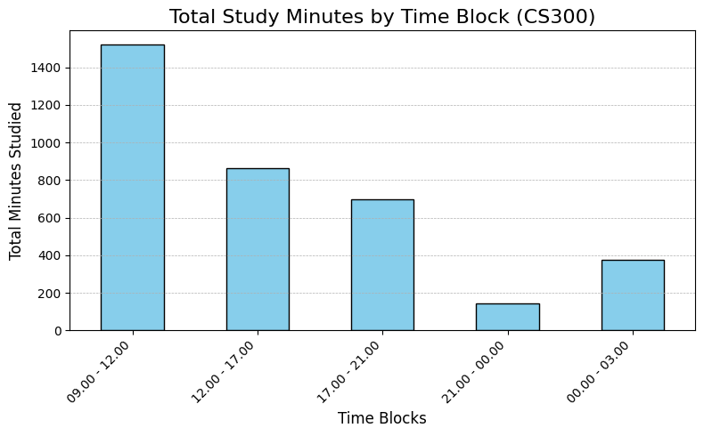
CS300 course - DATA VISUALIZATION

Slide 8
Cs303 course – data vısualızatıon

Slide 9
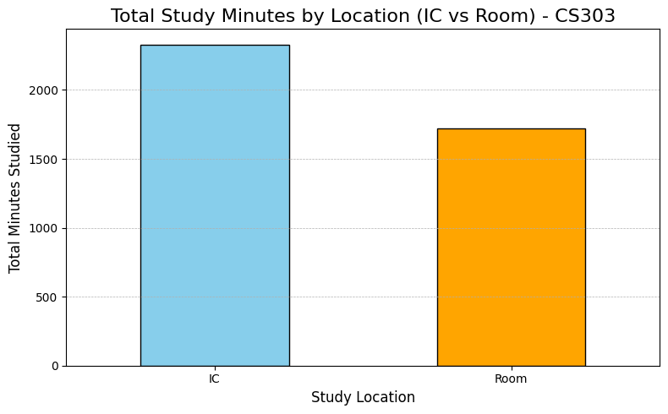
Cs303 course – data vısualızatıon

Slide 10
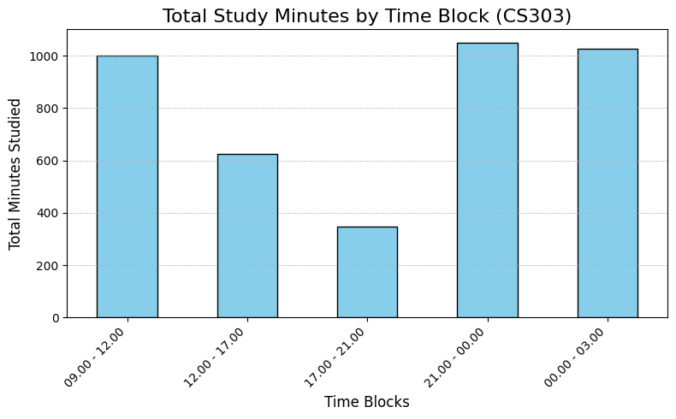
Cs303 course – data vısualızatıon

Slide 11
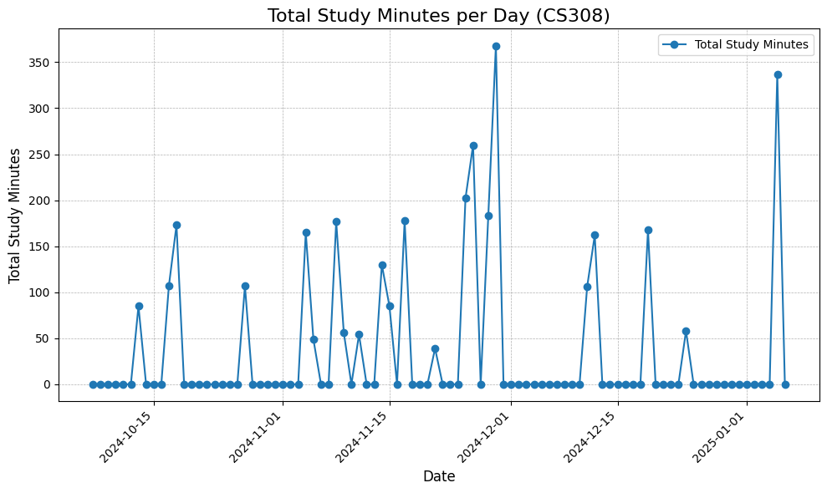
Cs308 course – data vısualızatıon

Slide 12
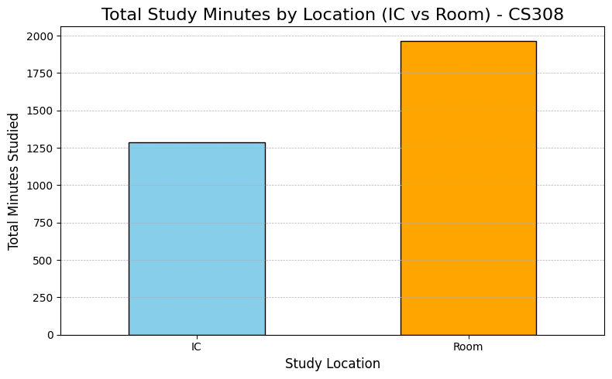
Cs308 course – data vısualızatıon

Slide 13
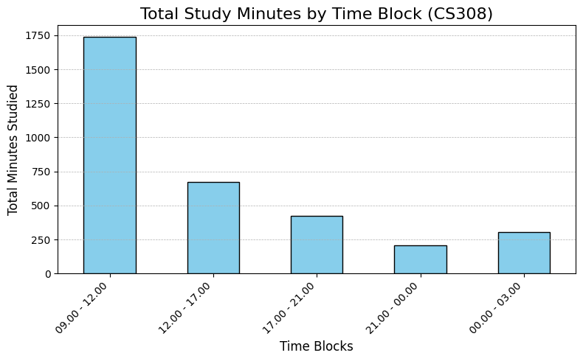
Cs308 course – data vısualızatıon

Slide 14
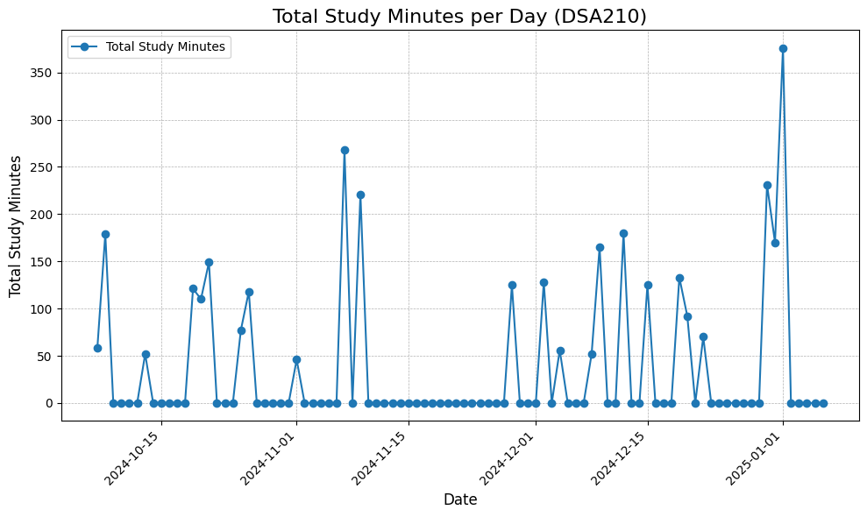
Dsa210 course – data vısualızatıon

Slide 15
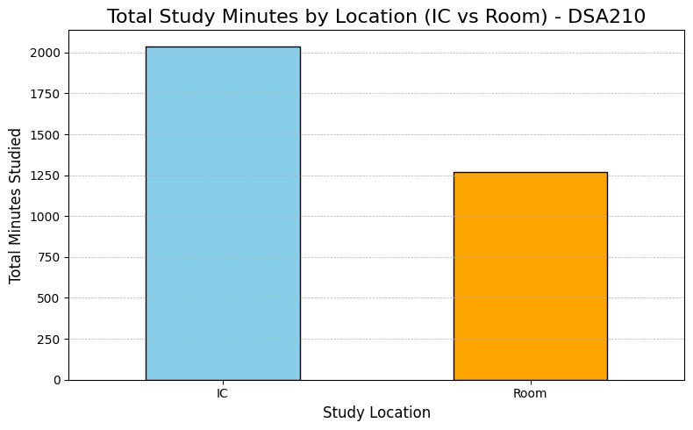
Dsa210 course – data vısualızatıon

Slide 16
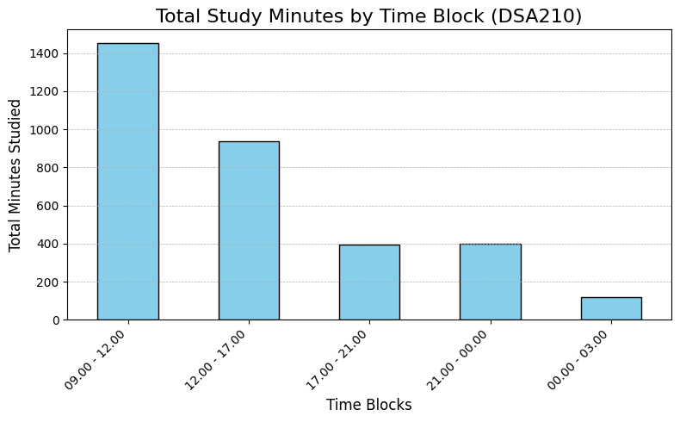
Dsa210 course – data vısualızatıon

Slide 17
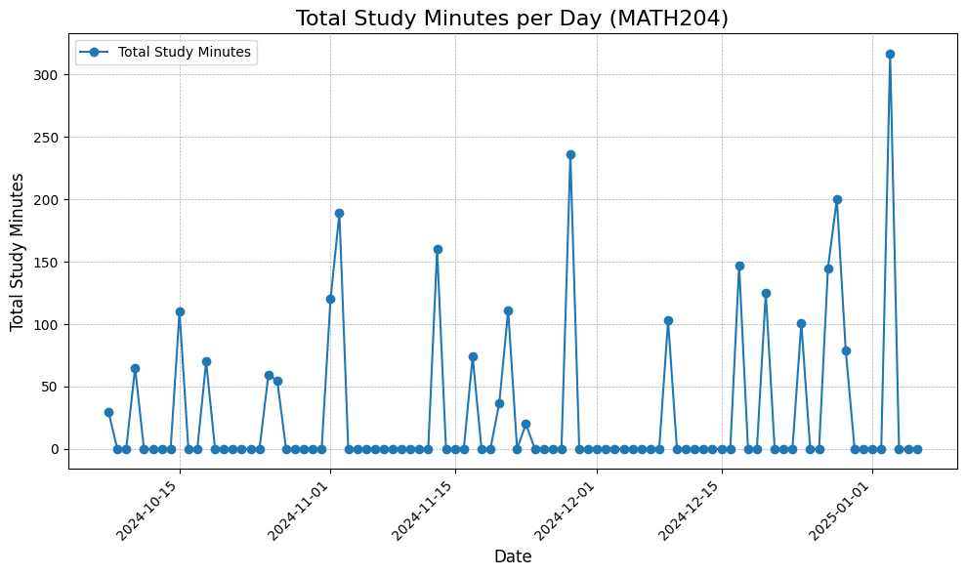
MATH204 COURSE – DATA VISUALIZATION

Slide 18
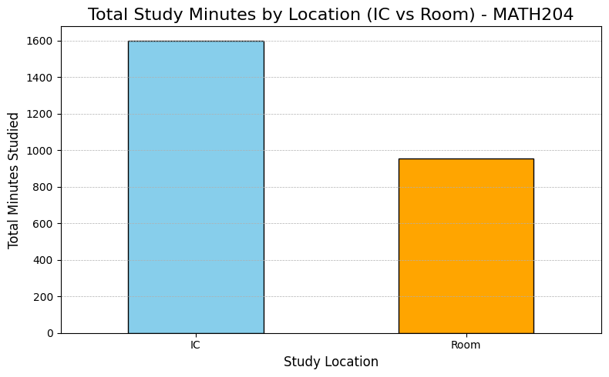
MATH204 COURSE – DATA VISUALIZATION

Slide 19
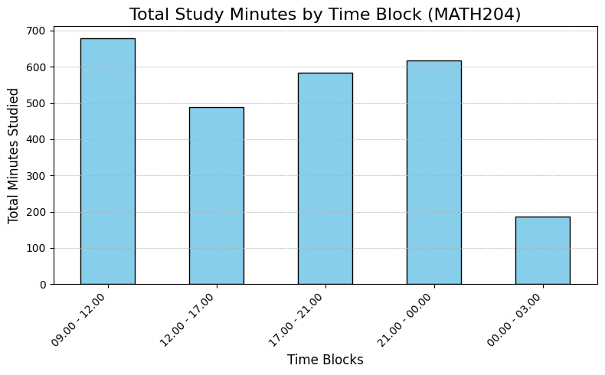
MATH204 COURSE – DATA VISUALIZATION

Slide 20
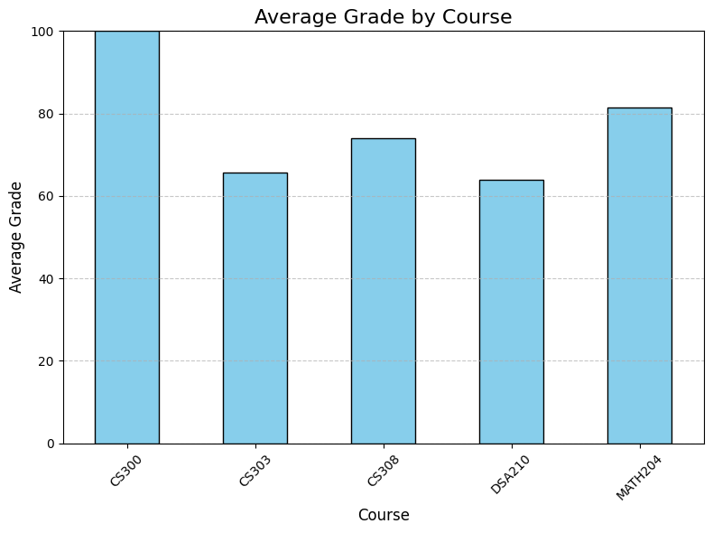
AVERAGE GRADES BY COURSE

Slide 21
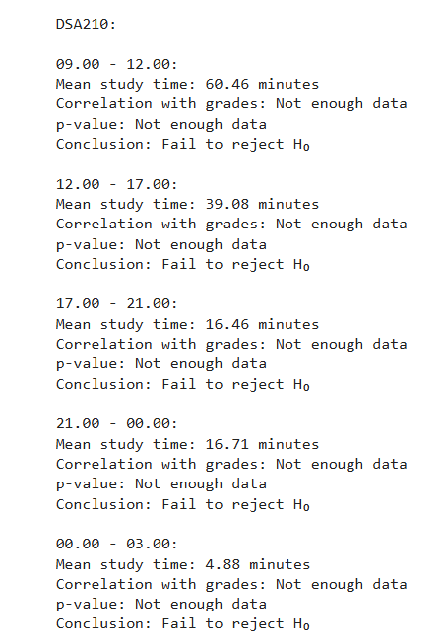
DATA ANALYSIS
After I gathered the necessary data and calculated total values, I also calculated the mean values. By the help of these values, I calculated Pearson Correlation Coefficient and p-values for each course’s study location and study time blocks.
In study location category, I got meaningful p-values in order to search for any possible correlation. However in the time blocks, I could not search for any correlation because of inadequate data.

Slide 22
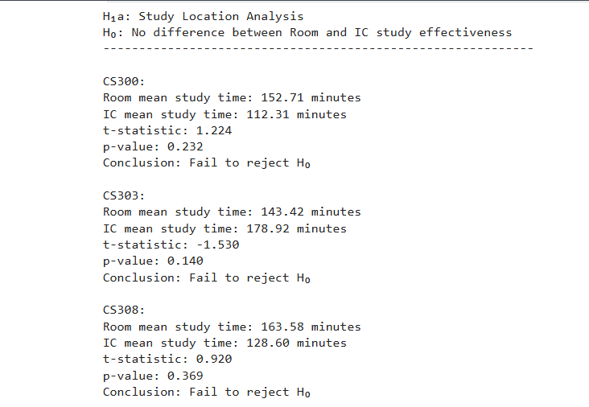
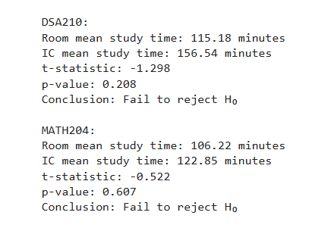
DATA ANALYSIS - LOCATION

Slide 23
DATA ANALYSIS - results
There are very few significant differences in study behavior or grades across courses, as most p-values fail to reject H₀ (p > 0.05). Notable exceptions include: IC study time between CS303 and MATH204 (p = 0.045). Morning block study time (09.00 - 12.00) between MATH204 and CS300 (p = 0.037). These findings could indicate that study location and specific time blocks might play a role in explaining differences between some courses, but the overall patterns suggest no strong relationship across the dataset. Further investigation with more granular or additional data could refine these results.

Slide 24
my overall comments
There may be a lot of factors explaining exam results. Study location and study time block of the day can be 2 of them. But also courses differ by their overall difficulties, specific exam difficulties as well. Even my sleep time in the exam day can affect my exam grade directly. If we were to exaggerate, my friend explaining me an important topic half an hour before the exam can directly increase my grade. So, even if I got some rejections in the end, factors affecting exam results can still be diversified and thoroughly analyzed.

Slide 25
Thank you for your tıme

