Slide 1


SCIPY TUTORIAL
Burak Büyükyüce
https://github.com/BurakB70

Slide 3
SciPY:CONSTANTS
>>>from scipy import constants
>>>import scipy as sp
>>>a = constants.pi # pi sabiti
>>>b = constants.Boltzmann # Boltzmann sabiti
>>># Sabitlerin değerlerini yazdır
>>>print(a, b)
>>>print(a/b)
3.141592653589793 1.380649e-23
2.2754462963358485e+23

Slide 8
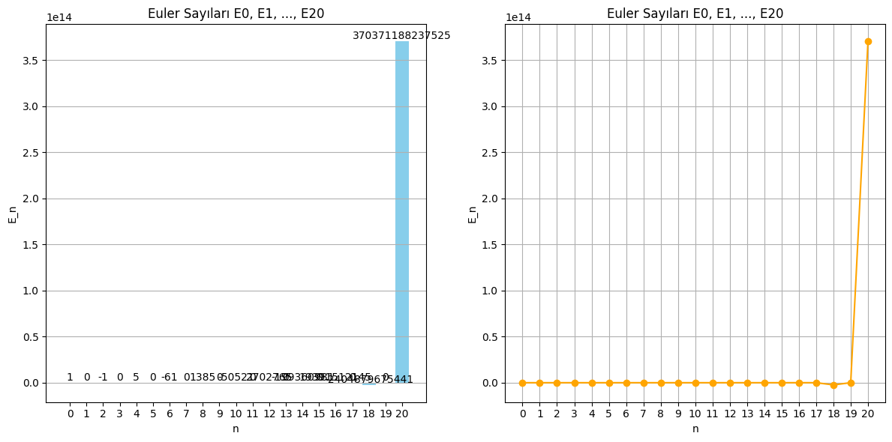
scipy.special
import numpy as np
import matplotlib.pyplot as plt
from scipy.special import euler
# Euler sayılarının hesaplanacağı n değeri
n = 20 # 0'dan 20'ye kadar Euler sayıları
# Euler sayılarını hesapla
euler_numbers = euler(n)
# Euler sayılarının görselleştirilmesi
plt.figure(figsize=(12, 6))
# Çubuk grafik
plt.subplot(1, 2, 1)
plt.bar(range(n + 1), euler_numbers, color='skyblue')
plt.title('Euler Sayıları E0, E1, ..., E{}'.format(n))
plt.xlabel('n')
plt.ylabel('E_n')
plt.xticks(range(n + 1))
plt.grid(axis='y')
# Euler sayılarının değerlerini yazdır
for i, value in enumerate(euler_numbers):
plt.text(i, value + 0.5, str(int(value)), ha='center', va='bottom')
# Euler sayılarının çizgi grafiği
plt.subplot(1, 2, 2)
plt.plot(range(n + 1), euler_numbers, marker='o', color='orange', linestyle='-')
plt.title('Euler Sayıları E0, E1, ..., E{}'.format(n))
plt.xlabel('n')
plt.ylabel('E_n')
plt.xticks(range(n + 1))
plt.grid()
# Grafiği göster
plt.tight_layout()
plt.show()
# Euler sayıları hakkında bilgi
print("Euler Sayıları:")
for i, value in enumerate(euler_numbers):
print(f"E_{i} = {value}")

Slide 9
Scipy.signal
import scipy as sp
from scipy import constants, integrate, optimize, signal, stats
import numpy as np
import matplotlib as mpl
import matplotlib.pyplot as plt
# Constants
print("Pi:", constants.pi)
print("Speed of light:", constants.c)
print("Gravitational constant:", constants.G)
# Integration
def f(x):
return x**2
result, error = integrate.quad(f, 0, 1)
print("\nIntegration of x^2 from 0 to 1:", result)
# Optimization
def g(x):
return x**2 + 2*x + 1
min_result = optimize.minimize_scalar(g)
print("\nMinimization of x^2 + 2x + 1:", min_result)
# Signal Processing
# Generate a sine wave
fs = 100 # Sampling frequency
t = np.arange(0, 1, 1/fs)
f = 5 # Frequency of the sine wave
x = np.sin(2 * np.pi * f * t)
# Apply a window function
window = signal.windows.hamming(len(x))
x_windowed = x * window
# Compute the FFT
X = np.fft.fft(x_windowed)
freqs = np.fft.fftfreq(len(x), 1/fs)
# Plot the original and windowed signals, and the FFT

Slide 10
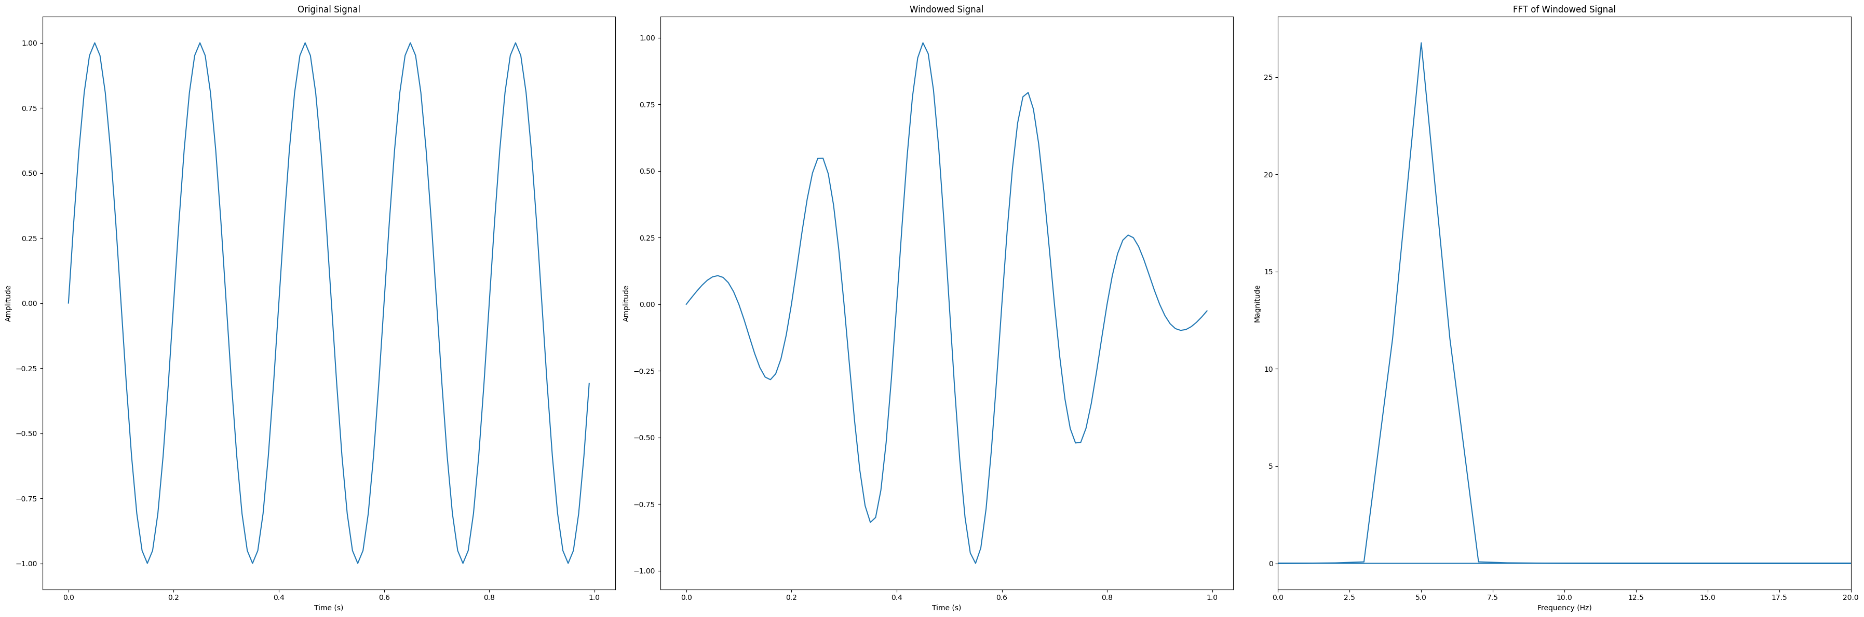
Scipy.signal
plt.figure(figsize=(36, 12))
plt.subplot(1, 3, 1)
plt.plot(t, x)
plt.title('Original Signal')
plt.xlabel('Time (s)')
plt.ylabel('Amplitude')
plt.subplot(1, 3, 2)
plt.plot(t, x_windowed)
plt.title('Windowed Signal')
plt.xlabel('Time (s)')
plt.ylabel('Amplitude')
plt.subplot(1, 3, 3)
plt.plot(freqs, np.abs(X))
plt.title('FFT of Windowed Signal')
plt.xlabel('Frequency (Hz)')
plt.ylabel('Magnitude')
plt.xlim(0, 20) # Limit x-axis for better visualization
plt.tight_layout()
plt.show()
# Statistics
data = np.random.normal(loc=0, scale=1, size=1000) # Generate random data
mean = np.mean(data)
std = np.std(data)
print("\nMean of the random data:", mean)
print("Standard deviation of the random data:", std)
# Statistical Tests
t_statistic, p_value = stats.ttest_1samp(data, 0) # One-sample t-test
print("\nOne-sample t-test t-statistic:", t_statistic)
print("One-sample t-test p-value:", p_value)

Slide 11
scipy.optimize
from scipy.optimize import minimize
import numpy as np
# Rosenbrock fonksiyonunun tanımı
def rosen(x):
return np.sum(100.0 * (x[1:] - x[:-1]**2.0)**2.0 + (1 - x[:-1])**2.0)
# Gradient (Jacobian) tanımı
def rosen_der(x):
xm = x[1:-1]
xm_m1 = x[:-2]
xm_p1 = x[2:]
grad = np.zeros_like(x)
grad[1:-1] = 200 * (xm - xm_m1**2) - 400 * (xm_p1 - xm**2) * xm - 2 * (1 - xm)
grad[0] = -400 * x[0] * (x[1] - x[0]**2) - 2 * (1 - x[0])
grad[-1] = 200 * (x[-1] - x[-2]**2)
return grad
# Başlangıç tahmini
x0 = [1.3, 0.7, 0.8, 1.9, 1.2]
# Minimize et
result = minimize(rosen, x0, method='BFGS', jac=rosen_der, options={'disp': True})
# Sonuçları yazdır
print("Optimal Çözüm:", result.x)
print("Minimum Değer:", result.fun)
Output:
Optimization terminated successfully.
Current function value: 0.000000
Iterations: 25
Function evaluations: 30
Gradient evaluations: 30
Optimal Çözüm: [1.00000004 1.0000001 1.00000021 1.00000044 1.00000092]
Minimum Değer: 4.0130879821599437e-13

Slide 12
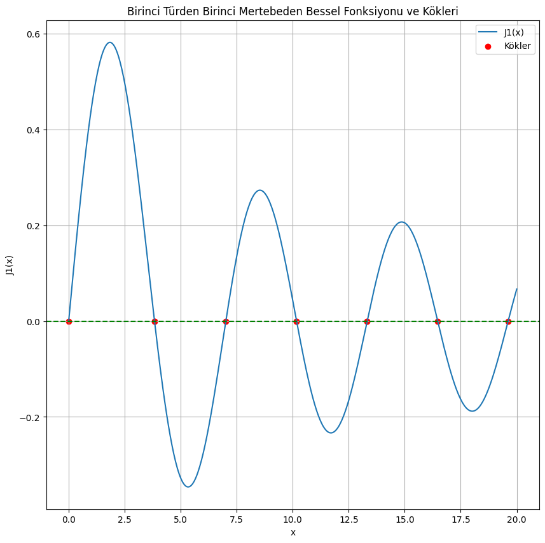
scipy.special
import numpy as np
from scipy.special import j1
from scipy.optimize import root
# Bessel fonksiyonunun köklerini bulmak için bir fonksiyon tanımla
def find_bessel_roots(func, x_guesses):
roots = []
for x_guess in x_guesses:
sol = root(func, x_guess)
if sol.success:
roots.append(sol.x[0]) # Kökü ekle
return np.array(roots)
# Birinci türden birinci mertebeden Bessel fonksiyonu J1(x)
def bessel_j1(x):
return j1(x)
# Başlangıç tahminlerini tanımla (yaklaşık kökler)
x_guesses = np.linspace(0.1, 20, 10) # 0.1'den 20'ye kadar yaklaşık tahminler
# Kökleri bul
roots = find_bessel_roots(bessel_j1, x_guesses)
# Sonuçları yazdır
print("Bessel J1(x) kökleri:")
print(roots)
# Köklerin bir grafiğini çiz
import matplotlib.pyplot as plt
x = np.linspace(0, 20, 500)
y = j1(x)
plt.figure(figsize=(10, 10))
plt.plot(x, y, label="J1(x)")
plt.axhline(0, color='green', linestyle='--')
plt.scatter(roots, [0]*len(roots), color='red', label="Kökler")
plt.title("Birinci Türden Birinci Mertebeden Bessel Fonksiyonu ve Kökleri")
plt.xlabel("x")
plt.ylabel("J1(x)")
plt.legend()
plt.grid()
plt.show()

Slide 13
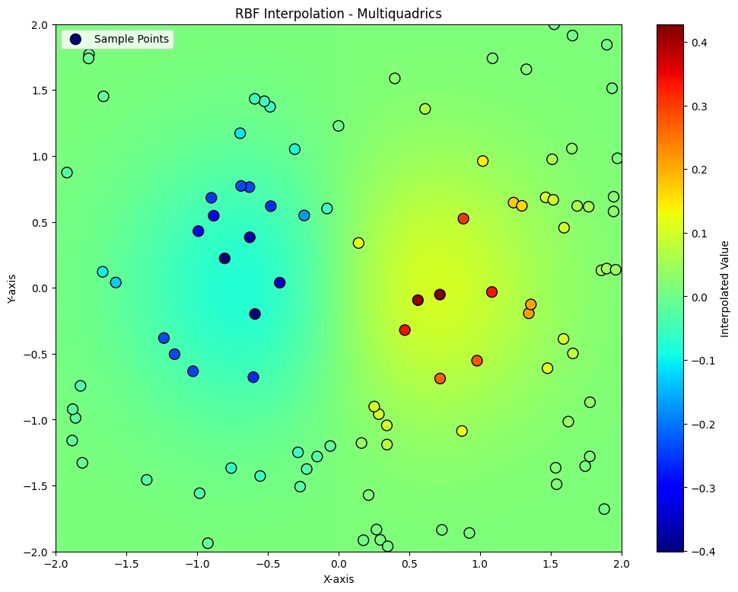
scipy.interpolate
import numpy as np
from scipy.interpolate import Rbf
import matplotlib.pyplot as plt
from matplotlib import cm, colors
# 2D tests - setup scattered data
x = np.random.rand(100) * 4.0 - 2.0
y = np.random.rand(100) * 4.0 - 2.0
z = x * np.exp(-x**2 - y**2)
# Define grid points for interpolation
ti = np.linspace(-2.0, 2.0, 100)
XI, YI = np.meshgrid(ti, ti)
# Use RBF for interpolation
rbf = Rbf(x, y, z, epsilon=2)
ZI = rbf(XI, YI)
# Normalize color values
norm = colors.Normalize(vmin=-2, vmax=2)
# Plot the result
plt.figure(figsize=(12, 9))
plt.pcolor(XI, YI, ZI, cmap=cm.jet, shading='auto', norm=norm)
plt.scatter(x, y, c=z, cmap=cm.jet, edgecolor='k', s=100, label="Sample Points")
plt.colorbar(label="Interpolated Value")
plt.title("RBF Interpolation - Multiquadrics")
plt.xlim(-2, 2)
plt.ylim(-2, 2)
plt.xlabel("X-axis")
plt.ylabel("Y-axis")
plt.legend()
plt.show()

Slide 14
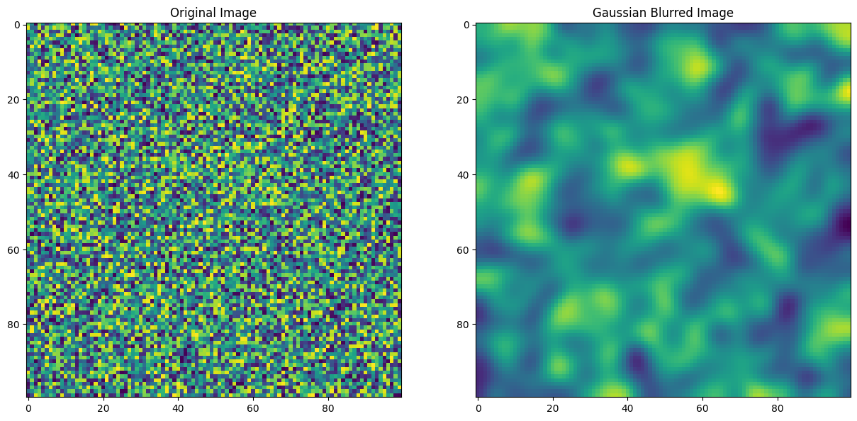
ndimage
from scipy import ndimage
import numpy as np
import matplotlib.pyplot as plt
image = np.random.random((100, 100))
blurred_image = ndimage.gaussian_filter(image, sigma=3)
plt.figure(figsize=(15, 15))
plt.subplot(1,2,1)
plt.imshow(image)
plt.title("Original Image")
plt.subplot(1,2,2)
plt.imshow(blurred_image)
plt.title("Gaussian Blurred Image")
plt.show()

Slide 15
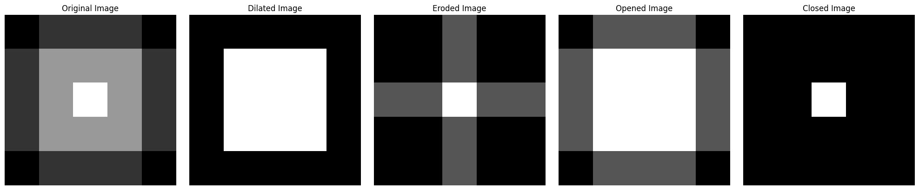
ndimage
import numpy as np
import matplotlib.pyplot as plt
from scipy.ndimage import grey_dilation, grey_erosion
# Create a sample 2D grey-scale image (5x5 matrix)
image = np.array([
[10, 20, 20, 20, 10],
[20, 40, 40, 40, 20],
[20, 40, 60, 40, 20],
[20, 40, 40, 40, 20],
[10, 20, 20, 20, 10]
])
# Define a structuring element (3x3 square)
structure = np.ones((3, 3))
# Apply grey dilation
dilated_image = grey_dilation(image, size=(3, 3), footprint=structure)
# Apply grey erosion
eroded_image = grey_erosion(image, size=(3, 3), footprint=structure)
# Apply opening (erosion followed by dilation)
opened_image = grey_dilation(grey_erosion(image, size=(3, 3), footprint=structure), size=(3, 3), footprint=structure)
# Apply closing (dilation followed by erosion)
closed_image = grey_erosion(grey_dilation(image, size=(3, 3), footprint=structure), size=(3, 3), footprint=structure)
# Plot the original and processed images
fig, axes = plt.subplots(1, 5, figsize=(20, 4))
axes[0].imshow(image, cmap='gray')
axes[0].set_title("Original Image")
axes[0].axis('off')
axes[1].imshow(dilated_image, cmap='gray')
axes[1].set_title("Dilated Image")
axes[1].axis('off')
axes[2].imshow(eroded_image, cmap='gray')
axes[2].set_title("Eroded Image")
axes[2].axis('off')
axes[3].imshow(opened_image, cmap='gray')
axes[3].set_title("Opened Image")
axes[3].axis('off')
axes[4].imshow(closed_image, cmap='gray')
axes[4].set_title("Closed Image")
axes[4].axis('off')
plt.tight_layout()
plt.show()

Slide 16
İ0
from scipy.io import savemat ,loadmat
# Kaydedilecek veri
data = {
"array": [1, 2, 3, 4, 5],
"matrix": [[1, 2], [3, 4]],
"scalar": 42
}
# Veriyi .mat dosyasına kaydet
savemat("example.mat", data)
print("Data saved to 'example.mat'")
# .mat dosyasını oku
loaded_data = loadmat("example.mat")
# MATLAB'ın özel anahtarlarını filtrele (örneğin '__header__')
filtered_data = {k: v for k, v in loaded_data.items() if not k.startswith("__")}
# Veriyi ekrana yazdır
print("Loaded Data:", filtered_data)
Output:
Data saved to 'example.mat'
Loaded Data: {'array': array([[1, 2, 3, 4, 5]]), 'matrix': array([[1, 2],
[3, 4]]), 'scalar': array([[42]])}

Slide 17
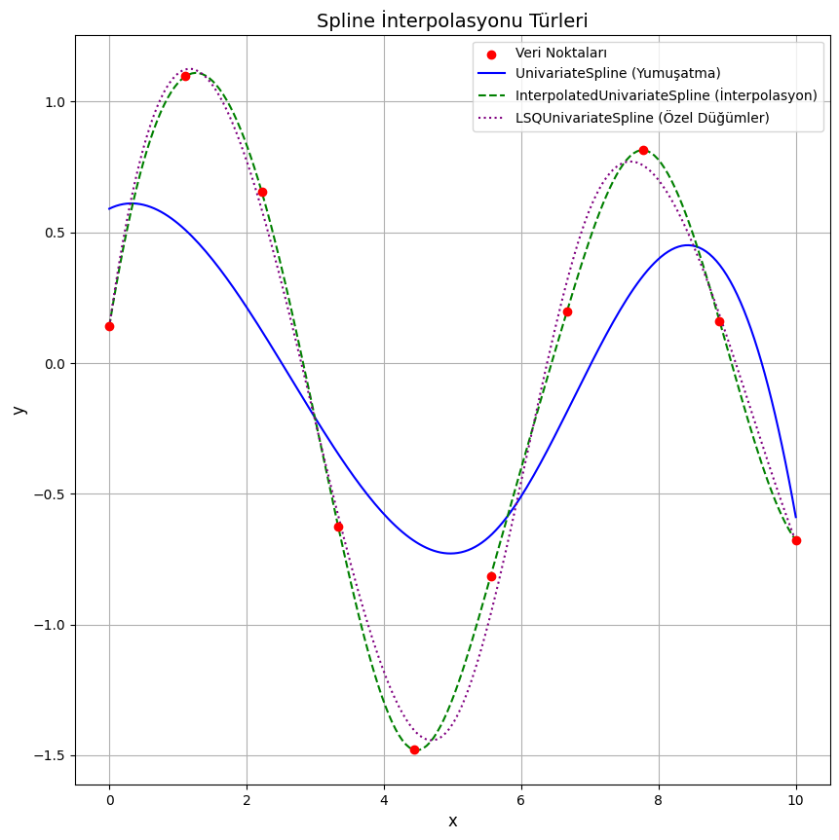
interpolate
import numpy as np
import matplotlib.pyplot as plt
from scipy.interpolate import UnivariateSpline, InterpolatedUnivariateSpline, LSQUnivariateSpline
# Veri oluşturma
x = np.linspace(0, 10, 10)
y = np.sin(x) + 0.3 * np.random.randn(10) # Gürültülü sinüs verisi
# 1. UnivariateSpline: Yumuşatma Spline
spline_smooth = UnivariateSpline(x, y, s=2) # Düzgünlük parametresi
x_new = np.linspace(0, 10, 200)
y_smooth = spline_smooth(x_new)
# 2. InterpolatedUnivariateSpline: Tüm noktalardan geçen spline
spline_interp = InterpolatedUnivariateSpline(x, y)
y_interp = spline_interp(x_new)
# 3. LSQUnivariateSpline: Özel düğümlerle spline
knots = [2, 5, 7] # Düğümler
spline_lsq = LSQUnivariateSpline(x, y, t=knots)
y_lsq = spline_lsq(x_new)
# Grafik
plt.figure(figsize=(10, 10))
plt.scatter(x, y, label="Veri Noktaları", color="red", zorder=5)
plt.plot(x_new, y_smooth, label="UnivariateSpline (Yumuşatma)", color="blue")
plt.plot(x_new, y_interp, label="InterpolatedUnivariateSpline (İnterpolasyon)", color="green", linestyle="--")
plt.plot(x_new, y_lsq, label="LSQUnivariateSpline (Özel Düğümler)", color="purple", linestyle=":")
# Grafik özellikleri
plt.title("Spline İnterpolasyonu Türleri", fontsize=14)
plt.xlabel("x", fontsize=12)
plt.ylabel("y", fontsize=12)
plt.legend()
plt.grid(True)
plt.show()

Slide 18
THANK YOU FOR LISTEN TO ME

