Slide 1

Retentive Networks
Edward Gunn
DARe, EME
Sun, Y., “Retentive Network: A Successor to Transformer for Large Language Models”, <i>arXiv e-prints</i>, 2023. doi:10.48550/arXiv.2307.08621.

Slide 2
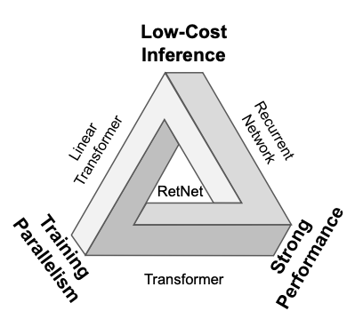
Notes:
low-cost inference,
efficient long sequence modelling
Transformer-comparable performance
parallel model training simultaneously
Three computation paradigms
Parallel allowing efficient training
Recurrent allowing efficient O(1) inference, reducing latency and
Chunkwise recurrent allows efficient long sequence modelling

Slide 3
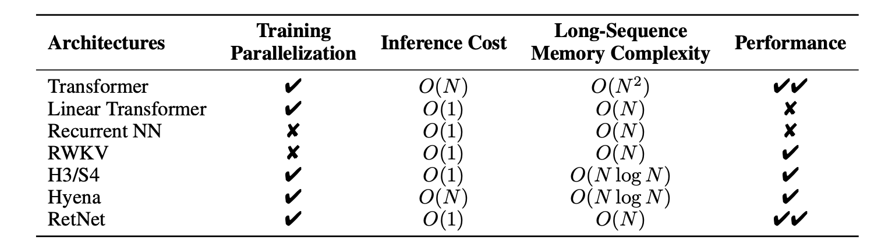

Slide 4






Retention
$$s_{n}=As_{n−1}+K_{n}^{⊤}v_{n}$$
$$Q=XW_{Q}$$
$$o_{n}=Q_{n}s_{n}$$
$$K=XW_{K}$$
$=\sum_{m=1}^{n}{Q_{n}}A^{n−m}K_{m}^{⊤}v_{m}$
$A=Λ\text{diag}\left(γ⊙e^{iθ}\right)Λ^{−1}$
$=\sum_{m=1}^{n}{Q_{n}Λ}{\text{diag}\left(γ⊙e^{iθ}\right)}^{n−m}Λ^{−1}K_{m}^{⊤}v_{m}$
$A^{n−m}=Λ{{\text{diag}\left(γ⊙e^{iθ}\right)}^{n−m}Λ}^{−1}$
$=\sum_{m=1}^{n}{Q_{n}}{\text{diag}\left(γ⊙e^{iθ}\right)}^{n−m}K_{m}^{⊤}v_{m}$
$=\sum_{m=1}^{n}{Q_{n}\text{diag}{\left(γ⊙e^{iθ}\right)}^{n}\text{diag}{\left(γ⊙e^{iθ}\right)}^{−m}}K_{m}^{⊤}v_{m}$
$=\sum_{m=1}^{n}{Q_{n}\text{diag}{\left(γ⊙e^{iθ}\right)}^{n}{\left(K_{m}\text{diag}{\left(γ⊙e^{iθ}\right)}^{−m}\right)}^{⊤}}v_{m}$
$o_{n}=\sum_{m=1}^{n}{γ^{n−m}\left(Q_{n}\text{diag}\left(e^{inθ}\right)\right){\left(K_{m}\text{diag}\left(e^{imθ}\right)\right)}^{†}v_{m}}$
Notes:
1. Formulate as recursive problem
2. Diagonalise A matrix
3. Sub in
4. Absorb Lambda into Qn and Km
5. Split eigenvalues
6. Put it in transpose
7. Assume gamma is scalar
This can be easily parallelised
Gamma and theta are vectors
Vm is input vector, linear transform of X

Slide 5
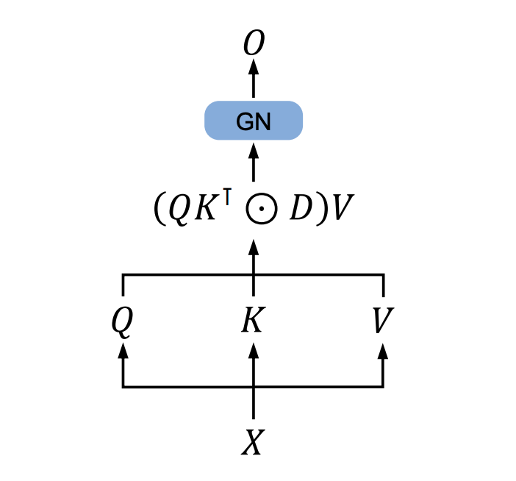

Parallel Representation
$Q=\left(XW_{Q}\right)⊙ Θ$
$K=\left(XW_{K}\right)⊙\overline{Θ}$
$V=XW_{V}$
$Θ_{n}=e^{inθ}$
$D_{nm}= \left\{\begin{aligned}γ^{n−m}, n≥m \\ 0, n<m\end{aligned}\right.$
$Retention\left(X\right)=\left(QK^{⊤}⊙D\right)V$
GN is GroupNorm
Notes:
Used during training

Slide 6
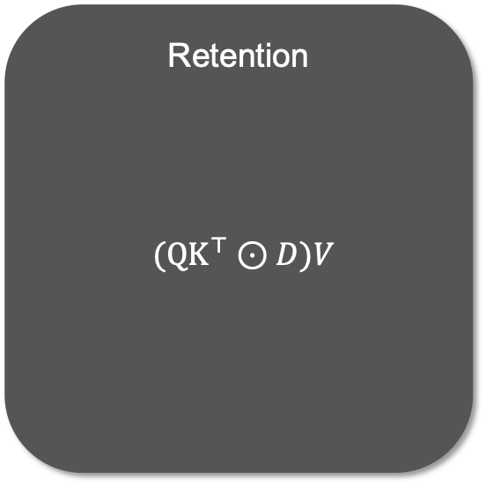
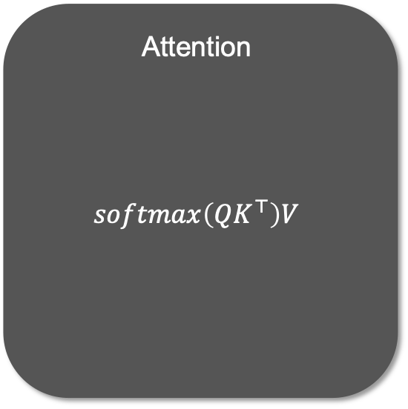
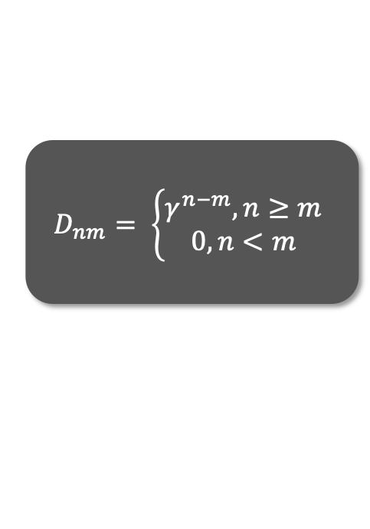
$$D_{nm}= \left\{\begin{aligned}γ^{n−m}, n≥m \\ 0, n<m\end{aligned}\right.$$
Comparison to attention
Attention
$$softmax\left(QK^{⊤}\right)V$$
Retention
$({QK}^{⊤}⊙D)V$

Slide 7
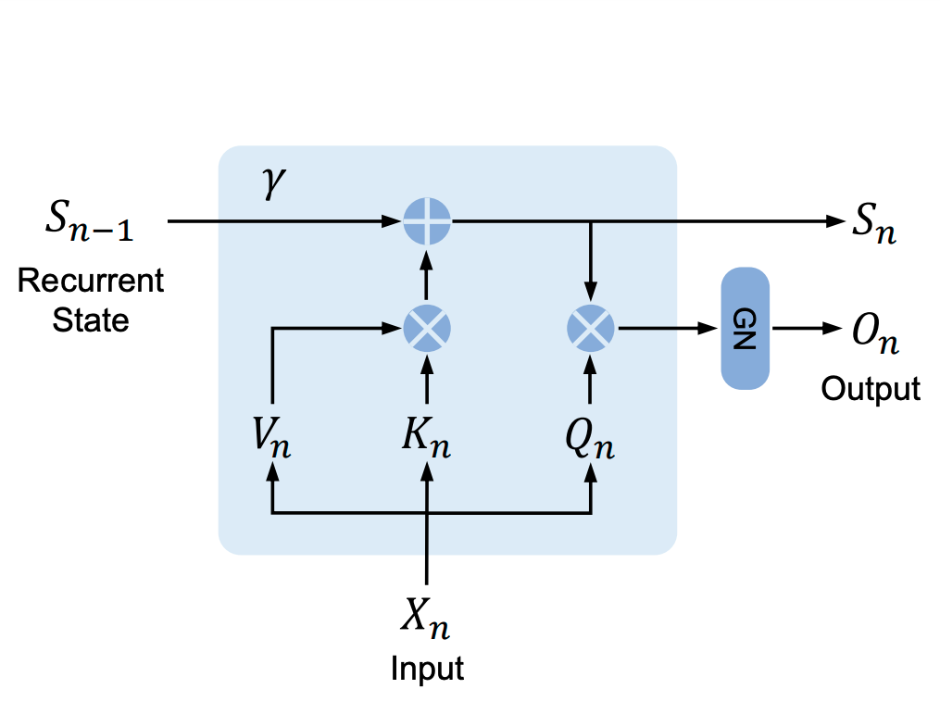

Recurrent Representation
$S_{n}=γS_{n−1}+K_{n}^{⊤}V_{n}$
$Retention\left(X_{n}\right)=Q_{n}S_{n}$
GN is GroupNorm
Notes:
Used during inference

Slide 8
Chunkwise Recurrent Representation
Chunk
Chunk
Chunk
Chunk
Chunk
Notes:
One chunk at at time
Used for training
Good for long sequences
Efficient for compute and memory
parallelly encode each local block for computation speed while recurrently encoding the global blocks to save GPU memory

Slide 9
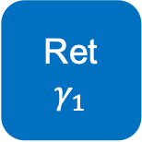
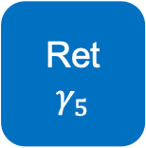

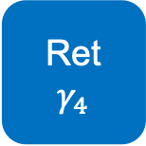
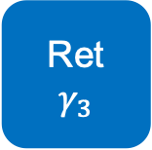
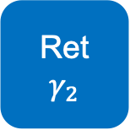
MSR
Gated Multi-scale Retention
GN
Concat
Ret
$$γ_{1}$$
Ret
$$γ_{2}$$
Ret
$$γ_{3}$$
Ret
$$γ_{4}$$
Ret
$$γ_{5}$$
Swish
$γ_{i}=1−2^{−5−i}$
$head_{i}=Retention\left(X, γ_{i}\right)$
$Y=GroupNorm(Concat\left(head_{1}, …, head_{h}\right))$
$MSR(X) = \left(swish\left(XW_{G}\right)⊙Y\right)W_{O}$

Slide 10

RetNet
FFN
$Y_{l}=MSR\left(LN\left(X^{l}\right)\right)+X^{l}$
$X^{l+1}=FFN\left(LN\left(Y^{l}\right)\right)+Y^{l}$
LN is LayerNorm
MSR
Notes:
Stack these layers for full model

Slide 11
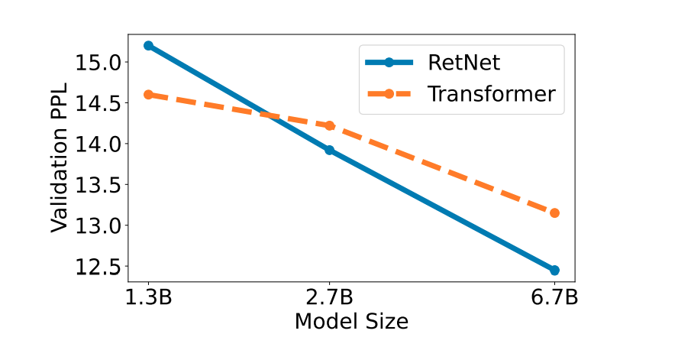
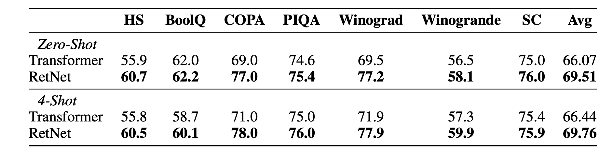
Performance
Notes:
RetNet overtakes transformers at 2B parameters
Table shows accuracy
Shows comparable performance with transformers

Slide 12
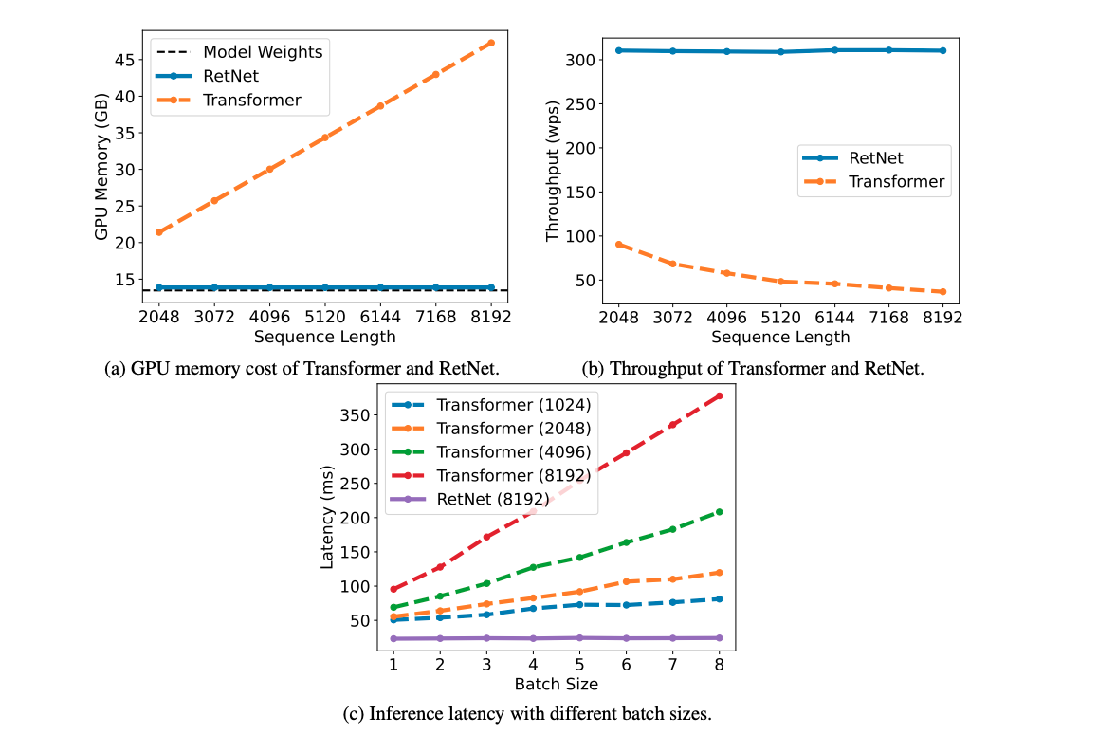
Inference Cost
Notes:
RetNet only uses negligible additional memory
Model weights occupy 97% of memory

Slide 13
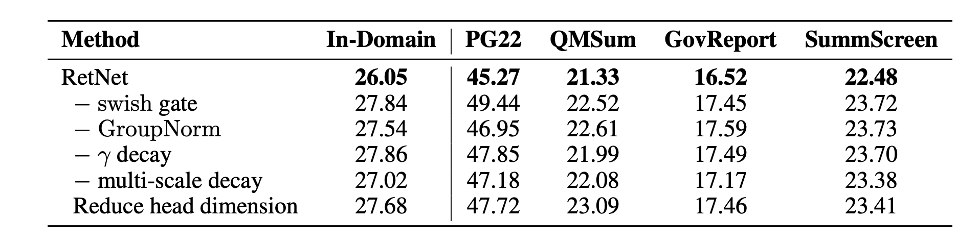
Ablations
Notes:
- gamma decay is gamma=1
- multi-scale decay is setting gamma the same for all heads

Slide 14
Questions?

