Slide 1
Alexander-Sadiku
Fundamentals of Electric Circuits
Chapter 4
Circuit Theorems

Slide 2
There is a quiz at the end of our todays discussion

Slide 3
Circuit Theorems - Chapter 4
4.1 Motivation
4.2 Linearity Property
4.3 Superposition
4.4 Source Transformation
4.5 Thevenin’s Theorem
4.6 Norton’s Theorem
4.7 Maximum Power Transfer

Slide 4
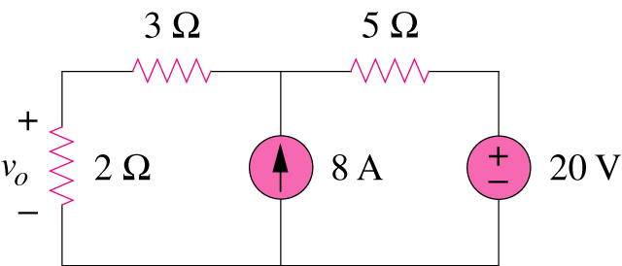
If you are given the following circuit, are there any other alternative(s) to determine the voltage across 2Ω resistor?
4.1 Motivation (1)
What are they? And how?
Can you work it out by inspection?

Slide 5
4.2 Linearity Property (1)
It is the property of an element describing a linear relationship between cause and effect.
A linear circuit is one whose output is linearly related (or directly proportional) to its input.
Homogeneity (scaling) property
v = i R → k v = k i R
Additive property
v₁ = i₁ R and v₂ = i₂ R
→ v = (i₁ + i₂) R = v₁ + v₂

Slide 6
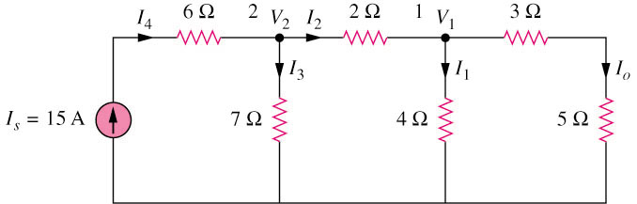
4.2 Linearity Property (2)
Example 1
By assume I_{o} = 1 A, use linearity to find the actual value of Io in the circuit shown below.
*Refer to in-class illustration, text book, answer I_{o} = 3A

Slide 7
4.3 Superposition Theorem (1)
It states that the voltage across (or current through) an element in a linear circuit is the algebraic sum of the voltage across (or currents through) that element due to EACH independent source acting alone.
The principle of superposition helps us to analyze a linear circuit with more than one independent source by calculating the contribution of each independent source separately.

Slide 8
4.3 Superposition Theorem (2)
We consider the effects of 8A and 20V one by one, then add the two effects together for final v_{o}.

Slide 9
4.3 Superposition Theorem (3)
Steps to apply superposition principle
Turn off all independent sources except one source. Find the output (voltage or current) due to that active source using nodal or mesh analysis.
Repeat step 1 for each of the other independent sources.
Find the total contribution by adding algebraically all the contributions due to the independent sources.

Slide 10
4.3 Superposition Theorem (4)
Two things have to be keep in mind:
When we say turn off all other independent sources:
  Independent voltage sources are replaced by 0 V (short circuit) and
  Independent current sources are replaced by 0 A (open circuit).
Dependent sources are left intact because they are controlled by circuit variables.

Slide 11
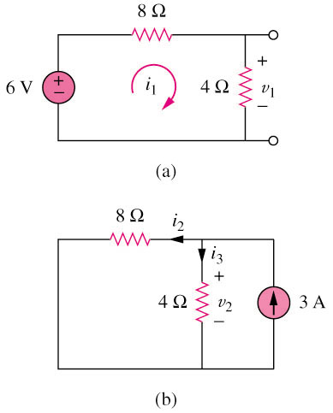
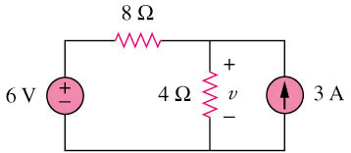
4.3 Superposition Theorem (5)
Example 2
Use the superposition theorem to find v in the circuit shown below.
3A is discarded by open-circuit
6V is discarded by short-circuit
*Refer to in-class illustration, text book, answer v = 10V

Slide 12
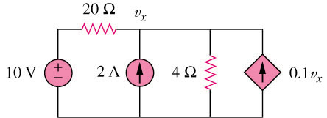
4.3 Superposition Theorem (6)
Example 3
Use superposition to find v_{x} in the circuit below.
2A is discarded by open-circuit
10V is discarded by open-circuit
Dependant source keep unchanged
20 Ω
v₁
20 Ω
v₂
+
−
10 V
4 Ω
0.1v₁
2 A
4 Ω
0.1v₂
(a)
(b)
*Refer to in-class illustration, text book, answer Vx = 12.5V

Slide 13
4.4 Source Transformation (1)
An equivalent circuit is one whose v-i characteristics are identical with the original circuit.
It is the process of replacing a voltage source v_{S} in series with a resistor R by a current source i_{S} in parallel with a resistor R, or vice versa.

Slide 14
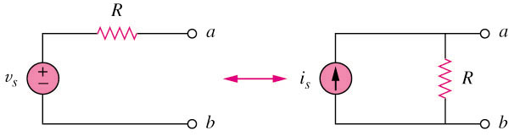
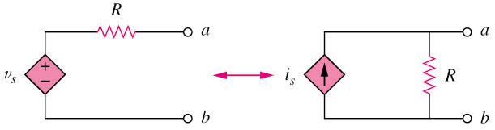
4.4 Source Transformation (2)
+
+
The arrow of the current source is directed toward the positive terminal of the voltage source.
The source transformation is not possible when R = 0 for voltage source and R = ∞ for current source.
-
-
(a) Independent source transform
+
+
-
-
(b) Dependent source transform

Slide 15
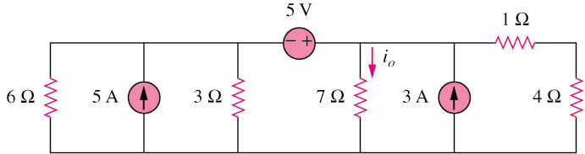
4.4 Source Transformation (3)
Example 4
Find i_{o} in the circuit shown below using source transformation.
*Refer to in-class illustration, textbook, answer i_{o} = 1.78A

Slide 16

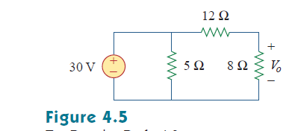
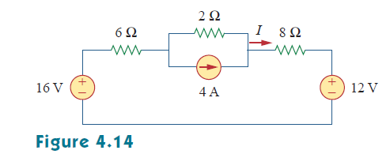
Quiz

Slide 17
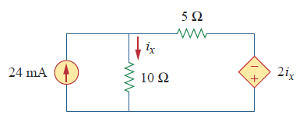
Quiz

Slide 18
There is a quiz at the end of our todays discussion

Slide 19
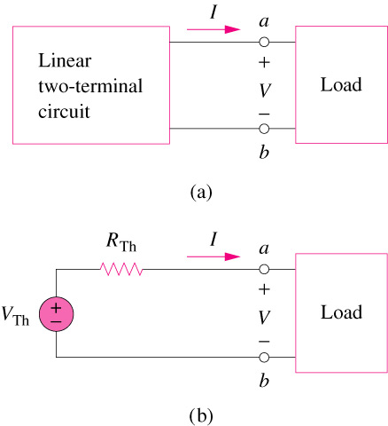
4.5 Thevenin’s Theorem (1)
It states that a linear two-terminal circuit (Fig. a) can be replaced by an equivalent circuit (Fig. b) consisting of a voltage source V_{TH} in series with a resistor R_{TH},
where
VTH is the open-circuit voltage at the terminals.
RTH is the input or equivalent resistance at the terminals when the independent sources are turned off.

Slide 20
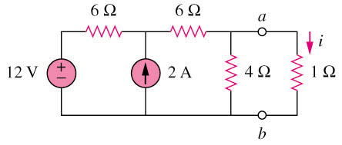
4.5 Thevenin’s Theorem (2)
Example 5
Using Thevenin’s theorem, find the equivalent circuit to the left of the terminals in the circuit shown below. Hence find i.
6 Ω
6 Ω
4 Ω
R_{Th}
(a)
6 Ω
+
V_{Th}
−
2A
6 Ω
2A
4 Ω
(b)
*Refer to in-class illustration, textbook, answer V_{TH} = 6V, R_{TH} = 3Ω, i = 1.5A

Slide 21
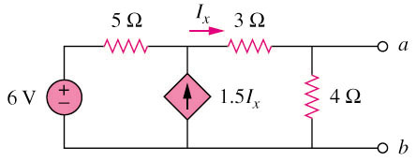
4.5 Thevenin’s Theorem (3)
5 Ω
I_{x}
3 Ω
a
Example 6
Find the Thevenin equivalent circuit of the circuit shown below to the left of the terminals.
+
−
+
V_{Th}
−
i₂
6 V
i₁
4 Ω
1.5I_{x}
i₁
i₂
o
b
(a)
0.5I_{x}
3 Ω
I_{x}
i
a
+
−
5 Ω
1.5I_{x}
4 Ω
1 V
(b)
b
*Refer to in-class illustration, textbook, answer V_{TH} = 5.33V, R_{TH} = 3Ω

Slide 22
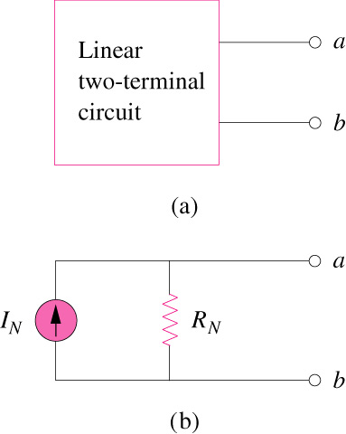
4.6 Norton’s Theorem (1)
It states that a linear two-terminal circuit can be replaced by an equivalent circuit of a current source I_{N} in parallel with a resistor R_{N},
Where
I_{N} is the short circuit current through
the terminals.
R_{N} is the input or equivalent resistance
at the terminals when the independent
sources are turned off.
The Thevenin’s and Norton equivalent circuits are related by a source transformation.

Slide 23
4.6 Norton’s Theorem (1)
Example 5
Using Norton’s theorem, find the equivalent circuit to the left of the terminals in the circuit shown below. Hence find i.
6 Ω
6 Ω
4 Ω
R_{Th}
(a)
6 Ω
+
V_{Th}
−
2A
6 Ω
2A
4 Ω
(b)
*Refer to in-class illustration, textbook, answer I_{N} = 2A, R_{TH} = 3Ω, i = 1.5A

Slide 24
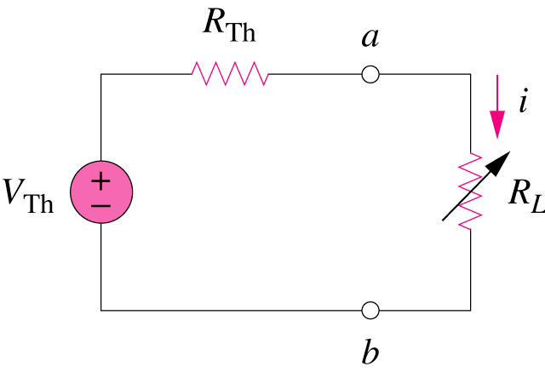
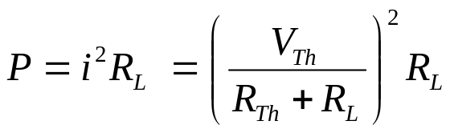
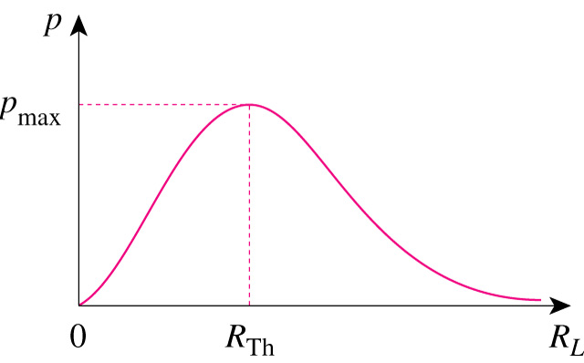
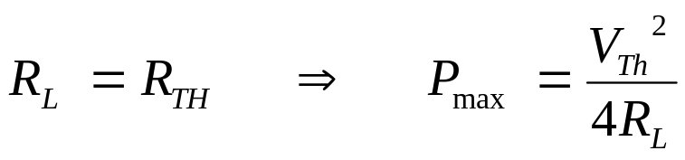
4.7 Maximum Power Transfer (1)
If the entire circuit is replaced by its Thevenin equivalent except for the load, the power delivered to the load is:
For maximum power dissipated in R_{L}, P_{max}, for a given R_{TH},
and V_{TH},
The power transfer profile with different R_{L}

Slide 25
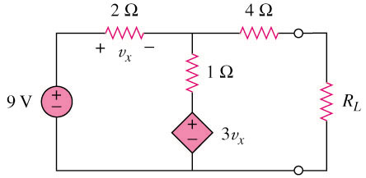
4.7 Maximum Power Transfer (2)
Example 8
Determine the value of R_{L} that will draw the maximum power from
the rest of the circuit shown below. Calculate the maximum power.
v_{x}
4 Ω
v_{x}
4 Ω
+ −
v₀
+ −
Fig. a
=> To determine R_{TH}
Fig. b
=> To determine V_{TH}
2 Ω
i
2 Ω
1 Ω
+
−
+
−
1 Ω
+
V_{Th}
−
1 V
9 V
i_{o}
+
−
+
−
3v_{x}
3v_{x}
(a)
(b)
*Refer to in-class illustration, textbook, R_{L} = 4.22Ω, P_{m} = 2.901W

Slide 26
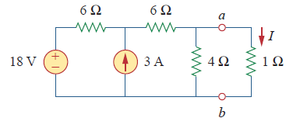
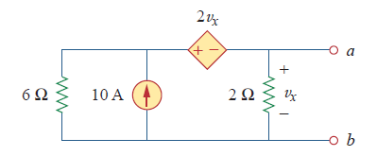
Quiz
Using Thevenin’s theorem, find the equivalent circuit to the left of the terminals in the circuit shown in the right. Then find I.
Find the Norton equivalent circuit of the circuit in in the right at terminals a-b.

