Slide 1
ComparePro
By: Clayton Burgess

Slide 2


Introduction
Web application that lets users compare computer components between different websites
Social media app like feeling that lets users like and comment on items
Developed to eliminate having multiple windows open at once
Eliminates use of using an excel document to allow users to do their research all through adding the comments

Slide 3
Background
Started various personal websites
Used Python to implement projects since high school
Done other relevant school projects using SQL and developing websites

Slide 4
MVP
Account creation and authentication
Working API
Comment boxes for users to comment on a product
Basic product information button click to see product information
Algorithm that recommends products to user based of what they previously viewed

Slide 5
V1.0
Like button functionality
Expand comment implementation to allow fields
Add comment functionality to allow users to compare different products
Better fitting recommendations logic

Slide 6
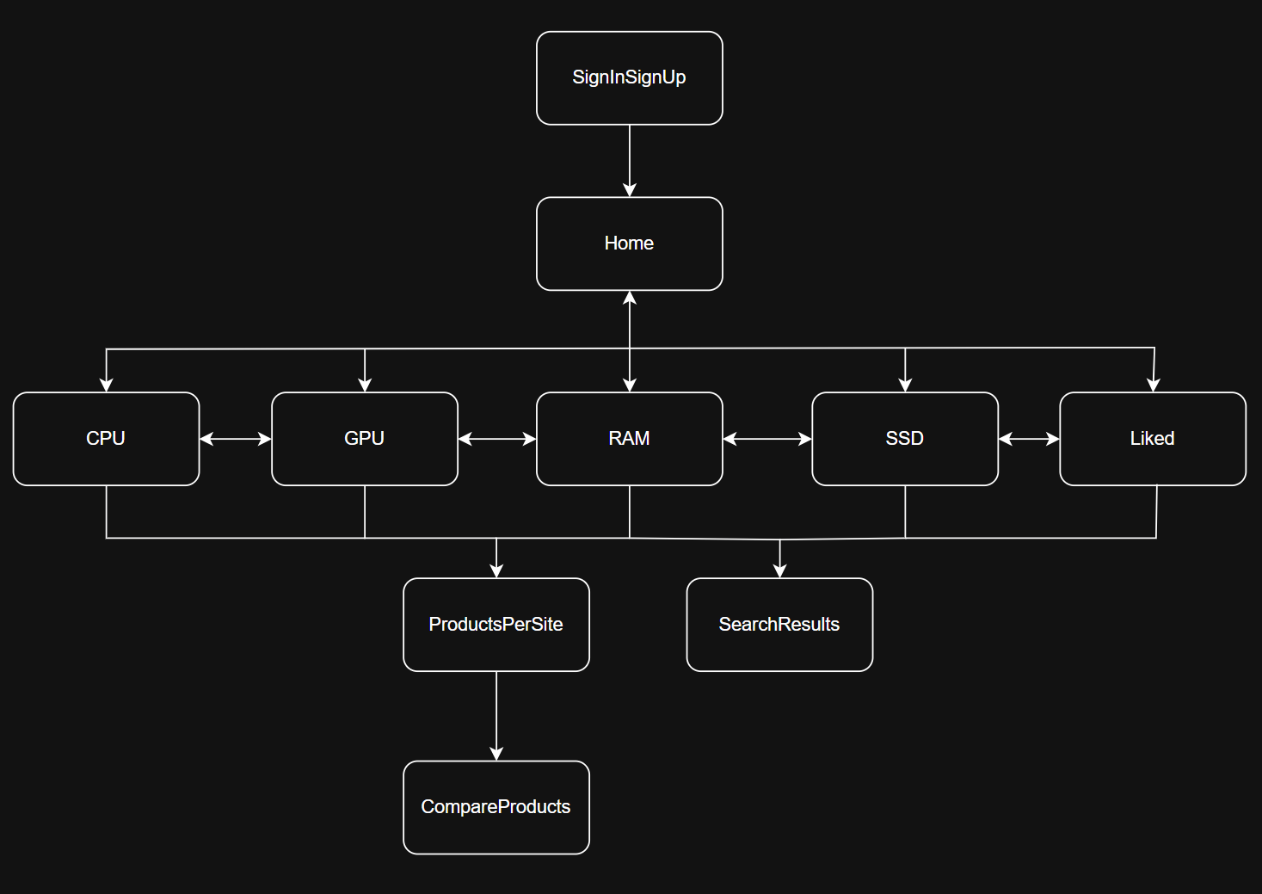
Pages

Slide 7
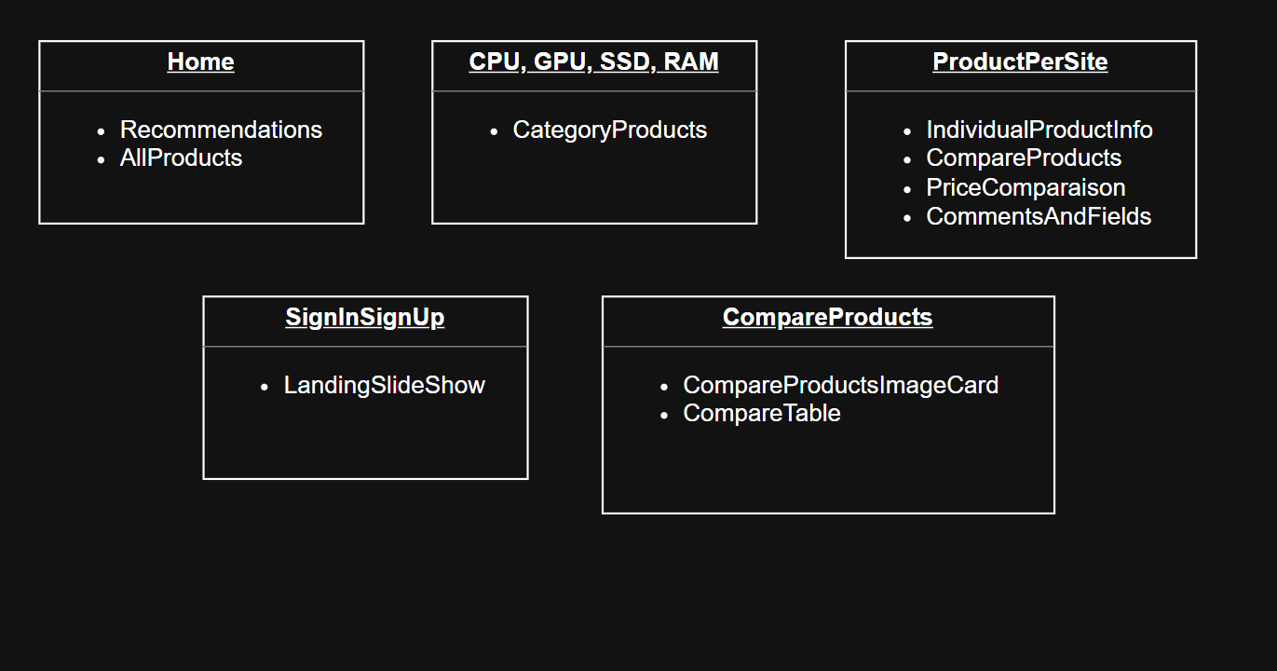
Components
All pages have a LikeButton component
All pages share a NavBar Component

Slide 8
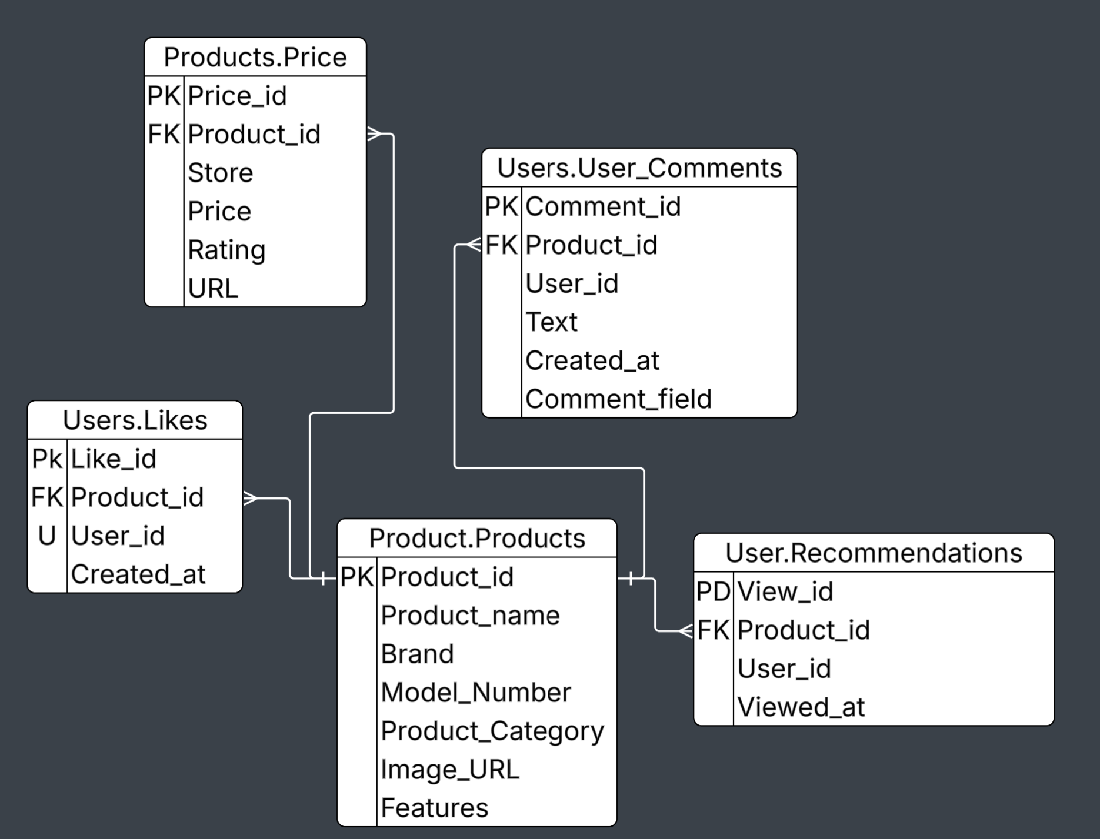
SQL Diagram

Slide 9
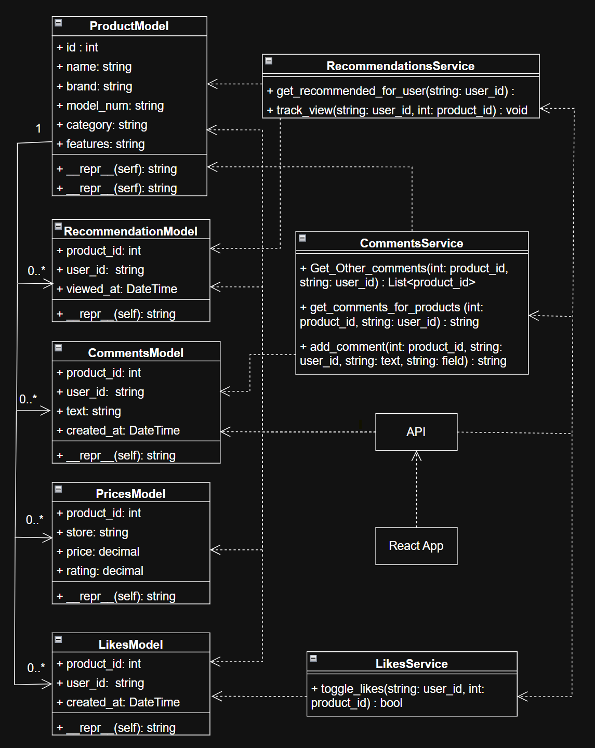
UML

Slide 10
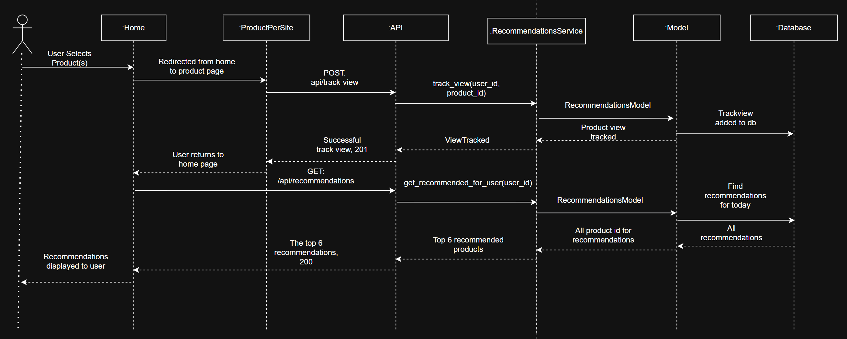
Sequence Diagram: View Product Changed Recommendations

Slide 11
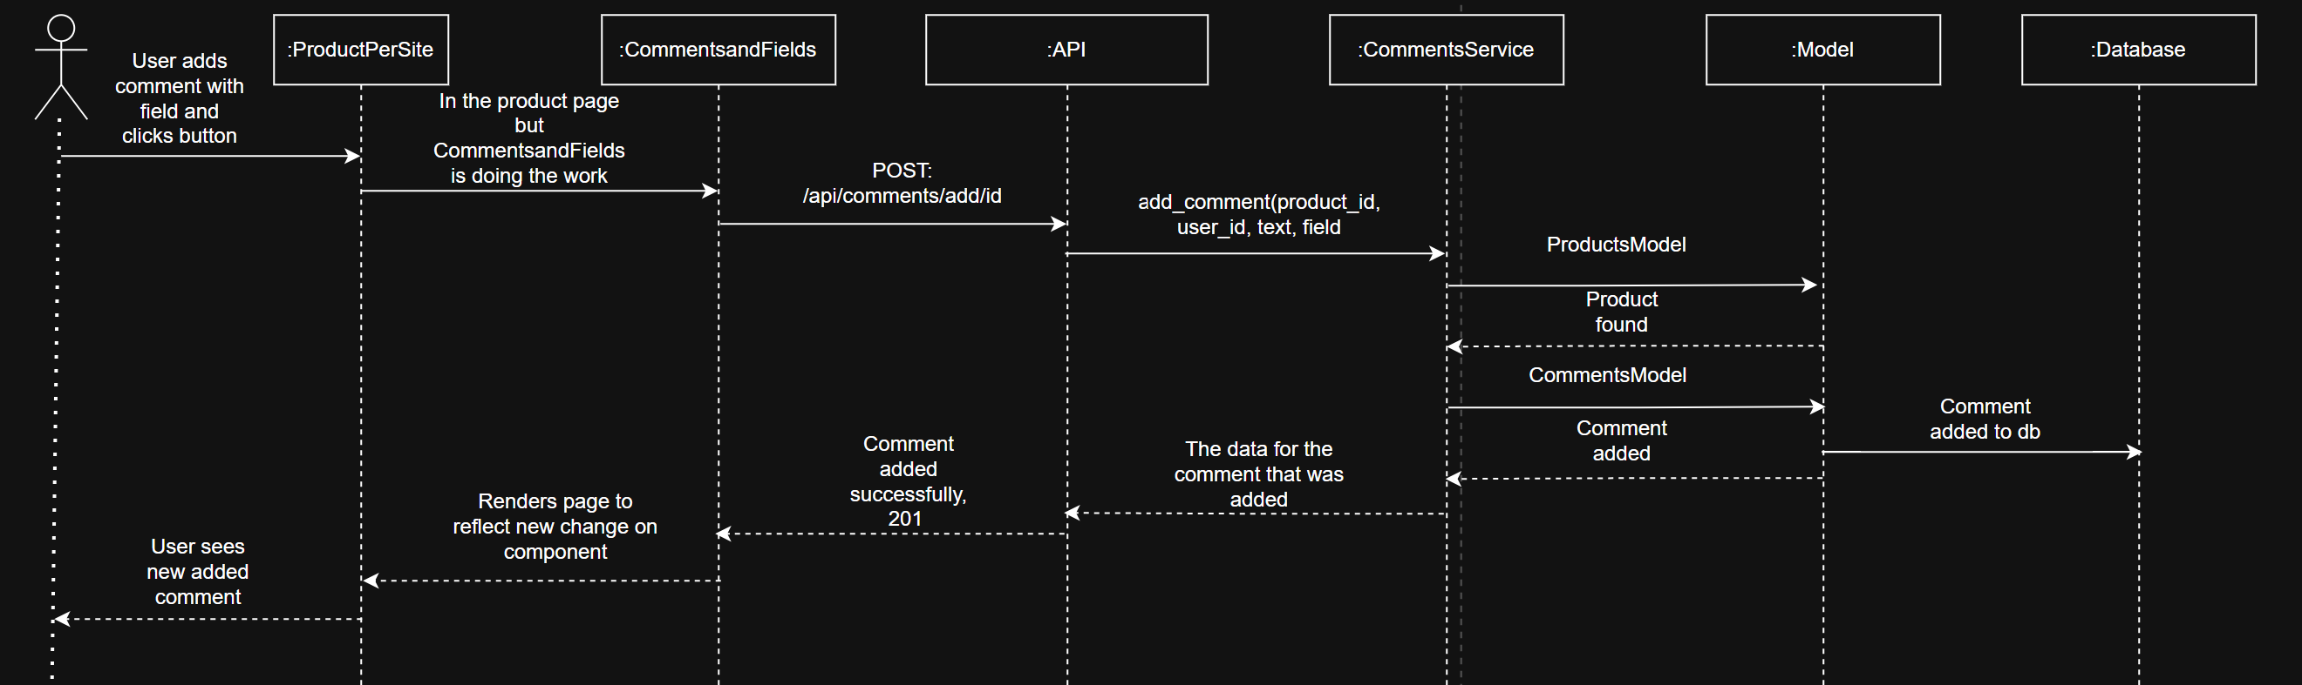
Sequence Diagram: Adding a Comment to Product

Slide 12
Project Implementation
Tech Stack:
Backend: Python with Flask API
Frontend: react JavaScript
Data storage: SQL Sever Management Studio(SSMS)
Follows a layered architecture

Slide 13
Testing
Edge cases - using pytests
Integration - using pytests
Postman – ensure data transfers between SQL and backend
End-to-end – ensure communication between all frameworks returns correct data throughout the whole app.
Usability – Sent out to friends to try and give feed back

Slide 14
DEMO

Slide 15
Future Work
Price updates to reflect the price in the websites
Add other sites that have these computer components
A cart that separates items from different websites that users want to buy
Create different categories of items to compare other than computer parts
Add ability to have user edit or delete a comment

Slide 16
Conclusion
ComparePro is a full stack web application
Uses a layered architecture with React, Python, and SSMS
Improves researching computer components across multiple websites

Slide 17
Questions?

