Slide 1

ComparePro
By: Clayton Burgess
Advisor: Julie Thornton

Slide 2

Overview
Eliminate having two or more windows open trying to find the best deals on computer parts.
Create a web app that allows users to search for just one product then be able to compare that product against different websites. Eliminate the use of using excel documents to compare items in the same realm. Create a comment-based system that allows the user to do just that.
A phone app like feel that allows users to like products they have an interest in to keep researching
A built-in recommendations that changes the order of the items and the item type based off what they have been looking at.

Slide 3



Frameworks
Python
Backend/scraping/API
Data Storage
SSMS
React
Frontend
This Photo by Unknown Author is licensed under CC BY-SA-NC
This Photo by Unknown Author is licensed under CC BY-NC

Slide 4

Use Case 1
Allow users to compare products between sites
User finds an item they are interested in and decided to check the prices between the sites.
Product button click
Sends request through other frameworks to get the correct data.
After the other data is retrieved it will refresh the UI and all instances of that product will be displayed side by side.

Slide 5
Use case 2
Allow users to search for items if they already have something in mind
User already knows what they want or has an idea of what they want so they search for it and click search
Edit text in search bar and click search
Request go through other frame works to get the products that fit the search criteria.
After the other data is retrieved it will refresh the UI and all instances of that search will be displayed on the screen.

Slide 6
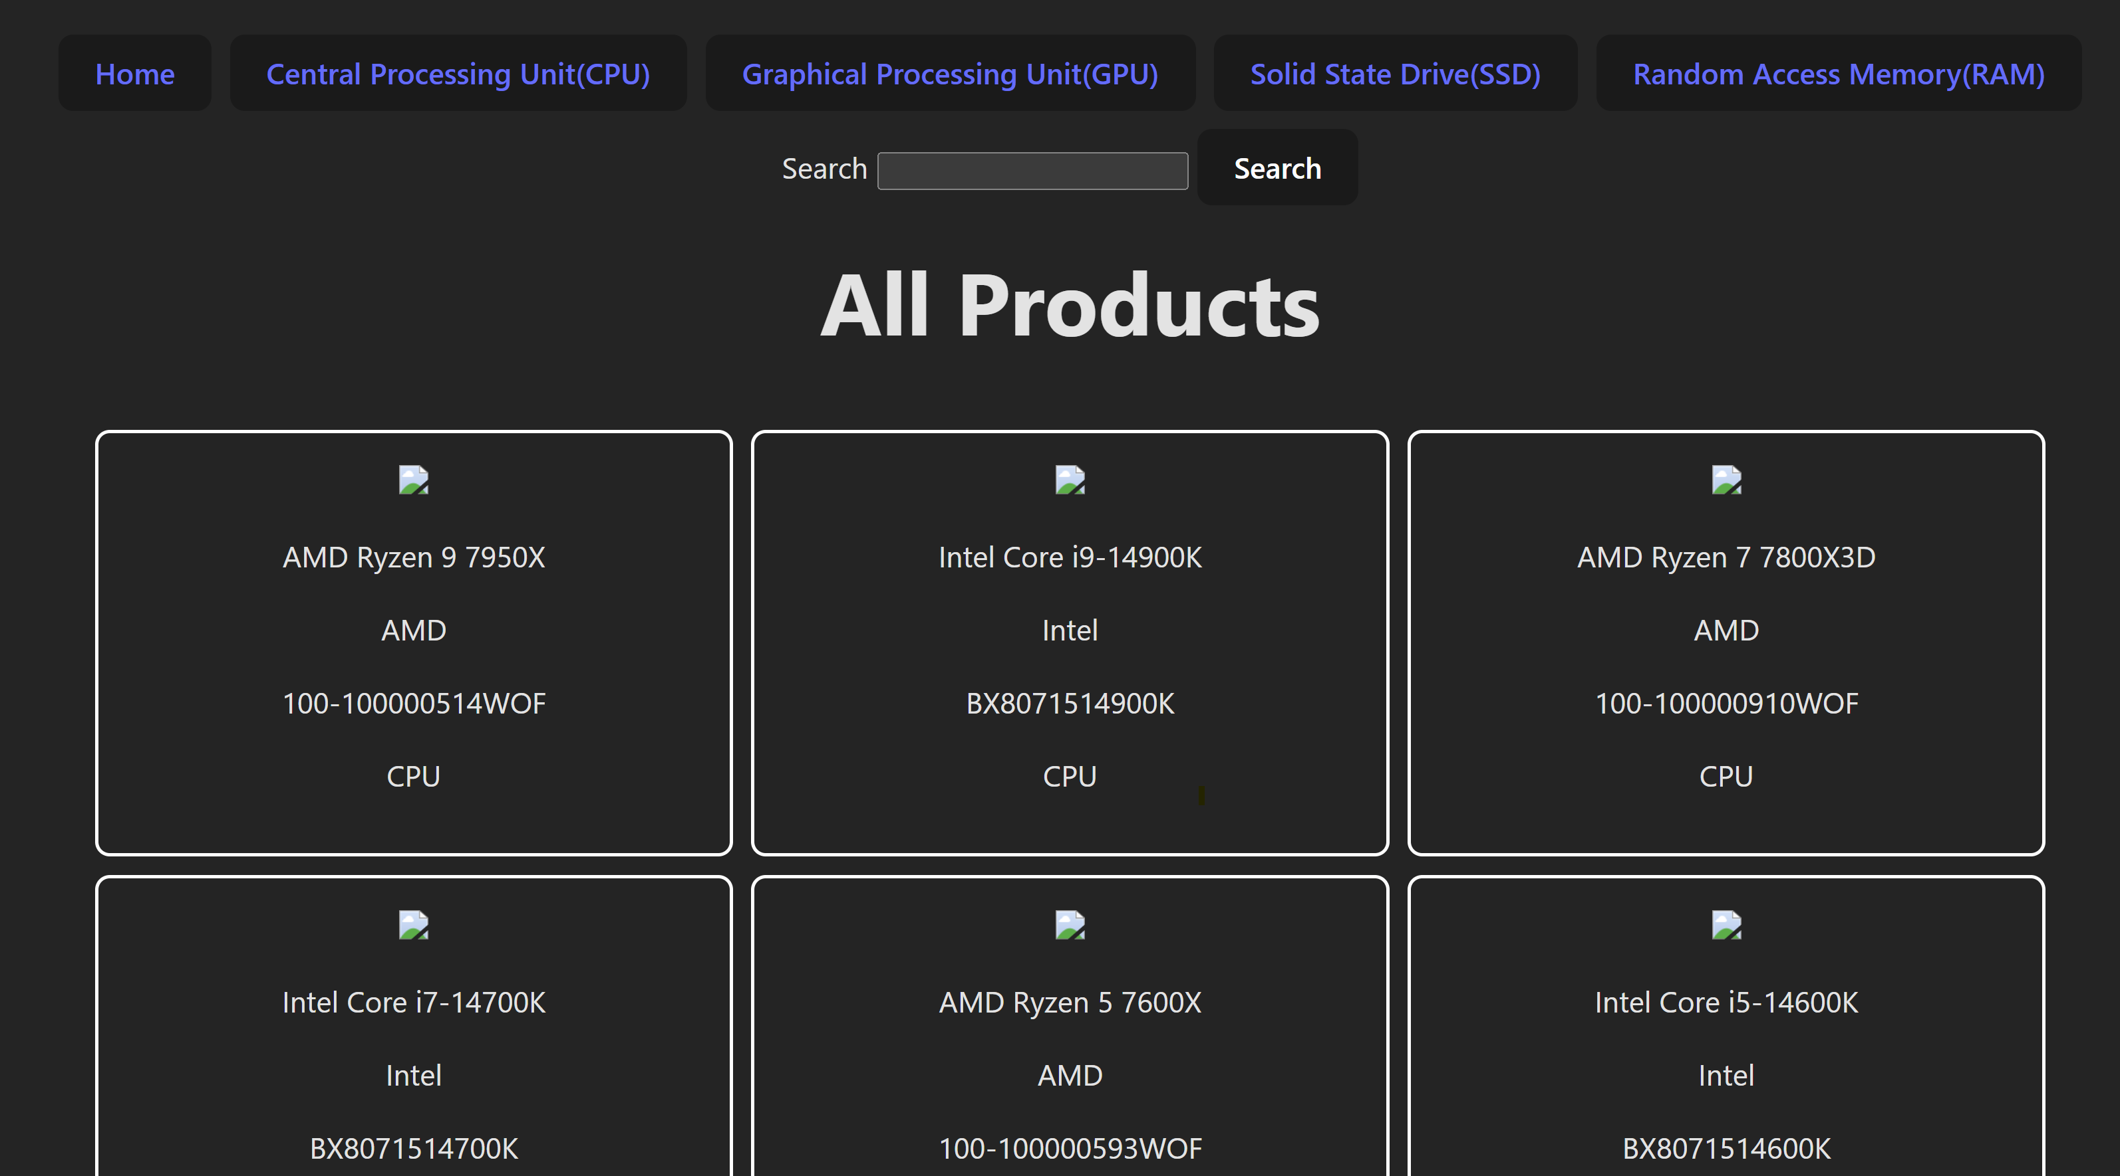
UserInterface Design

Slide 7
MVC
Account creation
A working API that reliably gets data from the database and transfers it over to the front end.
Be able to see recommended products at the top
Working comment box
Working product button clicks

Slide 8
Version 1.0
A place for users to like products that can be saved for later use
Expand upon the commenting implementation
Add addition functionality to comments section
More reliable and better fitting suggestions at the top of the list when they are looking at their home screen.
Real time price updates to get the latest prices from the sites.

Slide 9

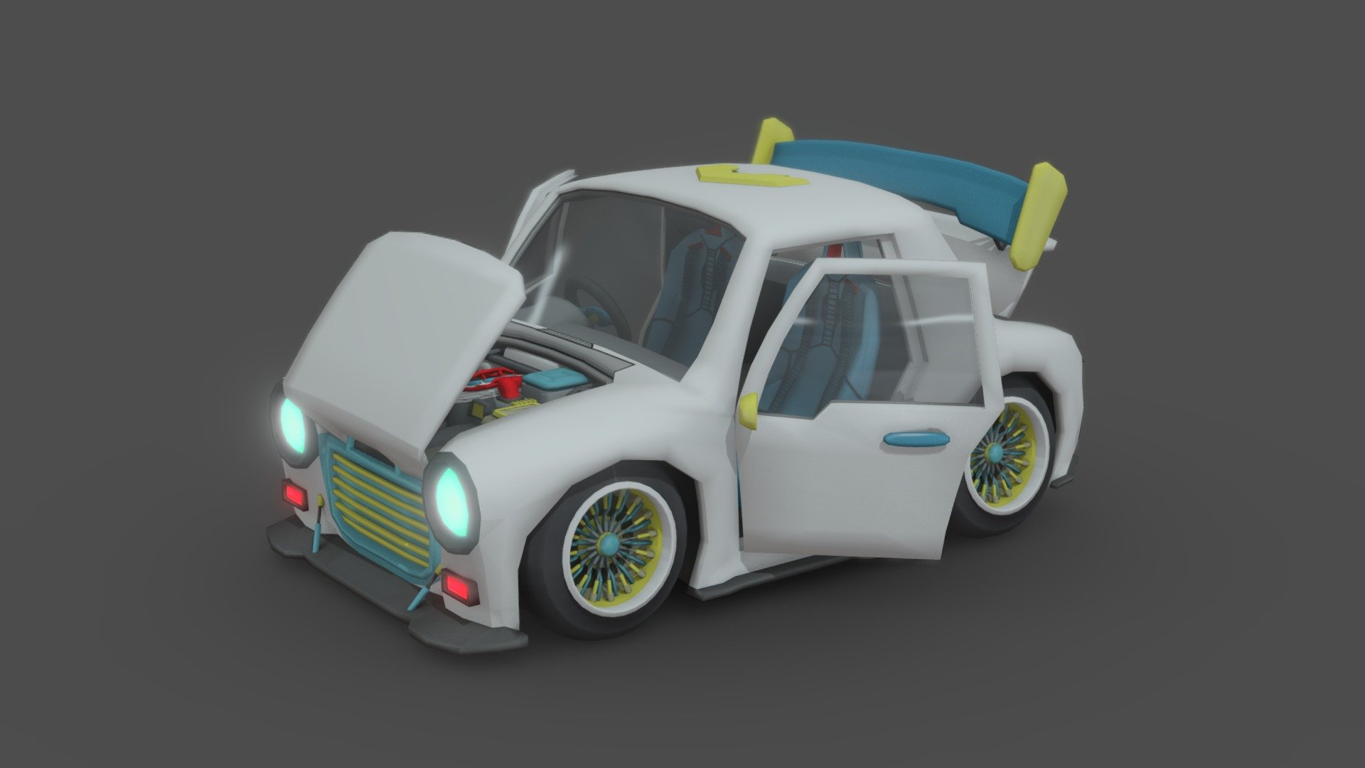
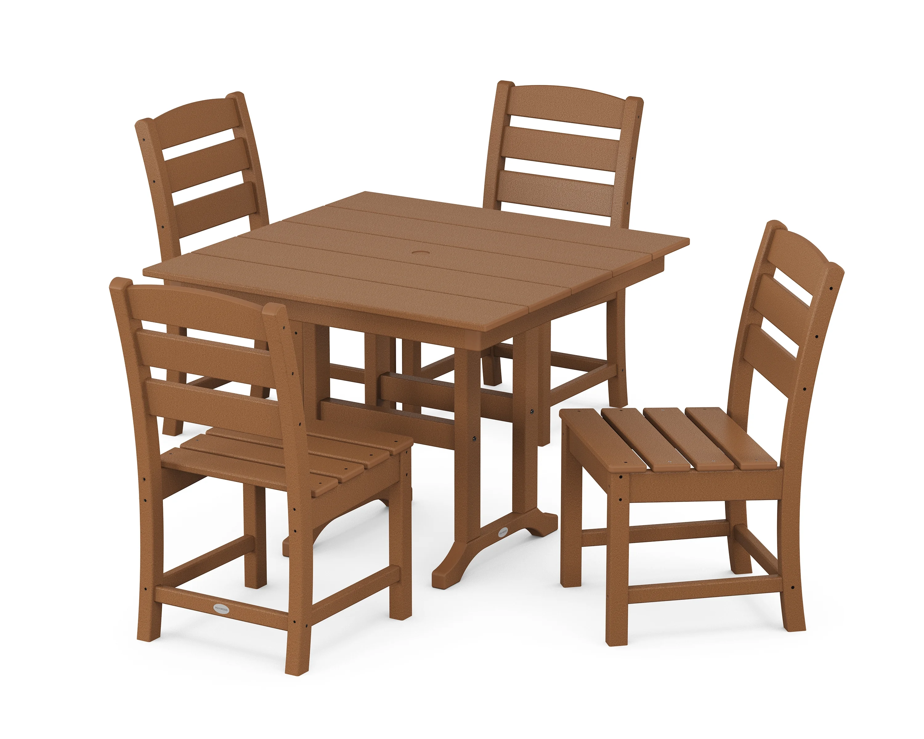
Version 2.0
Add more websites with computer parts for users to compare.
Add a shopping cart feature so users can add the item to the cart then go directly to the website to buy that product.
Expand beyond the computer parts and add other hot items people are doing research about getting (car parts, furniture ect.)
This Photo by Unknown Author is licensed under CC BY

Slide 10
Timeline
20–27 Jan.
Find an advisor, Project topic
28 Jan. – 8 Feb.
Hello world
9 Feb. – 6 Apr.
MVC Completed if not starting V1
8 Apr. – 1 May
V1 implementations if not starting V2
2 May
Day before final presentation: Testing and tidy up

Slide 11
Questions?

