Slide 1
ComparePro
By: Clayton Burgess
Advisor: Julie Thornton

Slide 2


Review
Website to compare computer components so users can find the best deals.
A phone app like feel so users can like and comment on products.
Goal is to eliminate having multiple windows open to look for products and to eliminate having another tool to way pros and cons when making a final decision.
Python back end with Flask API, react front end, SSMS Data storage

Slide 3
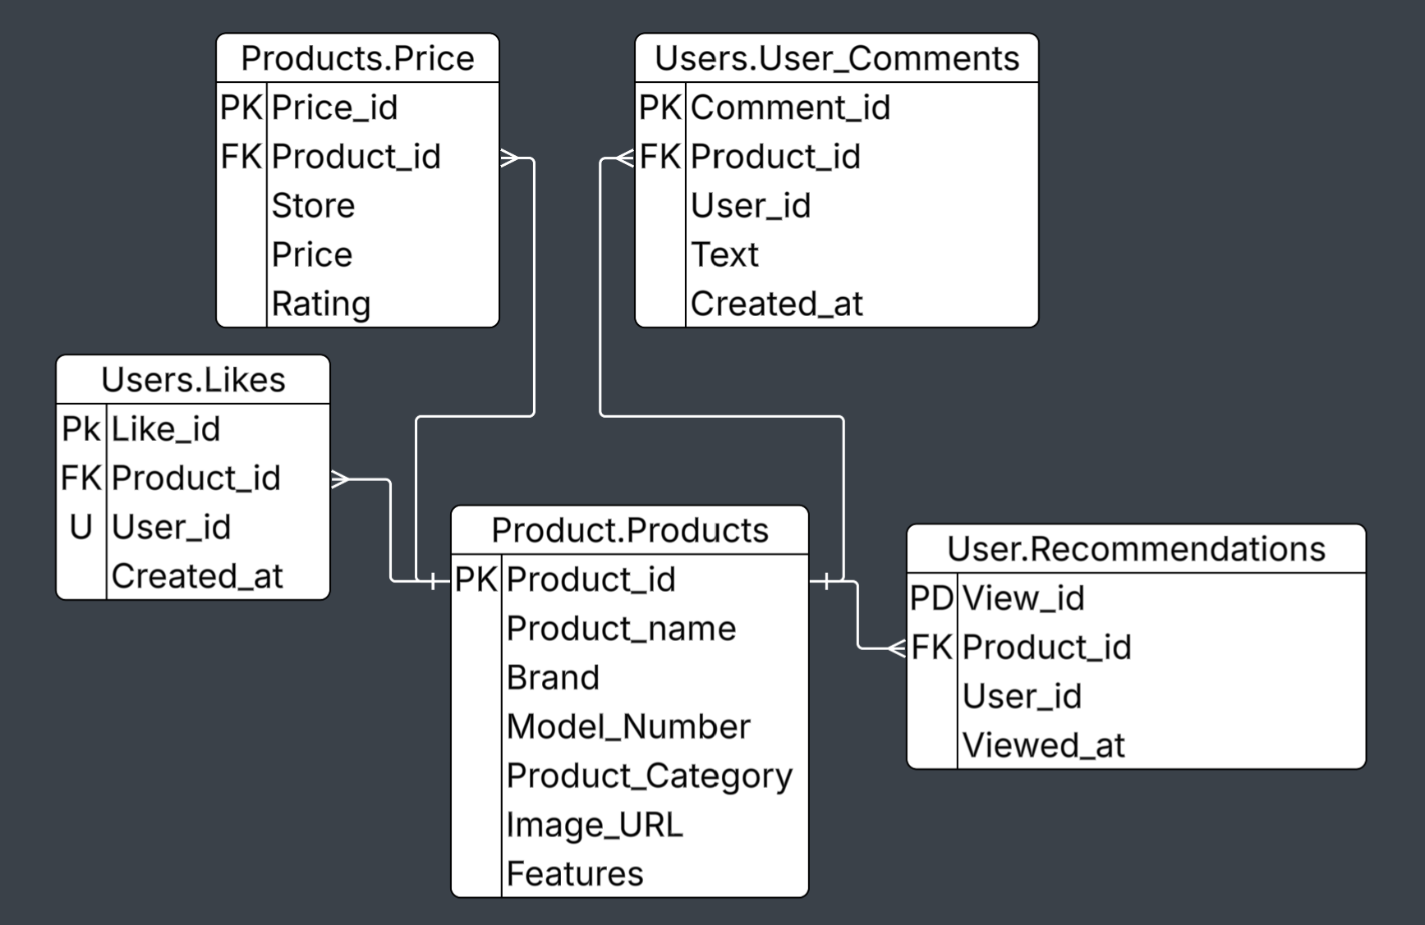
Database Design

Slide 4
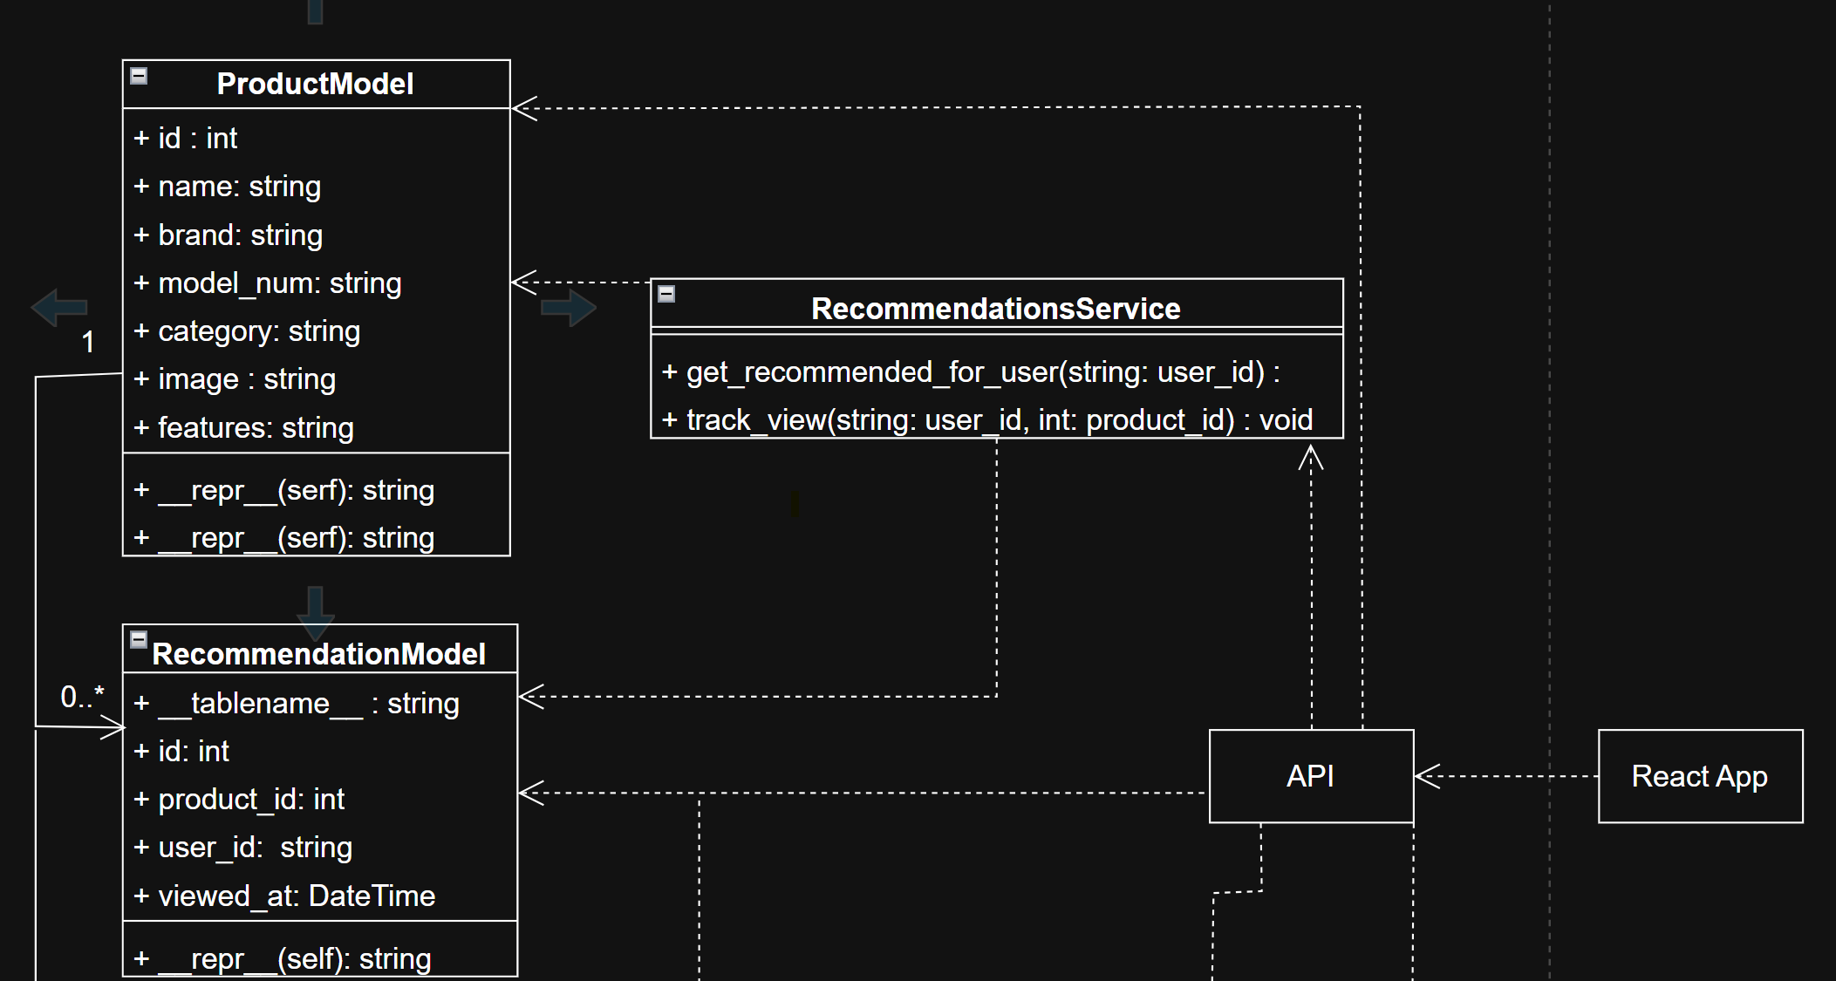
Class Diagram

Slide 5
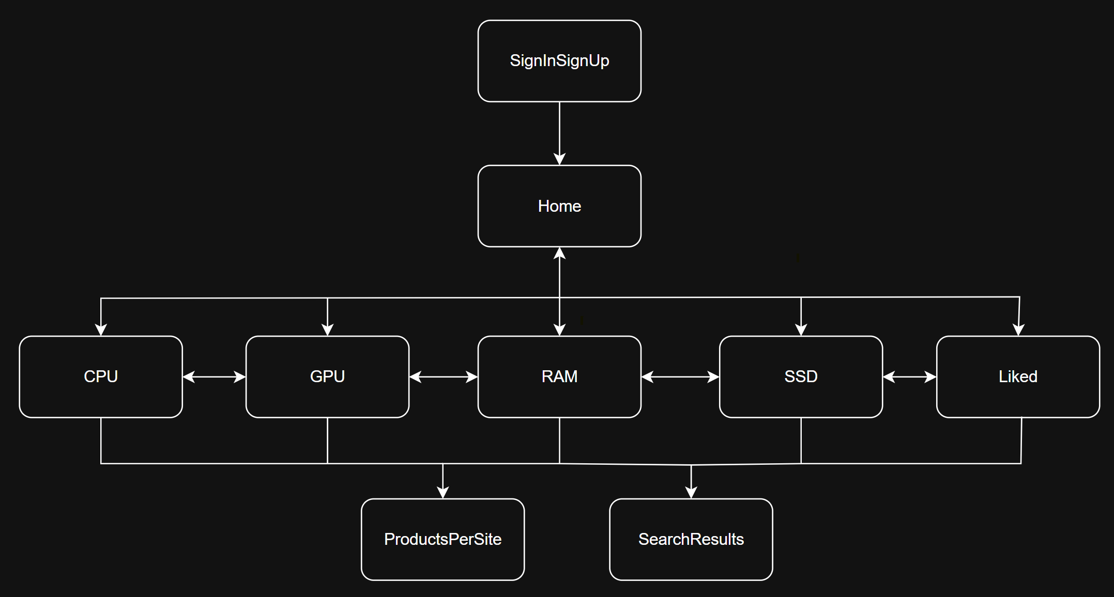
Component Architecture

Slide 6
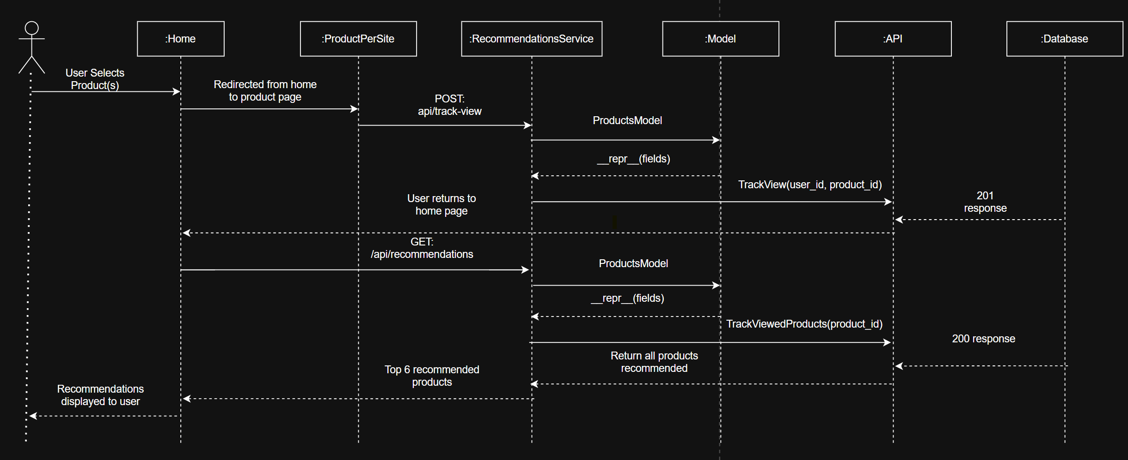
Sequence Diagram

Slide 7
EndPoints
GET /api/liked: Retrieves all liked products by the user id
GET /api/recommendations: Retrieves recommendations for a given user
GET /api/comments: Retrieves comments for a product from a given user
GET /api/products/ID: Retrieves the product id based off product user selected
POST /api/comments/add: Adds a comment from a given user for a product
POST /api/likes/toggle: Changes whether a user has liked a product or not
POST /api/track-view: Adds a product to the list of viewed products for recommendations

Slide 8
Testing
API/DataBase:
Manual
Postman
Integration
Endpoints match database
Correct data stored when user performs an action
Frontend:
Manual
Visual queues
Integration
Fetches correct data when going back to the API

Slide 9
Current State
Completed
Still To Complete
Finish 1.0 features
Clean up frontend
MVP
Data Inserted in database
Testing
A few 1.0 features

Slide 10
DEMO

Slide 11
Questions?

