Slide 1
Exam 70-533 Implementing Microsoft Azure Infrastructure Solutions
Design and Implement Azure App Service Apps (10-15%)
Create and Manage Compute Resources (20-25%)
Design and Implement a Storage Strategy (10-15%)
Implement virtual networks (15–20%)
Design and Deploy ARM Templates (10-15%)
Manage Azure Security, and Recovery Services (25-30%)
Manage Azure Operations (5-10%)
Manage Azure Identities (5-10%)
Gerald Parish
Azure Architect
MCT
https://www.microsoft.com/en-ie/learning/exam-70-533.aspx
Notes:
Presentation: 105 minutes
Lab: 50 minutes
After completing this module, students will be able to:
Identify suitable workloads for the cloud.
Identify services and capabilities that Microsoft Azure provides.
Use Azure portals to manage Azure services and subscriptions.
Use Windows PowerShell to manage Azure services and subscriptions.
Use Azure Command-Line Interface (CLI) to manage Azure services and subscriptions.
Describe the primary characteristics of Azure Resource Manager.
Use Azure services to enhance management and monitoring of Azure.
Required materials
To teach this module, you need the Microsoft PowerPoint file 20533D_01.pptx.
Preparation tasks
To prepare for this module, you should:
Read all this module’s materials.
Practice performing the demonstrations and labs.
Work through the Module Review and Takeaways section to determine how you will use the information to reinforce student learning and promote knowledge transfer to on-the-job performance.
As you prepare for this class, it is imperative that you complete the labs yourself. This gives you an understanding of how the labs work, as well as the concepts that each lab covers. This enables you to provide meaningful hints to students who might have issues while working in the labs. Furthermore, it will help guide your lecture to ensure that you discuss the concepts that the labs cover.
20533D
1: Introduction to Microsoft Azure

Slide 2
Manage Azure Security and Recovery Services (25-30%)
Manage data protection and security compliance
Implement recovery services
https://www.microsoft.com/en-ie/learning/exam-70-533.aspx
http://download.microsoft.com/download/8/4/8/848DD46A-05F2-4021-A118-036FC06647C5/533_OD_Changes.pdf

Slide 3
Manage data protection and services compliance
Manage data protection and security compliance
Create and import encryption keys with Key Vault; automate tasks for SSL/TLS certificates; prevent and respond to security threats with Azure Security Center; Configure single sign-on with SaaS applications using federation and password based; add users and groups to applications; revoke access to SaaS applications; configure access; configure federation with public consumer identity providers such as Facebook and Google
Implement recovery services
Create a backup vault; deploy a backup agent; backup and restore data; using of snapshots and Geo-replication for recovery; implement DR as service; Deploy Azure Site Recovery (ASR) agent; configure ASR; configure ASR one-click failover
http://download.microsoft.com/download/8/4/8/848DD46A-05F2-4021-A118-036FC06647C5/533_OD_Changes.pdf

Slide 4
Manage data protection and security compliance
Create and import encryption keys with Key Vault; automate tasks for SSL/TLS certificates; prevent and respond to security threats with Azure Security Center; Configure single sign-on with SaaS applications using federation and password based; add users and groups to applications; revoke access to SaaS applications; configure access; configure federation with public consumer identity providers such as Facebook and Google

Slide 5
Create and import keys with Key Vault
Secure storage of cryptographic keys
Uses FIPS 140-2 Level 2 validated hardware security modules (HSM)
Keys can be accessed using Azure AD
Two pricing tiers
A1 Standard
Allows for software-protected
P1 Premium
Allows keys to protected by Hardware Security Modules (HSM)
Created by
Azure portal
PowerShell
Azure CLI

Slide 6
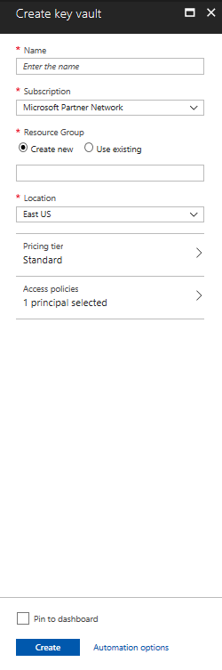
Create a Key Vault (Azure portal)
Marketplace
Specify name
Only alphanumeric characters
Must start with a letter and end with a letter or digit
Must be 3-24 characters in length
Cannot contain consecutive hyphens
Specify an Azure AD user or group and permission they have
Access Policy

Slide 7
Managing Secuirty
Create an Azure key Vault

Slide 8
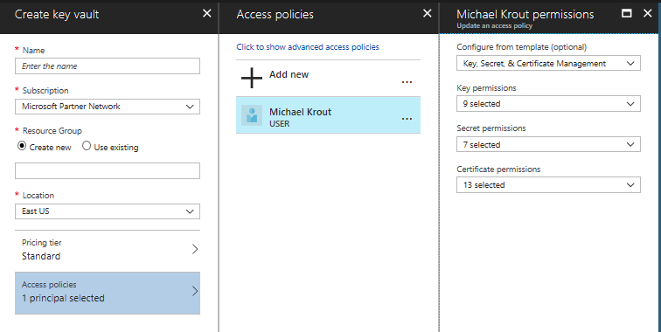
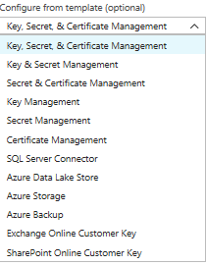
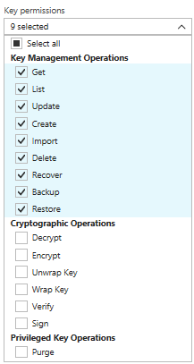
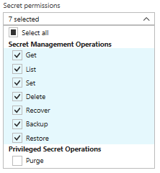
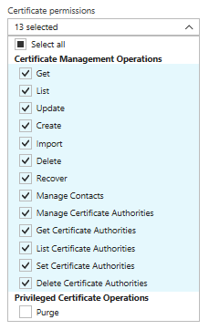
Access Policy

Slide 9
Create Key Vault (PowerShell)
Create Resource Group
$rg = New-AzureRmResourceGroup –name “MyKeyValutRG” –Location “East US”
Create Key Vault
New-AzureRmKeyVault – ValutName “MyKeyVault-0” –ResourceGroupName $rg.ResourceGroupName –Location “East US”

Slide 10
Create a Key Vault (CLI)
Create Resource group
az group create --name “MyKeyValutRG” --location “East US”
Create Key Vault
Az keyvault create –name “MyKeyVault-0” –resource-group “MyKeyVaultRG” --location “East US”

Slide 11
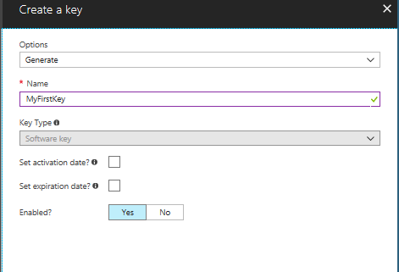
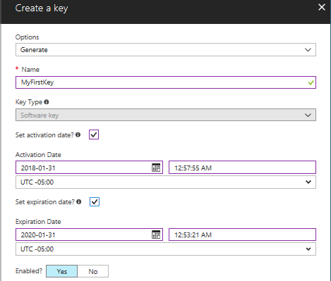
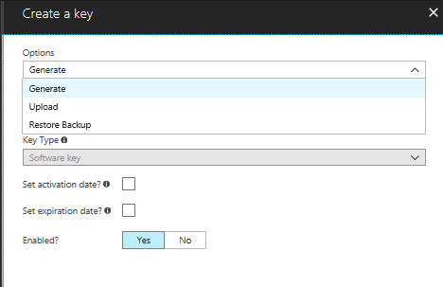
Create a Key (Azure Portal)
Keys stored
Encrypting
Decrypting
Secrets such as passwords
.pfx or .pem
Referenced through a URI
Authenticated by Azure AD
Steps
Select Key Vault from resource group
Click Keys
Click Add
Enter name
If P1 key then can be protected using HSM

Slide 12
Create a Key (PowerShell)
Create a key
Add-AzureRmKeyVaultKey –VaultName “MyKeyVault-0” –Name “MyFirstKey” –Destination “Software”

Slide 13
Create a Key (Azure CLI)
Create a key
az keyvault key create --vault-name ‘MyKeyVault-0’ –name ‘MyThirdKey’ --protection ‘software’

Slide 14
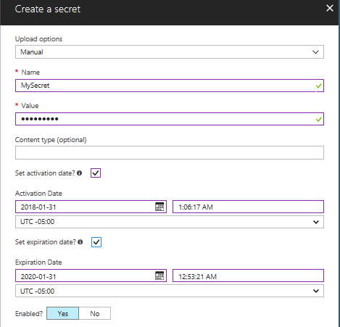
Create secrets (Azure Portal)
Click Secrets
Steps
Set upload to manual
Add a content type (optional)
Enter activation and expiration date
Enable the secret

Slide 15
Add a Secret (PowerShell)
Convert to a secure string
$mysecret = ConvertTo-SecureString –String ‘P@55w,rd’ –Force –AsPlainText
Add secret to vault
Set-AzureKeyValutSecret –VaultName ‘MyKeyVault-0’ –Name ‘MyFirstSecret’ –SecretValue $mysecret

Slide 16
Add Secret (Azure CLI)
Add a secret
az keyvault secret set --vault-name ‘MyKeyVault-01’ --name ‘MySecondSecret’ –value ‘P@ssw0rd’

Slide 17
Azure Key Vault Certificate Management
Azure Key Vault provides management of x509 certificates with the following features:
Segregation of duties
Use of policies
Settings of contacts
Automatic enrollment

Slide 18
Importing Certificates
Not available in Azure portal
Done using PowerShell
.PFX or .PEM format
Convert the private key password to a secure string
$CertPwd = Convert-To-SecureString –String “certP@ssword” –Force –AsplainText
Import the certificate
Import-AzureKeyVaultCertificate –VaultName ‘MyKeyVault-0’ –Name ‘MyFirstCert’ –FilePath ‘c:\certs\mycerts.pfx’ –Password $CertPwd

Slide 19
Creating Certificates
Define a Key Vault Policy
New-AzureKeyVaultCertificatePolicy
Creates a in-memory structure
Not a permanent policy
New-AzureKeyVaultCertificatePolicy –SecretContentType “application/x-pkscs12” –SubjectName “CN=newvisions.com” –IssuerName “Self” –ValidityInMonths 6 –ReuseKeyOnRenewal
Create Certificate
Add-AzureKeyVaultCertificate –VaultName ‘MyKeyVault-0’ –Name ‘TestCert01’ –CertificatePolicy = $Policy
Submits a job
Get the status of the job
Get-AzureKeyVaultCertificateOperation –VaultName ‘MyKeyVault-0’ –Name “TestCert01”

Slide 20
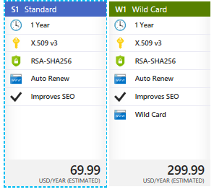
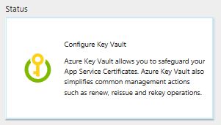
Azure App Service Certificate
Service used with
WebApps
Uses Azure Key Vault for certificate storage
Two Certificates
S1 Standard – provides SSL bindings to the root and www subdomain –
W1 Wildcard – need SSL bindings for root and any first level subdomain
Eliminates human error
Reduces time required to be done manually
Can set to autorenew

