Slide 1
Exam 70-533 Implementing Microsoft Azure Infrastructure Solutions
Design and Implement Azure App Service Apps (10-15%)
Create and Manage Compute Resources (20-25%)
Design and Implement a Storage Strategy (10-15%)
Implement virtual networks (15–20%)
Design and Deploy ARM Templates (10-15%)
Manage Azure Security, and Recovery Services (25-30%)
Manage Azure Operations (5-10%)
Manage Azure Identities (5-10%)
Gerald Parish
Azure Architect
MCT
https://www.microsoft.com/en-ie/learning/exam-70-533.aspx
Notes:
Presentation: 105 minutes
Lab: 50 minutes
After completing this module, students will be able to:
Identify suitable workloads for the cloud.
Identify services and capabilities that Microsoft Azure provides.
Use Azure portals to manage Azure services and subscriptions.
Use Windows PowerShell to manage Azure services and subscriptions.
Use Azure Command-Line Interface (CLI) to manage Azure services and subscriptions.
Describe the primary characteristics of Azure Resource Manager.
Use Azure services to enhance management and monitoring of Azure.
Required materials
To teach this module, you need the Microsoft PowerPoint file 20533D_01.pptx.
Preparation tasks
To prepare for this module, you should:
Read all this module’s materials.
Practice performing the demonstrations and labs.
Work through the Module Review and Takeaways section to determine how you will use the information to reinforce student learning and promote knowledge transfer to on-the-job performance.
As you prepare for this class, it is imperative that you complete the labs yourself. This gives you an understanding of how the labs work, as well as the concepts that each lab covers. This enables you to provide meaningful hints to students who might have issues while working in the labs. Furthermore, it will help guide your lecture to ensure that you discuss the concepts that the labs cover.
20533D
1: Introduction to Microsoft Azure

Slide 2
Manage Azure Security and Recovery Services (25-30%)
Manage data protection and security compliance
Implement recovery services
https://www.microsoft.com/en-ie/learning/exam-70-533.aspx
http://download.microsoft.com/download/8/4/8/848DD46A-05F2-4021-A118-036FC06647C5/533_OD_Changes.pdf

Slide 3
Manage data protection and services compliance
Manage data protection and security compliance
Create and import encryption keys with Key Vault; automate tasks for SSL/TLS certificates; prevent and respond to security threats with Azure Security Center; Configure single sign-on with SaaS applications using federation and password based; add users and groups to applications; revoke access to SaaS applications; configure access; configure federation with public consumer identity providers such as Facebook and Google
Implement recovery services
Create a backup vault; deploy a backup agent; backup and restore data; using of snapshots and Geo-replication for recovery; implement DR as service; Deploy Azure Site Recovery (ASR) agent; configure ASR; configure ASR one-click failover
http://download.microsoft.com/download/8/4/8/848DD46A-05F2-4021-A118-036FC06647C5/533_OD_Changes.pdf

Slide 4
Implementing recovery services
Create a backup vault; deploy a backup agent, backup and restore data, using snapshots and Geo-Replication for recovery; Implement DR as a service; Deploy Azure Site Recovery (ASR) agent; configure ASR; configure ASR one-click failover

Slide 5
Create a Recovery Services vault
Azure Backup
Azure Site Recovery
Recovery Services vault
Configuration management for
Azure Backup
Azure Site Recovery

Slide 6
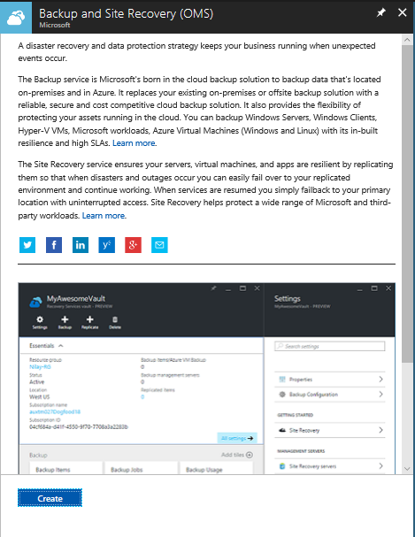
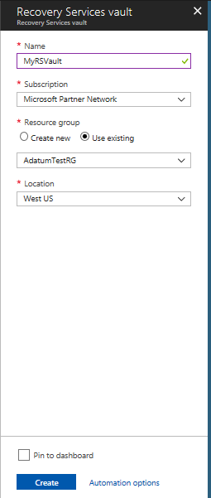
Create a Recovery Services vault (Azure Portal)

Slide 7
Create a Recovery vault (PowerShell)
Create resource group
New-AzureRmResourceGroup –Name ‘RSVaultRG’ –Location ‘East US’
Create the vault
New-AzureRmRecoveryServicesVault –Name ‘MyRSVault’ –ResourceGroupName ‘RSVaultRG’ –Location ‘East US’
Configure GRS for storage
$vault1 = Get-AzureRmRecoveryServicesVault –Name ‘MyRSVault’
Set-AzureRmRecoveryServicesBackupProperties –Vault $vault1 –BackupStorageRedundancy GeoRedundant

Slide 8
Deploy a Backup Agent
Different types of agents
Microsoft Azure Recovery Services (MARS) agent – standalone used to protect files and folders
DPM protection agent – used with Azure Backup Server and System Center Data Protection Manager
VMSnapshot extention – installed on Azure VMs to allow snapshots
Automation is available for Azure Backup Server DPM, VMSnapshot, VMSnapshotLinux

Slide 9
MARS agent install
Recovery Services vault
Steps
Click Backup under Getting started
Under the Where Is You Workload Running select On-Premises from the drop-down
What you want to backup select Files and Folders
Click Prepare Infrastructure
Recovery agent is made available
Backup files and folders only available on Windows devices
Download the agent
Click Proceed to registration
Enter credentials
Select either passphrase or allow installation to generate one
Enter twice
Specify the where passphrase should be stored

Slide 10
Backup and Restore Data
You need to configure the agent
When the backups occur
How often they occur
How long data is retained
What data is protected
Start by clicking Schedule Backup
Configured
Daily backup
Weekly backup
Recover Data option in MARS Agent
Where to restore the data
What to recover
When the data was backed up
Recovery point
Mount point
Can backup IaaS virtual machines in Azure
Individual files or entire VMs
Backup policy
How often they occur
How long backups are retained
Only VMs in same region as the Recovery Services vault can be backed up

Slide 11
Use of snapshots
Blob snapshots
Unmanaged VM disks are page blobs
Can be snapshotted and copied to another Region
Use the snapshot to recover VMs

Slide 12
Configure a snapshot in a different region
Create storage account
New-AzureRmResourceGroup –Name DRRecoveryStorageRG –Location eastus
$destinationStorageAcct = New-AzureRmStorageAccount –ResourceGroupName DRRecoveryStorageRG –Name recoverysa0434 –SkuName Standard_LRS –Location eastus –Kind Storage
Create a blob container
Set-AzureRmCurrentStorageAccount –ResourceGroupName DRRecoveryStorageRG –Name recoverysa0434
Create a container
New-AzureStorageContainer –Name recovery –Permission Off
Create a snapshot configuration
$sourceVHDURI = https://criticalserverrgddisks810.blob.core.windows.net/vhds/CriticalServer.vhd

Slide 13
Configure a snapshot to another destination –Cont.
Populate another variable with the Resource ID of the same storage account
$storageAccountID = “/subscriptions/<SubscriptionID>/resourceGroups/criticalserverrg/providers/Microsoft.Storage/storageAccounts/criticalserverrgdisks810”
Set the snapshot context
$snapshotConfig = New-AzureRmSnapShotConfig –AccountType StandardLRS –Location westus –CreateOption Import –StorageAccountID $storageAccountID –SourceUri $sourceVHDURI
Create the snapshot
New-AzureRmSnapShot –SnapShot $snapshotConfig –ResourceGroupName CriticalServerRG –SnapshotName MyCriticalServerDiskSnapShot
Obtain the destination storage account key
Done through Azure Portal

Slide 14
Configure a snapshot to another destination –Cont.
Populate the key value in a variable
$storageAccountKey = “<StorageAccountKey”>
Store name of the resource group
$resourceGroupName = “CriticalServerRG”
Store name of the snapshot
$snapShotName = “MyCriticalServerDiskSnapshot”
Create SAS (Shared Access Signature) and expiration time
$sasExpiryDuration = “3600”
$sas = Grant-AzureRmSnapshotAccess –ResourceGroupName $resourceGroupName –SnapSHotName $snapShotName –DurationInSecond $sasExpiryDuration –Access Read
Create the destination storage
$destinationContext = New-AzureStorageContext –StorageAccountName $storageAcct.StorageAccountName –StorageAccountKey $storageAccountKey

Slide 15
Configure a snapshot to another destination –Cont.
Start the copy process
Start-AzureStorageBlobCopy –AbsoluteUri $sas.AccessSAS –DestContainer “recovery” –DestContext $destinationContext –DestBlob “recoveredcriticalservos.vhd”

Slide 16
Recover VM by using the copied VHD
Create a new resource group for VM
Convert the VHD to a managed disk
Provision a virtual machine from the managed disk
Create a virtual network for the VM
Create NSG that allows the required network traffic
Create a public IP address and NIC
Specify the configuration for the VM
Name
Series
Assign NIC to VM
Add the OS disk created from the snapshot
Create the VM

Slide 17
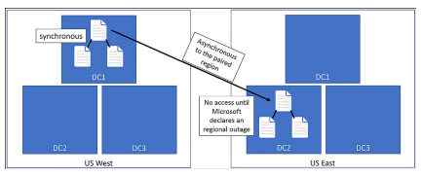
Geo-replication for recovery
Geo-Redundant storage (GRS)
Replication data to a paired region hundreds of miles away from the primary copy
No access until Microsoft declares a persistent outage and accomplished a geo-failover

Slide 18
Read Access Geo-Redundant Storage (RA-GRS)
Customers have read-only
IaaS
Unmanaged standard VM Disks
Asynchronous updates
Latency
Not an effective way to prepare for regional outages

Slide 19
Implement DR as service, Deploy ASR agent, ASR Configuration & best practices
ASR is a disaster recovery service
Data Center to Data Center (D2D)
On-premise to Azure (D2A)
One Azure to Azure (A2A)
Workloads on on-premises
Protect physical machines
VMware-based virtual machines
Hyper-V based virtual machines
Create the Recovery Services Vault
Azure Backup
Azure Site Recovery

Slide 20
Create and use a SAS with Blob storage
Generate a shared access signature on a container
Generate a shared access signature on a blob
Create a stored access policy to manage signatures on a container's resources
Test the shared access signatures in a client application
https://docs.microsoft.com/en-us/azure/storage/blobs/storage-dotnet-shared-access-signature-part-2

