Slide 1
Exam 70-533 Implementing Microsoft Azure Infrastructure Solutions
Design and Implement Azure App Service Apps (10-15%)
Create and Manage Compute Resources (20-25%)
Design and Implement a Storage Strategy (10-15%)
Implement virtual networks (15–20%)
Design and Deploy ARM Templates (10-15%)
Manage Azure Security, and Recovery Services (25-30%)
Manage Azure Operations (5-10%)
Manage Azure Identities (5-10%)
Gerald Parish
Azure Architect
MCT
https://www.microsoft.com/en-ie/learning/exam-70-533.aspx
Notes:
Presentation: 105 minutes
Lab: 50 minutes
After completing this module, students will be able to:
Identify suitable workloads for the cloud.
Identify services and capabilities that Microsoft Azure provides.
Use Azure portals to manage Azure services and subscriptions.
Use Windows PowerShell to manage Azure services and subscriptions.
Use Azure Command-Line Interface (CLI) to manage Azure services and subscriptions.
Describe the primary characteristics of Azure Resource Manager.
Use Azure services to enhance management and monitoring of Azure.
Required materials
To teach this module, you need the Microsoft PowerPoint file 20533D_01.pptx.
Preparation tasks
To prepare for this module, you should:
Read all this module’s materials.
Practice performing the demonstrations and labs.
Work through the Module Review and Takeaways section to determine how you will use the information to reinforce student learning and promote knowledge transfer to on-the-job performance.
As you prepare for this class, it is imperative that you complete the labs yourself. This gives you an understanding of how the labs work, as well as the concepts that each lab covers. This enables you to provide meaningful hints to students who might have issues while working in the labs. Furthermore, it will help guide your lecture to ensure that you discuss the concepts that the labs cover.
20533D
1: Introduction to Microsoft Azure

Slide 2
Manage Azure Security and Recovery Services (25-30%)
Manage data protection and security compliance
Implement recovery services
https://www.microsoft.com/en-ie/learning/exam-70-533.aspx
http://download.microsoft.com/download/8/4/8/848DD46A-05F2-4021-A118-036FC06647C5/533_OD_Changes.pdf

Slide 3
Manage data protection and services compliance
Manage data protection and security compliance
Create and import encryption keys with Key Vault; automate tasks for SSL/TLS certificates; prevent and respond to security threats with Azure Security Center; Configure single sign-on with SaaS applications using federation and password based; add users and groups to applications; revoke access to SaaS applications; configure access; configure federation with public consumer identity providers such as Facebook and Google
Implement recovery services
Create a backup vault; deploy a backup agent; backup and restore data; using of snapshots and Geo-replication for recovery; implement DR as service; Deploy Azure Site Recovery (ASR) agent; configure ASR; configure ASR one-click failover
http://download.microsoft.com/download/8/4/8/848DD46A-05F2-4021-A118-036FC06647C5/533_OD_Changes.pdf

Slide 4
Configure SSO with SaaS application using federation password based
Authentication of SaaS applications
Organizational account
Prolonged logon experience
Logon is federated or password based

Slide 5
Federated SSO
SaaS application redirects authentication to Azure AD
Application must have authorization settings for the user
Accounts can be created automatically with Azure AD or manually provisioned
Available for applications that support
SAML 2.0
WS-Federation
OpenID Connect

Slide 6
Be certain that you know the protocols that are supported for use with federated SSO, namely SAML 2.0, WS-Federation or OpenID Connect.

Slide 7
Register application with Azure AD
Click the Enterprise applications and new application located in Azure AD blade
Enter application name to add one from the gallery (2800 SaaS apps)
Click add
Go into the properties and select SSO
Set SSO mode to SAML based SSO

Slide 8
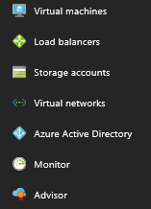
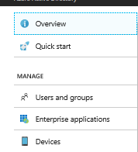
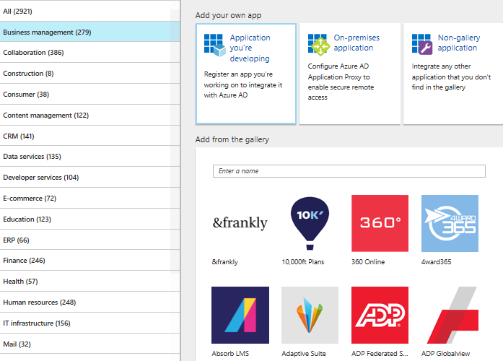
Review

Slide 9
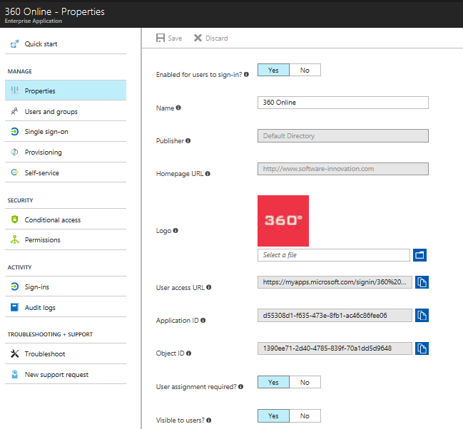

Slide 10
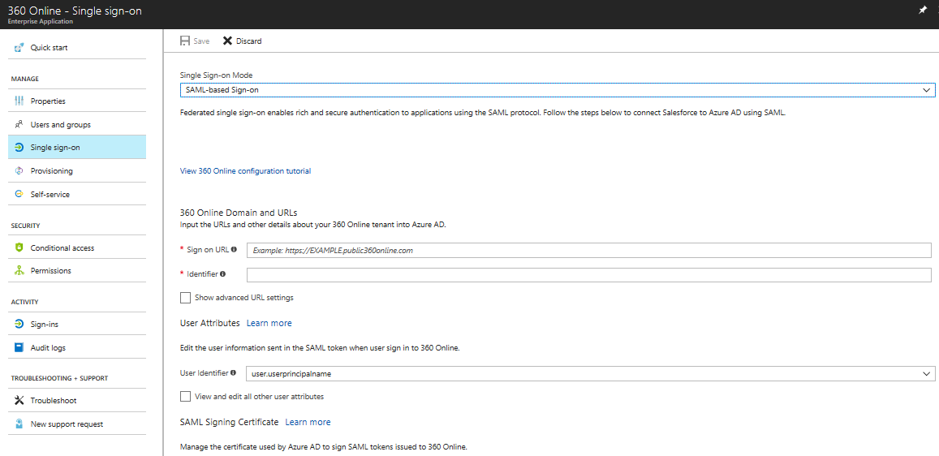
SAML 2.0 Sections

Slide 11
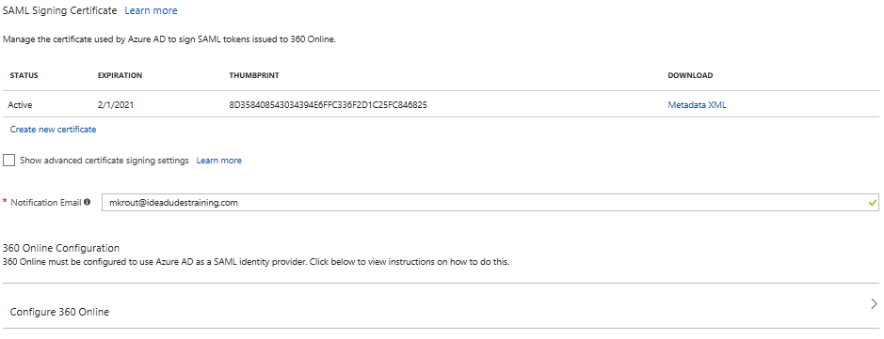
SAML Certificate
https://docs.mcirosoft.com/en-us/azure/active-directory/active-directory-saas-tutorial-list

Slide 12
Password-based SSO
Use their own identity present HTML page
Password-based SSO
Securely stores user account information
Presents it on behalf of the user
Two methods
Administrator managing the credentials
Enabling password-based SSO – user manages the credentials
Add an application within Azure AD like before but selecting password-based SSO
Requires web browser extension or plugin
Installed at first usage

Slide 13
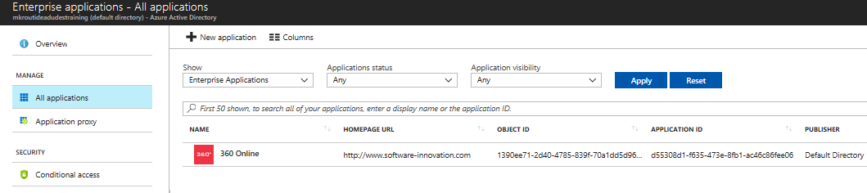
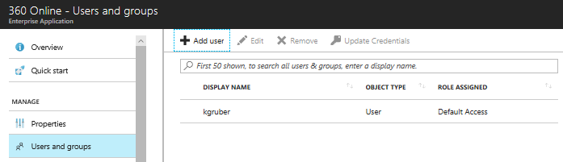
Add users and groups to applications
Adding groups to an application requires Azure AD Premium (at least P1)
Enterprise apps in the Azure AD blade

Slide 14
Revoke access to SaaS applications
Revoke access to a user in a group
Remove user from a group
Azure AD
Remove access to a single user
Enterprise applications
All applications
Select affected app and remove user access
Source of Authority – synchronization from on-premise, who is in charge. Make changes on-premise and allow to sync with cloud identities.

Slide 15
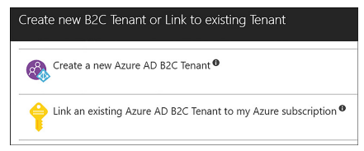
Configure federation with public consumer identity providers
Common feature among mobile apps is authentication
Azure AD B2C
Provide reliable scalable authentication experience
Users can use third parties as Identity providers (FaceBook, Google, Twitter and more)
Create a Azure AD B2C tenant

Slide 16
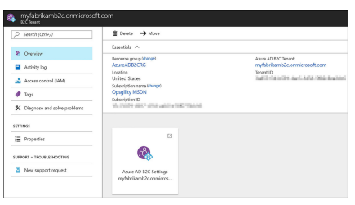
Configuring Azure AD B2C
Can be used with serval types of applications, including web, mobile, and API apps.

Slide 17
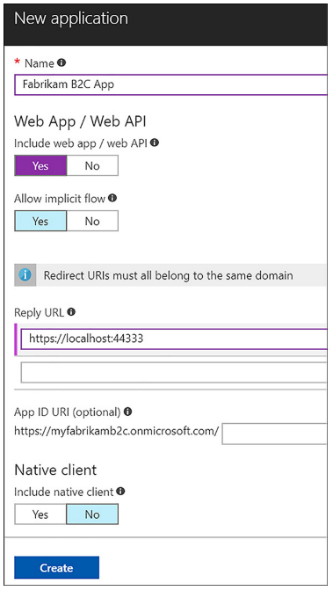
Registering a web application

Slide 18
Configure Social Identity Providers
Web application is registered
Identity providers can be added
Types
Local identities
Social identities
Two steps needed
Configure the identity provider side
Add Identity provider to Azure AD B2C tenant

