Slide 1
Exam 70-533 Implementing Microsoft Azure Infrastructure Solutions
Design and Implement Azure App Service Apps (10-15%)
Create and Manage Compute Resources (20-25%)
Design and Implement a Storage Strategy (10-15%)
Implement virtual networks (15–20%)
Design and Deploy ARM Templates (10-15%)
Manage Azure Security, and Recovery Services (25-30%)
Manage Azure Operations (5-10%)
Manage Azure Identities (5-10%)
Gerald Parish
Azure Architect
MCT
https://www.microsoft.com/en-ie/learning/exam-70-533.aspx
Notes:
Presentation: 105 minutes
Lab: 50 minutes
After completing this module, students will be able to:
Identify suitable workloads for the cloud.
Identify services and capabilities that Microsoft Azure provides.
Use Azure portals to manage Azure services and subscriptions.
Use Windows PowerShell to manage Azure services and subscriptions.
Use Azure Command-Line Interface (CLI) to manage Azure services and subscriptions.
Describe the primary characteristics of Azure Resource Manager.
Use Azure services to enhance management and monitoring of Azure.
Required materials
To teach this module, you need the Microsoft PowerPoint file 20533D_01.pptx.
Preparation tasks
To prepare for this module, you should:
Read all this module’s materials.
Practice performing the demonstrations and labs.
Work through the Module Review and Takeaways section to determine how you will use the information to reinforce student learning and promote knowledge transfer to on-the-job performance.
As you prepare for this class, it is imperative that you complete the labs yourself. This gives you an understanding of how the labs work, as well as the concepts that each lab covers. This enables you to provide meaningful hints to students who might have issues while working in the labs. Furthermore, it will help guide your lecture to ensure that you discuss the concepts that the labs cover.
20533D
1: Introduction to Microsoft Azure

Slide 2
Manage Azure Security and Recovery Services (25-30%)
Manage data protection and security compliance
Implement recovery services
https://www.microsoft.com/en-ie/learning/exam-70-533.aspx
http://download.microsoft.com/download/8/4/8/848DD46A-05F2-4021-A118-036FC06647C5/533_OD_Changes.pdf

Slide 3
Manage data protection and services compliance
Manage data protection and security compliance
Create and import encryption keys with Key Vault; automate tasks for SSL/TLS certificates; prevent and respond to security threats with Azure Security Center; Configure single sign-on with SaaS applications using federation and password based; add users and groups to applications; revoke access to SaaS applications; configure access; configure federation with public consumer identity providers such as Facebook and Google
Implement recovery services
Create a backup vault; deploy a backup agent; backup and restore data; using of snapshots and Geo-replication for recovery; implement DR as service; Deploy Azure Site Recovery (ASR) agent; configure ASR; configure ASR one-click failover
http://download.microsoft.com/download/8/4/8/848DD46A-05F2-4021-A118-036FC06647C5/533_OD_Changes.pdf

Slide 4
Prevent and respond to security threats with Azure Security Center
Eliminate threats by implementing security best practices
Azure Security Center lightens the burden
Evaluating deployments
Offering recommendations for hardening
Can use ASC to implement recommendations
Provides active monitoring
Identifying malicious activity allowing for rapid response

Slide 5
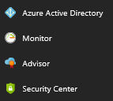
Enabling Azure Security Center
Free tier is enabled by default
Pinned to the services menu

Slide 6
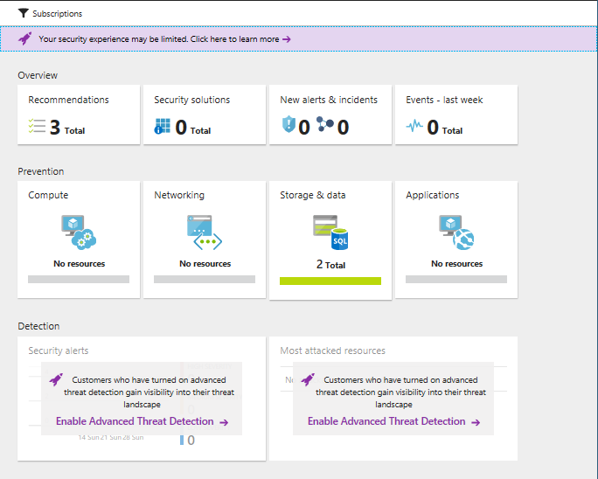
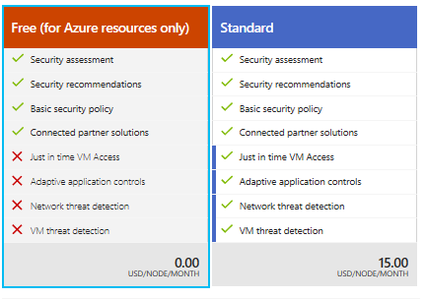
ASC (Azure Security Center)
Four sections
Overview
Prevention
Detection
Advanced Cloud defense
Security policy menu begins the process

Slide 7
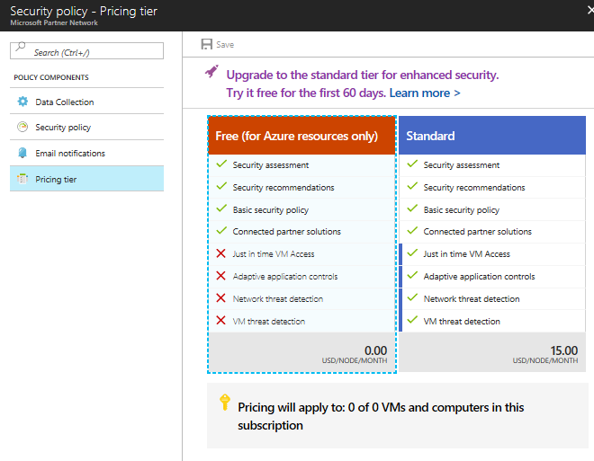
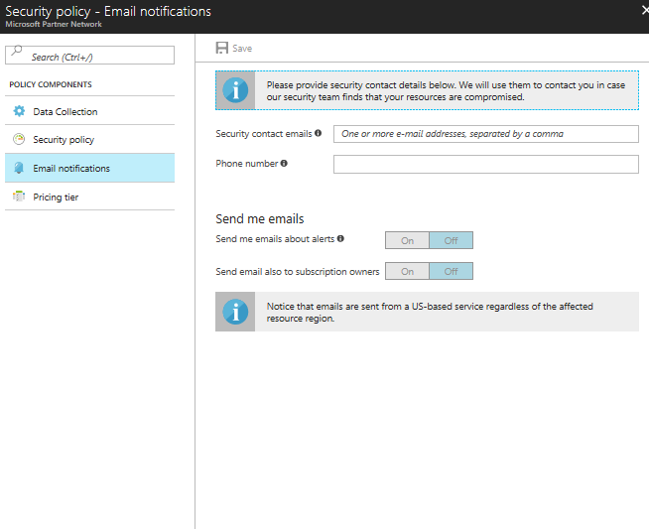
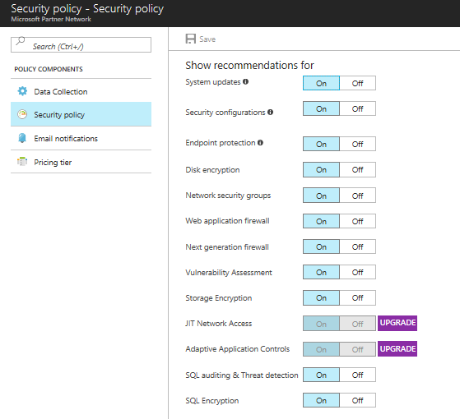
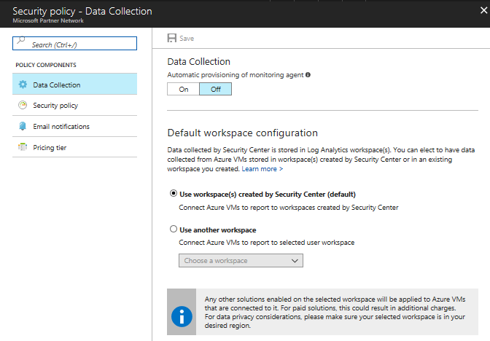
Security Policy
Four Sections
Data Collection
Security Policy
Email Notifications
Pricing Tier
Enabling protection for non-Azure computers
Standard pricing

Slide 8
Preventing Security Threats
Scanning your Azure deployments
Providing recommendations
Also mitigations from Microsoft
Integration with Microsoft partner solutions
Following recommendation will greatly minimize exposure

Slide 9
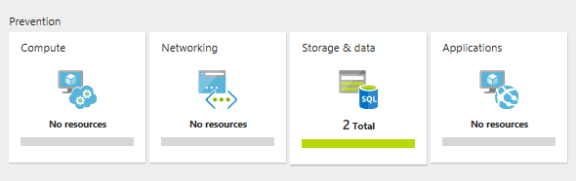
Azure Security Center’s prevention tiles

Slide 10
Compute
Monitor Configuration
IaaS
Cloud Services
Recommendations give additional information
JIT (Just-In-Time) access
Blocks inbound network traffic using a NSG (network security group)
User with write access will be given temporary access based on the ASC policy
Located in Advanced Cloud Defense section

Slide 11
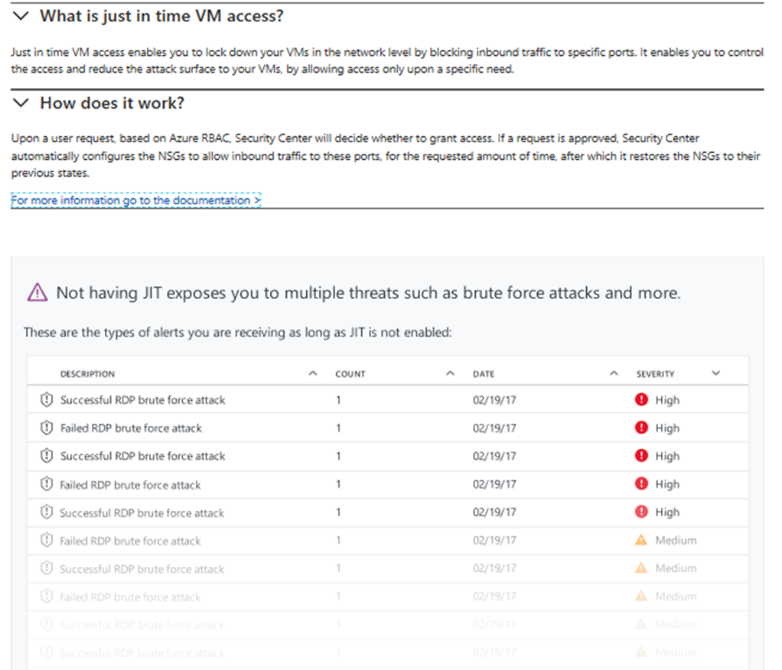

Slide 12
Azure Security Center’s prevention tiles

Slide 13
Networking
Evaluates the accessibility of external facing resources
Use of traffic/blocking/inspection
NSG
Network Firewalls
Web Application Firewalls
Recommendations made to restrict flow even further
Non-compliant can be remediated using ASC

Slide 14
Azure Security Center’s prevention tiles

Slide 15
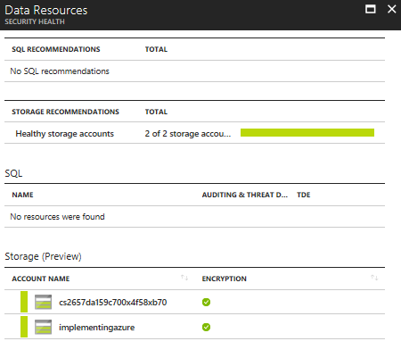
Storage and Data
Outside IaaS
Exposing vulnerabilities in PaaS solutions
Azure Storage
Blob
Disk
File
Queue
Azure SQL Database (DBaaS)
Recommendations for encryption

Slide 16
Azure Security Center’s prevention tiles

Slide 17
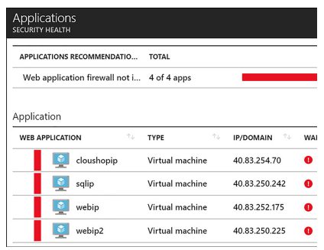
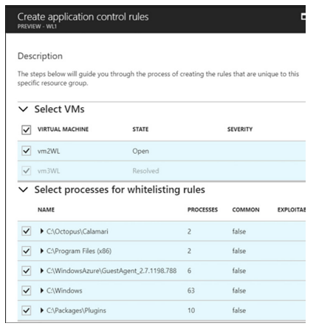
Applications
Evaluates public-facing services
Websites
Makes recommendations such as WAF
Integration with partners
F5
Barracuda
Fortinet
Adaptive application controls
Any process marked as exploitable should be carefully reviewed. These likely represent malware.

Slide 18
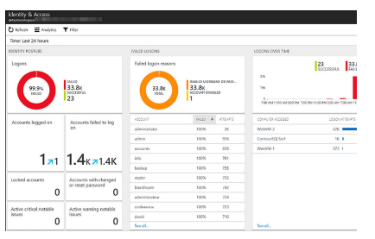
Other Prevention Areas
Recommendations blade
Ordered by severity
Provides detailed information that is actionable
Can dismiss recommendations
Identity and Access
Visualizations of security logs

Slide 19
Responding to security threats with ASC
What to do when there is an attack?
Collecting and analyzing security data from
Azure Deployments
Virtual networks
Any solution that is deployed
Information is correlated with Global threat intelligence using machine learning
Helps to detect the anomalies
Benefit without vast teams of data scientists and security experts

Slide 20
Advanced Threat Management
Standard plan
Wealth of information
Source IP address
How many logon attempts have failed
Create custom alerts

Slide 21
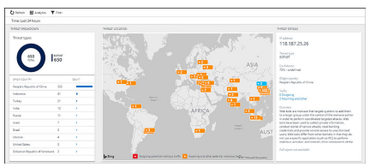
Threat Intelligence
Standard tier pricing
Dashboard tracking
Threat types
Origin country
Threat location
Threat Details

