Slide 1

Implementing Microsoft Azure Infrastructure Solutions
Data & Cloud Skill Up and Exam Ready Workshop
WiFi: MSFTGUEST
Password: msevent73ew
Content Location: https://github.com/guruskill/70-533
Notes:
Access codes for wifi should be provided on site

Slide 2

Day 1 – Date
Agenda
8:30 AM |  | Registration & Breakfast
8:45 AM |  | Welcome
9:00 AM |  | Agenda Overview
9:15 AM |  | Design and Implement Azure App Service Apps
10:30 AM |  | Break
10:45 AM |  | Create and Manage Compute Resources
12:00 PM |  | Labs / Lunch / Networking
1:00 PM |  | Design and implement a Storage Strategy
2:15 PM |  | Break
2:30 PM |  | Implement Virtual Networks
3:30 PM |  | Hands-On Labs (on-site and take home)
Notes:
Tentative Agenda

Slide 3
Day 2 – Date
Agenda
9:00 AM |  | Registration & Breakfast
9:30 AM |  | Design and Deploy ARM Templates
10:30 AM |  | Break
10:45 AM |  | Manage Azure Identities
11:30 AM |  | Lab
12:00 AM |  | Manage Azure Security, and Recovery Services
1:00 PM |  | Manage Azure Operations
2:30 PM |  | Break
2:45 PM |  | Q&A: How will you use what you have learned
3:30 PM |  | Hands-On Labs
4:30 PM |  | Wrap-Up
Notes:
Tentative Agenda

Slide 4
Exam 70-533 Implementing Microsoft Azure Infrastructure Solutions
Design and Implement Azure App Service Apps (10-15%)
Create and Manage Compute Resources (20-25%)
Design and Implement a Storage Strategy (10-15%)
Implement virtual networks (15–20%)
Design and Deploy ARM Templates (10-15%)
Manage Azure Security, and Recovery Services (25-30%)
Manage Azure Operations (5-10%)
Manage Azure Identities (5-10%)
Mohd Mishal
Clouds Consultant MCT
https://www.microsoft.com/en-ie/learning/exam-70-533.aspx
Notes:
Presentation: 105 minutes
Lab: 50 minutes
After completing this module, students will be able to:
Identify suitable workloads for the cloud.
Identify services and capabilities that Microsoft Azure provides.
Use Azure portals to manage Azure services and subscriptions.
Use Windows PowerShell to manage Azure services and subscriptions.
Use Azure Command-Line Interface (CLI) to manage Azure services and subscriptions.
Describe the primary characteristics of Azure Resource Manager.
Use Azure services to enhance management and monitoring of Azure.
Required materials
To teach this module, you need the Microsoft PowerPoint file 20533D_01.pptx.
Preparation tasks
To prepare for this module, you should:
Read all this module’s materials.
Practice performing the demonstrations and labs.
Work through the Module Review and Takeaways section to determine how you will use the information to reinforce student learning and promote knowledge transfer to on-the-job performance.
As you prepare for this class, it is imperative that you complete the labs yourself. This gives you an understanding of how the labs work, as well as the concepts that each lab covers. This enables you to provide meaningful hints to students who might have issues while working in the labs. Furthermore, it will help guide your lecture to ensure that you discuss the concepts that the labs cover.
20533D
1: Introduction to Microsoft Azure

Slide 5
Design and Implement Azure App Service Apps (10-15%)
Deploy Web Apps
Configure Web Apps
Configure diagnostics, monitoring, and analytics
Configure Web Apps for scale and resilience
https://www.microsoft.com/en-ie/learning/exam-70-533.aspx

Slide 6
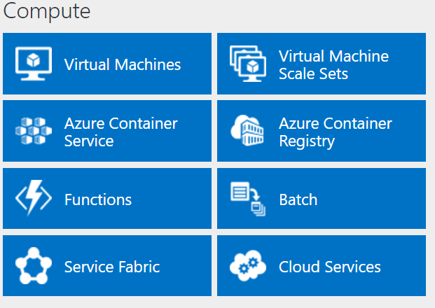
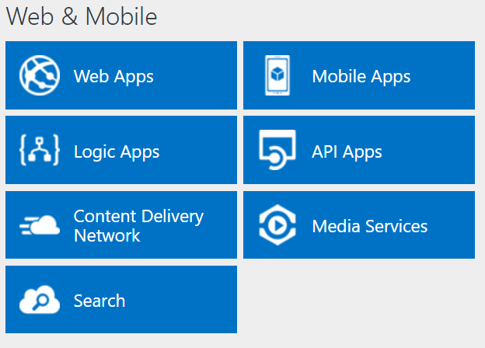
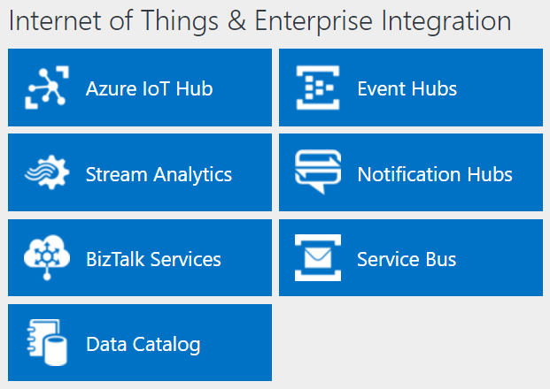
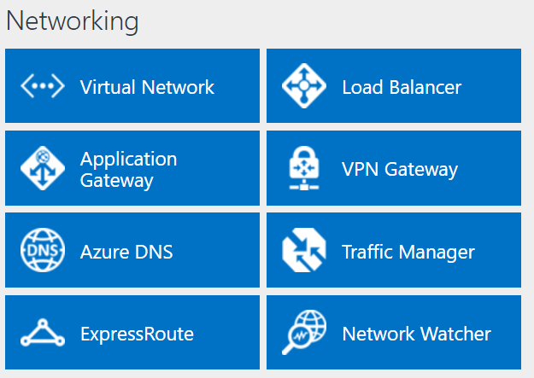
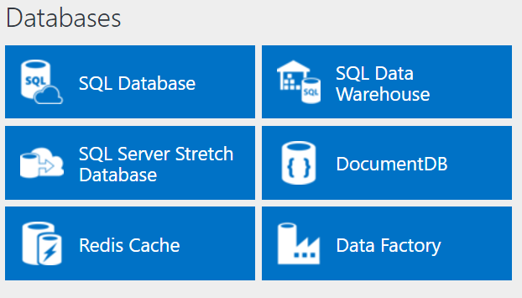
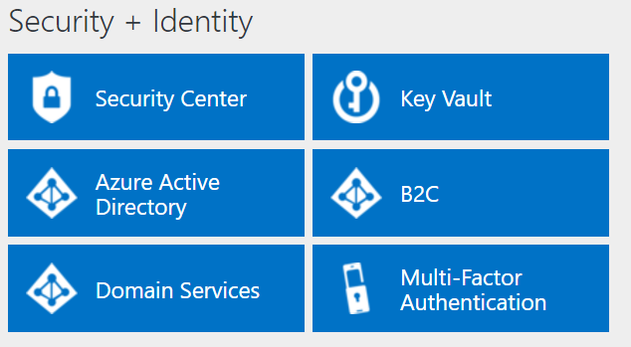
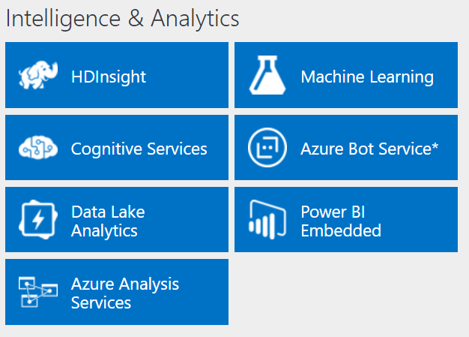
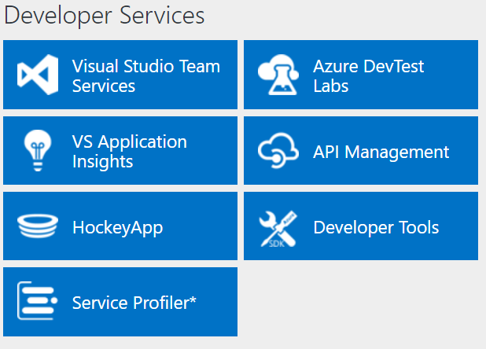
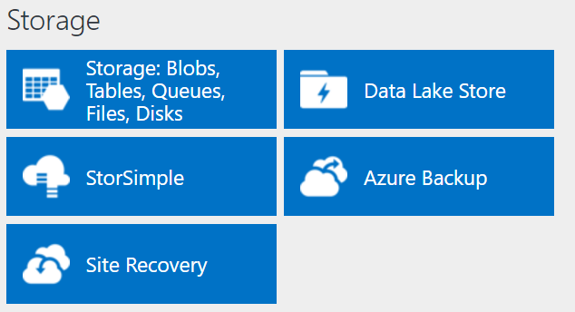
http://azureplatform.azurewebsites.net/
* Preview Services
Notes:
Preview Version 1.7 (2017-04-20)

Slide 7
Design and Implement Azure App Service Apps (10-15%)
Design and Implement Azure App Service Apps (10-15%)
Deploy Web Apps Define deployment slots; roll back deployments; implement pre- and post deployment actions; create, configure, and deploy packages; create App Service plans; migrate Web Apps between App Service plans; create a Web App within an App Service plan; determine when to use App Service Environment (ASE); select and use appropriate deployment methods including Git, FTP, and cloud sync
Configure Web Apps
Define and use app settings, connection strings, handlers, and virtual directories; configure certificates and custom domains; configure SSL bindings and runtime configurations; manage Web Apps by using Azure PowerShell and Azure-CLI; manage App Service backups; configure authentication and authorization for Web Apps; configure Web App notifications
Configure diagnostics, monitoring, and analytics
Retrieve diagnostics data; view streaming logs; configure endpoint monitoring; configure alerts; configure diagnostics; use remote debugging; monitor Web App resources
Configure Web Apps for scale and resilience
Configure auto-scale using built-in and custom schedules; configure by metric; change the size of an instance; configure Traffic Manager

Slide 8
Deploy Web Apps
Define deployment slots; roll back deployments; implement pre- and post deployment actions; create, configure, and deploy packages; create App Service plans; migrate Web Apps between App Service plans; create a Web App within an App Service plan; determine when to use App Service Environment (ASE); select and use appropriate deployment methods including Git, FTP, and cloud sync

Slide 9
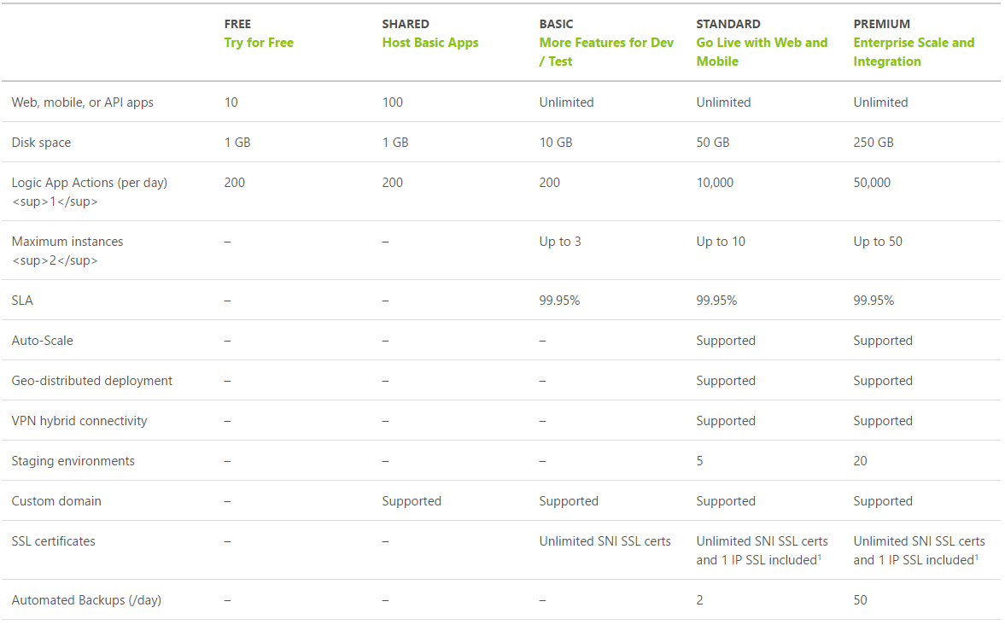
App Service Plan Tiers
https://azure.microsoft.com/en-us/pricing/details/app-service/plans/

Slide 10
Creating web apps
Create an Azure web app by using:
The Azure portal
New-AzureRmWebApp
az webapp create
An Azure Resource Manager template
Visual Studio
Notes:
Describe different ways of creating Azure web apps.
20533D
5: Implementing Azure App Service

Slide 11
Comparing app deployment methods in App Service
Cloud
VSTS
Web app
GitHub
On-premises
TFS
Git
FTP, Web Deploy,
Visual Studio,
Web Matrix,
MSBuild
Notes:
Describe different deployment options for App Service apps.
Question
Given the flexibility that you have when choosing an app-hosting model in Azure, what key factors will influence your decision?
Answer
You can run your apps in Azure by using:
An app service.
A cloud service.
An Azure virtual machine (VM).
Your choice of hosting model depends on several factors, such as the level of control you want to maintain over the hosting environment and your ability to customize apps. You get full control of apps when they run in an Azure VM. App services are optimized for running web-based applications. As an example of a PaaS service, they eliminate the need to maintain virtual machines and web server software. By using App Service, you can quickly provision apps and integrate them with Visual Studio. This option is generally more economical than Azure VMs. However, in more complex scenarios, PaaS cloud services provide better scalability because they can scale web and worker roles independently.
20533D
5: Implementing Azure App Service

Slide 12
Deploying web apps
Advantages of Web Deploy:
Uploads only modified files
Supports HTTPS
Allows setting NTFS permissions
Supports database publishing
Allows setting connection strings
Scripted deployment with:
MSDeploy.exe
Azure PowerShell
Azure CLI
Git
FTP:
Passive vs active
Limitations in comparison with Web Deploy
Notes:
Compare Web Deploy and FTP. Describe different methods of automating deployments.
20533D
5: Implementing Azure App Service

Slide 13
App Service Plan
Represents the collection of physical resources used to host your apps
Region (West US, East US, etc.)
Scale count (one, two, three instances, etc.)
Instance size (Small, Medium, Large)
SKU (Free, Shared, Basic, Standard, Premium)
Web Apps, Mobile Apps, API Apps, Functions run in an App Service Plan
Notes:
Create App Service Plans
Azure App Service plans in-depth overview
https://docs.microsoft.com/en-us/azure/app-service/azure-web-sites-web-hosting-plans-in-depth-overview?toc=%2fazure%2fapp-service-web%2ftoc.json

Slide 14
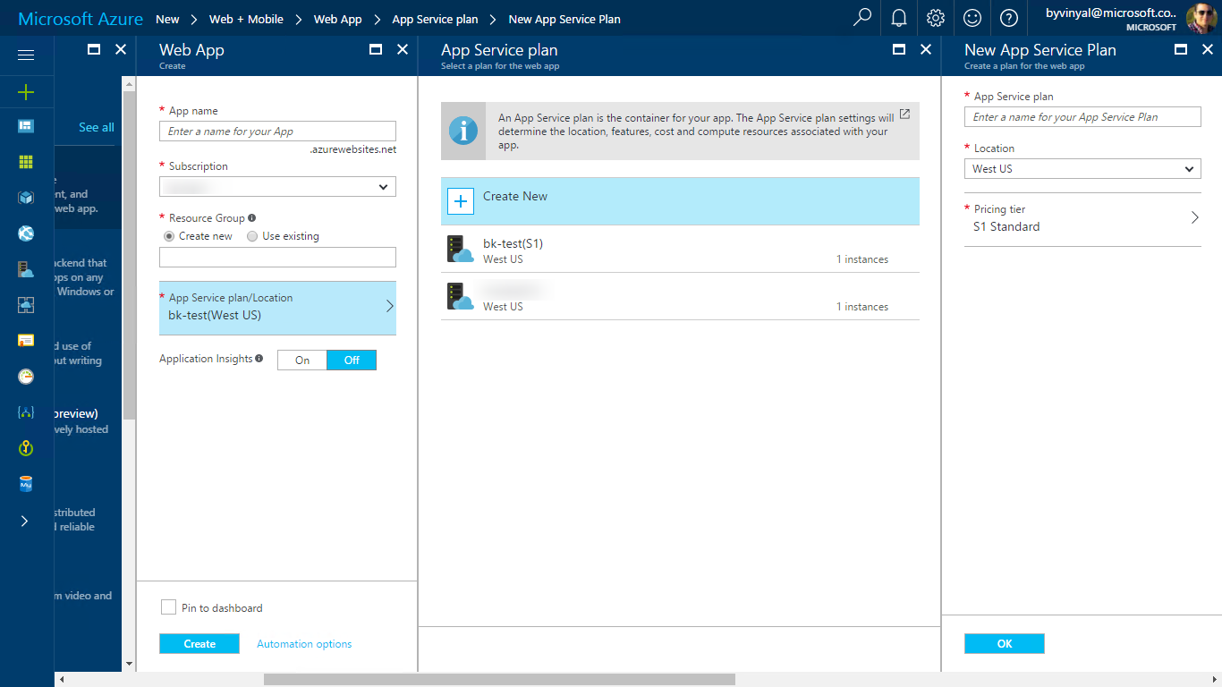
Migrate Apps
You can move an app to another App Service plan as long as the source plan and the target plan are in the same resource group and geographical region.

Slide 15
Deployment Slots
Deployment Slots are live apps with their own hostnames
Only available for Standard or Premium App Service plans
Number of slots available depend on App Service Plan
App content and configurations can be swapped between two deployment slots
Not all settings and configurations are swapped
Some settings can be marked to not swap
Testing in Production feature allows you to spread traffic across multiple deployment slots
Notes:
Update Azure Web Apps with Minimal Downtime
Set up staging environments in Azure App Service
https://docs.microsoft.com/en-us/azure/app-service-web/web-sites-staged-publishing

Slide 16
What gets Swapped with a Deployment Slot?
Swapped | Not Swapped
App Settings – can be configured to not swap | Custom Domain Names
Connection Strings – can be configured to not swap | SSL certificates and bindings
General settings | Scale settings (only production slots are scalable)
Handler mappings | Publishing endpoints
Diagnostic logs settings

Slide 17
Overview of the App Service Environment
Front-end and worker instances
Direct virtual network connectivity (a single subnet)
External or internal VIP
Two versions:
ASEv1:
Classic and Azure Resource Manager deployment models
Up to 55 instances
Requires instance–level and Service Plan–level scaling
Core-based pricing model
ASEv2:
Azure Resource Manager deployment model
Up to 100 instances
Service Plan–level scaling
Core-based plus flat monthly cost pricing model
Notes:
Describe the scenarios for which App Service Environment is suitable. Explain its implementation via the Azure portal.
Question
You work as a developer for your organization, and management asks you to list the major benefits of using App Service. How would you answer?
Answer
Major benefits of App Service include:
Enables you to deploy web and mobile apps rapidly.
Allows you to integrate authentication with Azure AD and other cloud-identity providers.
Supports both production and development environments.
Supports most common development platforms.
20533D
5: Implementing Azure App Service

Slide 18
You have a Web App and want to create a staging deployment slot in order to test a release before moving to production. Your app service plan is currently a Shared plan. What two things do you need to do?
Call Microsoft support
Change your App Service Plan to a Basic plan
Create a new deployment slot named staging
Change your App Service Plan to a Standard plan
Create a new Resource Group

Slide 19
You have a Web App and want to create a staging deployment slot in order to test a release before moving to production. Your app service plan is currently a Shared plan. What two things do you need to do?
Create a new deployment slot named staging
Change your App Service Plan to a Standard plan

Slide 20
Configure Web Apps
Define and use app settings, connection strings, handlers, and virtual directories; configure certificates and custom domains; configure SSL bindings and runtime configurations; manage Web Apps by using Azure PowerShell and Azure-CLI; manage App Service backups; configure authentication and authorization for Web Apps; configure Web App notifications

Slide 21
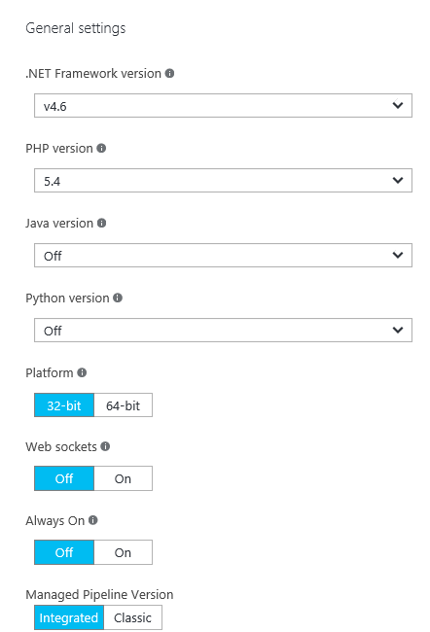
Configuring a web app’s application and authentication settings
Framework versions
Platform and Web sockets
Always On
Managed Pipeline Version
ARR Affinity
Auto Swap
Debugging
Certificates, Domain Names, and SSL Bindings
App Settings
Connection Strings
Default Documents
Diagnostic logs
Authentication and Authorization
Notes:
This slide includes many of the settings that appear in a web app’s Application settings blade.
Consider showing this blade to students as you talk about each setting. Also mention diagnostic logs as well as authentication and authorization settings.
Handler mappings
Use this area to add custom script processors to handle requests for specific file extensions
Virtual applications and directories
To configure virtual applications and directories, specify each virtual directory and its corresponding physical path relative to the website root. Optionally, you can select the Application checkbox to mark a virtual directory as an application.
https://docs.microsoft.com/en-us/azure/app-service/web-sites-configure
20533D
5: Implementing Azure App Service

Slide 22
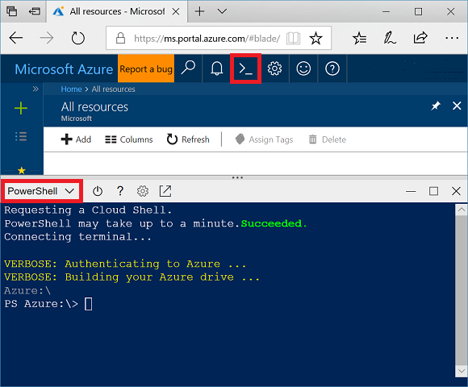
Web App and Powershell
New-AzureRmWebApp -Name $webappname -Location $location -AppServicePlan $webappname -ResourceGroupName myResourceGroup
az webapp create --name $webappname --resource-group myResourceGroup \
--plan $webappname

Slide 23
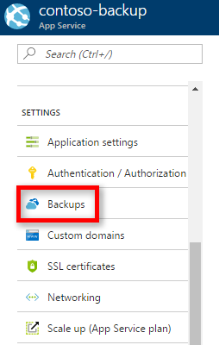
Backup Apps
App Service can back up the following information to an Azure storage account and container that you have configured your app to use:
App configuration
File content
Database connected to your app
https://docs.microsoft.com/en-us/azure/app-service/web-sites-backup

Slide 24
You are launching a beta site and have little budget to spend. You need to be ready in case the site or db goes down and are ok with some downtime. What is the best thing to do?
Deploy another Web App but don’t give anyone the URL
Setup Traffic Manager
Setup Backup for the Web App using a storage account in another region
Create a WebJob that backs up the database

Slide 25
You are launching a beta site and have little budget to spend. You need to be ready in case the site or db goes down and are ok with some downtime. What is the best thing to do?
3) Setup Backup for the Web App using a storage account in another region

Slide 26
Take a look at the Azure PowerShell cmdlets and the CLI documentation. The exam will have questions that use either PowerShell or CLI commands.
Just because this is a design level exam, does not mean there won’t be any code level questions.

Slide 27
Configure diagnostics, monitoring and analytics
Retrieve diagnostics data; view streaming logs; configure endpoint monitoring; configure alerts; configure diagnostics; use remote debugging; monitor Web App resources

Slide 28
Configuring application and site diagnostics
Configure the following application logging settings:
Log storage location
Logging level
Retention period
Configure the following site diagnostics settings:
Web server logging
Detailed error messages
Failed request tracing
Notes:
Application and site logging are useful for generating data to help diagnose faults and poor performance. However, you should emphasize that web apps run faster when you are logging less diagnostic information. Therefore, when you investigate a specific problem, increase the application or site diagnostic levels, but when you are tuning for performance, log as little information as necessary.
20533D
5: Implementing Azure App Service

Slide 29
Monitoring web apps
Access diagnostic logs by using:
FTP
Azure PowerShell
Azure CLI
View logs in Visual Studio by using Application Insights
Monitor web apps in the Azure portal by:
Adding metrics
Configuring alerts:
Email notifications
Webhooks
Logic apps
Notes:
Describe different ways of managing and viewing diagnostic logs. Explain how to configure alerts.
20533D
5: Implementing Azure App Service

Slide 30
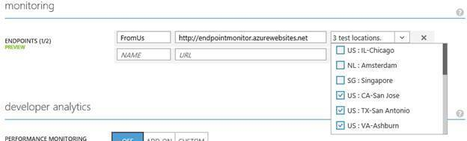
Configure App Service endpoint monitoring
Notes:
Web Server might have gone down
Database server might also have gone down.
Network issues
DNS issues
20533D
5: Implementing Azure App Service

Slide 31
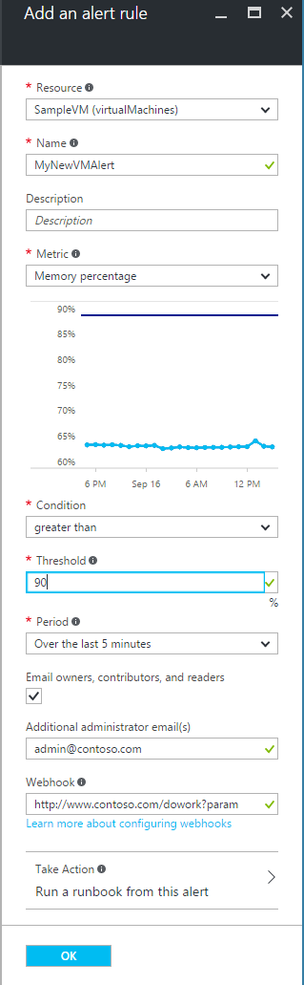
Configure Alerts
Triggers:
Metric values
Activity log events
Actions:
send email notifications
call a webhook
start execution of an Azure runbook
Notes:
You can receive an alert based on monitoring metrics for, or events on, your Azure services.
Metric values - The alert triggers when the value of a specified metric crosses a threshold you assign in either direction. That is, it triggers both when the condition is first met and then afterwards when that condition is no longer being met.
Activity log events - An alert can trigger on every event, or, only when certain events occurs. Learn more about activity log alerts.
You can configure a metric alert to do the following when it triggers:
send email notifications to the service administrator and co-administrators
send email to additional emails that you specify.
call a webhook
start execution of an Azure runbook (only from the Azure portal)
20533D
5: Implementing Azure App Service

Slide 32
Configure Web Apps for scale and resilience
Configure auto-scale using built-in and custom schedules; configure by metric; change the size of an instance; configure Traffic Manager

Slide 33
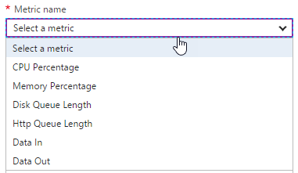
Design for Scalability and Performance
Scale Up – Change pricing tiers: Free, Shared, Basic, Standard, Premium
Scale Out – Change instance count: manually, auto
Scaling condition rules: Scheduled or Metric
Can have multiple condition rules
Can notify via email or webhook when autoscale events occur
Notes:
Design Web Apps for Scalability and Performance
Scale up an app in Azure
https://docs.microsoft.com/en-us/azure/app-service-web/web-sites-scale
Scale instance count manually or automatically
https://docs.microsoft.com/en-us/azure/monitoring-and-diagnostics/insights-how-to-scale?toc=%2fazure%2fapp-service-web%2ftoc.json

Slide 34
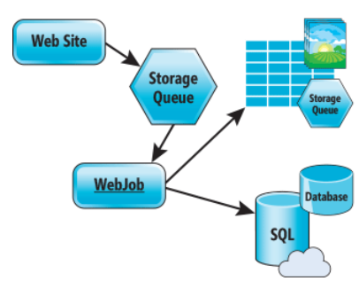
Design for Scalability and Performance
Design for Scale Out
Move towards stateless or at least distributed session/cache
Redis Cache for any Session/Cache needed
Move towards asynchronous UI
Queues for passing work off
Notes:
Azure Web Sites : Scaling Your Web Application with Azure Web Sites
https://msdn.microsoft.com/en-us/magazine/dn786914.aspx
Deploy Azure Web Apps to Multiple Regions for High Availability
Controlling Azure web app traffic with Azure Traffic Manager
https://docs.microsoft.com/en-us/azure/app-service-web/web-sites-traffic-manager
Add a Content Delivery Network (CDN) to an Azure App Service
https://docs.microsoft.com/en-us/azure/app-service-web/app-service-web-tutorial-content-delivery-network

Slide 35
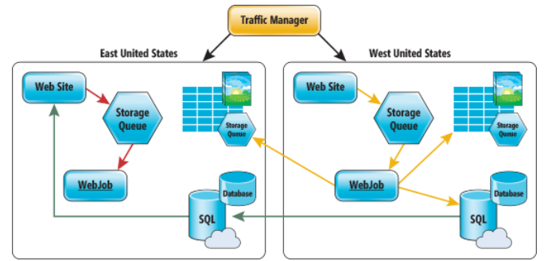
Deploy Azure Web Apps to Multiple Regions
Traffic Manager for routing traffic between regions
Performance – for directing user to closest region Failover – for secondary site Round Robin – for balancing traffic
CDN
Places static content close to user (images, media, etc)
Notes:
Deploy Azure Web Apps to Multiple Regions for High Availability
Controlling Azure web app traffic with Azure Traffic Manager
https://docs.microsoft.com/en-us/azure/app-service-web/web-sites-traffic-manager
Add a Content Delivery Network (CDN) to an Azure App Service
https://docs.microsoft.com/en-us/azure/app-service-web/app-service-web-tutorial-content-delivery-network
Best Practices: Windows Azure Websites (WAWS)
https://azure.microsoft.com/en-us/blog/best-practices-windows-azure-websites-waws/

Slide 36
You are going to deploy your web application on the east coast and west coast. You also want to make sure your users are sent to the closest location. What three things do you need to do?
Create a Traffic Manager profile
Set the Routing method to priority
Set the Routing method to performance
Create a new Resource Group
Add configure the endpoints in Traffic Manager

Slide 37
You are going to deploy your web application on the east coast and west coast. You also want to make sure your users are sent to the closest location. What three things do you need to do?
Create a Traffic Manager profile
Set the Routing method to performance
Add configure the endpoints in Traffic Manager

Slide 38
Creating and configuring a web app
Create a new web app in Azure by using the Azure portal
Browse the new web app
View scaling and configuration options in the Azure portal
Notes:
Review the steps in Lab A: Exercise 1 for guidance when performing this demonstration.
https://github.com/MicrosoftLearning/10979-MicrosoftAzureFundamentals/blob/master/Instructions/10979D_LAB_04.md

Slide 39
Creating and Configuring a Web App
Create a Web App
Managing allocated resources
Explore features and services available
https://github.com/guruskill/70-534/blob/master/Labs/WebAppsLab.md

