Slide 1
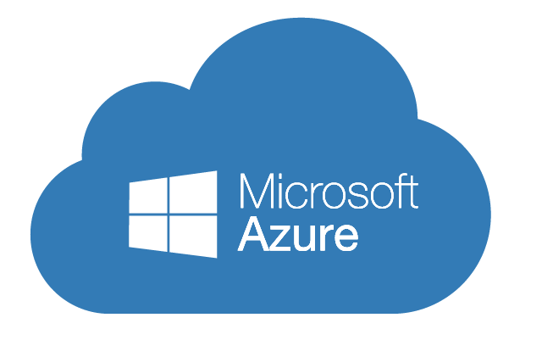
Implementing Microsoft Azure Infrastructure Solutions
Data & Cloud Skill Up and Exam Ready Workshop
WiFi: MSFTGUEST
Password: msevent73ew
Content Location: https://github.com/guruskill/70-533
Notes:
Access codes for wifi should be provided on site

Slide 2
Exam 70-533 Implementing Microsoft Azure Infrastructure Solutions
Design and Implement Azure App Service Apps (10-15%)
Create and Manage Compute Resources (20-25%)
Design and Implement a Storage Strategy (10-15%)
Implement Virtual Networks (15–20%)
Design and Deploy ARM Templates (10-15%)
Manage Azure Security, and Recovery Services (25-30%)
Manage Azure Operations (5-10%)
Manage Azure Identities (5-10%)
Speaker Information:
https://www.microsoft.com/en-ie/learning/exam-70-533.aspx
Notes:
Presentation: 105 minutes
Lab: 50 minutes
After completing this module, students will be able to:
Identify suitable workloads for the cloud.
Identify services and capabilities that Microsoft Azure provides.
Use Azure portals to manage Azure services and subscriptions.
Use Windows PowerShell to manage Azure services and subscriptions.
Use Azure Command-Line Interface (CLI) to manage Azure services and subscriptions.
Describe the primary characteristics of Azure Resource Manager.
Use Azure services to enhance management and monitoring of Azure.
Required materials
To teach this module, you need the Microsoft PowerPoint file 20533D_01.pptx.
Preparation tasks
To prepare for this module, you should:
Read all this module’s materials.
Practice performing the demonstrations and labs.
Work through the Module Review and Takeaways section to determine how you will use the information to reinforce student learning and promote knowledge transfer to on-the-job performance.
As you prepare for this class, it is imperative that you complete the labs yourself. This gives you an understanding of how the labs work, as well as the concepts that each lab covers. This enables you to provide meaningful hints to students who might have issues while working in the labs. Furthermore, it will help guide your lecture to ensure that you discuss the concepts that the labs cover.
20533D
1: Introduction to Microsoft Azure

Slide 3
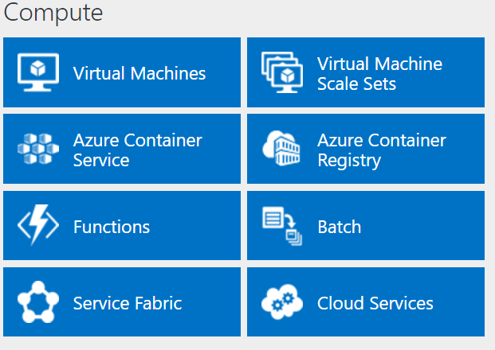
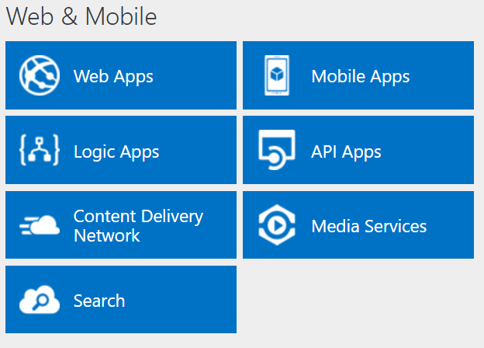
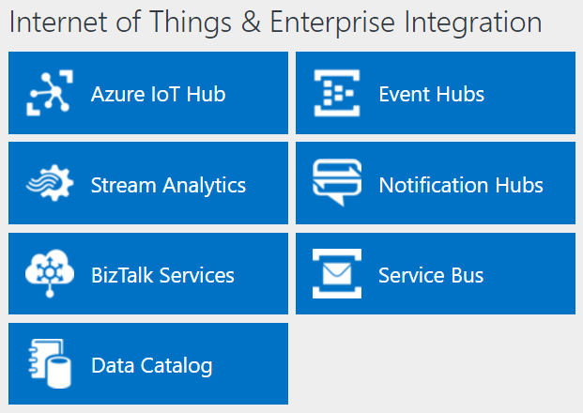
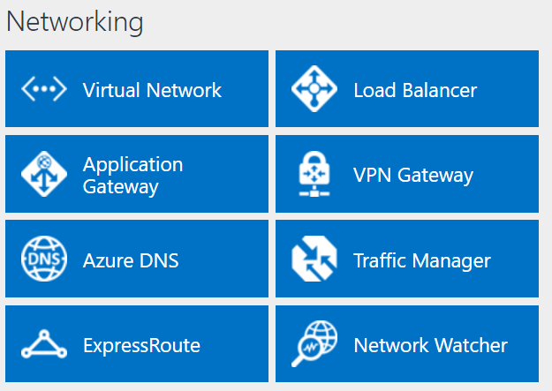
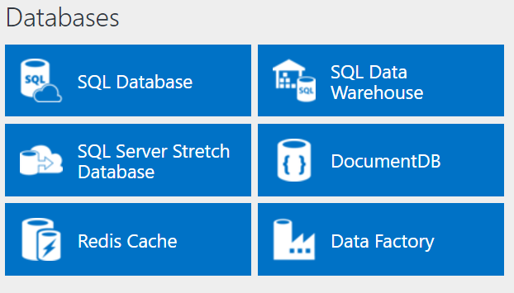
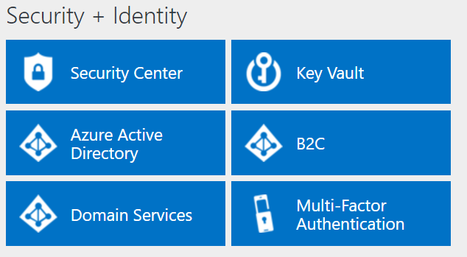
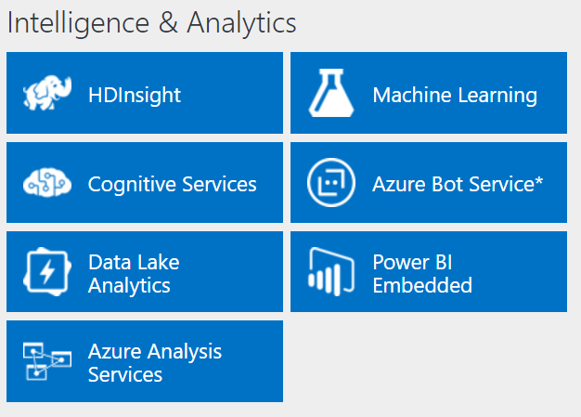
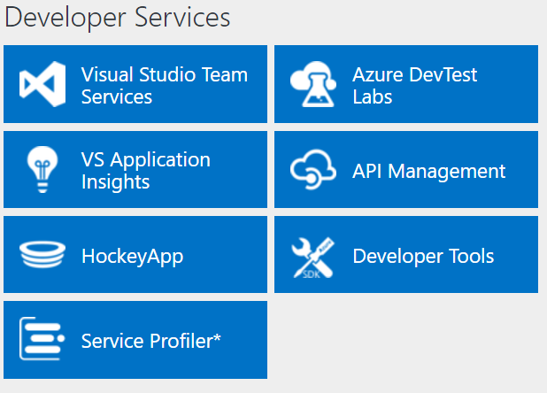
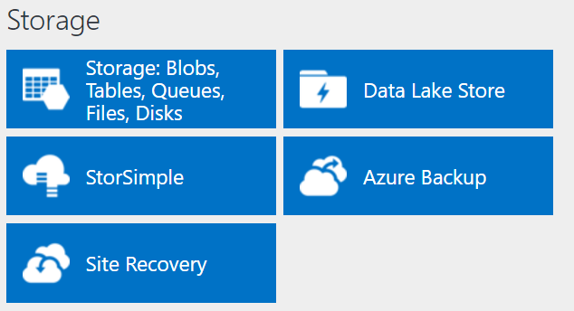
http://azureplatform.azurewebsites.net/
* Preview Services
Notes:
Preview Version 1.7 (2017-04-20)

Slide 4
Implement Virtual Networks (15-20%)
Configure virtual networks
Deploy a VM into a virtual network; configure external and internal load balancing; implement Application Gateway; design subnets; configure static, public, and private IP addresses; set up Network Security Groups (NSGs), DNS at the virtual network level, HTTP and TCP health probes, public IPs, User Defined Routes (UDRs), firewall rules, and direct server return; connect VNets by virtual network peering; configure VMs using a configuration management tool such as Puppet or Chef
Design and implement multi-site or hybrid network connectivity
Choose the appropriate solution between ExpressRoute, site-to-site, and point-to-site; choose the appropriate gateway; identify supported devices and software VPN solutions; identify networking prerequisites; configure virtual networks and multi-site virtual networks; implement virtual network peering and service chaining; implement hybrid connections to access on-premises data sources, leverage S2S VPNs to connect to on-premises infrastructure
Configure ARM VM networking
Configure static IP addresses, Network Security Groups (NSGs), DNS, User Defined Routes (UDRs), external and internal load balancing with HTTP and TCP health probes, public IPs, firewall rules, and direct server return; design and implement Application Gateway
Design and implement a connection strategy
Implement Hybrid Connections to access data sources on-premises; leverage S2S VPN to connect to an on-premises infrastructure
http://download.microsoft.com/download/8/4/8/848DD46A-05F2-4021-A118-036FC06647C5/533_OD_Changes.pdf

Slide 5
Configure Virtual Networks (15-20%)
Deploy a VM into a virtual network; configure external and internal load balancing; implement Application Gateway; design subnets; configure static, public, and private IP addresses; set up Network Security Groups (NSGs), DNS at the virtual network level, HTTP and TCP health probes, public IPs, User Defined Routes (UDRs), firewall rules, and direct server return; connect VNets by virtual network peering; configure VMs using a configuration management tool such as Puppet or Chef
https://www.microsoft.com/en-ie/learning/exam-70-533.aspx

Slide 6
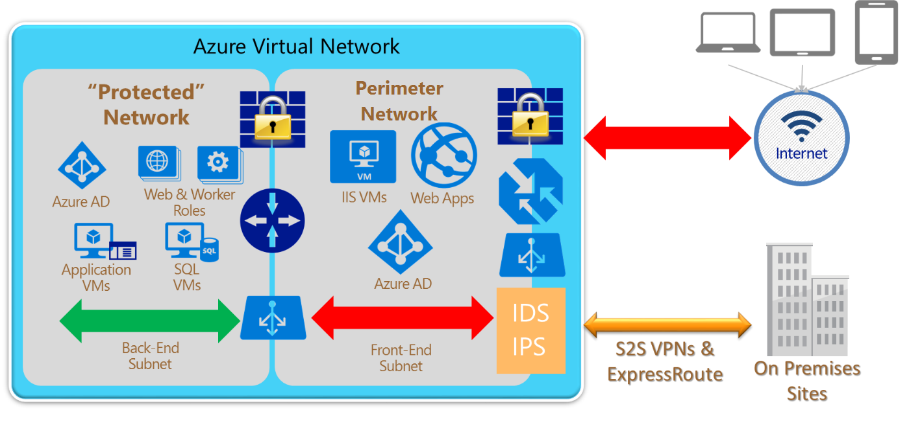
Azure Virtual Network
Notes:
20533D
2: Implementing and managing Azure networking

Slide 7
Creating a virtual network
Notes:
The main tasks for this exercise are as follows:
Create virtual networks by using Azure Portal
Task 1: Create a virtual network by using the Azure portal
From MIA-CL1, start Microsoft Edge, go to http://portal.azure.com, and then, if prompted, sign in to the Azure portal as the Service Administrator of your Azure subscription.
From the Azure portal, create a new virtual network by using the following settings:
Name: labVNet1
Address space: 10.0.0.0/16
Subnet name: Subnet1
Subnet address range: 10.0.0.0/24
Subscription: Your Azure subscription
Resource group: Create new
New resource group name: 10979D05-LabRG01
Location: Azure data center where you can deploy Azure VMs, closest to the location of your classroom
Pin to dashboard: Select the checkbox
From the Azure portal, create a new virtual network by using the following settings:
Name: labVNet2
Address space: 10.1.0.0/16
Subnet name: Subnet1
Subnet address range: 10.1.0.0/24
Subscription: Your Azure subscription
Resource group: Use existing 10979D05-LabRG01
Location: Azure data center where you can deploy Azure VMs, closest to the location of your classroom
Pin to dashboard: Select the checkbox
Task 2: Configure VNet peering by using the Azure portal
In the Azure portal, navigate to the labVNet1 blade.
From the labVNet1 blade, create a VNet peering with the following settings:
Name: labVNet1-labVNet2
Deployment model: Resource manager
Subscription: Your Azure subscription
Virtual network: labVNet2
Allow virtual network access: Enabled.
Allow forwarded traffic: Disabled
Allow gateway transit: Disabled
Use remote gateways: Disabled
In the Azure portal, navigate to the labVNet2 blade.
From the labVNet2 blade, create a VNet peering with the following settings:
Name: labVNet2-labVNet1
Deployment model: Resource manager
Subscription: Your Azure subscription
Virtual network: labVNet1
Allow virtual network access: Enabled.
Allow forwarded traffic: Disabled
Allow gateway transit: Disabled
Use remote gateways: Disabled

Slide 8
Load balancers
Azure Load Balancer:
Internal load balancer
Direct server return
Internet-facing load balancer
To configure:
Assign a front-end IP
Public for an Internet-facing load balancer
Private for an internal load balancer
Assign back-end address pool
Create load-balancing rules
Create inbound NAT rules (optional)
Create health probes
Application Gateway
Traffic Manager
Notes:
Provide an overview of Azure load-balancing solutions.
Direct server return One potential issue with Azure Load Balancing is the possibility of the load balancer to become a bottleneck if the volume of traffic is high. To remediate this issue, you can configure a load-balanced set to provide direct server return. This feature allows the VM that is servicing a client request to respond directly to the client. Effectively, the load balancer is free to handle new requests, rather than keep processing responses. Direct server return is commonly implemented for video or audio, which are susceptible to network delays.
20533D
2: Implementing and managing Azure networking

Slide 9
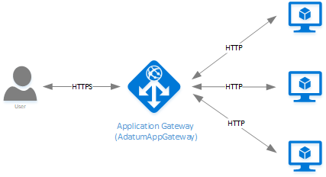
Application Gateway
Notes:
Application Gateway currently provides the following capabilities:
Web application firewall - The web application firewall (WAF) in Azure Application Gateway protects web applications from common web-based attacks like SQL injection, cross-site scripting attacks, and session hijacks.
HTTP load balancing - Application Gateway provides round robin load balancing. Load balancing is done at Layer 7 and is used for HTTP(S) traffic only.
Cookie-based session affinity - The cookie-based session affinity feature is useful when you want to keep a user session on the same back-end. By using gateway-managed cookies, the Application Gateway is able to direct subsequent traffic from a user session to the same back-end for processing. This feature is important in cases where session state is saved locally on the back-end server for a user session.
Secure Sockets Layer (SSL) offload - This feature takes the costly task of decrypting HTTPS traffic off your web servers. By terminating the SSL connection at the Application Gateway and forwarding the request to the server unencrypted, the web server is unburdened by decryption. Application Gateway re-encrypts the response before sending it back to the client. This feature is useful in scenarios where the back-end is located in the same secured virtual network as the Application Gateway in Azure.
End to End SSL - Application Gateway supports end to end encryption of traffic. Application Gateway does this by terminating the SSL connection at the application gateway. The gateway then applies the routing rules to the traffic, re-encrypts the packet, and forwards the packet to the appropriate backend based on the routing rules defined. Any response from the web server goes through the same process back to the end user.
URL-based content routing - This feature provides the capability to use different back-end servers for different traffic. Traffic for a folder on the web server or for a CDN could be routed to a different back-end. This capability reduces unneeded load on backends that don't serve specific content.
Multi-site routing - Application gateway allows for you to consolidate up to 20 websites on a single application gateway.
Websocket support - Another great feature of Application Gateway is the native support for Websocket.
Health monitoring - Application gateway provides default health monitoring of backend resources and custom probes to monitor for more specific scenarios.
SSL Policy and Ciphers - This feature provides the ability to limit the SSL protocol versions and the ciphers suites that are supported and the order in which they are processed.
Request redirect - This feature provides the capability to redirect HTTP requests to an HTTPS listener.
Multi-tenant back-end support - Application gateway supports configuring multi-tenant back-end services like Azure Web Apps and API Gateway as back-end pool members.
Advanced diagnostics - Application gateway provides full diagnostics and access logs. Firewall logs are available for application gateway resources that have WAF enabled.
20533D
2: Implementing and managing Azure networking

Slide 10


Azure Virtual Network Peering
10.0/16
Peering
ARM VNet10.1/16
ARM VNet10.2/16
VPN
On-Premises
Gateway transit via Peering
Direct and bidirectional L3 connectivity between VNet's in same region
High throughput, low latency connectivity
Bypass gateway, no bandwidth bottleneck
Supports Gateway Transit (ARM-to-ARM only)
10/50 Vnet Peering per Virtual network
Peer ASM and ARM VNet's
Peer across subscriptions
NSGs and UDRs will work across the link
Public preview – Global Vnet Peering
US West Central
Canada Central
US West 2
Notes:
Layer 3 connectivity
Connect Vnets that are in same region
Gateway Transit in ARM
ASM + ARM
Global Vnet Peering

Slide 11
IP Addresses
An IP address space with one or more subnets:
Private:
10.x.x.x
172.16.x.x – 172.31.x.x
192.168.x.x
Public (supported, but rarely used)
IP addresses:
Dynamic IP (DIP) address (Private)
Virtual IP (VIP) address (Public)
Instance-level public IP (ILPIP) address
Notes:
• Dynamic IP (DIP) address. A DIP address is a dynamic internal IP address. VMs in the virtual network use this address to communicate with other VMs in the same virtual network. When you have connected a VPN to an Azure virtual network, on-premises clients use DIPs tp communicate with virtual network VMs. DIPs are equivalent to the private IP addresses in the Azure Resource Manager deployment model.
• Virtual IP (VIP) address. A VIP address is a virtual IP address that is assigned to a cloud service. This IP address is a public internet IP address, and external clients use it to communicate with the cloud service and its VMs. All VMs within a single cloud service have the same VIP address.
• Instance-level public IP (ILPIP) address. An ILPIP address is associated directly with the VM, and enables direct communication with a VM from the internet without relying on VIP address.
20533D
2: Implementing and managing Azure networking

Slide 12
Private IP addresses
Private IP address allocation:
Dynamic
Static
Adding a static private IP address:
Azure PowerShell:
$vnet = Get-AzureRmVirtualNetwork -ResourceGroupName AdatumRG -Name AdatumVNet
$subnet = $vnet.Subnets[0].Id
$nic = New-AzureRmNetworkInterface -Name AdatumNIC -ResourceGroupName AdatumRG -Location centralus -SubnetId $vnet.Subnets[0].Id -PrivateIpAddress 192.168.0.10
Add-AzureRmVMNetworkInterface -VM $vm -Id $nic.Id
Azure CLI:
az network nic create --resource-group AdatumRG --name AdatumNIC \ --location centralus --subnet default --private-ip-address 192.168.0.10 \ --vnet-name AdatumVNet
Notes:
Provide an overview of managing private IP addressing on Azure Vnets.
20533D
2: Implementing and managing Azure networking

Slide 13
Configuring network security groups
Network security group rules consist of:
Name
Direction
Priority
Source
Source port range
Destination
Destination port range
Protocol
Action
Notes:
NSG:
are collections of network-level firewalls rules that you can associate with virtual network subnets. A NSG consists of rules that allow or deny inbound and outbound traffic based on a combination of IP address prefixes and ports
20533D
2: Implementing and managing Azure networking

Slide 14
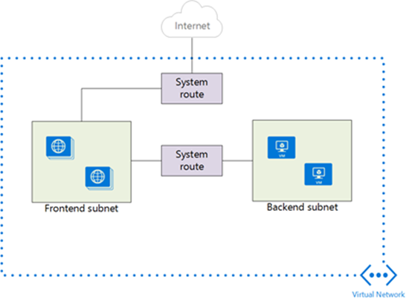
Routing
Default routing
User-defined routes
Boarder Gateway Protocol (BGP)
Notes:
Routing Azure implements a default routing configuration that facilitates basic connectivity, including the ability to reach the internet and to communicate with other resources on the same or directly connected virtual networks. You can modify this default configuration in two ways:
• User-defined routes involve creating custom static routes with one or more rules altering the default routing behavior and associating them with virtual network subnets. These rules apply to any traffic leaving these subnets and targeting IP address ranges that you referenced in your custom routes.
• Border Gateway Protocol (BGP) routes facilitate dynamic route exchange between on-premises networks and Azure virtual networks in hybrid scenarios
20533D
2: Implementing and managing Azure networking

Slide 15
Overview of Azure DNS
Record type | Full Name | Function
A (IPv4) AAAA (IPv6) | Address | Maps a host name such as www.adatum.com to an IP address, such as 131.107.10.10.
CNAME | Canonical name | Assigns a custom name, such as ftp.adatum.com, to a host record, such as host1.adatumcom.
MX | Mail exchange | Points to the host that accepts email for the domain. MX records must point to an A record, and not to a CNAME record.
NS | Name server | Contains the name of a server hosting a copy of the DNS zone.
SOA | Start of Authority | Provides information about the writable copy of the DNS zone, including its location and version number.
SRV | Service | Points to hosts that are providing specific services, such as the Session Initiation Protocol (SIP) or Active Directory Domain Services.
TXT | Text | Contains custom text.
Notes:
Describe different Domain Name System (DNS) record types that Azure DNS supports.
20533D
2: Implementing and managing Azure networking

Slide 16
V-Net Peering
Service chaining
Gateway transit
Requirements:
Same region
No overlapping IP address spaces
Same Azure Active Directory tenant
Azure Resource Manager
Read and write permissions
Limit is 10*
V-Net peering is nontransitive.
East US VNet 1 East US VNet 2
VNet peering
Notes:
As briefly mentioned in the first lesson of this module, you can connect two virtual networks residing in the same Azure region by setting up a VNet peering between them. This implements direct connectivity without using VPN gateways. As a result, you not only avoid the VPN gateway-related charges but the resulting latency and bandwidth match performance characteristics of connections within the same virtual network.
• Service chaining facilitates routing from one of two virtual networks via a virtual appliance located on the other.
• Gateway transit facilitates routing from one Azure virtual network to your on-premises location via another Azure virtual network configured with site-to-site VPN or ExpressRoute
You can establish VNet peering between the two virtual networks if you satisfy the following requirements: • Both virtual networks reside in the same region. • The virtual networks do not have overlapping IP address spaces. • The virtual networks belong either to the same Azure subscription or to separate Azure subscriptions that are associated with the same Azure Active Directory tenant. • At least one of the two networks is an Azure Resource Manager resource. It is not possible to establish VNet peering between two classic virtual networks. • Your user account has at least read and write permissions on the Virtual Network peering resource type scoped to the virtual networks that you want to connect via VNet peering. The built-in Network Contributor role-based access control (RBAC) role includes these permissions. • You have not reached the limit on the number of VNet peerings per virtual network. The default limit is 10. You can increase it to 50 by contacting Azure support.
20533D
2: Implementing and managing Azure networking

Slide 17
Creating an Azure load balancer
https://docs.microsoft.com/en-us/azure/load-balancer/load-balancer-get-started-ilb-arm-portal

Slide 18
Design and implement multi-site or hybrid network connectivity
Choose the appropriate solution between ExpressRoute, site-to-site, and point-to-site; choose the appropriate gateway; identify supported devices and software VPN solutions; identify networking prerequisites; configure virtual networks and multi-site virtual networks; implement virtual network peering and service chaining; implement hybrid connections to access on-premises data sources, leverage S2S VPNs to connect to on-premises infrastructure

Slide 19
Azure virtual network connectivity options
Azure
West US VNet
East US VNet 1 East US VNet 2
VNet-to-VNet
VNet peering
ExpressRoute
Site-to-site
Point-to-site
On-premises network
Notes:
ExpressRoute:
The ExpressRoute service relies on a private connection between your datacenter and an Azure datacenter via a non-Microsoft connectivity provider By eliminating the dependency on internet connectivity, you can ensure consistent, reliable performance levels.
ExpressRoute offers per-circuit throughput of up to 10(Gbps)
Site-to-site:
A site-to-site VPN connects an on-premises network to an Azure virtual network via an IPSec VPN tunnel. This requires an on-premises VPN infrastructure that routes traffic to and from the Azure virtual network. For this purpose, you can use either a hardware VPN device or a software-based VPN service. In addition, you need to modify the on-premises routing configuration to ensure that the traffic targeting Azure virtual networks reaches its destination.
Point-to-site:
Use point-to-site connections when you have up to 128 client computers that you want to connect to an Azure virtual network. Computers with a point-to-site VPN can use that connection from any location with internet access. There is no need for dedicated hardware or software.
20533D
2: Implementing and managing Azure networking

Slide 20
Virtual network connectivity
Cross-premises:
Point-to-Site
Site-to-Site
ExpressRoute
Cross-virtual network:
VNet peering - the same Azure region
VNet-to-VNet - different Azure regions
Virtual gateways:
VPN gateways
ExpressRoute gateways
Notes:
Provide an overview of different ways of connecting to Azure virtual networks.
Mention ExpressRoute support for public peering and Microsoft peering.
20533D
2: Implementing and managing Azure networking

Slide 21
Virtual network connectivity
Cross-premises:
Point-to-Site
Site-to-Site
ExpressRoute
Cross-virtual network:
VNet peering - the same Azure region
VNet-to-VNet - different Azure regions
Virtual gateways:
VPN gateways
ExpressRoute gateways
Notes:
Provide an overview of different ways of connecting to Azure virtual networks.
Mention ExpressRoute support for public peering and Microsoft peering.
20533D
2: Implementing and managing Azure networking

Slide 22
Configure ARM VM networking
Configure static IP addresses, Network Security Groups (NSGs), DNS, User Defined Routes (UDRs), external and internal load balancing with HTTP and TCP health probes, public IPs, firewall rules, and direct server return; design and implement Application Gateway
Covered in computer section
Notes:
Covered in compute seciont

Slide 23
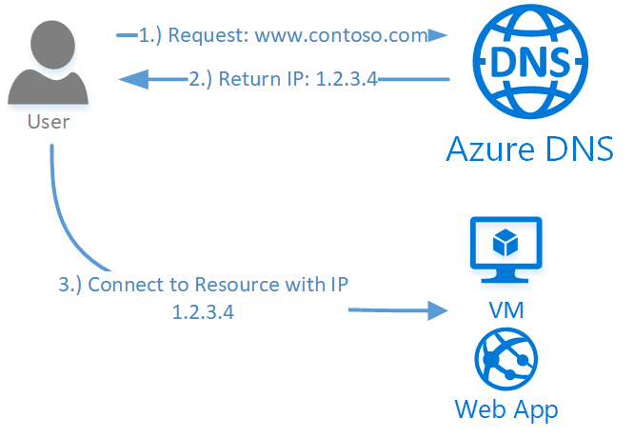
Network Services: Azure DNS
Azure Service for managing Public DNS (99.99% SLA)
Integrates with Azure Management Services
Controlled with Role Based Access Control
100 DNS Zones per subscription
5000 Record sets per zone
20 Records per record set
https://docs.microsoft.com/en-us/azure/dns/dns-overview

Slide 24
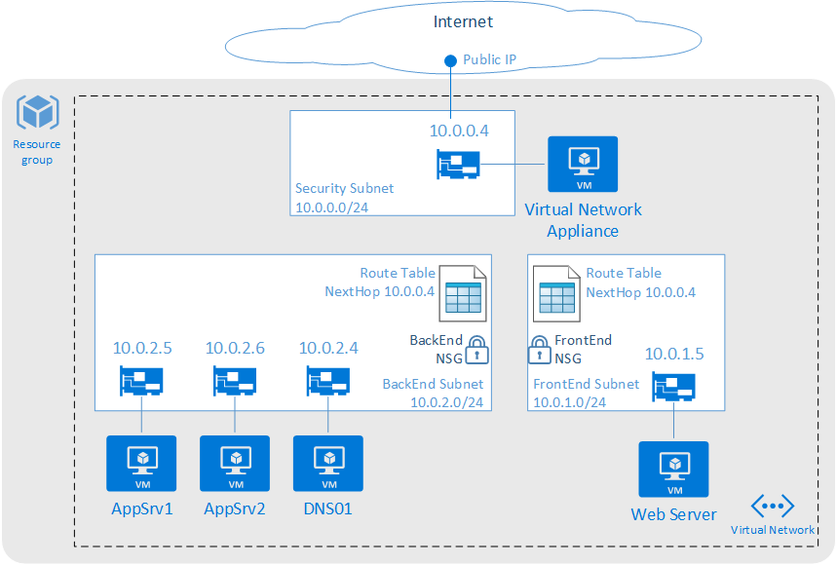
Route Tables
User defined routes
Routes to overwrite Azure system routes
Associated to subnets
Specify next hop
Virtual Appliance
Virtual Network Gateway
None
Virtual Network
Internet
Configure routes in route table
Route Name
Address Prefix (Destination Address)
Next hop type
Next hop address (Virtual Appliance)
100/200 Route Tables per subscription
100/400 routes per Route Table
Notes:
User Defined Routes
Ability to control traffic flow
Imagine we have two subnets within one Vnet
By default all machines in a Vnet can communicate with each other so there is full routed network between them
You don’t want your front end subnet communicate directly with your back end subnet
You want to have your own firewall appliance or an IDS system in between the traffic flow to accomplish that solution we can use User Defined Routes to force the traffic coming to backend subnet that is coming from front end subnet through the firewall instance
You can configure UDR’s for both internal traffic and the traffic leaving your Azure network

Slide 25
Health Probes
Capability of load balancer
Probe count and timeout
Default 15 seconds
Custom default 30 seconds
Definable
Guest agent probe
Guest running in VM HTTP 200 OK response
Custom probe allows greater flexibility (eg. monitor CPU or anything else. Your app returns 200 for success, anything else failure
TCP custom probe – three way handshake with port
https://docs.microsoft.com/en-us/azure/load-balancer/load-balancer-custom-probe-overview

Slide 26

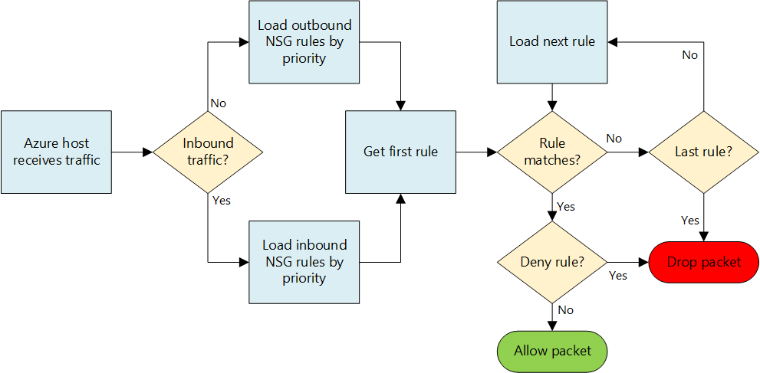
Networking: Network Security Groups
100/400 NSGs per region per sub
Rules per NSG: 200/500
Rules to allow/deny traffic
Rules for inbound/outbound
Can be associated with Subnets and/or directly to NICs attached to VMs.
Rules are based on Protocol, Source Port Range, Destination Port Range, Source Address Prefix, Destination Address Prefix
Default Tags for categories of IP addresses:
VirtualNetwork
AzureLoadbalancer
Internet
Default Rules
Inbound
Allow Vnet, Allow LoadBalancer, Deny All Inbound
Outbound
Allow Vnet, Allow Internet, Deny All Outbound
Service Tags
Application Security Groups
Augmented Rules
https://docs.microsoft.com/en-us/azure/virtual-network/virtual-networks-nsg

Slide 27
Design and implement a connection strategy
Implement Hybrid Connections to access data sources on-premises; leverage S2S VPN to connect to an on-premises infrastructure

Slide 28
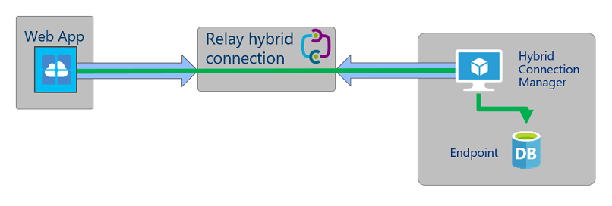
Hybrid Connectivity
https://docs.microsoft.com/en-us/azure/app-service/app-service-hybrid-connections
Notes:
Describe the options for connecting Azure App Service apps to Azure VMs on a virtual network without exposing Azure VMs to the Internet. Briefly mention ASEv2 as a possibility, but point out that its purpose is to build highly scalable, multi-instance deployments. Explain the architecture and implementation of hybrid connections.
20533D
2: Implementing and managing Azure networking

Slide 29
Create a Site-to-Site connection in the Azure portal
HINT: You can setup a SIMULATED on-premises environment by setting up another system in a different region.
https://docs.microsoft.com/en-us/azure/vpn-gateway/vpn-gateway-howto-site-to-site-resource-manager-portal

