Slide 1
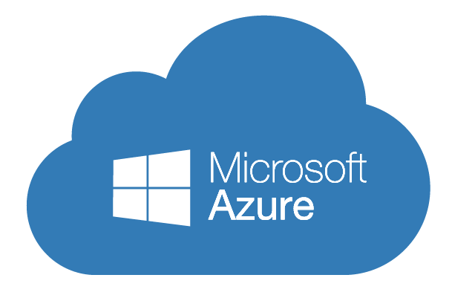
Implementing Microsoft Azure Infrastructure Solutions
Data & Cloud Skill Up and Exam Ready Workshop
WiFi: MSFTGUEST
Password: msevent73ew
Content Location: https://github.com/guruskill/70-533
Notes:
Access codes for wifi should be provided on site

Slide 2
Exam 70-533 Implementing Microsoft Azure Infrastructure Solutions
Design and Implement Azure App Service Apps (10-15%)
Create and Manage Compute Resources (20-25%)
Design and Implement a Storage Strategy (10-15%)
Implement virtual networks (15–20%)
Design and Deploy ARM Templates (10-15%)
Manage Azure Security, and Recovery Services (25-30%)
Manage Azure Operations (5-10%)
Manage Azure Identities (5-10%)
Speaker Information:
https://www.microsoft.com/en-ie/learning/exam-70-533.aspx
Notes:
Presentation: 105 minutes
Lab: 50 minutes
After completing this module, students will be able to:
Identify suitable workloads for the cloud.
Identify services and capabilities that Microsoft Azure provides.
Use Azure portals to manage Azure services and subscriptions.
Use Windows PowerShell to manage Azure services and subscriptions.
Use Azure Command-Line Interface (CLI) to manage Azure services and subscriptions.
Describe the primary characteristics of Azure Resource Manager.
Use Azure services to enhance management and monitoring of Azure.
Required materials
To teach this module, you need the Microsoft PowerPoint file 20533D_01.pptx.
Preparation tasks
To prepare for this module, you should:
Read all this module’s materials.
Practice performing the demonstrations and labs.
Work through the Module Review and Takeaways section to determine how you will use the information to reinforce student learning and promote knowledge transfer to on-the-job performance.
As you prepare for this class, it is imperative that you complete the labs yourself. This gives you an understanding of how the labs work, as well as the concepts that each lab covers. This enables you to provide meaningful hints to students who might have issues while working in the labs. Furthermore, it will help guide your lecture to ensure that you discuss the concepts that the labs cover.
20533D
1: Introduction to Microsoft Azure

Slide 3
Design and Deploy ARM Templates(10-15%)
Implement ARM templates
Control access
Design role-based access control (RBAC)
https://www.microsoft.com/en-ie/learning/exam-70-533.aspx
http://download.microsoft.com/download/8/4/8/848DD46A-05F2-4021-A118-036FC06647C5/533_OD_Changes.pdf

Slide 4
Design and Deploy ARM Templates (10-15%)
Implement ARM templates
Author ARM templates; create ARM templates to deploy multiple ARM Resource Providers resources of different types with count loops and Marketplace items; deploy templates with PowerShell; Azure CLI; Azure Portal and REST API
Control access
Leverage service principals with ARM authentication; use Azure Active Directory Authentication with ARM; set management policies; lock resources
Design role-based access control (RBAC)
Secure resource scopes such as the ability to create VMs and Azure Web Apps; implement Azure RBAC standard roles; design RBAC custom roles

Slide 5
Implement ARM templates
Author ARM templates; create ARM templates to deploy multiple ARM Resource Providers resources of different types with count loops and Marketplace items; deploy templates with PowerShell ; Azure CLI; Azure Portal and REST API

Slide 6
Azure Resource Manager template
JSON files
Define resources to be deployed
JSON editor (Visual Studio Code)
Visual Studio Code
Lightweight
Open source
Cross-platform code editor
https://code.visualstudio.com

Slide 7
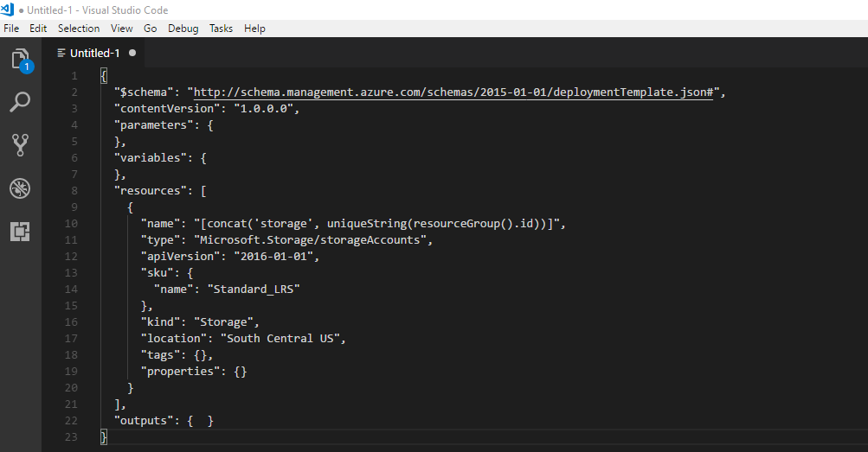
Create template
File-New to create a new template
Save as .json file

Slide 8
Deploy template
PowerShell
Login-AzureRMAccount
New-AzureRmResourceGroup –name webapp ‘South Central US’
New-AzureRmResourceGroupDeployment –location webapp –TemplateFile azuredeploy.json
Azure CLI
az login
az group create –name webapp –location ‘South Central US’
az group deployment create –resource-group webapp –template-file azuredeploy.json

Slide 9

Azure Cloud Shell
Interactive browser accessible shell
Flexible selection of workloads
Linux
Bash
Windows
PowerShell
Azure portal access

Slide 10
Cloud Shell features
Browser based shell experience
Choice of preferred shell experience
Bash
PowerShell
Managed by Microsoft
Command-line tools and language support
Automatically authenticates giving access to
Azure CLI 2.0
PowerShell

Slide 11
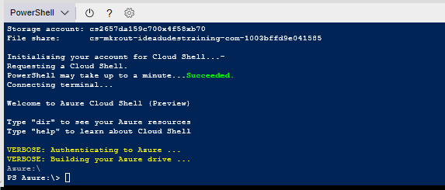
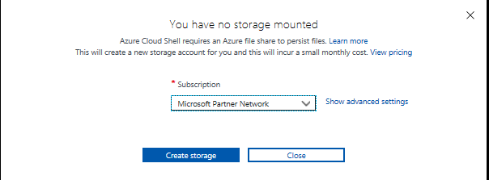
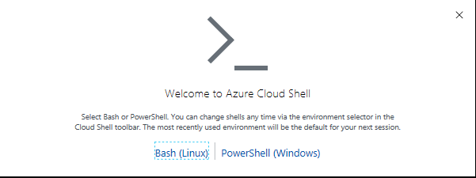
Connect your File Storage
Cloud Shell Machines are temporary
Require clouddrive mount point
First launch will configure
Resource group: cloud-shell-storage-<region>
Storage account: cs-<uniqueGuid>
Azure file share: <cs-<user>-<domain>-com-<uniqueGuid>
Pricing
Machine hosting is required (Free)
Storage account is required (costs apply)
Things to remember about Cloud Shell
Runs on a temporary host provided on a per-session, per-user-basis
Times out after 20 minutes of inactivity
Requires an Azure file share to be mounted
Uses the same Azure file share for Bash or PowerShell
Is assigned one machine per user account
Bash persists $Home using a 5GB image held in your file share
Permissions are set as a regular Linux user in Bash
https://docs.microsoft.com/en-us/azure/cloud-shell/persisting-shell-storage

Slide 12
Deploy template from Cloud Shell
Login to Azure portal
Select Resource Group
Select Storage Account
Select Files
Select the file share for Cloud Shell
Add a Directory
Select your directory
Select Upload
Find and upload your template file
Open Cloud Shell
CLI: https://docs.microsoft.com/en-us/azure/azure-resource-manager/resource-group-template-deploy-cli
PowerShell: https://docs.microsoft.com/en-us/azure/azure-resource-manager/resource-group-template-deploy

Slide 13
Parameterize a template
Parameters
"parameters": {
"storageSKU": {
"type": "string",
"allowedValues": [
"Standard_LRS",
"Standard_ZRS",
"Standard_GRS",
"Standard_RAGRS",
"Premium_LRS"
],
"defaultValue": "Standard_LRS",
"metadata": {
"description": "The type of replication to use for the storage account."
}
}
},

Slide 14
Add variables to a template
"variables": {
"storageName": "[concat(toLower(parameters('storageNamePrefix')), uniqueString(resourceGroup().id))]"
},

Slide 15
Change the Resources section
"resources": [
{
"name": "[variables('storageName')]",
"type": "Microsoft.Storage/storageAccounts",
"apiVersion": "2016-01-01",
"sku": {
"name": "[parameters('storageSKU')]"
},
"kind": "Storage",
"location": "[resourceGroup().location]",
"tags": {},
"properties": {}
}
],

Slide 16
ARM template basic structure
{
"$schema": "http://schema.management.azure.com/schemas/2015-01-01/deploymentTemplate.json#",
"contentVersion": "",
"parameters": { },
"variables": { },
"resources": [ ],
"outputs": { }
}
Element name | Required | Description
$schema | Yes | Location of the JSON schema file that describes the version of the template language.
contentVersion | Yes | Use for tracking updates to a template.
parameters | No | Used to customize deployment
variables | No | Values that are used as JSON fragments in the template to simplify template language expressions
resources | Yes | Resource types that are deployed or updated in a resource group
outputs | No | Values that are returned after deployment

Slide 17
Create multiple instances of a resource
{
"$schema": "https://schema.management.azure.com/schemas/2015-01-01/deploymentTemplate.json#",
"contentVersion": "1.0.0.0",
"resources": [
{
"apiVersion": "2016-01-01",
"type": "Microsoft.Storage/storageAccounts",
"name": "[concat(copyIndex(),'storage', uniqueString(resourceGroup().id))]",
"location": "[resourceGroup().location]",
"sku": {
"name": "Standard_LRS"
},
"kind": "Storage",
"properties": {},
"copy": {
"name": "storagecopy",
"count": 3
}
}
],
"outputs": {}
}

Slide 18
Control access
Leverage service principals with ARM authentication; use Azure Directory Authentication with ARM; set management policies; lock resources

Slide 19
Register and application in Azure AD
First thing
Tells Azure AD the type of application will be authenticating
OAuth2 protocol flow
Two types applications
Web App/API (browser based)
Native (does not use a browser)
Done using
Azure CLI
PowerShell

Slide 20
Service principals
Identity for an app
Authentication through own credentials
Enables you to
Assign permissions to the app apart from your own (impersonation)
Use a certificate for authentication when executing an unattended script

Slide 21
Service principal using a password (PowerShell)
Login-AzureRmAccount
$password = convertto-securestring {provide-password} -asplaintext -force
$sp = New-AzureRmADServicePrincipal -DisplayName exampleapp -Password $password
Sleep 20
New-AzureRmRoleAssignment -RoleDefinitionName Contributor -ServicePrincipalName $sp.ApplicationId
https://docs.microsoft.com/en-us/azure/azure-resource-manager/resource-group-authenticate-service-principal

Slide 22
Service principal using a self-signed certificate (PowerShell)
Login-AzureRmAccount
$cert = New-SelfSignedCertificate -CertStoreLocation "cert:\CurrentUser\My" -Subject "CN=exampleappScriptCert" -KeySpec KeyExchange
$keyValue = [System.Convert]::ToBase64String($cert.GetRawCertData())
$sp = New-AzureRMADServicePrincipal -DisplayName exampleapp -CertValue $keyValue -EndDate $cert.NotAfter -StartDate $cert.NotBefore
Sleep 20
New-AzureRmRoleAssignment -RoleDefinitionName Contributor -ServicePrincipalName $sp.ApplicationId
https://docs.microsoft.com/en-us/azure/azure-resource-manager/resource-group-authenticate-service-principal

Slide 23
Lock resources
Can be locked
Subscription
Resource group
Resource
Lock Level
CanNotDelete
ReadOnly
https://docs.microsoft.com/en-us/azure/azure-resource-manager/resource-group-lock-resources

Slide 24
How are locks applied
Parent Scope
All resources are locked from the top
New resources will inherit the lock setting
Most restrictive takes place
Resource Manager locks apply across all users and roles
Apply to management.azure.com
Resource changes are restricted but operations are not

Slide 25
Who can create and delete locks
Microsoft.Authorization/*
Microsoft.Authorization/locks/*
Owner
User Access Administrator

Slide 26
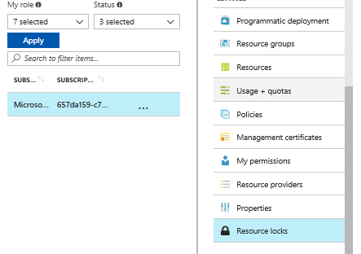
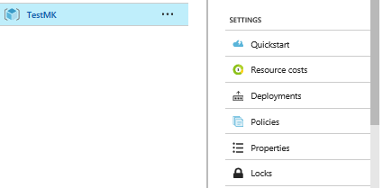
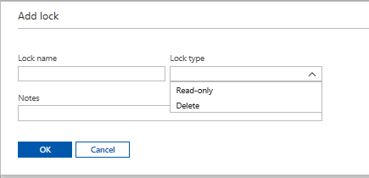
Locks through portal

Slide 27
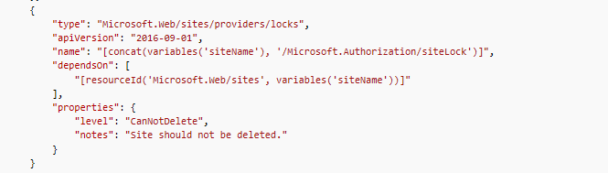
Locks through templates

Slide 28
Applying locks through PowerShell
New-AzureRmResourceLock -LockLevel CanNotDelete -LockName LockSite -ResourceName examplesite -ResourceType Microsoft.Web/sites -ResourceGroupName exampleresourcegroup
New-AzureRmResourceLock -LockName LockGroup -LockLevel CanNotDelete -ResourceGroupName exampleresourcegroup
Get-AzureRmResourceLock
Get-AzureRmResourceLock -ResourceName examplesite -ResourceType Microsoft.Web/sites -ResourceGroupName exampleresourcegroup
$lockId = (Get-AzureRmResourceLock -ResourceGroupName exampleresourcegroup -ResourceName examplesite -ResourceType Microsoft.Web/sites).LockId
Remove-AzureRmResourceLock -LockId $lockId
https://docs.microsoft.com/en-us/azure/azure-resource-manager/resource-group-lock-resources

Slide 29
Design role-based access control (RBAC)
Secure resource scopes such as the ability to create VMs and Azure Web Apps; Implement Azure RBAC standard roles; design Azure RBAC custom roles

Slide 30
Role-Based Access Control (RBAC)
Fine grained access management
Theory “Least Privilege”
2000 role assignments per subscription
Examples Owner, Contributor, Reader, View access, Add Access
Built-in roles for Azure role-based access control
https://docs.microsoft.com/en-us/azure/active-directory/role-based-access-built-in-roles
Use the Get-AzureRmRoleDefinition cmdlet to list all current roles
https://docs.microsoft.com/en-us/azure/active-directory/role-based-access-control-configure

Slide 31
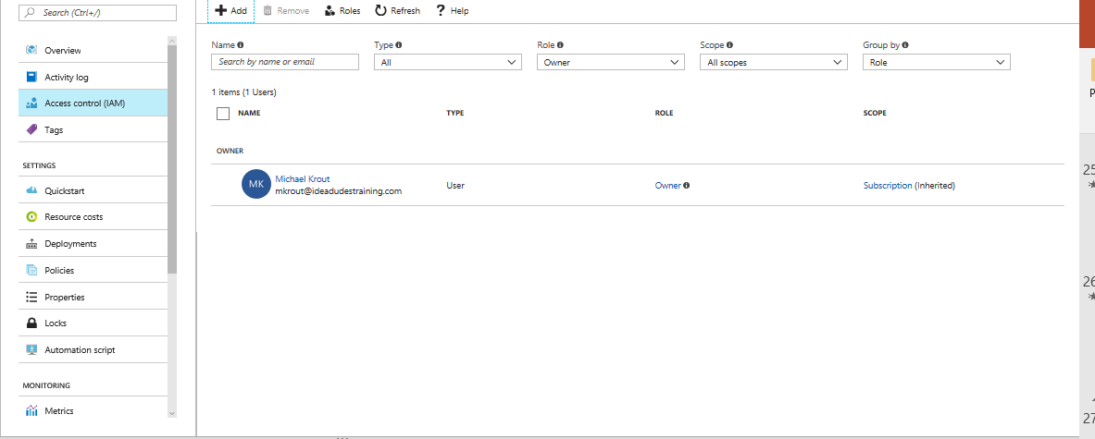
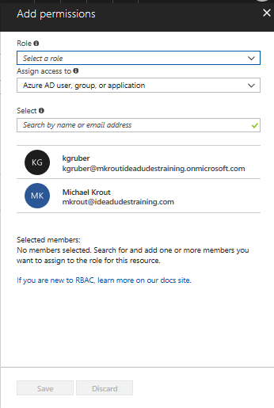
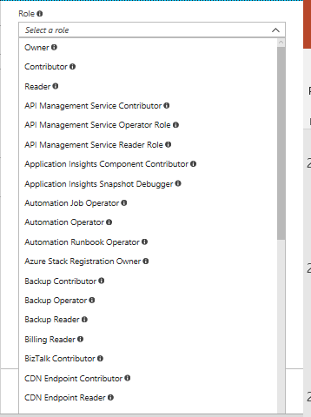
Viewing and assigning roles
Can be applied
Azure AD users, groups, applications
Virtual Machines

Slide 32
Owner built-in role
Unrestricted permissions - Can manage everything, including access
Assigned to any
Subscription
Resource group
Resource

Slide 33
Contributor built-in role
Same as Owner
Three actions not allowed
Microsoft.Authorization/*/Delete
Microsoft.Authorization/*/Write
Microsoft.Authorization/elevateAccess/Action
They cannot
Create, modify or delete classic adminstrators
Create, modify or delete locks
Create, modify or delete policy definitions or role definitions
Create, modify or delete policy assignments or role assignments
Elevate access as an Azure AD tenant administrator (i.e. manage access for others)

Slide 34
Reader built-in role
Can read any resource which is ‘/’

Slide 35
Create custom roles for Azure RBAC
None of built-in fit need
Created using
Azure PowerShell
Azure CLI
REST API
2000 custom roles
{
"Name": "Virtual Machine Operator",
"Id": "cadb4a5a-4e7a-47be-84db-05cad13b6769",
"IsCustom": true,
"Description": "Can monitor and restart virtual machines.",
"Actions": [
"Microsoft.Storage/*/read",
"Microsoft.Network/*/read",
"Microsoft.Compute/*/read",
"Microsoft.Compute/virtualMachines/start/action",
"Microsoft.Compute/virtualMachines/restart/action",
"Microsoft.Authorization/*/read",
"Microsoft.Resources/subscriptions/resourceGroups/read",
"Microsoft.Insights/alertRules/*",
"Microsoft.Insights/diagnosticSettings/*",
"Microsoft.Support/*"
],
"NotActions": [
],
"AssignableScopes": [
"/subscriptions/c276fc76-9cd4-44c9-99a7-4fd71546436e",
"/subscriptions/e91d47c4-76f3-4271-a796-21b4ecfe3624",
"/subscriptions/34370e90-ac4a-4bf9-821f-85eeedeae1a2"
]
}

Slide 36
Action property
Azure operations that are allowed
Look like
Microsoft.<ProviderName>/<ChildResourceType>/<Action>’
Get-AzureRmProviderOperation
PowerShell
List operations of Azure resource providers
azure provider operations show
Azure CLI

Slide 37
A developer creates an application that needs access to external resources. This application will be deployed in the domain.
You need to use Azure Command-Line Interface (CLI) to create a service principle. How should you configure the command?
Command segment
Service Principal unvalidated URI network path file path
Service Principal permissions: Reader Contributor Owner User Access Administrator Website Contributor

Slide 38
A developer creates an application that needs access to external resources. This application will be deployed in the domain.
You need to use Azure Command-Line Interface (CLI) to create a service principle. How should you configure the command?
Command segment
Service Principal unvalidated URI network path file path
Service Principal permissions: Reader Contributor Owner User Access Administrator Website Contributor

Slide 39
You are updating an Azure Resource Manager (ARM) template.
You need to ensure that the JSON file uses the latest version available. Which template element should you modify.
$schema
variables
resources
parameters

Slide 40
You are updating an Azure Resource Manager (ARM) template.
You need to ensure that the JSON file uses the latest version available. Which template element should you modify.
$schema
variables
resources
parameters

Slide 41
You use ARM templates to deploy resources.
You need to ensure the storage resources defined in a template cannot be deleted.
Solution:
“resources”: {
{
“name:”[concat(parameters(‘lockedResource’), ‘/Microsoft.Authorization/myLock’)}”, “type”: “Microsoft.Authorization/locks”, “apiVersion”: “2018-01-01”, “properties”: {
“level”: “ReadOnly”
} } }
Does the solution meet the goal?
Yes
No

Slide 42
You use ARM templates to deploy resources.
You need to ensure the storage resources defined in a template cannot be deleted.
Solution:
“resources”: {
{
“name:”[concat(parameters(‘lockedResource’), ‘/Microsoft.Authorization/myLock’)}”, “type”: “Microsoft.Authorization/locks”, “apiVersion”: “2018-01-01”, “properties”: {
“level”: “ReadOnly”
} } }
Does the solution meet the goal?
Yes
No

Slide 43
You use ARM templates to deploy resources.
You need to ensure the storage resources defined in a template cannot be deleted.
Solution:
“resources”: {
{
“name:”[concat(parameters(‘lockedResource’), ‘/Microsoft.Authorization/myLock’)}”, “type”: “Microsoft.Authorization/locks”, “apiVersion”: “2018-01-01”, “properties”: {
“level”: “CannotDelete”
} } }
Does the solution meet the goal?
Yes
No

Slide 44
You use ARM templates to deploy resources.
You need to ensure the storage resources defined in a template cannot be deleted.
Solution:
“resources”: {
{
“name:”[concat(parameters(‘lockedResource’), ‘/Microsoft.Authorization/myLock’)}”, “type”: “Microsoft.Authorization/locks”, “apiVersion”: “2018-01-01”, “properties”: {
“level”: “CannotDelete”
} } }
Does the solution meet the goal?
Yes
No

Slide 45
You created an application to authenticate using Azure AD.
You need to register the application in Azure AD. What ways can you do this?
Azure CLI
REST API
Python
Azure PowerShell

Slide 46
You created an application to authenticate using Azure AD.
You need to register the application in Azure AD. What ways can you do this?
Azure CLI
REST API
Python
Azure PowerShell

Slide 47
Create and deploy your first Azure Resource Manager template
Visual Studio Code. If needed, install it from https://code.visualstudio.com/.
https://docs.microsoft.com/en-us/azure/azure-resource-manager/resource-manager-create-first-template

