Slide 1
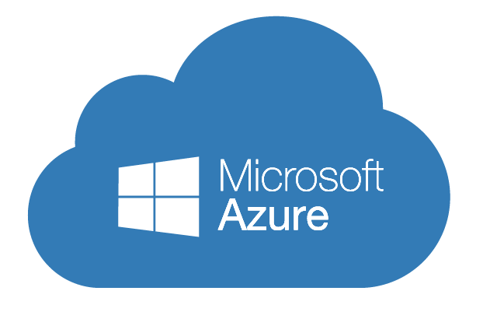
Implementing Microsoft Azure Infrastructure Solutions
Data & Cloud Skill Up and Exam Ready Workshop
WiFi: MSFTGUEST
Password: msevent73ew
Content Location: https://github.com/guruskill/70-533
Notes:
Access codes for wifi should be provided on site

Slide 2
Exam 70-533 Implementing Microsoft Azure Infrastructure Solutions
Design and Implement Azure App Service Apps (10-15%)
Create and Manage Compute Resources (20-25%)
Design and Implement a Storage Strategy (10-15%)
Implement virtual networks (15–20%)
Design and Deploy ARM Templates (10-15%)
Manage Azure Security, and Recovery Services (25-30%)
Manage Azure Operations (5-10%)
Manage Azure Identities (5-10%)
Speaker Information:
https://www.microsoft.com/en-ie/learning/exam-70-533.aspx
Notes:
Presentation: 105 minutes
Lab: 50 minutes
After completing this module, students will be able to:
Identify suitable workloads for the cloud.
Identify services and capabilities that Microsoft Azure provides.
Use Azure portals to manage Azure services and subscriptions.
Use Windows PowerShell to manage Azure services and subscriptions.
Use Azure Command-Line Interface (CLI) to manage Azure services and subscriptions.
Describe the primary characteristics of Azure Resource Manager.
Use Azure services to enhance management and monitoring of Azure.
Required materials
To teach this module, you need the Microsoft PowerPoint file 20533D_01.pptx.
Preparation tasks
To prepare for this module, you should:
Read all this module’s materials.
Practice performing the demonstrations and labs.
Work through the Module Review and Takeaways section to determine how you will use the information to reinforce student learning and promote knowledge transfer to on-the-job performance.
As you prepare for this class, it is imperative that you complete the labs yourself. This gives you an understanding of how the labs work, as well as the concepts that each lab covers. This enables you to provide meaningful hints to students who might have issues while working in the labs. Furthermore, it will help guide your lecture to ensure that you discuss the concepts that the labs cover.
20533D
1: Introduction to Microsoft Azure

Slide 3
Manage Azure Security and Recovery Services (25-30%)
Manage data protection and security compliance
Implement recovery services
https://www.microsoft.com/en-ie/learning/exam-70-533.aspx
http://download.microsoft.com/download/8/4/8/848DD46A-05F2-4021-A118-036FC06647C5/533_OD_Changes.pdf

Slide 4
Manage data protection and services compliance
Manage data protection and security compliance
Create and import encryption keys with Key Vault; automate tasks for SSL/TLS certificates; prevent and respond to security threats with Azure Security Center; Configure single sign-on with SaaS applications using federation and password based; add users and groups to applications; revoke access to SaaS applications; configure access; configure federation with public consumer identity providers such as Facebook and Google
Implement recovery services
Create a backup vault; deploy a backup agent; backup and restore data; using of snapshots and Geo-replication for recovery; implement DR as service; Deploy Azure Site Recovery (ASR) agent; configure ASR; configure ASR one-click failover
http://download.microsoft.com/download/8/4/8/848DD46A-05F2-4021-A118-036FC06647C5/533_OD_Changes.pdf

Slide 5
Manage data protection and security compliance
Create and import encryption keys with Key Vault; automate tasks for SSL/TLS certificates; prevent and respond to security threats with Azure Security Center; Configure single sign-on with SaaS applications using federation and password based; add users and groups to applications; revoke access to SaaS applications; configure access; configure federation with public consumer identity providers such as Facebook and Google

Slide 6
Create and import keys with Key Vault
Secure storage of cryptographic keys
Uses FIPS 140-2 Level 2 validated hardware security modules (HSM)
Keys can be accessed using Azure AD
Two pricing tiers
A1 Standard
Allows for software-protected
P1 Premium
Allows keys to protected by Hardware Security Modules (HSM)
Created by
Azure portal
PowerShell
Azure CLI

Slide 7
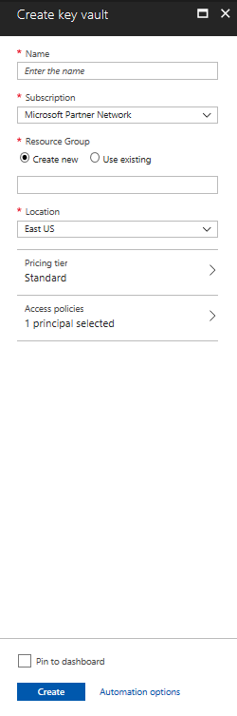
Create a Key Vault (Azure portal)
Marketplace
Specify name
Only alphanumeric characters
Must start with a letter and end with a letter or digit
Must be 3-24 characters in length
Cannot contain consecutive hyphens
Specify an Azure AD user or group and permission they have
Access Policy

Slide 8
Managing Security
Create an Azure key Vault

Slide 9
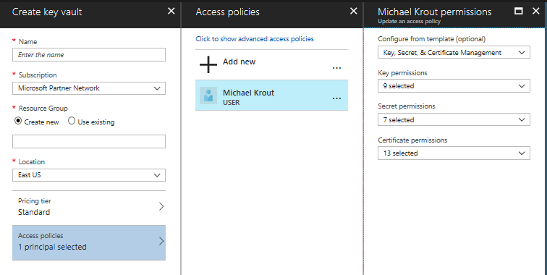
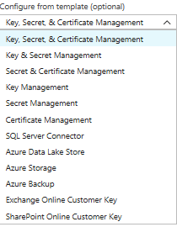
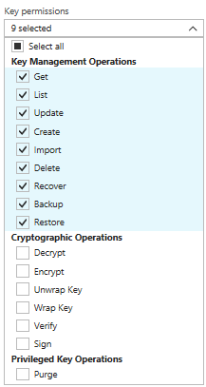
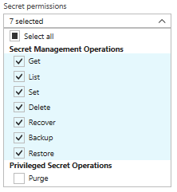
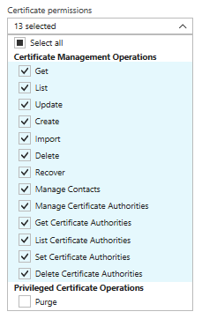
Access Policy

Slide 10
Create Key Vault (PowerShell)
Create Resource Group
$rg = New-AzureRmResourceGroup –name “MyKeyValutRG” –Location “East US”
Create Key Vault
New-AzureRmKeyVault – ValutName “MyKeyVault-0” –ResourceGroupName $rg.ResourceGroupName –Location “East US”

Slide 11
Create a Key Vault (CLI)
Create Resource group
az group create --name “MyKeyValutRG” --location “East US”
Create Key Vault
Az keyvault create –name “MyKeyVault-0” –resource-group “MyKeyVaultRG” --location “East US”

Slide 12
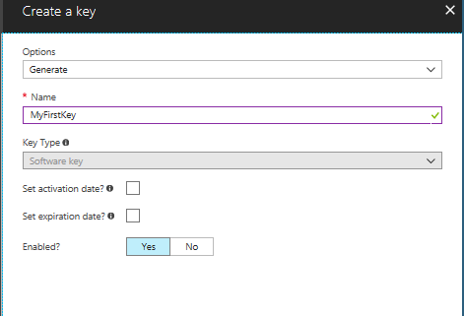
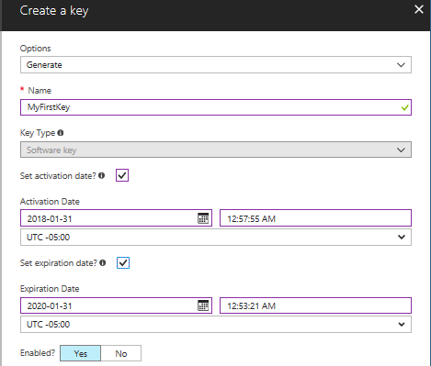
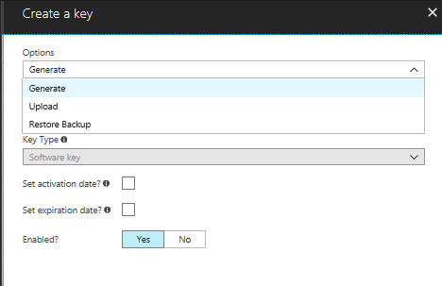
Create a Key (Azure Portal)
Keys stored
Encrypting
Decrypting
Secrets such as passwords
.pfx or .pem
Referenced through a URI
Authenticated by Azure AD
Steps
Select Key Vault from resource group
Click Keys
Click Add
Enter name
If P1 key then can be protected using HSM

Slide 13
Create a Key (PowerShell)
Create a key
Add-AzureRmKeyVaultKey –VaultName “MyKeyVault-0” –Name “MyFirstKey” –Destination “Software”

Slide 14
Create a Key (Azure CLI)
Create a key
az keyvault key create --vault-name ‘MyKeyVault-0’ –name ‘MyThirdKey’ --protection ‘software’

Slide 15
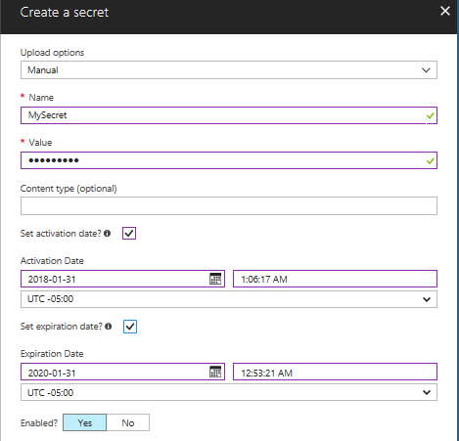
Create secrets (Azure Portal)
Click Secrets
Steps
Set upload to manual
Add a content type (optional)
Enter activation and expiration date
Enable the secret

Slide 16
Add a Secret (PowerShell)
Convert to a secure string
$mysecret = ConvertTo-SecureString –String ‘P@55w,rd’ –Force –AsPlainText
Add secret to vault
Set-AzureKeyValutSecret –VaultName ‘MyKeyVault-0’ –Name ‘MyFirstSecret’ –SecretValue $mysecret

Slide 17
Add Secret (Azure CLI)
Add a secret
az keyvault secret set --vault-name ‘MyKeyVault-01’ --name ‘MySecondSecret’ –value ‘P@ssw0rd’

Slide 18
Azure Key Vault Certificate Management
Azure Key Vault provides management of x509 certificates with the following features:
Segregation of duties
Use of policies
Settings of contacts
Automatic enrollment

Slide 19
Importing Certificates
Not available in Azure portal
Done using PowerShell
.PFX or .PEM format
Convert the private key password to a secure string
$CertPwd = Convert-To-SecureString –String “certP@ssword” –Force –AsplainText
Import the certificate
Import-AzureKeyVaultCertificate –VaultName ‘MyKeyVault-0’ –Name ‘MyFirstCert’ –FilePath ‘c:\certs\mycerts.pfx’ –Password $CertPwd

Slide 20
Creating Certificates
Define a Key Vault Policy
New-AzureKeyVaultCertificatePolicy
Creates a in-memory structure
Not a permanent policy
New-AzureKeyVaultCertificatePolicy –SecretContentType “application/x-pkscs12” –SubjectName “CN=newvisions.com” –IssuerName “Self” –ValidityInMonths 6 –ReuseKeyOnRenewal
Create Certificate
Add-AzureKeyVaultCertificate –VaultName ‘MyKeyVault-0’ –Name ‘TestCert01’ –CertificatePolicy = $Policy
Submits a job
Get the status of the job
Get-AzureKeyVaultCertificateOperation –VaultName ‘MyKeyVault-0’ –Name “TestCert01”

Slide 21
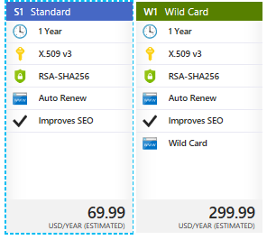
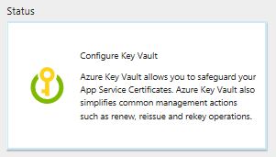
Azure App Service Certificate
Service used with
WebApps
Uses Azure Key Vault for certificate storage
Two Certificates
S1 Standard – provides SSL bindings to the root and www subdomain –
W1 Wildcard – need SSL bindings for root and any first level subdomain
Eliminates human error
Reduces time required to be done manually
Can set to autorenew

Slide 22
Prevent and respond to security threats with Azure Security Center
Eliminate threats by implementing security best practices
Azure Security Center lightens the burden
Evaluating deployments
Offering recommendations for hardening
Can use ASC to implement recommendations
Provides active monitoring
Identifying malicious activity allowing for rapid response

Slide 23
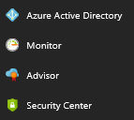
Enabling Azure Security Center
Free tier is enabled by default
Pinned to the services menu

Slide 24
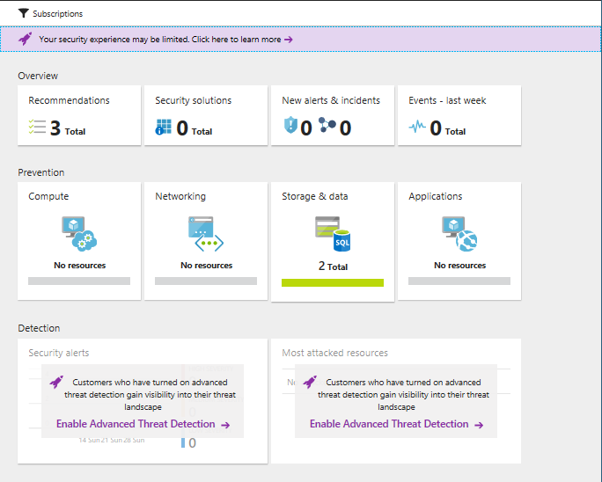
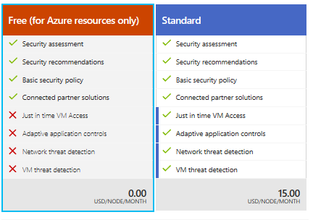
ASC (Azure Security Center)
Four sections
Overview
Prevention
Detection
Advanced Cloud defense
Security policy menu begins the process

Slide 25
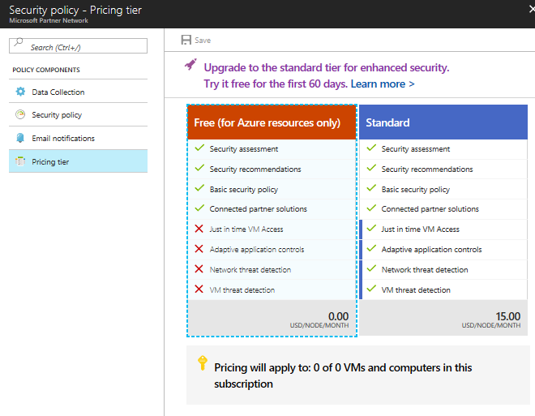
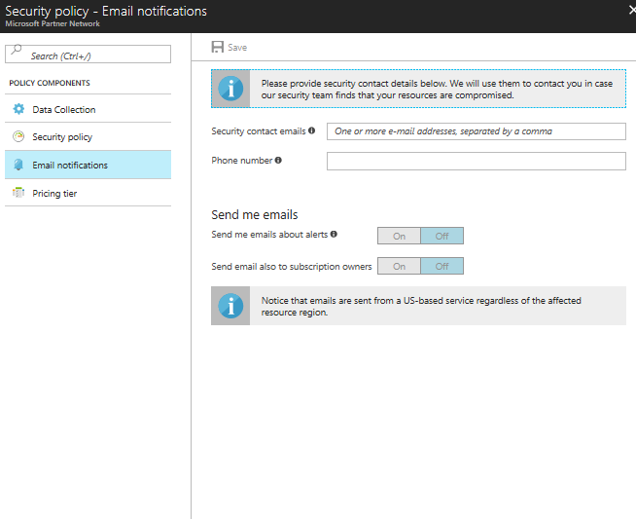
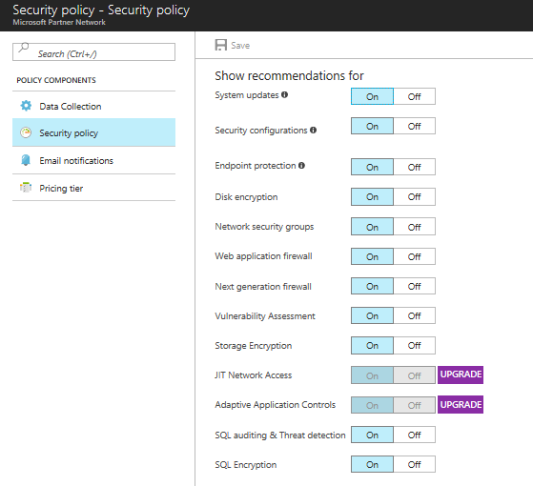
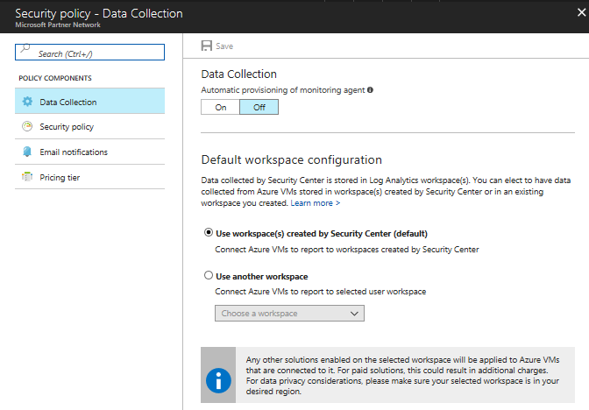
Security Policy
Four Sections
Data Collection
Security Policy
Email Notifications
Pricing Tier
Enabling protection for non-Azure computers
Standard pricing

Slide 26
Preventing Security Threats
Scanning your Azure deployments
Providing recommendations
Also mitigations from Microsoft
Integration with Microsoft partner solutions
Following recommendation will greatly minimize exposure

Slide 27
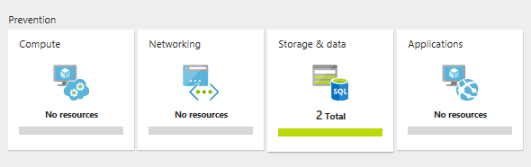
Azure Security Center’s prevention tiles

Slide 28
Compute
Monitor Configuration
IaaS
Cloud Services
Recommendations give additional information
JIT (Just-In-Time) access
Blocks inbound network traffic using a NSG (network security group)
User with write access will be given temporary access based on the ASC policy
Located in Advanced Cloud Defense section

Slide 29
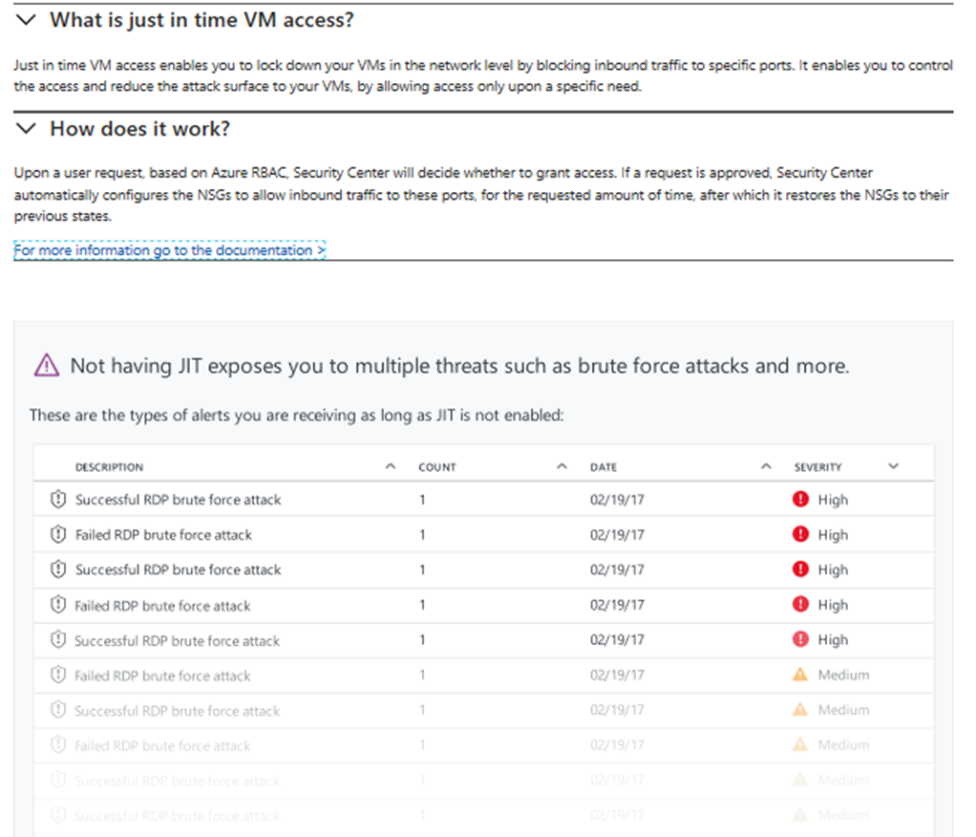

Slide 30
Azure Security Center’s prevention tiles

Slide 31
Networking
Evaluates the accessibility of external facing resources
Use of traffic/blocking/inspection
NSG
Network Firewalls
Web Application Firewalls
Recommendations made to restrict flow even further
Non-compliant can be remediated using ASC

Slide 32
Azure Security Center’s prevention tiles

Slide 33
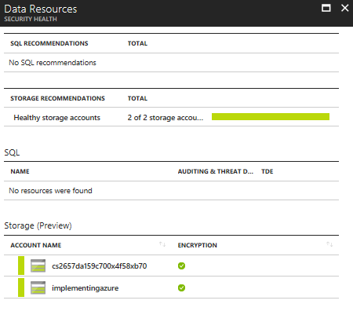
Storage and Data
Outside IaaS
Exposing vulnerabilities in PaaS solutions
Azure Storage
Blob
Disk
File
Queue
Azure SQL Database (DBaaS)
Recommendations for encryption

Slide 34
Azure Security Center’s prevention tiles

Slide 35
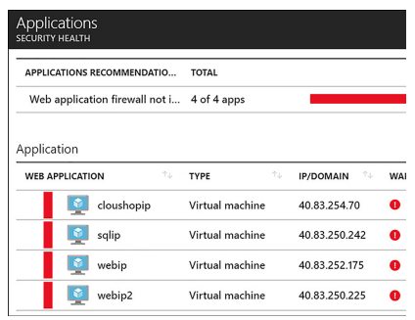
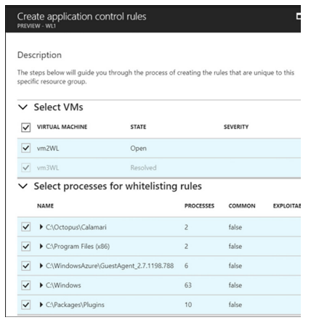
Applications
Evaluates public-facing services
Websites
Makes recommendations such as WAF
Integration with partners
F5
Barracuda
Fortinet
Adaptive application controls
Any process marked as exploitable should be carefully reviewed. These likely represent malware.

Slide 36
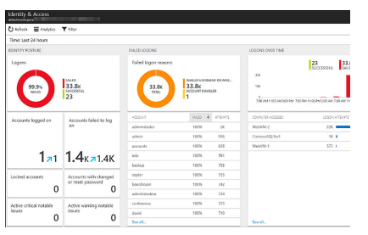
Other Prevention Areas
Recommendations blade
Ordered by severity
Provides detailed information that is actionable
Can dismiss recommendations
Identity and Access
Visualizations of security logs

Slide 37
Responding to security threats with ASC
What to do when there is an attack?
Collecting and analyzing security data from
Azure Deployments
Virtual networks
Any solution that is deployed
Information is correlated with Global threat intelligence using machine learning
Helps to detect the anomalies
Benefit without vast teams of data scientists and security experts

Slide 38
Advanced Threat Management
Standard plan
Wealth of information
Source IP address
How many logon attempts have failed
Create custom alerts

Slide 39
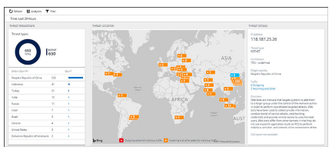
Threat Intelligence
Standard tier pricing
Dashboard tracking
Threat types
Origin country
Threat location
Threat Details

Slide 40
Configure SSO with SaaS application using federation password based
Authentication of SaaS applications
Organizational account
Prolonged logon experience
Logon is federated or password based

Slide 41
Federated SSO
SaaS application redirects authentication to Azure AD
Application must have authorization settings for the user
Accounts can be created automatically with Azure AD or manually provisioned
Available for applications that support
SAML 2.0
WS-Federation
OpenID Connect

Slide 42
Be certain that you know the protocols that are supported for use with federated SSO, namely SAML 2.0, WS-Federation or OpenID Connect.

Slide 43
Register application with Azure AD
Click the Enterprise applications and new application located in Azure AD blade
Enter application name to add one from the gallery (2800 SaaS apps)
Click add
Go into the properties and select SSO
Set SSO mode to SAML based SSO

Slide 44
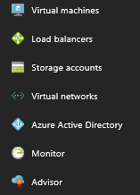
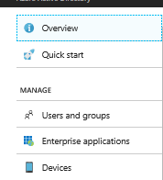
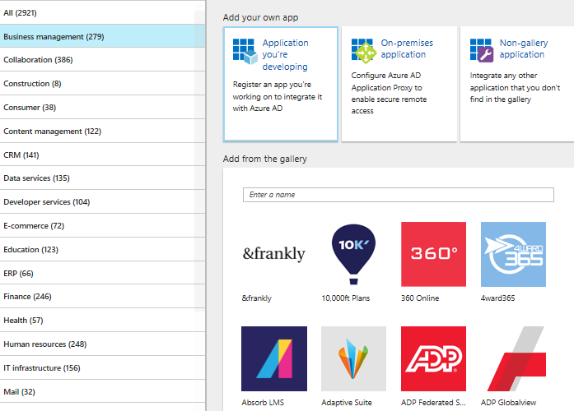
Review

Slide 45
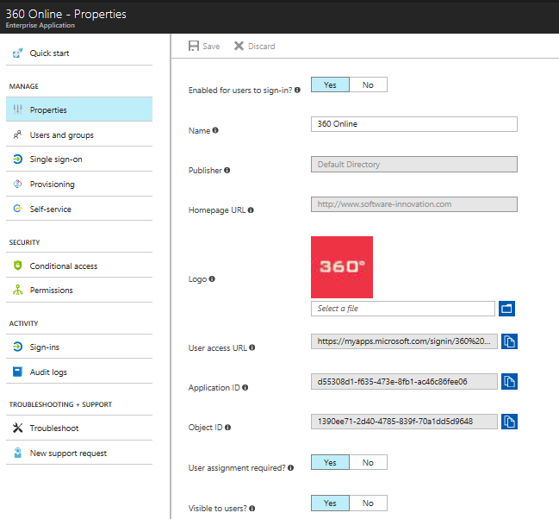

Slide 46
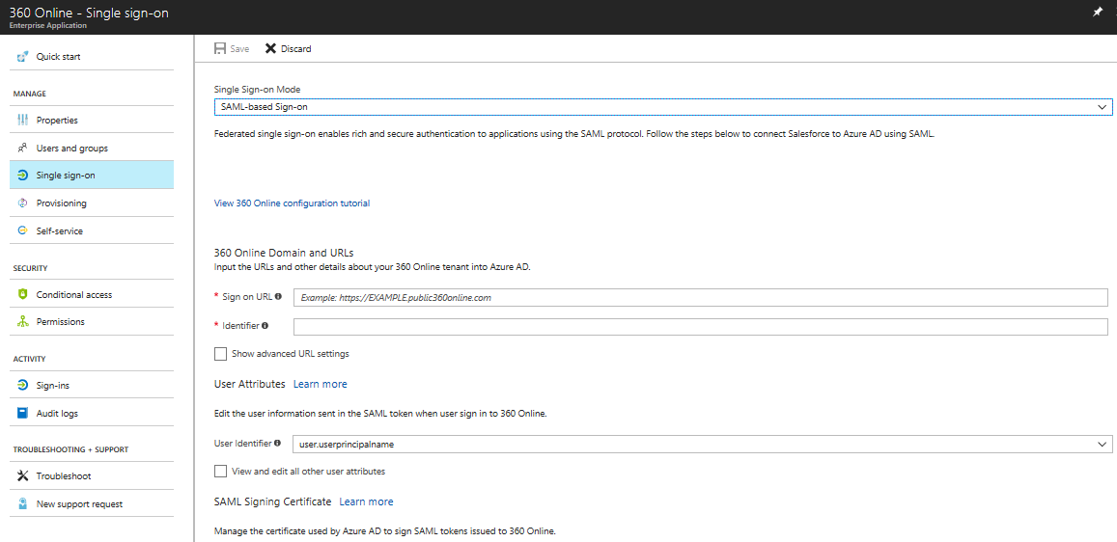
SAML 2.0 Sections

Slide 47
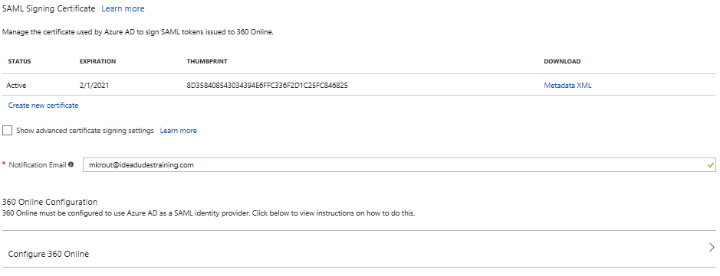
SAML Certificate
https://docs.mcirosoft.com/en-us/azure/active-directory/active-directory-saas-tutorial-list

Slide 48
Password-based SSO
Use their own identity present HTML page
Password-based SSO
Securely stores user account information
Presents it on behalf of the user
Two methods
Administrator managing the credentials
Enabling password-based SSO – user manages the credentials
Add an application within Azure AD like before but selecting password-based SSO
Requires web browser extension or plugin
Installed at first usage

Slide 49
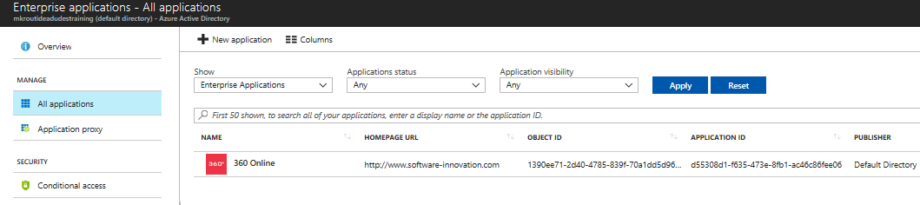
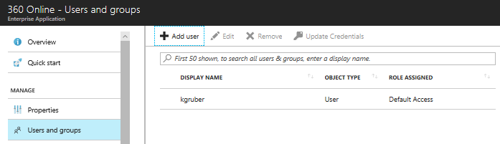
Add users and groups to applications
Adding groups to an application requires Azure AD Premium (at least P1)
Enterprise apps in the Azure AD blade

Slide 50
Revoke access to SaaS applications
Revoke access to a user in a group
Remove user from a group
Azure AD
Remove access to a single user
Enterprise applications
All applications
Select affected app and remove user access
Source of Authority – synchronization from on-premise, who is in charge. Make changes on-premise and allow to sync with cloud identities.

Slide 51
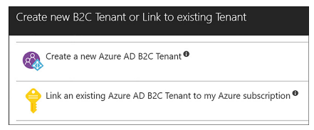
Configure federation with public consumer identity providers
Common feature among mobile apps is authentication
Azure AD B2C
Provide reliable scalable authentication experience
Users can use third parties as Identity providers (FaceBook, Google, Twitter and more)
Create a Azure AD B2C tenant

Slide 52
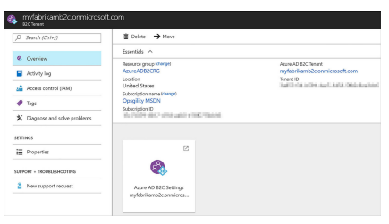
Configuring Azure AD B2C
Can be used with serval types of applications, including web, mobile, and API apps.

Slide 53
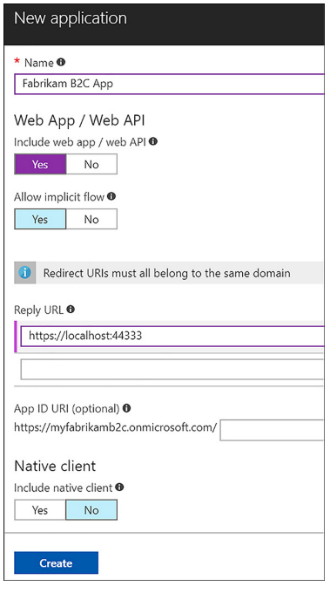
Registering a web application

Slide 54
Configure Social Identity Providers
Web application is registered
Identity providers can be added
Types
Local identities
Social identities
Two steps needed
Configure the identity provider side
Add Identity provider to Azure AD B2C tenant

Slide 55
Implementing recovery services
Create a backup vault; deploy a backup agent, backup and restore data, using snapshots and Geo-Replication for recovery; Implement DR as a service; Deploy Azure Site Recovery (ASR) agent; configure ASR; configure ASR one-click failover

Slide 56
Create a Recovery Services vault
Azure Backup
Azure Site Recovery
Recovery Services vault
Configuration management for
Azure Backup
Azure Site Recovery

Slide 57
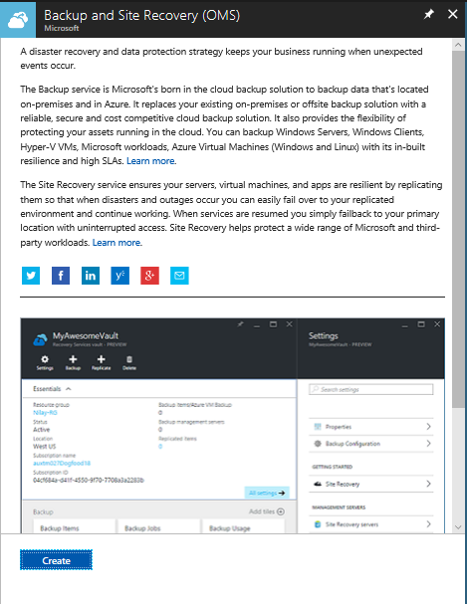
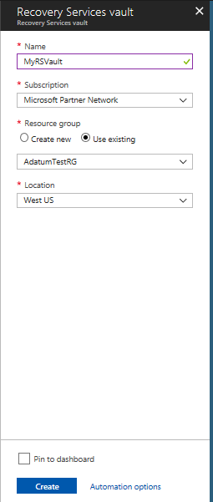
Create a Recovery Services vault (Azure Portal)

Slide 58
Create a Recovery vault (PowerShell)
Create resource group
New-AzureRmResourceGroup –Name ‘RSVaultRG’ –Location ‘East US’
Create the vault
New-AzureRmRecoveryServicesVault –Name ‘MyRSVault’ –ResourceGroupName ‘RSVaultRG’ –Location ‘East US’
Configure GRS for storage
$vault1 = Get-AzureRmRecoveryServicesVault –Name ‘MyRSVault’
Set-AzureRmRecoveryServicesBackupProperties –Vault $vault1 –BackupStorageRedundancy GeoRedundant

Slide 59
Deploy a Backup Agent
Different types of agents
Microsoft Azure Recovery Services (MARS) agent – standalone used to protect files and folders
DPM protection agent – used with Azure Backup Server and System Center Data Protection Manager
VMSnapshot extention – installed on Azure VMs to allow snapshots
Automation is available for Azure Backup Server DPM, VMSnapshot, VMSnapshotLinux

Slide 60
MARS agent install
Recovery Services vault
Steps
Click Backup under Getting started
Under the Where Is You Workload Running select On-Premises from the drop-down
What you want to backup select Files and Folders
Click Prepare Infrastructure
Recovery agent is made available
Backup files and folders only available on Windows devices
Download the agent
Click Proceed to registration
Enter credentials
Select either passphrase or allow installation to generate one
Enter twice
Specify the where passphrase should be stored

Slide 61
Backup and Restore Data
You need to configure the agent
When the backups occur
How often they occur
How long data is retained
What data is protected
Start by clicking Schedule Backup
Configured
Daily backup
Weekly backup
Recover Data option in MARS Agent
Where to restore the data
What to recover
When the data was backed up
Recovery point
Mount point
Can backup IaaS virtual machines in Azure
Individual files or entire VMs
Backup policy
How often they occur
How long backups are retained
Only VMs in same region as the Recovery Services vault can be backed up

Slide 62
Use of snapshots
Blob snapshots
Unmanaged VM disks are page blobs
Can be snapshotted and copied to another Region
Use the snapshot to recover VMs

Slide 63
Configure a snapshot in a different region
Create storage account
New-AzureRmResourceGroup –Name DRRecoveryStorageRG –Location eastus
$destinationStorageAcct = New-AzureRmStorageAccount –ResourceGroupName DRRecoveryStorageRG –Name recoverysa0434 –SkuName Standard_LRS –Location eastus –Kind Storage
Create a blob container
Set-AzureRmCurrentStorageAccount –ResourceGroupName DRRecoveryStorageRG –Name recoverysa0434
Create a container
New-AzureStorageContainer –Name recovery –Permission Off
Create a snapshot configuration
$sourceVHDURI = https://criticalserverrgddisks810.blob.core.windows.net/vhds/CriticalServer.vhd

Slide 64
Configure a snapshot to another destination –Cont.
Populate another variable with the Resource ID of the same storage account
$storageAccountID = “/subscriptions/<SubscriptionID>/resourceGroups/criticalserverrg/providers/Microsoft.Storage/storageAccounts/criticalserverrgdisks810”
Set the snapshot context
$snapshotConfig = New-AzureRmSnapShotConfig –AccountType StandardLRS –Location westus –CreateOption Import –StorageAccountID $storageAccountID –SourceUri $sourceVHDURI
Create the snapshot
New-AzureRmSnapShot –SnapShot $snapshotConfig –ResourceGroupName CriticalServerRG –SnapshotName MyCriticalServerDiskSnapShot
Obtain the destination storage account key
Done through Azure Portal

Slide 65
Configure a snapshot to another destination –Cont.
Populate the key value in a variable
$storageAccountKey = “<StorageAccountKey”>
Store name of the resource group
$resourceGroupName = “CriticalServerRG”
Store name of the snapshot
$snapShotName = “MyCriticalServerDiskSnapshot”
Create SAS (Shared Access Signature) and expiration time
$sasExpiryDuration = “3600”
$sas = Grant-AzureRmSnapshotAccess –ResourceGroupName $resourceGroupName –SnapSHotName $snapShotName –DurationInSecond $sasExpiryDuration –Access Read
Create the destination storage
$destinationContext = New-AzureStorageContext –StorageAccountName $storageAcct.StorageAccountName –StorageAccountKey $storageAccountKey

Slide 66
Configure a snapshot to another destination –Cont.
Start the copy process
Start-AzureStorageBlobCopy –AbsoluteUri $sas.AccessSAS –DestContainer “recovery” –DestContext $destinationContext –DestBlob “recoveredcriticalservos.vhd”

Slide 67
Recover VM by using the copied VHD
Create a new resource group for VM
Convert the VHD to a managed disk
Provision a virtual machine from the managed disk
Create a virtual network for the VM
Create NSG that allows the required network traffic
Create a public IP address and NIC
Specify the configuration for the VM
Name
Series
Assign NIC to VM
Add the OS disk created from the snapshot
Create the VM

Slide 68
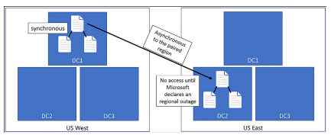
Geo-replication for recovery
Geo-Redundant storage (GRS)
Replication data to a paired region hundreds of miles away from the primary copy
No access until Microsoft declares a persistent outage and accomplished a geo-failover

Slide 69
Read Access Geo-Redundant Storage (RA-GRS)
Customers have read-only
IaaS
Unmanaged standard VM Disks
Asynchronous updates
Latency
Not an effective way to prepare for regional outages

Slide 70
Implement DR as service, Deploy ASR agent, ASR Configuration & best practices
ASR is a disaster recovery service
Data Center to Data Center (D2D)
On-premise to Azure (D2A)
One Azure to Azure (A2A)
Workloads on on-premises
Protect physical machines
VMware-based virtual machines
Hyper-V based virtual machines
Create the Recovery Services Vault
Azure Backup
Azure Site Recovery

Slide 71
Create and use a SAS with Blob storage
Generate a shared access signature on a container
Generate a shared access signature on a blob
Create a stored access policy to manage signatures on a container's resources
Test the shared access signatures in a client application
https://docs.microsoft.com/en-us/azure/storage/blobs/storage-dotnet-shared-access-signature-part-2

