Slide 1
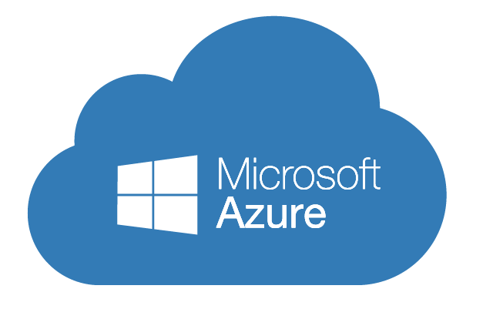
Implementing Microsoft Azure Infrastructure Solutions
Data & Cloud Skill Up and Exam Ready Workshop
WiFi: MSFTGUEST
Password: msevent73ew
Content Location: https://github.com/guruskill/70-533
Notes:
Access codes for wifi should be provided on site

Slide 2
Exam 70-533 Implementing Microsoft Azure Infrastructure Solutions
Design and Implement Azure App Service Apps (10-15%)
Create and Manage Compute Resources (20-25%)
Design and Implement a Storage Strategy (10-15%)
Implement virtual networks (15–20%)
Design and Deploy ARM Templates (10-15%)
Manage Azure Security, and Recovery Services (25-30%)
Manage Azure Operations (5-10%)
Manage Azure Identities (5-10%)
Speaker Information:
https://www.microsoft.com/en-ie/learning/exam-70-533.aspx
Notes:
Presentation: 105 minutes
Lab: 50 minutes
After completing this module, students will be able to:
Identify suitable workloads for the cloud.
Identify services and capabilities that Microsoft Azure provides.
Use Azure portals to manage Azure services and subscriptions.
Use Windows PowerShell to manage Azure services and subscriptions.
Use Azure Command-Line Interface (CLI) to manage Azure services and subscriptions.
Describe the primary characteristics of Azure Resource Manager.
Use Azure services to enhance management and monitoring of Azure.
Required materials
To teach this module, you need the Microsoft PowerPoint file 20533D_01.pptx.
Preparation tasks
To prepare for this module, you should:
Read all this module’s materials.
Practice performing the demonstrations and labs.
Work through the Module Review and Takeaways section to determine how you will use the information to reinforce student learning and promote knowledge transfer to on-the-job performance.
As you prepare for this class, it is imperative that you complete the labs yourself. This gives you an understanding of how the labs work, as well as the concepts that each lab covers. This enables you to provide meaningful hints to students who might have issues while working in the labs. Furthermore, it will help guide your lecture to ensure that you discuss the concepts that the labs cover.
20533D
1: Introduction to Microsoft Azure

Slide 3
Manage Azure Identities (5-10%)
Monitor on-premises identity infrastructure and synchronization services with Azure AD Connect Health
Manage domains with Azure Active Directory Domain Services
Integrate with Azure Active Directory (Azure AD)
Implement Azure AD B2C and Azure AD B2B

Slide 4
Manage Azure Identities (5-10%)
Monitor on-premises identity infrastructure and synchronization services with Azure AD Connect Health
Monitor AD FS proxy and web application proxy servers; setup email notifications for critical alerts; generate utilization reports; monitor Sync Engine; monitor domain controllers; monitor replication
Manage domains with Azure Active Directory Domain Services
Join Azure virtual machines to a domain, securely administer domain-joined virtual machines by using Group Policy; migrate on-permises apps to Azure; handle traditional directory-aware along with SaaS apps
Integrate with Azure Active Directory (Azure AD)
Implement Azure AD Connect and single sign-one with on-premises Windows Server 2016; add custom domains; monitor Azure AD; MFA, configure Windows 10 with Azure AD join; Implement Azure AD integration in web and desktop applications; leverage Microsoft Graph API
Implement Azure AD B2C and Azure B2B
Create an Azure AD B2C Directory; register an application; implement social identity provider authentication; enable multi-factor authentication; set-up self-service password reset; implement B2B collaboration; configure partner users; integrate with applications

Slide 5
Monitor on-premises identity infrastructure and synchronization services with Azure AD Connect Health
Monitor AD FS proxy and web application proxy servers; setup email notifications for critical alerts; generate utilization reports; monitor Sync Engine; monitor domain controllers; monitor replication

Slide 6
Monitoring On-Premises Identity Infrastructure and Synchronization Services with Azure AD Connect Health
AD Connect Health can monitor
On-premises identity infrastructure
Synchronization services to cloud
AD FS
Azure AD Connect servers (Sync Engine)
Active Directory Domain Services
Traditional AD Domain Controllers
Provides usage data to understand how users are leveraging the cloud

Slide 7
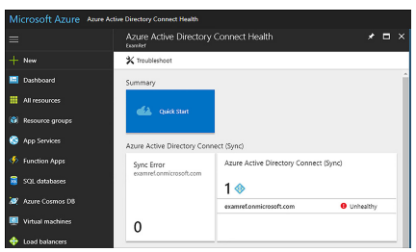
Monitor Sync Engine & Replication
Replication is a critical service
Directory objects are not available
Updated on a regular basis
Common Identity for on-premise and cloud
Install an agent on each identity servers

Slide 8
Azure AD Connect Health requires Azure AD Premium, either P1 or P2 SKU. The first Azure AD Connect Health agent requires a least one Azure AD Premium license. Each additional registered agent requires 25 additional Azure AD Premium licenses.

Slide 9
Monitor Domain Controllers
Azure AD Connect is installed on your on-premises DC
First DC installed with AD Connect will have the Health Agent installed and reports status
DCs in VNET install Health Agent
Download the agents from Quick Start on Azure Connect Health blade in Azure portal

Slide 10
Setup Email Notifications for Critical Alerts
Sync Error blade
Errors are located
Investigated
Notification settings can be configured
Notifications are configured under Notification settings
Default is sent to Global Administrator

Slide 11
Monitor ADFS proxy and Web Application proxy Servers
Supports
ADFS 2.0
ADFS 3.0
Windows 2008 R2
Windows Server 2012
Windows Server 2012 R2
Windows Server 2016
AD FS proxy and Web App Proxy

Slide 12
Monitoring with alerts to know when ADFS and ADFS proxy servers are not healthy; Email notification for critical alerts; Trends in performance data, which are useful for ADFS capacity planning; Usage analytics for ADFS signins with pivots (apps, users, and network location), which are useful to understand how ADFS is used; Reports for ADFS, such as top 50 users who have bad username/password attempts and their last IP address – You should know these.

Slide 13
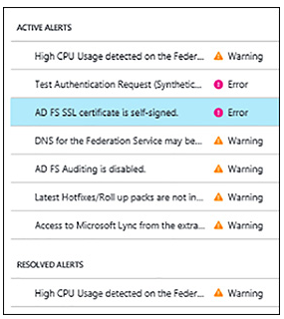
Azure AD Connect Health Alerts

Slide 14
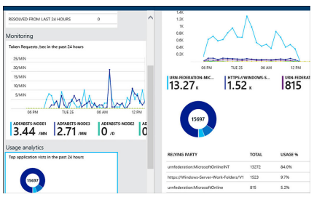
Azure AD Connect Health Usage

Slide 15
Generate Utilization Reports
Used to help understand how your environment is functioning
Troubleshoot issues preventing users
Two are two types
Security reports
Activity reports

Slide 16
Security Reports
Suspicious activities
Risk Event
Two types of security reports
Users flagged for risk
Risky sign-ins

Slide 17
Activity Reports
Audit logs report
Used for compliance
Two types
Audit logs
Sign-ins

Slide 18
Manage domains with Azure Active Directory Domain Services
Join Azure virtual machines to a domain; securely administer domain-joined virtual machines by using Group Policy; migrate on-premises apps to Azure; handle traditional directory-aware apps along with SaaS apps

Slide 19
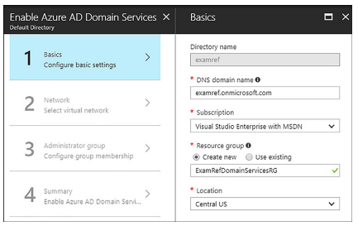
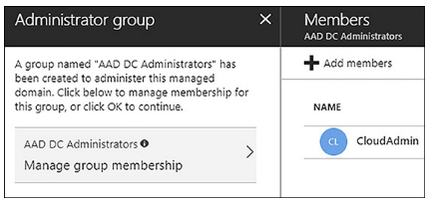
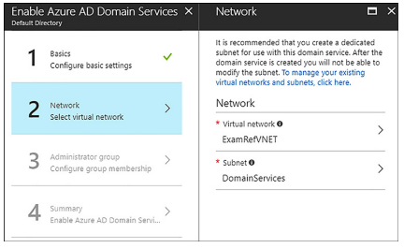
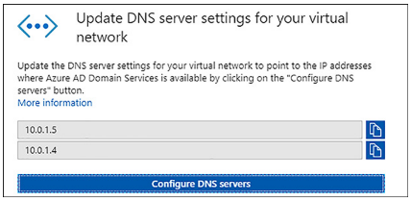
Implement Azure Active Directory Domain Services
newvisions.onmicrosoft.com
NevVisionVNET
NewVisionDomainServicesRG

Slide 20
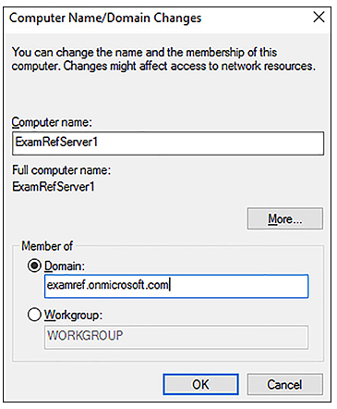
Join Azure virtual machines to a Domain
Add VMs that are running in your VNET to Domain
Use same steps as usual
WebServer1
Newvisions.onmicrosoft.com

Slide 21
Securely Administer Domain-joined virtual machine by using Group Policy
Cannot manage on-premises machines any type by using these GPOs only for VMs in Azure and Domain joined
Two Ous
Managed of users and groups
AD DC Users
AD DC Computers
Two GPOs connected to the Ous
Can be customized
AAD DC Group Policy Users belonging to the AAD DC Administrators group are granted Group Policy administration privileges on the managed Domain.

Slide 22
Migrate On-premises Apps to Azure
Traditional apps use
LDAP
NTLM
Kerberos
Apps cannot run in Azure IaaS
Azure AD Domain Services
Migrate legacy directory-aware application on-premises
No worry about identity requirements
Users can submit their corporate credentials to authenticate with the managed Domain
Credentials are kept in sync with Azure AD tenant

Slide 23
You have a Azure tenant named Tenant1. You plan to integrate Tenant1 and the on-premises Active Directory.
You need to create a user account that can be used to synchronize changes from the on-premises Active Directory. Solution should you an account with least privilege.
User administrator
Service administrator
Password administrator
Global administrator

Slide 24
You have a Azure tenant named Tenant1. You plan to integrate Tenant1 and the on-premises Active Directory.
You need to create a user account that can be used to synchronize changes from the on-premises Active Directory. Solution should you an account with least privilege.
User administrator
Service administrator
Password administrator
Global administrator

Slide 25
Company network includes a single forest and multiple domains. You plan to migrate from on-premise Exchange to Exchange online.
You want to provision the On-Premises Windows Active Directory and Azure Active Directory service accounts. You need to set the required permission for the Azure AD service account. (Pick Two)
Permissions | Service Account
Enterprise Admin
Domain Admin
Global Admin
Password Admin
IIS Admin

Slide 26
Company network includes a single forest and multiple domains. You plan to migrate from on-premise Exchange to Exchange online.
You want to provision the On-Premises Windows Active Directory and Azure Active Directory service accounts. You need to set the required permission for the Azure AD service account. (Pick Two)
Permissions | Service Account
Domain Admin
Enterprise Admin
Global Admin
Password Admin
IIS Admin

Slide 27
You have an On-Premises Active Directory that has a DNS domain named newvisions.local and email domain named newvisions.com.
You plan to migrate from On-Premises to Office 365. You configure DirSync and set all Azure AD usernames as %username%@newvisions.com. You need to ensure that each user is able to log on by using the email domain as the username. What two actions should you perform?
Edit the ProxyAddress attribute on the On-Premises Windows AD user account.
Verify the email domain in Azure AD domains
Run the Set-MsolUserPrincipalName –UserPrincipalName %username%@newvisions.onmicrosoft.com –NewUserPrincipalName %username%@newvisions.com PowerShell
Update the On-Premises Windows AD user account UPN to match the email address
Verify the Windows AD DNS domain in Azure AD domains

Slide 28
You have an On-Premises Active Directory that has a DNS domain named newvisions.local and email domain named newvisions.com.
You plan to migrate from On-Premises to Office 365. You configure DirSync and set all Azure AD usernames as %username%@newvisions.com. You need to ensure that each user is able to log on by using the email domain as the username. What two actions should you perform?
Edit the ProxyAddress attribute on the On-Premises Windows AD user account.
Verify the email domain in Azure AD domains
Run the Set-MsolUserPrincipalName –UserPrincipalName %username%@newvisions.onmicrosoft.com –NewUserPrincipalName %username%@newvisions.com PowerShell
Update the On-Premises Windows AD user account UPN to match the email address
Verify the Windows AD DNS domain in Azure AD domains

Slide 29
A company has an existing on-premises AD environment that is synchronized using DirSync. They plan to transition the DirSync to Azure AD Connect.
You need to identify a transition path for the company.
What should you do?
Deploy Azure AD Connect in parallel
Install a new on-premises domain controller
Create a new Azure AD instance
Upgrade the on-premises Active Directory Domain Services (AD DS) Forest Functional Level to Windows Server 2016

Slide 30
A company has an existing on-premises AD environment that is synchronized using DirSync. They plan to transition the DirSync to Azure AD Connect.
You need to identify a transition path for the company.
What should you do?
Deploy Azure AD Connect in parallel
Install a new on-premises domain controller
Create a new Azure AD instance
Upgrade the on-premises Active Directory Domain Services (AD DS) Forest Functional Level to Windows Server 2016

Slide 31
You administer a DirSync server configured with Azure AD.
You need to provision a user in Azure AD without waiting for the default DirSync synchronization interval.
What are two possible ways to achieve this goal?
Replicate the Directory in Active Directory Sites and Services
Restart the DirSync Server
Run the Enable-SyncShare PowerShell
Run the Azure AD Sync Tool ConfigurationWizard
Run the Start-OnlineCoexistenceSync PowerShell

Slide 32
You administer a DirSync server configured with Azure AD.
You need to provision a user in Azure AD without waiting for the default DirSync synchronization interval.
What are two possible ways to achieve this goal?
Replicate the Directory in Active Directory Sites and Services
Restart the DirSync Server
Run the Enable-SyncShare PowerShell
Run the Azure AD Sync Tool ConfigurationWizard
Run the Start-OnlineCoexistenceSync PowerShell

Slide 33
Integrate with Azure Active Directory (Azure AD)
Implement Azure AD Connect and single sign-on with on-premises Windows Server 2016; add custom domains; monitor Azure AD; MFA, configure Windows 10 with Azure AD join; Implement Azure AD integration in web and desktop applications, leverage Microsoft Graph API

Slide 34
Creating and managing an Azure AD tenant
Create an Azure AD tenant, assign to it a custom domain, and view the verification DNS records
Associate an Azure AD instance with the current Azure subscription
Create an Azure AD user account
Grant an Azure AD user administrative access to an Azure subscription
Notes:
Review the steps in Lab A for guidance when performing this demonstration.
https://github.com/MicrosoftLearning/10979-MicrosoftAzureFundamentals/blob/master/Instructions/10979D_LAB_08.md

Slide 35
Add Custom Domains
domain.onmicrosoft.com is the default domain
Cannot be changed or deleted
To add custom domain
Add custom domain name to your directory
Add a DNS entry for the domain name at domain name registrar
Verify the custom domain name in Azure AD
Add a TXT or MX record to your DNS server
Used to verify that you own the domain
On-Premises Credential
You should add your custom domain and verify it prior to synchronizing the directory to an on-premises Active Directory. This allows your users to log in to Azure AD by using their on-premises credentials.

Slide 36
Implement Azure AD Connect and SSO with On-premises Windows Server
Provides a common identity for on-premises and also cloud
Can be used for O365 and other SaaS applications
Azure AD Connect tool
Download on to a Domain Join computer from Azure AD Connect configuration screen
Wizard based

Slide 37
If your network has more than one Active Directory Forest, you must use the customized settings option in Azure AD Connect.

Slide 38
Multi-Factor Authentication (MFA)
Multi-Step account credential verification
Helps safeguard access to data and applications
Different ways to authenticate
Getting a phone call
Receiving a text message
Using a mobile app
Must have a Premium license
All Premium SKUs have MFA
Usage location needs to configured (United States)
Each user needs to be assigned to the Premium offering
Conditional Access policy to force MFA

Slide 39
Config Windows 10 with Azure AD Domain Join
Add and Manage Devices using Azure AD
Assists in compliance
BYOD can be accomplished by configuring Azure AD registered devices
Registered devices
Windows 10
iOS
Android
macOS
Understand the process as it relates to Windows 10 devices

Slide 40
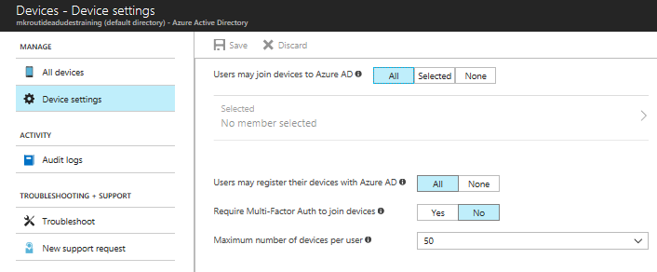
Configuring Registered Devices
Windows 10
Registration service must be configured
Fewer devices registered than the configured maximum
Access Devices from Azure Portal
Set users may join devices

Slide 41
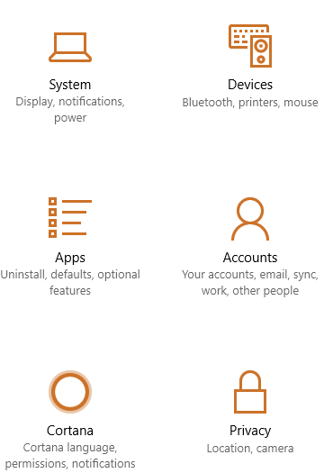
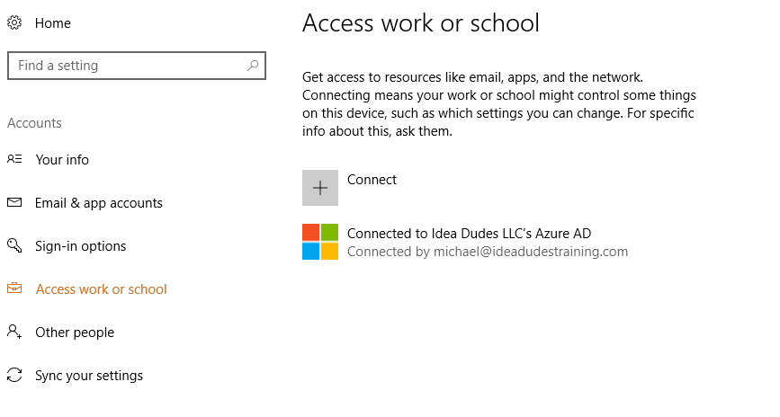
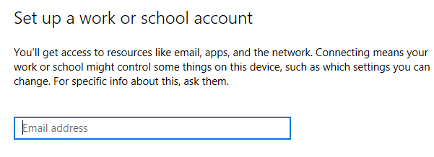
Windows 10
Device is now added to Azure and appears in Azure AD portal as a managed device.

Slide 42
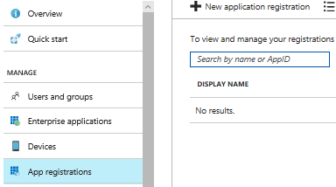
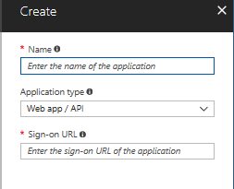
Implement Azure AD Integration in Web and Desktop Applications
SaaS applications provide SSO
Register the application
Involves providing Azure AD details about the application
URL where it is located
URL to send replies after a user is authenticated
URI that identifies it
Types of Apps
Web API
Native Apps (Client Installed)

Slide 43
Leverage Microsoft Graph API
Interact with Microsoft Cloud
Can be used to build apps connect to
Many types of resources
Relationships
Intelligence
https://graph.Microsoft.com
CRUD
Create
Read
Update
Delete

Slide 44
You have a tenant in an Azure subscription named Tenant1. You need to configure the integration of Tenant1 and Google Apps.
You perform the required configuration on the google apps tenant. Which three actions should you perform from Azure Management Portal?
Add a custom domain
Add a multi-factor authentication provider
Enable application integration
Configure SSO
Configure directory integration

Slide 45
You have a tenant in an Azure subscription named Tenant1. You need to configure the integration of Tenant1 and Google Apps.
You perform the required configuration on the google apps tenant. Which three actions should you perform from Azure Management Portal?
Add a custom domain
Add a multi-factor authentication provider
Enable application integration
Configure SSO
Configure directory integration

Slide 46
What tool is used to synchronize On-Premise Active Directory with Azure AD.
Select the right tool.
Azure AD Connect
Active Directory Sites and Services
repadmin /syncall
Azure Backup

Slide 47
What tool is used to synchronize On-Premise Active Directory with Azure AD.
Select the right tool.
Azure AD Connect
Active Directory Sites and Services
repadmin /syncall
Azure Backup

Slide 48
Implement Azure AD B2C and Azure AD B2B
Create an Azure AD B2C Directory; register an application; implement social identity provider authentication; enable multi-factor authentication; setup self-service password reset; implement B2B collaboration; configure partner users; integrate with applications

Slide 49
Create an Azure AD B2C Directory
Cloud identity management solution for web and mobile apps
Highly available global service
Scales to millions of identities
With minimal configuration allows authentication through
Social accounts (Facebook, Twitter etc)
Enterprise accounts (open standard protocols, OpenID Connect or SAML)
Local accounts (email address and password, or username and password)

Slide 50
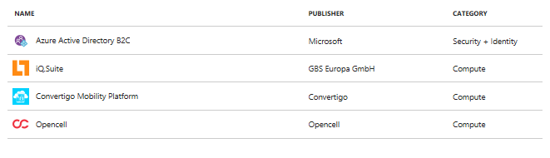
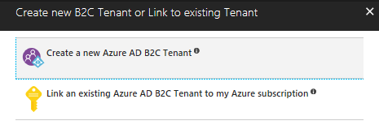
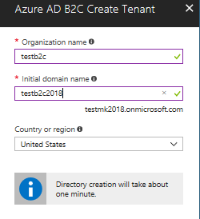
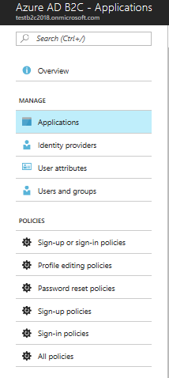
Create an Azure AD B2C tenant in the Azure Portal

Slide 51
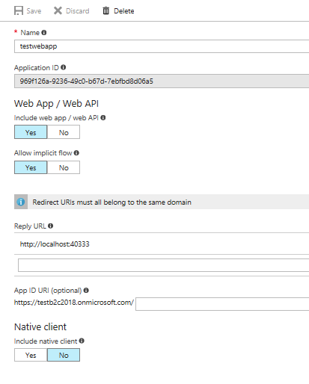
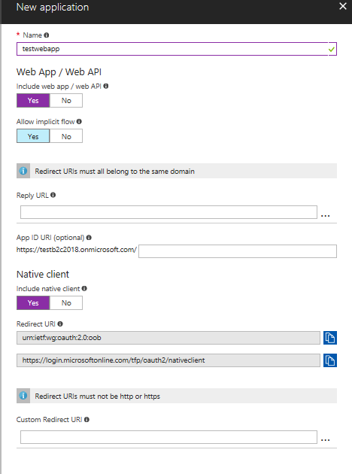
Register an Application
SSO to be configured you must register an app
Must be managed from same location
Types
Web apps
API apps
Mobile or Native Apps (Client applications)

Slide 52
Reply URLs are endpoints where Azure AD B2C returns any tokens that your application requests. Make sure enter a properly formatted Reply URL.

Slide 53
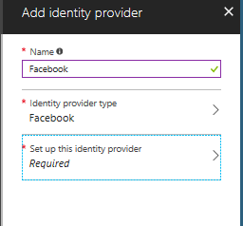
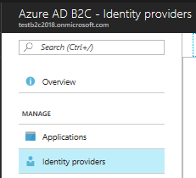
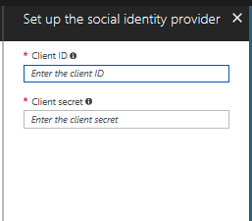
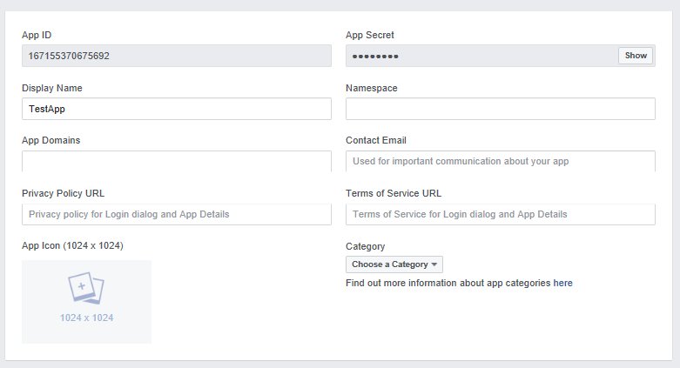
Implement Social Identity Provider Authentication
Azure AD B2C is an identity management solution for web and mobile applications for consumers
Allows your application’s user to leverage an existing account
Process
Setting up the provider

Slide 54
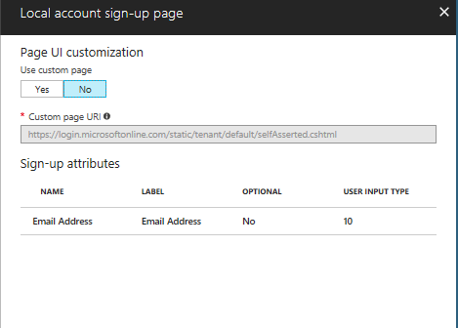
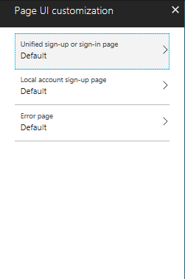
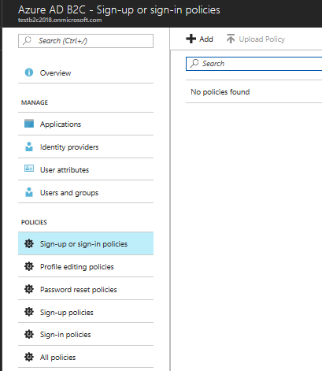
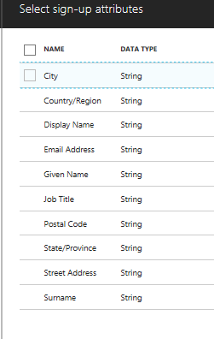
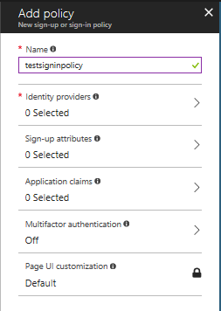
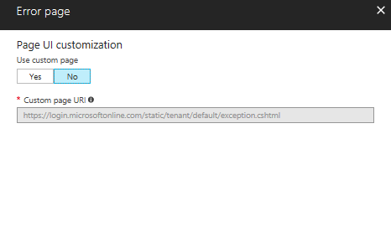
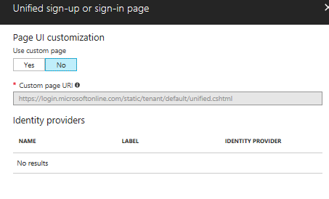
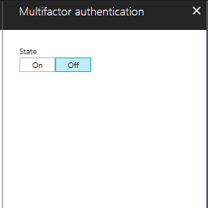
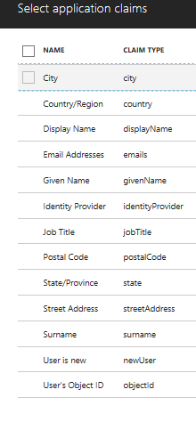
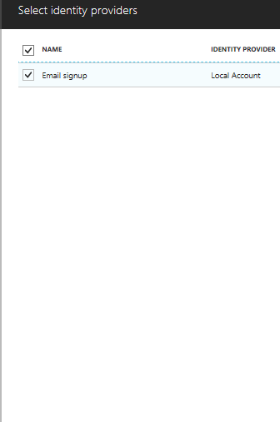
Sign-up or Sign-in Policy

Slide 55
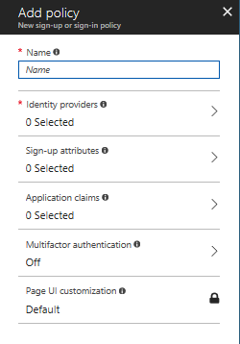
Enable MFA
Azure AD B2C integrates with Azure MFA
No additional code needed
Supports call and text messages

Slide 56
Configuring and using Multi-Factor Authentication
Enable Multi-Factor Authentication for an Azure AD user account
Authenticate to the Azure portal as an Azure AD user with Multi-Factor Authentication enabled
http://aka.ms/E9ep7z

Slide 57
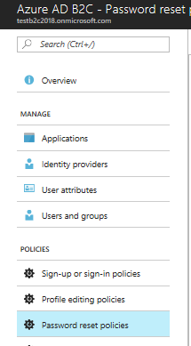
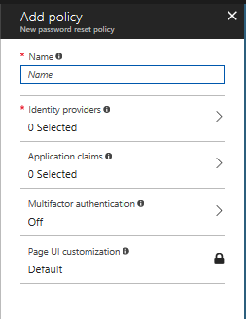
Set up Self-Service Password Reset

Slide 58
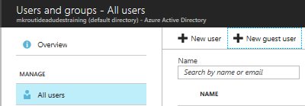
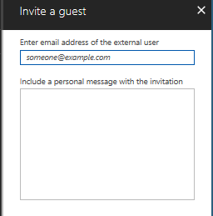
Implement B2B Collaboration and Configure Partner Users
Azure AD B2B provides authentication for partners
Can have their own Azure AD or not
Can provide access
Applications
Documents
Other resources
Maintain ownership and control of their own data
Easy to navigate results in less help desk calls
Global admins and limited admins can use Azure Portal to invite B2B users

Slide 59
Azure B2B works with any type of partner directory. Partners use their own credentials. There is no requirements for partners to use Azure AD and no external directories or complex setup is required. The invitation to join is the critical action that makes this scenario work.

Slide 60
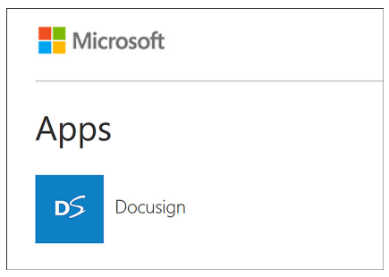
Integrate with Applications
Required for apps to show in MyApps
Open Enterprise Apps
Select application
Select Users and Groups
Add the B2B user
Navigate to https://myapps.Microsoft.com
App will be showing giving them access

Slide 61
You administer an Access Control Service namespace named newvisionsACS that is used by a web application. NewVisionsACS currently utilizes Microsoft and Yahoo accounts.
Several users have Google accounts and would like to access the web application through NewVisionsACS. You need to allow users to access the application by using their Google accounts.
What should you do?
Register the application directly with Google
Add a new Google identity provider
Edit the existing Microsoft Account identity provider and update the realm to include Google
Add a new WS-Federation identity provider and configure the WS-Federation metadata to point to the Google sign-in URL

Slide 62
You administer an Access Control Service namespace named newvisionsACS that is used by a web application. NewVisionsACS currently utilizes Microsoft and Yahoo accounts.
Several users have Google accounts and would like to access the web application through NewVisionsACS. You need to allow users to access the application by using their Google accounts.
What should you do?
Register the application directly with Google
Add a new Google identity provider
Edit the existing Microsoft Account identity provider and update the realm to include Google
Add a new WS-Federation identity provider and configure the WS-Federation metadata to point to the Google sign-in URL

Slide 63
https://github.com/MicrosoftLearning/10979-MicrosoftAzureFundamentals/blob/master/Instructions/10979D_LAB_08.md
Estimated Time: 30 minutes

