Slide 1
Exam 70-533 Implementing Microsoft Azure Infrastructure Solutions
Design and Implement Azure App Service Apps (10-15%)
Create and Manage Compute Resources (20-25%)
Design and Implement a Storage Strategy (10-15%)
Implement virtual networks (15–20%)
Design and Deploy ARM Templates (10-15%)
Manage Azure Security, and Recovery Services (25-30%)
Manage Azure Operations (5-10%)
Manage Azure Identities (5-10%)
Mohd Mishal
Clouds Consultant MCT
https://www.microsoft.com/en-ie/learning/exam-70-533.aspx
Notes:
Presentation: 105 minutes
Lab: 50 minutes
After completing this module, students will be able to:
Identify suitable workloads for the cloud.
Identify services and capabilities that Microsoft Azure provides.
Use Azure portals to manage Azure services and subscriptions.
Use Windows PowerShell to manage Azure services and subscriptions.
Use Azure Command-Line Interface (CLI) to manage Azure services and subscriptions.
Describe the primary characteristics of Azure Resource Manager.
Use Azure services to enhance management and monitoring of Azure.
Required materials
To teach this module, you need the Microsoft PowerPoint file 20533D_01.pptx.
Preparation tasks
To prepare for this module, you should:
Read all this module’s materials.
Practice performing the demonstrations and labs.
Work through the Module Review and Takeaways section to determine how you will use the information to reinforce student learning and promote knowledge transfer to on-the-job performance.
As you prepare for this class, it is imperative that you complete the labs yourself. This gives you an understanding of how the labs work, as well as the concepts that each lab covers. This enables you to provide meaningful hints to students who might have issues while working in the labs. Furthermore, it will help guide your lecture to ensure that you discuss the concepts that the labs cover.
20533D
1: Introduction to Microsoft Azure

Slide 2
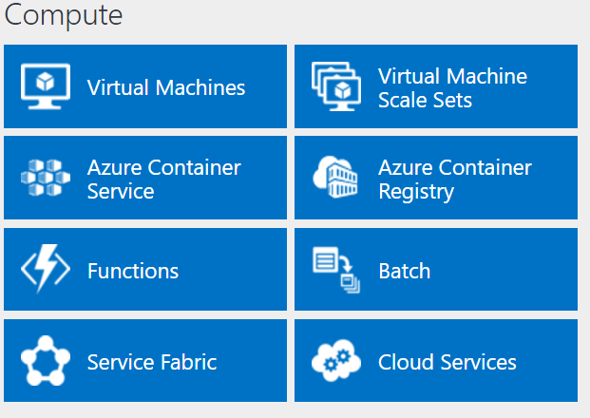
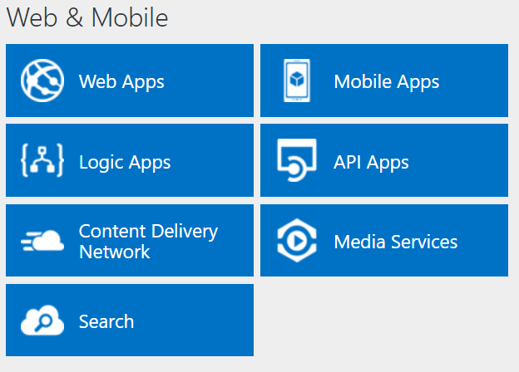
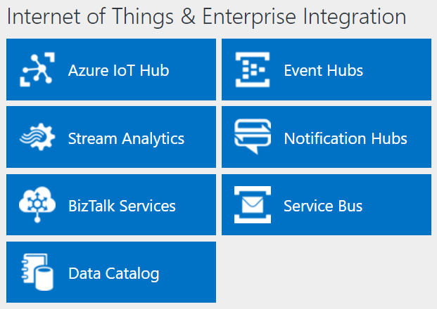
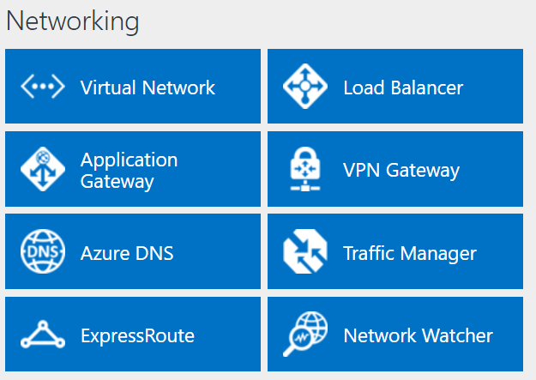
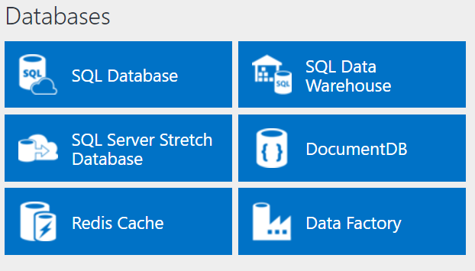
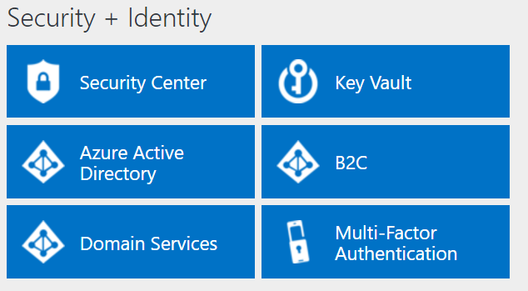
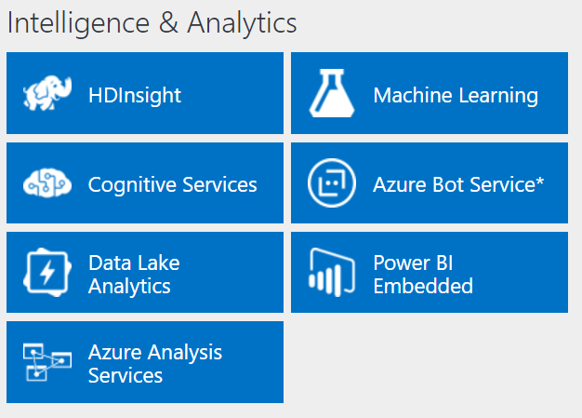
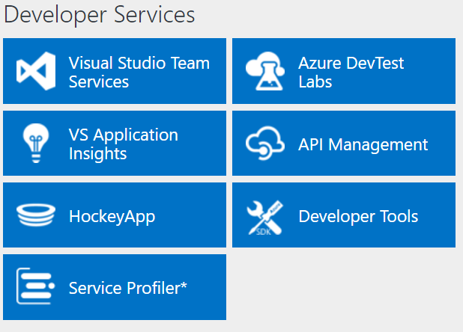
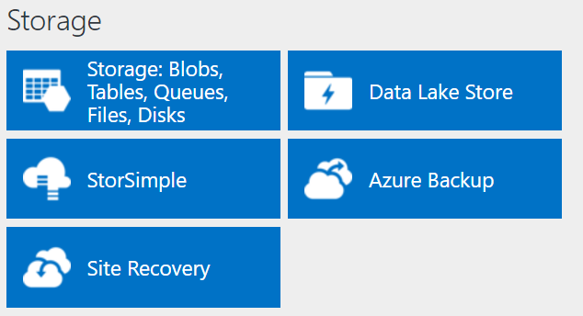
http://azureplatform.azurewebsites.net/
* Preview Services
Notes:
Preview Version 1.7 (2017-04-20)

Slide 3
Design and Implement a Storage Strategy (10-15%)
Implement Azure Storage blobs and Azure Files
Manage Access
Configure Diagnostics, Monitoring and analytics
Implement Storage Encryption
https://www.microsoft.com/en-ie/learning/exam-70-533.aspx
http://download.microsoft.com/download/8/4/8/848DD46A-05F2-4021-A118-036FC06647C5/533_OD_Changes.pdf

Slide 4
Design and Implement a Storage Strategy (10-15%)
Implement Azure Storage blobs and Azure Files
Identify appropriate blob type for specific storage requirements; read data; change data; set metadata on a container; store data using block and page blobs; stream data using blobs; access blobs securely; implement async blob copy; configure Content Delivery Network (CDN); design blob hierarchies; configure custom domains; scale blob storage; manage SMB file storage; implement Azure StorSimple
Manage access
Create and manage shared access signatures; use stored access policies; regenerate keys; encrypt keys by using Azure Key Vault integration
Configure diagnostics, monitoring, and analytics
Set retention policies and logging levels; analyze logs
Implement storage encryption
Encrypt data as written to Azure Storage by using Azure Storage Service Encryption (SSE); implement encrypted and role-based security for data managed by Azure Data Lake Store
http://download.microsoft.com/download/8/4/8/848DD46A-05F2-4021-A118-036FC06647C5/533_OD_Changes.pdf

Slide 5
Implement Azure Storage blobs and Azure Files
Identify appropriate blob type for specific storage requirements; read data; change data; set metadata on a container; store data using block and page blobs; stream data using blobs; access blobs securely; implement async blob copy; configure Content Delivery Network (CDN); design blob hierarchies; configure custom domains; scale blob storage; manage SMB file storage; implement Azure StorSimple

Slide 6



Storage Accounts
Blob Storage
Table Storage
Queue Storage
File Storage
Notes:
Blob Storage – stores unstructured object data , this can be text or binary data
Table storage – stores structured datasets, it is a NoSQL key attribute data store
Queue Storage – enables communication between segments of cloud services
File Storage – uses SMB file share based on SMB 3.0 , this used to provide UNC paths for legacy applications, this made available by using mounted shares

Slide 7
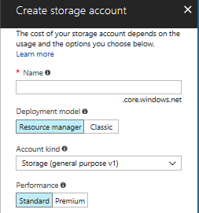
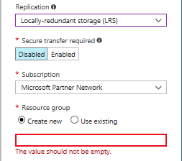
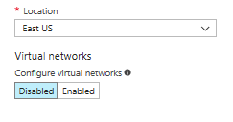
Creating a Storage Account

Slide 8
General Purpose Storage Account
Universal usuage
Can contain storage services of any type
Standard
Queues
Tables
Blobs
Files
Premium
Used to store VM disks

Slide 9
Blob Storage Account
Entrance to Azure Storage services
Tables
Queues
Files
Blobs
Azure VM machine disks
Two Performance tiers
Standard
Premium
Block or append Blob storage
Access tiers
Hot
Cool
Azure subscription
100 storage accounts / subscription

Slide 10
Replication and redundancy
Local Redundant Storage (LRS)
Data is held 3 times in a datacenter region
Protection from hardware failure
Zone-redundant storage (LRS)
Three copies
Guarded in two to three facilities
Different regions
Geo-Redundant storage (GRS)
Six copies replicated in primary region
3 more copies are replicated in a secondary region
Read-access geo-redundant storage (RA-GRS)
Secondary replica is provided for read-only access
Default option

Slide 11
PowerShell Implementation
New-AzureRmStorageAccount `
-ResourceGroupName 'AzureExamples' `
-Name 'implementingazuredemo' `
-Location 'northeurope' `
-SkuName 'Standard_LRS' `
-Kind 'Storage'

Slide 12
Blob Storage Services
Large unstructured data
Documents, photos, music
Containers /unlimited
500TB limit on overall size
Three types
Block
Append
Page (Disks)

Slide 13
Block Blobs
Streaming and storing cloud objects
Best used for
Storing documents
Media files
Backups

Slide 14
Append Blobs
Same as a block
Updates append new block to the end
Used for logging

Slide 15
Page Blob
Used to store IaaS disks
Support random writes
Azure IaaS VM VHD is stored in a page blob

Slide 16
Transporting Data
Not done over the wire
Ship a disk to Microsoft

Slide 17
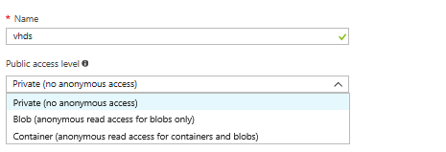
Containers
Top of the blob stack
Used to organize objects
VHD is stored in a container (folder)

Slide 18
PowerShell Implementation
#Define required variables
$storageAccountName = 'implementingazuredemo'
$resourceGroupName = 'AzureExamples'
#Get the Storage account keys
$storageAccountKey = Get-AzureRmStorageAccount `
-name $storageAccountName `
-ResourceGroupName $resourceGroupName `
| Get-AzureRmStorageAccountKey
#Create a Storage context for working with the Storage account
$storageContext = New-AzureStorageContext -StorageAccountName
$storageAccountName -StorageAccountKey $storageAccountKey[0].Value
#Create a blob container named testcontainer
New-AzureStorageContainer -Name 'testcontainer' -Context $storageContext
#Verify the creation
Get-AzureStorageContainer -Context $storageContext

Slide 19
Table Storage Services
NoSQL
Database has no schema
Each value has a type property name
Filtering, sorting and selection criteria
Higher performance, scalability and flexibility
Databases or datasets for web applications
Limiting factor is size of Storage account
No limit to number of tables or entities

Slide 20
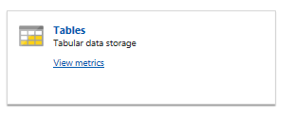
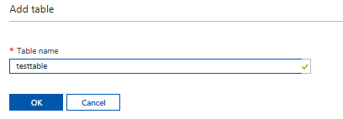
Table Storage
#Define required variables
$storageAccountName = 'implementingazuredemo'
$resourceGroupName = 'AzureExamples'
$tableName = 'testtable'
#Get the storage account keys
$storageAccountKey = Get-AzureRmStorageAccount `
-name $storageAccountName `
-ResourceGroupName $resourceGroupName `
| Get-AzureRmStorageAccountKey
#Create a Storage Context for working with the storage account
$storageContext = New-AzureStorageContext -StorageAccountName
$storageAccountName -StorageAccountKey
$storageAccountKey[0].Value
#Create a table named testtable
New-AzureStorageTable -Name $tableName -Context $storageContext
#Verify the creation
Get-AzureStorageTable -name $tablename -Context $storageContext

Slide 21
Queue Storage Services
Enables messaging between applications
Highly scalable and flexible applications
Components are decoupled
Asynchronous communications method
Workflows can built
No limit on the number of queues
Single message 64KB
Two Types
Azure Storage Queues
Azure Storage Bus

Slide 22

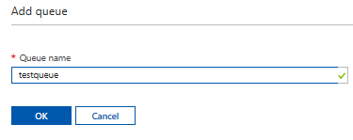
Implementing Queues
#Define required variables
$storageAccountName = 'implementingazuredemo'
$resourceGroupName = 'AzureExamples'
$queueName = 'testqueue'
#Get the storage account keys
$storageAccountKey = Get-AzureRmStorageAccount `
-name $storageAccountName `
-ResourceGroupName $resourceGroupName `
| Get-AzureRmStorageAccountKey
#Create a Storage Context for working with the storage account
$storageContext = New-AzureStorageContext -StorageAccountName
$storageAccountName -
StorageAccountKey $storageAccountKey[0].Value
#Create a queue named testqueue
$Queue = New-AzureStorageQueue -Name $queueName -Context
$storageContext
#Verify the creation
Get-AzureStorageQueue -name $queueName -Context $storageContext

Slide 23
File Storage
SMB (Server Message Block)
CIFS (Common Internet File System)
Cloud or On-premises
Windows, Linux, macOS
Cached (Azure File Sync (Preview))

Slide 24
Why Azure Files is Useful
Replace or supplement on-premise file servers
“Lift and Shift” applications
Simplify cloud deployment

Slide 25
Key benefits
Shared access
Fully managed
Scripting and tooling
Resiliency
Familiar programmability

Slide 26
Scenarios
Feature | Description | When to Use
Azure Files | SMB interface, client libraries and a REST interface | “lift and shift”
Azure Blobs | Client libraries, REST interface , unstructured and massive scale | Applications that support streaming and random access
Azure Disks | Client libraries and a REST interface , data is persistently stored and an attached virtual hard disk | Lift and shift applications that use native file system APIs to read and write data to persistent disks – data is not accessed outside the disk attached

Slide 27
Azure Files and Azure Blobs Comparison
Attribute | Azure Blobs | Azure Files
Durability options | LRS, ZRS, GRS, RA-GRS | LRS, ZRS, GRS
Accessibility | REST APIs | REST APIS, SMB 2.1, SMB 3.0
Connectivity | REST APIs – World-Wide | REST APIs – Worldwide SMB 2.1 – within Region SMB 3.0 Worldwide
EndPoints | http://myaccount.blob.core.windows.net/mycontainer/myblob | \\myaccount.file.core.windows.net\myshare\myfile http://myaccount.file.core.windows.net/myshare/m
Directories | Flat namespace | True directory objects
Case Sensitivity | Case sensitive | Case insensitive, but case preserving
Capacity | < 500TB | 5TB file shares
Throughput | < 60MB/s per block blob | < 60MB/s per file share
Object Size | < 200GB/block blob | < 1TB per file
Billed Capacity | Based on bytes written | Based on file size
Client libraries | Multiple languages | Multiple languages

Slide 28
Azure Files and Azure Disks Comparison
Attribute | Azure Disks | Azure Files
Scope | Exclusive to a single VM | Shared access across multiple VMs
Snapshot and Copy | Yes | No
Configuration | Connected at startup of VM | Connected after the VM has started
Authentication | Built-in | Set up with net use
Cleanup | Automatic | Manual
Access using REST | Files within VHD cannot be accessed | Files stored in share can be accessed
Max Size | 4TB disk | 5TB file share and 1TB file within share
Max 8KB Iops | 500 Iops | 1000 Iops
Throughput | < 60MB/s per disk | < 60MB/s per file share

Slide 29
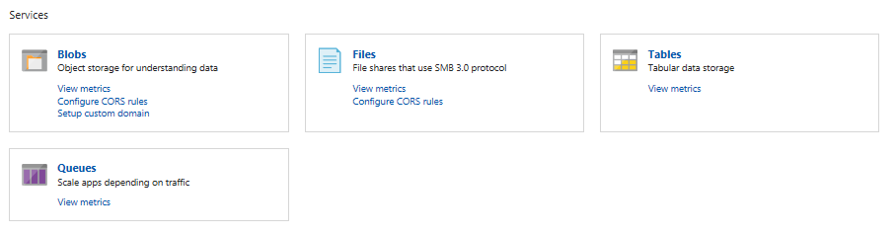
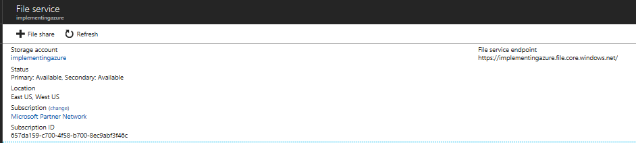
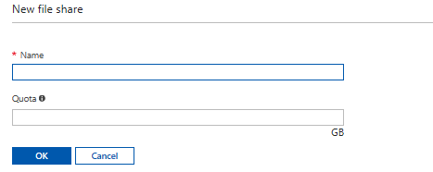
Creating a File Share

Slide 30
Create File Share using PowerShell
$storageContext = New-AzureStorageContext <storage acct-name><storage acct key>
$share = New-AzureStorageShare data –Context $storageContext
The name of the share must be in all lowercase.

Slide 31
Create Azure File Share using Azure CLI
current_env_conn_string = $(az storage account show-connection-string -n <storage-account> -g <resource-group> --query 'connectionString' -o tsv)
if [[ $current_env_conn_string == "" ]]; then
echo "Couldn't retrieve the connection string."
fi
az storage share create –name data –quota 2048 –connections-string $current_env_conn_string 1 > /dev/null

Slide 32
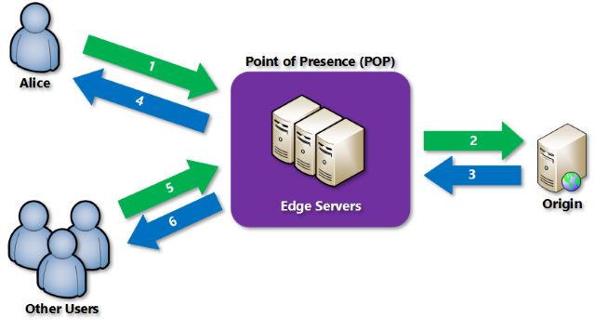
CDN
https://docs.microsoft.com/en-us/azure/cdn/cdn-overview
Notes:
A user (Alice) requests a file (also called an asset) using a URL with a special domain name, such as <endpointname>.azureedge.net. DNS routes the request to the best performing Point-of-Presence (POP) location, which is usually the POP that is geographically closest to the user.
If the edge servers in the POP do not have the file in their cache, the edge server requests the file from the origin. The origin can be an Azure Web App, Azure Cloud Service, Azure Storage account, or any publicly accessible web server.
The origin returns the file to the edge server, including optional HTTP headers describing the file's Time-to-Live (TTL).
The edge server caches the file and returns the file to the original requestor (Alice). The file remains cached on the edge server until the TTL expires. If the origin didn't specify a TTL, the default TTL is seven days.
Additional users may then request the same file using that same URL, and may also be directed to that same POP.
If the TTL for the file hasn't expired, the edge server returns the file from the cache. This process results in a faster, more responsive user experience.

Slide 33
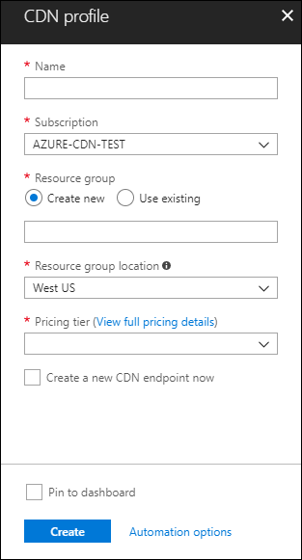
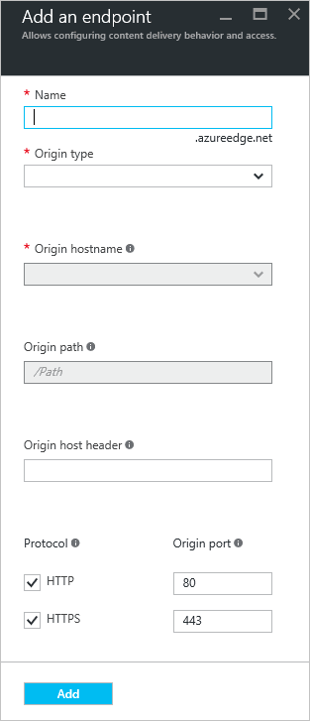
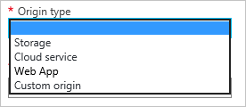
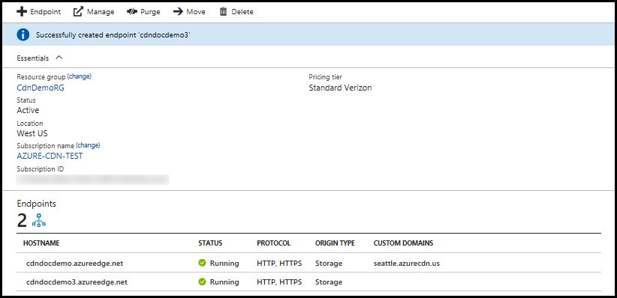
Configure CDN profile
Each profile can contain one or more CDN endpoints.
https://docs.microsoft.com/en-us/azure/cdn/cdn-create-new-endpoint

Slide 34
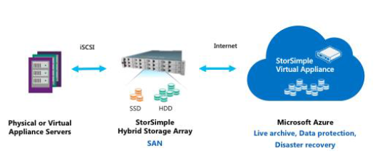
StorSimple

Slide 35
Manage Access
Create and manage shared access signatures; use stored access policies; regenerate keys; encrypt keys by using Azure Key Vault integration

Slide 36
Secure Storage Account using RBAC
Affect storage account
Resource Group
Azure Active Directory used to control access
RBAC
Assign a role to the account
Give them permissions to read storage account keys
Roles can be assigned to groups, users and applications
Each role has a list of actions and Not actions
Roles for storage
Owner
Storage account contributor
Virtual Machine Contributor
Custom roles
User setup in Azure AD
Report
PowerShell
Azure CLI

Slide 37
Managing Storage Account Keys
512 bit strings
Two keys
Key 1
Key 2
Reasons to regenerate
Regular security
Compromised key
Employee turn-over

Slide 38
Key regeneration plan
List applications
10 minutes to Sync
Process
Regenerate Key 2
Change Key 1 in applications to Key 2
Regenerate Key 1

Slide 39
Azure Key Vault
Store keys
Distribute keys
Negates the need to redeploy applications
Another level of protection
Keys are never hard coded in the application
Control access using Azure AD

Slide 40
Shared Access Signatures
String containing a security token
Attached to a URI
Gives temporary access
SAS token
Can be used to
Give access to a range of entities (such as a geographical area in a table)
Separate roles (writers from readers)

Slide 41
Why use Shared Access Signatures
Storage Account Keys give to much access
Limited time and limited access (principle of Least Privilege)
Restrictions to certain IP addresses
Specific protocols (require SSL)

Slide 42
What is a Shared Access Signature
Set of query parameters appended to a URL pointing to a resource
http://mystorage.blob.core.windows.net/mycontainer/myblob.txt (URL to the blob)
?sv=2015-04-05 (storage service version)
&st=2015-12-10T22%3A18%3A26Z (start time, in UTC time and URL encoded)
&se=2015-12-10T22%3A23%3A26Z (end time, in UTC time and URL encoded)
&sr=b (resource is a blob)
&sp=r (read access)
&sip=168.1.5.60-168.1.5.70 (requests can only come from this range of IP addresses)
&spr=https (only allow HTTPS requests)
&sig=Z%2FRHIX5Xcg0Mq2rqI3OlWTjEg2tYkboXr1P9ZUXDtkk%3D (signature used for the authentication of the SAS)

Slide 43
Shared Access Signature authentication to Azure Storage Service
Inputs query parameters and creates a signature from calling program
Compares signatures
Check if date and time within range
Types
Service-level SAS
Account-level SAS

Slide 44
Creation of SAS
Ad hoc URI
Logical group of parameters
Same each time
Stored Access Policy
Entire container, file share, table or queue
Base all SAS URIs you create
Up to 5 policies defined for each container , queue, table or file share
Revocation

Slide 45
Revocation of SAS
Ad hoc
Short expiration polices
Rename or delete the resource
Change the storage account keys
Stored Access Policy
Remove access policy
Change expiration date
Remove it

Slide 46
Implement Storage Encryption
Encrypt data as written to Azure Storage by using Azure Storage Service Encryption (SSE); implement encrypted and role-based security for data managed by Azure Data Lake Store

Slide 47
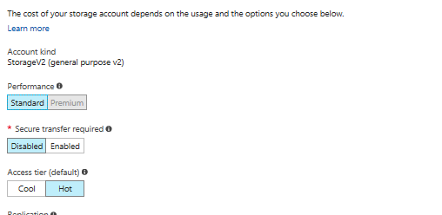
Transit-Level Encryption – using HTTPS
Ensures secure communication over public internet
Use HTTPS for REST APIs and SAS URIs
Forced secure transfer

Slide 48
Encryption during transit with Azure File shares
Same region in Azure
2.1 does not support
SMB 3.0 does
Windows 8 and above
Windows Server 2012 R2 and above
Cross region and desktop access
Not supported in Linux
Can enforce by configuring Azure Storage Account as in previous example (REST APIs)

Slide 49
Storage Service Encryption (SSE)
Automatic encrypt data when writing to Azure Storage
Decrypted when read
Whole storage account
Can be done
Azure portal
PowerShell
Azure CLI
Storage Resource Provider REST API
.NET Storage Client Library
Off by default
Keys are generated by Microsoft
Standard and Premium accounts
Resource Manager
Blob storage only and SSE enabled
Enabling or Disabling does not affect existing

Slide 50
Client-side Encryption
Programmatically encrypt in transit
In transit and also at rest
Still use HTTPS for in transit
Java and .NET storage client libraries
Azure Key Vault APIs
Uses Envelope technique and metadata
Generate and use your own encryption keys
Use keys generated by Azure Storage client library
Azure Key Vault keys

Slide 51
Azure Disk Encryption
Encrypt OS disks and Data disks in VMs
BitLocker for Windows
DM-Crypt for Linux
Integrated with Azure Key Vault

Slide 52
Supported by Azure Disk Encryption
Integration with Azure Key Vault
Standard VMs: A, D, G, GS
Enabling encryption on Windows and Linux IaaS VMs
Disabling encryption on data drives for Linux IaaS VMs
Enabling encryption on IaaS VMs running client Windows OS
Encryption on volumes and mount paths
Linux VMs configured with disk striping (RAID) by using mdadm
Linux VMs by using LVM for data disks
Windows VMs configured by using storage spaces
All Azure public regions

Slide 53
Not Support by Azure Disk Encryption
Basic tier IaaS VMs
Disabling encryption on an OS for Linux IaaS VMs
IaaS VMs that are created by using the classic VM creation method
Integration with your on-premises Key Management Service (KMS)
Azure files , NFS, dynamic volumes and Windows VMs that are configured with software-based RAID systems

Slide 54
Comparison of Azure Disk Encryption, SSE and CSE
VHDs on IaaS VMs
Azure Disk Encryption
No Encryption from Storage Account
No Encryption from Marketplace
CSE
Most secure
Requires code in application
CSE can encrypt table entities, queue messages and blobs
SSE can only encrypt blobs
Client-side requires more resources on the client
SSE
Managed by Azure Storage
Does not provide encryption in transit
Can encrypt any type of storage account
Azure Disk Encryption and SSE can be used in conjunction

Slide 55
Configure diagnostics, monitoring, and analytics
Set retention policies and logging levels; analyze logs

Slide 56
Storage Analytics to monitor authorization type
Enable on each storage account
Logging and storing metrics data
Tool
Performance metrics
Troubleshoot
Authentication auditing

Slide 57
Retention Policy for Storage Analytics Data
20TB limit by default
Independent of storage account limit
Ways to delete Storage Analytics data
Manually marking deletion requests
Setting a retention policy

Slide 58
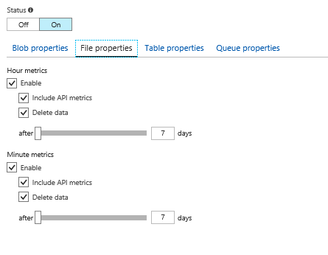
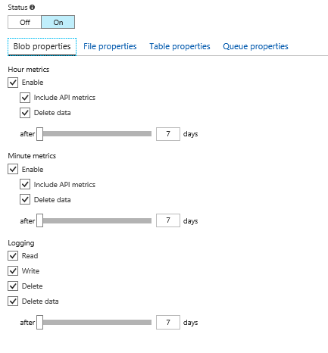
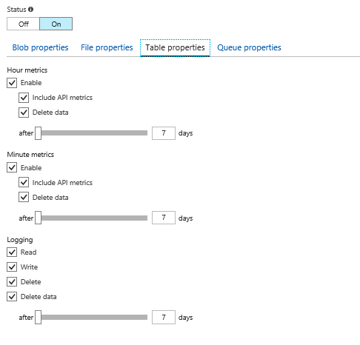
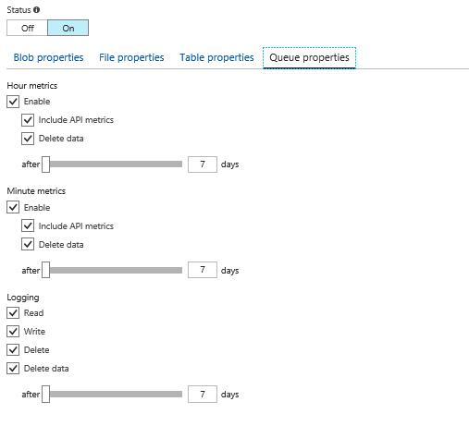
Setting a Data Retention Policy
Two policies
One for logging
One for metrics
Maximum retention is 365 days
<RetentionPolicy>
<Enabled>true</Enabled>
<Days>7</Days>
<RetentionPolicy>

Slide 59
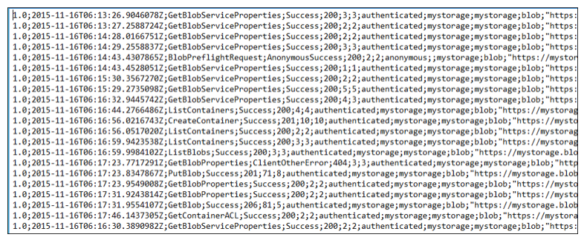
Storage Log

Slide 60
You are designing a Windows Azure application that will use a worker role. The worker role will create temporary files. You need to recommend an approach for creating the temporary files that minimizes storage transactions. What should you recommend?
A. Create the files in Windows Azure block blobs
B. Create the files on a Windows Azure Drive
C. Create the files in Windows Azure local storage
D. Create the files in Windows Azure Storage page blobs

Slide 61
C. Create the files in Windows Azure local storage

Slide 62
You are migrating a local VM to an Azure VM. You upload the VHD file to Azure Blob storage as a Block Blob. You need to change the Block blob to a page blob. What should you do?
A. Upload the metadata of the current blob and set the Blob-Type key to Page
B. Update the type of the blob programmatically by using the Azure Storage .NET SDK
C. Create a new empty page blob and use Azure Blob Copy PowerShell cmdlet to copy the current data to the new blob
D. Delete the Block Blob and re-upload the VHD as a page blob

Slide 63
D. Delete the Block Blob and re-upload the VHD as a page blob

Slide 64
You are working on a project that requires that data be encrypted both at rest and in transit. What do you use?
SSE (Sever Side Encryption)
CSE (Client Side Encryption)
Azure Disk Encryption
SSL (Secure Socket Layer)

Slide 65
CSE (Client Side Encryption)

Slide 66
You administer an Azure Storage account with a blob container. You enable Storage account logging for read, write and delete requests. You need to reduce the costs associated with storing logs. What should you do?
Execute Delete Blob requests over http
Set up a retention policy
Create an export job for your container
Execute Delete Blob requests over https

Slide 67
Set up a retention policy

Slide 69
Course outline
Module 1
Introduction to Microsoft Azure
Module 2
Implementing and managing Azure networking
Module 3
Implementing virtual machines
Module 4
Managing Azure VMs
Module 5
Implementing Azure App Service

Slide 70
Course outline (continued)
Module 6
Planning and implementing storage, backup, and recovery services
Module 7
Implementing containers in Azure
Module 8
Implementing Azure Cloud Services
Module 9
Implementing Azure Active Directory
Module 10
Managing an Active Directory infrastructure in a hybrid environment
Module 11
Implementing Azure-based management and automation

