Slide 1
Exam 70-533 Implementing Microsoft Azure Infrastructure Solutions
Design and Implement Azure App Service Apps (10-15%)
Create and Manage Compute Resources (20-25%)
Design and Implement a Storage Strategy (10-15%)
Implement virtual networks (15–20%)
Design and Deploy ARM Templates (10-15%)
Manage Azure Security, and Recovery Services (25-30%)
Manage Azure Operations (5-10%)
Manage Azure Identities (5-10%)
Speaker Information:
https://www.microsoft.com/en-ie/learning/exam-70-533.aspx
Notes:
Presentation: 105 minutes
Lab: 50 minutes
After completing this module, students will be able to:
Identify suitable workloads for the cloud.
Identify services and capabilities that Microsoft Azure provides.
Use Azure portals to manage Azure services and subscriptions.
Use Windows PowerShell to manage Azure services and subscriptions.
Use Azure Command-Line Interface (CLI) to manage Azure services and subscriptions.
Describe the primary characteristics of Azure Resource Manager.
Use Azure services to enhance management and monitoring of Azure.
Required materials
To teach this module, you need the Microsoft PowerPoint file 20533D_01.pptx.
Preparation tasks
To prepare for this module, you should:
Read all this module’s materials.
Practice performing the demonstrations and labs.
Work through the Module Review and Takeaways section to determine how you will use the information to reinforce student learning and promote knowledge transfer to on-the-job performance.
As you prepare for this class, it is imperative that you complete the labs yourself. This gives you an understanding of how the labs work, as well as the concepts that each lab covers. This enables you to provide meaningful hints to students who might have issues while working in the labs. Furthermore, it will help guide your lecture to ensure that you discuss the concepts that the labs cover.
20533D
1: Introduction to Microsoft Azure

Slide 2

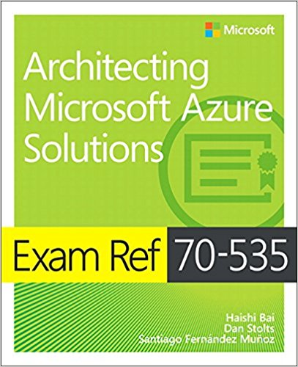
Exam 70-533 Implementing Microsoft Azure Infrastructure Solutions Manage Azure Operations (5-10%)
Program Home: https://aka.ms/certup
Content Home: http://github.com/guruskill/70-533
Dan Stolts - Author
Chief Technology Strategist, Microsoft
http://ITProGuru.com
http://ITProGuru.com/join
http://LinkedIn.com/in/danstolts
ITProGuru@Microsoft.com
@ITProGuru
Join for Thought Leadership and Events Information … http://ITProGuru.com/Join
Notes:
http://aka.ms/certification/70-534
https://mslibrary.measureup.com/

Slide 3
Manage Azure Operations (5-10%)
Enhance cloud management with automation
Collect and analyze data generated by resources in cloud and on-premises environments
https://www.microsoft.com/en-ie/learning/exam-70-533.aspx

Slide 4
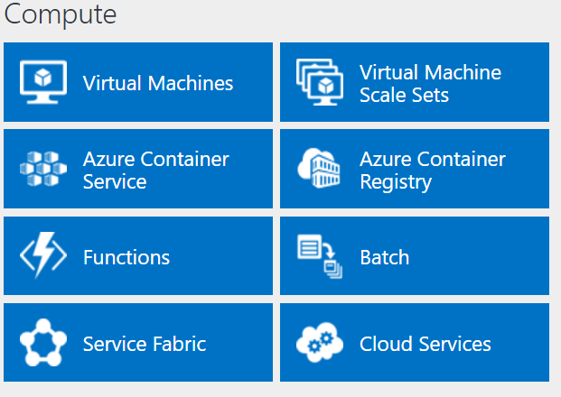
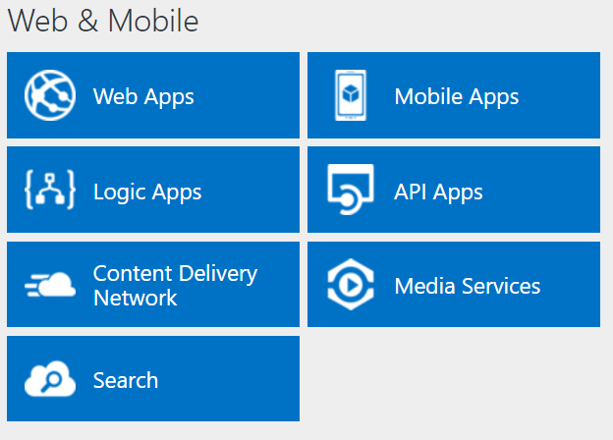
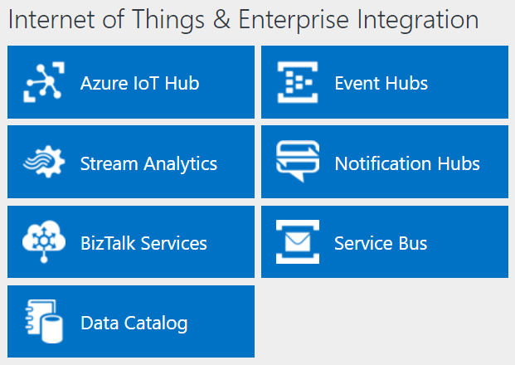
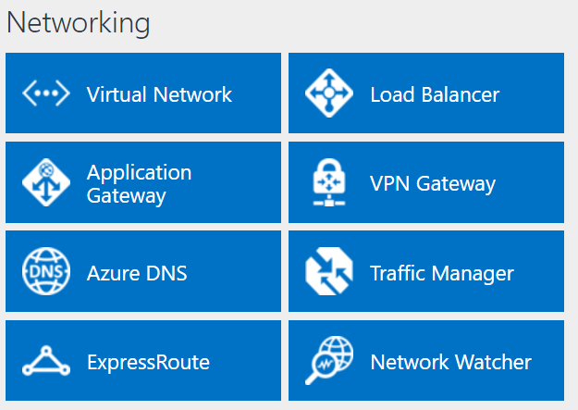
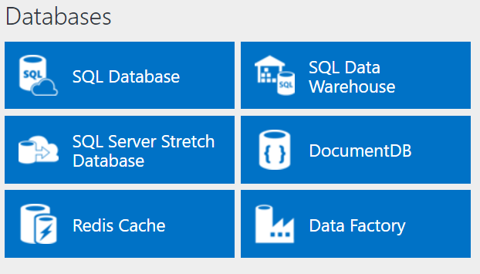
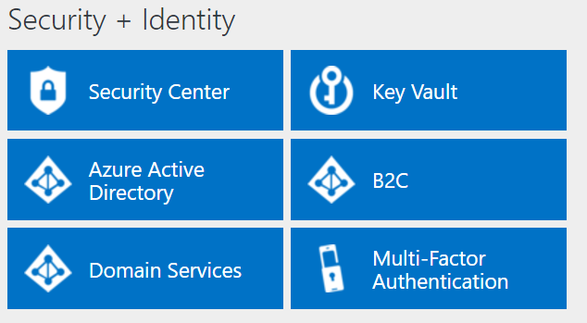
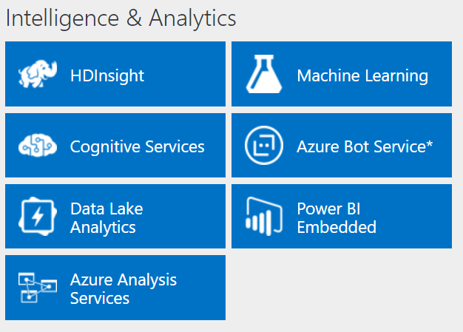
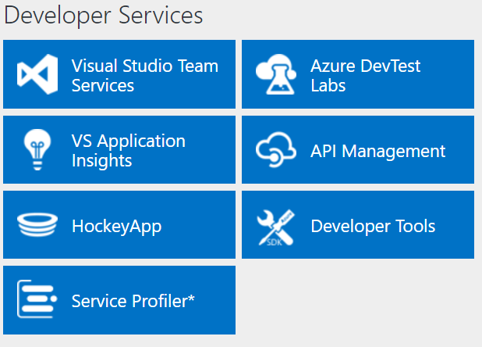
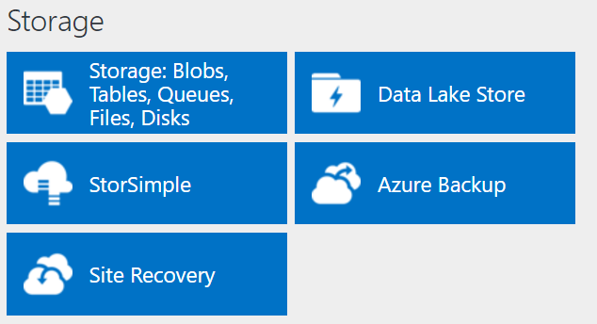
http://azureplatform.azurewebsites.net/
* Preview Services
Notes:
Preview Version 1.7 (2017-04-20)

Slide 5
Manage Azure Operations (5-10%)
Enhance cloud management with automation
Implement PowerShell runbooks; integrate Azure Automation with Web Apps; create and manage PowerShell Desired State Configurations (DSC); import DSC resources; generate DSC node configurations; monitor and automatically update machine configurations with Azure Automation DSC
Collect and analyze data generated by resources in cloud and on-premises environments.
Collect and search across data sources from multiple systems; build custom visualizations; visualize Azure resources across multiple subscriptions; transform Azure activity data and managed resource data into an insight with flexible search queries; monitor system updates and malware status; track server configuration changes by using Azure Log Analytics
http://download.microsoft.com/download/8/4/8/848DD46A-05F2-4021-A118-036FC06647C5/533_OD_Changes.pdf

Slide 6
6.4 Design a disaster recovery strategy (from 70-534)
Design and deploy Azure Backup and other Microsoft backup solutions
Use cases for StorSimple and System Center Data Protection Manager
Design and deploy Azure Site Recovery

Slide 7
Disaster recovery strategy
Backup Solutions
Microsoft Azure Backup
Reliable, Simple, Efficient
Use for Branch Office or Small Business
Hyper-V Recovery Manager
StorSimple
Proprietary Device | Multiple Tiers
Cloud Integrated Storage (CiS)
Seamless view of ALL Enterprise Storage | Windows and VMWare
System Center Data Protection Manager
Can Store backed up DPM data in Azure…
As Physical or VM
As Azure VM

Slide 8
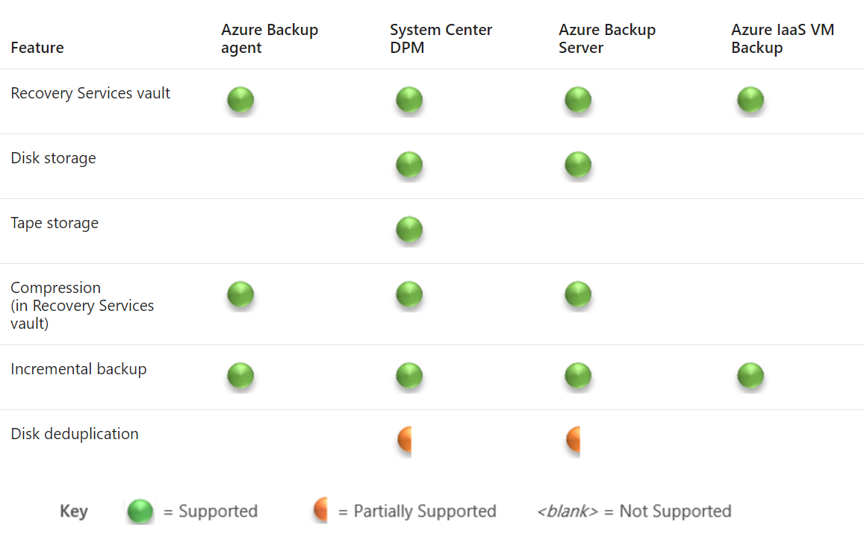
Disaster recovery strategy

Slide 9
Enhance Cloud Management with Automation
Implement PowerShell runbooks; integrate Azure Automation with Web Apps; create and manage PowerShell Desired State Configurations (DSC); import DSC resources; generate DSC node configurations; monitor and automatically update machine configurations with Azure Automation DSC

Slide 10










Introducing Azure Automation
Local server
Local resources Hybrid Runbook Worker
VMs
Azure resources
DSC configurations
Runbooks
Azure Automation
Automation solution
OMS workspace
Local
External resources
Azure
Internet
Notes:
Describe the high-level architecture of Azure Automation.
20533D
11: Implementing Azure-based management and automation

Slide 11
Creating Azure Automation accounts and assets
Create an Automation account by using:
Automation & Control from the Azure Marketplace
Automation service from the Azure Marketplace
OMS Management solutions
Azure Automation assets are grouped into the following categories:
Modules
Schedules
Certificates
Connections
Variables
Credentials
Notes:
Describe the methods for creating an Automation account and describe Automation assets.
20533D
11: Implementing Azure-based management and automation

Slide 12
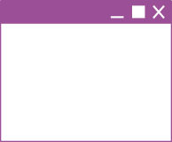



Using Automation runbooks on-premises
Runbooks work against local resources
Hybrid Runbook Worker
Runbooks work against
cloud resources
Azure
resources
Runbooks
Runbooks delivered
to on-premises
machine
Azure
Automation
Enterprise
Azure
Notes:
Describe the architecture of cross-premises Azure Automation deployments and the process of implementing Hybrid Runbook Workers.
20533D
11: Implementing Azure-based management and automation

Slide 13
Demonstration: Creating an Azure Automation account and assets
Create an Azure Automation account
Create an Azure Automation Schedule asset
Create an Azure Automation Variable asset
In this demonstration, you will see how to:
https://docs.microsoft.com/en-us/azure/automation/automation-create-standalone-account
Notes:
Demonstration Steps
Create an Azure Automation account
From the Azure portal, create a new Azure Automation account by using the following settings:
Name: DemoAutomationAccount
Resource group: Create a new resource group named 20533D1102-DemoRG
Subscription: Your current subscription
Location: The same Azure region that you chose while running the provisioning script or another region close to it
Create Azure Run As account: Yes
Pin to dashboard: Do not select this check box
Note: Wait for the Azure Automation account to be provisioned. This should take less than a minute.
Create an Azure Automation Variable asset
From the Azure portal, navigate to DemoAutomationAccount, and then create a new Automation variable by using the following settings:
Name: SubscriptionId
Description: Subscription Id
Type: String
Value: ID of your subscription
Encrypted: No
20533D
11: Implementing Azure-based management and automation
(More notes on the next slide)

Slide 14
Introduction to Azure Automation runbooks
Graphical runbooks:
Based on PowerShell workflows or PowerShell scripts
Edited by using the graphical editor in the Azure portal
Textual runbooks:
Based on PowerShell workflows or PowerShell scripts
Edited by using the textual editor in the Azure portal or imported from workflows and scripts created on-premises
Converting runbook types:
No support for converting between graphical and textual
Support for converting between graphical workflows and runbooks during import
Notes:
Describe the different types of runbooks and the differences between them.
20533D
11: Implementing Azure-based management and automation

Slide 15
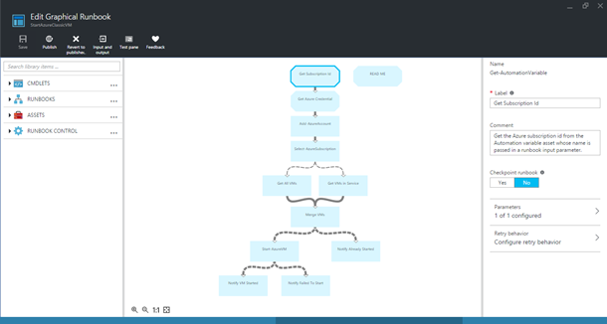
Graphical authoring of Automation runbooks
Library
Canvas
Configuration
Notes:
Explain the process of authoring a graphical runbook.
20533D
11: Implementing Azure-based management and automation

Slide 16
Overview of PowerShell workflows
Workflows support:
Long-running activities
Repeatable activities
Frequently executed activities
Running activities in parallel across one or more machines
Interruptible activities that you can stop and restart
Notes:
Point out the differences between workflows and traditional PowerShell scripts, including the ability to perform a set of activities in parallel and automatically restart from the most recent checkpoint.
20533D
11: Implementing Azure-based management and automation

Slide 17
Textual authoring of PowerShell workflow runbooks
Workflow syntax/keywords:
Parallel
Foreach –parallel
Sequence
InlineScript
Checkpoint-workflow
Suspend-workflow
workflow test {
InlineScript { Code }
parallel {
Command A
Command B
sequence {
Command C
Command D
}
}
}
Notes:
While PowerShell workflow activities use the same naming convention as Windows PowerShell cmdlets, there are some syntactical differences between them. In addition, it is possible to include Windows PowerShell cmdlets within a workflow by enclosing them in an InlineScript block.
20533D
11: Implementing Azure-based management and automation

Slide 18
Textual authoring of PowerShell runbooks
To create Automation PowerShell scripts:
Write code in textual editor
Add PowerShell cmdlets from integration modules imported into the Automation account
Reference Automation assets
Add runbooks
Notes:
Describe the basic steps involved in authoring PowerShell runbooks.
20533D
11: Implementing Azure-based management and automation

Slide 19
Implementing Automation DSC
Configurations
Node configurations
(.mof configuration
documents)
Configuration SharePoint {
Node WebService {
#Install the IIS Role
WindowsFeature IIS {
Ensure = “Present”
Name – “Web-Server”
}
#Install ASP.NET 4.5
WindowsFeature ASP {
Ensure = “Present”
Name – “Web-Asp-Net45”
}
}
}
Nodes
SharePoint.WebService
Compiled,
put on pull
server
via
compilation
jobs
Applied
via node pulls
One or more per
Automation account
One or more
per configuration
One or more
per node configuration
Notes:
Describe the process of implementing Automation Desired State Configuration (DSC).
20533D
11: Implementing Azure-based management and automation

Slide 20

Automation runbook lifecycle
Revert
Publish
New
In edit
Published
Publish
Possible actions in
the New status:
Test
Publish
Possible actions in
the Published status:
Start via Webhook
Start on schedule
Possible actions in
the In edit status:
Test
Publish (overwrite
published runbook)
Notes:
Describe the concept of the authoring status in the context of Automation runbooks.
20533D
11: Implementing Azure-based management and automation

Slide 21
Testing, publishing, and executing Automation runbooks
Testing validates a new or newly modified runbook operation before publishing
Not equivalent to the PowerShell WhatIf switch
Consider running in a dedicated test environment
Publishing designates runbook as production-ready
Can be scheduled
Can be called via Webhook
Notes:
Describe the tasks involved in testing, publishing, and executing Automation runbooks. Emphasize the considerations regarding testing.
20533D
11: Implementing Azure-based management and automation

Slide 22
Monitoring and troubleshooting Automation jobs
Possible job states:
Completed
Failed
Failed, waiting for resources
Queued
Starting
Running
Running, waiting for resources
Stopped
Stopping
Suspended
Suspending
Resuming
Notes:
Briefly describe each of the possible job execution states.
20533D
11: Implementing Azure-based management and automation

Slide 23
Protecting the Azure Automation environment
Built-in geo-replication of Automation accounts
90-day log retention period
Custom backup options for:
Runbooks
Assets
DSC configurations
Notes:
Describe the built-in and custom mechanisms that facilitate resiliency of Automation accounts.
20533D
11: Implementing Azure-based management and automation

Slide 24
Collect and analyze data generated by resources in cloud and on-premises environments
Collect and search across data sources from multiple systems; build custom visualizations; visualize Azure resources across multiple subscriptions; transform Azure activity data and managed resource data into an insight with flexible search queries; monitor system updates and malware status; track server configuration changes by using Azure Log Analytics

Slide 25












Data Collection Architecture
THREAT
INTELLIGENCE
AZURE
NETWORK & PAAS Netflow, SQL DB and Storage Logs, …
AZURE SECURITY CENTER
SECURITY ANALYTICS
Threat Detections, Prescriptive Recommendations
Security Dashboards Deliver Rapid Insights into Security State Across All Workloads
Security Dashboards Deliver Rapid Insights into Security State Across All Workloads
WINDOWS & LINUX AGENTS
Windows Events, Syslog, CEF, Configurations
Actionable Security Recommendations
NORMALIZATION & ENRICHMENT IP Geotagging, …
SCALABLE LOG ANALYTICS
PLATFORM
Curated, Prioritized Security Alerts
ON-PREMISES, PRIVATE AND PUBLIC CLOUDS
Investigation Tools and Log Search
Export to Excel and Power BI
REST APIs
Automation
Notifications

Slide 26
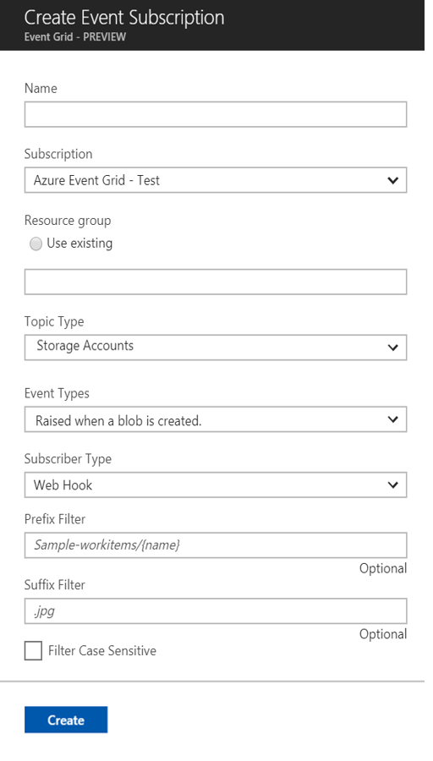
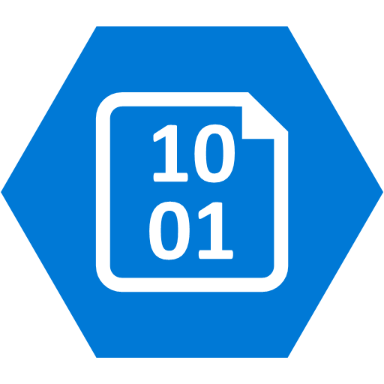


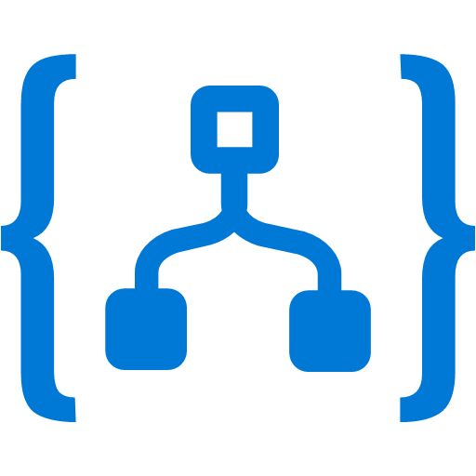
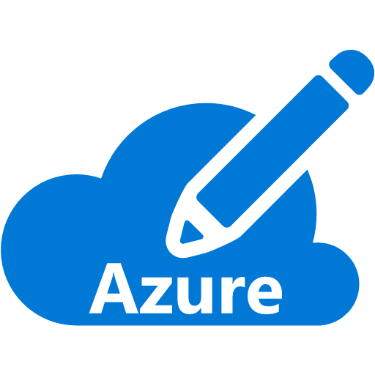



Manage all events in one place with Event Grid
Event publishers
Event handlers
Blob Storage
Azure Functions
Resource Groups
Subscribe to pre-defined system events in Azure or create your own custom topics
Logic Apps
Azure Subscriptions
Route events to any end-points, Azure or even beyond
Azure Automation
Event Hubs
WebHooks
Custom Events
Enable filtering and efficient routing of events
https://docs.microsoft.com/en-us/azure/event-grid/overview
Notes:
Near Real Time
Sub-second end-to-end latency in the 99th percentile
Massive Scale Out
10,000,000 events per second per region
Highly Reliability
24-hour retry with exponential back off for events not delivered

Slide 27
Full set of cloud management capabilities
GOVERN
SECURE
Policy Management
Cost Management
Security Management
Threat Protection
CONFIGURE
Microsoft Azure
PROTECT
Configuration
Update Management
Automation
Scripting
Backup
Disaster Recovery
MONITOR
App, Infra, & Network Monitoring
Log Analytics and Diagnostics
Notes:
Talk through the investments of what MSFT/Azure sees as important for enterprise cloud management platform
The combination together is powerful. Truly integrated capabilities SaaS management and security.
To be successful in the Cloud era, enterprises must have visibility/metrics and controls on every component to pinpoint issues efficiently, optimize and scale effectively, while having the assurance the security, compliance and polices are in place to ensure the velocity.
Native Security and Management in Azure
Enterprise grade capabilities natively from the cloud provider Azure
Integrated and interconnected across data and experiences
Management capabilities included with the flexibility to increase or choose 3rd party
Can make the point that for those familiar with OMS these were the foundation for what we now have natively within Azure.
5 main areas:
Secure: While Azure is trusted and secure platform, you as a customer have your own security settings you need to manage. You also need to be able to protect your individual machines against threats and monitor the security posture of your system.
Protect: Your VMs and applications in the cloud need to be backed up and protected in the event of data loss. With disaster recovery from on-prem to the cloud, or from one cloud to another, you can avoid downtime and keep your applications up and running.
Monitor: Every operations manager and every developer needs to be able to see the health and performance of their applications, infrastructure, and network. And seeing insights across all three together in a single dashboard can save time and resources in troubleshooting and preventing issues in the future.
Configure: For managing Azure and hybrid workloads at scale, automation and configuration capabilities help you create runbooks to automate tasks, manage the configuration settings and track changes, and monitor and deploy missing updates. Additionally in Azure you can use PowerShell and Cloud Shell for command line scripting.
Govern: Many customers need a way to look across cloud resources to assess and enforce enterprise-wide standards and policy compliance for security and management. In addition, they need to manage and monitor costs for the cloud. We recently acquired Cloudyn, a multi-cloud cost management solution to help our customers with this challenge.

Slide 28
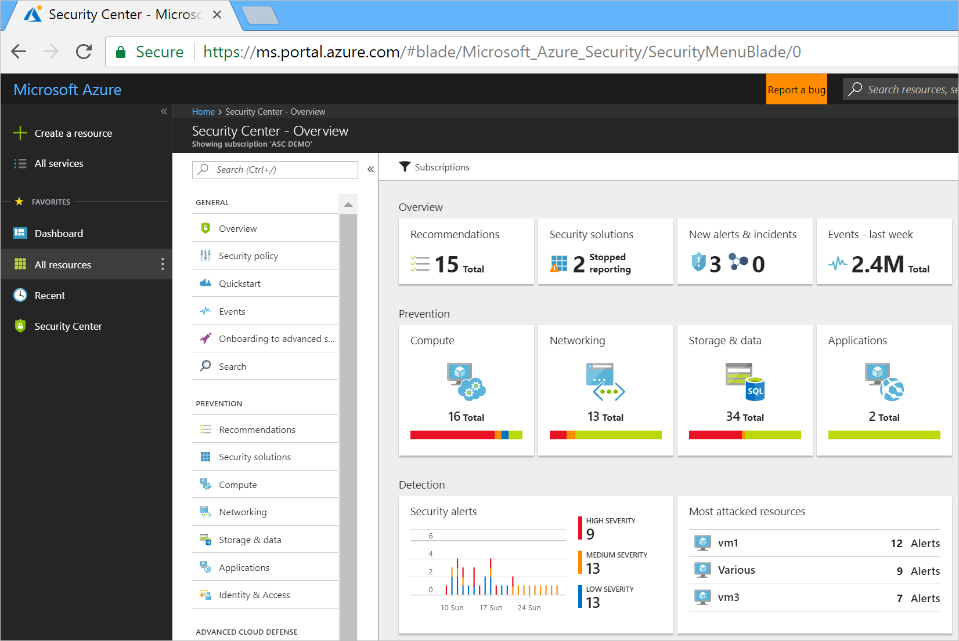
https://docs.microsoft.com/en-us/azure/security-center/security-center-intro
Notes:
https://docs.microsoft.com/en-us/azure/security-center/security-center-intro
Centralized policy management – Ensure compliance with company or regulatory security requirements by centrally managing security policies across all your hybrid cloud workloads.
Continuous security assessment – Monitor the security of machines, networks, storage and data services, and applications to discover potential security issues.
Actionable recommendations – Remediate security vulnerabilities before they can be exploited by attackers with prioritized and actionable security recommendations.
Advanced cloud defenses – Reduce threats with just in time access to management ports and whitelisting to control applications running on your VMs.
Prioritized alerts and incidents - Focus on the most critical threats first with prioritized security alerts and incidents.
Integrated security solutions - Collect, search, and analyze security data from a variety of sources, including connected partner solutions.

Slide 29
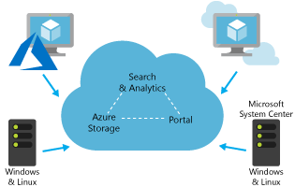
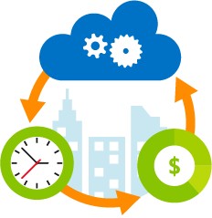
Log Analytics
Collect and correlate data from multiple sources
Collect and analyze Azure activity logs
Customize dashboards to focus on what matters most to you
Perform rich data exploration with interactive queries
Use smart analytics powered by machine learning
Turn insights into action with built-in notification and automation
Notes:
Transform your log data into insights and action
Quickly connect and collect log data from multiple sources
Correlate and analyze using powerful machine learning constructs
Search and query interactively using an expressive language
Develop deep insights using purpose-built management solutions
formerly known as OMS Log Analytics, is an Azure service that ingests log and metric data from Azure services (via Azure Monitor), Azure VMs, and on-premises or other cloud infrastructure and offers flexible log search and out-of-the box analytics on top of this data. It provides rich tools to analyze data across sources, allows complex queries across all logs, and can proactively alert on specified conditions. You can even collect custom data into its central repository so you can query and visualize it. You can also take advantage of Log Analytic's built-in solutions to immediately gain insights into the security and functionality of your infrastructure.

Slide 30
Demonstration: Creating an Azure Automation account and assets
Create an Azure Automation account
Create an Azure Automation Schedule asset
Create an Azure Automation Variable asset
In this demonstration, you will see how to:
https://docs.microsoft.com/en-us/azure/automation/automation-create-standalone-account
Notes:
Demonstration Steps
Create an Azure Automation account
From the Azure portal, create a new Azure Automation account by using the following settings:
Name: DemoAutomationAccount
Resource group: Create a new resource group named 20533D1102-DemoRG
Subscription: Your current subscription
Location: The same Azure region that you chose while running the provisioning script or another region close to it
Create Azure Run As account: Yes
Pin to dashboard: Do not select this check box
Note: Wait for the Azure Automation account to be provisioned. This should take less than a minute.
Create an Azure Automation Variable asset
From the Azure portal, navigate to DemoAutomationAccount, and then create a new Automation variable by using the following settings:
Name: SubscriptionId
Description: Subscription Id
Type: String
Value: ID of your subscription
Encrypted: No
20533D
11: Implementing Azure-based management and automation
(More notes on the next slide)

Slide 31
Creating an Azure Automation account and assets
Create an Azure Automation account
Create an Azure Automation Schedule asset
Create an Azure Automation Variable asset
https://docs.microsoft.com/en-us/azure/automation/automation-create-standalone-account

Slide 32
You plan to author an Automation runbook that, according to your estimates, will take seven hours to complete. What should you do to ensure that the runbook successfully executes?
Create a PowerShell script–based runbook
Create a PowerShell workflow–based runbook with a single checkpoint
Create a PowerShell workflow–based runbook with two checkpoints
Create a PowerShell workflow–based runbook with a single InlineScript
Create a PowerShell workflow–based runbook with two InlineScript elements
https://docs.microsoft.com/en-us/azure/automation/automation-powershell-workflow

Slide 33
You plan to author an Automation runbook that, according to your estimates, will take seven hours to complete. What should you do to ensure that the runbook successfully executes?
Create a PowerShell workflow–based runbook with two checkpoints

Slide 34
What actions are available for a runbook in the New authoring status?
Testing
Scheduling
Creating a webhook
Reverting to the published version
Editing

Slide 35
What actions are available for a runbook in the New authoring status?
Testing
Editing

Slide 36
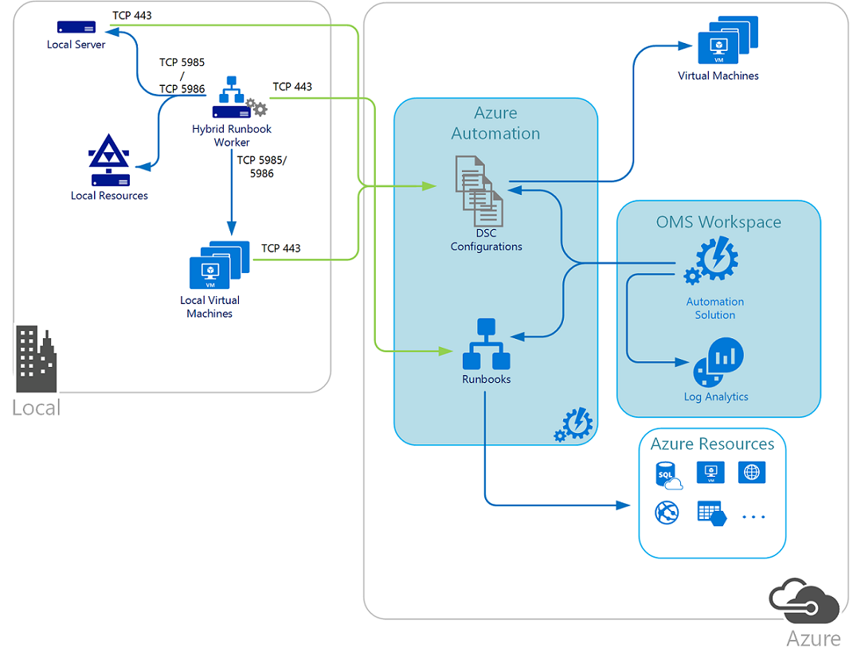
Hybrid Azure Automation - DSC
DSC configurations stored in Azure Automation can be directly applied to Azure virtual machines. Other physical and virtual machines can request configurations from the Azure Automation DSC pull server.
Note
TCP 443 from local to Azure
TCP 5985/5986 Hybrid Runbook Worker to local machines and resources
Hybrid Runbook worker is running locally and managing local resources
https://docs.microsoft.com/en-us/azure/automation/automation-offering-get-started

