Slide 1
Exam 70-533 Implementing Microsoft Azure Infrastructure Solutions
Design and Implement Azure App Service Apps (10-15%)
Create and Manage Compute Resources (20-25%)
Design and Implement a Storage Strategy (10-15%)
Implement virtual networks (15–20%)
Design and Deploy ARM Templates (10-15%)
Manage Azure Security, and Recovery Services (25-30%)
Manage Azure Operations (5-10%)
Manage Azure Identities (5-10%)
Speaker Information:
https://www.microsoft.com/en-ie/learning/exam-70-533.aspx
Notes:
Presentation: 105 minutes
Lab: 50 minutes
After completing this module, students will be able to:
Identify suitable workloads for the cloud.
Identify services and capabilities that Microsoft Azure provides.
Use Azure portals to manage Azure services and subscriptions.
Use Windows PowerShell to manage Azure services and subscriptions.
Use Azure Command-Line Interface (CLI) to manage Azure services and subscriptions.
Describe the primary characteristics of Azure Resource Manager.
Use Azure services to enhance management and monitoring of Azure.
Required materials
To teach this module, you need the Microsoft PowerPoint file 20533D_01.pptx.
Preparation tasks
To prepare for this module, you should:
Read all this module’s materials.
Practice performing the demonstrations and labs.
Work through the Module Review and Takeaways section to determine how you will use the information to reinforce student learning and promote knowledge transfer to on-the-job performance.
As you prepare for this class, it is imperative that you complete the labs yourself. This gives you an understanding of how the labs work, as well as the concepts that each lab covers. This enables you to provide meaningful hints to students who might have issues while working in the labs. Furthermore, it will help guide your lecture to ensure that you discuss the concepts that the labs cover.
20533D
1: Introduction to Microsoft Azure

Slide 2
Create and Manage Compute Resources (20-25%)
Deploy workloads on Azure Resource Manager (ARM) virtual machines (VMs)
Perform configuration management
Design and implement VM storage
Monitor ARM VMs
Manage ARM VM availability
Scale ARM VMs
Manage Containers with Azure Container Services (ACS)
120 min
https://www.microsoft.com/en-ie/learning/exam-70-533.aspx
http://download.microsoft.com/download/8/4/8/848DD46A-05F2-4021-A118-036FC06647C5/533_OD_Changes.pdf

Slide 3
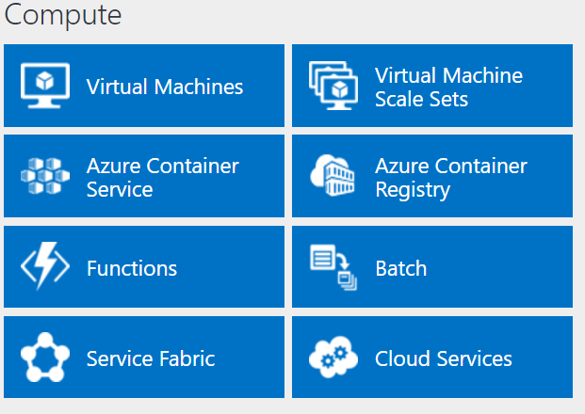
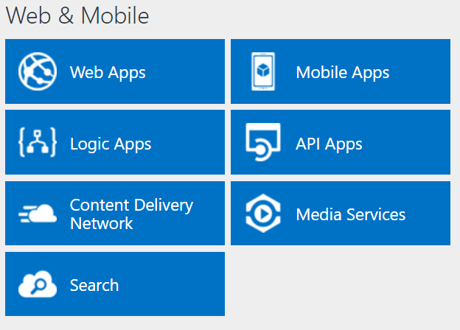
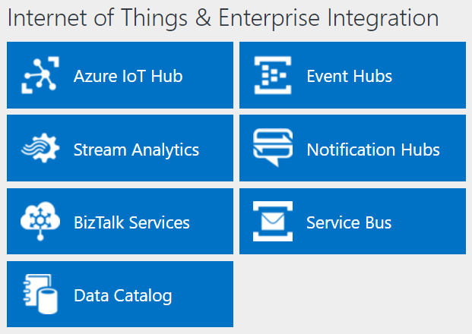
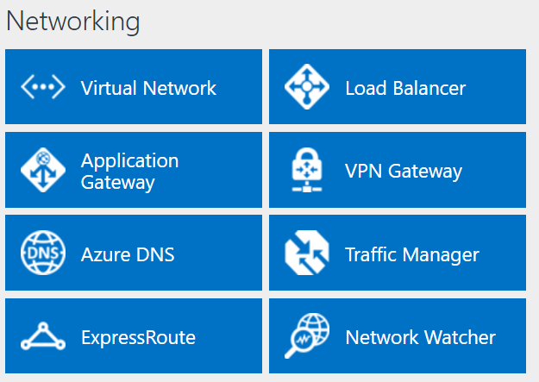
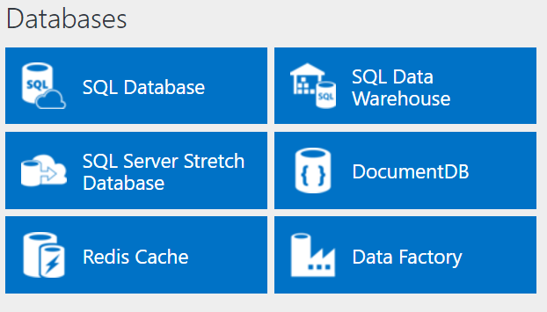
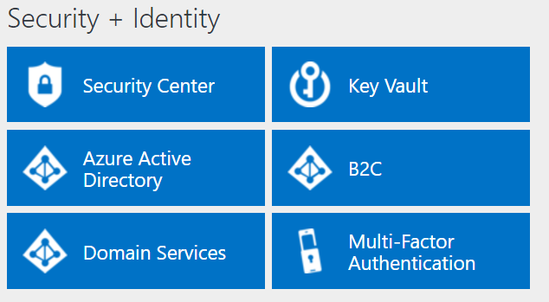
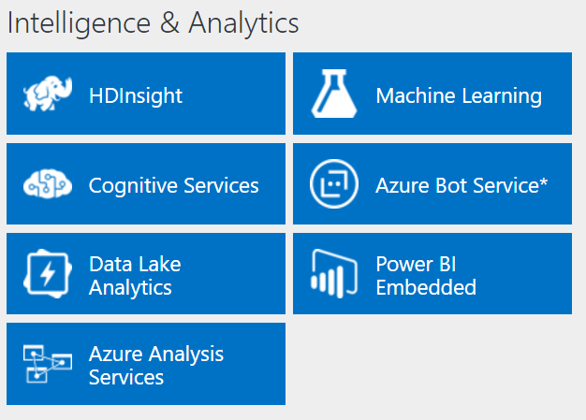
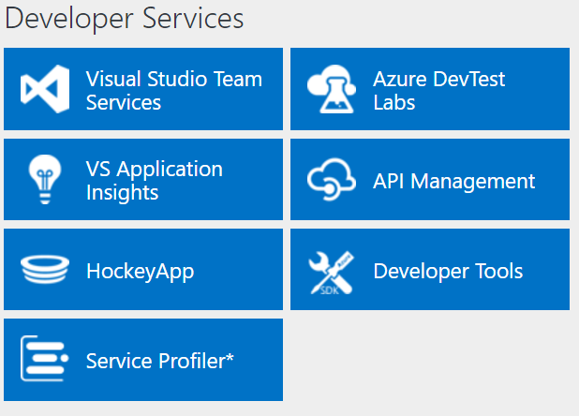
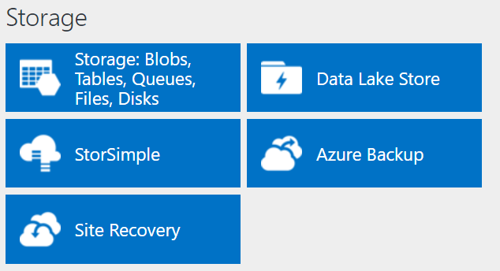
http://azureplatform.azurewebsites.net/
* Preview Services
Notes:
Preview Version 1.7 (2017-04-20)

Slide 4
Create and Manage Compute Resources (20-25%)
Deploy workloads on Azure Resource Manager (ARM) virtual machines (VMs)
Identify workloads that can and cannot be deployed; run workloads including Microsoft, run workloads including Linux; create VMs; connect to a Windows/Linux VM; deploy workloads; deploy Bring Your Own License (BYOL) images
Perform configuration management
Automate configuration management by using PowerShell Desired State Configuration (DSC) and VM Agent (custom script extensions); enable remote debugging
Design and implement VM storage
Configure disk caching; plan storage capacity; configure operating system disk redundancy; configure shared storage using Azure File service; configure Azure File Share snapshots; configure geo-replication; encrypt disks; implement ARM VMs with Standard and Premium Storage
Monitor ARM VMs
Configure ARM VM monitoring; configure alerts; configure diagnostic and monitoring storage location
Manage ARM VM availability
Configure multiple ARM VMs in an availability set for redundancy; configure each application tier into separate availability sets; combine the Load Balancer with availability sets; configure fault domains and update domains
Scale ARM VMs
Scale up and scale down VM sizes; deploy ARM VM Scale Sets (VMSS); configure ARM VMSS auto-scale
Manage Containers with Azure Container Services (ACS)
Deploy a Kubernetes cluster in ACS; create and manage container images; scale applications using Docker, DC/OS, Swarm, or Kubernetes; configure for open-source tooling; migrate container workloads to and from Azure; monitor Kubernetes by using Microsoft Operations Management Suite (OMS); implement Azure Container Registry
http://download.microsoft.com/download/8/4/8/848DD46A-05F2-4021-A118-036FC06647C5/533_OD_Changes.pdf

Slide 5
Deploy workloads on Azure Resource Manager (ARM) virtual machines (VMs)
Identify workloads that can and cannot be deployed
Run workloads including Microsoft, run workloads including Linux
Create VMs; connect to a Windows/Linux VM
Deploy workloads; deploy Bring Your Own License (BYOL) images

Slide 6
Identifying workloads for Azure VMs
Azure virtual machines support:
Windows Server:
All currently supported versions
All roles and features, except:
DHCP, Direct Access, RMS, Windows DS
iSNS, MPIO, NLB, PNRP, SNMP, Storage Manager for SANs, WINS, Wireless LAN Service
Linux:
CentOS, CoreOS, Debian, Oracle Linux, Red Hat, SUSE, openSUSE, and Ubuntu
Windows Server software:
FIM, MIM, SharePoint Server, SQL Server, System Center, and more
Virtual machine generations: Generation 1 only
Notes:
Identify workloads that are both suitable and unsuitable for Azure VMs. Review the Windows Server roles and features that have special considerations for Azure VMs.
20533D
3: Implementing virtual machines

Slide 7
Virtual machine sizing
General purpose:
Balanced CPU-to-memory ratio
A0-A7, Av2, D, Dv2, Dv3, DS, DSv2, Dsv3 series
Compute optimized:
High CPU-to-memory ratio
Fs and F series
Memory optimized:
High memory-to-CPU ratio
D, Dv2, DS, DSv2, Ev3, Esv3, Ms, G, and GS series
Storage optimized:
High-performance disk I/O
Ls series
GPU:
Graphic Processing Unit support
NV and NC series
High performance compute:
Fastest CPUs and optional high-throughput RDMA
H series and A8-A11
https://docs.microsoft.com/en-us/azure/cloud-services/cloud-services-sizes-specs
Notes:
Describe the categories of Azure VM sizes.
20533D
3: Implementing virtual machines

Slide 8
Azure VM availability
Azure VMs in an availability set:
Logical grouping of two or more Azure VMs
Must be assigned during Azure VM deployment
Up to 3 fault domains
Up to 20 update domains
99.95% availability SLA
Considerations:
Add multiple virtual machines to the same availability set
Place application tiers in separate availability sets
Combine availability sets with load balancing
Standalone VMs:
99.9% availability SLA if using Premium storage disks https://buildazure.com/2016/11/24/single-instance-vms-now-with-99-9-sla/
Notes:
Explain how availability sets allow for greater availability of Azure VMs that use the same or similar configurations. Explain the concept of fault domains and update domains in the context of availability sets. Identify the considerations for configuring availability sets. Point out that there is a 99.9% availability Service Level Agreement (SLA) available for individual VMs if they use Premium storage.
20533D
3: Implementing virtual machines

Slide 9
Determining the deployment method
Tools for deploying Azure VMs:
Azure portal
Azure PowerShell
Azure CLI
Azure Resource Manager templates
Create Azure VMs from:
Azure Marketplace images
Custom images (on premises)
Managed
Unmanaged
Notes:
Identify the primary tools and methods that you can use to create virtual machines in Azure. Describe the process of generating managed and unmanaged custom images.
20533D
3: Implementing virtual machines

Slide 10
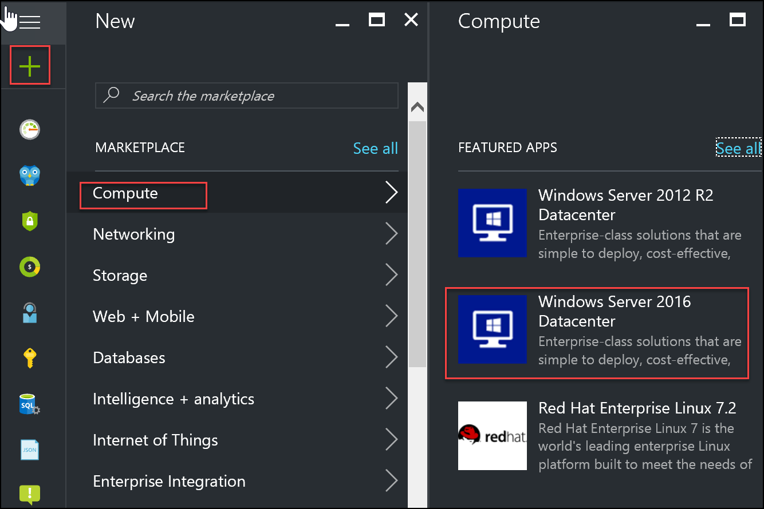
Using the Azure portal to create virtual machines
Notes:
Explain the process of creating a virtual machine by using the Azure portal.
20533D
3: Implementing virtual machines

Slide 11
Demonstration: Creating a VM by using the Azure portal
Log in to the Azure portal at http://portal.azure.com
Create virtual machine
Connect to virtual machine
In this demonstration, you will see how to create a VM from the Azure portal by using a Marketplace image
https://docs.microsoft.com/en-us/azure/virtual-machines/windows/quick-create-portal
Notes:
Additional Reading: Deploy a new Windows VM named 20533D03DemoVM1 into a new resource group named 20533D03-DemoRG01 by following the steps listed on “Create a Windows virtual machine with the Azure portal” at: https://aka.ms/pzxh13
Additional Reading: Deploy a Linux VM named 20533D03DemoVM2 into a new resource group named 20533D03-DemoRG02 by following the steps listed on “Create a Linux virtual machine with the Azure portal” at: https://aka.ms/ajqf8q
Note: Do not wait for the deployment to complete. Continue with the next topic.
Preparation Steps
Before starting this demonstration, ensure that you have performed the “Preparing the lab environment” demonstration in this module’s first lesson. Also, ensure that the setup script has completed and that you completed the previous demonstration in this module.
Demonstration Steps
In Microsoft Edge, navigate to the Azure portal.
Sign in by using the Microsoft account that is the Service Administrator of your subscription.
From the hub menu, create a new Windows Server 2016 Datacenter Azure VM in the Azure region that is closest to the classroom location and that is available in your subscription. Specify the following settings (accept all other settings with their default values):
Name: 20533D03LabVM1
User name: Instructor
Password: Pa55w.rd1234
Resource Group: The existing resource group that you created in the previous demonstration, named 20533D0301-DemoRG
Size: Standard_D1_v2
20533D
3: Implementing virtual machines
(More notes on the next slide)

Slide 12
Connecting to an Azure VM
Windows VMs:
RDP:
User-based authentication
Generates .rdp file from the Azure portal or via Azure PowerShell
WinRM:
Generates a certificate and uploads it to Azure Key Vault
References the URL of the certificate in the VM configuration
Linux VMs:
SSH:
User based or certificate-based authentication
Use an SSH client
Remote Desktop:
xfce4 – desktop environment
xrdp – RDP server
When using SSH key to authenticate, assign a password to the admin user
Notes:
Describe the primary methods of connecting to Windows and Linux running in Azure VMs.
20533D
4: Managing Azure VMs

Slide 13
Configuring security of Azure VMs
Network security groups
Restrict access to individual IP addresses
Combine with OS-level protection
Azure Key Vault
Store secrets and keys
Use Azure AD authentication to control access
Azure Drive Encryption
Encrypt OS and data volumes on Windows and Linux VMs
Integrate with Azure Key Vault
Encrypt by using existing keys
Notes:
Note: This topic has one additional slide.
Describe different mechanisms that enhance security of Azure VM deployments. Explain Azure Disk Encryption capabilities, focusing on Key Vault and Azure Active Directory (Azure AD).
20533D
4: Managing Azure VMs

Slide 14

Configuring VM security
Keys/secrets are protected
in customer key vault
OS and data disks are protected in customer
storage account
Azure Resource Manager/ Windows PowerShell
cmdlets/ Azure CLI
Encrypt
config
VM
Encrypt
config
Azure Storage
Customer
Notes:
Describe the process of implementing Azure Disk Encryption.
20533D
4: Managing Azure VMs

Slide 15
Demonstration: Connecting to a VM
Notes:
Additional Reading: Deploy a new Windows VM named 20533D03DemoVM1 into a new resource group named 20533D03-DemoRG01 by following the steps listed on “Create a Windows virtual machine with the Azure portal” at: https://aka.ms/pzxh13
Additional Reading: Deploy a Linux VM named 20533D03DemoVM2 into a new resource group named 20533D03-DemoRG02 by following the steps listed on “Create a Linux virtual machine with the Azure portal” at: https://aka.ms/ajqf8q
Note: Do not wait for the deployment to complete. Continue with the next topic.
Preparation Steps
Before starting this demonstration, ensure that you have performed the “Preparing the lab environment” demonstration in this module’s first lesson. Also, ensure that the setup script has completed and that you completed the previous demonstration in this module.
Demonstration Steps
In Microsoft Edge, navigate to the Azure portal.
Sign in by using the Microsoft account that is the Service Administrator of your subscription.
From the hub menu, create a new Windows Server 2016 Datacenter Azure VM in the Azure region that is closest to the classroom location and that is available in your subscription. Specify the following settings (accept all other settings with their default values):
Name: 20533D03LabVM1
User name: Instructor
Password: Pa55w.rd1234
Resource Group: The existing resource group that you created in the previous demonstration, named 20533D0301-DemoRG
Size: Standard_D1_v2
20533D
3: Implementing virtual machines
(More notes on the next slide)

Slide 16
Design and implement VM storage
Configure disk caching; plan storage capacity
Configure operating system disk redundancy
Configure shared storage using Azure File service
Configure Azure File Share snapshots
Configure geo-replication; encrypt disks I
Implement ARM VMs with Standard and Premium Storage

Slide 17
Azure VM Disk Sizing
Virtual machine disks:
Size limit: 4TB – Overcome using Storage Spaces
Performance limit:
Standard. 60 MBps or 500 8-KB IOPS per disk
Premium. 250 MBps or 7500 256-KB IOPS per disk
Disk type and format: .vhd fixed only
Notes:
Describe the primary features of Azure VMs.
20533D
3: Implementing virtual machines

Slide 18
Virtual machine storage
Azure VM
C:\
operating system disk
D:\
Temporary disk
(contents can be
lost)
F:\Data disks
Azure page blob
Notes:
Describe virtual disks of Azure VMs. Most students will likely be familiar with the virtual disks that Microsoft Hyper‑V uses. If that is the case, you can focus on virtual disks that Azure supports.
20533D
3: Implementing virtual machines

Slide 19
Overview of unmanaged and managed disks
Unmanaged disks:
Up to 200 storage accounts per region
Up to 40 disks per Standard storage account
Storage accounts for VMs in the same availability set might be in the same storage stamp
A custom image must be in the same storage account as VM disks
Managed disks:
Up to 10,000 disks per region
Storage account performance limits not relevant
Disks of VMs in the same availability set in different stamps
A custom image must be in the same region as VM disks
Notes:
Compare and contrast unmanaged disks and managed disks.
20533D
3: Implementing virtual machines

Slide 20
Managing VM disks
Attach an OS or data disk:
Unmanaged disks:
New (empty)
Existing blob
Managed disks:
New (empty)
Existing blob
Snapshot
Detach a data disk
Modify disk settings:
Host caching mode
Disk size (up to 4 TBs)
Storage account type (standard unmanaged disks only)
Performance tier (managed disks only)
Notes:
Describe the main Azure VM disk management tasks.
20533D
4: Managing Azure VMs

Slide 21
Azure VM disk mobility
Azure virtual disk files:
.vhd format (.vhdx not supported)
Fixed type (dynamic not supported)
4-TB maximum size (use multi-disk volumes if larger size is needed)
Azure virtual disk mobility:
Upload and download:
Add-AzureRmVHD and Save-AzureRmVHD
az storage blob upload and az storage blob download
Attach and detach:
Add-AzureRmVmDataDisk and Remove-AzureRmVMDataDisk
azure vm disk attach-new and azure vm disk detach
Import/Export service (for larger disk sizes)
AzCopy and Azure portal
Azure virtual disk files copy and snapshot:
Managed and unmanaged disks (full snapshots only)
Notes:
Describe cross-premises and Azure-only scenarios that involve disk copy, attach, detach, and snapshot operations.
20533D
4: Managing Azure VMs

Slide 22
Monitor ARM VMs
Configure ARM VM monitoring; configure alerts
Configure diagnostic and monitoring storage location

Slide 23
Monitoring Azure VMs
Metrics:
Available for VMs running Windows and Linux
Displayed in the Azure portal
Diagnostics:
Implemented as a VM extension
Stored in Azure Storage (tables and blobs)
Windows – basic metrics, performance counters, logs,crash dumps, Application Insights data, boot diagnostics
Linux – basic metrics and boot diagnostics
Alerts:
Based on metric, condition, threshold, and time period
Can trigger
Email notification
Webhook
Azure Automation runbook
Azure Logic App
Notes:
Describe metrics, diagnostics, and alerts available for Linux and Azure VMs.
20533D
4: Managing Azure VMs

Slide 24
Demonstration: Explore VM Monitoring and Diagnostics
Notes:
Additional Reading: Deploy a new Windows VM named 20533D03DemoVM1 into a new resource group named 20533D03-DemoRG01 by following the steps listed on “Create a Windows virtual machine with the Azure portal” at: https://aka.ms/pzxh13
Additional Reading: Deploy a Linux VM named 20533D03DemoVM2 into a new resource group named 20533D03-DemoRG02 by following the steps listed on “Create a Linux virtual machine with the Azure portal” at: https://aka.ms/ajqf8q
Note: Do not wait for the deployment to complete. Continue with the next topic.
Preparation Steps
Before starting this demonstration, ensure that you have performed the “Preparing the lab environment” demonstration in this module’s first lesson. Also, ensure that the setup script has completed and that you completed the previous demonstration in this module.
Demonstration Steps
In Microsoft Edge, navigate to the Azure portal.
Sign in by using the Microsoft account that is the Service Administrator of your subscription.
From the hub menu, create a new Windows Server 2016 Datacenter Azure VM in the Azure region that is closest to the classroom location and that is available in your subscription. Specify the following settings (accept all other settings with their default values):
Name: 20533D03LabVM1
User name: Instructor
Password: Pa55w.rd1234
Resource Group: The existing resource group that you created in the previous demonstration, named 20533D0301-DemoRG
Size: Standard_D1_v2
20533D
3: Implementing virtual machines
(More notes on the next slide)

Slide 25
Scale ARM VMs
Scale up and scale down VM sizes
Deploy ARM VM Scale Sets (VMSS)
Configure ARM VMSS auto-scale

Slide 26
Scaling Azure VMs
Scale sets provide VM autoscaling:
With managed disks:
Up to 1000 VMs when using VM Marketplace image
Up to 100 VMs when using custom images
With unmanaged disks:
Up to 100 VMs when using VM Marketplace image
Up to 40 VMs when using custom images (overprovision = $true)
Up to 20 VMs when using custom images (overprovision = $false)
5 fault domains and 5 update domains
Stateless workloads
Implement by using:
Microsoft.Compute resource provider
Microsoft.Insights resource provider
Notes:
Note: This topic has one additional slide.
Review the basic characteristics of scale sets. Introduce and describe scale sets in Azure. Explain that scale sets are only available in the Azure Resource Manager deployment model. Point out the key components of a scale set configuration in Azure Resource Manager templates.
20533D
4: Managing Azure VMs

Slide 27
Vertical scaling of Azure VMs
Vertical scaling:
Current configuration must comply with constraints of the target VM size:
Hardware characteristics
Maximum number of network adapters or disks
Requires temporary downtime:
Restart if resizing within the same cluster
Stop (deallocate) if resizing requires cluster change
Horizontal scaling:
Azure Resource Manager: VM Scale Sets
Classic: preprovisioned VMs
Notes:
Describe vertical and horizontal scaling of Azure VMs.
20533D
4: Managing Azure VMs

Slide 28
Demonstration: Create a Scale Set
Notes:
Additional Reading: Deploy a new Windows VM named 20533D03DemoVM1 into a new resource group named 20533D03-DemoRG01 by following the steps listed on “Create a Windows virtual machine with the Azure portal” at: https://aka.ms/pzxh13
Additional Reading: Deploy a Linux VM named 20533D03DemoVM2 into a new resource group named 20533D03-DemoRG02 by following the steps listed on “Create a Linux virtual machine with the Azure portal” at: https://aka.ms/ajqf8q
Note: Do not wait for the deployment to complete. Continue with the next topic.
Preparation Steps
Before starting this demonstration, ensure that you have performed the “Preparing the lab environment” demonstration in this module’s first lesson. Also, ensure that the setup script has completed and that you completed the previous demonstration in this module.
Demonstration Steps
In Microsoft Edge, navigate to the Azure portal.
Sign in by using the Microsoft account that is the Service Administrator of your subscription.
From the hub menu, create a new Windows Server 2016 Datacenter Azure VM in the Azure region that is closest to the classroom location and that is available in your subscription. Specify the following settings (accept all other settings with their default values):
Name: 20533D03LabVM1
User name: Instructor
Password: Pa55w.rd1234
Resource Group: The existing resource group that you created in the previous demonstration, named 20533D0301-DemoRG
Size: Standard_D1_v2
20533D
3: Implementing virtual machines
(More notes on the next slide)

