Slide 1
Exam 70-533 Implementing Microsoft Azure Infrastructure Solutions
Design and Implement Azure App Service Apps (10-15%)
Create and Manage Compute Resources (20-25%)
Design and Implement a Storage Strategy (10-15%)
Implement virtual networks (15–20%)
Design and Deploy ARM Templates (10-15%)
Manage Azure Security, and Recovery Services (25-30%)
Manage Azure Operations (5-10%)
Manage Azure Identities (5-10%)
https://www.microsoft.com/en-ie/learning/exam-70-533.aspx
Notes:
Presentation: 105 minutes
Lab: 50 minutes
After completing this module, students will be able to:
Identify suitable workloads for the cloud.
Identify services and capabilities that Microsoft Azure provides.
Use Azure portals to manage Azure services and subscriptions.
Use Windows PowerShell to manage Azure services and subscriptions.
Use Azure Command-Line Interface (CLI) to manage Azure services and subscriptions.
Describe the primary characteristics of Azure Resource Manager.
Use Azure services to enhance management and monitoring of Azure.
Required materials
To teach this module, you need the Microsoft PowerPoint file 20533D_01.pptx.
Preparation tasks
To prepare for this module, you should:
Read all this module’s materials.
Practice performing the demonstrations and labs.
Work through the Module Review and Takeaways section to determine how you will use the information to reinforce student learning and promote knowledge transfer to on-the-job performance.
As you prepare for this class, it is imperative that you complete the labs yourself. This gives you an understanding of how the labs work, as well as the concepts that each lab covers. This enables you to provide meaningful hints to students who might have issues while working in the labs. Furthermore, it will help guide your lecture to ensure that you discuss the concepts that the labs cover.
20533D
1: Introduction to Microsoft Azure

Slide 2
Manage Azure Security and Recovery Services (25-30%)
Manage data protection and security compliance
Implement recovery services
https://www.microsoft.com/en-ie/learning/exam-70-533.aspx
http://download.microsoft.com/download/8/4/8/848DD46A-05F2-4021-A118-036FC06647C5/533_OD_Changes.pdf

Slide 3
Manage data protection and services compliance
Manage data protection and security compliance
Create and import encryption keys with Key Vault; automate tasks for SSL/TLS certificates; prevent and respond to security threats with Azure Security Center; Configure single sign-on with SaaS applications using federation and password based; add users and groups to applications; revoke access to SaaS applications; configure access; configure federation with public consumer identity providers such as Facebook and Google
Implement recovery services
Create a backup vault; deploy a backup agent; backup and restore data; using of snapshots and Geo-replication for recovery; implement DR as service; Deploy Azure Site Recovery (ASR) agent; configure ASR; configure ASR one-click failover
http://download.microsoft.com/download/8/4/8/848DD46A-05F2-4021-A118-036FC06647C5/533_OD_Changes.pdf

Slide 4
Manage data protection and security compliance
Create and import encryption keys with Key Vault
Automate tasks for SSL/TLS certificates
Prevent and respond to security threats with Azure Security Center
Configure single sign-on with SaaS applications using federation and password based
Add users and groups to applications
Revoke access to SaaS applications
Configure access
Configure federation with public consumer identity providers such as Facebook and Google

Slide 5
Create and import keys with Key Vault
Secure storage of cryptographic keys
Azure Storage Accounts
Passwords
Uses FIPS 140-2 Level 2 validated hardware security modules (HSM)
Keys can be accessed using Azure AD
Two pricing tiers
A1 Standard
Allows for software-protected
P1 Premium
Allows keys to protected by Hardware Security Modules (HSM)

Slide 6
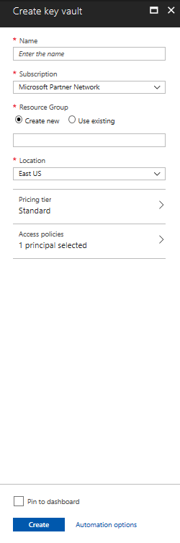
Create a Key Vault (Azure portal)
Marketplace
Specify name
Only alphanumeric characters
Must start with a letter and end with a letter or digit
Must be 3-24 characters in length
Cannot contain consecutive hyphens
Specify an Azure AD user or group and permission they have
Access Policy

Slide 7
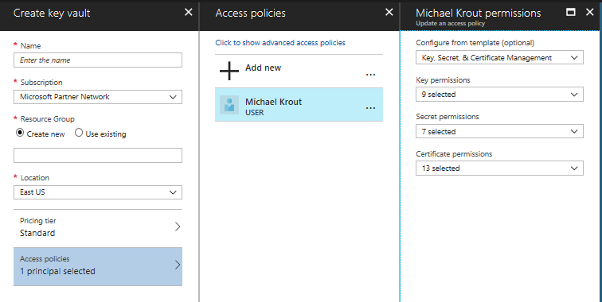
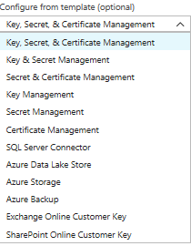
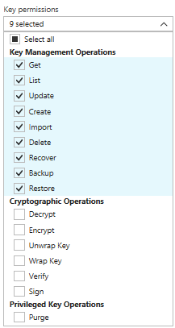
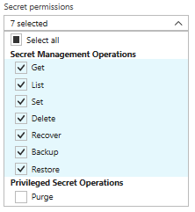
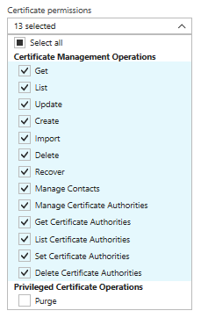
Access Policy

Slide 8
Azure Key Vault Certificate Management
Azure Key Vault provides management of x509 certificates with the following features:
Segregation of duties
Use of policies
Settings of contacts
Automatic enrollment

Slide 9
Managing Security
Create an Azure key Vault

Slide 10
Importing Certificates
.PFX or .PEM format
Convert the private key password to a secure string
$CertPwd = Convert-To-SecureString –String “certP@ssword” –Force –AsplainText
Import the certificate
Import-AzureKeyVaultCertificate –VaultName ‘MyKeyVault-0’ –Name ‘MyFirstCert’ –FilePath ‘c:\certs\mycerts.pfx’ –Password $CertPwd

Slide 11
Creating Certificates
Define a Key Vault Policy
New-AzureKeyVaultCertificatePolicy
Creates a in-memory structure
Not a permanent policy
New-AzureKeyVaultCertificatePolicy –SecretContentType “application/x-pkscs12” –SubjectName “CN=newvisions.com” –IssuerName “Self” –ValidityInMonths 6 –ReuseKeyOnRenewal
Create Certificate
Add-AzureKeyVaultCertificate –VaultName ‘MyKeyVault-0’ –Name ‘TestCert01’ –CertificatePolicy = $Policy
Submits a job

Slide 12
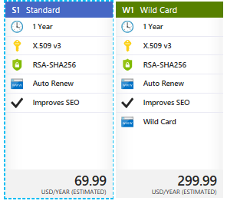
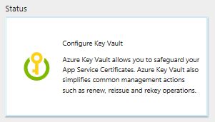
Azure App Service Certificate
Service used with
WebApps
Uses Azure Key Vault for certificate storage
Two Certificates
S1 Standard – provides SSL bindings to the root and www subdomain –
W1 Wildcard – need SSL bindings for root and any first level subdomain
Eliminates human error
Reduces time required to be done manually
Can set to autorenew

Slide 13
Prevent and respond to security threats with Azure Security Center
Eliminate threats by implementing security best practices
Azure Security Center lightens the burden
Evaluating deployments
Offering recommendations for hardening
Can use ASC to implement recommendations
Provides active monitoring
Identifying malicious activity allowing for rapid response

Slide 14
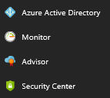
Enabling Azure Security Center
Free tier is enabled by default
Pinned to the services menu

Slide 15
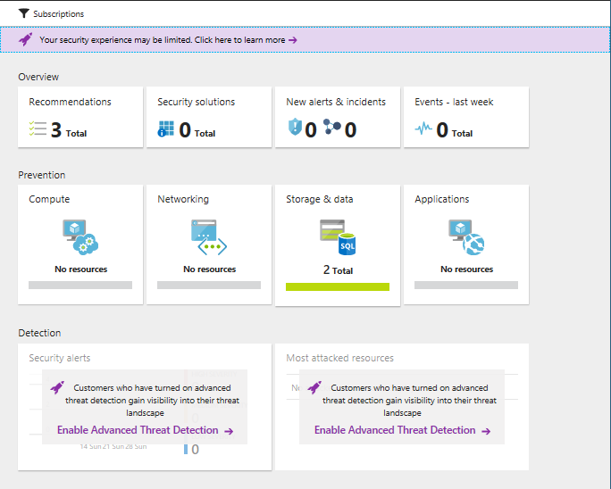
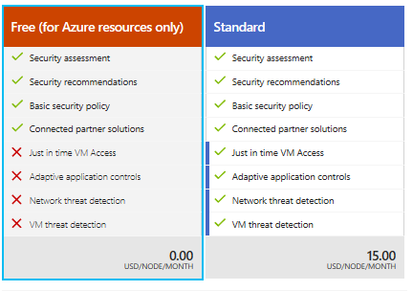
ASC (Azure Security Center)
Four sections
Overview
Prevention
Detection
Advanced Cloud defense
Security policy menu begins the process

Slide 16
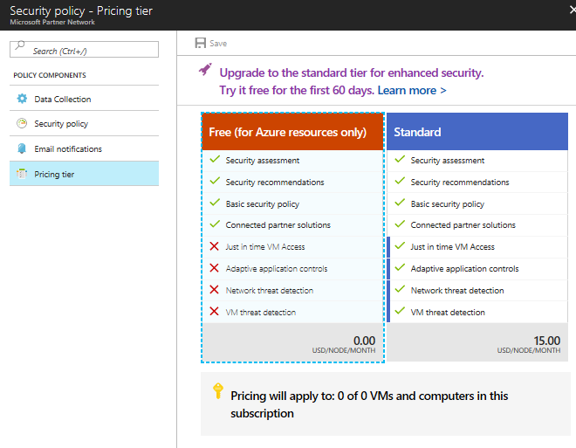
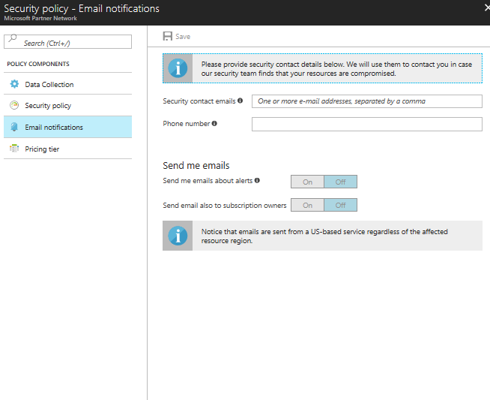
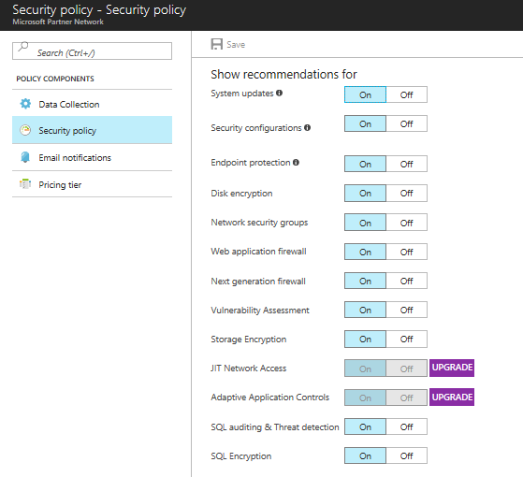
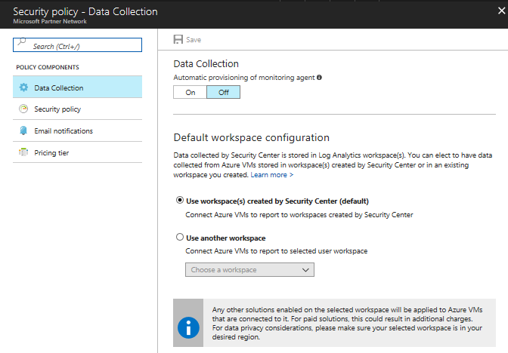
Security Policy
Four Sections
Data Collection
Security Policy
Email Notifications
Pricing Tier
Enabling protection for non-Azure computers
Standard pricing

Slide 17
Compute
Monitor Configuration
IaaS
Cloud Services
Recommendations give additional information
JIT (Just-In-Time) access
Blocks inbound network traffic using a NSG (network security group)
User with write access will be given temporary access based on the ASC policy
Located in Advanced Cloud Defense section

Slide 18
Networking
Evaluates the accessibility of external facing resources
Use of traffic/blocking/inspection
NSG
Network Firewalls
Web Application Firewalls
Recommendations made to restrict flow even further
Non-compliant can be remediated using ASC

Slide 19
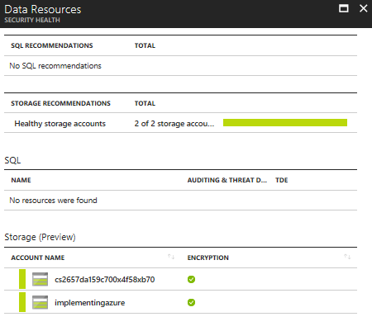
Storage and Data
Outside IaaS
Exposing vulnerabilities in PaaS solutions
Azure Storage
Blob
Disk
File
Queue
Azure SQL Database (DBaaS)
Recommendations for encryption

Slide 20
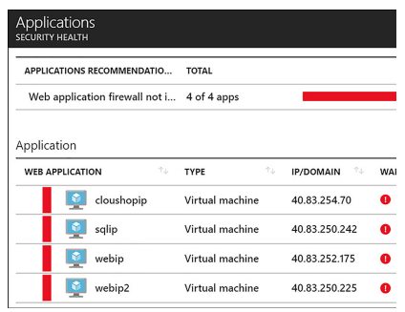
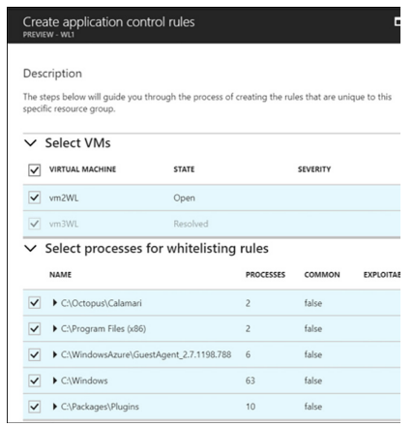
Applications
Evaluates public-facing services
Websites
Makes recommendations such as WAF
Integration with partners
F5
Barracuda
Fortinet
Adaptive application controls
Any process marked as exploitable should be carefully reviewed. These likely represent malware.

Slide 21
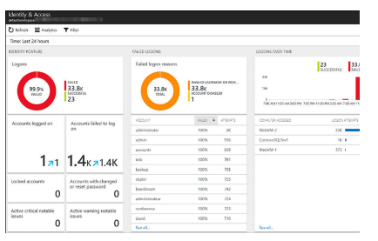
Other Prevention Areas
Recommendations blade
Ordered by severity
Provides detailed information that is actionable
Can dismiss recommendations
Identity and Access
Visualizations of security logs

Slide 22
Managing Security
Create a Security Policy

Slide 23
Implementing recovery services
Create a backup vault
Deploy a backup agent, backup and restore data, using snapshots and Geo-Replication for recovery
Implement DR as a service
Deploy Azure Site Recovery (ASR) agent
Configure Azure Site Recovery
Configure Azure Site Recovery one-click failover

Slide 24
Create a Recovery Services vault
Virtual Destination for Backup Data
Azure Backup
Azure Site Recovery
Recovery Services vault
Configuration management for
Azure Backup
Azure Site Recovery

Slide 25
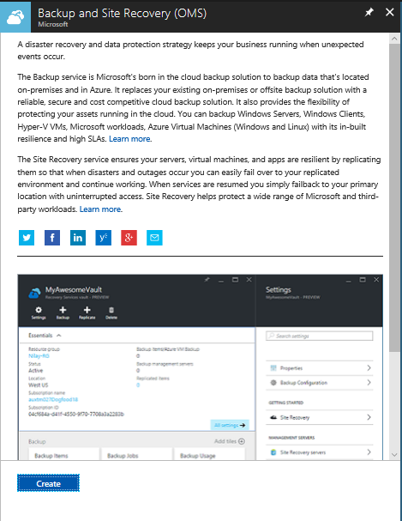
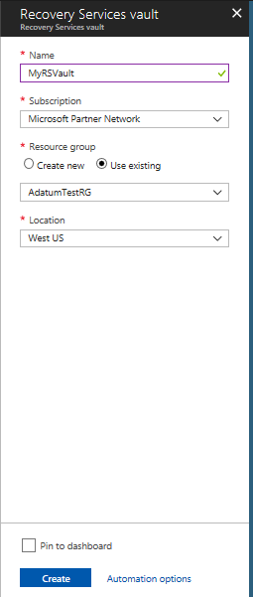
Create a Recovery Services vault (Azure Portal)

Slide 26
Deploy a Backup Agent
Different types of agents
Microsoft Azure Recovery Services (MARS) agent – standalone used to protect files and folders
DPM protection agent – used with Azure Backup Server and System Center Data Protection Manager
VMSnapshot extention – installed on Azure VMs to allow snapshots
Automation is available for Azure Backup Server DPM, VMSnapshot, VMSnapshotLinux

Slide 27
Backup and Restore Data
You need to configure the agent
When the backups occur
How often they occur
How long data is retained
What data is protected
Start by clicking Schedule Backup
Configured
Daily backup
Weekly backup
Recover Data option in MARS Agent
Where to restore the data
What to recover
When the data was backed up
Recovery point
Mount point
Can backup IaaS virtual machines in Azure
Individual files or entire VMs
Backup policy
How often they occur
How long backups are retained
Only VMs in same region as the Recovery Services vault can be backed up

Slide 28
Use of snapshots
Blob snapshots
Unmanaged VM disks are page blobs
Can be snapshotted and copied to another Region
Use the snapshot to recover VMs

Slide 29
Recover VM by using the copied VHD
Create a new resource group for VM
Convert the VHD to a managed disk
Provision a virtual machine from the managed disk
Create a virtual network for the VM
Create NSG that allows the required network traffic
Create a public IP address and NIC
Specify the configuration for the VM
Name
Series
Assign NIC to VM
Add the OS disk created from the snapshot
Create the VM

Slide 30
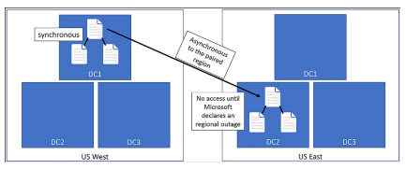
Geo-replication for recovery
Geo-Redundant storage (GRS)
Replication data to a paired region hundreds of miles away from the primary copy
No access until Microsoft declares a persistent outage and accomplished a geo-failover

Slide 31
Read Access Geo-Redundant Storage (RA-GRS)
Customers have read-only
IaaS
Unmanaged standard VM Disks
Asynchronous updates
Latency
Not an effective way to prepare for regional outages

Slide 32
Managing Security
Create a Recovery Services Vault

