Slide 1
Module 1
Introduction to Microsoft Azure
Notes:
Presentation: 105 minutes
Lab: 50 minutes
After completing this module, students will be able to:
Identify suitable apps for the cloud.
Identify services and capabilities that Microsoft Azure provides.
Use Azure portals to manage Azure services and subscriptions.
Use Windows PowerShell to manage Azure services and subscriptions.
Use Azure Resource Manager to manage Azure resources.
Use Azure management services to extend the management and monitoring of Azure.
Required materials
To teach this module, you need the Microsoft PowerPoint file 20533C_01.pptx.
Preparation tasks
To prepare for this module, you should:
Read all of this module’s materials.
Practice performing the demonstrations and labs.
Work through the Module Review and Takeaways section to determine how you will use the information to reinforce student learning and promote knowledge transfer to on-the-job performance.
As you prepare for this class, it is imperative that you complete the labs yourself. This gives you an understanding of how the labs work, as well as the concepts that each lab covers. This enables you to provide meaningful hints to students who might have issues while working in the labs. Furthermore, it will help guide your lecture to ensure that you discuss the concepts that the labs cover.
20533C
1: Introduction to Microsoft Azure

Slide 2
Module Overview
Cloud technology overview Overview of Azure Managing Azure with the Azure portal Managing Azure with Windows PowerShell Overview of Azure Resource Manager Azure management services
Notes:
20533C
1: Introduction to Microsoft Azure

Slide 3
Lesson 1: Cloud technology overview
Demonstration: Preparing the environment Introduction to cloud computing Types of cloud services
Notes:
Question
What advantages does a hybrid cloud model present to an organization that is new to Azure?
Answer
With a hybrid cloud model, an organization can host services on-premises and in the cloud at the same time. This provides a smoother transition from on-premises to the cloud, and the organization incurs only the costs from the actual resources that it uses on Azure. The students might also mention the advantages of cloud storage and virtual machine migration to Azure to extend the on-premises disaster recovery environment.
20533C
1: Introduction to Microsoft Azure

Slide 4
Demonstration: Preparing the environment
In this demonstration, you will see how to prepare the Azure environment
Notes:
Have the students perform the steps with you so that the lab environment is correctly configured for the lab at the end of this module. You must perform these tasks to prepare the environment for the demonstrations in this module.
The labs in this course use custom Azure PowerShell cmdlets, including Setup-Azure to prepare the Azure environment for a lab, and Reset-Azure to perform clean-up tasks at the end of a lab. These cmdlets are loaded as modules, and you can view the source .psm1 files in D:\Modules.
Important: Note that the reset script will delete services in your Azure subscription. If you are using your own Azure subscription and not a trial subscription obtained by using a learning pass, you will lose your existing services and data.
Preparation Steps
Perform the tasks in this demonstration to prepare the lab environment. The Azure services you will use in the lab will be described in this module while the environment is being configured.
Important: The scripts used in this course might delete objects that you have in your subscription. Therefore, you should complete this course by using a new Azure subscription. You should have received sign-up details and instructions for creating an Azure learning pass for this reason. Alternatively, you can create a new Azure trial subscription. In both cases, use a new Microsoft account that has not been associated with any other Azure subscription. This will eliminate the possibility of confusion when running setup scripts.
The labs in this course use custom Azure PowerShell cmdlets including Setup-Azure to prepare the Azure environment for a lab, and Reset-Azure to perform clean-up tasks at the end of a lab. Setup-Azure removes any current Azure subscription and account references from the Azure PowerShell session.
Start the MSL-TMG1 and 20533C-MIA-CL1 virtual machines, and then sign in to 20533C-MIA-CL1 as Student with the password Pa55w.rd.
20533C
1: Introduction to Microsoft Azure
(More notes on the next slide)

Slide 5
Notes:
Demonstration Steps
Prepare the Azure environment
On the taskbar, right-click Windows PowerShell, and then click Run as administrator. In the User Account Control dialog box, click Yes.
Type the following command, and then press Enter:
Setup-Azure
At the prompt, type the module number, and then press Enter.
Confirm your selection, and then press Enter.
When the script is complete, close Azure PowerShell.
Note: This script might remove Azure services in your subscription. We recommend that you use an Azure trial pass that was provisioned specifically for this course, and not your own Azure account.
20533C
1: Introduction to Microsoft Azure

Slide 6
Introduction to cloud computing
Characteristics of cloud computing solutions:
On-demand self-service
Broad network access
Resource pooling
Rapid elasticity
Measured service
Notes:
Note: This topic has one additional slide.
Define cloud computing, and compare cloud computing to on-premises computing. List the advantages of cloud computing (scalability, availability, elasticity), and compare public, private, and hybrid clouds.
20533C
1: Introduction to Microsoft Azure

Slide 7
Introduction to cloud computing
Public, private, and hybrid clouds
A public cloud is an infrastructure, platform, or application service that a cloud service provider delivers for access and consumption by the public
A private cloud is a privately owned and managed cloud that offers benefits similar to those of a public cloud, but is designed and secured for use by a single organization
A hybrid cloud is a technology that binds two separate clouds—public and private—together for the specific purpose of obtaining resources from both
Notes:
20533C
1: Introduction to Microsoft Azure

Slide 8
Types of cloud services
SaaS
A complete
software solution
PaaS
A platform of services for hosting a custom solution
IaaS
A way to run virtual servers in the cloud with full control
Notes:
Use the following examples of Software as a Service (SaaS), Platform as a Service (PaaS), and Infrastructure as a Service (IaaS) services, and ask the students to suggest others:
Microsoft Office 365. This service is a good example of a SaaS offering. It offers a complete software app that Microsoft delivers through the cloud.
Azure Web apps and Azure SQL Database. These services are good examples of PaaS services. They both offer a platform for building application solutions (a website and a relational database, respectively) but do not require any configuration and management at the underlying operating-system level.
Note: Sometimes SQL Database is described as a Database as a Service offering, which is a specific subset of PaaS for database management solutions.
Azure Virtual Machines. This service is a good example of an IaaS solution. It enables you to host servers in the cloud with full control over the operating system and virtual hardware.
Identify the continual evolution of various IT functions into packaged services, such as Identity as a Service (IDaaS) and Disaster Recovery as a Service (DRaaS).
20533C
1: Introduction to Microsoft Azure

Slide 9
Lesson 2: Overview of Azure
Understanding Azure datacenters Understanding Azure services Compute hosting options provided by Azure Understanding the Azure service model Understanding other Azure resources Demonstration: Working with Azure resources Azure management tools
Notes:
Question
Which of the following services is not provided by Azure?
( ) Option 1: Virtual Machines
( ) Option 2: Web Apps
( ) Option 3: Storage Spaces
( ) Option 4: Azure Active Directory
( ) Option 5: Azure DNS
Answer
( ) Option 1: Virtual Machines
( ) Option 2: Web Apps
(√) Option 3: Storage Spaces
( ) Option 4: Azure Active Directory
( ) Option 5: Azure DNS
Feedback
Storage Spaces is not an Azure service. You can host a Windows Server 2012 virtual machine that provides Storage Spaces, but it is not available directly from Azure as a service.
20533C
1: Introduction to Microsoft Azure

Slide 10
Understanding Azure datacenters
Azure datacenters are located in the following geographic areas:
Americas | Europe | Asia Pacific
Central US East US East US 2 North Central US South Central US West Central US West US West US2 US Gov Arizona US Gov Iowa US Gov Texas US Gov Virginia Canada Central Canada East Brazil South | France Central France South Germany Central Germany Northeast North Europe West Europe UK South UK West | Australia East Australia Southeast China East China North Central India South India West India Japan East Japan West Korea Central Korea South East Asia Southeast Asia
Notes:
Note: This topic has one additional slide.
The details of Azure datacenter architecture and cluster implementation are interesting for IT professionals, and an understanding of how Azure is implemented is beneficial when planning and implementing Azure services. The key point at this stage is that students and organizations can be assured that Azure datacenters are designed to provide a highly resilient, scalable, and security- enhanced platform for cloud infrastructure and apps.
20533C
1: Introduction to Microsoft Azure

Slide 11
Understanding Azure datacenters
Global distribution
Management by Microsoft
Modular architecture:
Clusters of thousands of servers in pluggable units
Full power redundancy and contingency
High-speed, redundant intra-datacenter networks
High-speed inter-datacenter and Internet connectivity
Triple-redundant data storage and geo-replication
High power and water efficiency
Servers that run Windows Server
Azure Service Fabric
Notes:
20533C
1: Introduction to Microsoft Azure

Slide 12
Understanding Azure services
Compute
Networking
Data & Storage
Web & Mobile
Virtual Network
Service Fabric
Azure DNS
Container Service
Storage
Application Gateway
Web Apps
DocumentDB
Azure Virtual Machines
Traffic Manager
Mobile Apps
Azure SQL Database
ExpressRoute
Azure Cloud Services
Notification Hub
Load Balancer
StorSimple
Other services
Service Bus
Automation
Azure AD
Scheduler
Azure AD DS
Azure Backup
Key Vault
MFA
Site Recovery
Azure Security Center
Notes:
Introduce the available Azure resources, focusing on high‑level descriptions and the core functionality of the services.
Note: This slide does not represent all the available Azure service offerings.
20533C
1: Introduction to Microsoft Azure

Slide 13
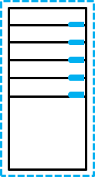




Compute hosting options provided by Azure
Control
Support for earlier apps
Ease of management
Azure Virtual Machines
Agility
Control
Support for earlier apps
Ease of management
Azure Cloud Services
Agility
Control
Support for earlier apps
Ease of management
App Service
Agility
Low
Medium
High
Notes:
Explain the options for hosting apps in Azure. You can use the slide to illustrate the primary differences among the first three listed in this topic. Explain how you can also use Service Fabric and Azure Container Service to support and host apps in the cloud for more complex or special-use situations.
20533C
1: Introduction to Microsoft Azure

Slide 14
Understanding the Azure service model
Azure is a pay-per-use, multi-tenant service
The purchase options are:
Pay-As-You-Go
Microsoft reseller
Enterprise Agreement
The support options are:
Developer
Standard
Professional Direct
Premier
Notes:
Explain the basic service model for Azure. List and explain the pricing options and provide details about the available support plans. You can research the current costs for the purchase and support plans by using the links in the student handbook prior to presenting this topic.
20533C
1: Introduction to Microsoft Azure

Slide 15
Understanding other Azure resources
Azure Marketplace: certified, open source, and community apps, and developer services
GitHub: APIs, SDKs, and open source projects
Azure Trust Center: information and guidance around security, privacy, and compliance
Notes:
Explain Azure Marketplace, GitHub, and Azure Trust Center.
20533C
1: Introduction to Microsoft Azure

Slide 16
Demonstration: Working with Azure resources
In this demonstration, you will see how to:
Use the Azure Marketplace
Use GitHub
Use the Azure Trust Center
Notes:
Preparation Steps
Before starting this demonstration, ensure that you have performed the “Preparing the environment” demonstration tasks at the beginning of the first lesson in this module, and ensure that the setup script has completed.
Demonstration Steps
Use the Azure Marketplace
In Internet Explorer, navigate to the Azure Marketplace.
Search for Windows resources.
View the entry for Windows Server.
On the Windows Server page, click GET IT NOW to start the virtual machine creation process in Azure.
When prompted, sign in with the Microsoft account that is either the Service Administrator or a Co-Administrator of your Azure subscription.
When prompted for the software plan, click Windows Server 2016 Datacenter, and then click Continue.
In the Azure portal, view the Windows Server 2016 Datacenter blade, and then close it.
In the Azure portal, click New, and then, next to Marketplace, click See all. View the available choices in the Azure Marketplace from the Azure portal.
Search for and click Windows Server 2016 Datacenter. Note that the Windows Server 2016 Datacenter blade is the same as the one shown earlier in the demonstration.
Close the blade.
20533C
1: Introduction to Microsoft Azure
(More notes on the next slide)

Slide 17
Notes:
Use GitHub
In Internet Explorer, go to http://www.github.com/azure.
View the available repositories.
View the available templates under the azure-quickstart-templates repository.
Use the Azure Trust Center
In Internet Explorer, go to http://azure.microsoft.com/support/trust-center to view the home page for the Azure Trust Center.
20533C
1: Introduction to Microsoft Azure

Slide 18
Azure management tools
Azure portals
Windows PowerShell
Azure CLI
Azure Automation
Visual Studio
Notes:
Introduce the tools and their primary purposes.
20533C
1: Introduction to Microsoft Azure

Slide 19
Lesson 3: Managing Azure with the Azure portal
Using the Azure classic portal Using the Azure portal Managing account subscriptions with the Azure portal Demonstration: Using the Azure portals
Notes:
Question
What are some of the advantages of the Azure portal as compared to the Azure classic portal?
Answer
Answers will vary but might include a more modern interface, better organization, the more-streamlined running of tasks, and better integration.
20533C
1: Introduction to Microsoft Azure

Slide 20
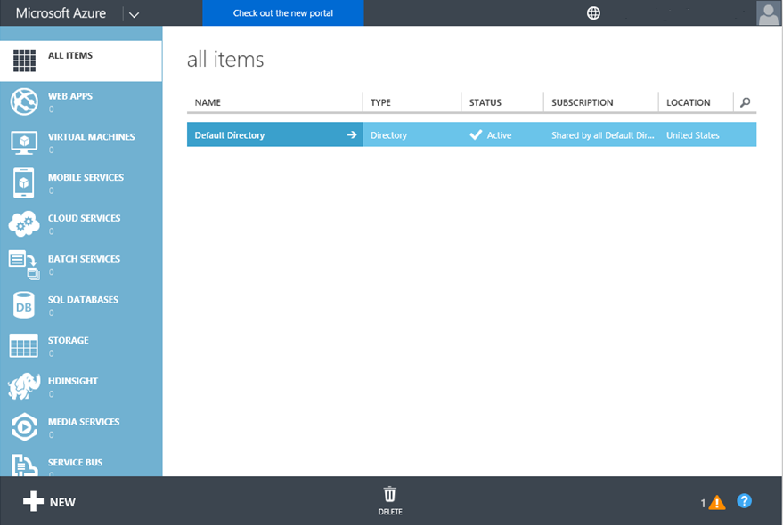
Using the Azure classic portal
Notes:
Introduce the Azure classic portal.
20533C
1: Introduction to Microsoft Azure

Slide 21
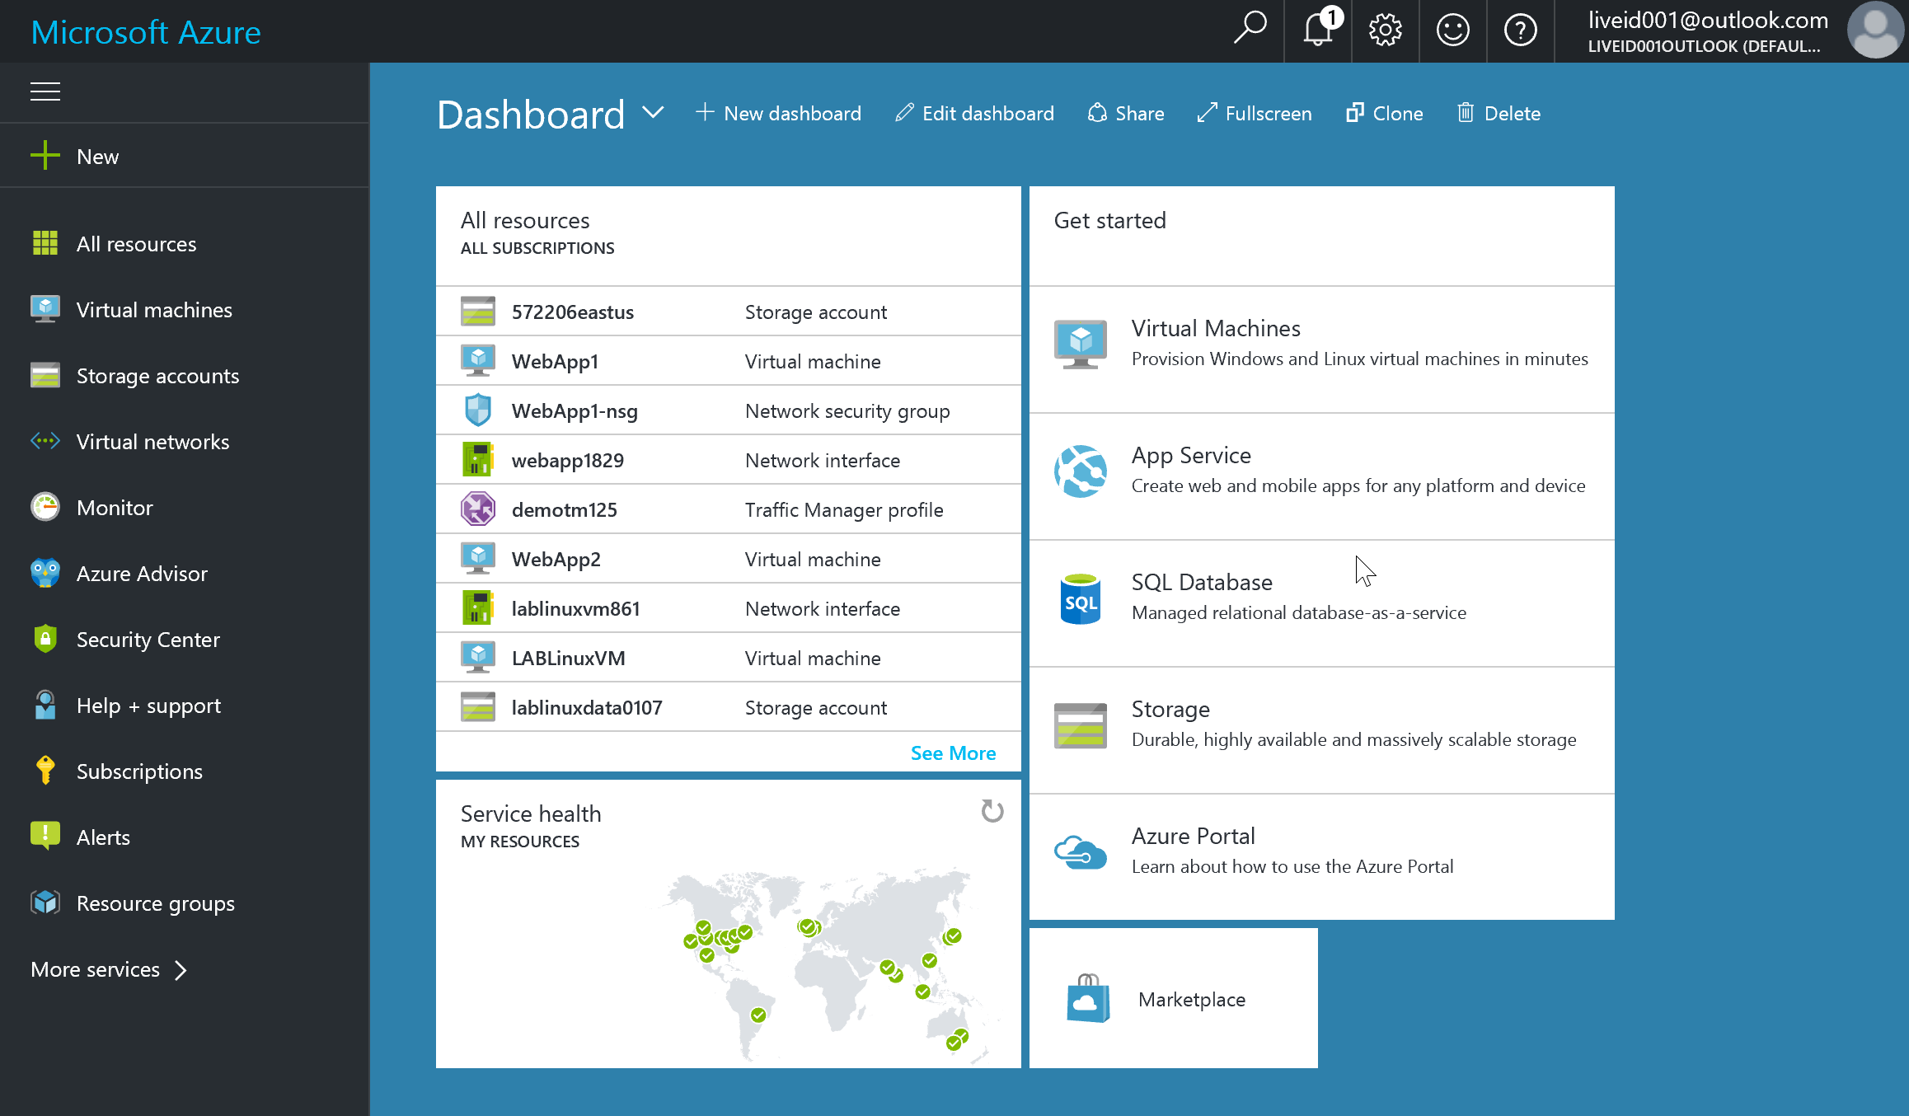
Using the Azure portal
Notes:
Introduce the Azure portal, along with the primary components for navigation.
20533C
1: Introduction to Microsoft Azure

Slide 22
Managing account subscriptions with the Azure portal
The Subscription and Billing blades at https://portal.azure.com
View cost by resource and burn rate charts
Perform cost analysis
View billing information
The subscriptions page at http://account.windowsazure.com/subscriptions
Manage payment methods
Download usage details
Edit subscription details
Edit partner information
Change subscription address
Cancel subscription
Notes:
Introduce the Billing and the Subscription blades of the Azure portal and also the subscriptions page of the Azure account portal.
20533C
1: Introduction to Microsoft Azure

Slide 23
Demonstration: Using the Azure portals
In this demonstration, you will see how to:
Use the Azure classic portal
Use the Azure portal
Use the Azure account portal
Notes:
Preparation Steps
Before starting this demonstration, ensure that you have performed the “Preparing the Environment” demonstration tasks at the beginning of the first lesson in this module and that the setup script has completed.
Demonstration Steps
Use the Azure classic portal
In Internet Explorer, browse to http://manage.windowsazure.com, and then sign in by using the Microsoft account that is either the Service Administrator or a Co-Administrator of your Azure subscription.
Navigate to SETTINGS and then SUBSCRIPTIONS. View the ADMINISTRATORS tab.
Use the Azure portal
Navigate from the Azure classic portal to the Azure portal.
View the tiles on the dashboard.
View the Service Health blade.
Navigate to the Billing blade and view the contact info of your subscription.
Click the name of your subscription in the Subscription cost tile.
Review breakdown of current charges and burn rate.
View cost analysis information.
From the Billing blade, switch to the Account portal.
20533C
1: Introduction to Microsoft Azure
(More notes on the next slide)

Slide 24
Notes:
Use the Azure account portal
In the Azure account portal, on the subscriptions page, click your subscription. Then review the summary of usage and billing.
Close Internet Explorer, closing all the tabs.
20533C
1: Introduction to Microsoft Azure

Slide 25
Lesson 4: Managing Azure with Windows PowerShell
Azure PowerShell modules Authenticating to Azure by using Windows PowerShell Azure PowerShell cmdlets for Azure classic deployment model and Azure Resource Manager Demonstration: Using Azure PowerShell
Notes:
Question
How can you differentiate between classic model cmdlets and Azure Resource Manager cmdlets?
Answer
Azure Resource Manager cmdlets will have Rm in the cmdlet name. For example, New-AzureVM creates a virtual machine using the classic model, while New-AzureRmVM creates a virtual machine using the Azure Resource Manager model.
20533C
1: Introduction to Microsoft Azure

Slide 26
Azure PowerShell modules
PowerShell modules for Azure include:
Azure Resource Manager
Azure Service Management (classic)
Azure Storage
Azure Active Directory V2 PowerShell
Azure AD Module for Windows PowerShell - Azure AD
Azure Automation authoring toolkit
Notes:
Introduce and explain the modules available for Azure administration by using PowerShell.
20533C
1: Introduction to Microsoft Azure

Slide 27
Authenticating to Azure by using Windows PowerShell
Azure AD Authentication:
Use a Microsoft account
Use a work or school account
Certificate-based authentication:
Azure Resource Manager:
Generate a certificate on the local computer
Create an Azure AD application associated with the certificate
Create a service principal associated with the application
Assign the Reader role to the service principal
Classic:
Generate a management certificate in Azure or on the local computer
Store the private key on the local computer and the public key in Azure
Login-AzureRmAccount
Notes:
Explain the primary methods for authenticating by using Windows PowerShell.
20533C
1: Introduction to Microsoft Azure

Slide 28
Azure PowerShell cmdlets for Azure classic deployment model and Azure Resource Manager
Functionality or command | Classic | Azure Resource Manager
Create a resource group | New_AzureResourceGroup | New-AzureRmResourceGroup
Create a virtual machine | New-AzureVM | New-AzureRmVM
Create a web app | New-AzureWebsite | New-AzureRmWebapp
Sign in to Azure | Add-AzureAccount | Login-AzureRmAccount
GUI Element | The Azure portal and the Azure classic portal | The Azure portal only
Notes:
Too many Azure cmdlets exist to discuss all of them all in detail, and the rest of the course will introduce the students to many of them. The key points in this topic are:
Azure Resource Manager cmdlets have Rm in the cmdlet name. For example: New-AzureRmVM.
You can use standard Windows PowerShell commands like Get-Command and Get-Help to see more information about the available Azure cmdlets in each module.
20533C
1: Introduction to Microsoft Azure

Slide 29
Demonstration: Using Azure PowerShell
In this demonstration, you will see how to:
Create a resource group
Create a storage account
Delete a resource group with its resources
Notes:
Demonstration Steps
Create a resource group
Open the Windows PowerShell ISE as an Administrator.
From the Windows PowerShell ISE console, sign into your Azure subscription by running the following command:
Login-AzureRmAccount
From the Windows PowerShell ISE console, use the New-AzureRmResourceGroup cmdlet to create a new storage group called 20533C0101-DemoRG in the Azure region closest to your lab location.
Use the Get-AzureRmResourceGroup to verify that the new resource group was successfully created.
Create a storage account
From the Windows PowerShell ISE console, create a new storage account storage account by using the New-AzureRmStorageAccount cmdlet with the following settings:
Resource group name: 20533C0101-DemoRG
Location: the same location as the resource group
Storage account name: a unique name between 3 and 24 characters consisting of lowercase letters, digits, or dashes and starting with a letter.
SkuName: Standard_LRS
Use the Get-AzureRmStorageAccount cmdlet to verify that the new storage account was successfully created.
20533C
1: Introduction to Microsoft Azure
(More notes on the next slide)

Slide 30
Notes:
Delete a resource group with its resources
From the Windows PowerShell ISE, run the Remove-AzureRmResourceGroup cmdlet to delete the resource group you created earlier in this demo.
Use the Get-AzureRmResourceGroup cmdlet to verify that the resource group has been deleted.
Use the Get-AzureRmStorageAccount cmdlet to verify that the new storage account was deleted with the resource group.
Reset the environment
In the Windows PowerShell ISE, type the following command, and then press Enter:
Reset-Azure
When prompted (twice), sign in by using the Microsoft account associated with your Azure subscription.
If you have multiple Azure subscriptions, select the one you want the script to target.
When prompted for confirmation, type y.
Wait for the script to complete, and then close all open windows.
20533C
1: Introduction to Microsoft Azure

Slide 31
Lesson 5: Overview of Azure Resource Manager
What is Azure Resource Manager? Resources and resource groups Azure Resource Manager deployment methodologies
Notes:
Question
If you are creating an IaaS infrastructure using the Azure Resource Manager model, which tools can you use?
Answer
The primary tools for implementing Azure Resource Manager resources are the Azure portal, the Azure Resource Manager module for Windows PowerShell, and Azure CLI. You can also use Visual Studio to author, modify, and deploy Azure Resource Manager templates.
20533C
1: Introduction to Microsoft Azure

Slide 32
What is Azure Resource Manager?
Azure Resource Manager core concepts:
Resources:
Individual building blocks of Azure-based solutions
Managed by resource providers
Resource groups:
Custom collections of resources
Typically represents common lifecycle of its resources
Commonly used to delegate permissions to its resources
Aggregates billing data and auditing events of its resources
Each resource belongs to only one resource group
RBAC
Tagging
Policies and locks
Notes:
Explain Azure Resource Manager and its primary components.
20533C
1: Introduction to Microsoft Azure

Slide 33
Resources and resource groups
Resource groups enable logical groupings of resources
Resources are assigned to a resource group when created
Most resources can be moved between resource groups
Notes:
Explain resource groups, the function they provide within Azure Resource Manager, and the ways in which you can create and modify them.
20533C
1: Introduction to Microsoft Azure

Slide 34
Azure Resource Manager deployment methodologies
Imperative:
Based on Azure PowerShell or Azure CLI scripts
Specified by each provisioning step
Declarative:
Based on Azure Resource Manager templates:
JSON-formatted
Describes the end state
Idempotent
Support versioning
Allows for OS configuration via VM Agent extensions
Azure determines provisioning steps based on the end state
You can specify resource dependencies
Notes:
Explain how templates are useful in deploying apps or solutions by using Azure Resource Manager.
20533C
1: Introduction to Microsoft Azure

Slide 35
Lesson 6: Azure management services
OMS Logging and diagnostics in Azure Azure access management
Notes:
Question
Which built-in role holds the greatest scope of administrative privilege in Azure?
Answer
The Service Administrator role grants access to all resources in a subscription.
20533C
1: Introduction to Microsoft Azure

Slide 36

OMS
1
4
Sign up by using OMS and create a workspace
Connect servers directly to workspace
Collect logs from your data sources
3
2
Add solutions
Connect servers to workspace by using Systems Center Operations Manager
+ -
Sign up by using Azure management portal and create a workspace
5
Analyze data by using solutions and your custom searches
Connect servers to workspace by using Azure Diagnostics
Notes:
Provide an overview of the primary feature set for Microsoft Operations Management Suite (OMS). Point out that Module 11: “Implementing Azure-based management and automation” covers OMS in more detail.
20533C
1: Introduction to Microsoft Azure

Slide 37
Logging and diagnostics in Azure
The primary logging and analysis components in Azure are:
Activity logs
Azure Diagnostics
Metrics
Notes:
Identify and explain the primary sources of logging for Azure.
20533C
1: Introduction to Microsoft Azure

Slide 38
Azure access management
Azure administrative roles:
Account administrator
Service administrator
Co-administrator
Use RBAC to provide granular access to resources and resource groups
Notes:
Explain the different methods available for access management in Azure. Focus on the benefits of RBAC and how it can best be implemented in Azure.
20533C
1: Introduction to Microsoft Azure

Slide 39
Lab: Managing Microsoft Azure
Exercise 1: Using the Azure portals Exercise 2: Using the Azure Resource Manager features in the Azure portal Exercise 3: Using Azure PowerShell
Logon Information
Virtual machine: 20533C-MIA-CL1
User name: Student
Password: Pa55w.rd
Estimated Time: 50 minutes
Notes:
Exercise 1: Using the Azure portals
You have been asked to explore the available browser-based Azure portals to assess how A. Datum Corporation will use them. In the Azure classic portal, you must create a co-administrator account and confirm the domain name of your subscription for use in your testing.
In the Azure portal, you must observe the organization of resources and customize the interface to make your testing environment more accessible. In the account page of the Azure portal, you must view and download your current billing data and sign up for an available preview feature that you will use later in your testing.
Exercise 2: Using the Azure Resource Manager features in the Azure portal
You have been asked to create some temporary resources in Azure to test the management interface of the Azure portal. You must create a resource group in Azure, create a new storage account and a new virtual machine in the Azure portal, and then tag the resources as test resources before assigning your newly added co-administrator to the Automation Operator role in the Azure portal.
Exercise 3: Using Azure PowerShell
You have been asked to investigate the capabilities of Azure PowerShell for A. Datum Corporation. You must connect to your Azure subscription by using Azure PowerShell and then use Azure PowerShell to create an IaaS v2 web app, create a new resource group named TestWebRG, and reassign the web app to the new resource group.
20533C
1: Introduction to Microsoft Azure

Slide 40
Lab Scenario
A. Datum Corporation wants to expand their cloud presence by taking advantage of the benefits of Azure. You have been asked to explore and compare the available IaaS v2 features by using the Azure portals and Windows PowerShell.
Notes:
20533C
1: Introduction to Microsoft Azure

Slide 41
Lab Review
Why did you use Azure PowerShell cmdlets that contained Rm in the lab?
Notes:
Question
Why did you use Azure PowerShell cmdlets that contained Rm in the lab?
Answer
These cmdlets are from the Azure Resource Manager module for Windows PowerShell, and they create Azure Resource Manager resources in Azure, which is what we recommend.
20533C
1: Introduction to Microsoft Azure

Slide 42
Module Review and Takeaways
Real-world Issues and Scenarios Tools
Notes:
Real-world Issues and Scenarios
You can use the Azure module for Windows PowerShell to create simple and easy-to-use provisioning scripts that enable you to create complex cloud-based solutions and infrastructure components on demand.
Tools
The following table lists the tools that this module references:
20533C
1: Introduction to Microsoft Azure

