Slide 1
Module 3
Implementing virtual machines
Notes:
Presentation: 90 minutes
Labs: 60 minutes
After completing this module, students will be able to:
Explain Azure Resource Manager virtual machines (VMs).
Plan for Azure Virtual Machines.
Deploy Azure Resource Manager VMs.
Author Azure Resource Manager templates.
Explain IaaS version 1 (v1) virtual machines.
Required materials
To teach this module, you need the Microsoft PowerPoint file 20533C_03.pptx.
Preparation tasks
To prepare for this module, you should:
Read all of this module’s materials.
Practice performing the demonstrations and labs.
Work through the Module Review and Takeaways section to determine how you will use the information to reinforce student learning and promote knowledge transfer to on-the-job performance.
As you prepare for this class, it is imperative that you complete the labs yourself. This gives you an understanding of how the labs work, as well as the concepts that each lab covers. This enables you to provide meaningful hints to students who might have issues while working in the labs. Furthermore, it will help guide your lecture to ensure that you discuss the concepts that the labs cover.
20533C
3: Implementing virtual machines

Slide 2
Module Overview
Overview of Azure Resource Manager virtual machines Planning for Azure Virtual Machines Deploying Azure Resource Manager virtual machines Authoring Azure Resource Manager templates Overview of classic virtual machines
Notes:
20533C
3: Implementing virtual machines

Slide 3
Lesson 1: Overview of Azure Resource Manager virtual machines
Demonstration: Preparing the environment for the lab and demos in this module What are Azure virtual machines? Comparing classic and Azure Resource Manager virtual machines
Notes:
Question
What are the primary differences between classic and Azure Resource Manager virtual machines?
Answer
Answers can vary, but might include:
Differences in the tools that you use for VM provisioning and management, including Azure portal and Azure Resource Manager Windows PowerShell cmdlets for the Azure classic portal and Azure Service Management cmdlets.
Functional differences, such as support for Key Vault-based encryption in case of VMs created by using the Azure Resource Manager deployment model.
20533C
3: Implementing virtual machines

Slide 4
Demonstration: Preparing the environment for the lab and demos in this module
To prepare the demonstration and lab environment for this module, you must:
Launch Windows PowerShell as an administrator
Run the Setup-Azure command
Specify the module number, and confirm your selection
Notes:
Have students perform the steps with you so that the environment is configured correctly for the lab at this module’s end. You also must perform these steps to prepare the environment for this module’s demonstrations.
The demonstrations and labs in this course use custom Windows PowerShell modules, including Setup-Azure to prepare the environment and Reset-Azure to perform clean-up tasks after you complete the demonstrations and labs. You can view the source .psm1 files in the D:\Modules folder.
The provisioning script for this module creates an Azure Resource Manager virtual network containing three subnets in the Azure region that the students designated.
Preparation Steps
Start the 20533C-MIA-CL1 virtual machines, and then sign in as Student with the password Pa55w.rd. You should have provisioned a Microsoft Azure subscription before the lab.
Demonstration Steps
Launch Windows PowerShell with Administrator privileges.
At the Windows PowerShell prompt, run the following command:
Setup-Azure
At the prompt, type the module number, and then press Enter.
Confirm your selection, and then press Enter.
When prompted, sign in to your Azure subscription by using an account that is either the Service Administrator or a Co-administrator of your subscription.
If you have multiple Azure subscriptions, select the one you want to use for this module.
When prompted, provide the number corresponding to the Azure region that you want to use for the Azure services that this script creates, and then press Enter. The script will take about a minute to complete.
After the script completes, close the Windows PowerShell command prompt.
20533C
3: Implementing virtual machines

Slide 5
What are Azure virtual machines?
Virtual machine sizes:
Basic tier (development and test workloads):
Five sizes: A0 to A4
Standard tier (production workloads):
Multiple series: A, Av2, D, Dv2, DS, DSv2, F, Fs, G, GS, NV, NC
70+ sizes with up to 32 cores, 448 GB of RAM, and 64 disks
Virtual machine disks:
Size limit: 1TB
Performance limit:
Standard. 60 MBps or 500 8KB IOPS per disk
Premium. 200 MBps or 5000 256 KB IOPS per disk
Disk type and format: .vhd fixed only
Virtual machine generations: Generation 1 only
Notes:
Describe the primary features of Azure VMs.
20533C
3: Implementing virtual machines

Slide 6
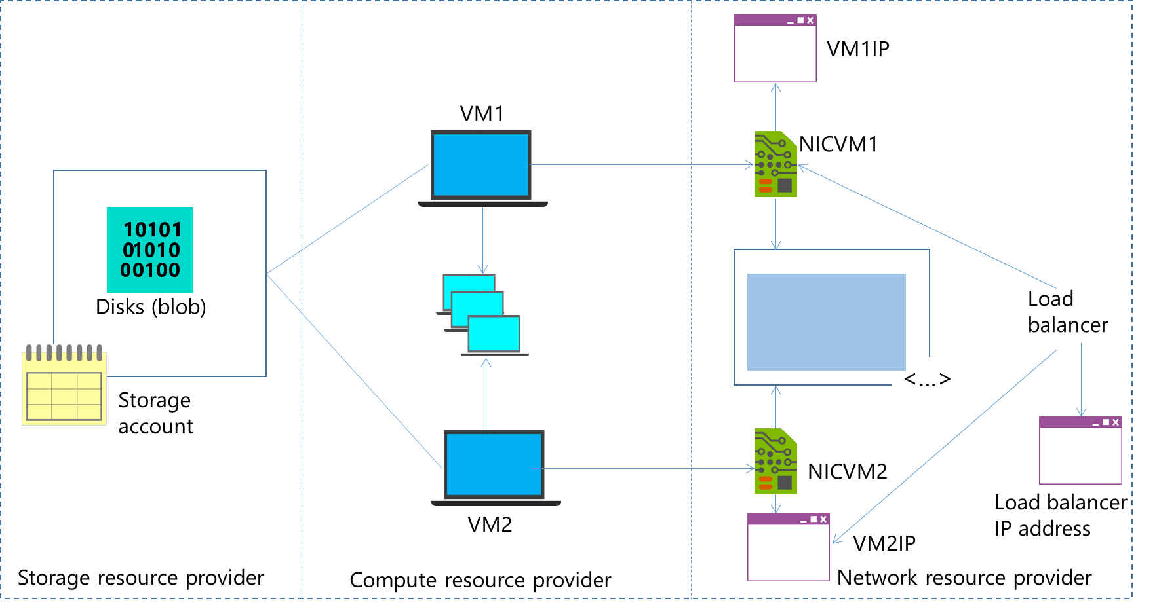
Comparing classic and Azure Resource Manager virtual machines
Notes:
The slide illustrates the Azure Resource Manager object model including the resources that comprise a typical deployment of an Azure virtual machine.
20533C
3: Implementing virtual machines

Slide 7
Lesson 2: Planning for Azure Virtual Machines
Identifying workloads for Azure Virtual Machines Virtual machine sizing Migrating workloads to Azure Evaluating the use of Azure containers
Notes:
Question
A finance application that employees of A. Datum Corporation use experiences a relatively low amount of traffic for most of the year, with the exception of the fiscal year’s end, when the traffic spikes by up to 100 times the normal amount. Is this a suitable workload for Microsoft Azure, and why?
Answer
Yes, this would be a suitable workload for Azure. The spike in traffic can be handled by Azure’s ability to scale resources to meet application demand, while the application could run in a low resource, low cost environment for the remainder of the year.
20533C
3: Implementing virtual machines

Slide 8
Identifying workloads for Azure Virtual Machines
Azure virtual machines support:
Windows Server:
All currently supported versions (CSA required for older ones)
All roles and features, except:
DHCP, Hyper-V, Direct Access, RMS, Windows DS
iSNS, MPIO, NLB, PNRP, SNMP, Storage Manager for SANs, WINS, Wireless LAN Service
Linux:
CentOS, CoreOS, Debian, Oracle Linux, Red Hat, SUSE, openSUSE, Ubuntu
Windows Server software:
FIM, MIM, SharePoint Server, SQL Server, System Center, and more
Notes:
Identify workloads that are both suitable and unsuitable for Azure Virtual Machines. Review the Windows Server roles and features that have special considerations for Azure Virtual Machines.
20533C
3: Implementing virtual machines

Slide 9
Virtual machine sizing
Azure virtual machine sizing:
A-series: General-purpose compute
A-series with compute-intensive instances
D-series: Local SSD storage
Dv2-series: 35 percent faster CPU (compared with the D-series)
F-series: Lower-priced compute (comparable to Dv2-series)
G-series: Largest virtual machine sizes (up to 448GB of memory, 64 disks)
DS, DSv2, Fs, and GS:
CPU, RAM, and number of disks are equivalent to D, Dv2, F, and G
Support for Premium Storage
N-series: NVIDIA GPU for graphics-intensive workloads
In migration scenarios, use Microsoft Azure (IaaS) Cost Estimator tool
Notes:
Explain the sizing levels, using the content and the links provided in the student handbook. Explain the Basic and Standard tiers, and the primary differences. Explain the Microsoft Azure (IaaS) Cost Estimator tool, and explain how you can use it to assess an on-premises infrastructure prior to migrating workloads to Azure.
20533C
3: Implementing virtual machines

Slide 10
Migrating workloads to Azure
Verify prerequisites:
A Hyper-V virtual machine must be Generation 1
Disks must be no larger than 1,023 GB
Generalize the image
Capture and prepare disks for upload to Azure
Create an Azure storage account
Upload .vhd file to the Azure storage account
When creating an Azure virtual machine:
In the Set-AzureRmVMOSDisk cmdlet:
Add the -SourceImageUri parameter
Add the –CreateOption fromImage parameter
In the Set-AzureRmVMOperatingSystem cmdlet:
Add the –ProvisionVMAgent parameter
Notes:
Describe the steps required to implement Azure virtual machines.
20533C
3: Implementing virtual machines

Slide 11
Evaluating the use of Azure containers
Feature | Virtual machines | Containers
Security level | Greater control | Lesser control, but easier implementation
Memory required | Must accommodate complete operating system and apps | Must accommodate apps only
Startup time | Includes the boot of the operating system, as well as the startup of services and apps | Incudes only the startup of apps and dependent services. Operating system is already running
Portability | Portable with proper configuration | Portable by design and typically smaller in size
Image automation | Dependent on operating system and apps | Based on Docker registry
Notes:
Explain containers at a high level, describing the fundamental concepts to students. Identify the purpose for containers, and the key differences between containers and virtual machines.
20533C
3: Implementing virtual machines

Slide 12
Lesson 3: Deploying Azure Resource Manager virtual machines
Creating Azure Resource Manager virtual machines Using the Azure portal to create virtual machines Using Azure PowerShell to create virtual machines Creating virtual machines by using a deployment template Demonstration: Creating a virtual machine by using the Azure portal
Notes:
Question
Why is an Azure Resource Manager template beneficial for deploying multiple virtual machines?
Answer
Templates make use of the intelligence built into the platform to optimize deployment speed. Majority of ready-to-use templates are parameterized. This helps in reusing the same templates for multiple deployments.
20533C
3: Implementing virtual machines

Slide 13
Creating Azure Resource Manager virtual machines
Tools
Azure portal
Azure PowerShell
Azure CLI
Azure Resource Manager templates
Create Azure Virtual Machines from:
Azure Marketplace images
On-premises custom images uploaded to Azure
Captured Azure VMs
Notes:
Identify the primary tools and methods that you can use to create virtual machines in Azure. Focus at a high level on the Azure portal and the Azure PowerShell methods, because later topics provide more detail on these. You can provide more detail around Azure command-line interface (Azure CLI) and capturing images. A later section of this module provides more detail about deploying images.
20533C
3: Implementing virtual machines

Slide 14
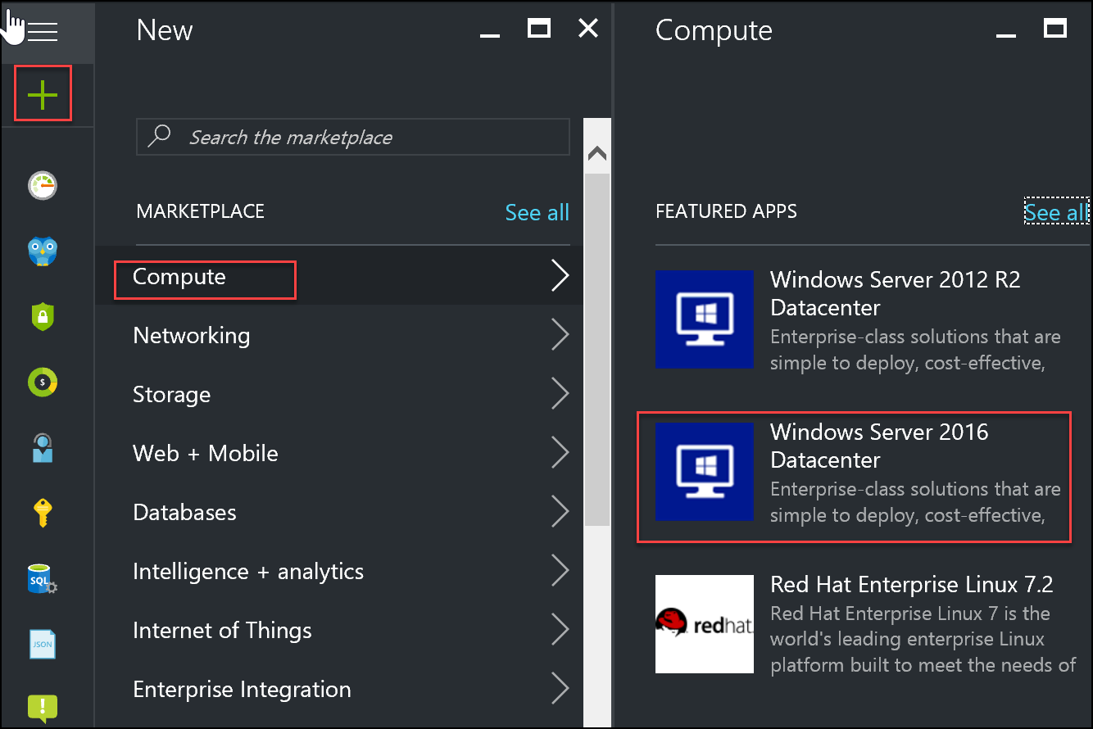
Using the Azure portal to create virtual machines
Notes:
Explain the process for creating a virtual machine by using the Azure portal. You will demonstrate this process later in this lesson.
20533C
3: Implementing virtual machines

Slide 15
Using Azure PowerShell to create virtual machines
Create a new virtual machine in Azure PowerShell by using the New-AzureRmVM cmdlet
$vm = New-AzureRmVMConfig -VMName WindowsVM -VMSize "Standard_A1"
$vm = Set-AzureRmVMOperatingSystem -VM $vm -Windows -ComputerName MyWindowsVM -Credential $cred -ProvisionVMAgent -EnableAutoUpdate
$vm = Set-AzureRmVMSourceImage -VM $vm -PublisherName MicrosoftWindowsServer -Offer WindowsServer -Skus 2012-R2-Datacenter -Version "latest"
$vm = Add-AzureRmVMNetworkInterface -VM $vm -Id $nic.Id
$osDiskUri = $storageAcc.PrimaryEndpoints.Blob.ToString() + "vhds/WindowsVMosDisk.vhd"
$vm = Set-AzureRmVMOSDisk -VM $vm -Name "windowsvmosdisk" -VhdUri $osDiskUri -CreateOption fromImage
New-AzureRmVM -ResourceGroupName $rgName -Location $locName -VM $vm
Notes:
Explain the steps that are required to create a new virtual machine by using the Azure Resource Manager cmdlets in Azure PowerShell.
20533C
3: Implementing virtual machines

Slide 16
Creating virtual machines by using a deployment template
Deploy the template by using:
Azure PowerShell
Azure CLI
Deploy to Azure link on GitHub
New-AzureRmResourceGroupDeployment -Name <DeploymentName>-ResourceGroupName <ResourceGroupName -TemplateUri <TemplateUri>
azure group deployment create
Notes:
Explain different methods of deploying a new virtual machine by using Azure Resource Manager templates.
20533C
3: Implementing virtual machines

Slide 17
Demonstration: Creating a virtual machine by using the Azure portal
In this demonstration, you will see how to create a virtual machine by using the Azure portal
Notes:
Preparation Steps
Before starting this demonstration, ensure that you have performed the “Preparing the environment” demonstration in this module’s first lesson, and ensure that the setup script has completed.
Demonstration Steps
In Internet Explorer, navigate to the Azure portal.
Sign in using the Microsoft account that is either the Service Administrator or a Co-administrator of your subscription.
From the Hub menu, create a new Azure Resource Manager Windows Server 2016 Datacenter virtual machine in the Azure region closest to your location. Specify the following settings (accept all other settings with their default values):
Name: AdatumSvr03
User name: Instructor
Password: Pa55w.rd1234
Resource Group: A new resource group named 20533C0301-DemoRG
Size: A1 Standard
Storage: Use managed disks
20533C
3: Implementing virtual machines

Slide 18
Lab A: Creating Azure Resource Manager virtual machines in Azure
Exercise 1: Creating virtual machines by using the Azure portal and Azure PowerShell Exercise 2: Validating virtual-machine creation
Logon Information
Virtual machine: 20533C-MIA-CL1
User name: Student
Password: Pa55w.rd
Estimated Time: 35 minutes
Notes:
This lab assumes that students have completed the “Preparing the Environment” demonstration at the beginning of this module’s first lesson.
We are updating the Azure portal regularly, and the user interface might have been updated since this lab was written. Therefore, before students begin the lab, you should make them aware of any differences between the steps that the lab describes and the current Azure portal’s user interface (UI).
The high-level steps in the labs are designed to help students complete tasks, while promoting learning and the consolidation of the module’s material. Students should be able to complete the high-level steps with the knowledge they gained in the module. However, sometimes students find it hard to complete all tasks and write Azure PowerShell commands without extra help. Make sure that students know where to find the Lab Answer Keys (LAKs), which have very detailed, step-by-step instructions, for each lab.
Before students start the lab, you need to decide which Azure region is the closest to your classroom location. Ensure that all students have this information, because they will need it during the lab.
Exercise 1: Creating virtual machines by using the Azure portal and Azure PowerShell
You must deploy two virtual machines that are running Windows Server 2016 Datacenter. Name these machines ResDevDB1 and ResDevDB2, and use them as database servers for the Research and Development app, ResDev. You will use the Azure portal to deploy one of the virtual machines, and you will use Azure PowerShell to deploy the other VM. You must deploy both virtual machines into the ResDevRG resource group, and you must configure the virtual machines to use the database subnet of the HQ-VNET virtual network. After deploying the virtual machines, you will confirm that the virtual machines are deployed to the correct resource group and are on the database subnet.
Exercise 2: Validating virtual-machine creation
You now must validate the creation and configuration of the virtual machines that you created to ensure that they function properly.
20533C
3: Implementing virtual machines

Slide 19
Lab Scenario
As part of the planning for deployment of Azure Resource Manager virtual machines to Azure, A. Datum has evaluated its deployment options. You must use the Azure portal and Azure PowerShell to deploy two Windows virtual machines for the Database tier of the Research and Development application. Additionally, to facilitate resource tracking, you should ensure that the virtual machines are part of the same resource group.
Notes:
20533C
3: Implementing virtual machines

Slide 20
Lab Review
What differences regarding Azure VM storage did you notice when you created a virtual machine in the Azure portal versus in Azure PowerShell?
Notes:
Question
What differences regarding Azure VM storage did you notice when you created a virtual machine in the Azure portal versus in Azure PowerShell?
Answer
The Azure portal automatically assigns a unique name to a storage account. It also generates a name of the operating system disk. When using Azure PowerShell, you have to explicitly provide these names.
20533C
3: Implementing virtual machines

Slide 21
Lesson 4: Authoring Azure Resource Manager templates
Azure Resource Manager templates overview Modifying Azure Resource Manager templates Demonstration: Authoring an Azure Resource Manager template
Notes:
Question
What purpose do resource groups have when you deploy Azure resources by using Azure Resource Manager templates?
Answer
Typically, you use resource groups to perform deployment and management of resources that share the same management or operational lifecycle.
20533C
3: Implementing virtual machines

Slide 22
Azure Resource Manager templates overview
When creating and working with resource templates, consider:
Which resources you are going to deploy
Where your resources will be located
Which version of the resource provider API you will use
Whether there are dependencies between resources
When you will specify values of resource properties
The template consist of the following sections:
{
"$schema": "http://schema.management.azure.com/schemas/2015-01-01/deploymentTemplate.json#",
"contentVersion": "",
"parameters": { },
"variables": { },
"resources": [ ],
"outputs": { }
}
Notes:
Explain the main sections of the Azure Resource Manager template and the function of each. Use a complete template-code sample to show students the syntax and examples for each template section.
20533C
3: Implementing virtual machines

Slide 23
Modifying Azure Resource Manager templates
Azure Resource Manager template components:
Parameters
Variables
Resources
Outputs
Azure Resource Manager template functions types:
Numeric
String
Array
Deployment value
Resource
Notes:
Explain the syntax and format of the different components of the Azure Resource Manager template. Explain the purpose and general categories of template functions. Note that specifics of template operations is a complex topic and the details of each individual function are outside the scope of this course.
20533C
3: Implementing virtual machines

Slide 24
Demonstration: Authoring an Azure Resource Manager template
In this demonstration, you will see how to:
Open an Azure Resource Manager template in Visual Studio
View the different sections of an Azure Resource Manager template
Notes:
Preparation Steps
Before starting this demonstration, ensure that you have performed the “Preparing the environment” demonstration in this module’s first lesson, and ensure that the setup script has completed.
Demonstration Steps
On MIA-CL1, start Visual Studio. If prompted with the message that the evaluation period has ended, click Sign in, and then provide your Microsoft account credentials.
Use Visual Studio to open the solution located at D:\Labfiles\Lab03\Starter\ResDev\ResDevLinuxDeploy\ResDevLinuxDeploy.sln.
View the contents of the azuredeploy.json template.
Initiate the template-based deployment process stepping through all its intermediate steps, but do not complete it.
Close all open applications without saving any files.
On the taskbar, right-click Windows PowerShell, and then click Run as administrator.
In the User Account Control dialog box, click Yes.
At the command prompt, type the following command, and then press Enter:
Reset-Azure
When prompted, sign in twice by using the Microsoft account that is either the Service Administrator or a Co-administrator of your subscription.
If you have multiple Azure subscriptions, select the one you want to target with the script.
20533C
3: Implementing virtual machines
(More notes on the next slide)

Slide 25
Notes:
When prompted for confirmation, type y.
Note: This script might remove Azure services in your subscription. Therefore, we recommend that you use an Azure trial pass that was provisioned specifically for this course, and not your own Azure account.
The script will take 5-10 minutes to reset your Microsoft Azure environment, and ready it for demos and labs in the next module.
The script removes all storage, virtual machines (VMs), virtual networks and gateways, cloud services, and resource groups.
Important: The script might not be able to get exclusive access to a storage account to delete it (you will see an error, if this occurs). If you find objects remaining after the reset script is complete, you can re-run Reset-Azure script, or use the Azure portal to manually delete all the objects in your Azure subscription, with the exception of the default directory.
20533C
3: Implementing virtual machines

Slide 26
Lesson 5: Overview of classic virtual machines
Overview of IaaS Cloud Services Creating classic virtual machines
Notes:
Question
In which situations would you choose to deploy Azure classic virtual machines instead of Azure Resource Manager virtual machines?
Answer
Answers may vary, but most answers will revolve around the need for a virtual machine to be compatible with an existing IaaS v1 infrastructure.
20533C
3: Implementing virtual machines

Slide 27
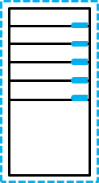
Overview of IaaS Cloud Services
Azure
Cloud Services
Direct internal communications
Azure Virtual
Machines
DNS name: unique cloud service name.cloudapp.net
Notes:
Explain the concepts of classic virtual machines and IaaS cloud services.
20533C
3: Implementing virtual machines

Slide 28
Creating classic virtual machines
Deploy classic virtual machines by:
Using the Azure portal:
Networking settings include:
Cloud service (domain name)
Endpoints
Using Azure PowerShell:
Define the virtual-machine configuration first, and then create the virtual machine
Create and configure the virtual machine in one step
Notes:
Describe the process of creating classic virtual machines in the Azure portal and by using Azure PowerShell.
20533C
3: Implementing virtual machines

Slide 29
Lab B: Deploying Azure Resource Manager virtual machines by using Azure Resource Manager templates
Exercise 1: Using Visual Studio and an Azure Resource Manager template to deploy Azure Resource Manager virtual machines Exercise 2: Using Azure PowerShell and an Azure Resource Manager template to deploy virtual machines
Logon Information
Virtual machine: 20533C-MIA-CL1
User name: Student
Password: Pa55w.rd
Estimated Time: 25 minutes
Notes:
The virtual machine should be running from the previous lab.
Exercise 1: Using Visual Studio and an Azure Resource Manager template to deploy Azure Resource Manager virtual machines
You must use Visual Studio to deploy two Linux Azure Resource Manager virtual machines for use as app servers in the ResDev app. You should name the servers ResDevApp1 and ResDevApp2. You have a deployment-template solution and the deployment details for both virtual machines. You must deploy the two virtual machines from Visual Studio, and then confirm that the virtual machines have been deployed successfully by using Azure PowerShell.
Exercise 2: Using Azure PowerShell and an Azure Resource Manager template to deploy virtual machines
You must deploy the Web tier virtual machines by using an Azure Resource Manager template and the Azure portal. The Web tier should consist of two virtual machines that are running Windows Server 2012 R2, ResDevWeb1 and ResDevWeb2. You should deploy them to the ResDevRG resource group, and then host them on the web subnet of the HQ-VNet virtual network. You have a template and a Windows PowerShell script that you should edit to complete the deployment. After you deploy the virtual machines, confirm the deployment by viewing the newly deployed resources in the Azure portal.
20533C
3: Implementing virtual machines

Slide 30
Lab Scenario
You must use an Azure Resource Manager template to deploy two additional Linux virtual machines and two additional Windows virtual machines that the ResDev application will use. The virtual machines should be part of the ResDevRG resource group, to facilitate resource tracking. Linux virtual machines should reside on the app subnet of the HQ-VNET virtual network, and Windows virtual machines should reside on the web subnet of the HQ-VNET virtual network.
Notes:
20533C
3: Implementing virtual machines

Slide 31
Lab Review
Can Visual Studio and Windows PowerShell use the same Azure Resource Manager template to deploy a virtual machine? How would you configure an Azure Resource Manager template to deploy multiple virtual machines with different configurations?
Notes:
Question
Can Visual Studio and Windows PowerShell use the same Azure Resource Manager template to deploy a virtual machine?
Answer
Yes. JSON templates are reusable throughout the various mechanisms for deploying virtual machines.
Question
How would you configure an Azure Resource Manager template to deploy multiple virtual machines with different configurations?
Answer
You can use parameters in the template to allow for different deployment values each time you use the template to deploy a virtual machine. In the lab, you had the option to provide basic information, such as virtual-machine name and virtual-network information. However, you can use a parameter to input almost any information used in the deployment process.
20533C
3: Implementing virtual machines

Slide 32
Module Review and Takeaways
Review Questions
Best Practices
Notes:
Review Questions
Question
Can you migrate on-premises virtual machines directly to Azure?
Answer
While there is no one-step solution to migrate on-premises virtual machines, you can generalize, export, and upload to Azure for creating new virtual machines.
Question
What tools can you use to implement Azure Resource Manager templates?
Answer
You can use Azure PowerShell, Visual Studio, and the Azure portal to manage and implement templates.
Best Practices
Use Azure Resource Manager virtual machines for new virtual-machine and solution deployments.
Use Azure Resource Manager resource groups to manage and deploy virtual machines.
Use a consistent naming convention for your IaaS infrastructure.
Use Azure Resource Manager templates to deploy and modify virtual machines that have the same management or operational lifecycle.
20533C
3: Implementing virtual machines

