Slide 1
Module 6
Planning and implementing storage, backup, and recovery services
Notes:
Presentation: 130 minutes
Lab: 60 minutes
After completing this module, students will be able to:
Choose appropriate Microsoft Azure Storage options to address business needs.
Implement and manage Azure Storage.
Improve web application performance by implementing Azure Content Delivery Networks (CDNs).
Protect on-premises systems and Azure virtual machines (VMs) by using Azure Backup.
Describe Azure Site Recovery capabilities.
Required materials
To teach this module, you need the Microsoft PowerPoint file 20533C_06.pptx.
Preparation tasks
To prepare for this module, you should:
Read all of this module’s materials.
Practice performing the demonstrations and labs.
Work through the Module Review and Takeaways section to determine how you will use the information to reinforce student learning and promote knowledge transfer to on-the-job performance.
As you prepare for this class, it is imperative that you complete the labs yourself. This gives you an understanding of how the labs work, as well as the concepts that each lab covers. This enables you to provide meaningful hints to students who might have issues while working in the labs. Furthermore, it will help guide your lecture to ensure that you discuss the concepts that the labs cover.
20533C
6: Planning and implementing storage, backup, and recovery services

Slide 2
Module Overview
Planning storage Implementing and managing Azure Storage Implementing Azure Content Delivery Networks Implementing Azure Backup Planning and implementing Azure Site Recovery
Notes:
20533C
6: Planning and implementing storage, backup, and recovery services

Slide 3
Lesson 1: Planning storage
Demonstration: Preparing the environment for the lab and demos in this module Storage as an Azure component Overview of Azure Storage Planning for standard Azure Storage Planning for Azure Premium Storage
Notes:
Before students start the lab preparation, you need to identify the Azure region that is the closest to your classroom location. Ensure that all students have this information because they will need it during the lab.
Question
Which type of storage does a zone-redundant storage account support?
( ) Option 1: Page blob
( ) Option 2: Block blob
( ) Option 3: Tables
( ) Option 4: Queues
( ) Option 5: Files
Answer
( ) Option 1: Page blob
(√) Option 2: Block blob
( ) Option 3: Tables
( ) Option 4: Queues
( ) Option 5: Files
20533C
6: Planning and implementing storage, backup, and recovery services

Slide 4
Storage as an Azure component
Compute
Networking
Data & Storage
Web & Mobile
Web Apps
Virtual Networks
Mobile Services
Storage
Traffic Manager
DocumentDB
Push Notifications
Virtual Machines
ExpressRoute
Azure SQL
Mobile Engagement
Cloud Services
Load Balancer
StorSimple
Other services
Service Bus Backup
Azure AD
Scheduler
Azure AD
Azure AD DS
Site Recovery
Security Center
Azure AD DS
MFA
Key Vault
MFA
MFA
Notes:
Use this slide to describe the relationship of Azure Storage and storage-related services such as Azure Backup, Azure Site Recovery, and Azure content delivery network to other Azure services. This is the same slide presented in the “Overview of Microsoft Azure” lesson in Module 1. However, the principal subjects of this module, Azure Storage, Azure Backup, Azure Site Recovery, and Content Delivery Network, are highlighted. Closely related subjects are also highlighted, infrastructure as a service (IaaS) V1 and V2 virtual machines.
20533C
6: Planning and implementing storage, backup, and recovery services

Slide 5
Overview of Azure Storage
Storage types:
Blob storage. Containers for data blobs. The three types of blobs are:
Page blobs:
Optimized for random access
Azure virtual machine disk files
Block blobs:
Optimized for sequential access
Ideal for media and backups
Append blobs:
Optimized for append operations only
Ideal for logging
Table storage. Store for non-relational key/value entities
Queue storage. Temporary store for asynchronous exchange of messages
File storage. File sharing store through SMB 3.x and SMB 2.1
Notes:
Emphasize that a standard storage account represents a namespace that identifies a storage area, which can include blob, table, queue, and file storage for standard storage accounts. Point out that premium storage accounts allow for hosting page blobs only.
This lesson later compares the storage types that Azure Storage supports. The last topic of this lesson covers premium storage accounts in more detail.
20533C
6: Planning and implementing storage, backup, and recovery services

Slide 6
Planning for standard Azure Storage
Blob storage:
Block blobs - variable-sized blocks, optimized for large blobs
Page blob - 512-byte pages, optimized for random read/write
Append blob - specifically for append operations
Table storage:
Stores data as key/value pairs in rows
Row entities or 252 custom properties (columns)
Single clustered index
Queue storage:
Stores inter-application messages
File storage:
SMB 3.x file shares
Notes:
This slide offers the basic capabilities of each storage option, but Azure offers more nuanced criteria for selecting a storage option. Application developers will have multiple requirements, which will affect storage choice. The choices include many storage options beyond Azure Storage:
Blobs:
Use block blobs for applications that need to upload large files to Azure. Block blobs are optimized for fast uploads and high throughput.
Use page blocks for applications that need to read and write data by using random I/O access patterns. For example, Azure VMs use page blobs to store virtual hard disks.
Tables:
Use tables as a NoSQL store for key/value pair records.
Queues:
Use queues to implement applications that need to store a backlog of asynchronous tasks or to enable asynchronous service-to-service messages.
Note: Many application developers use the newer Azure Service Bus service instead of Azure Queue storage.
Files:
Use the Azure File Service to create file shares in Azure storage that users can access by using standard Server Message Block (SMB) semantics from VMs in Azure and from on-premises locations via a site-to-site virtual private network (VPN) or ExpressRoute.
20533C
6: Planning and implementing storage, backup, and recovery services

Slide 7
Planning for Azure Premium Storage
DS or GS virtual machine
Blobcache
RAM cache
Server SSD cache
Azure storage page blobs
Notes:
Point out the main differences between standard and premium storage accounts. In addition to the supported storage service types that the overview of Azure storage mentioned, note the different billing models. With Premium Storage, you pay for provisioned capacity rather than used capacity, which is applicable to standard storage accounts. On the other hand, Premium Storage does not incur separate charges for transactional volume.
20533C
6: Planning and implementing storage, backup, and recovery services

Slide 8
Lesson 2: Implementing and managing Azure Storage
Storage access tools Creating a storage account Implementing blobs Implementing Azure file storage Implementing Azure table and queue storage Controlling access to storage Monitoring storage Demonstration: Implementing storage
Notes:
Question
You need to provide a customer time-limited access to the content of a blob container in an Azure Storage account. You must ensure that the access can be revoked without affecting other customers who access the same storage account. What should you do?
( ) Option 1: Give the customer the primary access key.
( ) Option 2: Give the customer the secondary access key.
( ) Option 3: Configure the container as public.
( ) Option 4: Give the customer a shared access signature.
( ) Option 5: Configure a stored access policy. Give the customer a shared access signature based on the stored access policy.
Answer
( ) Option 1: Give the customer the primary access key.
( ) Option 2: Give the customer the secondary access key.
( ) Option 3: Configure the container as public.
( ) Option 4: Give the customer a shared access signature.
(√) Option 5: Configure a stored access policy. Give the customer a shared access signature based on the stored access policy.
20533C
6: Planning and implementing storage, backup, and recovery services

Slide 9
Storage access tools
REST APIs and Client Libraries
Azure PowerShell
AzCopy
Azure Storage Explorer (CodePlex)
Server Explorer (Visual Studio 2015)
Notes:
20533C
6: Planning and implementing storage, backup, and recovery services

Slide 10
Creating a storage account
General purpose storage accounts:
Blobs (page, block, append), tables, queues, files
Performance
Standard or Premium (page blobs, LRS only)
Replication
LRS, ZRS (block blobs only), GRS, RA-GRS
Blob storage accounts:
Block and append blobs only (optimized pricing)
Access tiers (depending on frequency of data access):
Hot or cool
Switching between tiers is supported (consider cost implications)
Replication:
LRS, GRS, RA-GRS
Notes:
20533C
6: Planning and implementing storage, backup, and recovery services

Slide 11
Implementing blobs
Create a container in a storage account
Specify an access level:
Private
Public Blob
Public Container
Manage by using:
AzCopy
Azure Storage Explorer
Azure PowerShell
Azure portal
Notes:
20533C
6: Planning and implementing storage, backup, and recovery services

Slide 12
Implementing Azure file storage
Creating file shares:
Azure portal, Windows PowerShell, or REST API
Accessing file shares:
Map a drive with the net use command:
Provide an account name and a key
Run from the same region (SMB 2.1 or SMB 3.x)
Run from another Azure region or from any on-premises location (SMB 3.x required)
Alternatively, use Windows PowerShell, AzCopy, or the REST API
Notes:
Point out that Azure files allow shared access to files.
20533C
6: Planning and implementing storage, backup, and recovery services

Slide 13
Implementing Azure table and queue storage
Create and update programmatically by applications
Manage by using:
Azure Storage Explorer
Azure PowerShell:
Tables:
Queues:
New-AzureStorageTable –Name $tabName –Context $context
Get-AzureStorageTable –Name $tabName –Context $context
Remove-AzureStorageTable –Name $tabName –Context $context
New-AzureStorageQueue –Name $qName –Context $context
Get-AzureStorageQueue –Name $qName –Context $context
Remove-AzureStorageQueue –Name $qName –Context $context
Notes:
20533C
6: Planning and implementing storage, backup, and recovery services

Slide 14
Controlling access to storage
Storage account access keys:
Primary and secondary
Automatically generated but can be recycled
Provide full access to a storage account
SAS:
Granular (container or resource level)
Time-limited
Stored access policy:
Granular (container level)
Time-limited
You can easily revoke policy-linked SAS
Role-based access control:
Default roles
Custom roles
Notes:
Point out that you can use a combination of access control mechanisms.
Note that shared access signatures that do not rely on a shared access policy typically are known as ad hoc shared access signature.
20533C
6: Planning and implementing storage, backup, and recovery services

Slide 15
Monitoring storage
You can enable monitoring for a new or existing standard storage account:
Aggregate metrics
Per-API metrics
Logs
Not supported for Azure Premium storage accounts
Metrics and logs are stored in the same storage account
Metrics can be displayed in the Monitoring lens
Metric-based alerts:
Delivered through email
Routed to a Webhook
Notes:
20533C
6: Planning and implementing storage, backup, and recovery services

Slide 16
Demonstration: Implementing storage
In this demonstration, you will see how to:
Create a storage account
Use Windows PowerShell to upload blobs
View blob storage in Visual Studio
Configure monitoring and logging
View logged events
Notes:
Preparation Steps
Before starting this demonstration, ensure that you have performed the “Preparing the environment” demonstration tasks at the beginning of the first lesson in this module, and ensure that the setup script has completed.
Demonstration Steps
Create a storage account
Ensure that you are signed in to MIA-CL1 as Student with the password Pa55w.rd and that the setup script that you ran in the previous demonstration to prepare the environment has completed.
Start Internet Explorer, and then browse to the Azure portal. When prompted, sign in by using the Microsoft account that is either the Service Administrator or a Co-Administrator of your Azure subscription.
Create a new storage account with the following settings:
Name: Enter a valid, unique name consisting of between 3 and 24 lower-case characters or digits.
Deployment model: Resource Manager
Account kind: General purpose
Performance: Standard
Storage service encryption: Disabled
Replication: Locally-redundant storage (LRS)
Storage service encryption: Disabled
Subscription: your Azure subscription name
Resource group: create a new resource group named 20533C0601-DemoRG
Location: select the same location you chose when running Setup-Azure at the beginning of this module
Pin to dashboard: Clear the check box
20533C
6: Planning and implementing storage, backup, and recovery services
(More notes on the next slide)

Slide 17
Notes:
Wait for the storage account to be provisioned.
In the newly created storage account, create a blob container named demo-container with the private access type.
Use the Azure portal to view the access keys for the storage account.
Leave the Internet Explorer window open. You will use it later in this demonstration.
Use Windows PowerShell to upload blobs
Open the Upload-Blobs_20533C06.ps1 file in the D:\Demofiles\Mod06 folder in the Windows PowerShell Interactive Scripting Environment (ISE).
From within the Windows PowerShell ISE session, sign in to your Azure subscription.
In the script, set the value of the $storageAccountName variable to the name of the Azure storage account that you created in the previous task.
Review the script, noting that it:
Declares a variable named $containerName that references the demo-container container that you created in the previous task.
Finds the folder where the script is stored and declares a variable named $sourceFolder that references the data subfolder.
Uses the Get-AzureRmStorageAccountKey cmdlet to retrieve the access key for your storage account.
Uses the New-AzureStorageContext cmdlet to create a storage context to allow for connectivity to your storage account by using one of two access keys.
Iterates through the files in the source folder and uses the Set-AzureStorageBlobContent cmdlet to write each file as a blob in the container.
(More notes on the next slide)
20533C
6: Planning and implementing storage, backup, and recovery services

Slide 18
Notes:
Run the script and monitor its output, showing that the three files in the D:\Demofiles\Mod06\data folder uploaded the demo-container container in your storage account.
Close Windows PowerShell ISE without saving any changes.
View blob storage in Visual Studio
Start Microsoft Visual Studio 2015, and then from its interface, connect to your Azure subscription by using Server Explorer.
From Server Explorer in the Visual Studio interface, view the demo-container blob container that you created earlier in this demonstration. Verify that the container has the files that the Windows PowerShell script uploaded in the previous task.
Close Visual Studio.
Configure monitoring and logging
In Internet Explorer, on the Azure portal, navigate to the Diagnostics blade of the newly created storage account.
Ensure that diagnostics for the storage account are enabled.
Review the content of the Metrics blade.
View logged events
In Internet Explorer, on the Azure portal, navigate to the Activity log blade of the newly created storage account.
Display the most recent events in the Activity log blade of the storage account.
Close Internet Explorer.
20533C
6: Planning and implementing storage, backup, and recovery services

Slide 19
Lesson 3: Implementing Azure Content Delivery Networks
Overview of CDNs CDN architecture Caching content from Azure blobs Caching content from cloud services and web apps Using custom domains to access CDNs
Notes:
Question
What is the default period during which content remains cached by a CDN?
( ) Option 1: One day
( ) Option 2: Two days
( ) Option 3: Five days
( ) Option 4: Seven days
( ) Option 5: 14 days
Answer
( ) Option 1: One day
( ) Option 2: Two days
( ) Option 3: Five days
(√) Option 4: Seven days
( ) Option 5: 14 days
20533C
6: Planning and implementing storage, backup, and recovery services

Slide 20

Overview of CDNs
Azure storage
account
in Europe
Content
Seattle
POP
New
York
POP
Paris
POP
Seoul
POP
Tokyo
POP
Client in
South Korea
Notes:
Explain that to improve the web customer experience, CDNs provide low latency and high speed when accessing static web content. This is achieved by caching content in globally distributed locations and directing customer requests to the closest one.
Point out that Azure content delivery networks support HTTPS calls, allowing you to integrate content from a CDN into secure webpages.
20533C
6: Planning and implementing storage, backup, and recovery services

Slide 21
CDN architecture
CDN endpoints are globally distributed
Data from Azure Storage is cached at each CDN endpoint
Users access data from their closest CDN endpoint
If data is not available at a CDN endpoint, Azure retrieves it from the origin and caches it at the CDN endpoint
Notes:
Point out that CDNs are distinct from Azure Storage and that they bill separately from Azure Storage.
20533C
6: Planning and implementing storage, backup, and recovery services

Slide 22
Caching content from Azure blobs
Azure can only cache publicly available blobs in CDN endpoint
After a CDN is implemented, all publically available blobs in the container will be cached
Cached content remains in the cache for the duration of TTL, which is 7 days by default
Notes:
Explain that blobs must be accessible anonymously to cache with a CDN.
20533C
6: Planning and implementing storage, backup, and recovery services

Slide 23
Caching content from cloud services and web apps
You can cache PaaS cloud service or Azure Web App content in a CDN
The content to cache should be static and must be accessible via HTTP on port 80
The cloud service must be in the production deployment slot
You can configure TTL:
At the site level (applicationHost.config)
At the web app level (web.config)
Programmatically (HttpResponse.Cache)
Notes:
You can enable CDN access for cloud services and Azure web apps.
20533C
6: Planning and implementing storage, backup, and recovery services

Slide 24
Using custom domains to access CDNs
You can map the fully qualified domain name of a CDN endpoint to a custom subdomain
Create an alias (CNAME) record that automatically points all traffic to the corresponding CDN endpoint
Use asverify to avoid downtime when assigning CNAME to an existing CDN-based implementation
Notes:
Note that you can only map to a subdomain and not to the root of a custom domain.
20533C
6: Planning and implementing storage, backup, and recovery services

Slide 25
Lesson 4: Implementing Azure Backup
Overview of Azure Backup File and folder backups with the Azure Site Recovery agent VM-level backup by using the Azure Backup VM extension Integrating Azure Backup with Data Protection Manager and Microsoft Azure Backup Server Demonstration: Implementing Azure IaaS virtual machine backups
Notes:
Question
You need to perform an application-level backup and restore of a Windows Azure IaaS virtual machine. What solution can you use?
( ) Option 1: Install an Azure Site Recovery agent on the virtual machine.
( ) Option 2: Install an Azure Site Recovery agent on a Microsoft System Center 2016 Data Protection Manager (Data Protection Manager) server. Install the DPM agent on the Azure virtual machine.
( ) Option 3: Install Azure Backup Server. Install the DPM agent on the Azure virtual machine.
( ) Option 4: Install the Azure VM Backup extension on the Azure virtual machine.
( ) Option 5: Use the built-in Windows Backup feature.
Answer
( ) Option 1: Install an Azure Site Recovery agent on the virtual machine.
(√) Option 2: Install an Azure Site Recovery agent on a Microsoft System Center 2016 Data Protection Manager (Data Protection Manager) server. Install the DPM agent on the Azure virtual machine.
(√) Option 3: Install Azure Backup Server. Install the DPM agent on the Azure virtual machine.
( ) Option 4: Install the Azure VM Backup extension on the Azure virtual machine.
( ) Option 5: Use the built-in Windows Backup feature.
20533C
6: Planning and implementing storage, backup, and recovery services

Slide 26
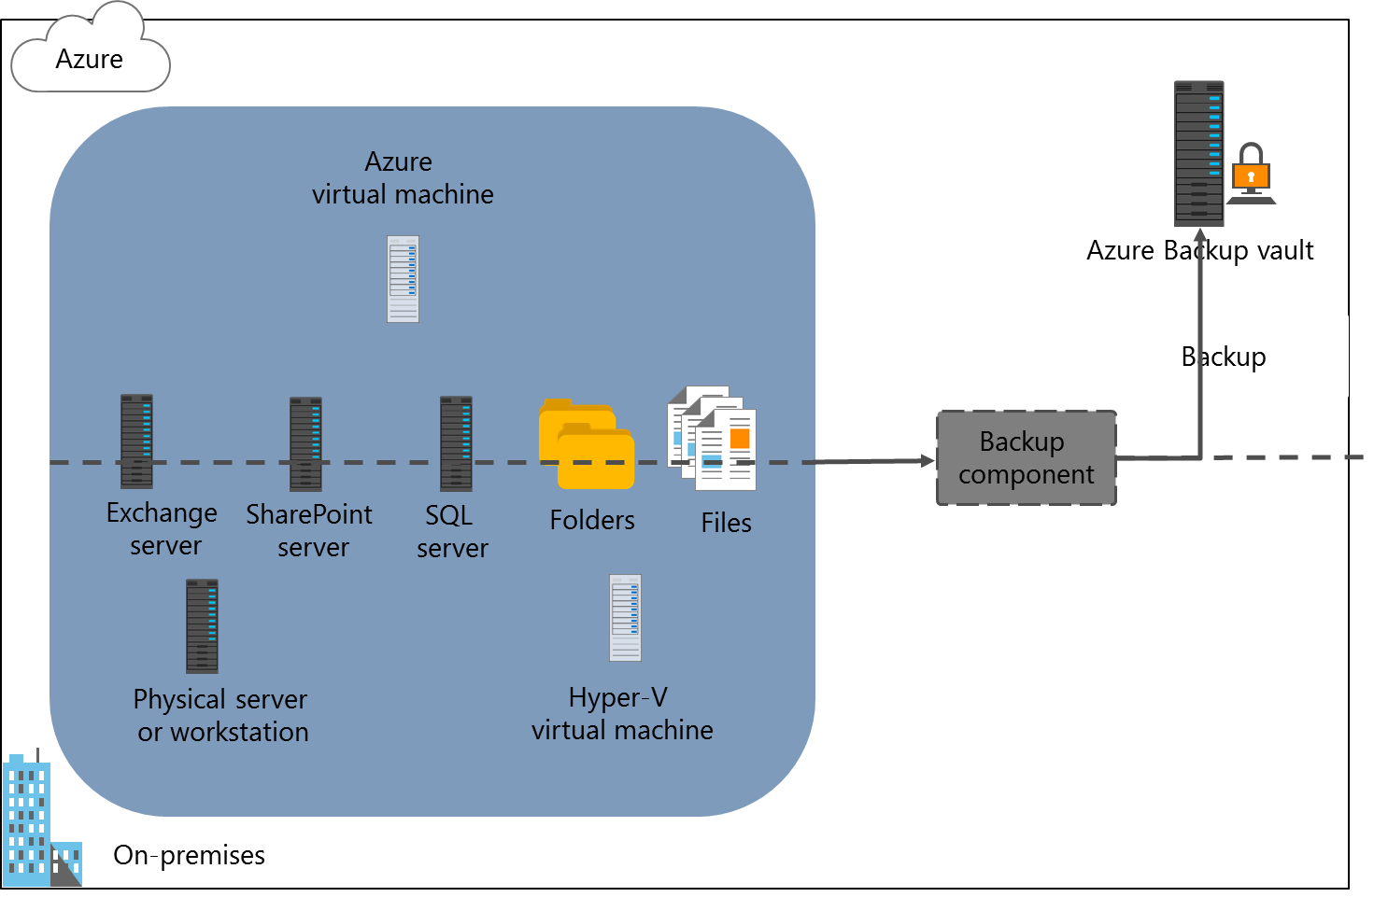
Overview of Azure Backup
Notes:
Students will implement Azure Site Recovery agent–based protection in the lab.
20533C
6: Planning and implementing storage, backup, and recovery services

Slide 27
File and folder backups with the Azure Site Recovery agent
Create an Azure Backup vault
Configure vault replication type
Specify the backup goal
Location of the workload: On-premises
The workload type: Files and folders
Download the vault credentials
Download and install the Site Recovery agent
Register the computer with the vault and set the passphrase
Configure the initial backup type, choose files and folders to back up, and create a backup schedule
Notes:
Point out that the Azure Import/Export service options integrate into the Choose Initial Backup Type page of the Schedule Backup Wizard of the Azure Backup console.
20533C
6: Planning and implementing storage, backup, and recovery services

Slide 28
VM-level backup by using the Azure Backup VM extension
Create an Azure Backup vault
Configure vault replication type
Specify the backup goal
Location of the workload: Azure
The workload type: Virtual machine
Choose the backup policy
Specify the virtual machines to back up
Notes:
20533C
6: Planning and implementing storage, backup, and recovery services

Slide 29
Integrating Azure Backup with Data Protection Manager and Microsoft Azure Backup Server
Feature | System Center 2016 DPM | Azure Backup Server
Application workloads | Yes | Yes
Tape backup | Yes | No
Integration with System Center suite | Yes | No
System Center licensing required | Yes | No
Deduplication support | Yes | Yes
Notes:
Point out the differences between System Center 2016 DPM and Azure Backup Server.
20533C
6: Planning and implementing storage, backup, and recovery services

Slide 30
Demonstration: Implementing Azure IaaS virtual machine backups
In this demonstration, you will see how to:
Create an Azure Recovery Services vault
Create a custom backup policy
Register an Azure VM in the Recovery Services vault
Notes:
Demonstration Steps
Create a Recovery Services vault
Start Internet Explorer, and then sign in to the Azure portal by using the Microsoft account that is the Service Administrator or Co-Administrator of your Azure subscription.
Create a new Azure Recovery Services vault with the following settings:
Name: Demo-RecoveryVault
Subscription: Your Azure subscription name
Resource group: Create a new resource group named 20533C0602-DemoRG
Location: The same region that you chose when running Setup-Azure at the beginning of this module
Wait until the vault is created.
Create a custom backup policy
In the Demo-BackupVault Azure Recovery Services vault, from the Getting started with backup blade, specify the following backup goal:
Where is your workload running? Azure
What do you want to backup? Virtual machine
Create a new backup policy with the following settings:
Policy name: DemoBackupPolicy
Backup frequency: Daily 6:00 AM local time
Keep the default values for the other settings. Wait until the operation completes.
Register an Azure VM in the Azure Recovery Services vault
From the Recovery Services vault blade, navigate to the Select virtual machines blade, and select the Azure VM named AdatumSvr06 that was deployed when running Setup-Azure at the beginning of this module.
20533C
6: Planning and implementing storage, backup, and recovery services
(More notes on the next slide)

Slide 31
Notes:
Verify that the registration completed successfully by navigating to the Backup items blade of the vault in the Azure portal. AdatumSvr06 should be listed with the Warning (Initial backup pending) entry in the LAST BACKUP STATUS column.
Unregister an Azure VM in the Azure Recovery Services vault and delete the vault
From the Backup items blade of the vault in the Azure portal, stop the backup of AdatumSvr06 with the Delete Backup Data option.
From the Demo-RecoveryVault blade, delete the vault.
Reset the demo environment
Close all open applications without saving any files.
On the taskbar, right-click Windows PowerShell, and then click Run as administrator.
In the User Account Control dialog box, click Yes.
At the command prompt, type the following command, and then press Enter:
Reset-Azure
When prompted, sign in (twice) by using the Microsoft account associated with your Azure subscription.
If you have multiple Azure subscriptions, select the one you want to target with the script.
When prompted for confirmation, type y.
Close the Windows PowerShell window.
Note: This script might remove Azure services in your subscription. Therefore, we recommend that you use an Azure trial pass that was provisioned specifically for this course, and not your own Azure account.
The script will take 5-10 minutes to reset your Microsoft Azure environment and prepare it for demonstrations and labs in the next module.
(More notes on the next slide)
20533C
6: Planning and implementing storage, backup, and recovery services

Slide 32
Notes:
The script removes all storage, VMs, virtual networks and gateways, cloud services, and resource groups.
Important: The script might not be able to get exclusive access to a storage account to delete it (you will see an error if this occurs). If you find objects remaining after the reset script is complete, you can rerun the Reset-Azure script or use the full Azure Management Portal to delete all the objects in your Azure subscription manually, with the exception of the default directory.
20533C
6: Planning and implementing storage, backup, and recovery services

Slide 33
Lesson 5: Planning and implementing Azure Site Recovery
Overview of Azure Site Recovery Planning for Azure Site Recovery Implementing Azure Site Recovery
Notes:
Question
Which components do you have to implement to facilitate Azure Site Recovery between a Virtual Machine Manager environment on-premises and Azure?
( ) Option 1: An Azure Site Recovery vault
( ) Option 2: An Azure storage account
( ) Option 3: An Azure virtual network
( ) Option 4: A Configuration server
( ) Option 5: A Master target server
Answer
(√) Option 1: An Azure Site Recovery vault
(√) Option 2: An Azure storage account
(√) Option 3: An Azure virtual network
( ) Option 4: A Configuration server
( ) Option 5: A Master target server
20533C
6: Planning and implementing storage, backup, and recovery services

Slide 34
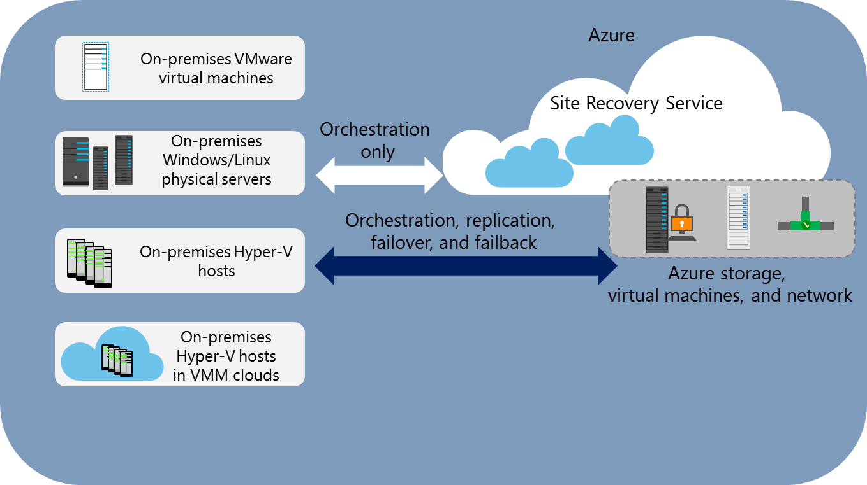
Overview of Azure Site Recovery
Notes:
20533C
6: Planning and implementing storage, backup, and recovery services

Slide 35
Planning for Azure Site Recovery
Choose scenario:
Replicating Hyper-V VMs to Azure with VMM
Replicating Hyper-V VMs to Azure without VMM
Replicate VMware virtual machines and physical servers to Azure
Replicate Hyper-V VMs to a secondary datacenter
Replicate Hyper-V VMs to a secondary datacenter with SAN replication
Replicate between on-premises physical servers or VMware virtual machines in primary and secondary datacenters
Plan capacity
Azure Site Recovery Capacity Planner
Hyper-V capacity planning tool
vSphere capacity planning appliance
Identify supported workloads
Notes:
20533C
6: Planning and implementing storage, backup, and recovery services

Slide 36
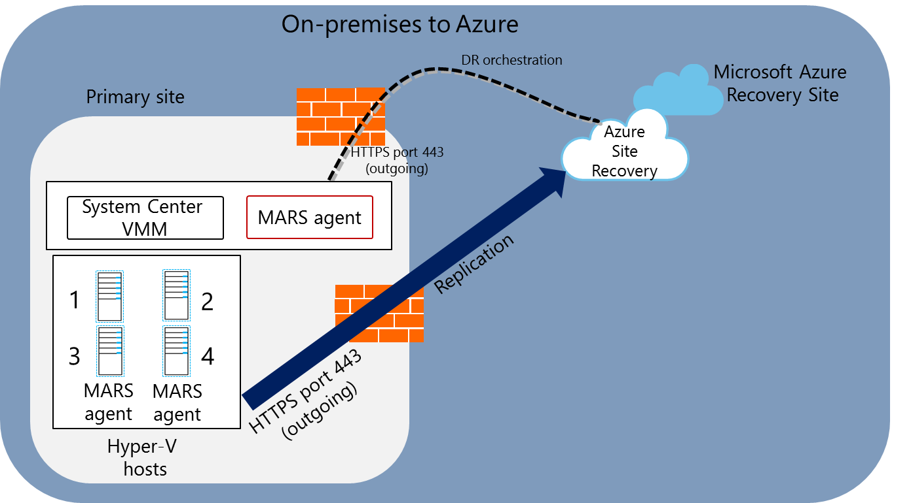
Implementing Azure Site Recovery
Notes:
20533C
6: Planning and implementing storage, backup, and recovery services

Slide 37
Lab: Planning and implementing Azure Storage
Exercise 1: Creating and configuring Azure Storage Exercise 2: Using Azure File storage Exercise 3: Protecting data with Azure Backup
Logon Information
Virtual machine: 20533C-MIA-CL1
User name: Student
Password: Pa55w.rd
Estimated Time: 60 minutes
Notes:
This lab assumes that students have completed the “Preparing the environment” demonstration at the beginning of the first lesson in this module.
The Azure portal improves continually, and the user interface might have updated since this lab was written. Before students start the lab, make them aware of any differences between the steps described in the lab and the current Azure portal user interface.
The high-level steps in this and other labs help students through the tasks while promoting learning and consolidation of the material in the module. Students should be able to complete the high-level steps with the knowledge they gained in the module. However, sometimes students find it hard to complete all tasks and Windows PowerShell commands without extra help. Make sure that students know where to find the Lab Answer Keys (LAKs), which have detailed, systematic instructions for each lab.
Before students start the lab, you need to decide which Azure region is the closest to your classroom location. Ensure that all students have this information because they will need it during the lab.
Exercise 1: Creating and configuring Azure Storage
A. Datum currently stores images for IT assets as files in a local folder. As part of your Azure evaluation, you want to test storing these images as blobs in Azure so that a new Azure-based version of the asset management application can easily access them.
Exercise 2: Using Azure File storage
A. Datum currently stores invoices for IT assets in the Microsoft Word format in a local folder. As part of your evaluation of Azure, you want to test the uploading of these files to a file share in your Azure storage account to make it easier for users to access them from VMs in Azure.
Instructor Note: The script that you ran in the “Preparing the environment” demonstration created the AdatumSvr1 VM.
Exercise 3: Protecting data with Azure Backup
A. Datum currently uses an on-premises backup solution. As part of your Azure evaluation, you want to test the protection of on-premises master copies of your image files and invoices by backing them up to the cloud. To accomplish this, you intend to use Azure Backup.
Instructor Note: The Reset-Azure script does not remove the Azure Recovery Services vault; this is because of a limitation with the current version of Azure PowerShell. Students can remove the vault manually or leave it because it does not affect subsequent labs.
20533C
6: Planning and implementing storage, backup, and recovery services

Slide 38
Lab Scenario
The IT department at A. Datum Corporation uses an asset management application to track IT assets such as computer hardware and peripherals. The application stores images of asset types and invoices for purchases of specific assets. As part of A. Datum’s evaluation of Azure, you need to test Azure storage features as part of your plan to migrate the storage of these images and invoice documents to Azure. A. Datum also wants to evaluate Azure File storage for providing SMB 3.0 shared access to installation media for the asset management application client software. Currently, corporate file servers host the media. Additionally, A. Datum wants to evaluate the ability of Azure Backup to protect the content of on-premises computers and Azure IaaS virtual machines.
Notes:
20533C
6: Planning and implementing storage, backup, and recovery services

Slide 39
Lab Review
The asset management application stores images of hardware components as blobs and invoices as files. If the application also needed to search the location of each asset by using an asset type, a unique asset number, and a text description of the location, what storage options should you consider?
Notes:
Question
The asset management application stores images of hardware components as blobs and invoices as files. If the application also needed to search the location of each asset by using an asset type, a unique asset number, and a text description of the location, what storage options should you consider?
Answer
If the data is to store in Azure storage, a table would be the best option. The data can store as key/value pairs in which an asset type is the partition key, an asset number is the row key, and the text location is the value.
20533C
6: Planning and implementing storage, backup, and recovery services

Slide 40
Module Review and Takeaways
Best Practices
Review Question
Notes:
Review Question
Question
Why should you co-locate storage accounts and the Azure services that use them?
Answer
Co-locating storage accounts and applications that use them in the same datacenter will significantly reduce latency when transferring data between storage and services, and it will reduce costs by minimizing charges for data transfers in and out of the datacenter.
Best Practices
When using Azure Storage, consider the following best practices:
Choose the most appropriate storage type based on your application requirements and the format of the data to store.
Co-locate storage accounts and the services that use them in the same region or affinity group.
When storing blobs, use block blobs for large objects that you want to upload or stream, and use page blobs when the application will read and write data in a random manner.
20533C
6: Planning and implementing storage, backup, and recovery services

