Slide 1
PIP HW#3
22211236
Taehyeon Jeong

Slide 2
Contents
Introduction
Problem
Main code
Weight function
Serial interpolation
OpenMP interpolation
Result
Conclusions And Discussions

Slide 3
Introduction
Load image using OpenCV
Decide the number of pixels for interpolation
Allocate the memory for output image
Calculate the weighting function using the equation
Bileanaer, Bi-cubic, Lagrange, B-Spline
Complete the interpolation funciton

Slide 4
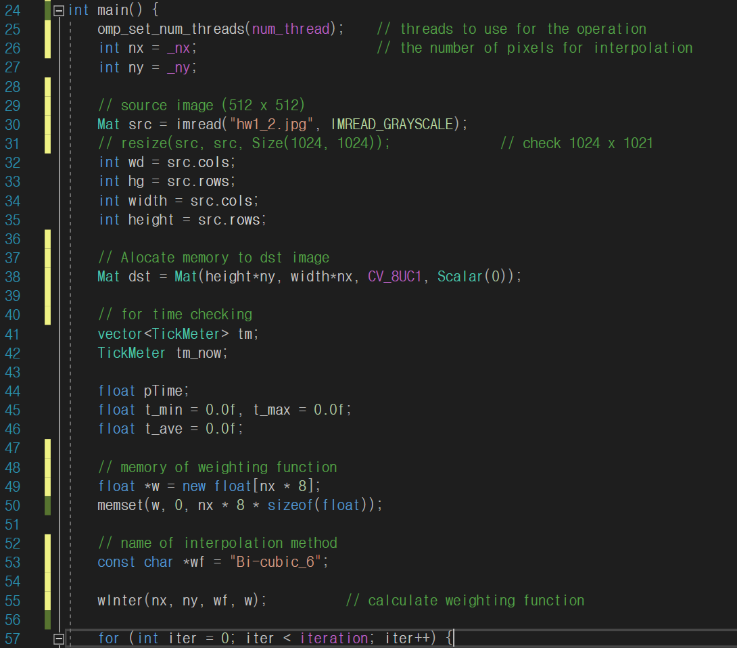
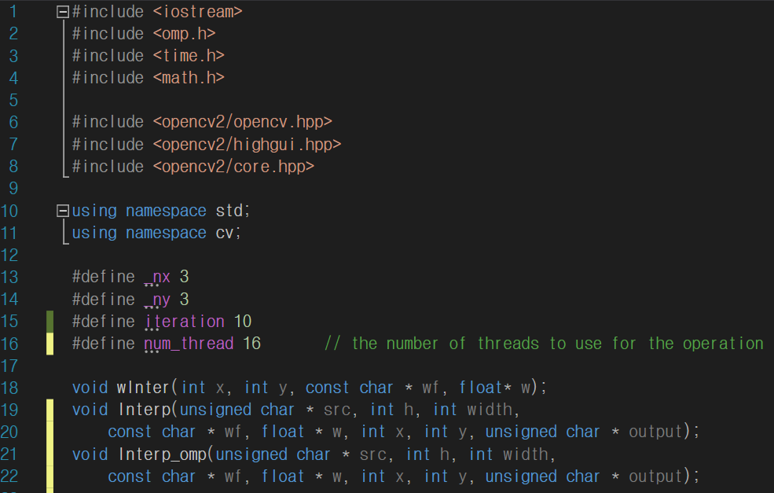
Code(main #1)

Slide 5
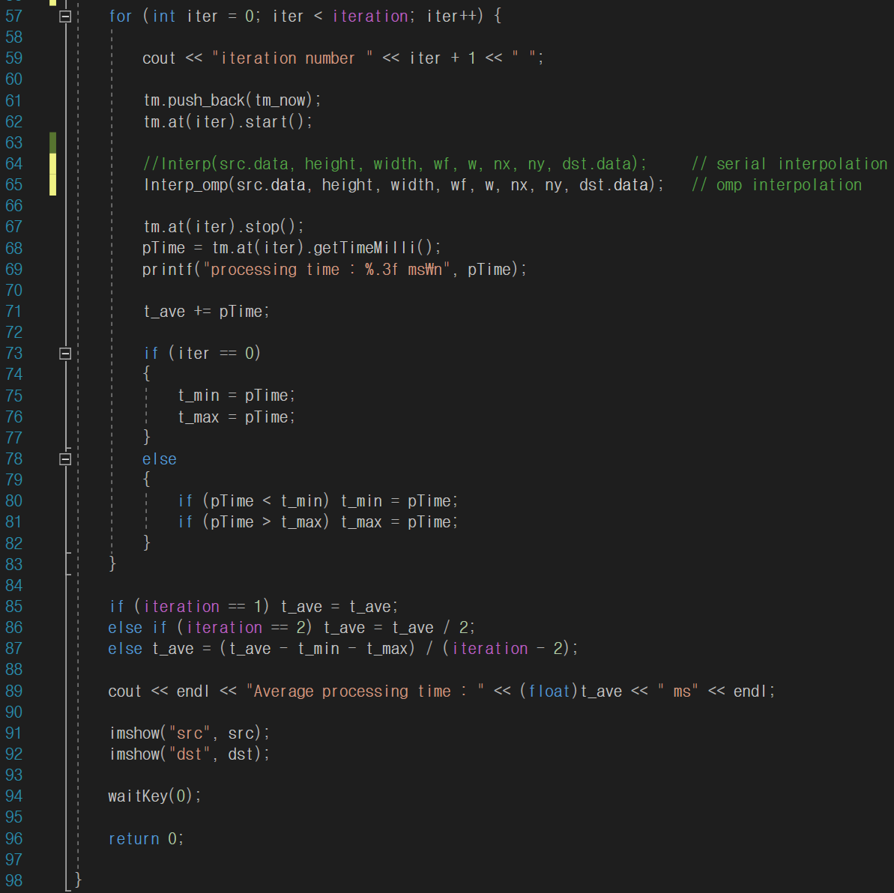
Code(main #2)

Slide 6
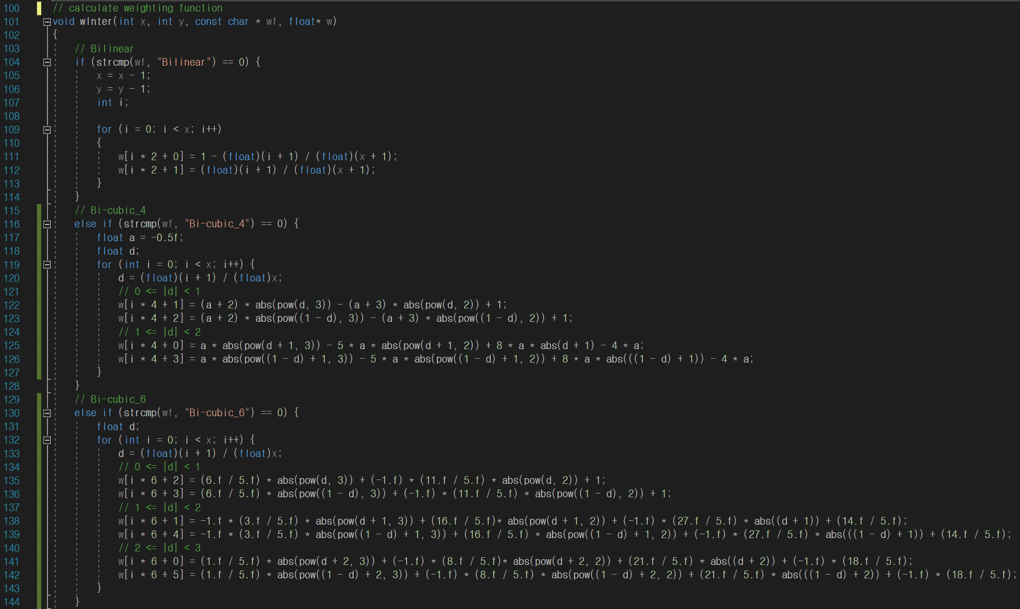
Code(wInter #1)

Slide 7
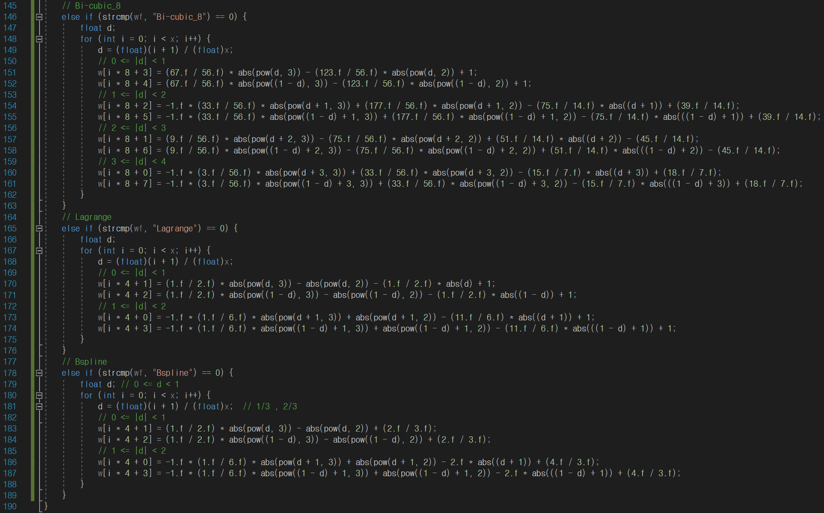
Code(wInter #2)

Slide 8
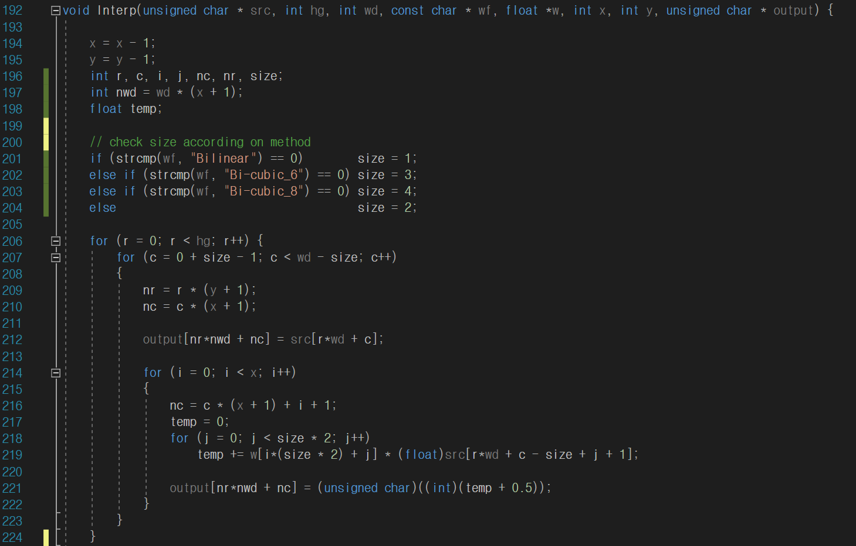
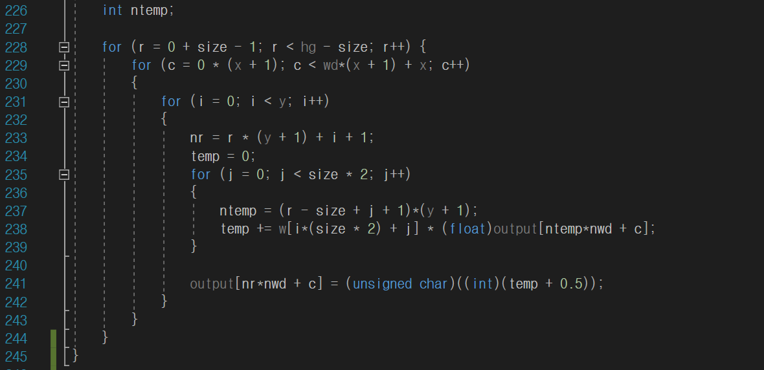
Code(Serial #1)

Slide 9
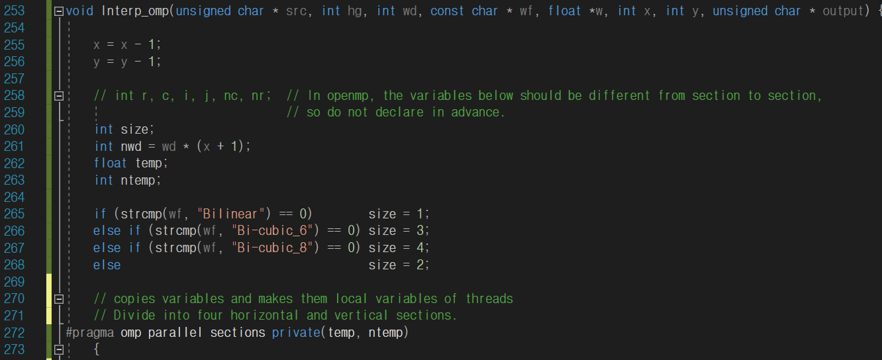
Code(OpenMP #1)

Slide 10
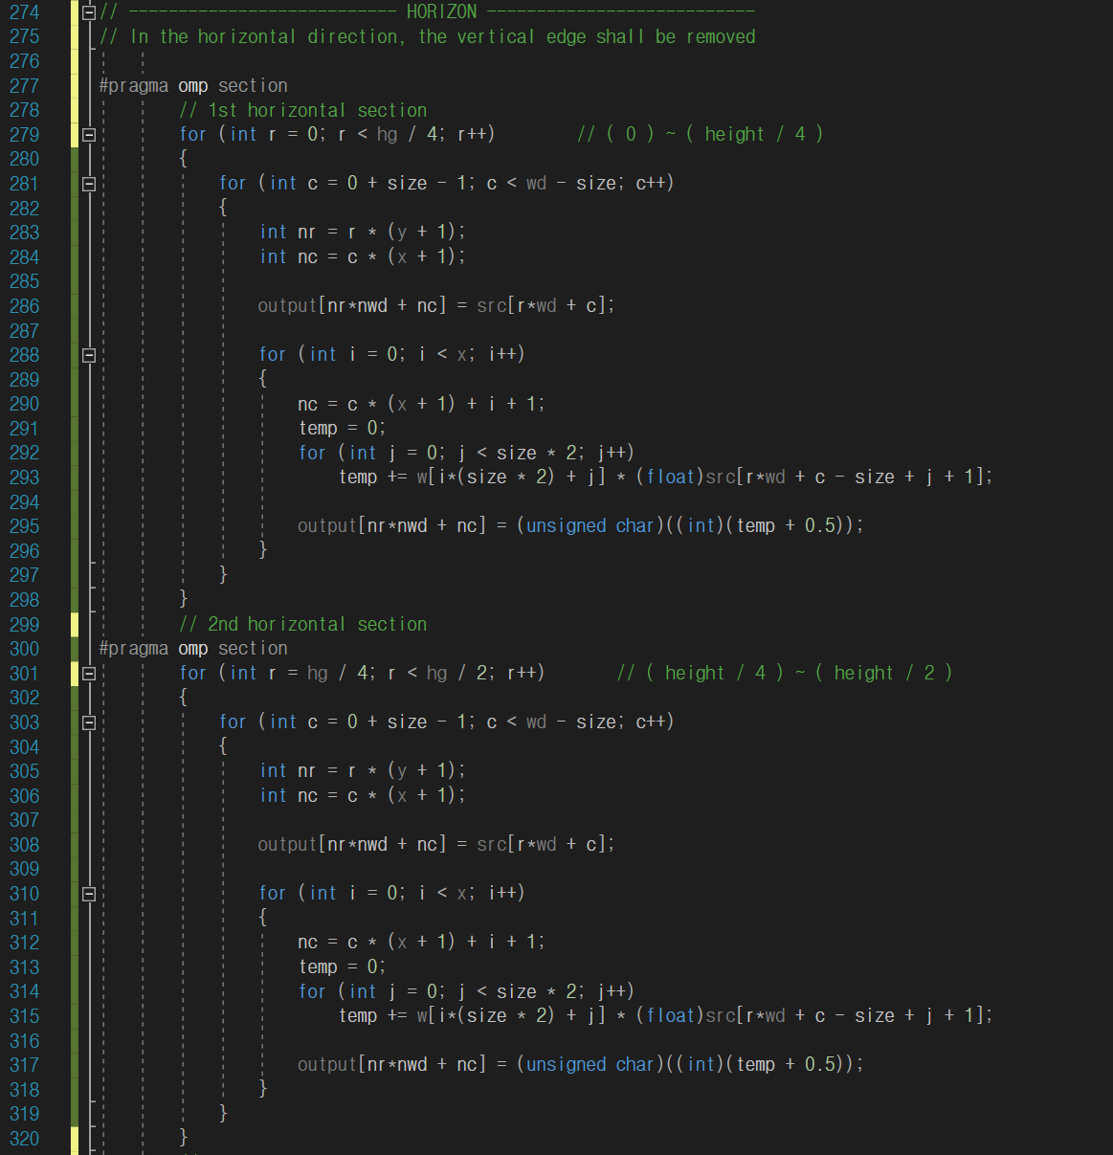
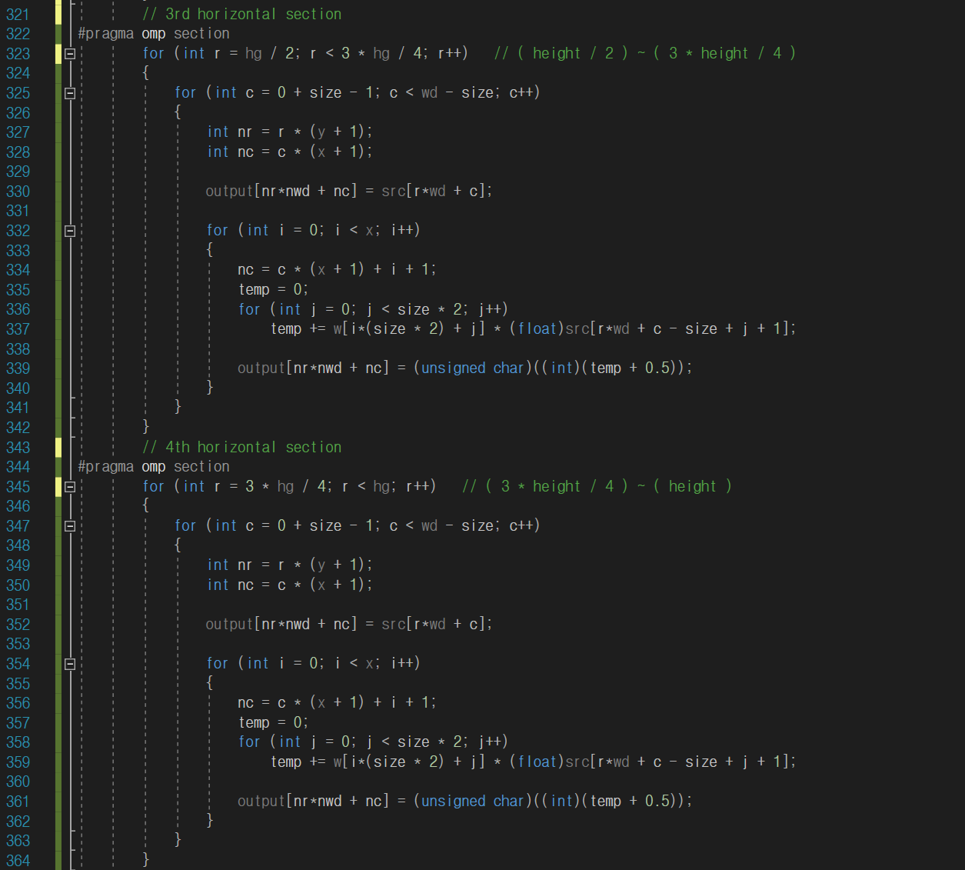
Code(OpenMP #2) Horizon

Slide 11
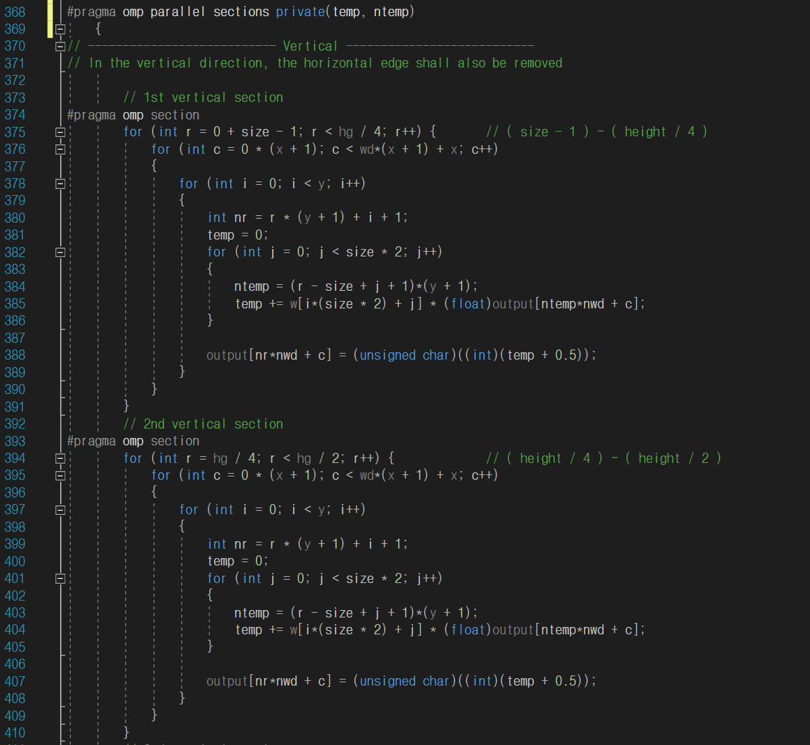
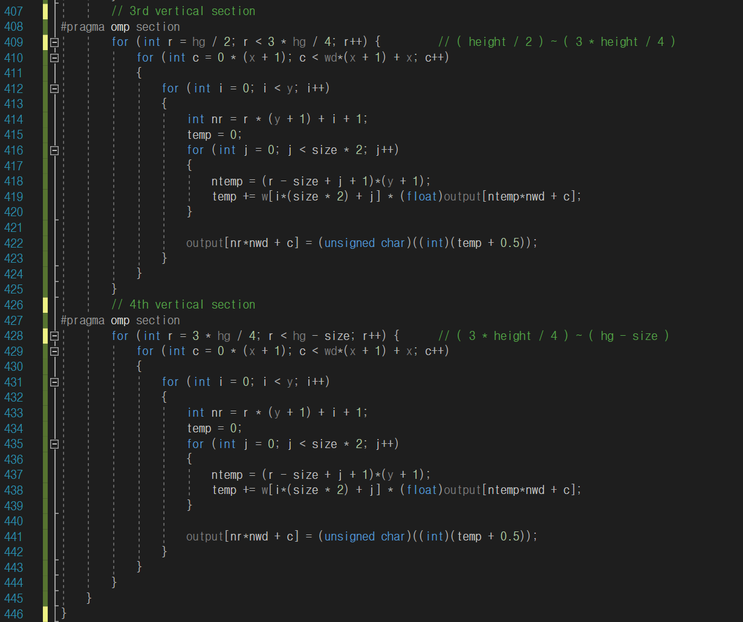
Code(OpenMP #3)

Slide 12
Bilinear
Image | Size | # of Thread | nx / ny | Serial (msec) | OpenMP(msec)
Lena | 512 x 512 | 1 | 2/1 | 0.75 | 1.64
 |  |  | 2/2 | 2.78 | 4.63
 |  |  | 3/3 | 9.16 | 11.50
 |  | 2 | 2/1 | 0.84 | 0.84
 |  |  | 2/2 | 2.80 | 2.31
 |  |  | 3/3 | 9.04 | 5.78
 |  | 4 | 2/1 | 0.76 | 0.48
 |  |  | 2/2 | 2.81 | 1.15
 |  |  | 3/3 | 8.77 | 2.60

Slide 13
Bilinear
Image | Size | # of Thread | nx / ny | Serial (msec) | OpenMP(msec)
Lena | 1024 x 1024 | 1 | 2/1 | 3.07 | 6.62
 |  |  | 2/2 | 11.31 | 18.47
 |  |  | 3/3 | 35.32 | 45.88
 |  | 2 | 2/1 | 3.12 | 3.40
 |  |  | 2/2 | 11.16 | 9.30
 |  |  | 3/3 | 35.18 | 22.93
 |  | 4 | 2/1 | 3.07 | 1.72
 |  |  | 2/2 | 11.16 | 4.23
 |  |  | 3/3 | 36.08 | 10.27

Slide 14
Bi-cubic 4
Image | Size | # of Thread | nx / ny | Serial (msec) | OpenMP(msec)
Lena | 512 x 512 | 1 | 1/1 | 1.09 | 1.92
 |  |  | 2/2 | 4.00 | 6.43
 |  |  | 3/3 | 12.27 | 16.58
 |  | 2 | 1/1 | 1.09 | 0.97
 |  |  | 2/2 | 4.04 | 3.23
 |  |  | 3/3 | 12.10 | 8.59
 |  | 4 | 1/1 | 1.09 | 0.51
 |  |  | 2/2 | 4.02 | 1.59
 |  |  | 3/3 | 12.16 | 5.24

Slide 15
Bi-cubic 4
Image | Size | # of Thread | nx / ny | Serial (msec) | OpenMP(msec)
Lena | 1024 x 1024 | 1 | 1/1 | 4.55 | 7.77
 |  |  | 2/2 | 16.08 | 25.73
 |  |  | 3/3 | 50.47 | 68.96
 |  | 2 | 1/1 | 4.42 | 3.94
 |  |  | 2/2 | 16.15 | 12.89
 |  |  | 3/3 | 50.34 | 34.53
 |  | 4 | 1/1 | 4.36 | 1.99
 |  |  | 2/2 | 16.05 | 7.59
 |  |  | 3/3 | 50.38 | 15.79

Slide 16
Bi-cubic 6
Image | Size | # of Thread | nx / ny | Serial (msec) | OpenMP(msec)
Lena | 512 x 512 | 1 | 2/1 | 1.60 | 2.52
 |  |  | 2/2 | 5.69 | 8.71
 |  |  | 3/3 | 18.37 | 23.35
 |  | 2 | 2/1 | 1.61 | 1.27
 |  |  | 2/2 | 5.73 | 4.52
 |  |  | 3/3 | 18.39 | 11.76
 |  | 4 | 2/1 | 1.63 | 0.78
 |  |  | 2/2 | 5.81 | 2.19
 |  |  | 3/3 | 18.39 | 5.56

Slide 17
Bi-cubic 6
Image | Size | # of Thread | nx / ny | Serial (msec) | OpenMP(msec)
Lena | 1024 x 1024 | 1 | 2/1 | 6.29 | 10.22
 |  |  | 2/2 | 22.57 | 34.94
 |  |  | 3/3 | 70.23 | 93.71
 |  | 2 | 2/1 | 6.21 | 5.37
 |  |  | 2/2 | 22.63 | 17.78
 |  |  | 3/3 | 70.22 | 46.91
 |  | 4 | 2/1 | 6.48 | 2.60
 |  |  | 2/2 | 22.88 | 9.96
 |  |  | 3/3 | 69.05 | 25.65

Slide 18
Bi-cubic 8
Image | Size | # of Thread | nx / ny | Serial (msec) | OpenMP(msec)
Lena | 512 x 512 | 1 | 2/1 | 1.75 | 2.61
 |  |  | 2/2 | 5.95 | 8.48
 |  |  | 3/3 | 17.50 | 22.03
 |  | 2 | 2/1 | 1.69 | 1.30
 |  |  | 2/2 | 5.98 | 4.73
 |  |  | 3/3 | 17.44 | 11.16
 |  | 4 | 2/1 | 1.83 | 0.72
 |  |  | 2/2 | 6.01 | 2.02
 |  |  | 3/3 | 18.12 | 7.11

Slide 19
Bi-cubic 8
Image | Size | # of Thread | nx / ny | Serial (msec) | OpenMP(msec)
Lena | 1024 x 1024 | 1 | 2/1 | 7.05 | 10.54
 |  |  | 2/2 | 23.70 | 34.11
 |  |  | 3/3 | 70.21 | 88.86
 |  | 2 | 2/1 | 7.12 | 5.50
 |  |  | 2/2 | 24.12 | 17.16
 |  |  | 3/3 | 70.33 | 44.61
 |  | 4 | 2/1 | 7.04 | 2.70
 |  |  | 2/2 | 24.23 | 8.25
 |  |  | 3/3 | 70.31 | 20.92

Slide 20
Larange
Image | Size | # of Thread | nx / ny | Serial (msec) | OpenMP(msec)
Lena | 512 x 512 | 1 | 2/1 | 1.08 | 1.92
 |  |  | 2/2 | 3.99 | 6.42
 |  |  | 3/3 | 11.94 | 16.55
 |  | 2 | 2/1 | 1.12 | 1.01
 |  |  | 2/2 | 3.98 | 3.24
 |  |  | 3/3 | 11.95 | 8.30
 |  | 4 | 2/1 | 1.13 | 0.50
 |  |  | 2/2 | 4.06 | 1.94
 |  |  | 3/3 | 11.98 | 4.04

Slide 21
Larange
Image | Size | # of Thread | nx / ny | Serial (msec) | OpenMP(msec)
Lena | 1024 x 1024 | 1 | 2/1 | 4.35 | 7.79
 |  |  | 2/2 | 16.07 | 25.62
 |  |  | 3/3 | 50.73 | 68.94
 |  | 2 | 2/1 | 4.34 | 3.93
 |  |  | 2/2 | 16.03 | 12.86
 |  |  | 3/3 | 50.86 | 34.56
 |  | 4 | 2/1 | 4.50 | 2.01
 |  |  | 2/2 | 15.86 | 7.75
 |  |  | 3/3 | 51.03 | 16.26

Slide 22
Bi-Spline
Image | Size | # of Thread | nx / ny | Serial (msec) | OpenMP(msec)
Lena | 512 x 512 | 1 | 2/1 | 1.08 | 1.92
 |  |  | 2/2 | 3.97 | 6.41
 |  |  | 3/3 | 12.43 | 16.55
 |  | 2 | 2/1 | 1.13 | 0.99
 |  |  | 2/2 | 4.02 | 3.25
 |  |  | 3/3 | 12.41 | 8.41
 |  | 4 | 2/1 | 1.33 | 0.52
 |  |  | 2/2 | 4.13 | 1.51
 |  |  | 3/3 | 12.53 | 4.10

Slide 23
Bi-Spline
Image | Size | # of Thread | nx / ny | Serial (msec) | OpenMP(msec)
Lena | 1024 x 1024 | 1 | 2/1 | 4.39 | 7.75
 |  |  | 2/2 | 16.12 | 25.79
 |  |  | 3/3 | 50.53 | 68.93
 |  | 2 | 2/1 | 4.53 | 4.04
 |  |  | 2/2 | 16.20 | 12.92
 |  |  | 3/3 | 50.58 | 34.56
 |  | 4 | 2/1 | 4.38 | 2.09
 |  |  | 2/2 | 16.12 | 7.83
 |  |  | 3/3 | 50.63 | 15.63

Slide 24
Conclusions and discussions
Through this task, I was able to understand the concept of parallel image processing through OpenMP. In particular, I learned the method of thread allocation directly by dividing it into sections rather than omp parallel for functions.
When images were processed in parallel, when the size of the images was small, and when the number of parallel threads was large, the computational speed was increased.
In the interpolation process, an exact target image was not produced due to problems with the calculation start point setting, and an image with empty edges was printed. This is likely to be improved in two ways.
First, use padding. Set the extra pixel around the image and proceed. However, it is difficult to say that this is the right result because extravaganza affects the image value.
The second method is to use a simple if statement to fill the index with surrounding pixels when the index is at the edge. This is expected to output the best results, but the index check operation may slow down.

