Slide 1
PIP HW#1
22211236
Taehyeon Jeong

Slide 2
Contents
Problem
Noise Removing
Segmentation Using Threshold
Circle detection
Conclusions And Discussions

Slide 3
Problem
HW #1-1
Remove the salt and pepper noise from the given image (hw1_1.ppm).
HW #1-2
Develop the thresholding program using OpenCV funcion for given color lena image(hw1_2.jpg)
HW #1-3
Design an algorithm to detect the circle object
Test on given images (circle_blob1.png ~ circle_blob4.png)
Hough circle, Blob detection

Slide 4
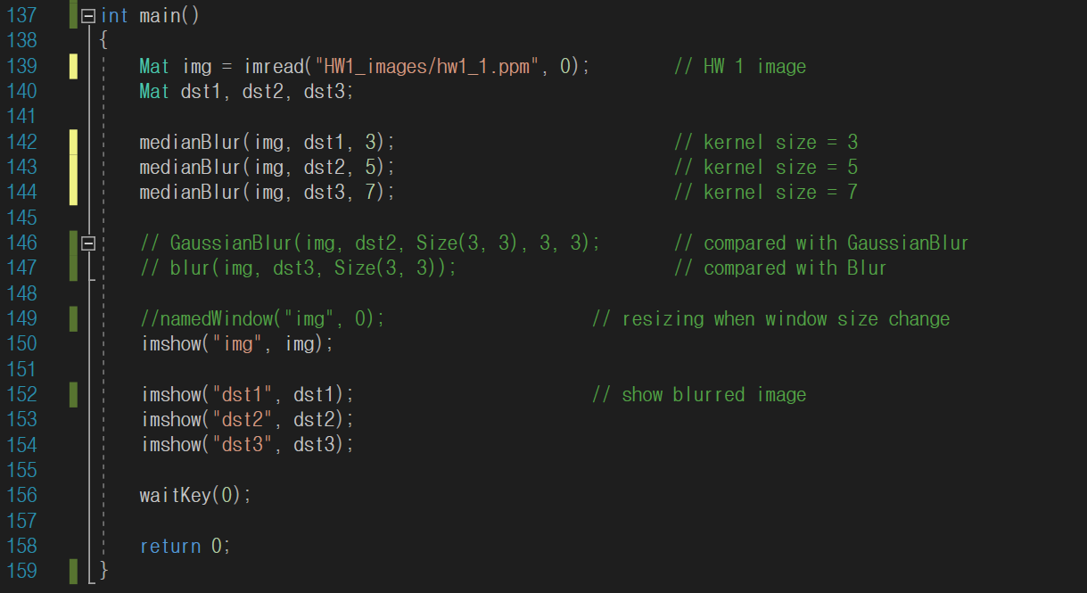
HW #1-1 source code
Blur source code

Slide 5
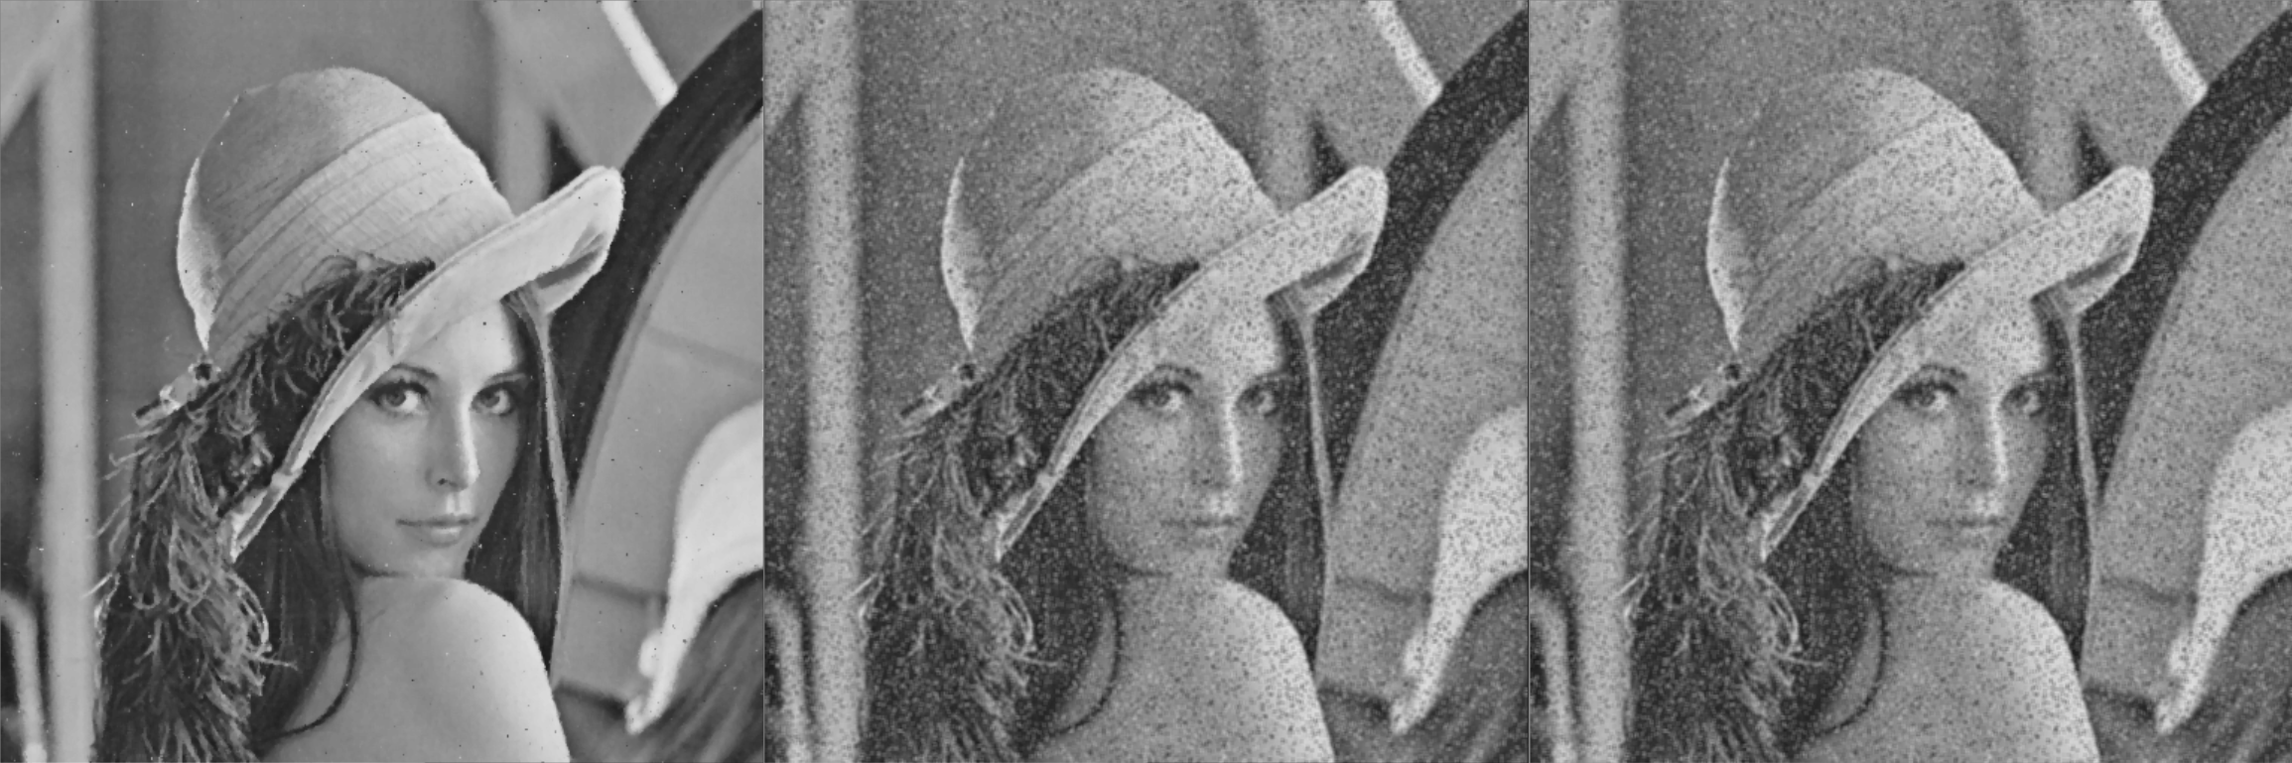
HW #1-1 solution
Median Blur
Gaussian Blur
Mean Blur
Blurred the image through a total of 3 techniques
In Gaussian and Mean, salt and pepper noise is not removed even if blur is applied
However, it was successfully removed from Median Blur. And this explanation will proceed on the next slide.

Slide 6
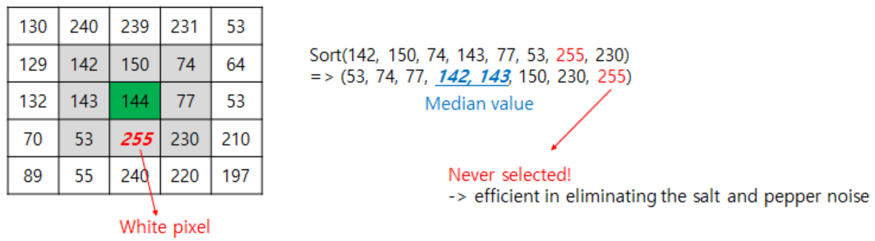
HW #1-1 solution
Median Blur
The median filter replaces the value with the middle of neighborhood set
With Gaussian Blur or Min Blur, all values in the kernel affect the result pixel
Therefore, it cannot produce good results compared to midian blur

Slide 7
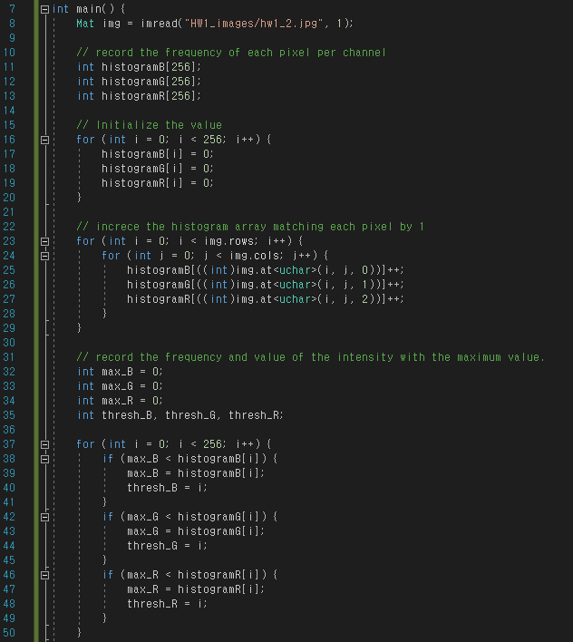
HW #1-2 source code (draw histogram)
Draw Histogram source code

Slide 8
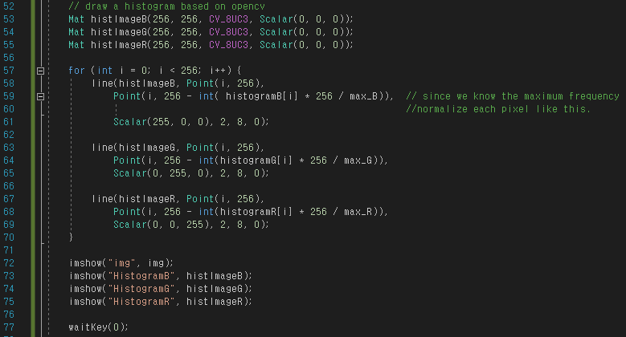
HW #1-2 source code (draw histogram)
Draw Histogram source code

Slide 9
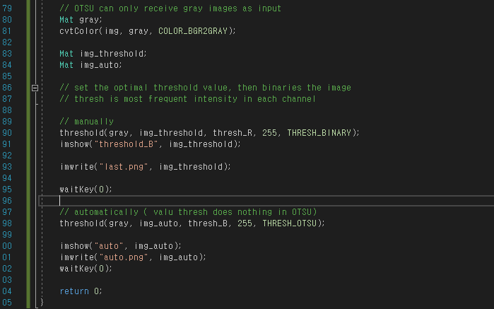
HW #1-2 source code (threshold)
Threshold source code

Slide 10
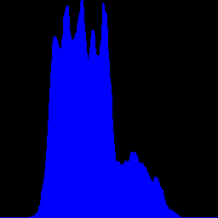
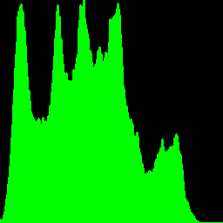
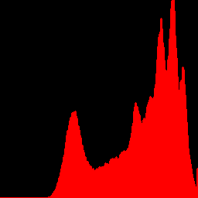
HW #1-2 solution (draw histogram)
Histogram of B
Max_freq : 3387
Max_intensity : 96
Histogram of G
Max_freq : 2205
Max_intensity : 96
Histogram of R
Max_freq : 3901
Max_intensity : 224

Slide 11
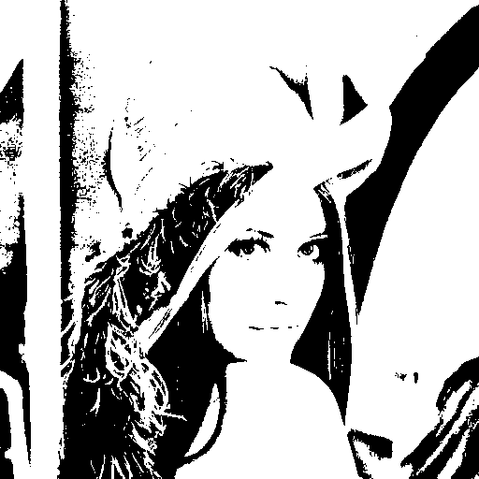
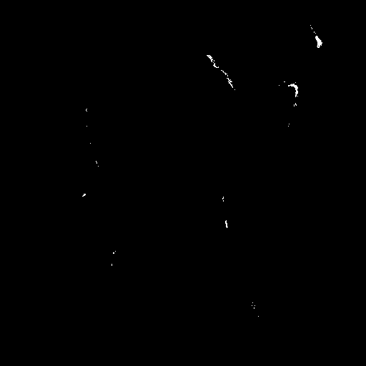
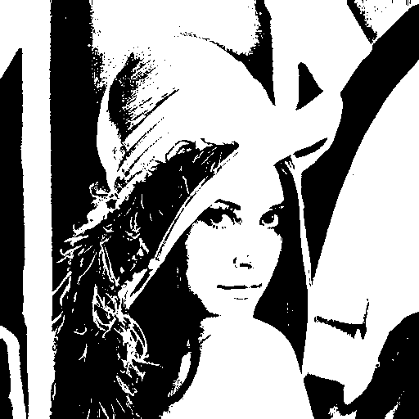
HW #1-2 solution (threshold)
THRESH_BINARY
Threshold in B : 96
THRESH_BINARY
Threshold in G : 96
THRESH_BINARY
Threshold in R : 224
THRESH_OTSU
Otsu’s Thresholding Concept
Process the input image
Obtain image histogram
Compute the threshold value T
Replace image pixels into white in those regions, where saturation is greater than T and into the black in the opposite cases
OTSU selects the maximum value as a critical point and then performs post-processing to output a better result

Slide 12
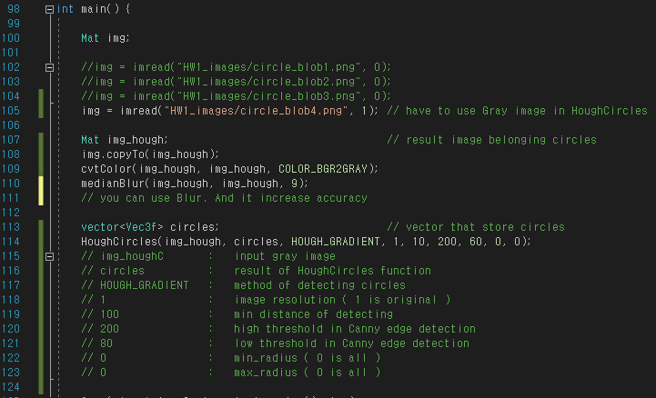
HW #1-3 source code (Hough Circles-1)
Hough Circle source code

Slide 13
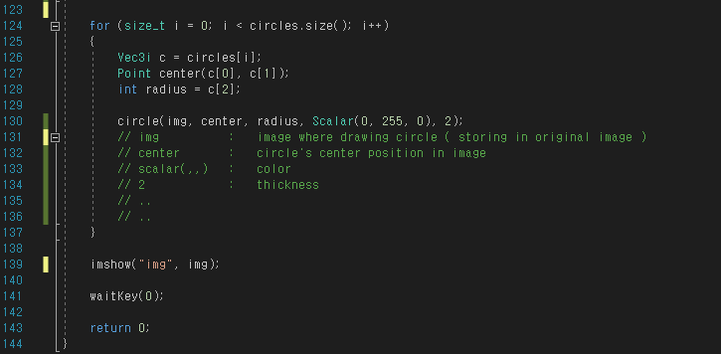
HW #1-3 source code (Hough Circles-2)
Hough Circle source code

Slide 14
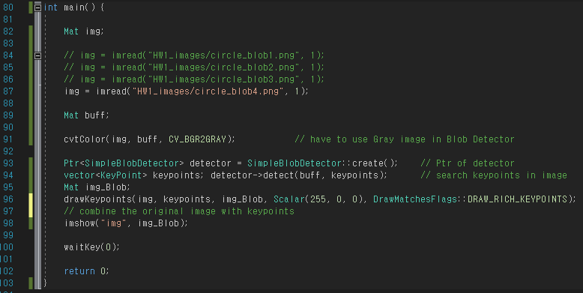
HW #1-3 source code (Blob Detection-1)
Blob Detection source code

Slide 15
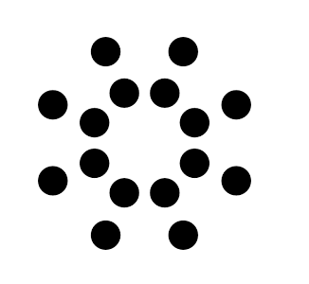
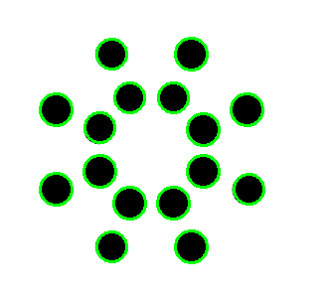
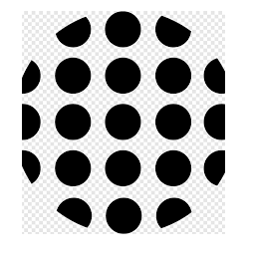
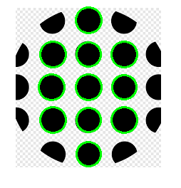
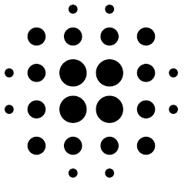
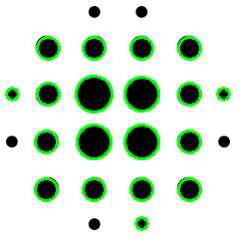
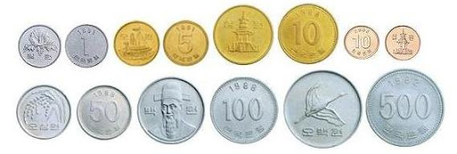
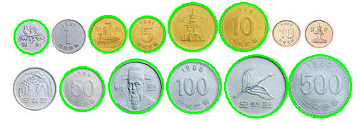
HW #1-3 solution (Hough Circles)
circle_blob1
circle_blob2
circle_blob3
original
output
original
output
original
output
circle_blob4
original
output

Slide 16
HW #1-3 solution (Hough Circles)
The Hog Circle consists of the coordinates and radius of the center of the circle. Therefore, it requires a three-dimensional accumulator and uses the “Hough gradient” method for acceleration.
Hough Gradient Method
Perform edge detection like canny.
Compute the gradient for the edge detection result.
Create a straight line accumulator for each gradient direction. At the same time, store the positions of the edges.
On the edge of the circle, the gradient will be towards the center of the circle and it will intersect at the center. Therefore, the local maximum among accumulators is determined as the center of the circle.
Change the radius at the center of each circle and find the largest value that matches the edge.
Finally, select a circle that contains more than an appropriate level of edges and is properly separated from others.

Slide 17
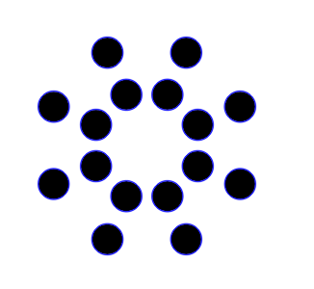
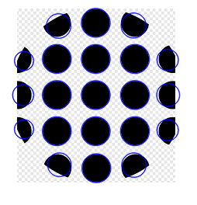
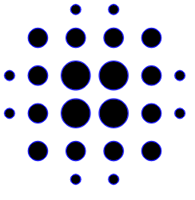
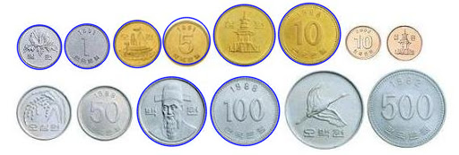
HW #1-3 solution (Blob Detection)
circle_blob1
circle_blob2
circle_blob3
original
output
original
output
original
output
circle_blob4
original
output

Slide 18
HW #1-3 solution (Blob Detection)
BLOB (Binary Large Object) refers to a group of pixels connected in a binary scale. SimpleBlobDetector is a detector that considers small objects as noise and finds only objects larger than a certain size.
Blob Detector algorithm
Convert the source image to binary images by applying thresholding with several thresholds from minThreshold (inclusive) to maxThreshold (exclusive) with distance thresholdStep between neighboring thresholds.
Extract connected components from every binary image by findContours and calculate their centers.
Group centers from several binary images by their coordinates. Close centers form one group that corresponds to one blob, which is controlled by the minDistBetweenBlobs parameter.
From the groups, estimate final centers of blobs and their radiuses and return as locations and sizes of keypoints.

Slide 19
Conclusions and discussions
It was very interesting that even with the blur that plays the same role, the result varies depending on the algorithm. I realized the importance of using different techniques depending on the situation in question.
In the hough circle and blob detection example, it worked successfully only by changing the hyper parameter according to the image. This is the same phenomenon as the previous problem, because each image has a different situation. Therefore, in the future image processing, I will try to create a function that can automatically adjust the hyper parameter as well.
I'm currently studying GPU coding personally, and I want to implement these taskes myself and run it in an on-device environment.

