Slide 1
PIP HW#2
22211236
Taehyeon Jeong

Slide 2
Contents
Problem
Implement the Gaussian function 5x5 filter using IPP
Implement the median 5x5 filter using IPP
Test on different size of images such as 256x256, 512x512, 1024x1024, 2048x2048
Conclusions And Discussions

Slide 3
Introduction
Compare the results image and processing time between opencv and ipp
Check the result images same or not
If the results are different, explain why they are different

Slide 4
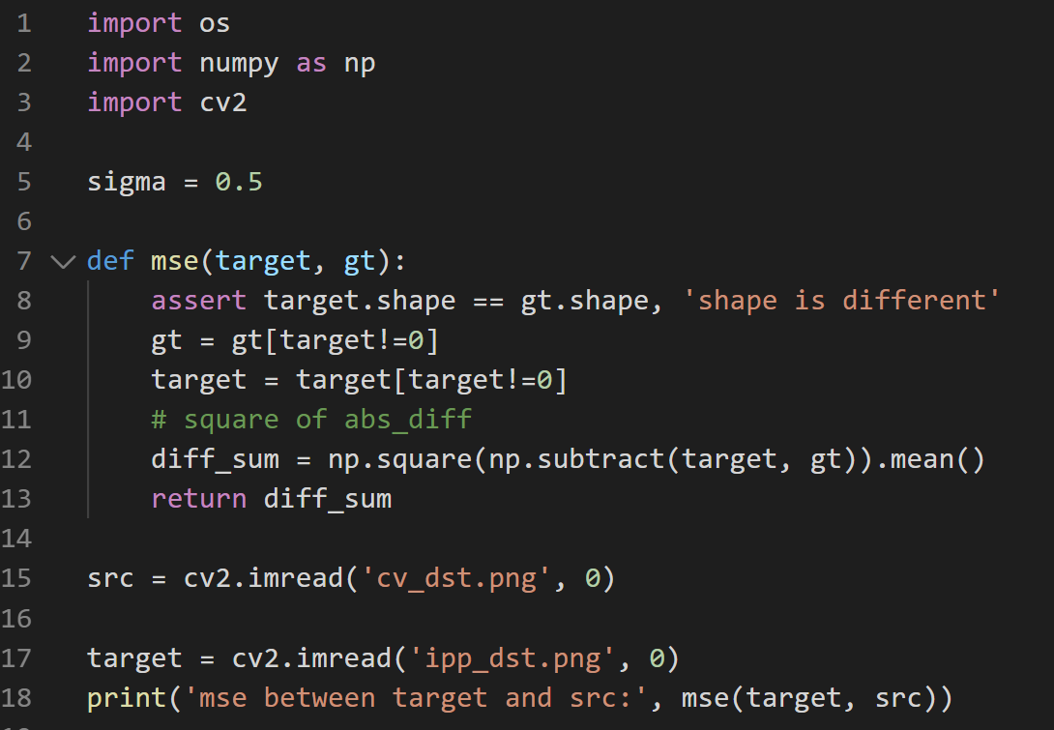
HW #2. Code
Mse Evaluation code

Slide 5
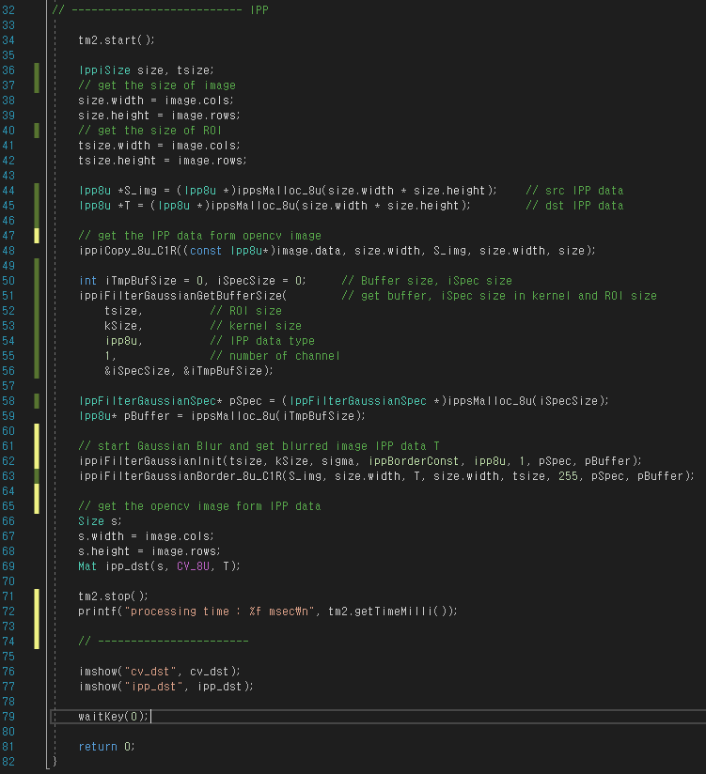
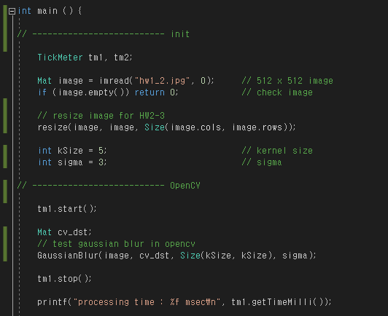
HW #2-1. Code
init and OpenCV
IPP and show result

Slide 6



HW #2-1. Result
Using OpenCV
Using IPP
Mse Result
Gaussian 5x5
Gaussian 5x5
This is the Gaussian blur result of a 512x512 size image
When IPP is used, image processing speed is improved by about 2.3 times

Slide 7
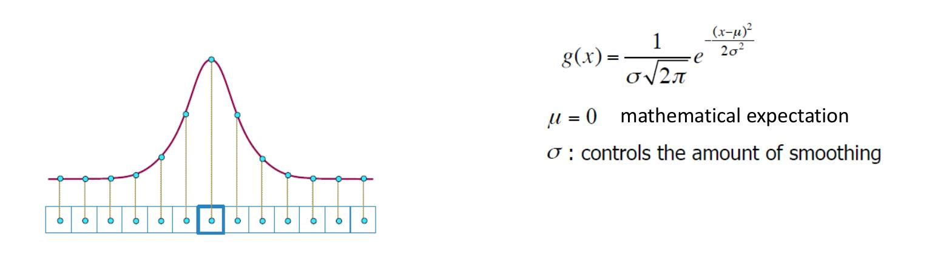
HW #2-1. Gaussian Blur
Gaussian blur means applying the Gaussian distribution to image processing
It is calculated with different weights depending on the distance from the center
Therefore, Image noise can be removed through normal distribution and probability distribution

Slide 8
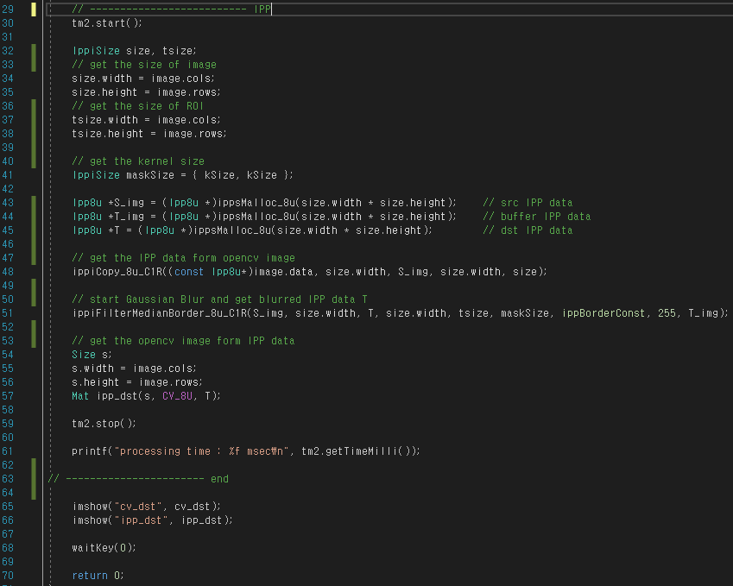
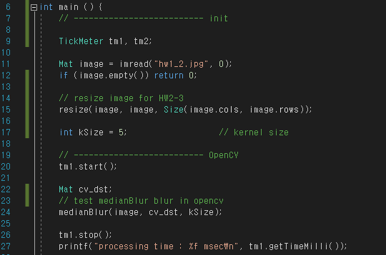
HW #2-2. Code
init and OpenCV
IPP and show result

Slide 9


HW #2-2. Result
Using OpenCV
Using IPP
Mse Result
Median 5x5
Median 5x5
This is the Median blur result of a 512x512 size image
When IPP is used, image processing speed is improved
Compared to the Gaussian blur, it has a lower speed

Slide 10
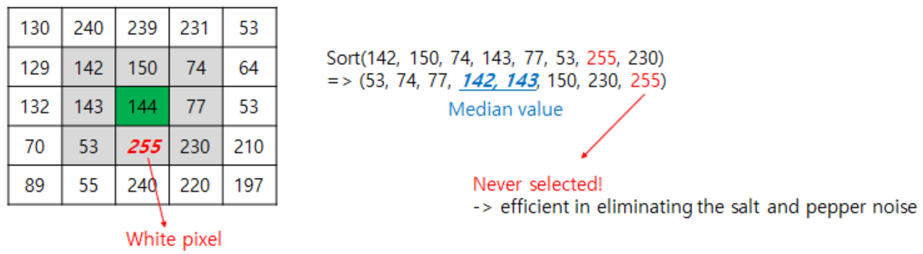
HW #2-2. Median Blur
Median Blur
The median filter replaces the value with the middle of neighborhood set
Therefore Compared to the Gaussian blur, it has a lower speed

Slide 11
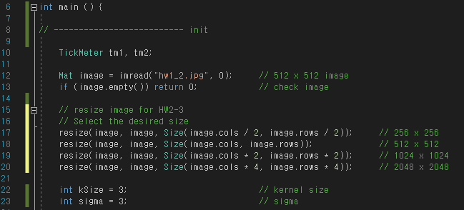
HW #2-3. Code
Change init code to resize

Slide 12
HW #2-3. Result
256 x 256
512 x 512
1024 x 1024
2048 x 2048
OpenCV Gaussian
OpenCV Gaussian
OpenCV Gaussian
OpenCV Gaussian
IPP Gaussian
IPP Gaussian
IPP Gaussian
IPP Gaussian
OpenCV Median
OpenCV Median
OpenCV Median
OpenCV Median
IPP Median
IPP Median
IPP Median
IPP Median
From 1024 pixels, IPP is slower than Opencv
As the number of pixels increases, the overall processing time increases. However, an exception occurred in the opencv Gaussian blur processing speed at 1024

Slide 13
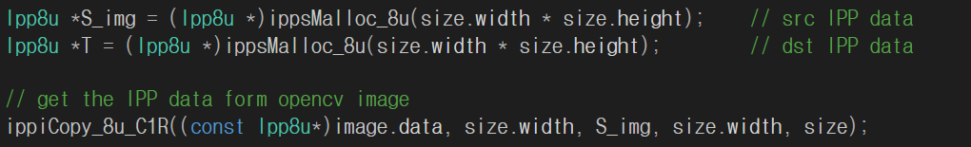
Conclusions and discussions
Through this assignment, I learned a tool that can perform image processing other than OpenCV, and I was able to understand the concept and method of ipp memory allocation.
The operation speed of IPP is basically faster than opencv. However, to use IPP, memory allocation is required as shown in the code below. Therefore, in a high pixel environment, the efficiency decreases due to the corresponding copy time.
An exception occurred in Opencv Gaussian Blur. It showed the fastest computation speed at 1024 pixels. This seems to be a peculiarity of my code in Opencv, and I will try to analyze the code later to find out why.

