Slide 1


Slide 2
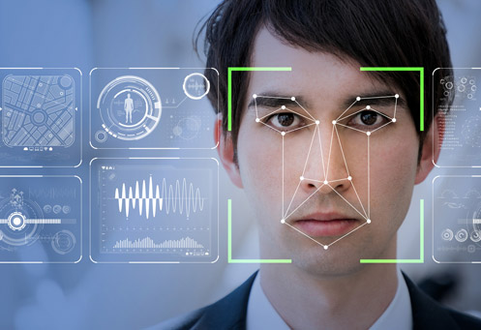
Real-Time Face Identification & Detection
PRESENTED BY:
Bilal Sarwar (210315)
Arbab Ahmed (210306)
Burhan Ahmed (210287)
SUPERVISOR:
Sir Shahid Hussain

Slide 3
Presentation Sequence
Introduction/Aim
Literature Review
Face Identification and Detection
Possible approaches
Block Diagram
Time Line
Final Deliverables
References

Slide 4
Introduction
Real-time face identification and detection is a technology that has gained significant attention in recent years. It involves the use of advanced algorithms and deep learning techniques to identify and detect faces in real-time.
The application of this technology has been widespread, with its use in security systems, social media platforms, and even in healthcare settings.
The aim Face detection and normalization.
Face identification.

Slide 5
Literature Review
S. No. | Title of Research Paper | First Author | Area of work | Published In | Content of Paper
1. | Automatic Facial Expression Analysis | B. Fasel and J. Luettin | facial expression recognition systems | January 2003 | Algorithm of face recognition technology
2. | A Survey of Face Recognition Techniques | Rabia Jafri and Hamid R Arabnia | Face Recognition Techniques | June 2009
3. | Face Recognition | AH El-Baz and AA El-Harby | limitations of face databases | February 2006 | face recognition technology
4. | A MATLAB based Face Recognition System using Image Processing and Neural Networks | Omkar M Parkhiand Andrew Zisserman | removing redundant data from face images | January 2008 | Face recognition using MATLAB
5. | Deep face recognition | Omkar M Parkhi, Andrea Vedaldi, and Andrew Zisserman | convolutional neural network (CNN) | 2015 | faces tracked in a video

Slide 6
Literature Review (Continued)
[1]Automatic+Facial+Expression+Analysis%3A+A+Survey"+by+B.+Fasel+and+J.+Luettin&rlz=1C1UEAD_enPK1035PK1035&oq=Automatic+Facial+Expression+Analysis%3A+A+Survey"+by+B.+Fasel+and+J.+Luettin&aqs=chrome..69i57.463j0j1&sourceid=chrome&ie=UTF-8
[2]cholar.google.com.pk/scholar?q=A+Survey+of+Face+Recognition+Techniques"+by+Rabia+Jafri+and+Hamid+R+Arabnia&hl=en&as_sdt=0&as_vis=1&oi=scholart
[3] https://scholar.google.com.pk/scholar?q=Face+Recognition:+A+Literature+Review%22+by+AS+Tolba,+AH+El-Baz,+and+AA+El-Harby&hl=en&as_sdt=0&as_vis=1&oi=scholart
[4]https://www.researchgate.net/publication/228963208_A_MATLAB_based_Face_Recognition_System_using_Image_Processing_and_Neural_Networks
[5]https://scholar.google.com.pk/scholar?q=Deep+Face+Recognition%22+by+Omkar+M+Parkhi,+Andrea+Vedaldi,+and+Andrew+Zisserman&hl=en&as_sdt=0&as_vis=1&oi=scholart

Slide 7
Face Identification
Real-time face identification works by analyzing the unique features of a person's face, such as the distance between their eyes, the shape of their nose, and the contours of their cheeks.
This information is then compared to a database of known faces, and if a match is found, the system can identify the person in real-time.
Lithosphere

Slide 8
Problem Statement
Identify the given Image or extract face from the given image.
Retrieve the similar image from the database.

Slide 9
Possible Strategy
Following are the two approaches for face-detection:
Face detection in images.
Real-time face detection.

Slide 10
Possible Strategy
Personal Identification
Human-Computer Interaction.
Security Systems.

Slide 11
Solution
Eigen Faces
LEM (Edge Mapping)

Slide 12
CONTINUED
Eigenfaces is a dimensionality reduction method that captures the variations the dataset and use this information to encode the face images.

Slide 13
Stages of Face Recognition
Face Location Detection.
Feature Extraction.
Facial Image Classification.

Slide 14
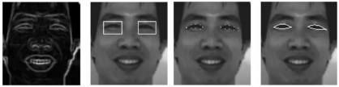
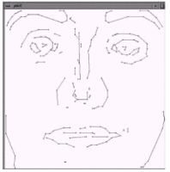
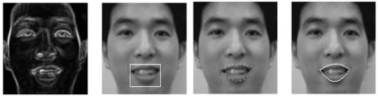
CONTINUED
Figure 1: Eye Extraction
Figure 2: Mouth Extraction Figure 3: An illustration of a face LEM

Slide 15
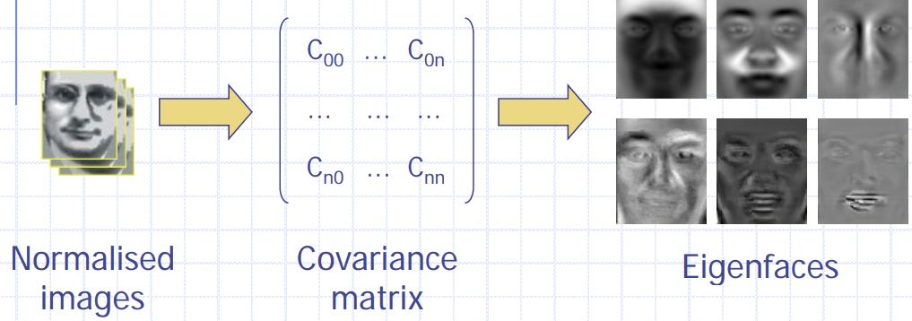
CONTINUED

Slide 16
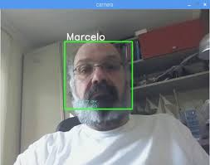
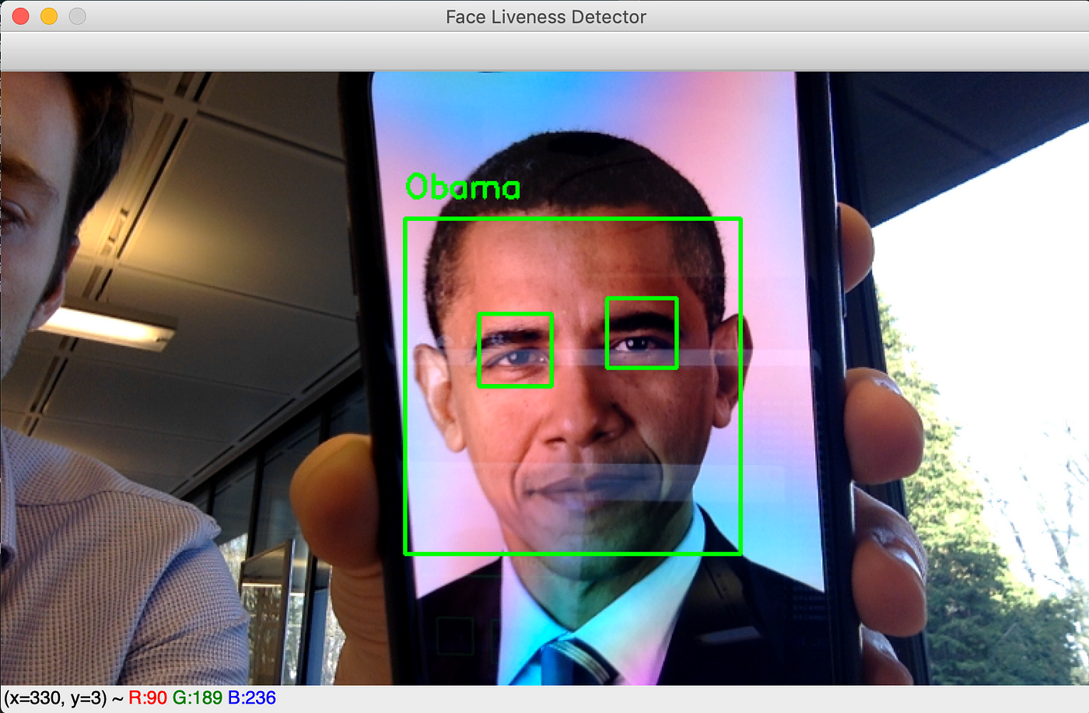
CONTINUED

Slide 17
Benefits of Real-Time Face Identification
Real-time face identification offers several benefits, including increased security and safety in public spaces, improved access control in workplaces and healthcare settings, and enhanced user experience on social media platforms.
It also has the potential to improve law enforcement efforts by identifying suspects in real-time and reducing the need for manual identification processes.

Slide 18
Future of Real-Time Face Identification
As technology continues to advance, the future of real-time face identification looks promising.
Advancements in machine learning and artificial intelligence are expected to improve the accuracy and reliability of these systems, while also addressing some of the current challenges.

Slide 19
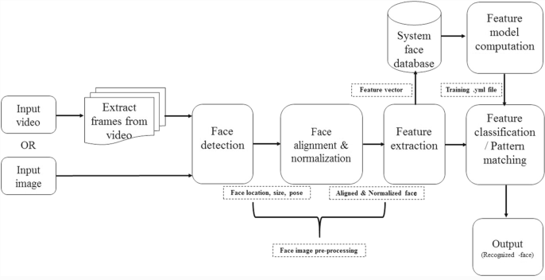
Block Diagram

Slide 20
Estimated Timeline
S. No. | Elapsed time since start of the project | Milestone | Deliverable
1. | 3 Months | Research & data gathering | Dataset
2. | 3 Months | Data Pre Processing | Processed Data
3. | 3 Months | Data Modeling (Extracting features) | Feature of Data
4. | 3 Months | Model Training (Prototype) | Trained Model
5. | 3 Months | Model Deployment | Hardware/Application

Slide 21
Final Deliverables
Develop a real-time recognition system that can accurately recognize faces for the purpose of biometric analysis and surveillance.
Application/Hardware
Research Paper Publishing
Estimated Budget
1.25 Lakhs

Slide 22
References
[1] B. Fasel and J. Luettin. In: Automatic facial expression analysis: A survey (). url: https: //airccse.org/journal/ijcses/papers/3612ijcses04.pdf.
[2] G. C. Feng, P. C. Yuen, and D. Q. Dai. “Human face recognition using PCA on wavelet subband”. In: Journal of Electronic Imaging 9.2 (2000), pp. 226–233. doi: 10.1117/1. 482742. url: https://doi.org/10.1117/1.482742.
[3] Rabia Jafri and Hamid R Arabnia. “A survey of face recognition techniques”. In: journal of information processing systems 5.2 (2009), pp. 41–68.
[4] Manisha M Kasar, Debnath Bhattacharyya, and TH Kim. “Face recognition using neural network: a review”. In: International Journal of Security and Its Applications 10.3 (2016), pp. 81–100.
[5] Jawad Nagi, Syed Khaleel Ahmed, and Farrukh Nagi. “A MATLAB based face recognition system using image processing and neural networks”. In: 4th International Colloquium on Signal Processing and its Applications. Vol. 2. 2008, pp. 83–8.
[6] Omkar M Parkhi, Andrea Vedaldi, and Andrew Zisserman. “Deep face recognition”. In: (2015).
[7] AS Tolba, AH El-Baz, and AA El-Harby. “Face recognition: A literature review”. In: International Journal of Signal Processing 2.2 (2006), pp. 88–103.

Slide 23
Thank You
Any Questions and Suggestions?

