Slide 1
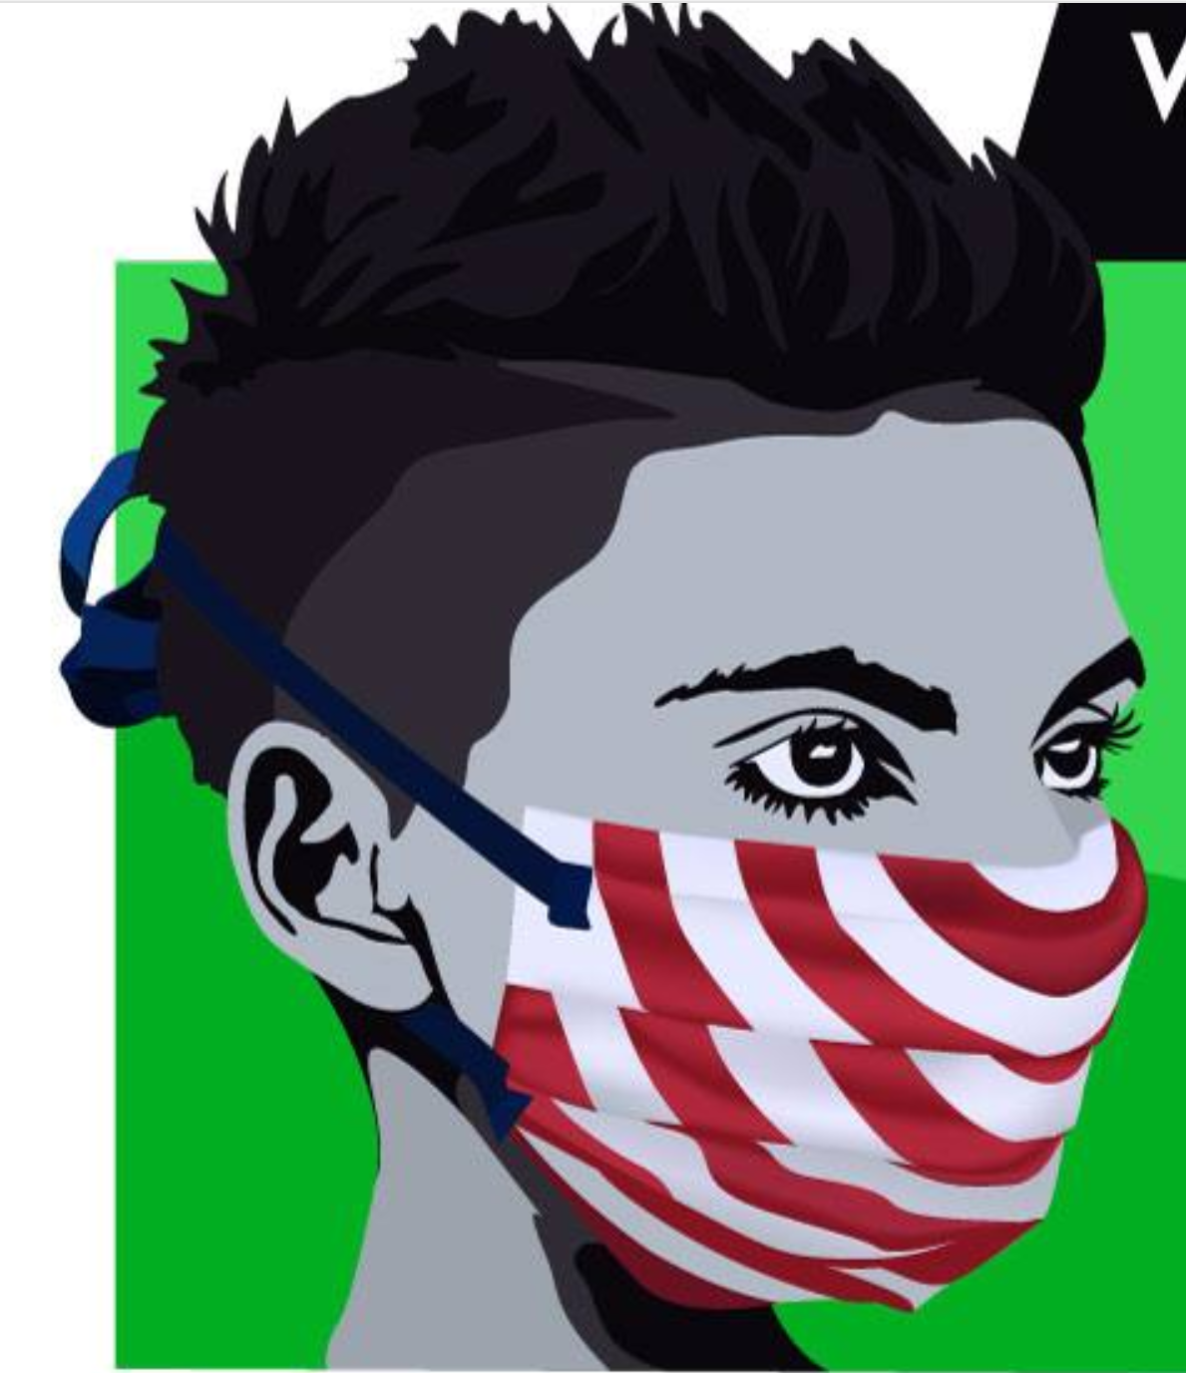









MakerMask: Surge
Body Contacting Materials: | Other Materials:
Nonwoven Polypropylene (NWPP) | Steel Wire
Cotton | Copper Wire
Other (specify): _______________________ | Other (specify): _______________________
Body contacting materials include all materials used for the main portion of the mask and the head ties. Other materials include those used for the nose piece reinforcement. This Table MUST be filled in!
This mask was made locally by: Name: __________________________________
Contact Info: _____________________________
Date Made: ______________________________
Inspect Mask Before Each Use:
 | Inspect mask for defects. Ensure mask is breathable without restriction. Discard if defects are detected or if concerns arise.
Recommended Disinfection Instructions: Before first use (select one). After each use (select one):
 | Boil: Submerge mask in boiling water for 10 minutes. Hang dry.
 | Autoclave: Follow facility infection control policies and autoclave (moist heat) at 15 psi, 121°C for 15 minutes.
Recommended Cleaning Instructions: Discard heavily soiled masks. Wash lightly soiled masks as needed (select one):
 | For best results (longer mask life): Hand wash warm. Rinse thoroughly. Hang to dry. Do Not Bleach. Do Not Iron.
 | For simplicity: Machine wash warm (50°C) in laundry bag. No fabric softener. Tumble dry low. Do Not Bleach. Do Not Iron.
Product Description:
The MakerMask: Surge is intended for use by a single individual as a face mask to cover the nose and mouth for source control (to help contain the wearer’s respiratory secretions). It may be worn and safely discarded after a single use or washed/disinfected for multiple uses. For more information visit: MakerMask.org
Warnings:
 | Use at your own risk. DO NOT USE in a clinical setting where the infection risk level through inhalation exposure is high. This product is NOT a surgical mask. This product is NOT Personal Protective Equipment (PPE) and should not be used to meet a professional healthcare facility’s obligations to protect workers against infectious disease hazards.
REQUIRED LABEL INFORMATION: This product has not been FDA cleared or approved. The product has been authorized by FDA under an EUA for use as source control by the general public as well as by HCP in healthcare settings as to help prevent the spread of infection or illness during the COVID-19 pandemic. This product is authorized only for the duration of the declaration that circumstances exist justifying the authorization of the emergency use of medical devices, including alternative products used as medical devices, during the COVID-19 outbreak, under section 564(b)(1) of the Act, 21 U.S.C. § 360bbb-3(b)(1) unless the authorization is terminated or revoked sooner. For mor information see: https://www.fda.gov/media/137121/download

