Slide 1
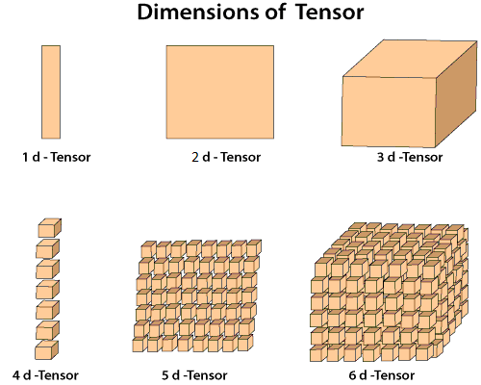
Tensor: Tensors are simply mathematical objects
1D,2D,3D…. nD
Tensor Basics

Slide 2
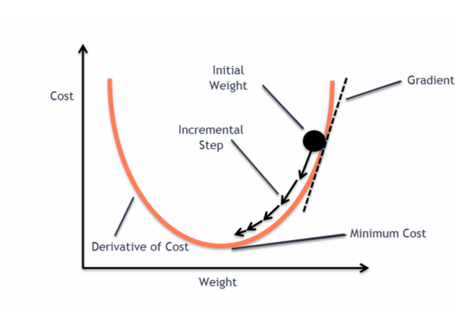
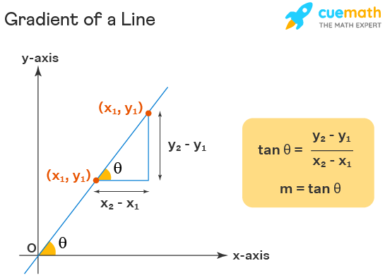
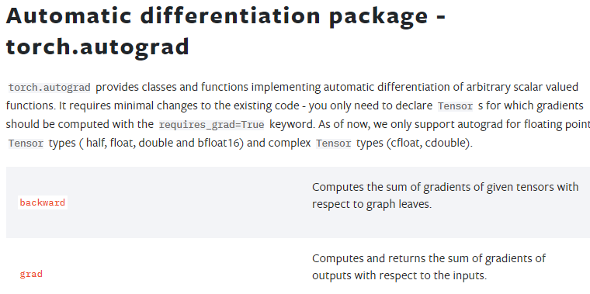
Gradient: Central concept for model optimization, So this is the must needed for Machine learning task.
What is gradient?
Gradient
Pytorch provides autograde package which can do all computation for us.
So we just to know how to use it

