Slide 1
🍟
Chips Category Review
Retail Analytics | Trial Store Performance & Customer Insights
Prepared by: Burhan | April 2026
Chips Category Review | Retail Analytics

Slide 2
:
⭐ Executive Summary : The objective of this analysis was to evaluate customer behavior and assess the effectiveness of a new store layout.
📋 Key Findings
🏪 Trial Store Results
Older segments (Retirees, Older Singles) = biggest sales drivers
Mainstream & Budget customers = majority of revenue
100–200g pack size = most popular category
Trial results were mixed across 3 stores
Store 86: ✅ Success
Store 88: ✅ Success
Store 77: ❌ Unsuccessful
✅ Recommendation
Roll out layout selectively (not all stores)
Focus on high-performing customer segments
Chips Category Review | Retail Analytics

Slide 3
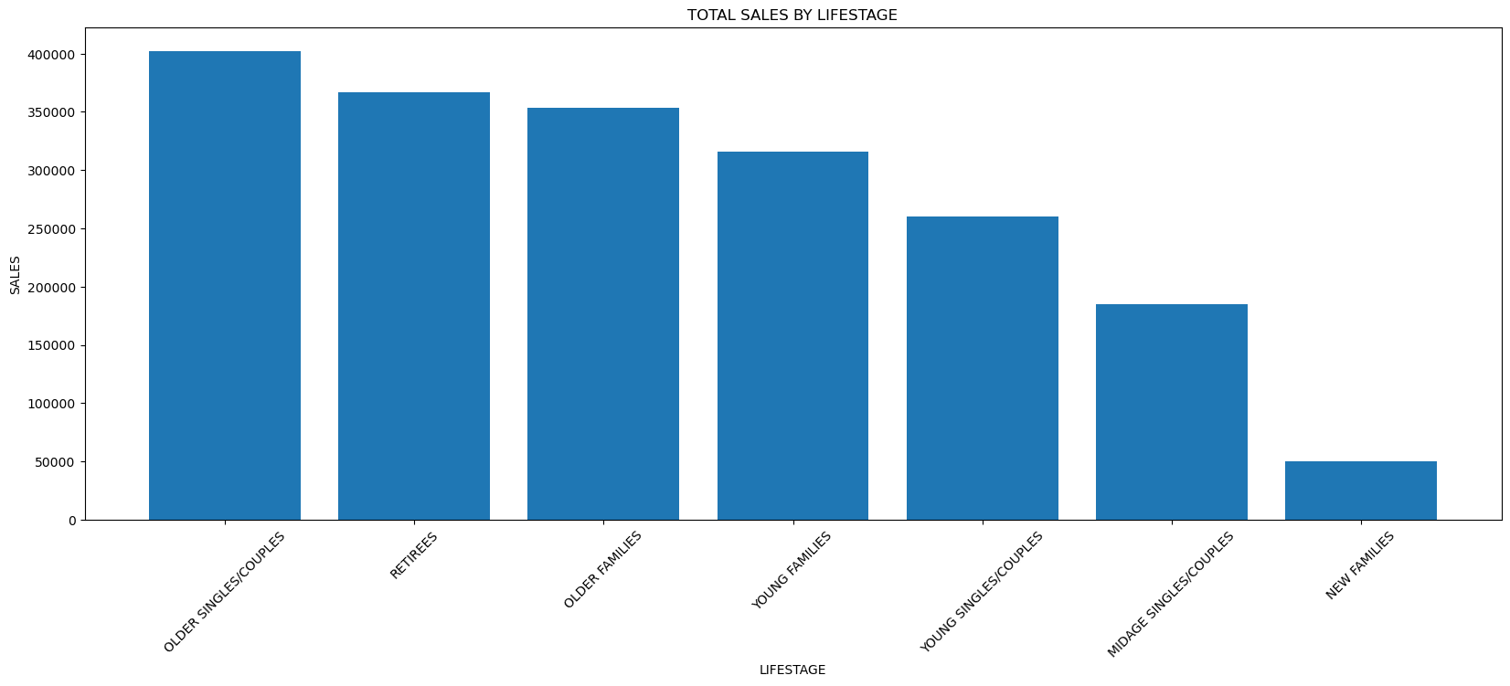
Task 1 | Customer Insights: Lifestage Analysis
🥇
Highest Sales
Older Singles/Couples
~₹402K
🥈
2nd Highest
Retirees
~₹366K
📉
Lowest
New Families
~₹50K
👉 Older customers are the main revenue drivers
Chips Category Review | Retail Analytics

Slide 4
Task 1 | Customer Type Insights
🟢 Mainstream
~₹750K — Highest segment
🟠 Budget
~₹676K — Strong contributor
⚪ Premium
~₹507K — Lowest segment
👉 Mainstream & Budget customers dominate chip sales
Chips Category Review | Retail Analytics

Slide 5
Task 1 | Key Customer Segments
🏆 Top: Older Budget Families & Mainstream Singles/Couples.
📉 Lowest: New Families (₹11K–21K)
Chips Category Review | Retail Analytics

Slide 6
Task 1 | Spending Behavior per Transaction
💳 Highest Spend: Midage and Young Singles/Couples (Mainstream).
📉 Lowest Spend: Midage and Young Singles/Couples (Budget and Premium).
Chips Category Review | Retail Analytics

Slide 7
Task 1 | Product Insights: Brand Performance
🏆 Top Brands
KETTLE — ₹390K (Leader)
SMITHS, DORITOS, PRINGLES
📉 Low Performers
CCS, NATURAL CHIP, CHEETOS AND SUNBITES.
Each contributed less than ₹20K in sales
👉 Few brands dominate majority of sales
Chips Category Review | Retail Analytics

Slide 8
Task 1 | Pack Size Insights
100–200g
₹1.46M | ⭐ Most Popular
200–300g and 300-400g
₹244k and ₹ 213k | ✅ Moderate
<100g
Very Low | 📉 Least Preferred
👉 Mid-size packs (100–200g) are most preferred by customers
Chips Category Review | Retail Analytics

Slide 9
Task 2
Trial Store
Experiment
🎯 Objective
🏪 Trial Stores
Evaluate a new store layout
Compare trial store performance vs control stores
Decide if layout should be rolled out widely
Store 77 (Trial Group)
Store 86 (Trial Group)
Store 88 (Trial Group)

Slide 10
Task 2 | Trial Store Results — Store by Store
Store 77
Store 86
Store 88
📉
📈
📊
❌ UNSUCCESSFUL
✅ SUCCESSFUL
✅ SUCCESSFUL
Sales appeared to increase visually, but statistical testing (t-test) showed a significant negative impact, so the trial was unsuccessful
Sales increased significantly above control stores.
Moderate sales increase observed compared to control stores
Control stores showed better performance during the same period.
Strong positive customer response. Layout worked well here.
Positive response. Consistent improvement over the trial period.
Chips Category Review | Retail Analytics

Slide 11
Task 2 | Trial Performance Summary
✅ Successful
2 out of 3 stores improved sales
Store 86 & Store 88
❌ Unsuccessful
1 out of 3 stores showed decline.
Although Store 77 shows an increase in sales visually, statistical testing (t-test) indicates a significant negative impact, so the trial is not considered successful for this store
👉 Store characteristics significantly affect layout success
Chips Category Review | Retail Analytics

Slide 12
🚀 Final Recommendations
01
🏪 Selective Rollout Only
02
🔍 Investigate Store 77
Do NOT roll out the new layout to all stores. Apply only to stores with similar characteristics to Store 86 & 88.
Understand why Store 77's sales dropped. Identify unique store characteristics before any further decisions.
03
🎯 Target Key Segments
04
📦 Boost Top Products
Focus marketing & product placement on Older Customers, Mainstream & Budget Customer Type— they drive the most revenue.
Increase shelf space for top brands (KETTLE, SMITHS) and prioritize 100–200g pack sizes in all stores.
Chips Category Review | Retail Analytics

Slide 13
Next Steps
1
🔬 Test the new layout in more stores similar to Store 86 & 88
2
📅 Monitor long-term performance over next 6–12 months
3
📦 Improve product placement for top brands & popular pack sizes
4
🔍 Conduct deeper analysis on Store 77 failure to prevent repeat
Thank You

