Slide 1

Maximally Entangled Multipartite Symmetric States
Burke Brockelbank
Supervisor: Gilad Gour

Slide 2
Entanglement
“I would not call [entanglement] one but rather the characteristic trait of quantum mechanics, the one that enforces its entire departure from classical lines of thought.”
- Erwin Shrödinger, 1936

Slide 3
Entanglement
Superdense coding
Teleportation
Cryptography
Quantum computation
Solid state physics

Slide 4
Entanglement
Multipartite entanglement is desired
Maximal entanglement is most useful
Absolute maximal entanglement

Slide 5
Absolute Maximal Entanglement (AME) of Qubits
Number of Qubits | AME State
2 | ✓
3 | ✓
4 | ✗
5 | ✓
6 | ✓
7 | ✗
8+ | ✗

Slide 6
Symmetric States
Identical bosons form symmetric states
Restriction on the scope of problem
Notes:
Add a picture

Slide 7
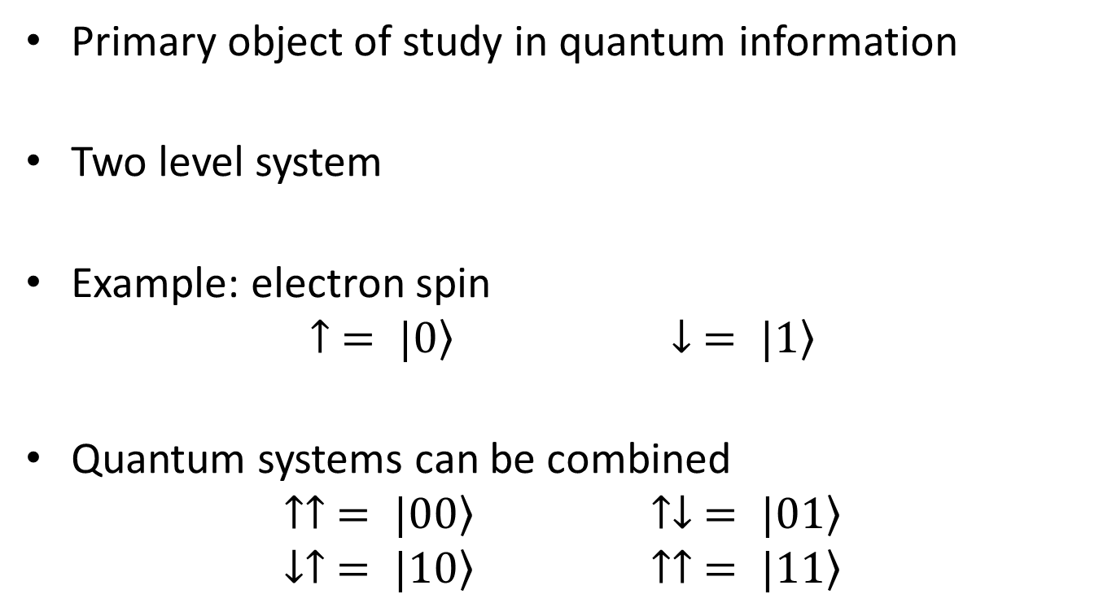
Qubits
Primary object of study in quantum information
Two level system
Example: electron spin
$$↑ = \left.|0\right\rangle ↓ = \left.|1\right\rangle$$
Quantum systems can be combined
$$↑↑ = \left.|00\right\rangle ↑↓ = \left.|01\right\rangle$$
$$↓↑ = \left.|10\right\rangle ↑↑ = \left.|11\right\rangle$$

Slide 8
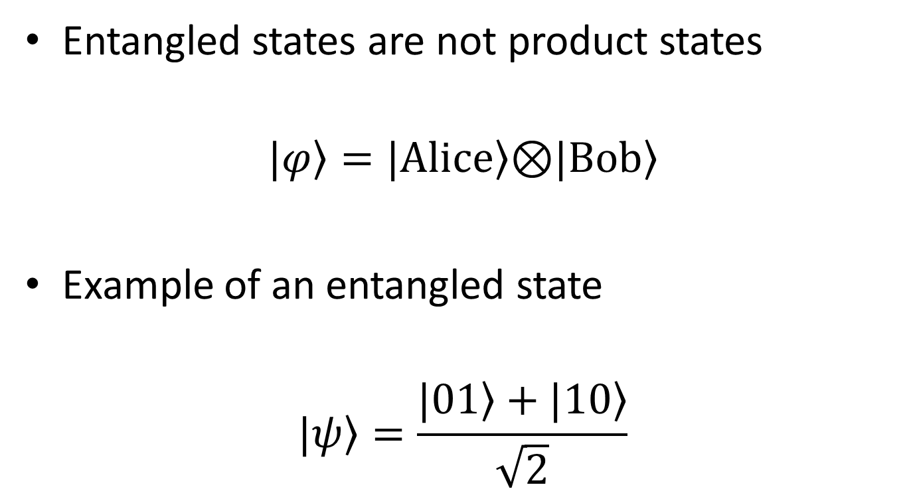
Quantifying Entanglement
Entangled states are not product states
$$\left.|φ\right\rangle =\left.|Alice\right\rangle \text{⊗}\left.|Bob\right\rangle$$
Example of an entangled state
$$\left.|ψ\right\rangle =\frac{\left.|01\right\rangle +\left.|10\right\rangle }{\sqrt{2}}$$
Alice
Bob

Slide 9
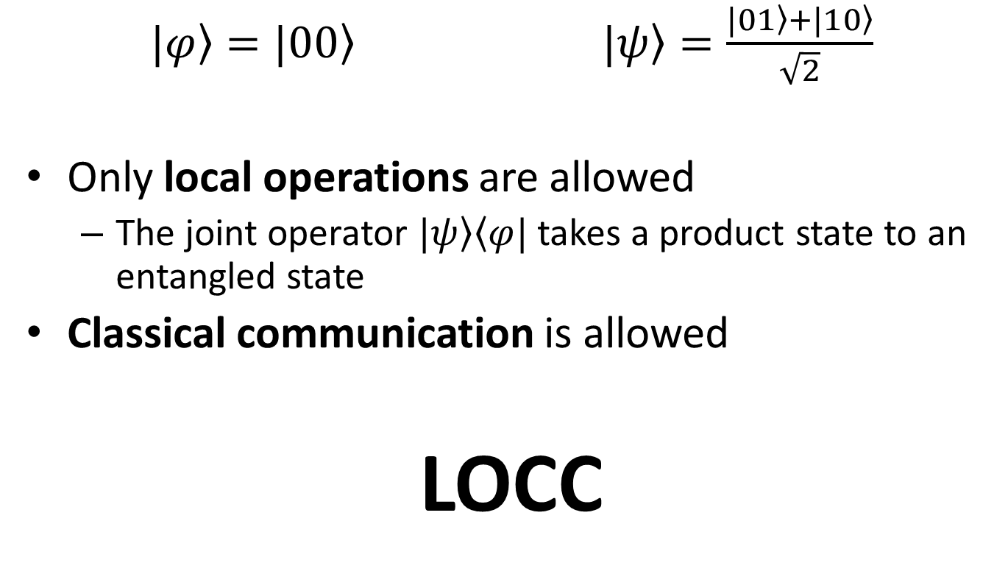
Quantifying Entanglement
$\left.|φ\right\rangle =\left.|00\right\rangle$ $\left.|ψ\right\rangle =\frac{\left.|01\right\rangle +\left.|10\right\rangle }{\sqrt{2}}$
Only local operations are allowed
The joint operator $\left.|ψ\right\rangle \left\langle φ|\right.$ takes a product state to an entangled state
Classical communication is allowed
LOCC

Slide 10
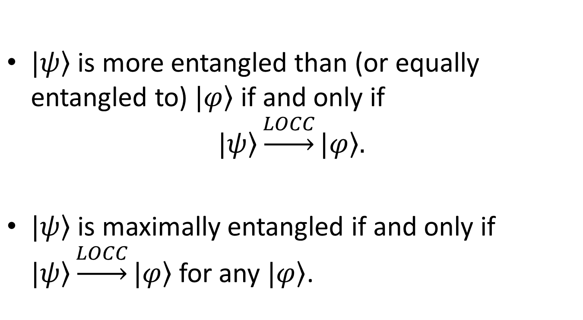
Quantifying Entanglement
$\left.|ψ\right\rangle$ is more entangled than (or equally entangled to) $\left.|φ\right\rangle$ if and only if
$$\left.|ψ\right\rangle \underset{→}{LOCC}\left.|φ\right\rangle .$$
$\left.|ψ\right\rangle$ is maximally entangled if and only if $\left.|ψ\right\rangle \underset{→}{LOCC}\left.|φ\right\rangle$ for any $\left.|φ\right\rangle$.

Slide 11
Bipartite Entanglement
Defining multipartite entanglement with respect to bipartite entanglement
Entanglement is shared between two parties
Simple entanglement measure

Slide 12
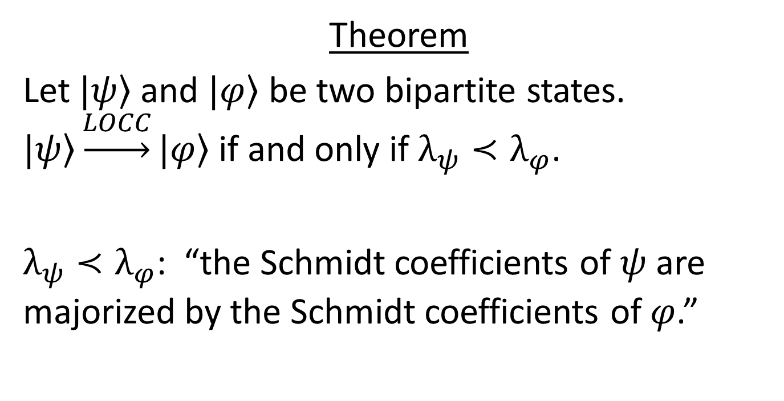
Nielsen’s Theorem
Theorem
Let $\left.|ψ\right\rangle$ and $\left.|φ\right\rangle$ be two bipartite states. $\left.|ψ\right\rangle \underset{→}{LOCC}\left.|φ\right\rangle$ if and only if $λ_{ψ}≺λ_{φ}$.
$λ_{ψ}≺λ_{φ}$: “the Schmidt coefficients of $ψ$ are majorized by the Schmidt coefficients of $φ$.”
Nielsen, M.A., 1999. Conditions for a class of entanglement transformations.
Physical Review Letters, 83(2), p.436.

Slide 13
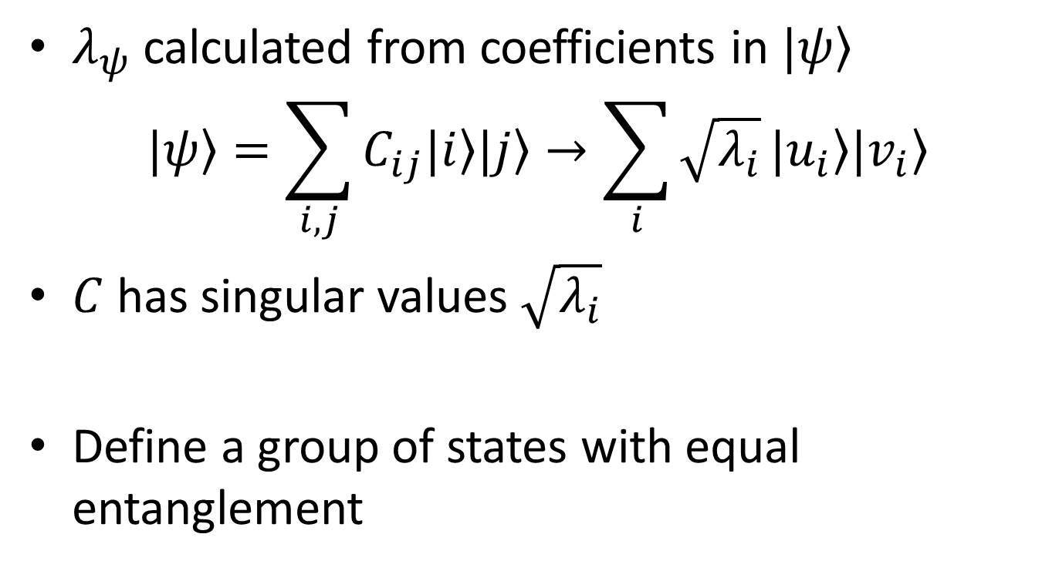
Schmidt Coefficients
$λ_{ψ}$ calculated from coefficients in $\left.|ψ\right\rangle$
$$\left.|ψ\right\rangle =\sum_{i,j}{C_{ij}\left.|i\right\rangle \left.|j\right\rangle }→\sum_{i}{\sqrt{λ_{i}}}\left.|u_{i}\right\rangle \left.|v_{i}\right\rangle$$
$C$ has singular values $\sqrt{λ_{i}}$
Define a group of states with equal entanglement
Notes:
Put the majorization equation in
MEET WITH GILAD AT TWO
Should define Schmidt coefficients

Slide 14
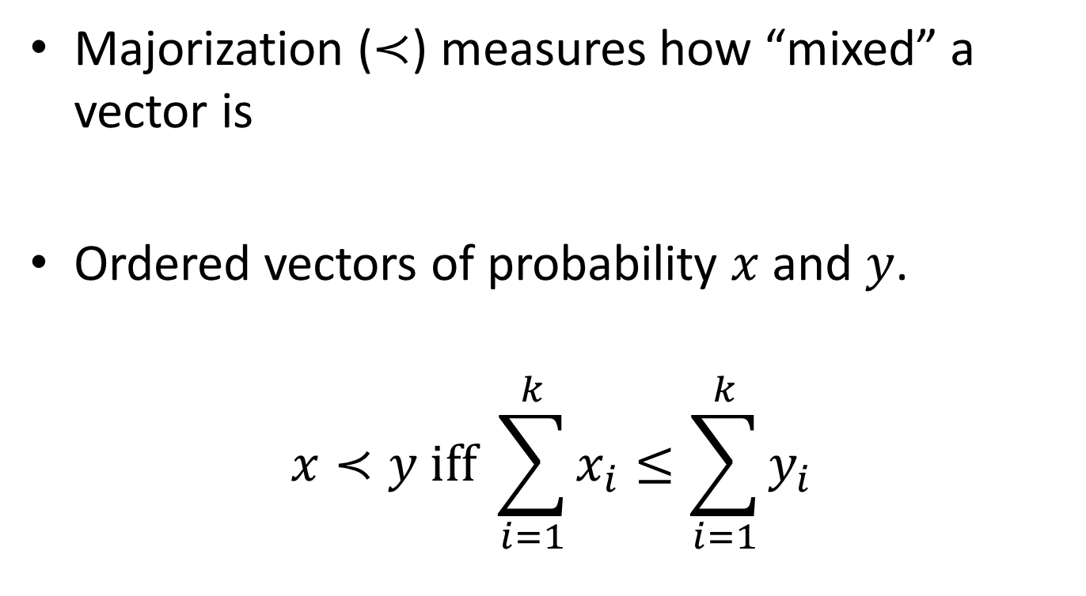
Majorization
Majorization ($≺$) measures how “mixed” a vector is
Ordered vectors of probability $x$ and $y$.
$$x≺y iff \sum_{i=1}^{k}{x_{i}}≤\sum_{i=1}^{k}{y_{i}}$$

Slide 15
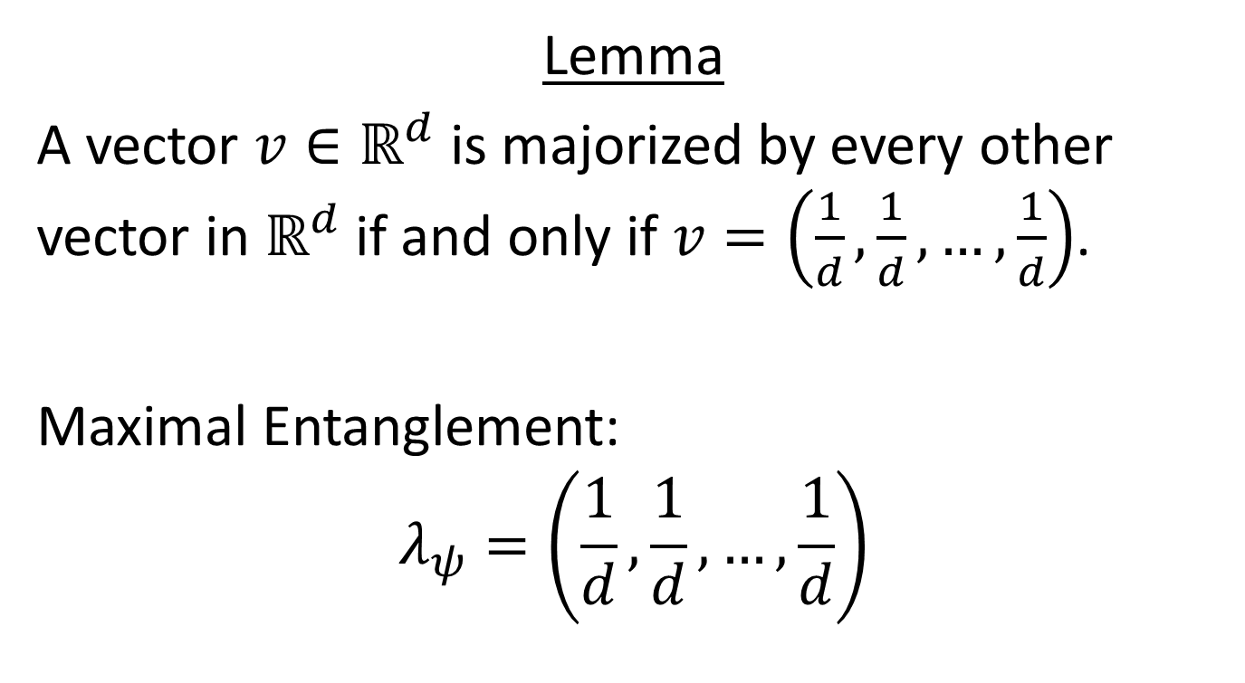
Maximal Bipartite Entanglement
Lemma
A vector $v∈ℝ^{d}$ is majorized by every other vector in $ℝ^{d}$ if and only if $v=\left(\frac{1}{d},\frac{1}{d},…,\frac{1}{d}\right)$.
Maximal Entanglement:
$$λ_{ψ}=\left(\frac{1}{d},\frac{1}{d},…,\frac{1}{d}\right)$$

Slide 16
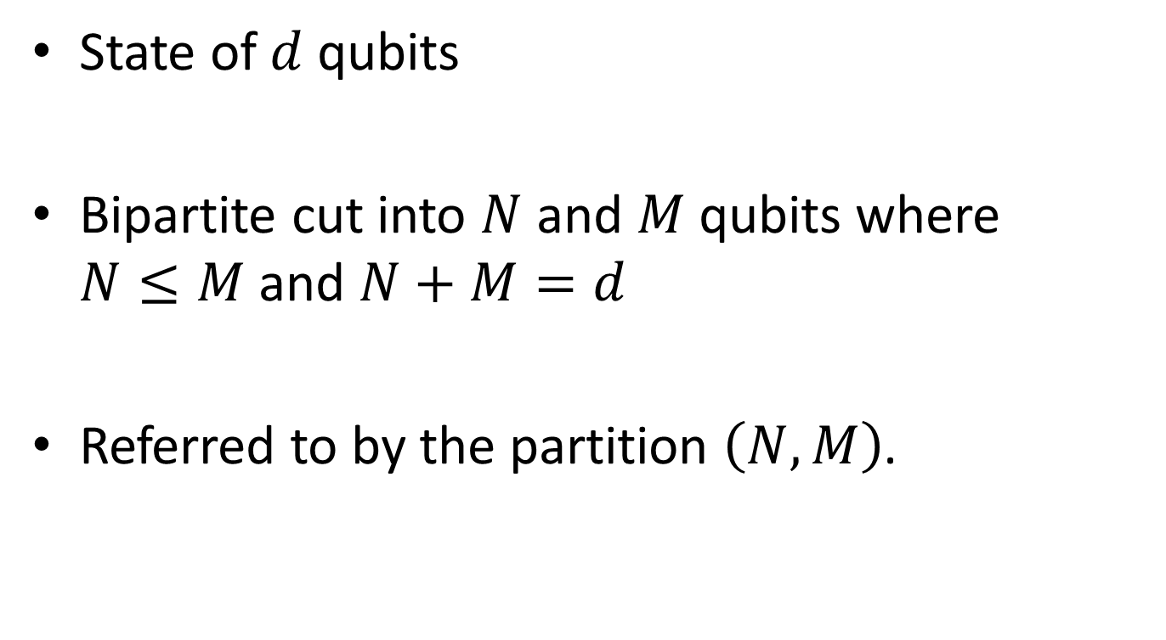
Symmetric Bipartite State
State of $d$ qubits
Bipartite cut into $N$ and $M$ qubits where $N≤M$ and $N+M=d$
Referred to by the partition $\left(N,M\right)$.
Notes:
9:00

Slide 17
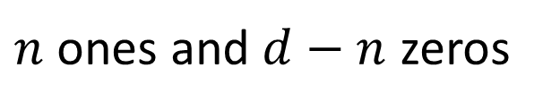

Dicke Basis
Basis of symmetric states
$$\left.|D_{n}\right\rangle =\sum_{i}{P_{i}\left.|00…011…1\right\rangle }$$
$n$ ones and $d−n$ zeros

Slide 18
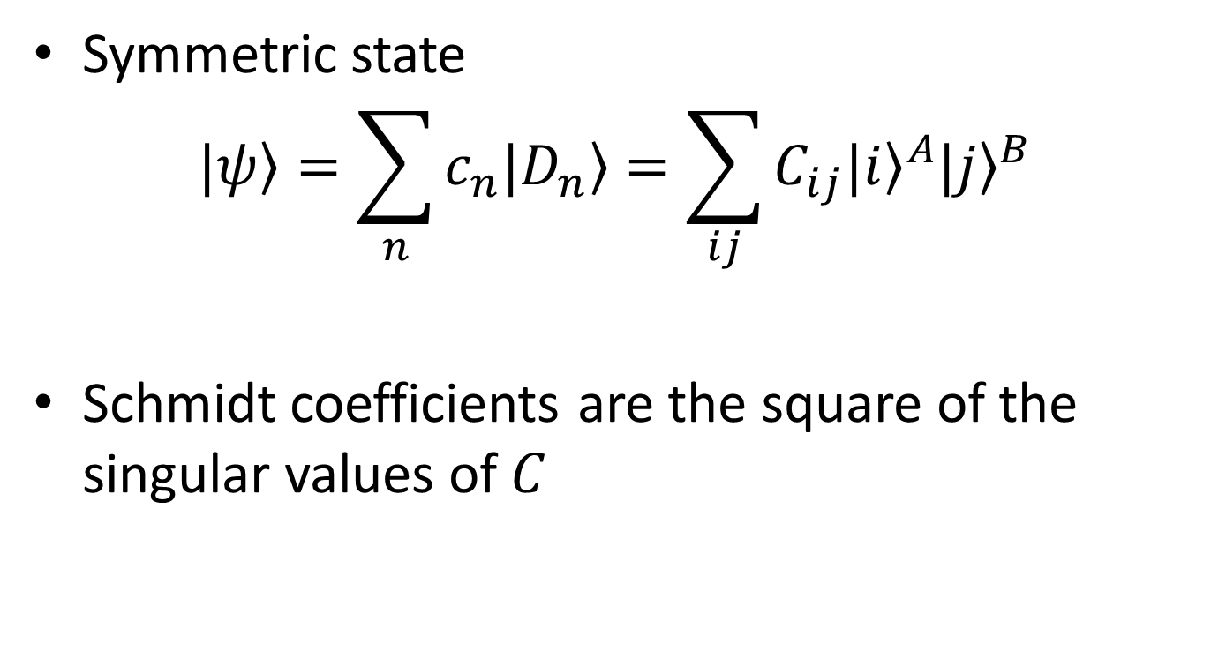
Dicke Basis
Symmetric state
$$\left.|ψ\right\rangle =\sum_{n}{c_{n}\left.|D_{n}\right\rangle }=\sum_{ij}{C_{ij}{\left.|i\right\rangle }^{A}{\left.|j\right\rangle }^{B}}$$
Schmidt coefficients are the square of the singular values of $C$

Slide 19

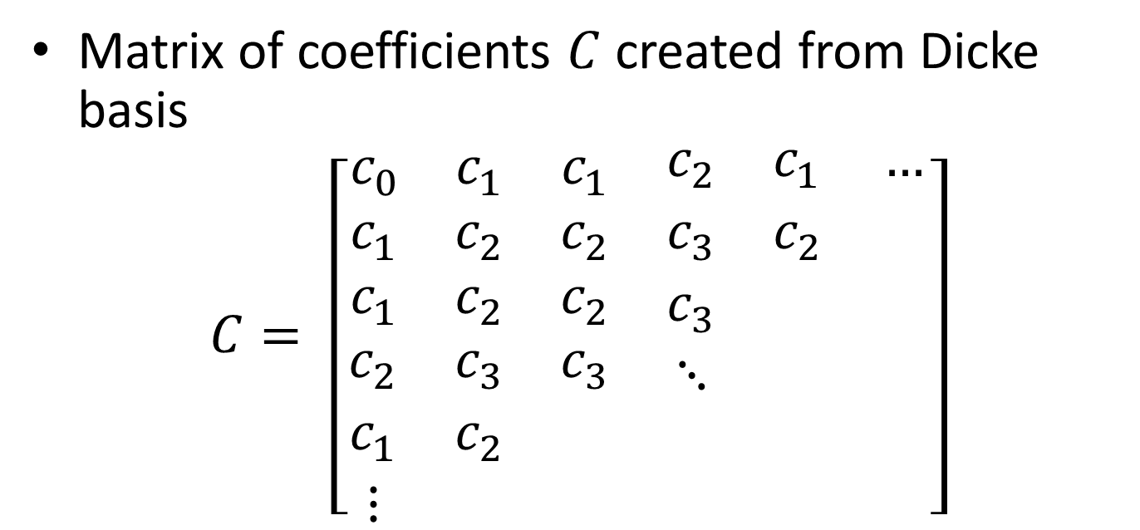

Schmidt Coefficients
Matrix of coefficients $C$ created from Dicke basis
$$C= \left[\begin{matrix}\begin{matrix}c_{0} & c_{1} & c_{1} \\ c_{1} & c_{2} & c_{2} \\ c_{1} & c_{2} & c_{2}\end{matrix} & \begin{matrix}c_{2} & c_{1} & … \\ c_{3} & c_{2} & \\ c_{3} & & \end{matrix} \\ \begin{matrix}c_{2} & c_{3} & c_{3} \\ c_{1} & c_{2} & \\ ⋮ & & \end{matrix} & \begin{matrix}⋱ & & \\ & & \\ & & \end{matrix}\end{matrix}\right]$$
$$2^{N}$$
$$2^{M}$$

Slide 20
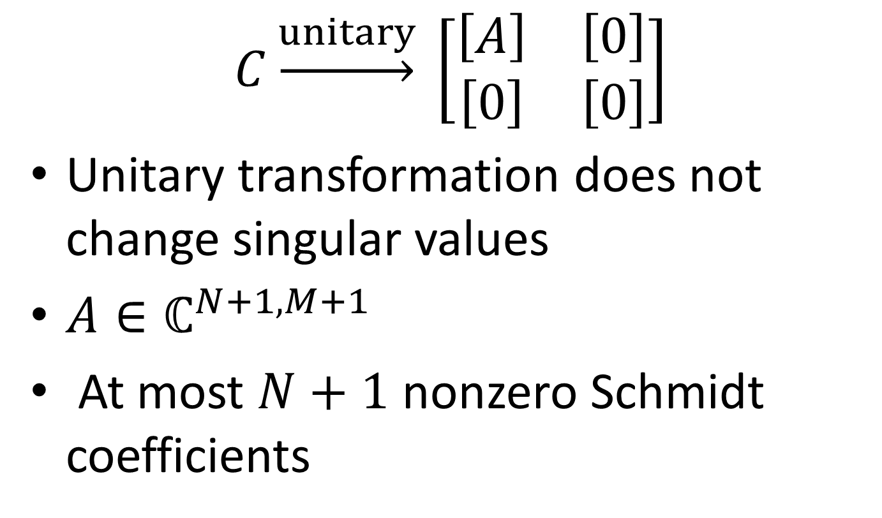
Schmidt Coefficients
$$C\underset{→}{unitary} \left[\begin{matrix}\left[A\right] & \left[0\right] \\ \left[0\right] & \left[0\right]\end{matrix}\right]$$
Unitary transformation does not change singular values
$A∈ℂ^{N+1, M+1}$
At most $N+1$ nonzero Schmidt coefficients

Slide 21
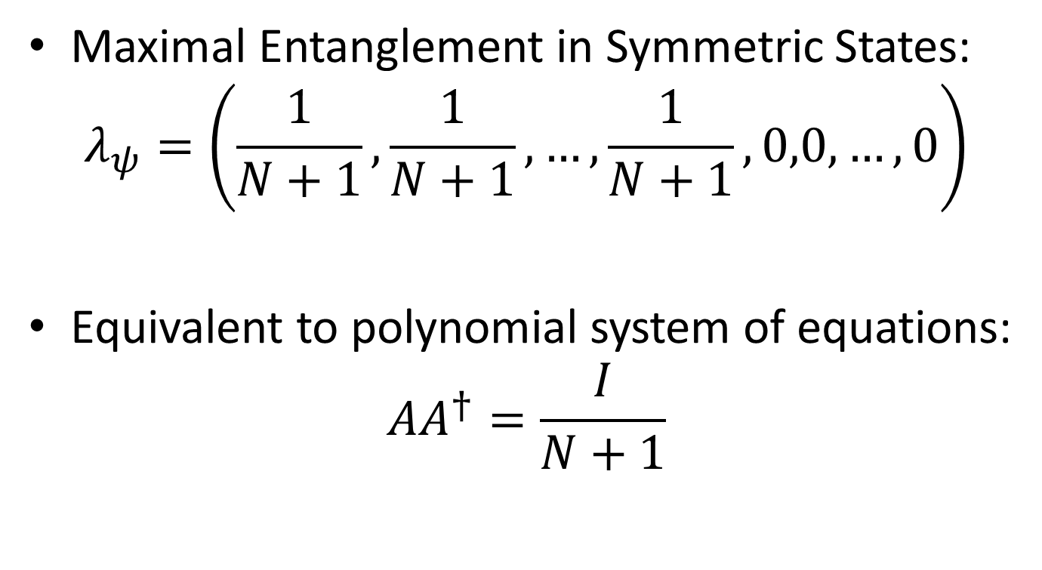
Maximal Entanglement of Symmetric States
Maximal Entanglement in Symmetric States:
$$λ_{ψ}=\left(\frac{1}{N+1},\frac{1}{N+1},…,\frac{1}{N+1},0,0,…,0\right)$$
Equivalent to polynomial system of equations:
$$AA^{†}=\frac{I}{N+1}$$

Slide 22
Theoretical Results

Slide 23
Cascade Lemma

Slide 24
Absolutely Maximally Entangled Symmetric States

Slide 25
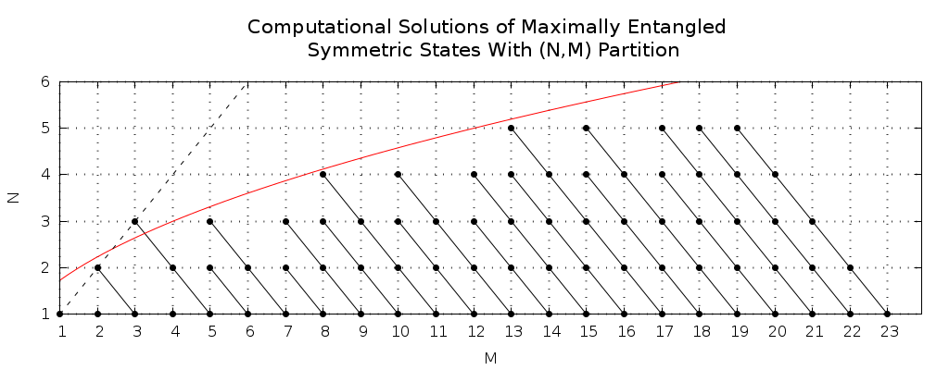
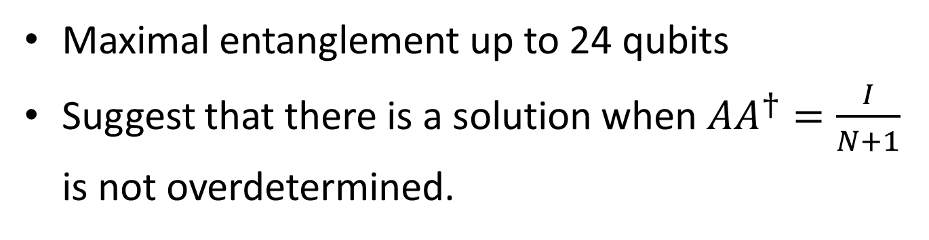
Numerical Search
Maximal entanglement up to 24 qubits
Suggest that there is a solution when $AA^{†}=\frac{I}{N+1}$
is not overdetermined.

Slide 26
Analytical Solution
Notes:
Noncritical state

Slide 27
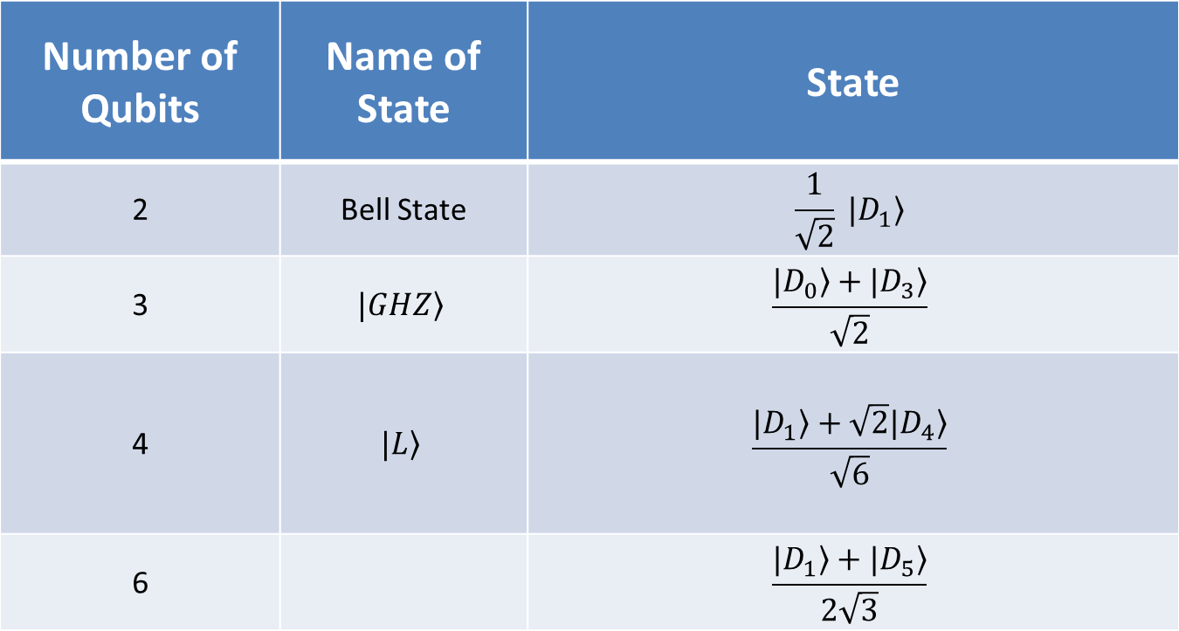
Absolutely Maximally Entangled Symmetric States
Number of Qubits | Name of State | State
2 | Bell State | $$\frac{1}{\sqrt{2}} \left.|D_{1}\right\rangle$$
3 | $$\left.|GHZ\right\rangle$$ | $$\frac{\left.|D_{0}\right\rangle +\left.|D_{3}\right\rangle }{\sqrt{2}}$$
4 | $$\left.|L\right\rangle$$ | $$\frac{\left.|D_{1}\right\rangle +\sqrt{2}\left.|D_{4}\right\rangle }{\sqrt{6}}$$
6 |  | $$\frac{\left.|D_{1}\right\rangle +\left.|D_{5}\right\rangle }{2\sqrt{3}}$$

Slide 28
Summary
Number of Qubits | AME State | AMES State
2 | ✓ | ✓
3 | ✓ | ✓
4 | ✗ | ✓
5 | ✓ | ✗
6 | ✓ | ✓
7 | ✗ | ✗
8+ | ✗ | ?

Slide 29
Thank you

Slide 30

Form of the Matrix
$$A=\sqrt{F_{N}}G\sqrt{F_{M}}$$
$F_{j}=diag\left(\left({j \atop 0}\right),\left({j \atop 1}\right),…,\left({j \atop j}\right)\right)$
$$G=\left[\begin{matrix}\begin{matrix}c_{0} & c_{1} \\ c_{1} & c_{2}\end{matrix} & \begin{matrix}c_{2} & ⋯ \\ & \end{matrix} \\ \begin{matrix}c_{2} & \\ ⋮ & \end{matrix} & \begin{matrix}⋱ & \\ & \end{matrix}\end{matrix}\right]$$

Slide 31
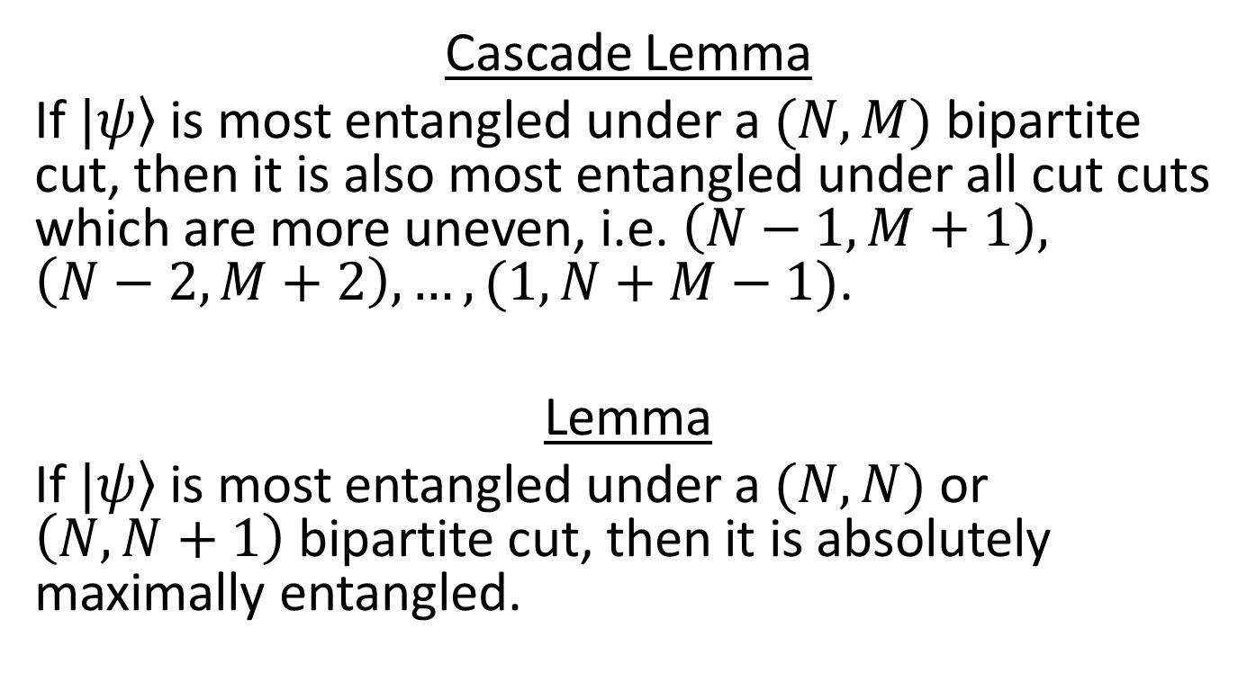
Lemmas
Cascade Lemma
If $\left.|ψ\right\rangle$ is most entangled under a $(N,M)$ bipartite cut, then it is also most entangled under all cut cuts which are more uneven, i.e. $\left(N−1,M+1\right), \left(N−2,M+2\right),…,(1,N+M−1)$.
Lemma
If $\left.|ψ\right\rangle$ is most entangled under a $(N,N)$ or $\left(N,N+1\right)$ bipartite cut, then it is absolutely maximally entangled.

