Slide 1
Ingress Controller
Node
Node
Client
Service[HeadLess]
Pod1
Ingress Controller
Pod2
Service
NodePort
LB
Pod3
Pod4

Slide 2
创建nginx 相关的pod和cm [with rbac]
https://kubernetes.github.io/ingress-nginx/deploy/#prerequisite-generic-deployment-command

Slide 3
[root@k8s-1 deploy]# less ingress-svc.yaml
apiVersion: v1
kind: Service
metadata:
name: ingress-nginx
namespace: ingress-nginx
spec:
type: NodePort
ports:
- name: http
port: 80
targetPort: 80
protocol: TCP
nodePort: 30080
- name: https
port: 443
targetPort: 443
nodePort: 30443
protocol: TCP
selector:
app: ingress-nginx
[root@k8s-1 deploy]
https://raw.githubusercontent.com/kubernetes/ingress-nginx/master/deploy/provider/baremetal/service-nodeport.yaml
通过创建service 类型为NodePort来引导外部流量到Ingress-Nginx pod 即为：Ingress controller

Slide 4
ingress-tomcat.yaml
apiVersion: extensions/v1beta1
kind: Ingress
metadata:
name: ingress-tomcat
namespace: default
annotations:
kubernetes.io/ingress.class: "nginx"
spec:
rules:
- host: www.burlyluotomcat.com
http:
paths:
- path:
backend:
serviceName: tomcat-svc
servicePort: 8080
先创建后端的deployment[Pods]和service，然后被nginx引用
通过这里来关联service，然后到达后端Pods

Slide 5
[root@k8s-1 tomcat]# less tomcat-svc-deploy.yaml
---
apiVersion: v1
kind: Service
metadata:
name: tomcat-svc
spec:
selector:
run: tomcat
ports:
- protocol: TCP
port: 8080
targetPort: 8080
type: ClusterIP
clusterIP: None
---
apiVersion: apps/v1beta1
kind: Deployment
metadata:
name: tomcat
spec:
replicas: 1
template:
metadata:
labels:
run: tomcat
spec:
containers:
- name: tomcatd
image: tomcat:9-jre8-slim
imagePullPolicy: IfNotPresent
ports:
- containerPort: 8080
构造后端响应Pods的service和deployment

Slide 6
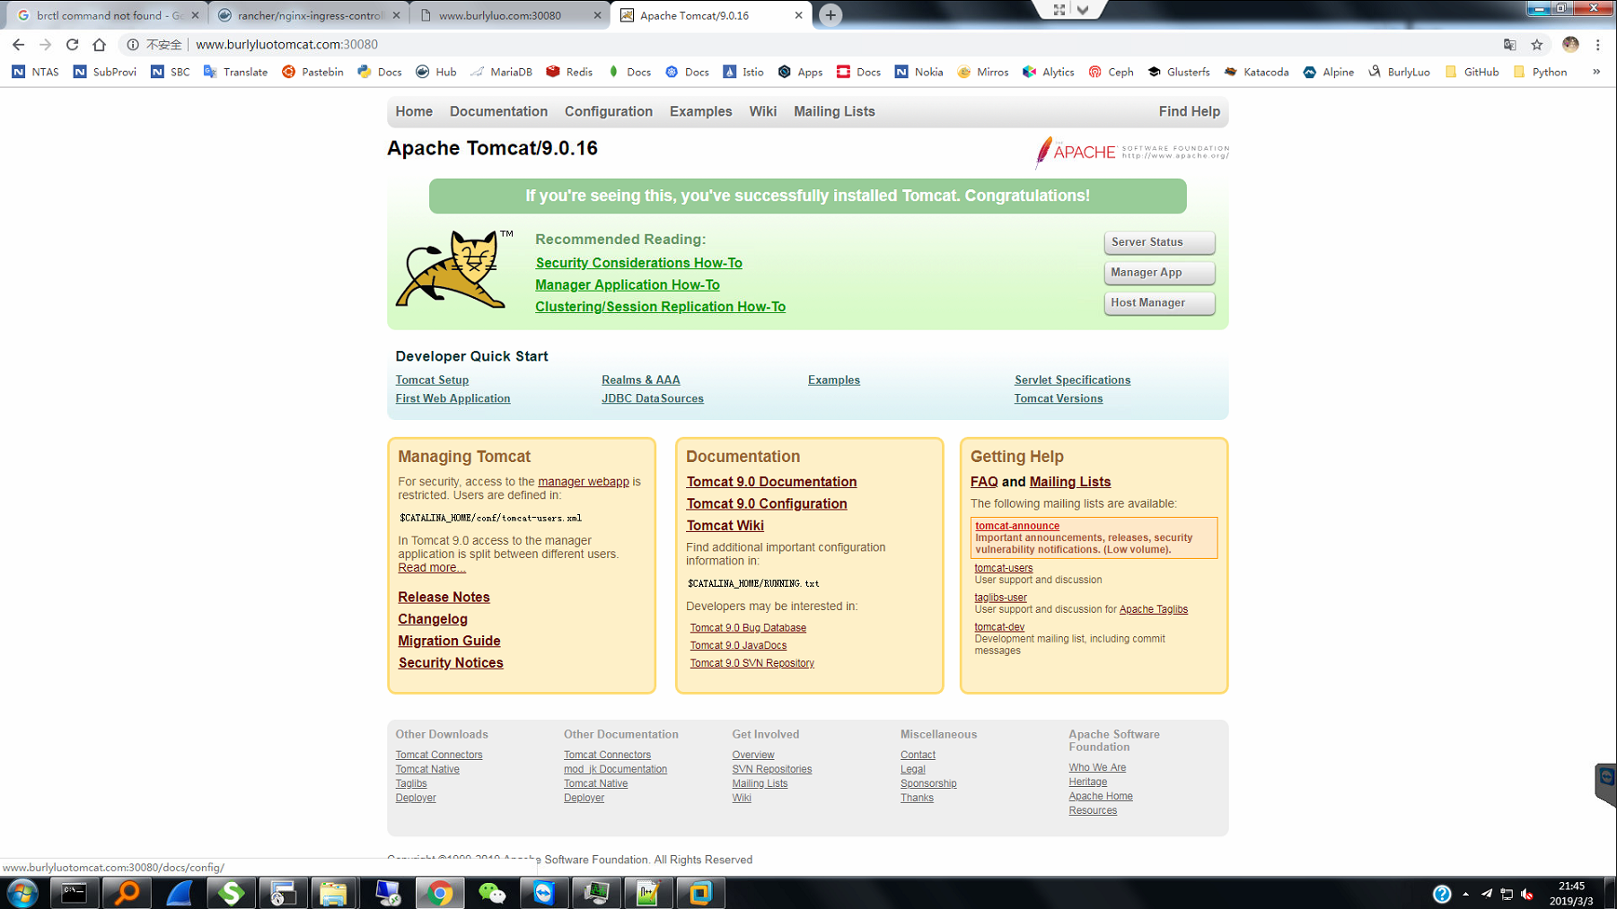
效果：基于http形式

Slide 7
https
[root@k8s-1 tomcat]# less tomcat-svc-deploy.yaml
---
apiVersion: v1
kind: Service
metadata:
name: tomcat-svc
spec:
selector:
run: tomcat
ports:
- protocol: TCP
port: 8080
targetPort: 8080
type: ClusterIP
clusterIP: None
---
apiVersion: apps/v1beta1
kind: Deployment
metadata:
name: tomcat
spec:
replicas: 1
template:
metadata:
labels:
run: tomcat
spec:
containers:
- name: tomcatd
image: tomcat:9-jre8-slim
imagePullPolicy: IfNotPresent
ports:
- containerPort: 8080
构造后端响应Pods的service和deployment

Slide 8
制作证书：
1072 ll
1073 openssl genrsa -out tls.key 2048
1074 ll
1075 openssl req -new -x509 -key tls.key -out tls.crt -subj /C=CN/ST=BeiJing/L=BeiJing/O=DevOps/CN=www.burlyluotomcat.com
1076 ll
1077 kubectl create secret tls tomcat-ingress-secret --cert=tls.crt --key=tls.key
1078 kubectl get secret
1079 kubectl describe secret tomcat-ingress-secret
1080 ll
1084 cd /root/tomcat
1085 ll
1086 vi ingress-tomcat.yaml
1087 cp ingress-tomcat.yaml ingress-tomcat-tls.yaml
1088 vi ingress-tomcat-tls.yaml
1089 kubectl apply -f ingress-tomcat-tls.yaml
1090 vi ingress-tomcat-tls.yaml
1091 kubectl apply -f ingress-tomcat-tls.yaml
1092 kubectl get pods -o wide
1093 kubectl get ingress
1094 history
[root@k8s-1 tomcat]#

Slide 9
ingress-tomcat-tls.yaml
[root@k8s-1 tomcat]# less ingress-tomcat-tls.yaml
apiVersion: extensions/v1beta1
kind: Ingress
metadata:
name: ingress-tomcat-tls
namespace: default
annotations:
kubernetes.io/ingress.class: "nginx"
spec:
tls:
- hosts:
- www.burlyluotomcat.com
secretName: tomcat-ingress-secret
rules:
- host: www.burlyluotomcat.com
http:
paths:
- path:
backend:
serviceName: tomcat-svc
servicePort: 8080
通过这里来关联service，然后到达后端Pods

Slide 10
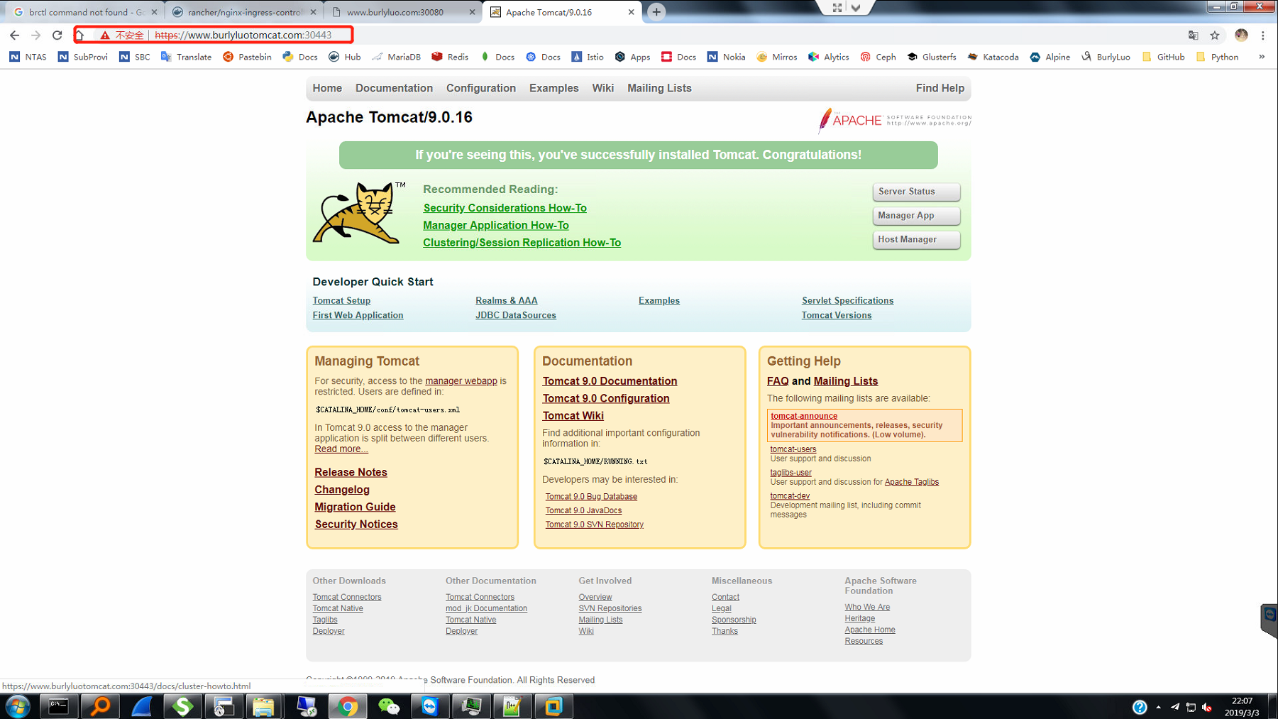
效果：https形式

