Slide 1

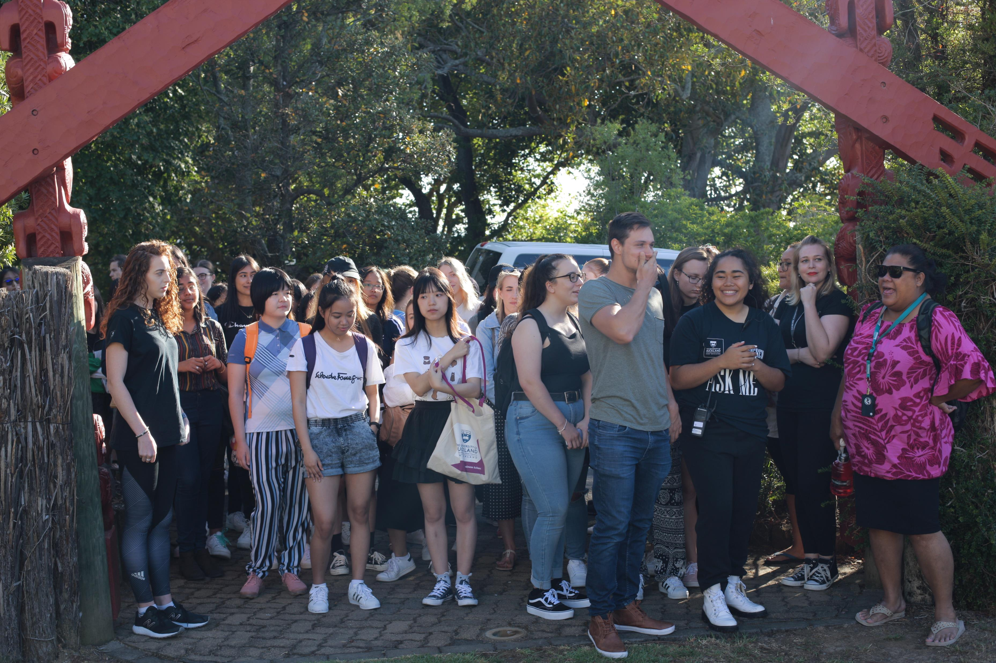

Optimisation of our courses and programmes
July 2024

Slide 2

Transformation is key
As a University we aspire to achieve…
Delivery of a distinctive Waipapa Taumata Rau | University of Auckland experience
Creating connection to place and our students’ capacities for meaningful contribution and leadership as citizens, in the professions, and in communities in Aotearoa New Zealand and Te Moana-nui-a-Kiwa, the Pacific Region
Creating a personalised experience in a collective environment
Meeting and leading our market, not reacting to it

Slide 3

Drivers for institutional curriculum change
Disruption in the tertiary sector – changing student expectations, impact of Covid on school leaver preparedness, employer expectations, online providers
Expectations to prepare graduates for increasingly complex societal challenges and systemic workplace change
Advances in knowledge and digital technology
Flux in terms of commercial and regulatory settings, markets, competition, funding, and legislation
Pressures on staff workload
Uncertainty of long-term financial sustainability or tertiary institutions
The University’s Strategic Plan

Slide 4
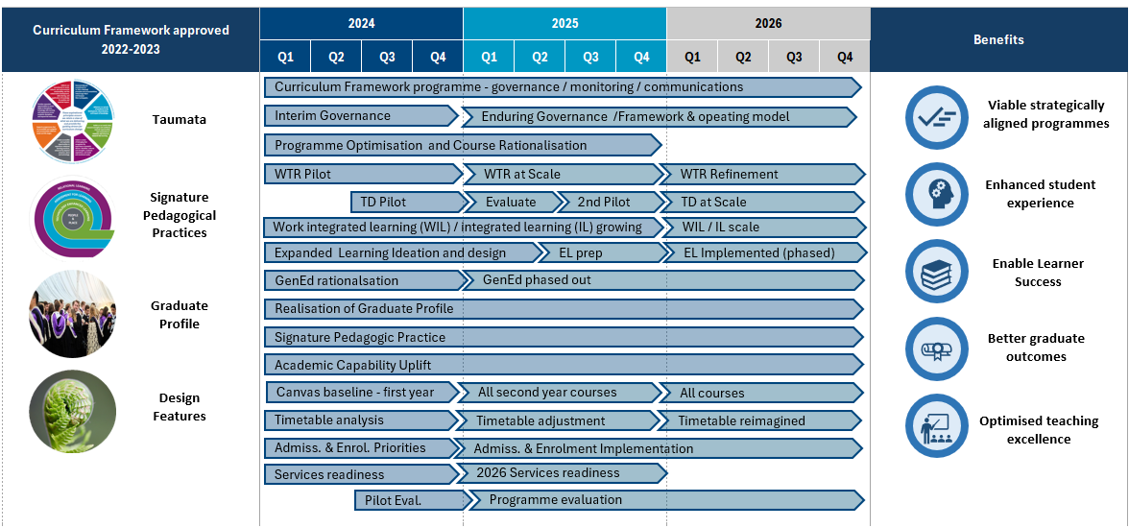
The Curriculum Framework transformation is enabling us to deliver on Taumata Teitei. This is where we are today with implementation
WE ARE HERE
Notes:
The Curriculum Framework is a transformation programme to deliver on the Education and Student Experience priorities articulated in Taumata Teitei.
The left hand side of this diagram shows the four Elements of the Curriculum Framework (CF) which were developed with academic staff and endorsed by PDDC together with a cross university steering committee.
The right hand side of this diagram outlines the benefits that we will realise through implementation of the CF
In the middle are the principal streams of work some led by a programme working teams, others led by faculties or are being undertaken in partnership with other teams across the university like RAA.
Programme optimisation and course rationalisation are a stream of activity faculties were undertaking as part of implementing the CF to create space for staff to work on design and delivery of the new elements from CF

Slide 5
The strategic environment has changed which extends and accelerates the existing need for course and programme optimisation
Financial position
The University is operating in a challenging external operating environment which requires action. As part of the response to this Finance have determined that there will be an increase of financial contributions from Faculties by $15m in 2026.
Academic workload
The challenge of high academic workload has been evidenced in feedback from staff surveys over multiple years. As an institution we know there are areas where we over teach or over assess which creates high workload for both our staff and students.
Within the Curriculum Framework programme Faculties were encouraged to optimise courses and programmes to balance design and delivery of new elements but overall, there has been insufficient optimisation to date.
Timetabling constraints in 2026
The volume of courses and programmes proposed for 2026 is not workable within our current timetable.
Increase demand on certain types of space of which we have a limited type e.g. flat floor 60 person capacity
Notes:
Since October, the environment has changed both external to and within our University and requires us to accelerate programme and course optimisation to not only create space for the CF changes within our timetable but to reduce academic workload and to respond to the increasing gap in our future financial situation.

Slide 6


There are two actions required in the next 2-3 months
Accelerate course and programme optimisation
Deans committed to an accelerated collaborative university wide approach looking at course and programme optimisation
Taking a University-wide view to achieve institutional benefits as well as school/faculty
Will need to be able to adjust financials across faculties following recommendations to ensure no barriers to implementation
Prioritisation of 2026 changes
Due to the volume of curriculum changes being planned for 2026 prioritisation is required
Prioritisation task relates to all changes including; those planned as part of the Curriculum Framework implementation, currently proposed faculty changes, and changes due to optimisation.
Service partners and Faculties will be involved to scope and assess the workload required to implement.
This work is to be completed to enable commitment to 2026 changes and clarity around messaging for the Prospectus in early November 2024.

Slide 7
PDDC* are taking a university wide insight informed approach to course and programe optimisation
Deans and ADAs have agreed a set of parameters that will identify programmes and courses in scope for an optimisation review.
Faculties will review the in-scope courses and programmes and make recommendations for retirement, retention as is or retention with substantial revision (including delivery/ merging etc.).
PDDC will then make a collective recommendation on optimisation.
PDDC are working on the principle that by 13 August they will have a list of courses/programmes to be removed by 2026 and those that will be changed to deliver to the optimisation goals.
Optimisation includes both the reduction of the number of courses and programmes (rationalisation) as well as changing how remaining courses are delivered. This will include looking at the cross faculty/department/programme opportunities.
*PDDC = Provosts, Deans, and Directors Committee (chaired by the Provost – Prof Valerie Linton)
Notes:
PDDC agreed to accelerate course and programme optimisation and reach decisions in the next 2-3 months to be confident that we will be in a stronger financial position, that we can deliver all the 2026 changes and we can be clear in our prospectus what our educational offer is for 2026.
PDDC have decided take collective ownership for this challenge and to lead the review working in partnership with service partners including Finance, Planning and Information Office and Academic Services.

Slide 8

The pipeline of curriculum change for 2026 has expanded
Curriculum Framework Implementation:
UG changes including Transdisciplinary (at scale) & integrated learning
SPP Course delivery ychanges
Removal of Gen Ed as a requirement
PG changes
(2026 unless stated)
Curriculum changes influenced by Curriculum Framework:
BA – Introduce core
BArch/BUrbPlan(Hons) - Introduce shared Y1 S1 (for 2025)
BC - Revise degree structure (to a "specialist" degree not majors)
BEd - Revise degree (for 2025)
BEng(Hons) - Revise Y1
BMus - Revise course structure
BSci - Introduce numeracy; revise majors and specialisations
(2026 unless stated)
In addition to larger programme changes already planned:
BSJS - Introduce degree (for 2025)
JD – Introduce degree
LLB(Hons) - Revise degree to 480 points
UG Health - Revise UG experience study options for non-clinical programmes
(2026 unless stated)

Slide 9
CFT implementation for 2025 – we are broadly on track though pressure from the environmental changes has increased risk
What’s being implemented in 2025
Readiness and risks to deliver
Largest risk is the quantum of course and programme optimisation.
High faculty confidence of readiness for 2025 changes outside of WTR. Including embedded programme graduate profiles, programme and course changes, TD pilots
Implementation partners readiness on track with mitigations.
WTR delivery risks are being managed but need to be closely monitored, on-going support needed from leadership. Risks include staffing readiness, Faculty change impact (course design & build), workload to manage concessions, timetabling. (refer Appendix 5)
Standardised GPA calculation risks are being managed.
Emerging risk around the volume of change required to content e.g. webpages, knowledge base articles etc. Quantum of change being quantified
Note: excludes preparation activity for 2026
WTR for all UG Students
GPA calculation for PG
Graduate profiles
Optimisation

Slide 10
CFT Implementation 2026 – aspirations have lifted, and capacity has reduced requiring a collective approach to prioritising curriculum change
What’s being implemented in 2026
High level assessment
Largest risk is that aspiration will exceed implementation partner capacity to deliver. Academic workload looks to have increased and not yet offset by optimisation. There is a need to prioritise curriculum change which will impact benefit realisation
PDDC are aligned on taking a collective approach to prioritising curriculum change
Timetabling constraints: demand for ‘studio’ spaces in 2026 currently far exceeds capacity. Need to reconsider delivery mode, teaching hours, space requirements
EFTS redistribution remains a challenge in 2026. Further levers to readjust may be required
More opportunities remain for PG programmes (pathways, navigability). Would benefit from alignment to a University-wide strategic view of programmes.
Expanded Learning has been phased to reduce implementation complexity for 2026
The potential for reduced 2025 project funding and transitioning to BAU early is likely to impact benefit realisation
Optimised suite of UG and PG programmes
Constructive alignment / graduate profile
Admissions and Enrolment
New Cross Faculty Offers - TD for all UG Students, Flexi-choice and Expanded Learning (phased) / removal of GenEd

